Slide 1
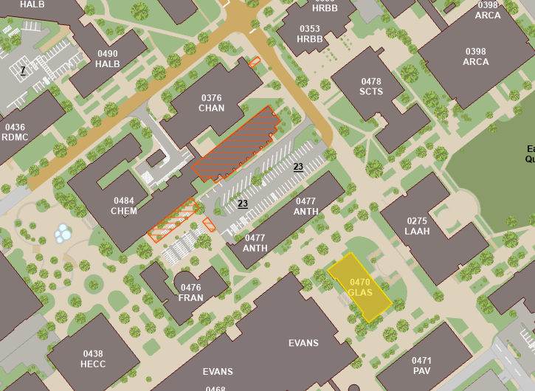
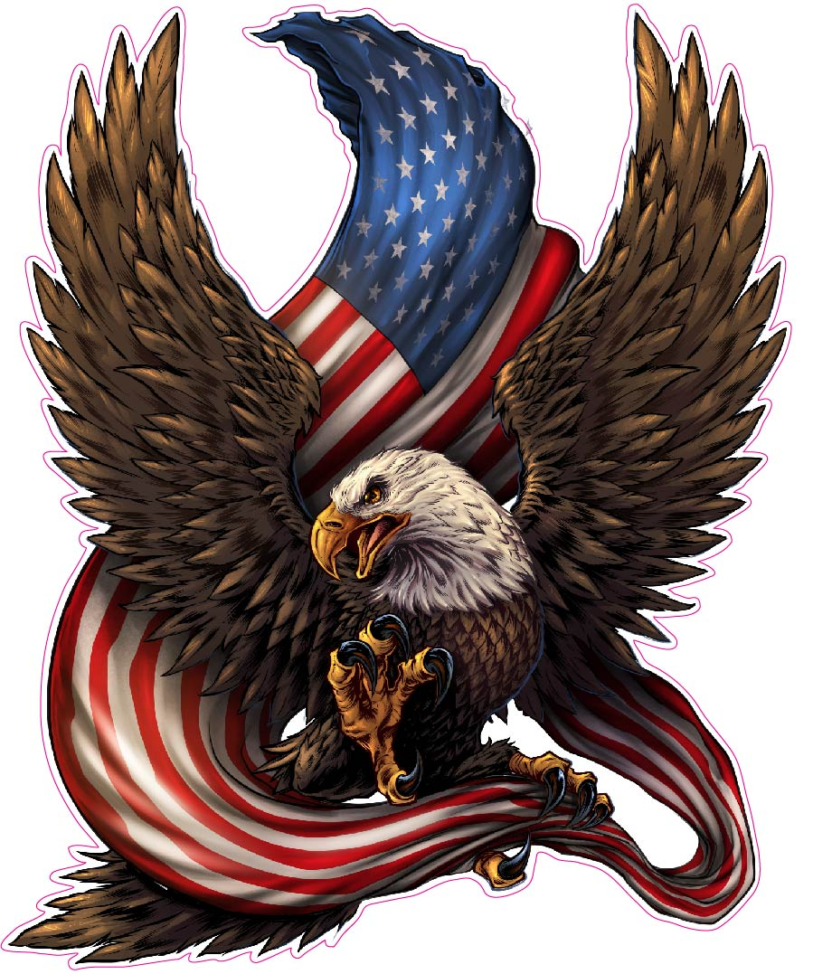
Course Info
Time: MW 4:10-5:25 PM
Location: Chem 100
Instructor: Dr. Lorien Foote
Office: GLASS 211A
Email: lfoote@tamu.edu
Office Hours
MW 10:20-11:20 AM
MW 1:30-2:30 PM
By appointment
Teaching Assistant: John Lewis
Office: GLASS 003B
Email: john-lewis@tamu.edu
Office Hours
TR 10:00-11:00 AM
Grading:
Assignment | Due Date | Max Points
Martin Essay Quiz | Sep. 4 | 25
Sledge Essay Quiz | Oct 30 | 25
Military Image | Nov 20 | 25
Sherman Quiz | Sep 25 | 25
Cordon of Steel MC Quiz | Nov 11 | 10
Soldier Comparison Essay | Dec 6 | 40
Midterm | Oct 9 | 100
Final | Dec 6 (3:30-5:30) | 100

Slide 2
Topics Covered:
Aug 19: Indian Warfare and Adaptation
Aug 21: Colonial Wars
Aug 26: American Revolution
Aug 28: American Revolution
Sep 4: Early Republic
Sep 9: War of 1812
Sep 11: National Expansion
Sep 16: The Mexican War
Sep 18: The Civil War
Sep 23: The Civil War
Sep 25: The Civil War
Sep 30: Reconstruction and Frontier Wars
Oct 2: War for Empire
Oct 9: Midterm
Oct 14: Early 20th Century
Oct 16: The Great War
Oct 21: Inter-War Years
Oct 23: World War II
Oct 28: World War II
Oct 30: World War II
Nov 4: Atomic and Cold War
Nov 6: Korean War
Nov 11: Vietnam
Nov 13: Vietnam
Nov 18: Vietnam
Nov 20: Recovery and End of Cold War
Nov 25: Gulf War
Dec 2: War on Terror

Slide 3
Overarching Questions:
How have Americans applied the concepts of civilization and mortality to how they practice war? How have Americans justified guerilla war and hard war against civilians?
How have Americans conceived of the citizen-soldier vs. the professional soldier?
How have social and cultural forces shaped American military institutions and how Americans practice war? What role have wars played in transforming social life in the United States?
How have military theories, strategies, and tactics changed over time? What factors have contributed to the changes?
How did the enlisted soldier experience duty and combat? How did that experience change and remain the same across time?

Slide 4
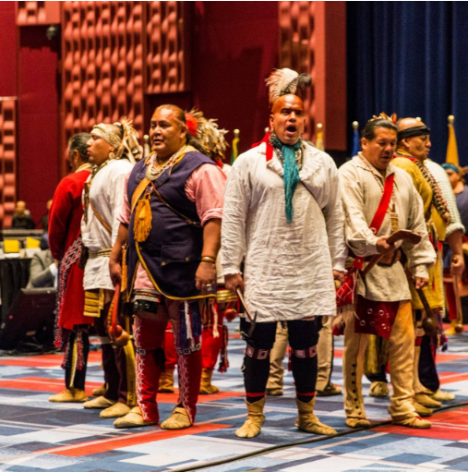
Indigenous Wars
Characterized by conflict between 2 societies with different military cultures
Native Military Culture
Cause For Wars among natives:
Revenge against another tribe for killing one of their own
Taking captives to replace that lost member
Native battle Tactics
Focused on ambush to surprise enemy and get captives
Parties usually consist of a few people with good senses
Communicate with accurate animal sounds
Attack with tomahawks and knives
Masters of concealment
Hand-to-Hand combat
Important to natives because the only way to become a “man” was to participate in hand to hand-to-hand combat
Torture
Natives viewed resisting torture as manly. Dying while resisting torture was a great honor.
Europeans viewed torture as savage.

Slide 5
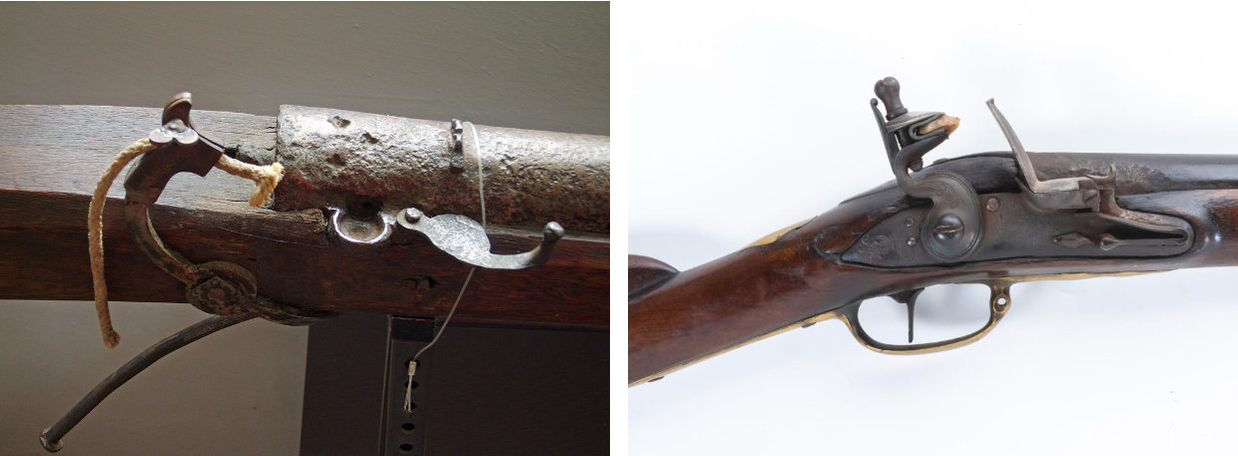
European Military Culture
English military culture is characterized by a fear of standing armies
Standing armies were viewed as tyrannical and against liberty
Instead, militias were used, and war was supposed to be fought by the people
Every man would participate in drills every other month
English line tactics
Men would stand shoulder-to-shoulder and fire timed volleys at the enemy to instill shock
A lot of precision and training were necessary to perform effectively
Common weapons during this time were the matchlock, and later, the flintlock
Colonial adaptations
Tidewater War (Virginia, 1622-1632)
On March 22nd, 1622, Natives ambushed settlements in Virginia, killing 25% of the population.
Colonists would march into the woods asking for battle but were only met with more ambushes and laughter.
Made the colonists realize they were vulnerable to native tactics
Colonials trying to adapt
Create strongholds and defenses to protect people
Natives would not put the defenses under siege, leading to a waste of time and resources
Create a defensive line and forts
Natives could easily sneak through the line with concealment
Create rangers
Semi useful, could report whereabouts of natives

Slide 6
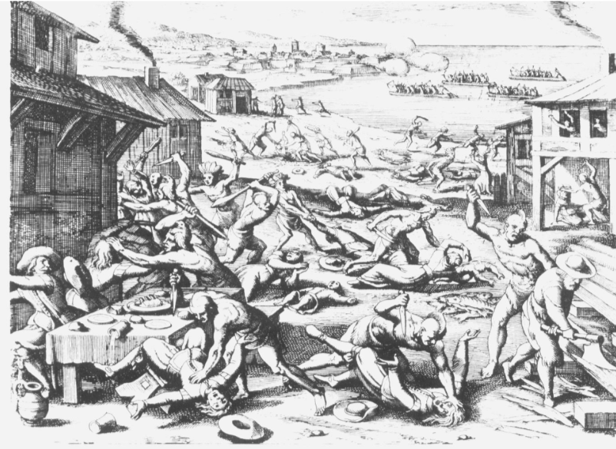
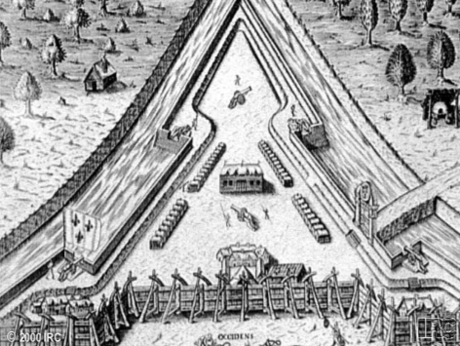
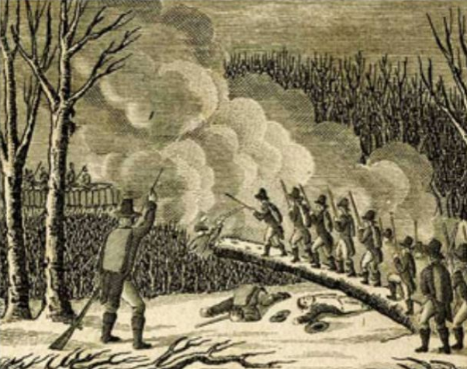
Successful Adaptations during Tidewater War:
Create alliances with other natives to have them reveal settlements to the colonists
Use this information to destroy food supplies, crippling natives
Use ambush tactics of their own by hiding behind trees and firing
King Phillip’s War (New England, 1675-1676)
Bloodiest war in American history (by percentages)
40% of natives died, 5% of English colonists
Started with the devastation of New England towns by the Wampanoag
English use their new tactics to go and destroy native towns
Battle of great swamp (1676)
Fearing an attack next year, the colonists made a preemptive attack on the natives during the winter
The entire village was burnt to the ground

Slide 7
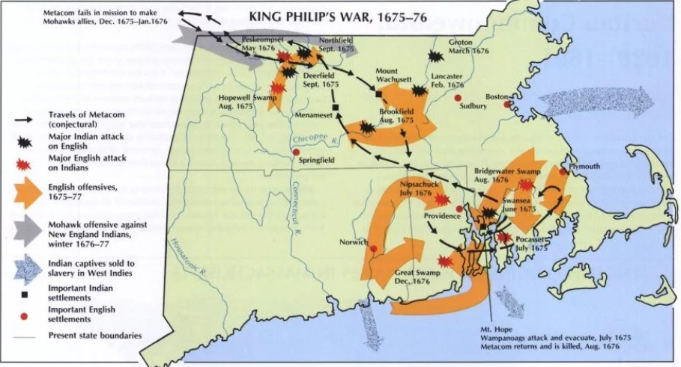
Colonial Adaptation: Benjamin Church
Benjamin church got permission to make a militia that fought like the natives.
The ambush tactics used were very successful
Native Adaptation: Volley fire
During one example, Benjamin Church’s group encountered a native unit that ambushed them with volley fire.
Outcome from the war
Many accounts of the war were created for the time.
This was the start of the colonists viewing themselves as Americans
Led to the natives being viewed as savages
Significance to question 1 of the overarching questions
The enemies were savages, the only way that they could be beat was to adapt their savage tactics

