Slide 1


Course Info
Time: MWF 9:10-10:00 AM
Location: CHEN 106
Instructor: Hung-Jen Wu
Office: CHEN 227
Phone: (979) 862-1454
Email: hjwu@tamu.edu
Office Hours
MW 10:00-11:00 AM
By appointment
Teaching Assistant: Beth Wei
Office: TBA
Email: bettywey@tamu.edu
Office Hours
TBA
Message brought to you by Python gang
Category | Date | Percentage
Practice Quizzes | N/A | 15%
Pop Quizzes | N/A | 5%
Homework | N/A | 15%
Midterm 1 | Sep 27th | 20%
Midterm 2 | Nov 13th | 20%
Final | Dec 6th 8:00-10:00 | 20%
Reflection Letter | TBA | 5%

Slide 2
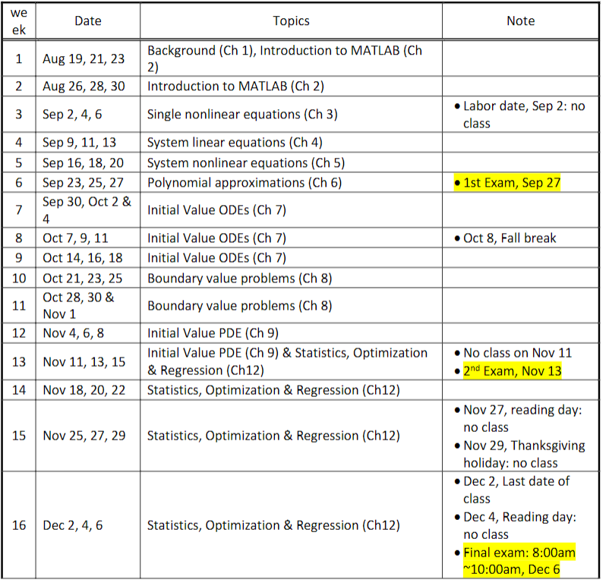

Slide 3


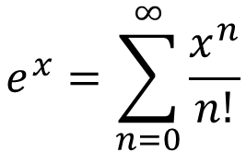
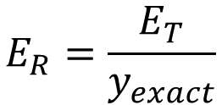
Chapter 1: Introduction
Issues for computational methods
Convergence
The way we try to solve problems is through iterations, so we must make an initial guess to solve it. If the guess doesn’t work out, we must make another guess. A good numerical method will converge to the answer we want.
Accuracy
The answers we get must be correct. Usually expressed by the number of significant digits
Stability
Like convergence, but for differential equations, stability has a different meaning. Will be covered when we get there
Computational Efficiency
Most questions are simple in this course, but large-scale simulations can cause issues, so efficiency is necessary.
Example Problem:
$$f\left(x\right)=(x+3)(x+1)$$
A numerical analysis solution could test points what you give it, and from there, find the answer.
Numerical Error
Total error: difference between the true value and the numerical approximation.
$$E_{T}=y_{exact}−y_{approx}$$
Relative error: Total error over the exact answer
$$E_{R}=\frac{E_{T}}{y_{exact}}$$
These are not practical, because would you find the numerical approximation, if you already know the answer?
Truncation errors: Difference between the exact value and the power/Taylor series expansion with a finite number of terms
$$e^{x}=\sum_{n=0}^{∞}{\frac{x^{n}}{n!}}$$

Slide 4
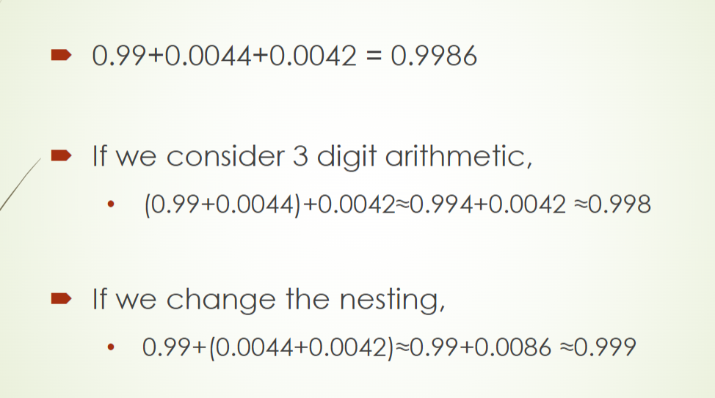
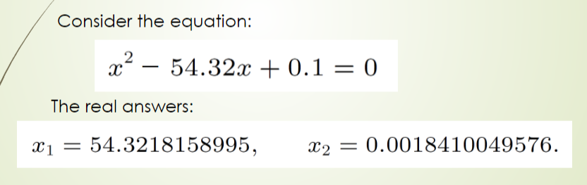
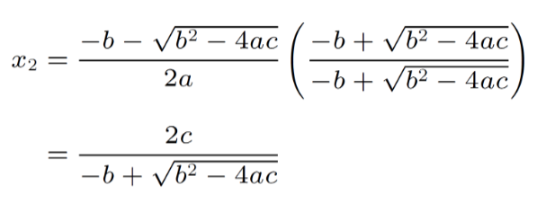
Computer related stuff
Round-Off Error: comes form computer itself
Computers can only hold a certain number of digits
Digits left off by the computer are called round off errors.
Round off error can make a significant impact when subtracting two very close numbers
Suppose your computer can only hold 3 sig digits
Precision (floating point format)
Single (32 bits): ~7 sig digits
Double (64 bits): ~15 sig digits
MATLAB uses double by default, so to get single, you will have to specify
Triple precision is possible with 128 bits
Cancellation error: comes when there is a massive difference between the expected and calculated answers
EX: consider a situation when your square root function only goes to 4 digits
One solution is only off by 0.04%, but due to a cancelation error, the other one is off by 100%
You can reformulate the equation to get a better answer
This may not be very useful now because most function in the computer have a higher accuracy, but later, for differential equations, this becomes more useful

Slide 5
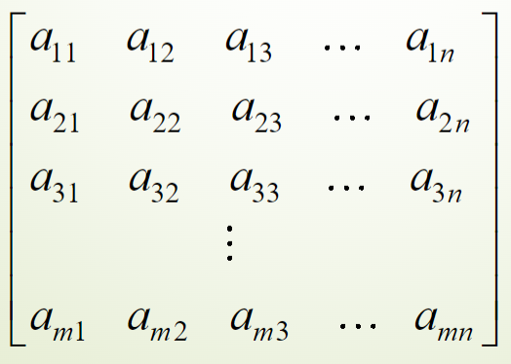
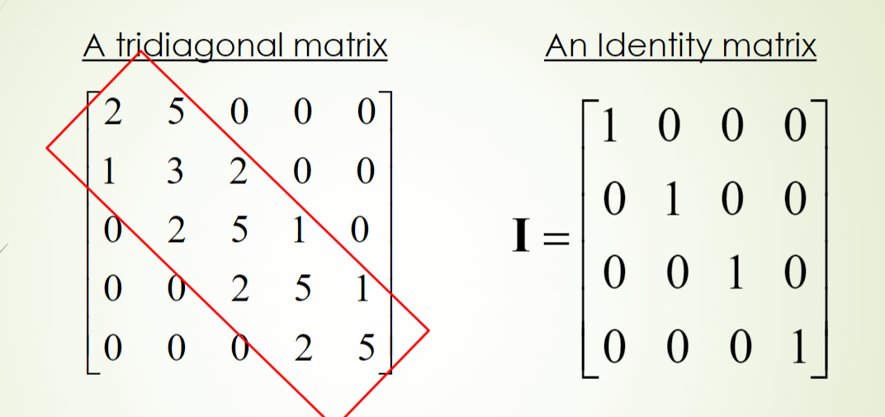
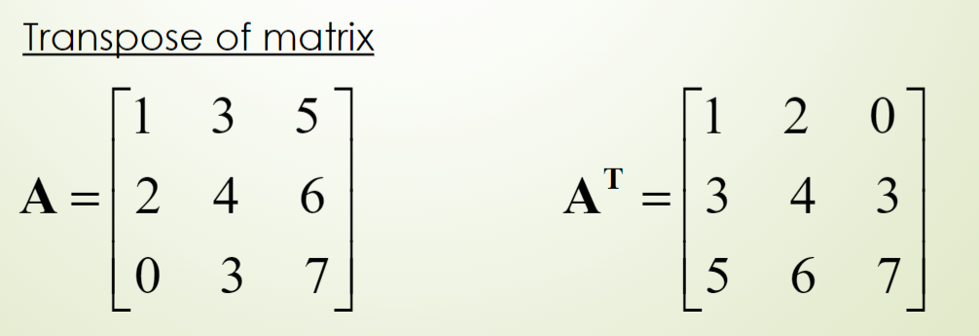
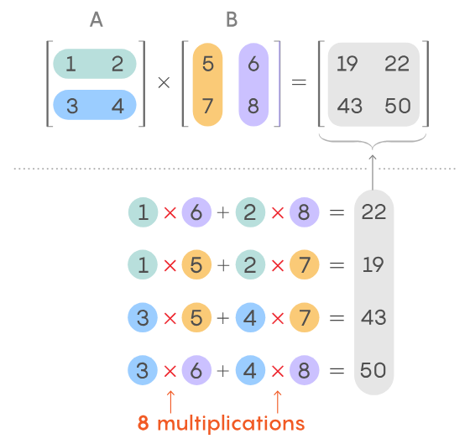
Fundamental mathematics to know: Vectors and Matrices
A matrix is characterized by the number of rows and columns it has. Rows are the horizontal elements and columns are the vertical elements.
General matrix with m rows and n columns
Matrix Operations
Matrix Equality: (A = B) means that A and B have the same number of columns and rows, and the values in the same positions are the same
Matrix Addition: (A + B = C) means that A and B had the same numbers or rows and columns, and C is the values in the same positions in A and B added together
Matrix Addition: (A + B = C) means that A and B had the same numbers or rows and columns, and C is the values in the same positions in A and B added together
Matrix Multiplication: The element in the resulting matrix is found by doing the scalar product for the values in the original matrices of the same column and row.
The first matrix should have as many columns as the second has rows

Slide 6
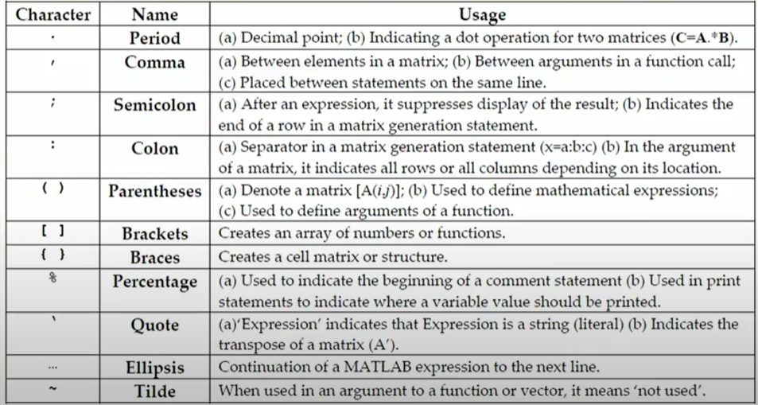
Chapter 2: MATLAB
Variables
Can store numbers, strings or unknown quantities
Variable names operate like python, assignments are like python as well
Globally defined
Floats are double by default
Operators
‘+’ addition
‘-’ subtraction
‘*’ multiplication
‘/’ division
‘^’ exponentiation
Syntax special variables
‘ans’ used to store the result of an expression
‘clock’ variable that contains the current time
‘date’ contains the current day
‘i’ sqrt(-1)
‘Inf’ when a number exceeds the maximum or minimum number
>1.7E308 or <-1.7E308
‘j’ sqrt(-1)
‘NaN’ stands for not a number
Usually, the result of an undefined math operation (0/0 or log(-2))
‘pi’ pi to 15 sig digits

Slide 7
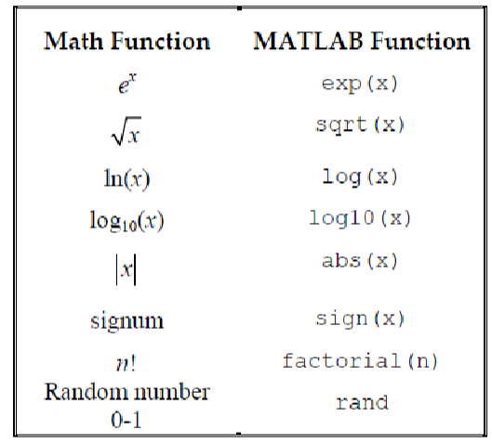
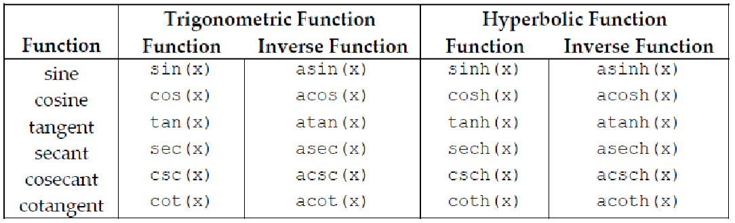
Some Tips
Use a semicolon at the end of a line to prevent it from printing on the command line
Use ‘%’ to comment
Use ‘%%’ to designate sections

Slide 8
Matrices and Vectors
Transposing Vectors
v = v’
v = transpose(v)
Some Vector info
Get a certain value from a vector
v(index)
Indices start at 1, not 0
Max and min
[value, index] = max(v)
[value, index] = min(v)
Length
v_length = length(v)
Creating vectors
Creating a row vector: v = [1, 2, 3]
Creating a column vector: v=[1; 2; 3]
Creating a larger vector:
v = [start:step:stop]
The stop is inclusive
v = Linspace(start, stop, # of indices)
Creating Matrices
M = [1, 2, 3; 4, 5, 6]
To make matrices easier to read in the code, use ‘…’ after the row, and proceed to the next row. This will make it, so your matrix looks as it functions in the code.
You can also create them by using vector variables
M = [r1; r2; r3]
Or you can make them with a collection of columns
M = [c1, c2, c3]
Vector with sequences:
M = [start:step:stop; …]
Vector with all 1’s or 0’s
M = ones(height, width)
M = zeros(height, width)
Identity matrix
M = eye(size)
Accessing info from matrices
M(row, column)
Retrieving a row or column
M(row, :)
M(:, column)
Getting the size of a matrix
result = size(M)
Given as ‘rows columns’
Transposing Matrices
Same as Vectors

Slide 9
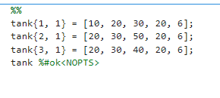
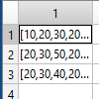
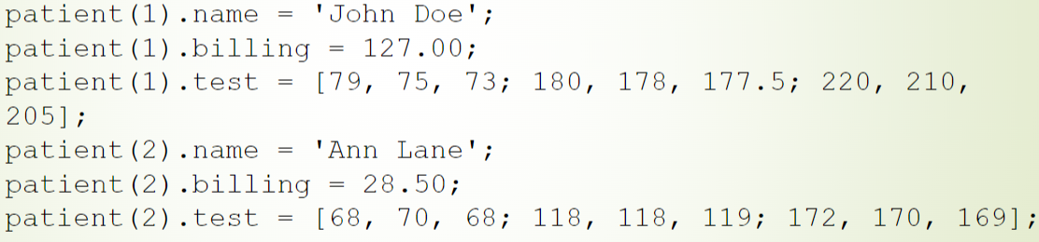
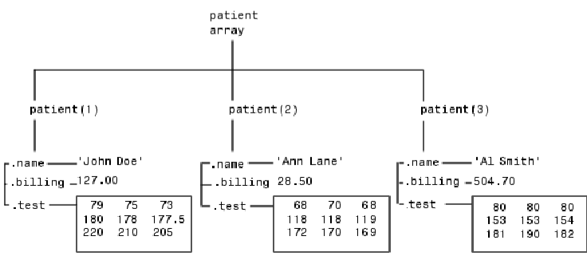

Cell Arrays
Can hold any data type and data in the cells can differ in type
Like a list of lists from python
Useful Applications:
When you have many instances of a similar structure of data
EX: you have 100 reactors and don’t want to individually define all of them
Creating Cell Arrays
cell_array{row, column} = (any type of data)
Structured Arrays
Organize data and access it by name
Like a cell array but the second dimension is not just an integer, but a way to name the data
Like a python dictionary

Slide 10
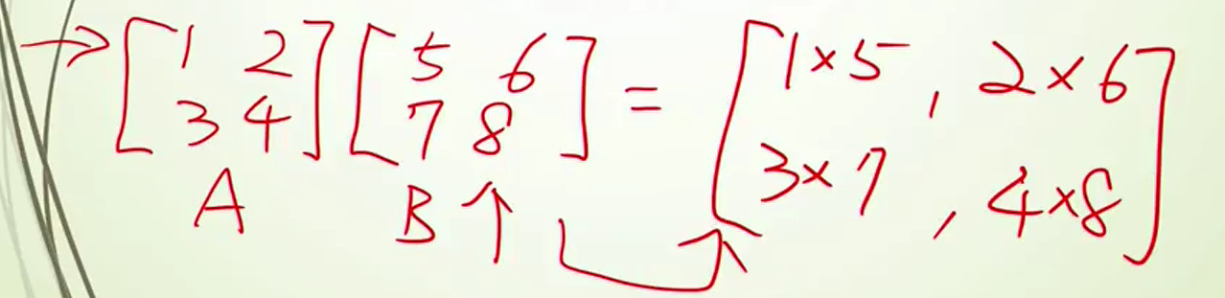
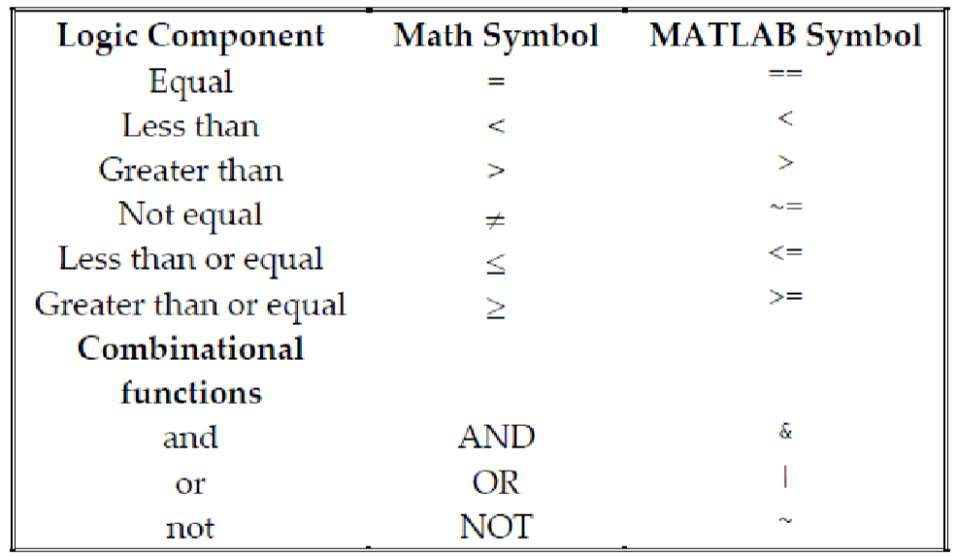
Common Operations
Importing Data:
csvread: reads a csv file
M = csvread(filename)
We will mainly use this function for importing data
xlsread: reads excel file
Don’t use this, it works for older spreadsheets
readcell: new version for reading excel file
Dot Operations:
Allows you to combine two matrices in a variety of ways
‘.*’ will multiply the elements of two matrices together
‘./’ will divide the elements of the first matrix by the second matrix
‘.^’ will raise the elements of the first matrix by the second matrix
All these work with scalars

Slide 11
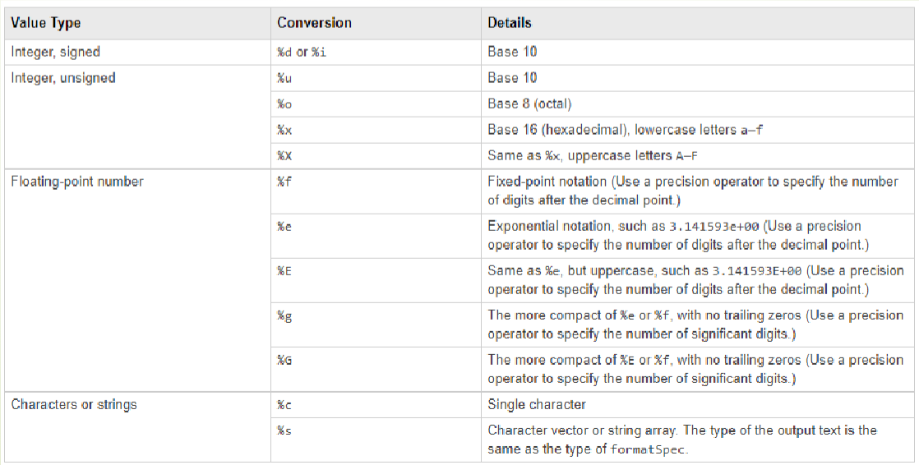
Logic
While Loops
while condition
code
end
For loops
for iterable
code
end
Iterables take the form i = start:step:stop
If Else Statements:
If condition
Code to execute
elseif condition
Code to execute
else
Code to execute
end
break and continue are available for loops
Output
Copying values from MATLAB into excel is possible
Just open the spreadsheet menu and copy and paste
Also, downloading .mat files for a single variable or all variables in your workspace is possible
fprintf(formatted string)
Can use this to format your outputs (like an f string)
Can put multiple variables in a string
Use ‘\n’ to jump to the next line

Slide 12
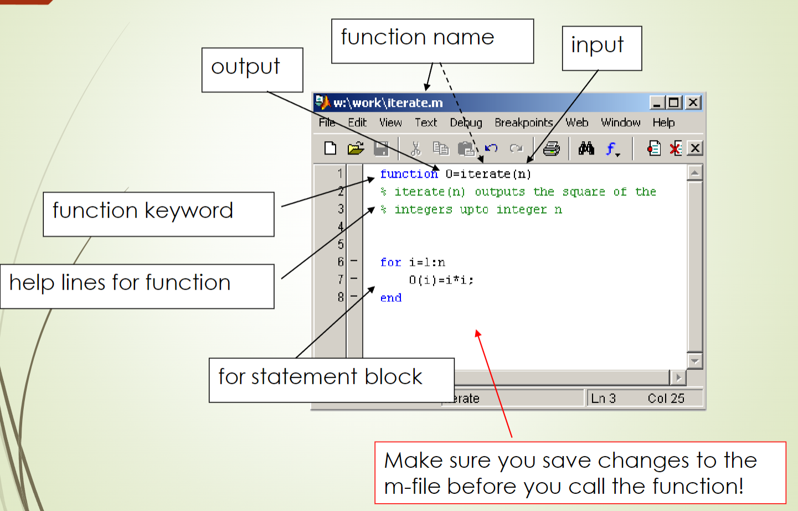
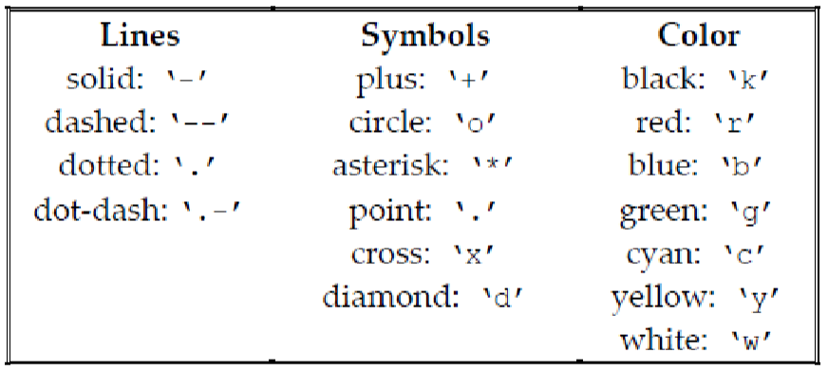
m-files
Used for creating functions\
Anonymous functions (Lambda functions)
Takes the form: function_name = @(var1, var2…) function
Actual functions as files
Functions can have multiple outputs. To take advantage of this, use a vector [var1, var2]
Useful for large amounts of code
Plotting
plot(x, y) creates quick, dirty plots
Some formatting can easily be applied to make your plots better

Slide 13
Plot formatting
plotted_data = plot(x_data, y_data)
To put multiple data sets on a plot, use ‘hold on’ after the first one
set(plotted_data, ‘Color’, [R, G, B]) The RGB values are normalized to 1
set(plotted_data, ‘LineStyle’, ‘-’)
to change bounds
xlim([start, stop])
ylim([start, stop])
to change axis labels
xlabel(‘name’, ‘FontSize’, int)
xlabel(‘name’, ‘FontSize’, int)
Title:
title(‘title’, ‘FontSize’, int)
Symbolic Toolbox
defining symbolic variables
syms var
To do fractional math without decimal points
sym(frac)
Simplify functions
expand(sym_func)
simplify(sym_func)
substitute values in a symbolic function
subs(sym_func, [var1, var2, …], [val1, val2, …])
Factor polynomials
factor(sym_func)
Convert to anonymous function
matlabFunction(sym_func)
Derivatives/Integrals
diff(sym_func, var, order)
int(sym_func, var): indefinite
int(sym_func, var, from, to) definite
can use symbolic variables for form and to
What if your integral has no easy solution?
vpa(integral)

Slide 14
Some other functions that are useful
lower(str) -> returns the string but in all lowercase
error(message) -> raises an error

