Slide 1
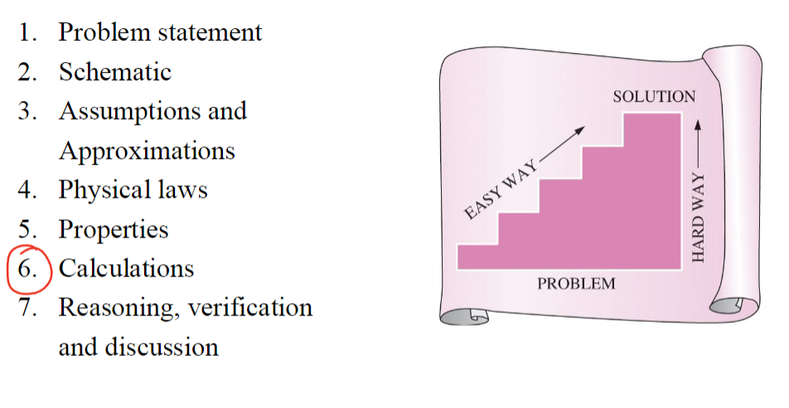
Course Info
Time: TR 8:00-9:15 AM
Location: CHEN 106
Teaching Assistants:
Reagan Kutter
Email: regankk@tamu.edu
Time: Friday 1:45-2:45 PM
Location: CHEN 340
Ashish Shyam Tangade
Email: ashish.tangade@tamu.edu
Time: Wednesday 4:00-5:00 PM
Location: CHEN 340
Instructor: Jeetain Mittal
Office: CHEN 500
Phone: (979) 862-1920
Email: Jeetain@tamu.edu
Office Hours:
Monday 2:00-3:00 PM
By appointment
Grading Info
Category | Date | Percentage
Participation/Quizzes | N/A | 5%
Homework | N/A | 10%
Midterm 1 | Sep 24th | 25%
Midterm 2 | Nov 7th | 25%
Final | Dec 6th 1:00-3:00 | 35%

Slide 2
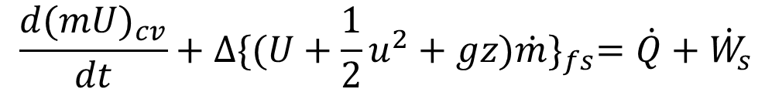






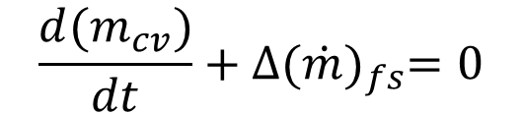
1st Law of Thermodynamics: Energy is conserved
Energy Balance on closed system
$$∆U^{t}=Q+W$$
$$dU^{t}=dQ+dW$$
$$W=−PdV$$
Enthalpy
$$H≡U+PV$$
$$dH=dU+PdV+VdP$$
$$dH=dQ+VdP$$
Energy Balance on open system
$$\frac{{d(m}_{cv})}{dt}+∆{(\dot{m})}_{fs}=0$$
$$\frac{{d(mU)}_{cv}}{dt}+∆{\{(U+\frac{1}{2}u^{2}+gz)\dot{m}\}}_{fs}=\dot{Q}+{\dot{W}}_{s}$$

Slide 3
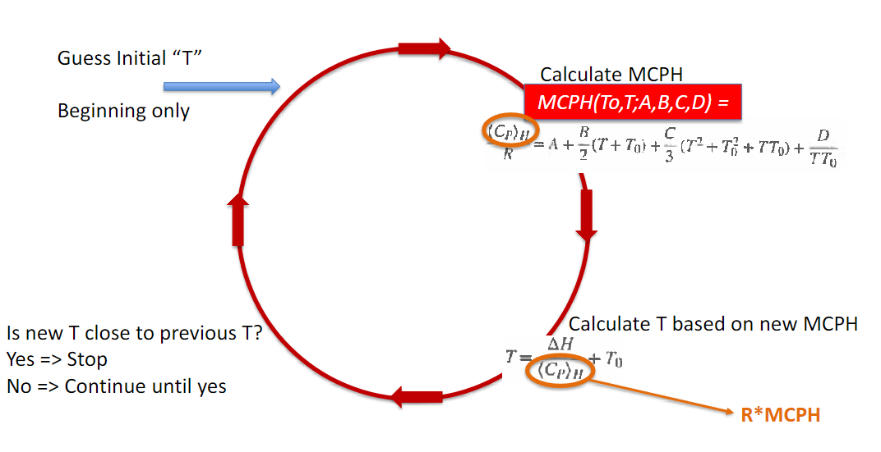
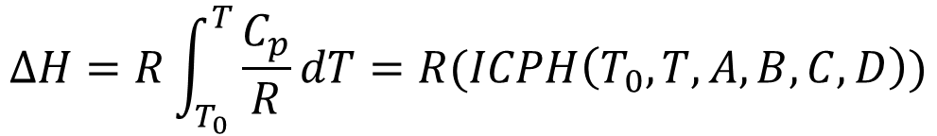

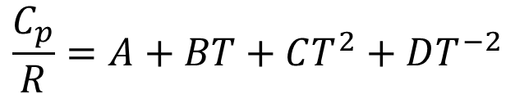
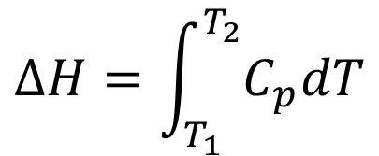
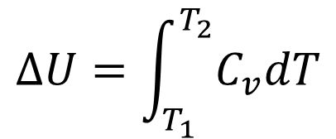
Constant Volume and constant Pressure heat capacity
$$∆U=\int_{T_{1}}^{T_{2}}{C_{v}dT}$$
$$∆H=\int_{T_{1}}^{T_{2}}{C_{p}dT}$$
Temperature Dependence on heat capacity
$$\frac{C_{p}}{R}=A+BT+CT^{2}+DT^{−2}$$
$$∆H=R\int_{T_{0}}^{T}{\frac{C_{p}}{R}dT}=R(ICPH\left(T_{0},T,A,B,C,D\right))$$
Finding Temperature through changes in enthalpy
$$ICPH\left(T_{0},T,A,B,C,D\right)=MCPH\left(T_{0},T,A,B,C,D\right)\left(T_{0}−T\right)=\frac{<C_{p}>}{R}(T_{0}−T)$$
$$∆H=<C_{p}>(T_{0}−T)$$

Slide 4
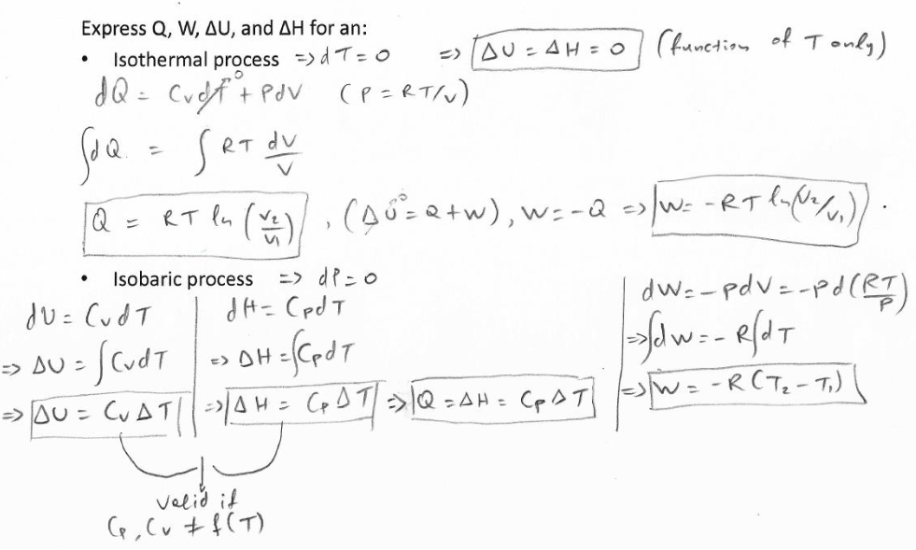
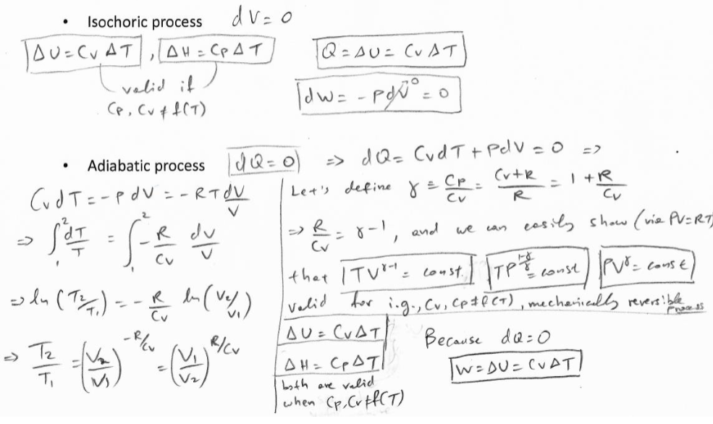


Equations of State
Gibbs’ Phase Rule
$$DoF=2−π+N$$
π = Number of phases, N = number of species
Ideal Gas Law
$$PV=RT$$
Finding Q, W, U, and H for reversible, closed systems

Slide 5
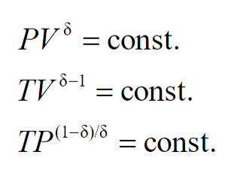

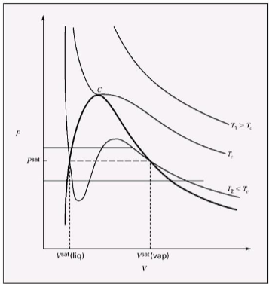
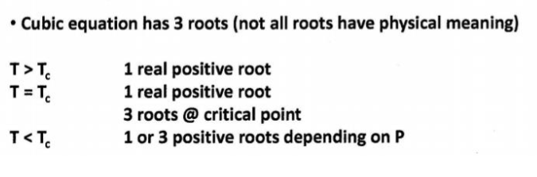
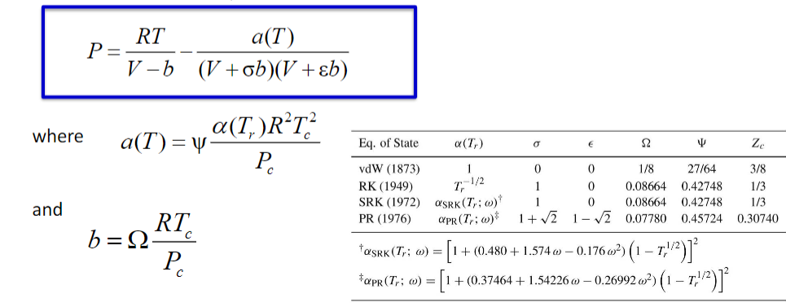
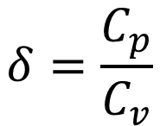
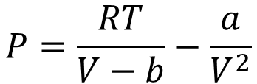
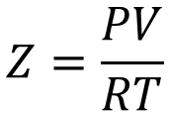
$$δ=\frac{C_{p}}{C_{v}}$$
Real Gasses
$$Z=\frac{PV}{RT}$$
Virial equation
Cubic Equations of state
Van der Waals Equation of state
$$P=\frac{RT}{V−b}−\frac{a}{V^{2}}$$

Slide 6
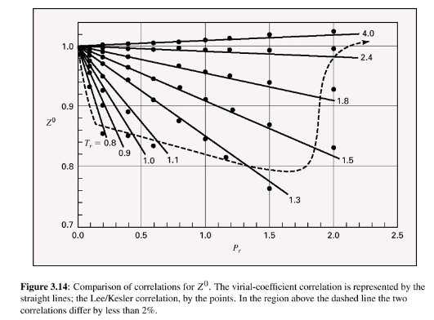
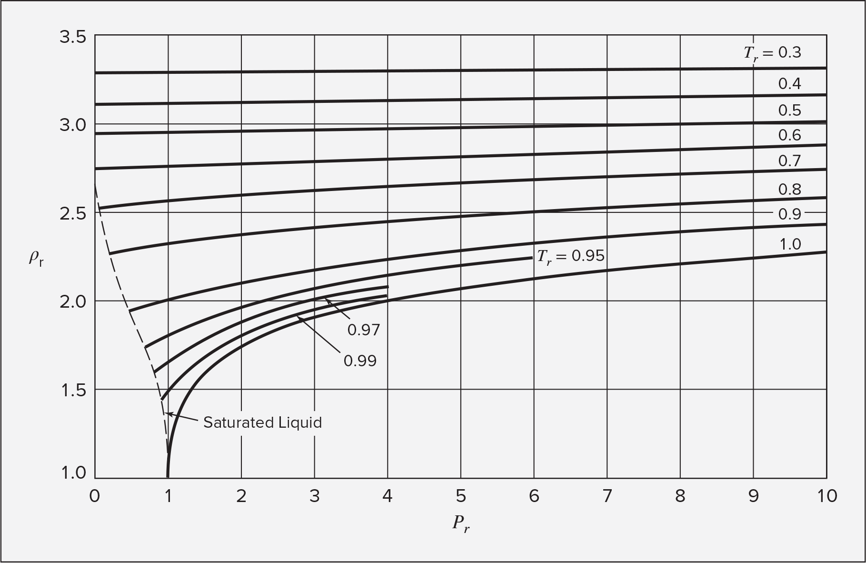

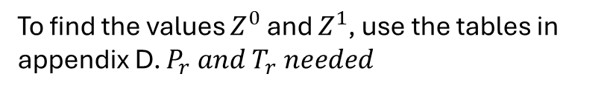




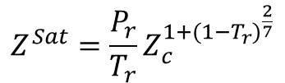



Pitzer Correlations
Compressibility Factor
Second virial coefficient
$$Z=Z^{0}+ωZ^{1}$$
To find the values $Z^{0}$ and $Z^{1}$, use the tables in appendix D. $P_{r} and T_{r} needed$
Note: Ideal gas law is acceptable to use if $Z^{0}$ is between 0.98 and 1.02 (2% error)
$$Z=1+ B^{0}\frac{P_{r}}{T_{r}}+ωB^{1}\frac{P_{r}}{T_{r}}$$
The Pitzer correlation for the second virial coefficient can only be used if inside the dotted line in on the figure below
$$B^{0}=0.083−\frac{0.422}{T_{r}^{1.6}}$$
$$B^{1}=0.139−\frac{0.172}{T_{r}^{4.2}}$$
Changes in states for liquids based on isothermal compressibility and volume expansivity:
$$\frac{dV}{V}=βdT−κdP$$
Generalized correlations for liquids
Rackett equation
Two parameter corresponding states
Use density with the chart to get other info
$$V^{Sat}=V_{c}Z_{c}^{{(1−T_{r})}^{\frac{2}{7}}}$$
Good For saturated liquids
$$Z^{Sat}=\frac{P_{r}}{T_{r}}Z_{c}^{1+{(1−T_{r})}^{\frac{2}{7}}}$$
$$ρ=\frac{1}{V}$$
$$ρ_{r}=\frac{ρ}{ρ_{c}}=\frac{V_{C}}{V}$$

Slide 7
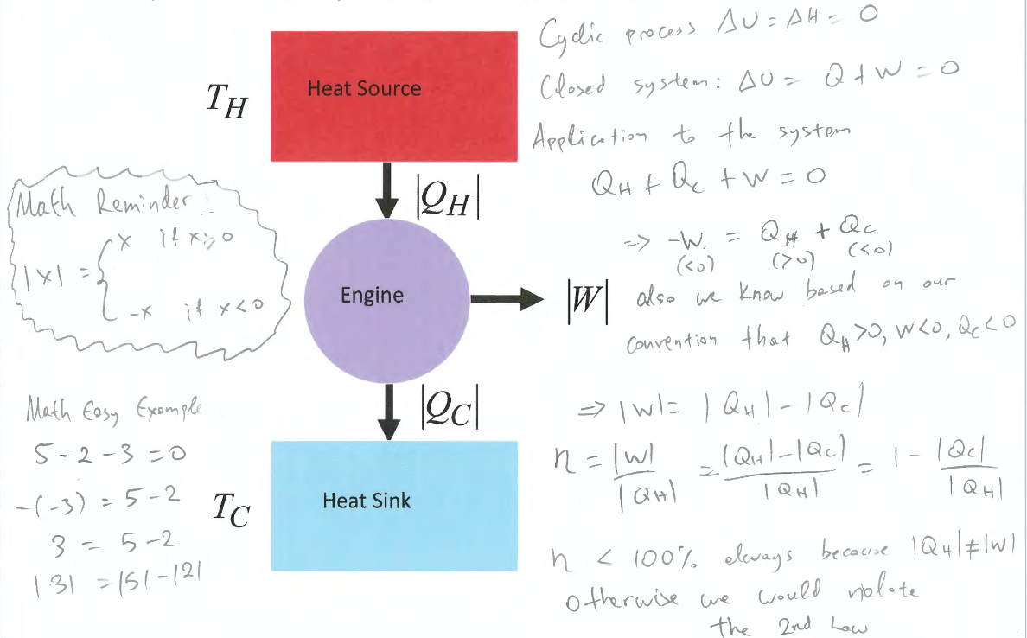

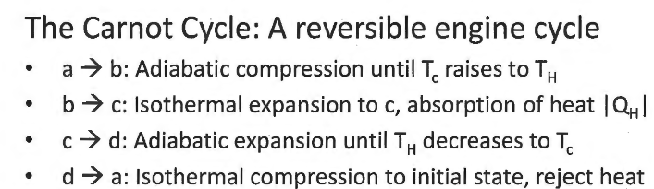
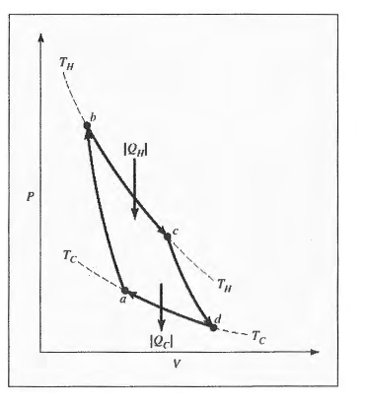

Entropy
2nd law: energy has different amounts of quality
EX: Work is more useful than heat

Slide 8



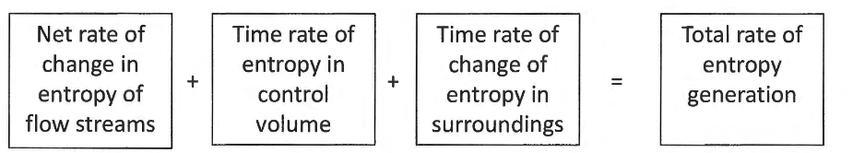




Changes in entropy of an ideal gas
Changes in entropy of an ideal gas in an open system
Chapter 6
Internal Energy
$$dU=TdS−PdV$$
Enthalpy
$$dH=TdS+VdP$$
Gibbs Free Energy
$$dG=VdP−SdT$$
Helmholtz Free Energy
$$dA=−PdV−SdT$$

Slide 9
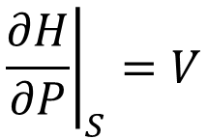
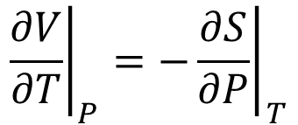
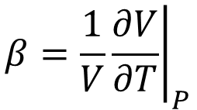
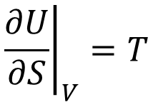
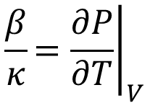
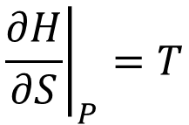
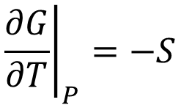
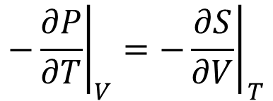
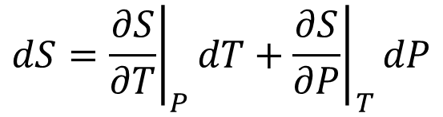

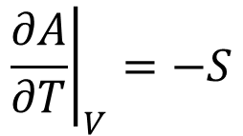
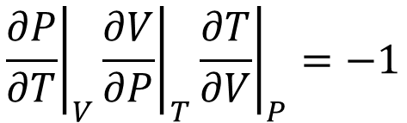

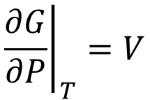
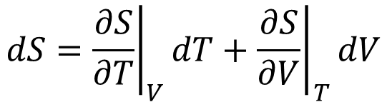
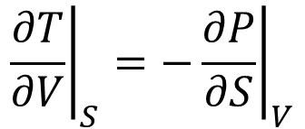
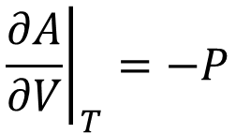
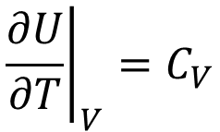

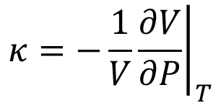
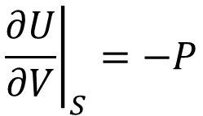
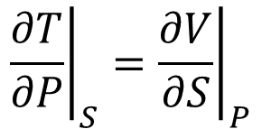

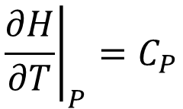
Maxwell’s Relations
Internal Energy
Enthalpy
$$dU=TdS−PdV$$
$$dH=TdS+VdP$$
$${\left.\frac{∂U}{∂S}\right|}_{V}=T$$
$${\left.\frac{∂U}{∂V}\right|}_{S}=−P$$
$${\left.\frac{∂H}{∂S}\right|}_{P}=T$$
$${\left.\frac{∂H}{∂P}\right|}_{S}=V$$
$${\left.\frac{∂T}{∂V}\right|}_{S}={\left.−\frac{∂P}{∂S}\right|}_{V}$$
$${\left.\frac{∂T}{∂P}\right|}_{S}={\left.\frac{∂V}{∂S}\right|}_{P}$$
Gibbs Free Energy
Helmholtz Free Energy
$$dG=VdP−SdT$$
$$dA=−PdV−SdT$$
$${\left.\frac{∂G}{∂P}\right|}_{T}=V$$
$${\left.\frac{∂G}{∂T}\right|}_{P}=−S$$
$${\left.\frac{∂A}{∂V}\right|}_{T}=−P$$
$${\left.\frac{∂A}{∂T}\right|}_{V}=−S$$
$${\left.\frac{∂V}{∂T}\right|}_{P}=−{\left.\frac{∂S}{∂P}\right|}_{T}$$
$${\left.−\frac{∂P}{∂T}\right|}_{V}=−{\left.\frac{∂S}{∂V}\right|}_{T}$$
Other Relations to keep in mind
$${\left.β=\frac{1}{V}\frac{∂V}{∂T}\right|}_{P}$$
$${\left.κ=−\frac{1}{V}\frac{∂V}{∂P}\right|}_{T}$$
$${\left.\frac{∂P}{∂T}\right|}_{V}{\left.\frac{∂V}{∂P}\right|}_{T}{\left.\frac{∂T}{∂V}\right|}_{P}=−1$$
$$\frac{β}{κ}{\left.=\frac{∂P}{∂T}\right|}_{V}$$
$${\left.\frac{∂H}{∂T}\right|}_{P}=C_{P}$$
$${\left.\frac{∂U}{∂T}\right|}_{V}=C_{V}$$
$$dS={\left.\frac{∂S}{∂T}\right|}_{V}dT+{\left.\frac{∂S}{∂V}\right|}_{T}dV$$
$$dS={\left.\frac{∂S}{∂T}\right|}_{P}dT+{\left.\frac{∂S}{∂P}\right|}_{T}dP$$

Slide 10
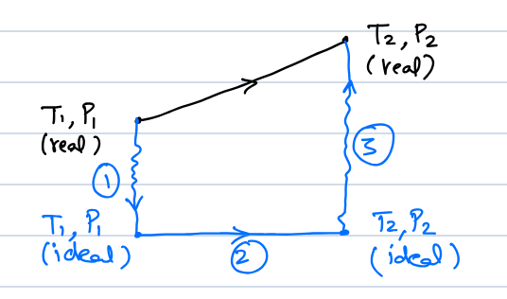
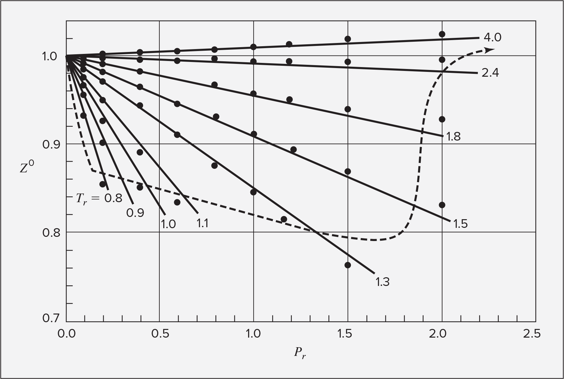
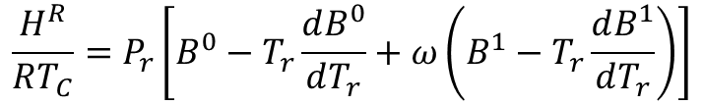
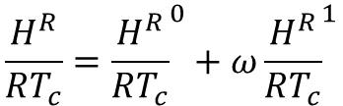



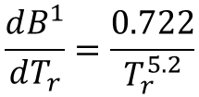



Residual Properties
$$M^{R}≡M−M^{i}$$
Residual = Actual - Ideal
Using Lee Kesler Tables
$$\frac{H^{R}}{RT_{c}}={\frac{H^{R}}{RT_{c}}}^{0}+ω{\frac{H^{R}}{RT_{c}}}^{1}$$
$$\frac{S^{R}}{R}={\frac{S^{R}}{R}}^{0}+ω{\frac{S^{R}}{R}}^{1}$$
Values can be found in appendix D
Using second virial generalized correlation
Note: this method can only be used if you are inside the line on the figure below
$$\frac{H^{R}}{RT_{C}}=P_{r}\left[B^{0}−T_{r}\frac{dB^{0}}{dT_{r}}+ω\left(B^{1}−T_{r}\frac{dB^{1}}{dT_{r}}\right)\right]$$
$$\frac{S^{R}}{RT_{C}}=P_{r}\left[\frac{dB^{0}}{dT_{r}}+ω\frac{dB^{1}}{dT_{r}}\right]$$
$$B^{0}=0.083−\frac{0.422}{T_{r}^{1.6}}$$
$$B^{1}=0.139−\frac{0.172}{T_{r}^{4.2}}$$
$$\frac{dB^{0}}{dT_{r}}=\frac{0.675}{T_{r}^{2.6}}$$
$$\frac{dB^{1}}{dT_{r}}=\frac{0.722}{T_{r}^{5.2}}$$

Slide 11








Introduction
Equilibrium
State of balance, no unbalanced driving forces
Thermal EQ: Uniform temperature
Mechanical EQ: Uniform pressure to no tendency for pressure to change locally
Phase EQ: Mass of each phase stays in the same quantity
Chemical EQ: No tendency for changes in chemical composition
Thermodynamic EQ: Equilibrium with respect to all possible changes in state
To be at equilibrium, the system must be
isolated (No exchange of energy, mass or
volume). Entropy must also be at a maximum.
Internal energy will be at a minimum
Process: any change that a system undergoes
from one state to another
Path: The series of states a system
goes through during the process
To fully describe a process, one must know the
initial and final states, as well as the path taken
New way to define internal energy:
$$dS^{t}=\frac{δQ_{rev}}{T}$$
$$dU^{t}=δQ+δW$$
$δ$ <- inexact differential
(used for path functions)
$$dU^{t}=TdS^{t}−PdV^{t}$$
From Themo I
New Term associated with chemical potential
$$dU^{t}=TdS^{t}−PdV^{t}+μdn$$
$$d(nU)=Td(nS)−Pd(nV)+μdn$$
If n=1
$$dU=TdS−PdV+μdn$$
The fundamental equation

Slide 12













$${\left.\frac{∂U}{∂S}\right|}_{V, n}=T$$
$${\left.\frac{∂U}{∂V}\right|}_{S,n}=−P$$
$${\left.\frac{∂U}{∂n}\right|}_{S,V}=μ$$
$$dU={\left.\frac{∂U}{∂S}\right|}_{V, n}dS+{\left.\frac{∂U}{∂V}\right|}_{S,n}dV+{\left.\frac{∂U}{∂n}\right|}_{S,V}dn$$
U(S, V, n)
Expressing thermodynamic properties in terms of different variables
Internal Energy
Enthalpy
$$U\left(S, V, n\right)$$
$$H\left(S, P, n\right)=U+PV$$
$$dU=TdS−PdV+μdn$$
$$dH=TdS+VdP+μdn$$
Entropy
$$S(U,V,n)$$
$$dS=\frac{1}{T}dU+\frac{P}{T}dV−\frac{μ}{T}dn$$
Helmholtz Free Energy
Gibbs Free Energy
$$A\left(T, V, n\right)=U−TS$$
$$G\left(T, P, n\right)=U−TS+PV=H−TS$$
$$dA=−SdT−PdV+μdn$$
$$dG=−SdT+VdP+μdn$$
Helmholtz and Gibbs are the most useful, because they are expressed in easily found values
All of the energies are at a minimum at equilibrium, and entropy is at a maximum

