Slide 1


Red Hat JBoss A-MQ Overview

Slide 2

What is Apache ActiveMQ?
Apache ActiveMQ
Top level Apache Software Foundation project
Wildly popular, high performance, reliable message broker
Clustering and Fault Tolerance
Supports publish/subscribe, point to point, message groups, out of band messaging and streaming, distributed transactions, …
Myriad of connectivity options
Native Java, C/C++, and .NET
AMQP 1.0, MQTT 3.1.1, STOMP 2.0, and OpenWire
STOMP protocol enables Ruby, JS, Perl, Python, PHP, ActionScript, ...
Embedded and standalone deployment options
Pre-integrated with open source integration and application frameworks
Deep integration with Spring Framework, OSGi, and Java EE
Confidential - Do not duplicate or distribute without written permission from Red Hat
Notes:
We support all the JMS spec stuff, also other stuff e.g. virtual destinations
Multiple clients Java C/C++
Multiple protocols (OpenWire, STOMP AMQP 1.0). Can use our libraries or your own libraries so we can talk your protocol
MQTT (IoT), AMQP 1.0 for more JMS specific stuff, STOMP (text oriented protocol, easy to write), OpenWire is the native protocol of A-MQ
Standalone – most common. Embedded – good for largest retailer who has it embedded in every cash register to feedback real-time data. Talks over VM transport (not over network) – uses a network of brokers to feedback info to a centralized standalone broker

Slide 3
Red Hat JBoss A-MQ
RED HAT JBOSS A-MQ
Development and tooling Develop, test, debug, refine, deploy JBoss Developer Studio | Reliable Messaging JMS/STOMP/NMS/MQTT, publishing-subscribe/point-2-point, store and forward | Management and monitoring System metrics, automated discovery, container status, automatic updates JBoss Operations Network + hawtio (Fuse Management Console)
 | Apache ActiveMQ
 | Container Life cycle management, resource management, dynamic deployment, security and provisioning
 | Apache Karaf + Fabric, OpenShift
RED HAT ENTERPRISE LINUX Windows, UNIX, and other Linux
Confidential - Do not duplicate or distribute without written permission from Red Hat

Slide 4
Configuring Persistence Adapters
Apache ActiveMQ
File system based
kahaDB - recommended; improved scalability and quick recovery
levelDB - high throughput, quick recovery, better indexing
RDBMS based
jdbcPersistenceAdapter - quick and easy to setup
journaledJDBC - faster than pure JDBC; file journaling with long term JDBC storage
Memory based
memoryPersistenceAdapter – testing only; same as <broker persistent=“false”>
Confidential - Do not duplicate or distribute without written permission from Red Hat
Notes:
Memory based – equivalent of zero persistent. Very fast but non-reliable
RDBMS – lots of writes, not so many reads. A little chatty. Writing it as a blob (inefficient) plus an update to say “marked handled”
File based - hash maps on disk. Very fast, high throughput, noSQL so not a typical dB – can ‘t query it. kahaDB is home grown and created specifically for A-MQ. Recommended FS is local storage (fastest), otherwise shared FS (requirements are that must provide proper file locking NFSv4 or SAN appliance). HornetQ has it’s own replicated datastore which RH believes is better than the replicated version of leveldb.

Slide 5
High Availability
Apache ActiveMQ
Two complementary approaches:
Master/Slave - access to persistent messages after broker failure
A given message is in one and only one broker (persistence store)
If a broker instance fails, all persistent messages are recoverable upon broker restart
Master/Slave allows a 2nd broker instance (slave) to be ready to process persistent messages upon master (1st broker) failure
Clients should use failover transport to automatically connect to slave
failover:(tcp://master:61616,tcp://slave:61616)?randomize=false
Network of Brokers - scale out message processes
Messages can be load balanced to consumers across multiple brokers
A message can be forwarded to another broker when a valid consumer is present
Brokers can be configured to prioritize local & nearby brokers to reduce network traffic
Confidential - Do not duplicate or distribute without written permission from Red Hat
Notes:
This is specific to A-MQ – doesn’t translate 1-1 with other broker technologies
How do I failover in-flight messages? How do I distribute load? 2 separate use cases that are treated differently in A-MQ
NWOB is active-active – does intelligent store and forward messages around. Allows us to scale-out. 9/10 the bottleneck are slow consumers – not the producer or network.
Easiest way to scale up is the to scale up the number of consumers. So we use a load-balanced network of brokers. When a producer sends a message to a broker, the broker will pass it around until it finds a broker that has a consumer listening for that message. Never a lose a message, but it is possible to have a stuck message
Master/Slave pairs (active-passive) is the automated failover solution for our current inflight messages (or stuck messages). Most applications have a manual failover procedure. Master/slave pairs are automated failover.

Slide 6
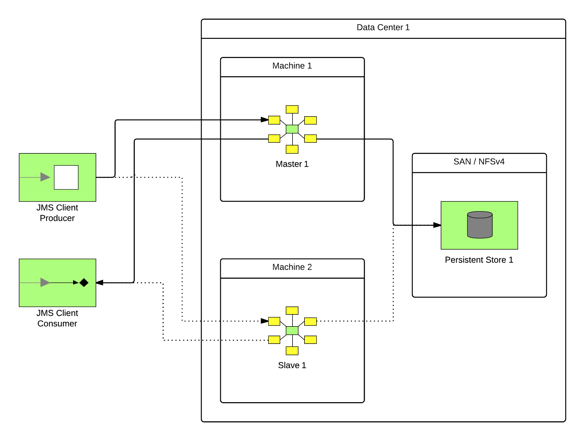
Master/Slave
Apache ActiveMQ
Confidential - Do not duplicate or distribute without written permission from Red Hat
Notes:
Both writing to some sort of shared store
Slave is running but has no open connectors. Just waiting for a lock to come available when the master goes down.
In A-MQ – you don’t manually dictate who is master or slave. They can switch roles. Also, you can have as many slaves as you want
Very important to have a file system that implements proper file locking, otherwise there lies a potential to corrupt kahadb

Slide 7
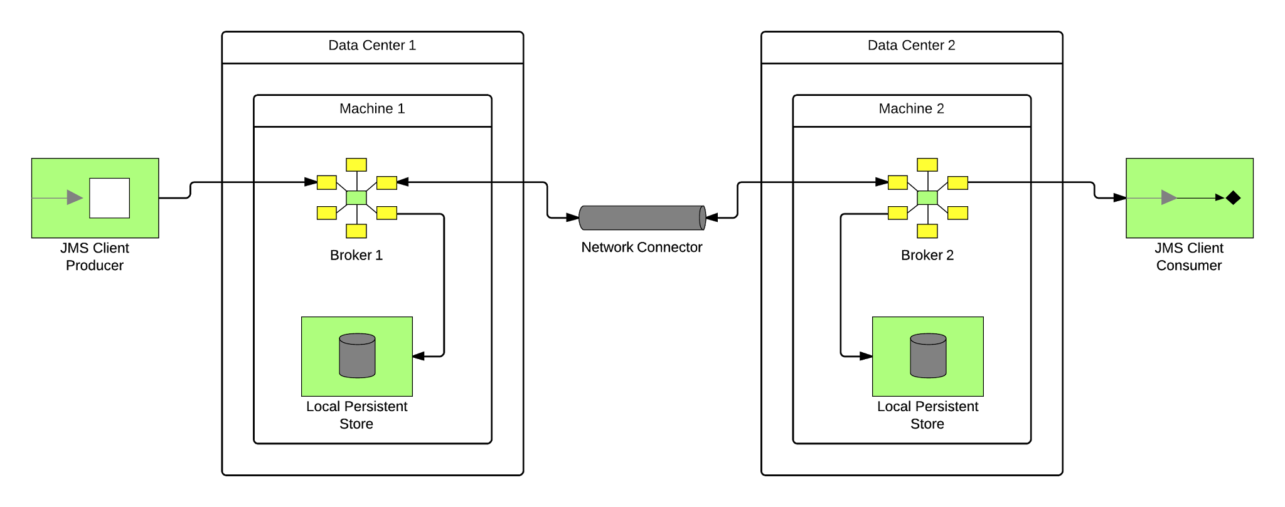
Network of Brokers
Apache ActiveMQ
Confidential - Do not duplicate or distribute without written permission from Red Hat
Notes:
Can span data centers (active-active)
No share of persistent store
If there are no consumers in Data Center 1, the message is forwarded to Data Center 2
Broker 1 knows everything about which consumers are listening and what queues / topics they’re interested in (intelligent store and forward)

Slide 8
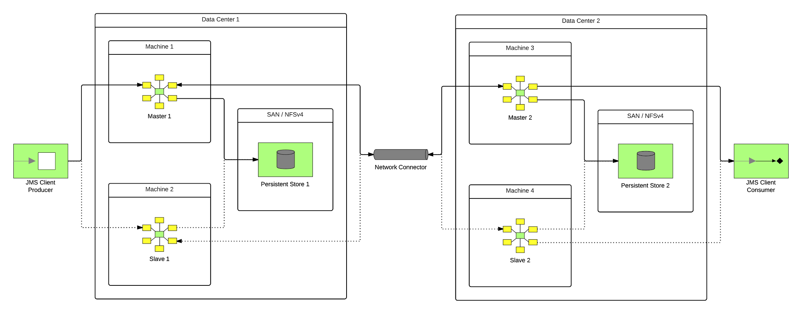
Network of Master/Slave
Apache ActiveMQ
Confidential - Do not duplicate or distribute without written permission from Red Hat
Notes:
This is a common architecture that we’ve seen
We have failover and scaling of our current production load, plus failover of inflight messages
The only time we can have stuck messages is if the complete data center is down. They will be released when the data center comes back online

Slide 9

More Information
Apache ActiveMQ
ActiveMQ in Action
Community website
http://activemq.apache.org/
Confidential - Do not duplicate or distribute without written permission from Red Hat
Notes:
- Lots of cool features like producer flow control, tweaks for optimization are described in this book

Slide 10
Next Generation Messaging

Slide 11
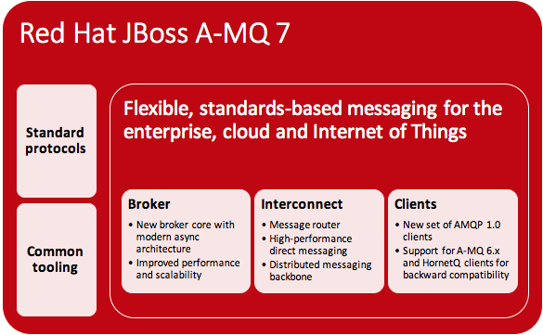
Confidential - Do not duplicate or distribute without written permission from Red Hat

Slide 12
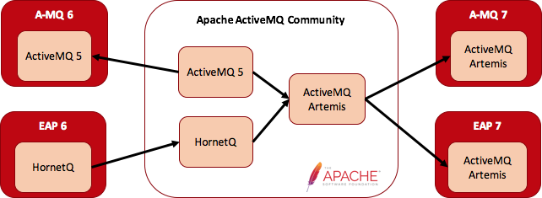
A-MQ 7 Broker: Consolidation
Confidential - Do not duplicate or distribute without written permission from Red Hat

Slide 13
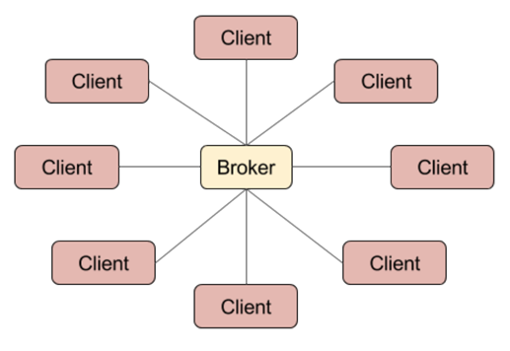
A-MQ 7 Broker: Highlights
Pure Java, high-performance (non-blocking) message broker
Multi-protocol: AMQP 1.0, MQTT, STOMP, OpenWire, HornetQ Core
Polyglot: Java JMS 1.1, C++, .NET, Python, JavaScript (inc. Node.js)
Flexible persistence: high performance journal or JDBC
Support for large messages
Flexible clustering
High availability: shared SAN or shared nothing
Cloud Ready: AWS EC2 and Google Compute
Confidential - Do not duplicate or distribute without written permission from Red Hat

Slide 14
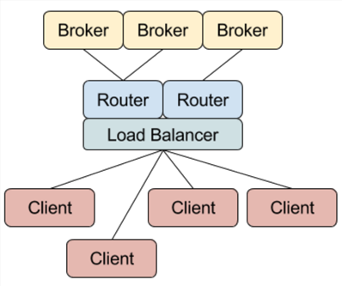
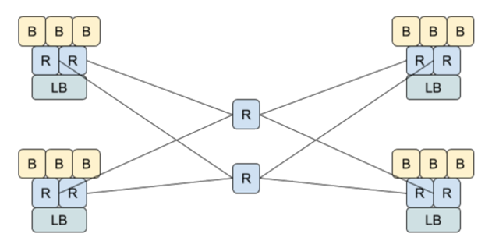
A-MQ 7 Interconnect Router: Highlights
AMQP-native message router
Supports high performance direct messaging
Best effort or end-to-end guaranteed delivery
1-to-1 or 1-to-many
Can be used a single instance or connected as a network
Network offers shortest-path routing with redundancy
Can be used standalone or in conjunction with broker
Confidential - Do not duplicate or distribute without written permission from Red Hat

Slide 15
A-MQ 7: Comparing Broker and Router
 | A-MQ 7 Broker | A-MQ 7 Interconnect Router
Role | Intermediary between clients | Intermediary between clients
Protocol | Supports AMQP (and others) | Supports AMQP
Patterns | 1:1 (queue) & 1:many (topic) | 1:1 (anycast) & 1:many (multicast)
Delivery guarantees | Best-effort or guaranteed delivery | Best-effort or guaranteed delivery
Ownership | Takes ownership of messages | Does not take ownership of messages
Contracts | sender-broker & broker-receiver | sender-receiver
High availability | Provided by broker clustering | Provided by redundant topology
Confidential - Do not duplicate or distribute without written permission from Red Hat

Slide 16
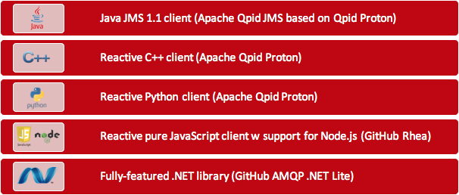
A-MQ 7 Clients
For Broker and Interconnect
Confidential - Do not duplicate or distribute without written permission from Red Hat

Slide 17
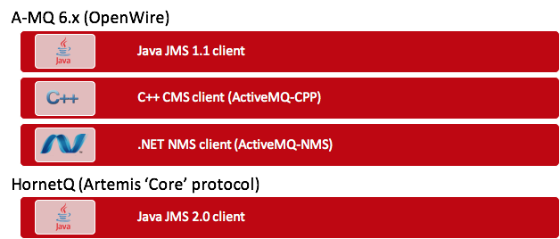
A-MQ 7 Clients: Compatibility
For Broker
Confidential - Do not duplicate or distribute without written permission from Red Hat

Slide 18
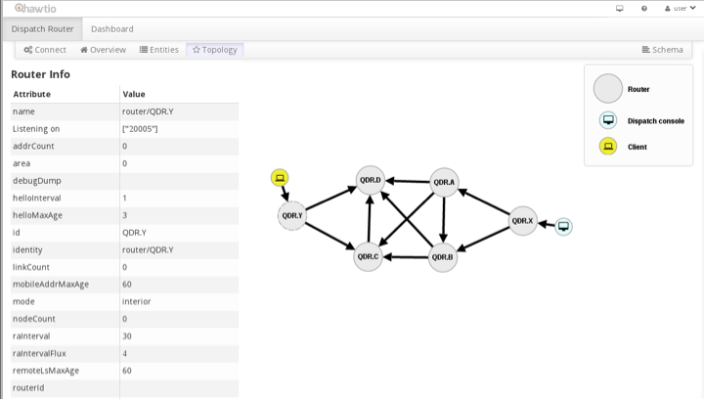
A-MQ 7 Console
Confidential - Do not duplicate or distribute without written permission from Red Hat

Slide 19
AMQ7 Topologies – Shared Filesystem
Essentially the same model as AMQ-6
Uses AIO native journaling, or in-memory paging for persistence
Confidential - Do not duplicate or distribute without written permission from Red Hat

Slide 20
AMQ 7 - Shared Nothing
Brokers replicate message(s) directly to another broker synchronously before ACKing back to the messaging client, and each broker stores messages in its local storage.
Use this model to save on infrastructure cost.
This is lower cost from an infrastructure perspective, as there isn't additional cost of buying a clustered filesystem, or cross datacenter replication tools. You would still want a high speed network link across datacenters.
Confidential - Do not duplicate or distribute without written permission from Red Hat

Slide 21
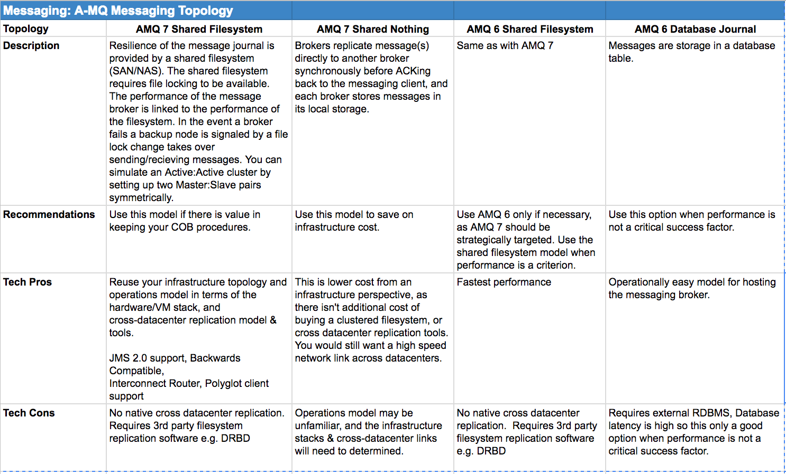
Topology Comparison
Confidential - Do not duplicate or distribute without written permission from Red Hat

Slide 22
AMQ 7 Roadmap
AMQ7 is currently late-stage beta
GA May 2017
AMQ 7 provides a major update with a new high performance core, featuring low latency file journaling and vertical scalable threading models.
Choice of topology & infrastructure: Shared Filesystem, or Broker-to-Broker replication.
Fast scalable core messaging runtime.
Confidential - Do not duplicate or distribute without written permission from Red Hat

Slide 23
Messaging as a Service (MaaS)

Slide 24
Messaging as a Service
Elastic-scale messaging utility built using A-MQ 7 on OpenShift
Separation of concerns
Application provisioning and monitoring vs. infrastructure administration
Multi-tenancy
Different namespaces
Permissions, quotas and limits
Support a variety of communication patterns
Request-response (point-to-point & service pool)
Pub-sub, events
Store-and-forward
Support a variety of different protocols
AMQP, MQTT, HTTP(1.1& 2)/CoAP, STOMP
Confidential - Do not duplicate or distribute without written permission from Red Hat

Slide 25
AMQ 7 MaaS on OpenShift
Roadmap item targeted for 2017 year end.
Multitenancy
Elasticity
Abstracted from static infrastructure
Confidential - Do not duplicate or distribute without written permission from Red Hat

Slide 26

Questions
and
Discussion

