Slide 1

Intro Session
Mr.Rajat Srivastava
Data Scientist – WNS
Data Science Trainer - Techstack

Slide 2

Meet the Trainer
I am Rajat Srivastava , Data Scientist at WNS Global Services Gurgaon A Postgraduate in Statistics from Banaras Hindu University . I am an EX- AMEX, Ex- LIC and Ex- Statsoft . Having more than 10 years experience in the field of Data Analytics Which includes : Statistical Analysis Statistical Modelling & Data Mining Machine learning NLP and NLG and NLU-Deep Learning and AI Computer Vision - Deep Learning and AI SQL/R/Python /SAS/SPSS/Statistica/ AWS/AZURE etc

Slide 3
Mode of learning : Python Notebook/python files Jupyter/Colab/pycharm/spyder/jupyter lab/vs code etc. Ebooks/Notes for the relevant topic For any query mail at rajatsrivastava@techstack.in /whatsapp at 9711245316 only (no calls )

Slide 4
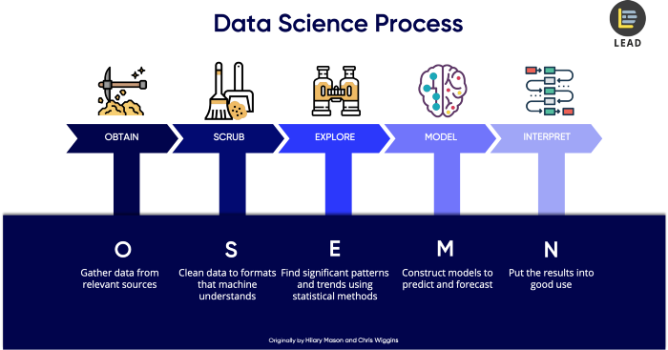

Slide 5
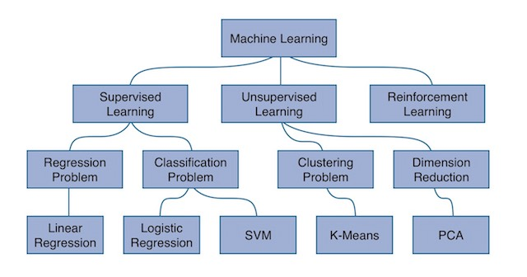
MACHINE LEARNING HIERARCHY

Slide 6
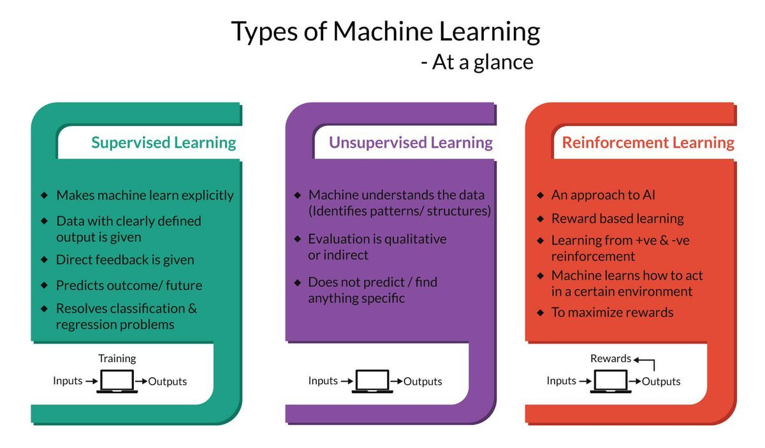

Slide 7
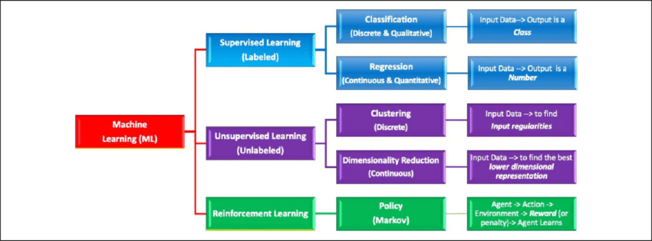

Slide 8
