Slide 1

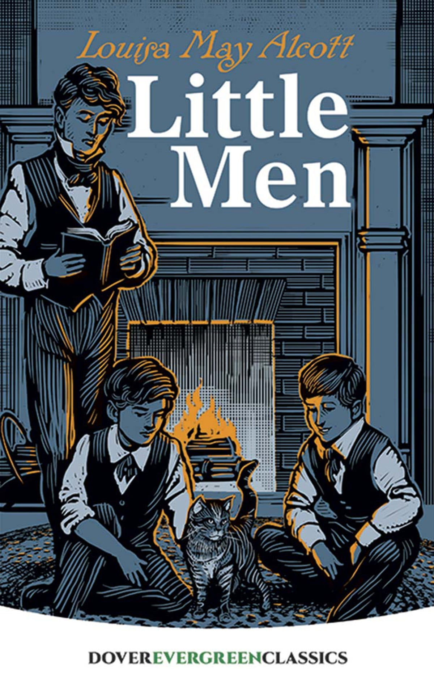
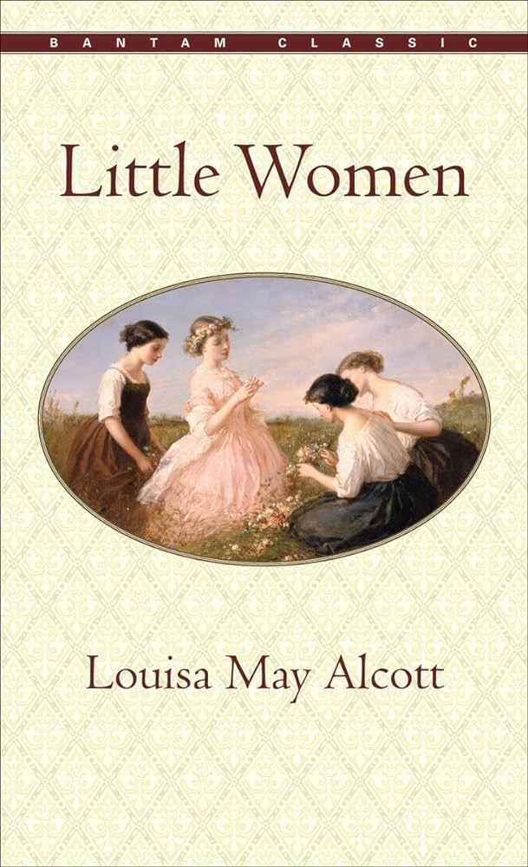
PRONOUN WARS: GENDERED LANGUAGE SHOWDOWN IN MID-1800S LITERATURE
A Spark NLP Project
Alaina Holland and Jonathan McGechie
July 25, 2024
Notes:
Moby-Dick
Author: Herman Melville Summary: "Moby-Dick" follows the obsessive quest of Captain Ahab to hunt the white whale, Moby Dick, who had previously destroyed Ahab's ship and severed his leg. Narrated by Ishmael, the novel explores themes of revenge, fate, and the struggle between man and nature.
Little Women
Author: Louisa May Alcott Summary: "Little Women" chronicles the lives of the four March sisters—Meg, Jo, Beth, and Amy—as they grow up during and after the Civil War. The novel explores themes of family, love, and personal growth as each sister navigates her own path to adulthood.
Little Men
Author: Louisa May Alcott Summary: "Little Men" continues the story of Jo March, now Jo Bhaer, who runs a school for boys with her husband, Professor Bhaer. The novel follows the lives and adventures of the boys at Plumfield, highlighting themes of education, growth, and the value of kindness and discipline.

Slide 2
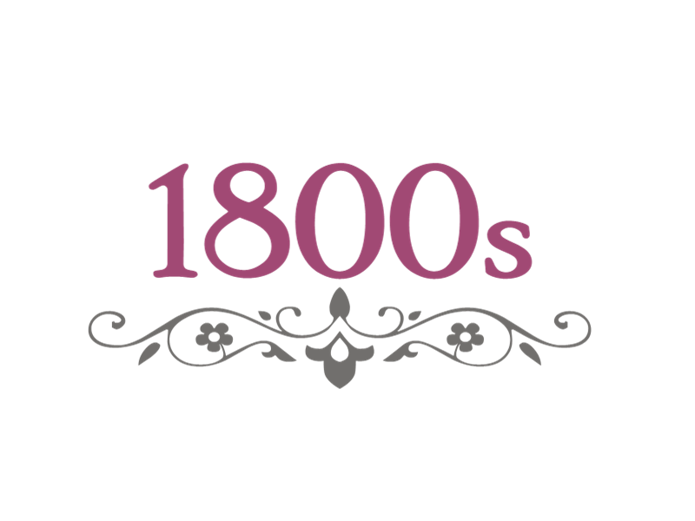
OBJECTIVE/ METHODOLOGY
Objective
Aim: Determine if there's a statistically significant difference in the frequencies of subject and object pronouns for feminine and masculine pronouns in historical texts.
Explore: Investigate whether the author's gender influences these results.
Goal: Shed light on gender bias and representation in mid-19th century literature.
Importance
Reflects societal norms: Understanding gendered language in literature reveals and reinforces societal biases.
Historical Insight: Examining mid-1800s texts provides context for gender representation.
Contemporary Relevance: Inform current discussions about gender bias in media and literature.
Context:
Understanding gender representation in mid-1800s literature.
METHODOLOGY
Books:
"Moby-Dick" by Herman Melville
"Little Women" and "Little Men" by Louisa May Alcott
Technologies:
SparkNLP: For advanced natural language processing.
PySpark: For large-scale data processing.
GoogleColab: For python interface.
Steps:
Text Preprocessing: Clean and tokenize text.
Part-of-Speech Tagging: Identify personal pronouns and their grammatical roles.
Pronoun Frequency Analysis: Calculate frequencies of subject (e.g., he, she) and object (e.g., him, her) pronouns.
Statistical Testing: Perform chi-square tests to determine statistical significance.
Notes:
The chi-square test is appropriate for this analysis because it evaluates whether the distribution of categorical variables differs from what is expected
We analyzed three texts: "Moby-Dick" by Herman Melville and "Little Women" and "Little Men" by Louisa May Alcott. We used SparkNLP for natural language processing and PySpark for large-scale data processing. Our methodology includes text preprocessing, part-of-speech tagging, pronoun frequency analysis, and statistical testing.

Slide 3

HYPOTHESIS
Hypothesis 1: Author’s Gender Influences Pronoun Usage
"Little Women" will have a higher frequency of feminine pronouns.
"Moby-Dick" will have a higher frequency of masculine pronouns.
Null Hypothesis (H0): There is no significant difference in the frequency of masculine and feminine pronouns between the texts.
Alternative Hypothesis (H1): There is a significant difference in the frequency of masculine and feminine pronouns between the texts.
Hypothesis 2: Gender Narration Perspective Impacts Pronoun Usage
"Little Women" and "Little Men" will show different feminine pronoun usage patterns due to different narrative perspectives.
Null Hypothesis (H0): There is no significant difference in feminine pronoun frequency between "Little Women" and "Little Men".
Alternative Hypothesis (H1): There is a significant difference in feminine pronoun frequency between "Little Women" and "Little Men".
Notes:
We formed two hypotheses. First, we hypothesized that the author’s gender influences pronoun usage, expecting "Little Women" to have more feminine pronouns and "Moby-Dick" more masculine pronouns. Second, we hypothesized that the gender perspective in narration impacts pronoun usage, expecting differences between "Little Women" and "Little Men."

Slide 4
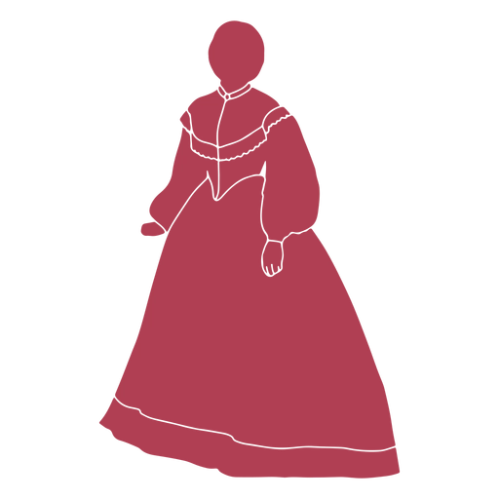
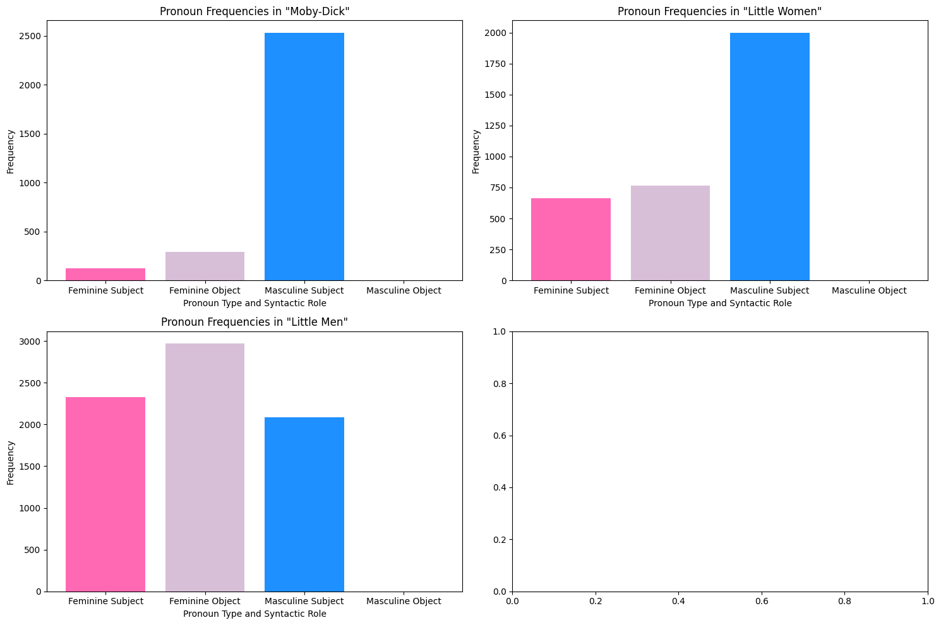
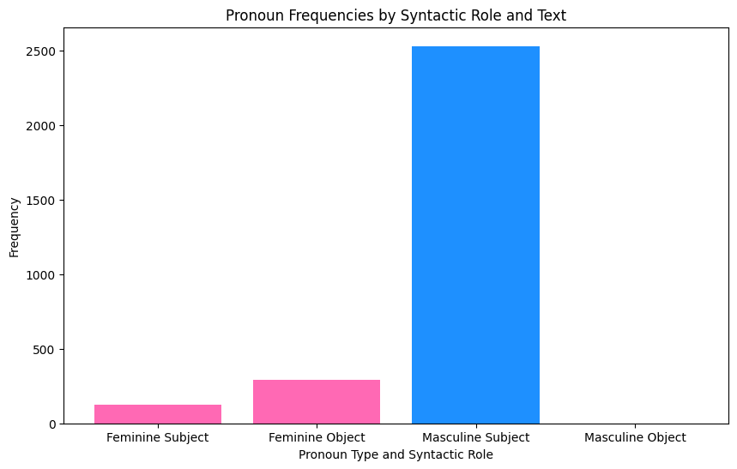
EDA
Overall Pronoun Usage
Chi2 Statistic: 1947.796335480638
P-value: 0.0
Pronouns: Subject (e.g., he, she) and Object (e.g., him, her)
Notes:
Pronoun Counts in 'Moby-Dick':
Feminine Subject: 127
Feminine Object: 291
Masculine Subject: 2532
Masculine Object: 0
Pronoun Counts in 'Little Women':
Feminine Subject: 663
Feminine Object: 766
Masculine Subject: 1998
Masculine Object: 0
Pronoun Counts in 'Little Men':
Feminine Subject: 2327
Feminine Object: 2968
Masculine Subject: 2083
Masculine Object: 0
Chi-square Statistic (1947.796): This high value indicates a big difference between the observed and expected frequencies of pronoun usage.
P-value (0.0): A p-value of 0.0 means the observed differences in pronoun usage are extremely unlikely to be due to chance.
Conclusion:
The difference in overall pronoun usage between the texts is statistically significant.
This result strongly supports the idea that there is a meaningful difference in pronoun usage, likely influenced by factors like the gender of the authors and the perspectives of the narratives.

Slide 5
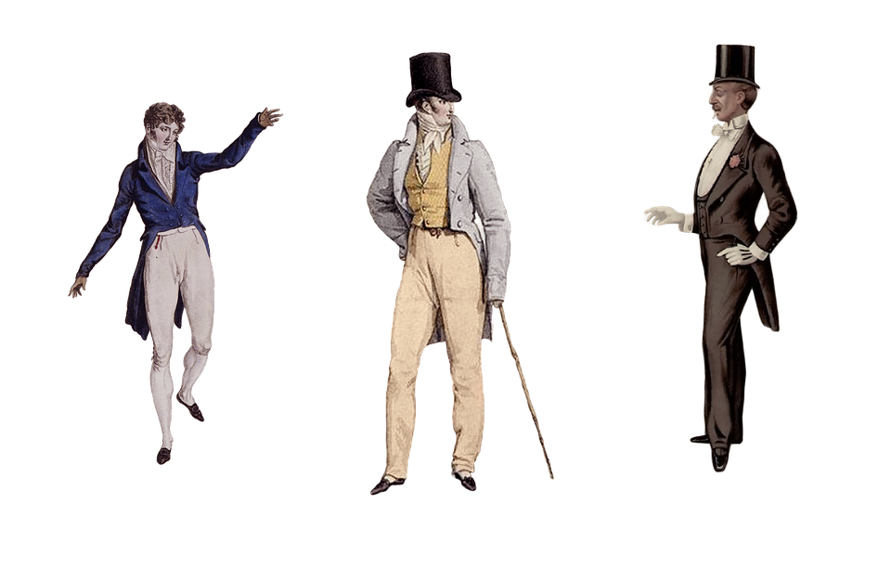
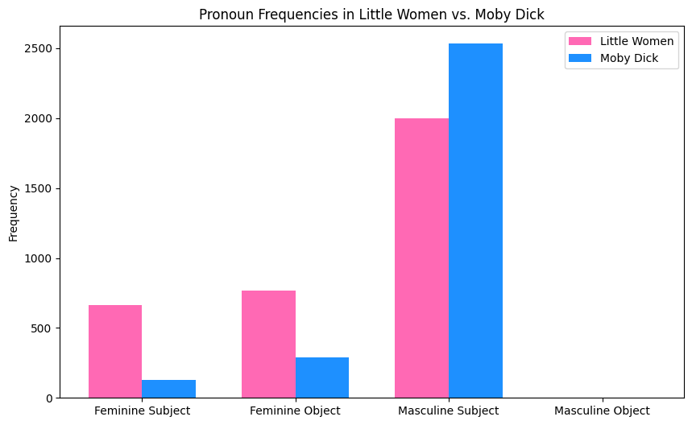
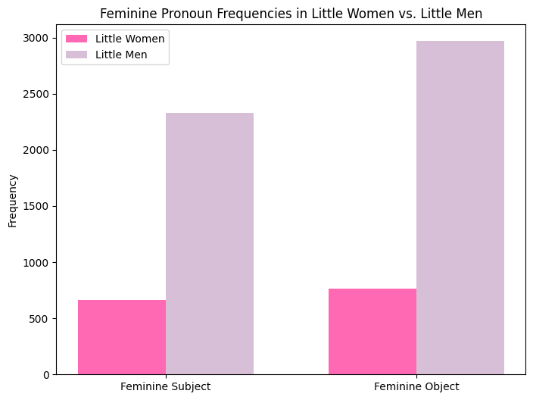
EVALUATION
Little Women vs. Moby-Dick
Overall Pronoun Usage:
Chi2 Statistic: 607.79
P-value: 1.0457e-132
REJECT THE NULL
Little Women vs. Little Men
Feminine Pronoun Usage:
Chi2 Statistic: 2.63
P-value: 0.1045
FAIL TO REJECT THE NULL
Hypothesis 1: Author’s Gender Influences Pronoun Usage
Null Hypothesis (H0): There is no significant difference in the frequency of masculine and feminine pronouns between the texts.
Alternative Hypothesis (H1): There is a significant difference in the frequency of masculine and feminine pronouns between the texts.
Hypothesis 2: Gender Narration Perspective Impacts Pronoun Usage
Null Hypothesis (H0): There is no significant difference in feminine pronoun frequency between "Little Women" and "Little Men".
Alternative Hypothesis (H1): There is a significant difference in feminine pronoun frequency between "Little Women" and "Little Men".
Notes:
Interpretation: Significant difference in overall pronoun usage between "Little Women" and "Little Men."
We performed chi-square tests to evaluate our hypotheses. There is a significant difference in overall pronoun usage between "Little Women" and "Moby-Dick," leading us to reject the null hypothesis. However, we found no significant difference between "Little Women" and "Little Men," so we fail to reject the null hypothesis for our second hypothesis.

Slide 6
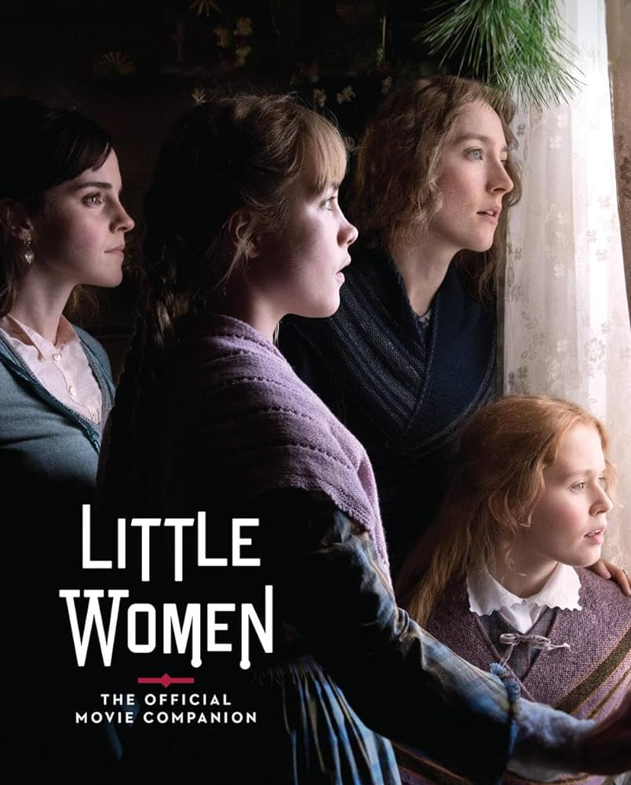
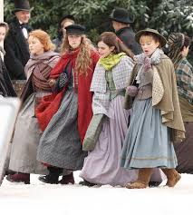
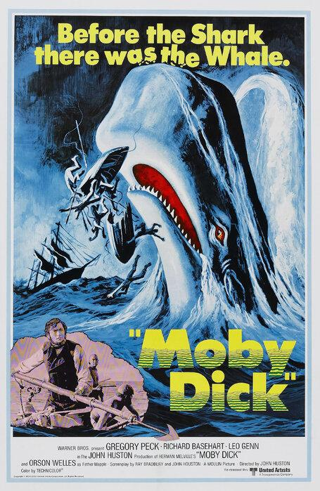
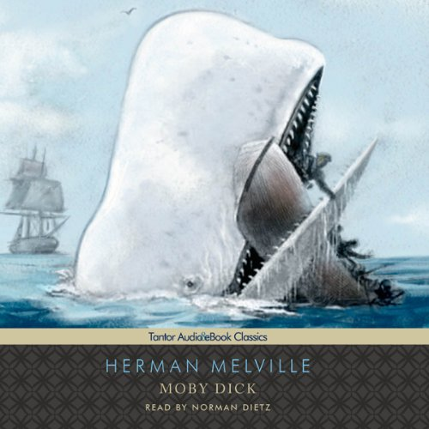
CONCLUSION
Findings:
Significant differences in pronoun usage were found between "Little Women," "Little Men," and "Moby-Dick."
The absence of masculine object pronouns in all three works potentially reflects the narrative styles and societal norms of the time.
"Moby-Dick" shows a male-centric narrative, while "Little Women" and "Little Men" highlight female experiences.
Fallacy:
Moby Dick:: 214,675 words
Little Women: 163,750 words
Little Men 54,750 words
Implications:
These differences underline how gender and societal norms influenced literature in the mid-1800s.
Notes:
In conclusion, we found significant differences in pronoun usage between the texts, reflecting gender and societal norms of the mid-1800s. "Moby-Dick" presents a male-centric narrative, whereas "Little Women" and "Little Men" emphasize female experiences. These findings highlight the influence of gender and societal norms on literature during this period.

