Slide 1








Web page title
http://webapps.seattleu.edu/eServe/
Sign In Register
About Us
The Team
Contact Us
Copyright © 2014 NobleHour.com. All Rights Reserved. Terms & Conditions | Privacy Policy | Security Policy

Slide 2
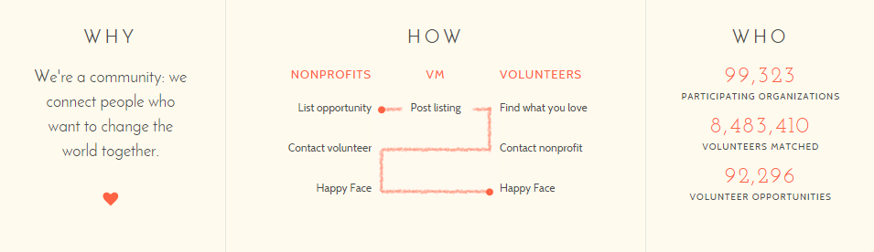

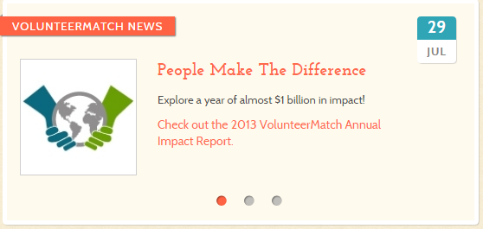
Web page title
http://webapps.seattleu.edu/eServe/
Sign In Register
About Us
The Team
Contact Us
Copyright © 2014 NobleHour.com. All Rights Reserved. Terms & Conditions | Privacy Policy | Security Policy

Slide 3
Web page title
http://webapps.seattleu.edu/eServe/
Register
Login
Login
Password
Password
Forgot your password?
Sign In
About Us
The Team
Contact Us
Copyright © 2014 NobleHour.com. All Rights Reserved. Terms & Conditions | Privacy Policy | Security Policy

Slide 4

Web page title
http://webapps.seattleu.edu/eServe/
Welcome, Jacob, W.
Sign out
Student View
Profile
Current
Alerts
History
Legal name
Xiao Ming Wong
Prefer name
Jacob
Last Background Check
6/15/2013
Address
901 12th AVE
P.O. Box 222000
Seattle, WA 98122
International Student
Yes
No
Date of birth
11/20/1980
Phone
206-999-1234
Gender
Select
Ethnicity
Select
Areas of interest
Seattle University Youth Initiative
Children and Youth
Making Intercultural Connections
Working with Families
Hunger and Homelessness
Sustainability
Aging and Disabilities
Other Social Justice Issues
About Us
The Team
Contact Us
Copyright © 2014 NobleHour.com. All Rights Reserved. Terms & Conditions | Privacy Policy | Security Policy
Notes:
Cut resume upload
Gender
Male
Female
Transgender
Prefer not to answer
International student
Yes
No
Ethnicity (check all that apply)
Hispanic or Latino
American Indian or Alaska Native
Asian
Black or African American
Native Hawaiian or Pacific Islander
White
Areas of interest (check all that apply)
Seattle University Youth Initiative
Children and Youth
Making Intercultural Connections
Working with Families
Hunger and Homelessness
Sustainability
Aging and Disabilities
Other Social Justice Issues

Slide 5
Web page title
http://webapps.seattleu.edu/eServe/
Welcome, Jacob, W.
Sign out
Student View
Profile
History
Profile
Current
Alerts
Class | Partner | Job Description | Availability | Duration | Email
Class 1 | Opportunity 1 | English conversation partner or Food bank helper. | 9 slots(s) Open | 3 months | Julie@opp1.com
Class 1 | Opportunity 2 | Tutor | Full | 9/15/2014 | Jason@opp2.com
Class 2 | Opportunity 3 | Server | 1 slots(s) Open | 6/15/2014 - | jones@opp3.com
Previous 1- 3 of 5 Next
About Us
The Team
Contact Us
Copyright © 2014 NobleHour.com. All Rights Reserved. Terms & Conditions | Privacy Policy | Security Policy
Notes:
Cut resume upload
Gender
Male
Female
Transgender
Prefer not to answer
International student
Yes
No
Ethnicity (check all that apply)
Hispanic or Latino
American Indian or Alaska Native
Asian
Black or African American
Native Hawaiian or Pacific Islander
White
Areas of interest (check all that apply)
Seattle University Youth Initiative
Children and Youth
Making Intercultural Connections
Working with Families
Hunger and Homelessness
Sustainability
Aging and Disabilities
Other Social Justice Issues

Slide 6
Web page title
http://webapps.seattleu.edu/eServe/
Welcome back, Jacob G.
Sign out
Student View
Profile
Current
Alerts
Current
Registered, By Class, By Quarter, By Radius, By Service Learning
Update
Class | Partner | Title | Hours Volunteered | Evaluation Submitted? | Self-Reflection Submitted | End Date
Class 1 | Opportunity 1 | English conversation partner or Food bank helper. | 15 | No | Yes | 6/15/2014
Class 1 | Opportunity 2 | Tutor | 0 | No | Yes | 9/15/2014
Class 2 | Opportunity 3 | Server | 2 | No | Yes | 6/15/2014
About Us
The Team
Contact Us
Copyright © 2014 NobleHour.com. All Rights Reserved. Terms & Conditions | Privacy Policy | Security Policy

Slide 7


Web page title
http://webapps.seattleu.edu/eServe/
Welcome back, Jacob G.
Sign out
Student View
Profile
Current
Alerts
Current
Class: Class 1
Partner: Opportunity 1
search
Update
Evaluation
Browse…
Upload
Class | Partner | Title | Hours Volunteered | Evaluation Submitted? | Self-Reflection Submitted | End Date
Class 1 | Opportunity 1 | English conversation partner or Food bank helper. | 15 | No | Yes | 6/15/2014
Class 1 | Opportunity 2 | Tutor | 0 | No | Yes | 9/15/2014
Class 2 | Opportunity 3 | Server | 2 | No | Yes | 6/15/2014
Reflection
Browse…
Upload
Hours
text
/ /
Submit
Date | Hours | Comment
6/15/2014 | 3 | Please be sure to bring…
6/15/2014 | 6 | Need more experience
6/15/2014 | 5 | Please meet at building 101 on 6/15 @ 8am.
About Us
The Team
Contact Us
Copyright © 2014 NobleHour.com. All Rights Reserved. Terms & Conditions | Privacy Policy | Security Policy

Slide 8
Web page title
http://webapps.seattleu.edu/eServe/
Welcome back, Jacob G.
Sign out
Student View
Update Profile
Current
Alerts
Class | Partner | Title | Status | Start Date | Comment
Class 1 | Opportunity 1 | English conversation partner. | Accepted | 6/15/2014 | Please attend orientation on 12/5 @ 5pm @ Seattle U room 105.
Class 1 | Opportunity 2 | Food bank helper | Pending… | N/A | Please bring your own gloves.
Class 2 | Opportunity 3 | Server | Accepted | 6/15/2014 | Please meet at building 101 on 6/15 @ 8am.
About Us
The Team
Contact Us
Copyright © 2014 NobleHour.com. All Rights Reserved. Terms & Conditions | Privacy Policy | Security Policy

Slide 9
Web page title
http://webapps.seattleu.edu/eServe/
Welcome back, Jacob G.
Sign In Register
Release Form
Enter Full Name:
Sign
About Us
The Team
Contact Us
Copyright © 2014 NobleHour.com. All Rights Reserved. Terms & Conditions | Privacy Policy | Security Policy

Slide 10
Web page title
http://webapps.seattleu.edu/eServe/
Welcome back, Jacob G.
Sign In Register
Background Check
Enter Full Name:
Sign
About Us
The Team
Contact Us
Copyright © 2014 NobleHour.com. All Rights Reserved. Terms & Conditions | Privacy Policy | Security Policy

Slide 11
Web page title
http://webapps.seattleu.edu/eServe/
Welcome back, Jacob G.
Sign In Register
Confirmation Page
About Us
The Team
Contact Us
Copyright © 2014 NobleHour.com. All Rights Reserved. Terms & Conditions | Privacy Policy | Security Policy

Slide 12
Web page title
http://webapps.seattleu.edu/eServe/
Welcome back, Jacob G.
Sign out
Update Profile | Search Opportunities | View History
Class 1
Class 2
Class 3
Sign up
Class | Partner | Job Description | Availability | Duration | Email
Class 1 | Opportunity 1 | English conversation partner or Food bank helper. | 9 slots(s) Open | 3 months | Julie@opp1.com
Class 1 | Opportunity 2 | Tutor | Full | 9/15/2014 | Jason@opp2.com
Class 2 | Opportunity 3 | Server | 1 slots(s) Open | 6/15/2014 - | jones@opp3.com
Previous 1- 3 of 5 Next
About Us
The Team
Contact Us
Copyright © 2014 NobleHour.com. All Rights Reserved. Terms & Conditions | Privacy Policy | Security Policy

