Slide 1


Seattle University eServe System
Sponsor: Elizabeth O’Brien
Advising Professor: Gilles Jeffrey
Team (MSE01): Jyoti Thakur, Dawn Wang & Tsun Tsai
Notes:
jyoti

Slide 2
Agenda
Overview of e-Serve System
Business value for new e-Serve
Our Solutions
Architecture Design
Database Model
Test Plan
Project Management
Demo
Lessons Learned
Q&A
Notes:
jyoti

Slide 3
Overview
Center for Service and Community Engagement (CSCE) founded in 2004
eServe is a web application to manage the volunteer opportunities and process for Seattle University.
As per Seattle University requirement – using Microsoft technologies and Cloud for eServe development.
Notes:
tsun

Slide 4
Business Value
78% students take a service-learning course
1,500 students
75 courses
30 faculty members
50 local community partners
To 25 college/university by U.S. News & World Report for service-learning
70+ hours manually to manage
Notes:
tsun

Slide 5
eServe End-to-End Workflow
Community Partner
Creates opportunity
Admin
Approves & Assign to Course
Student
Sign up for Opportunity
Community Partner
Review Evaluation
Faculty

Slide 6
Notes:
dawn

Slide 7
Goals To Achieve
Security
Performance / Scalability
Usability
Maintainability / Extensibility
Notes:
jyoti

Slide 8
Architecture Design
Core Technology
Visual Studio 2013 ASP.NET for SDK
SQL Azure for data storage.
3-tiers structure
UI - HTML, Javascript and CSS.
Business and Data Access layer: ASP.NET C#
Data Storage layer: SQL
Responsive web design (RWD)
Notes:
dawn

Slide 9
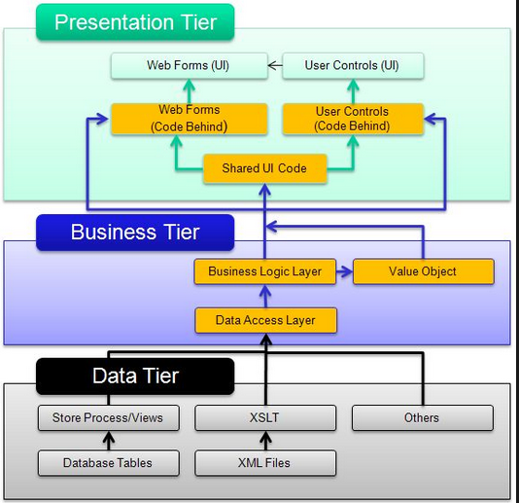
Architecture Design – 3-tiers design
Notes:
dawn

Slide 10
Notes:
dawn

Slide 11
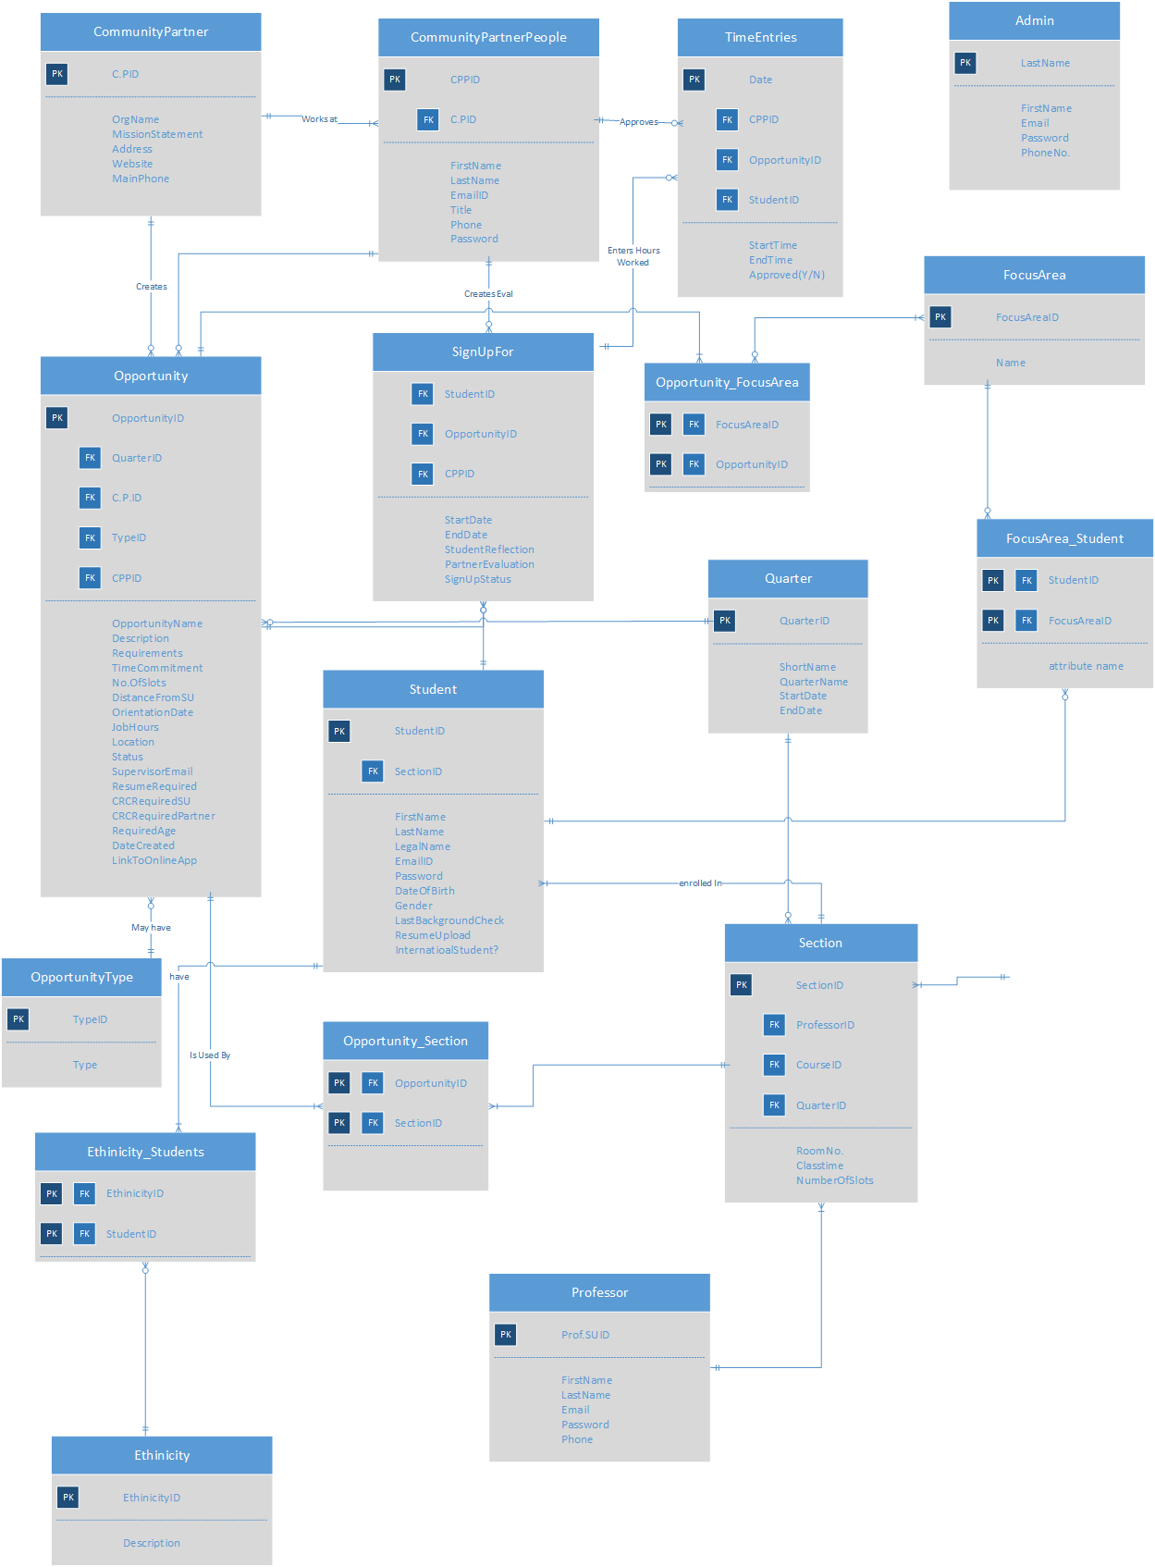
Notes:
jyoti

Slide 12
Database
Stored procedures
Triggers
Views

Slide 13
Test Plan
Each user story will have test case(s)
Create end-to-end test script for acceptance testing
Continuous delivery to Azure
User acceptance test
No automation

Slide 14
Notes:
2 Weeks
Sprint 1 – Nothing added
Sprint 2 – Added tasks / flushing out requirements / VSO creation / source control
Sprint 3 – Added tasks, experimenting, mostly waiting for backend stuff
Sprint 4 – Added tasks for development work
Sprint 5 – Added tasks for development and presentation (spike at end as we realize more stuff are required)

Slide 15
Team Stats
Business Value = 17/117 (first quarter)
(MVP is subset of 117)
Velocity = 2 large + 1 medium user stories (28 hours per sprint per person average | should increase next quarter)
(Small = 4 hours, Medium = 8 hours, Large = 12 hours)
Notes:
Tsun
Velocity can increase

Slide 16
Demo
Notes:
Dawn/Jyoti/tsun
Opportunity List page
Opportunity Edit page
Student
Profile/Current/History

Slide 17
Lessons Learned
Commit to only working on user stories assigned to each sprint
Assigning tasks to User stories
More consistency in team communication & schedule

Slide 18
Q & A

Slide 19
Resources
VSO site - https://eservesu.visualstudio.com
Notes:
Scope, goals and requiremetns
Horizontal or vertical stack
Team picture

