Slide 1


Seattle University eServe
Sponsor: Elizabeth O’Brien
Advising Professor: Gilles Jeffrey
Team (MSE01): Jyoti Thakur, Dawn Wang & Tsun Tsai
Notes:
jyoti

Slide 2
Agenda
eServe overview
Business Value > Solution
Demo
Lessons Learned
Q&A

Slide 3
Overview
Center for Service and Community Engagement (CSCE) founded in 2004
eServe is a web application to manage the volunteer opportunities and process for Seattle University.
Build on Microsoft technologies and Cloud for eServe development based on Seattle University IT requirements
Notes:
tsun

Slide 4
Business Value
78% students take a service-learning course
1,500 students
75 courses
30 faculty members
50 local community partners
To 25 college/university by U.S. News & World Report for service-learning
70+ hours manually to manage
Notes:
tsun

Slide 5
eServe Stats (2013-2014)
104 faculty members
230 course sections
2711 students (UG, GR & LW)
433 undergrads took 2+ Service Learning courses
100+ community partners
75% of 2014 graduating seniors took at least one Service Learning course while at SU

Slide 6
eServe end-to-end solution
1. Create Opportunities
2. Approve/Assign Opportunities
3. Register Opportunities
4. View Registered Opportunities
5. Enter Volunteering Hours
7. Submit Self Evaluation/Reflection
8. View Student Evaluation/Reflection
9. View Student Evaluation/Reflection
6. Approve Volunteering Hours
Community Partner
Admin
Student
Faculty
Notes:
Admin can view opportunities
Admin can approve opportunities
Admin can link opportunities to sections
Student can view opportunities
Student can register for opportunities
Student can view opportunities registered
Student can view profile
Partner can edit profile
Partner can edit supervisor
Partner can add/edit opportunity
Partner can view student evaluation
Partner can see alerts
Partner can manage student signup status
Partner can manage volunteer hours
Partner can view student profile

Slide 7
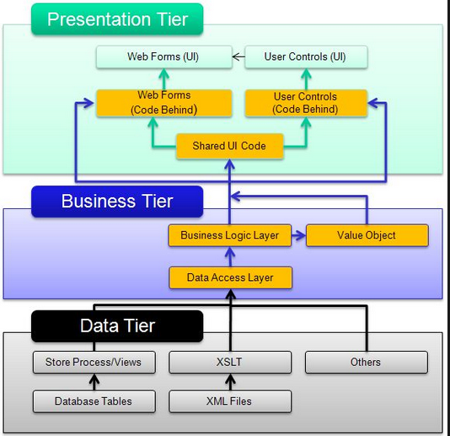
Architecture Design – 3-tiers design
Notes:
dawn

Slide 8
Notes:
dawn

Slide 9
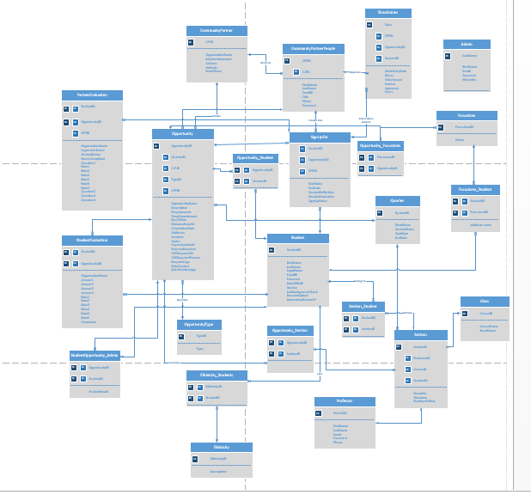
Notes:
jyoti

Slide 10
Demo
Notes:
--DELETE FROM [dbo].[SignUpFor]
--WHERE OpportunityID=17

Slide 11
Team Stats
 | Business Value | MVP
Fall Quarter | 17/117 | 17/52
Winter Quarter | 73/117 | 25/52
Fall Quarter | 105/117 | 52/52
Velocity = 2 large + 1 medium user stories (28 hours per sprint per person average)
(Small = 4 hours, Medium = 8 hours, Large = 12 hours)
Notes:
Tsun
Velocity can increase

Slide 12
Lessons Learned
Team communication
Required Technology
Project Management
Notes:
Last Quarter:
Commit to only working on user stories assigned to each sprint
Assigning tasks to User stories
More consistency in team communication & schedule

Slide 13
Q & A

Slide 14
Resources
VSO site - https://eservesu.visualstudio.com
Notes:
Scope, goals and requiremetns
Horizontal or vertical stack
Team picture

Slide 15
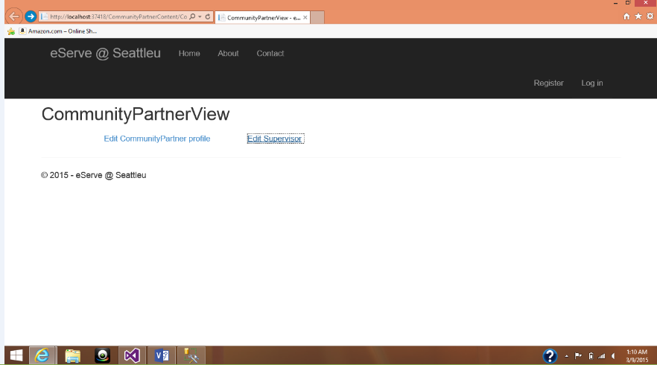
Community Partner
Community Partner can Edit their Profile

Slide 16
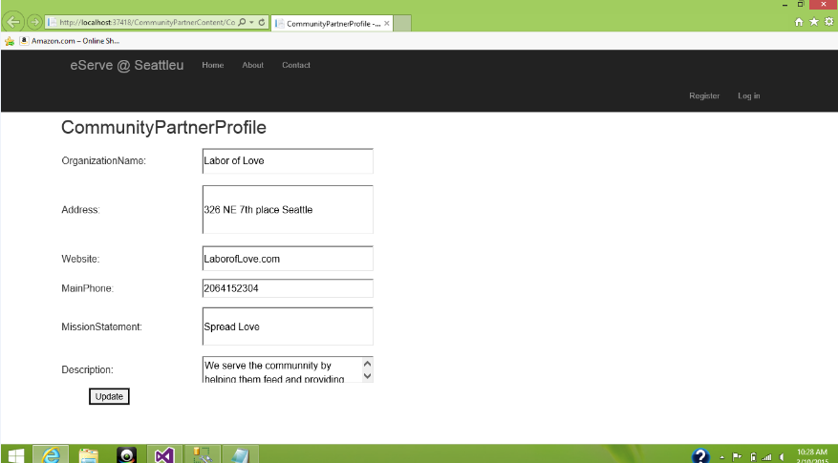

Slide 17
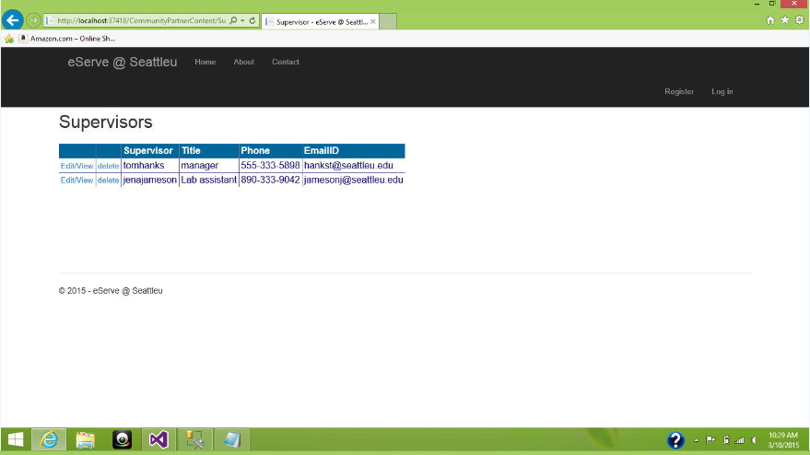
Community Partner can Edit/view/Delete Supervisors

Slide 18
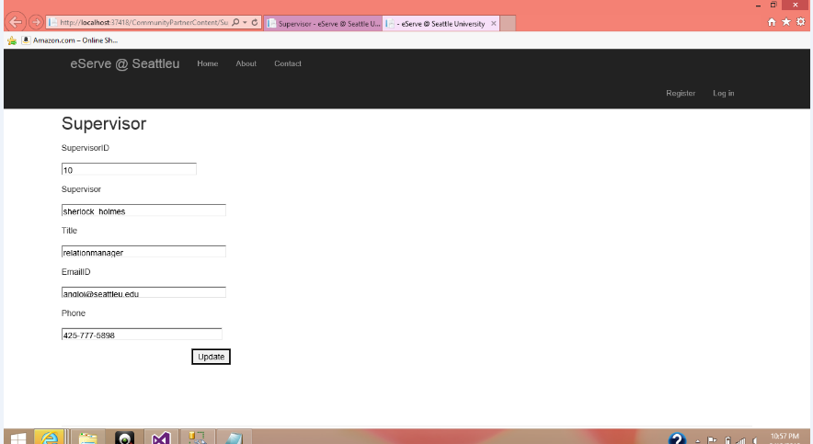

Slide 19
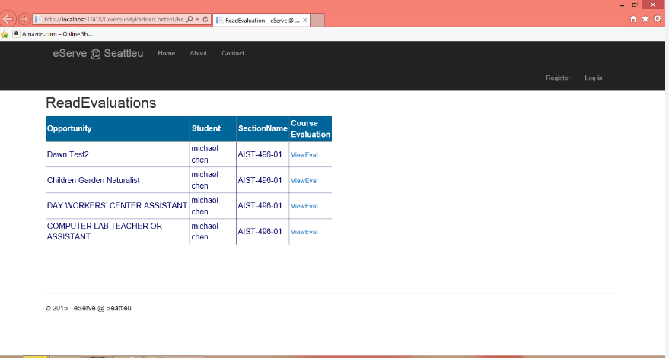
Community Partners can read Evaluations

Slide 20
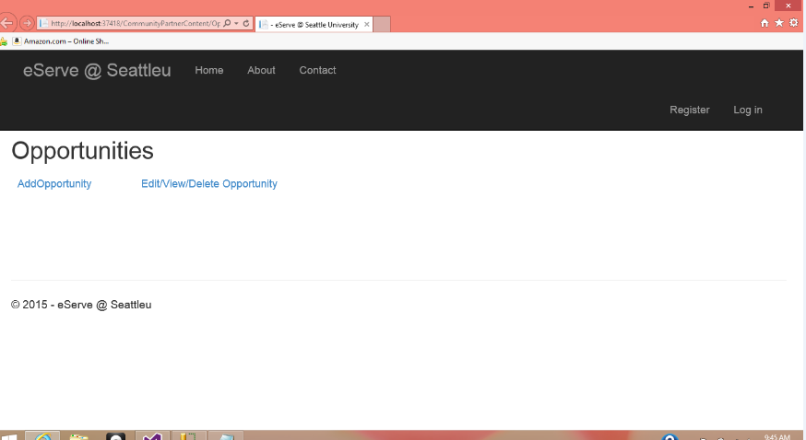
Community Partners can Add/Edit/Delete Opportunities

Slide 21
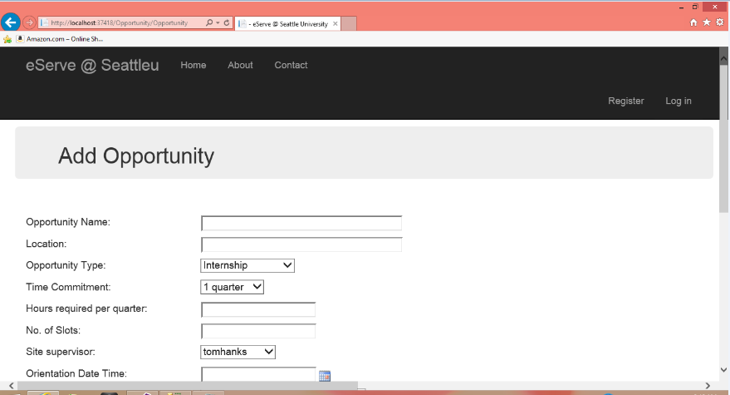

Slide 22
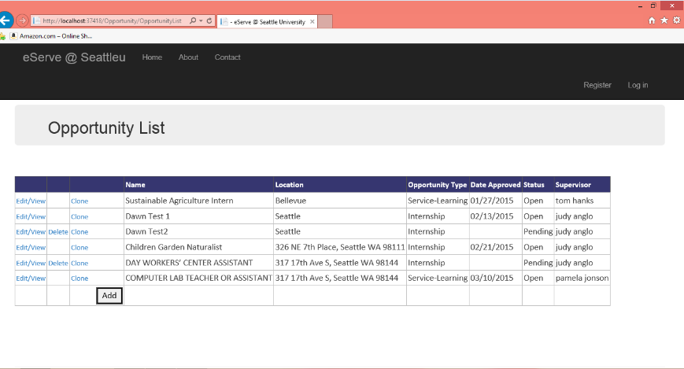

Slide 23
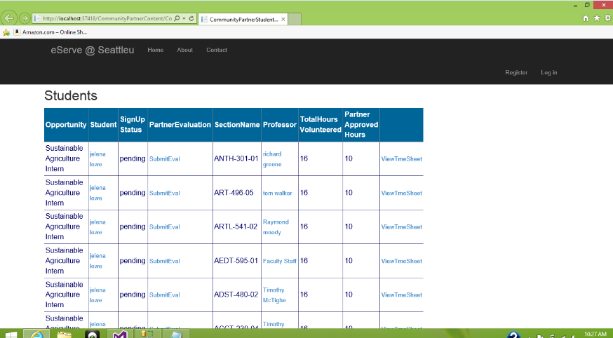
Community Partner can manage students sign up status, view profile, view professor, time sheet

Slide 24
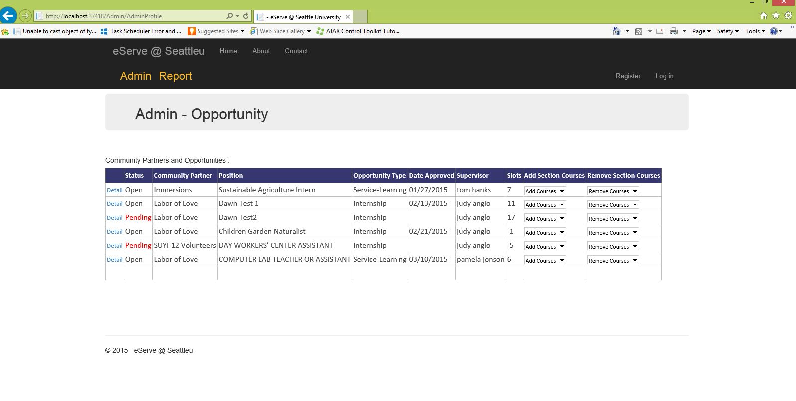

Slide 25
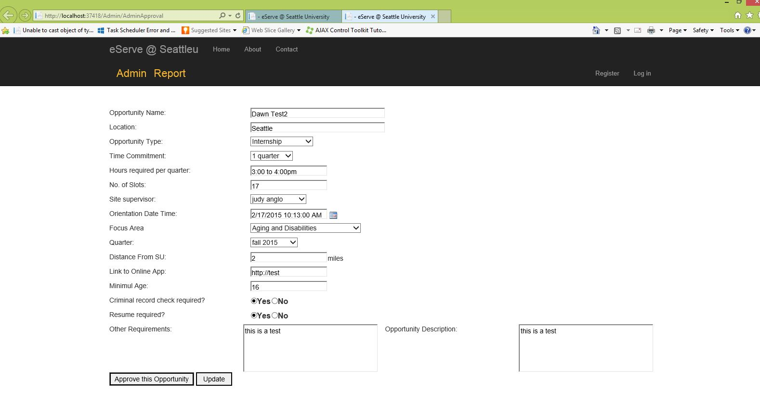

Slide 26
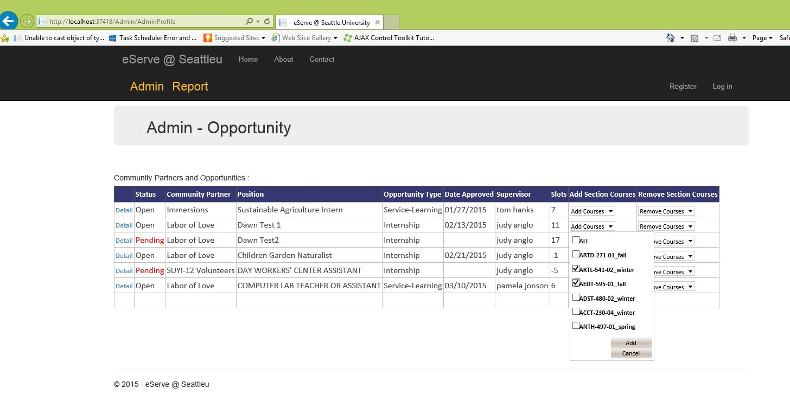

Slide 27
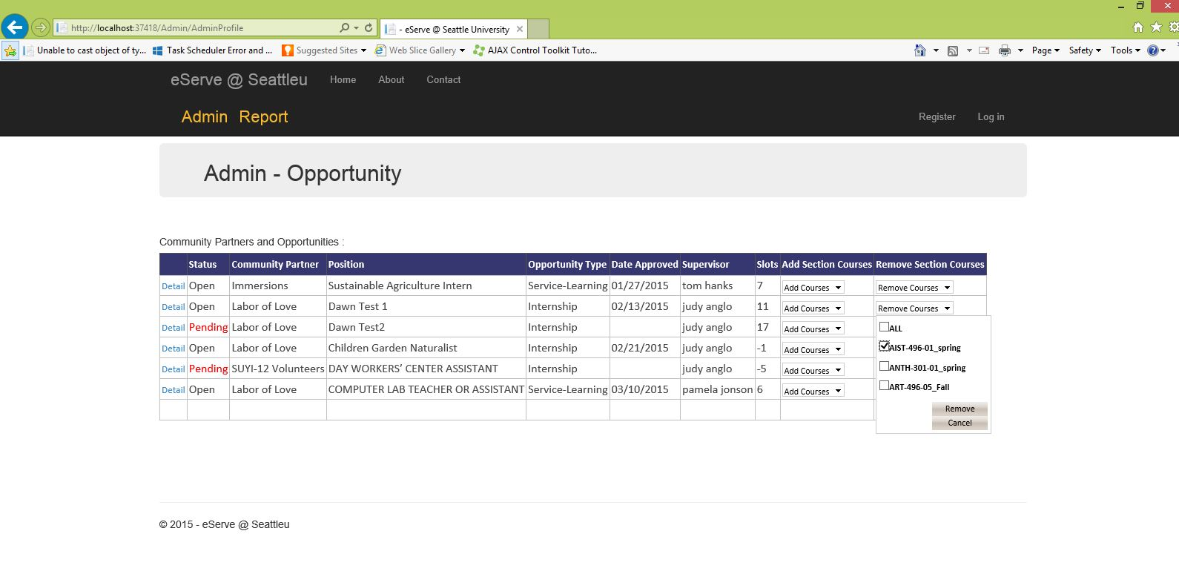

Slide 28
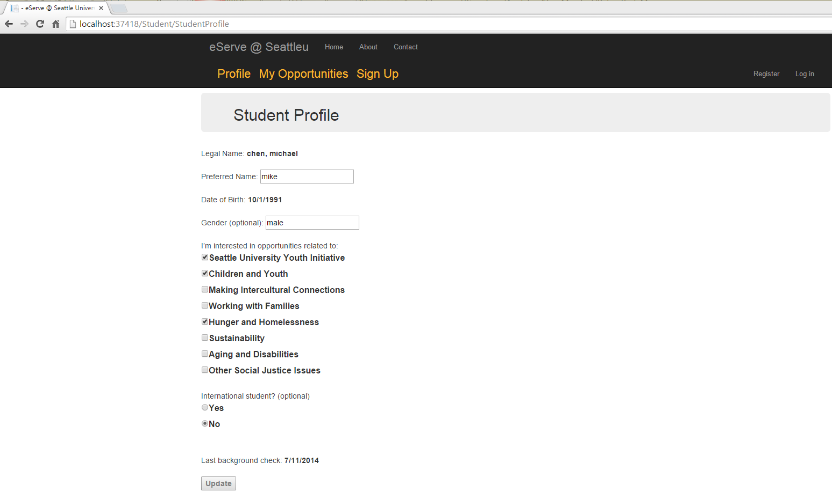

Slide 29
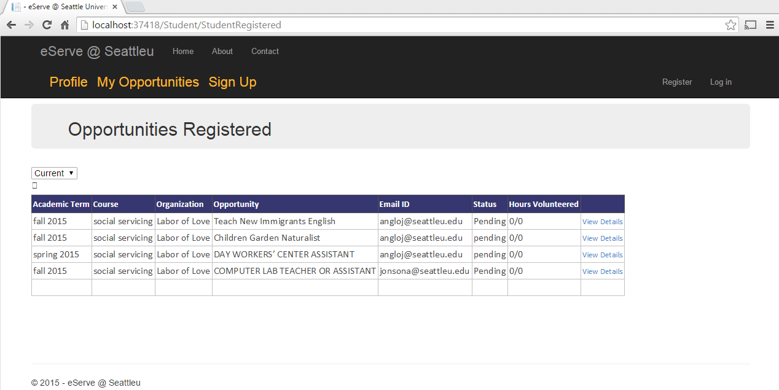

Slide 30
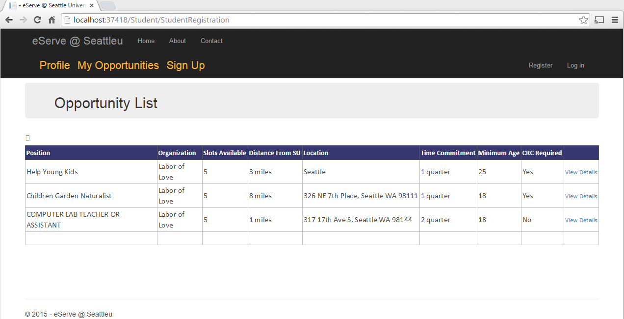

Slide 31
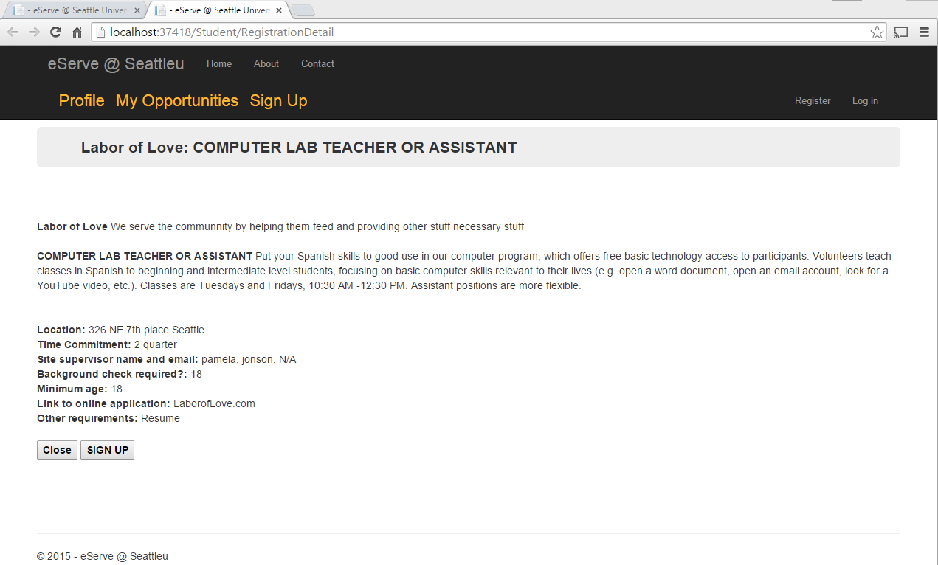

Slide 32
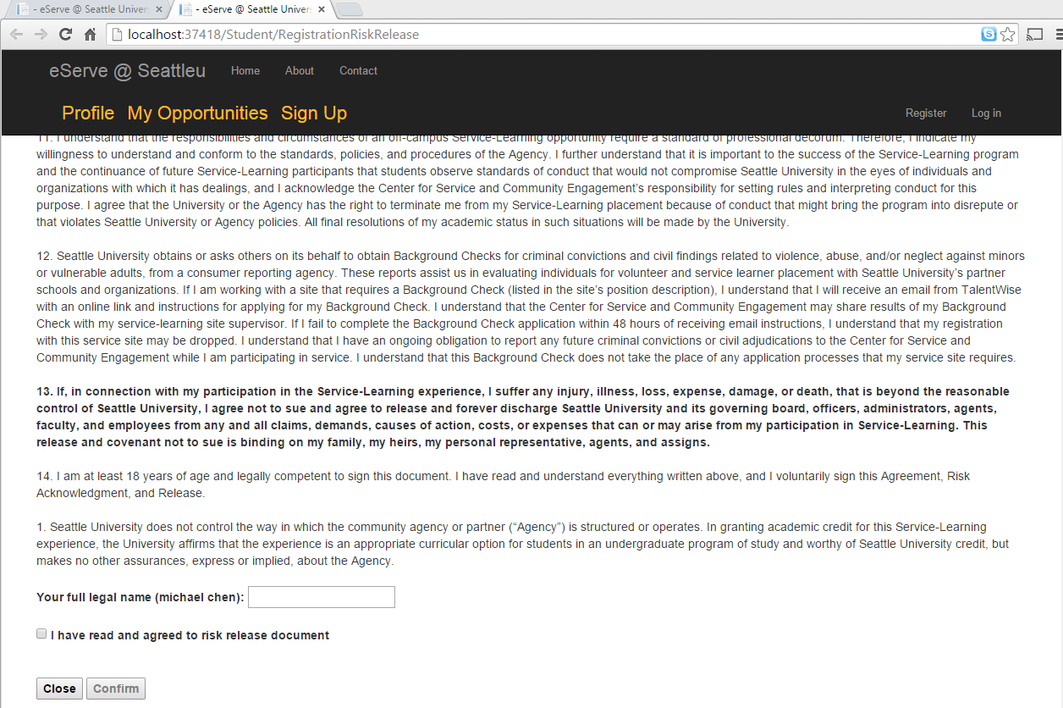

Slide 33
