Slide 1


Seattle University eServe System
Sponsor: Elizabeth O’Brien
Advising Professor: Gilles Jeffrey
Team (MSE01): Jyoti Thakur, Dawn Wang & Tsun Tsai
Notes:
jyoti

Slide 2
Agenda
Refresher of eServe System
Status Update
Finalize Database/Schema
Unit testing created
Site is LIVE!
Workflow:
Admin
Student
Partner
Demo
Lessons Learned
Q&A

Slide 3
Refresher
Center for Service and Community Engagement (CSCE) founded in 2004
eServe is a web application to manage the volunteer opportunities and process for Seattle University.
As per Seattle University requirement – using Microsoft technologies and Cloud for eServe development.
Notes:
tsun

Slide 4
Database & Schema
Notes:
--DELETE FROM [dbo].[SignUpFor]
--WHERE OpportunityID=17

Slide 5
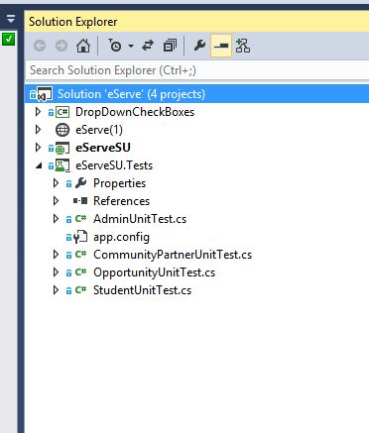
Unit Tests
Notes:
tsun

Slide 6
eServe End-to-End Workflow
1. Create Opportunities
2. Approve/Assign Opportunities
3. Register Opportunities
4. View Registered Opportunities
5. Enter Volunteering Hours
7. Submit Self Evaluation/Reflection
8. View Student Evaluation/Reflection
9. View Student Evaluation/Reflection
6. Approve Volunteering Hours
Community Partner
Admin
Student
Faculty
Notes:
Admin can view opportunities
Admin can approve opportunities
Admin can link opportunities to sections
Student can view opportunities
Student can register for opportunities
Student can view opportunities registered
Student can view profile
Partner can edit profile
Partner can edit supervisor
Partner can add/edit opportunity
Partner can view student evaluation
Partner can see alerts
Partner can manage student signup status
Partner can manage volunteer hours
Partner can view student profile

Slide 7
Demo
Notes:
--DELETE FROM [dbo].[SignUpFor]
--WHERE OpportunityID=17

Slide 8
Team Stats
 | Business Value | MVP
Fall Quarter | 17/117 | 17/52
Winter Quarter | 73/117 | 25/52
Velocity = 2 large + 1 medium user stories (28 hours per sprint per person average)
(Small = 4 hours, Medium = 8 hours, Large = 12 hours)
Notes:
Tsun
Velocity can increase

Slide 9
Lessons Learned
Team communication is better, but still more room for improvement
Team made huge progress with learning the technology
Team still needs to improve on sprint process
Notes:
Last Quarter:
Commit to only working on user stories assigned to each sprint
Assigning tasks to User stories
More consistency in team communication & schedule

Slide 10
Next Quarter
Sprint 1 – Working on features
Sprint 2 – Working on features
Sprint 3 – Working on features
Sprint 4 – Refactoring / Stabilization Code
Sprint 5 – Testing / RTS (Release to SeattleU)

Slide 11
Q & A

Slide 12
Resources
VSO site - https://eservesu.visualstudio.com
Notes:
Scope, goals and requiremetns
Horizontal or vertical stack
Team picture

Slide 13
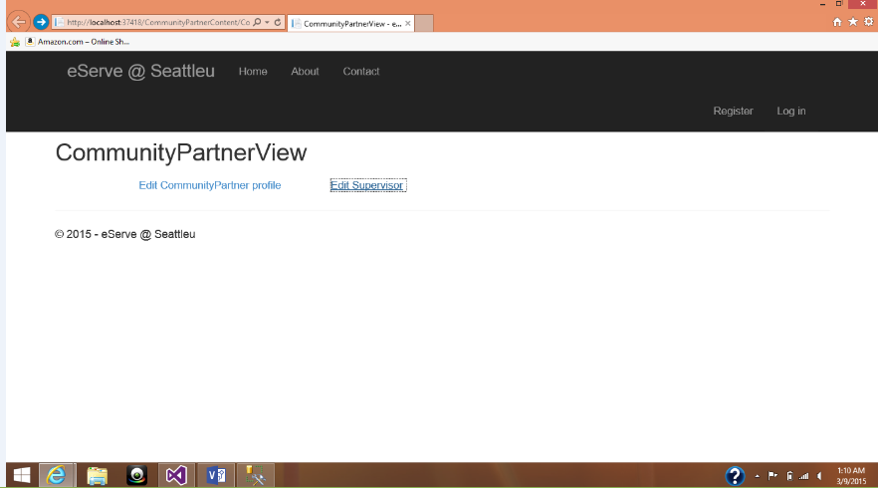
Community Partner
Community Partner can Edit their Profile

Slide 14
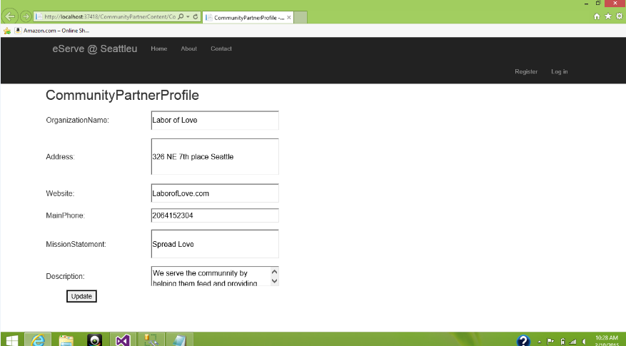

Slide 15
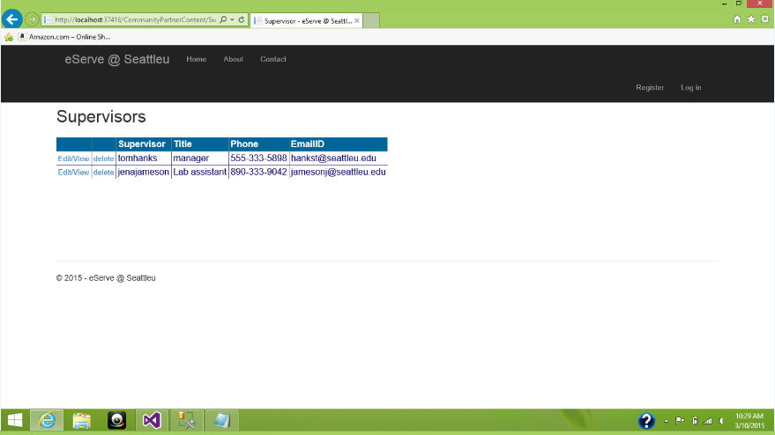
Community Partner can Edit/view/Delete Supervisors

Slide 16
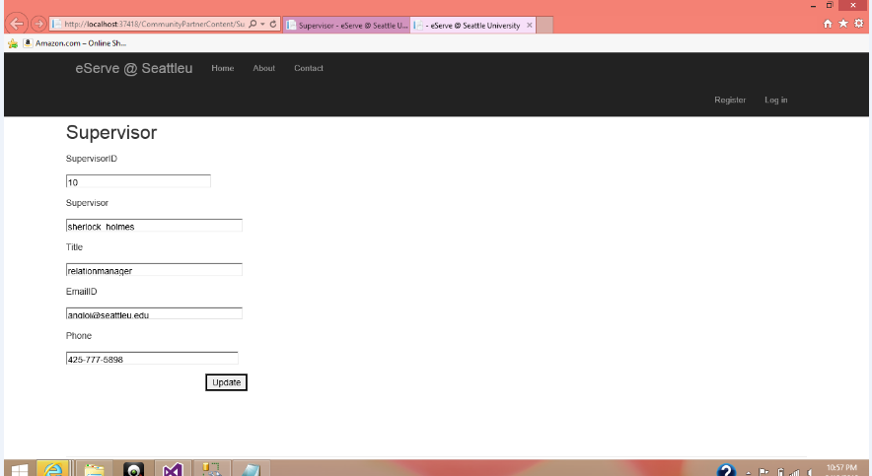

Slide 17
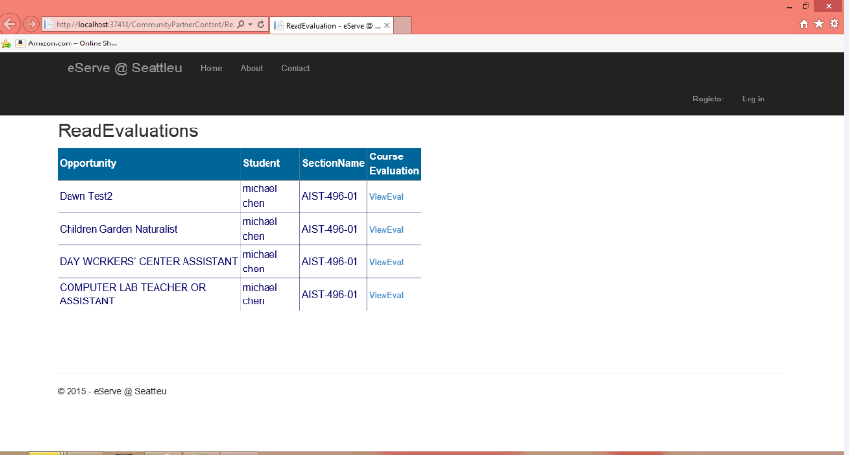
Community Partners can read Evaluations

Slide 18
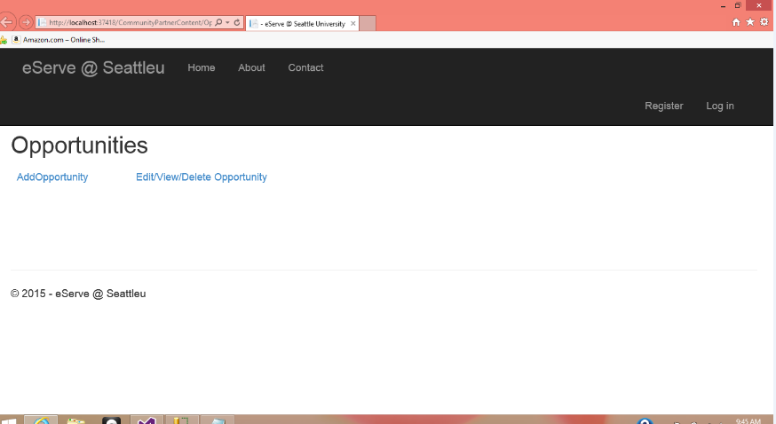
Community Partners can Add/Edit/Delete Opportunities

Slide 19
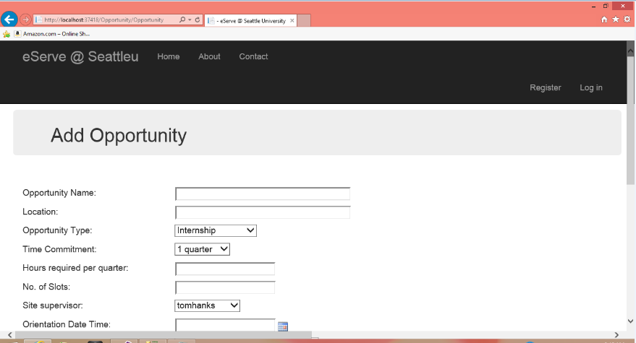

Slide 20
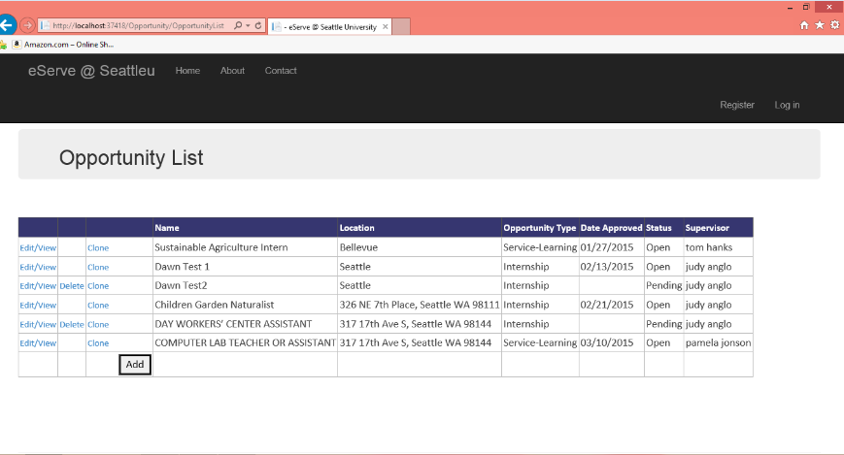

Slide 21
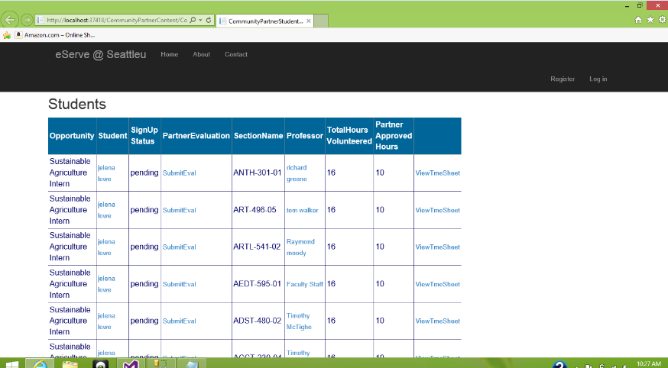
Community Partner can manage students sign up status, view profile, view professor, time sheet

Slide 22
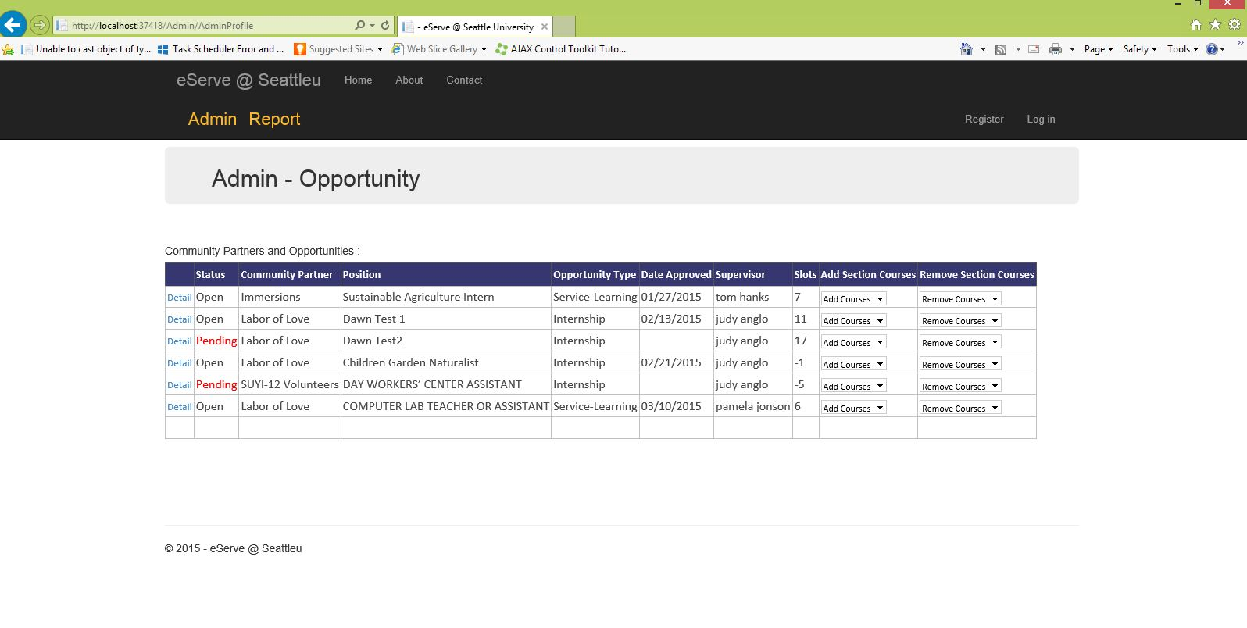

Slide 23
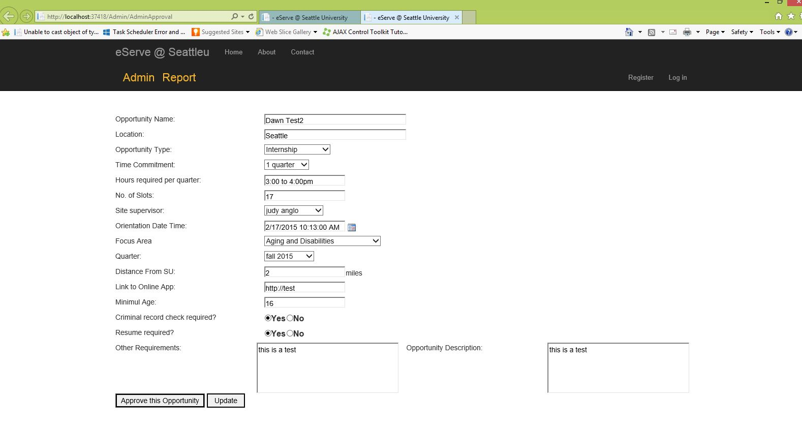

Slide 24
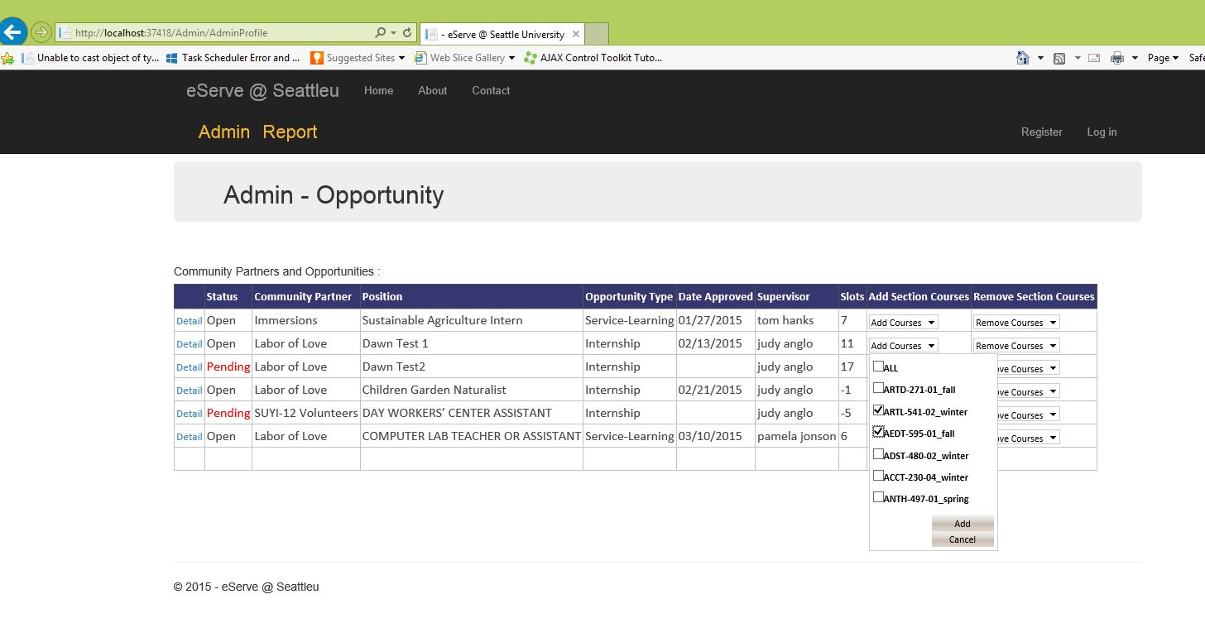

Slide 25
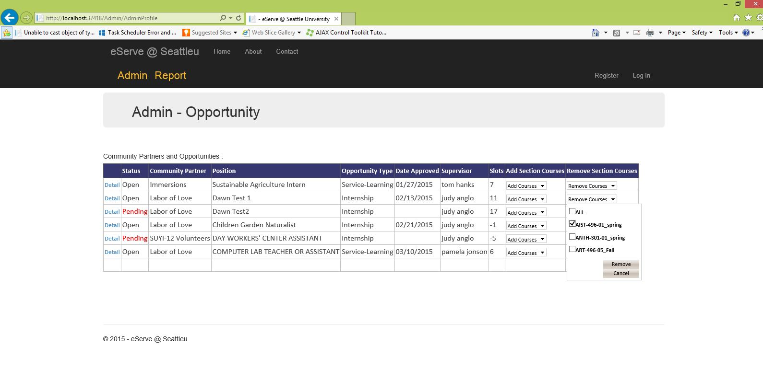

Slide 26
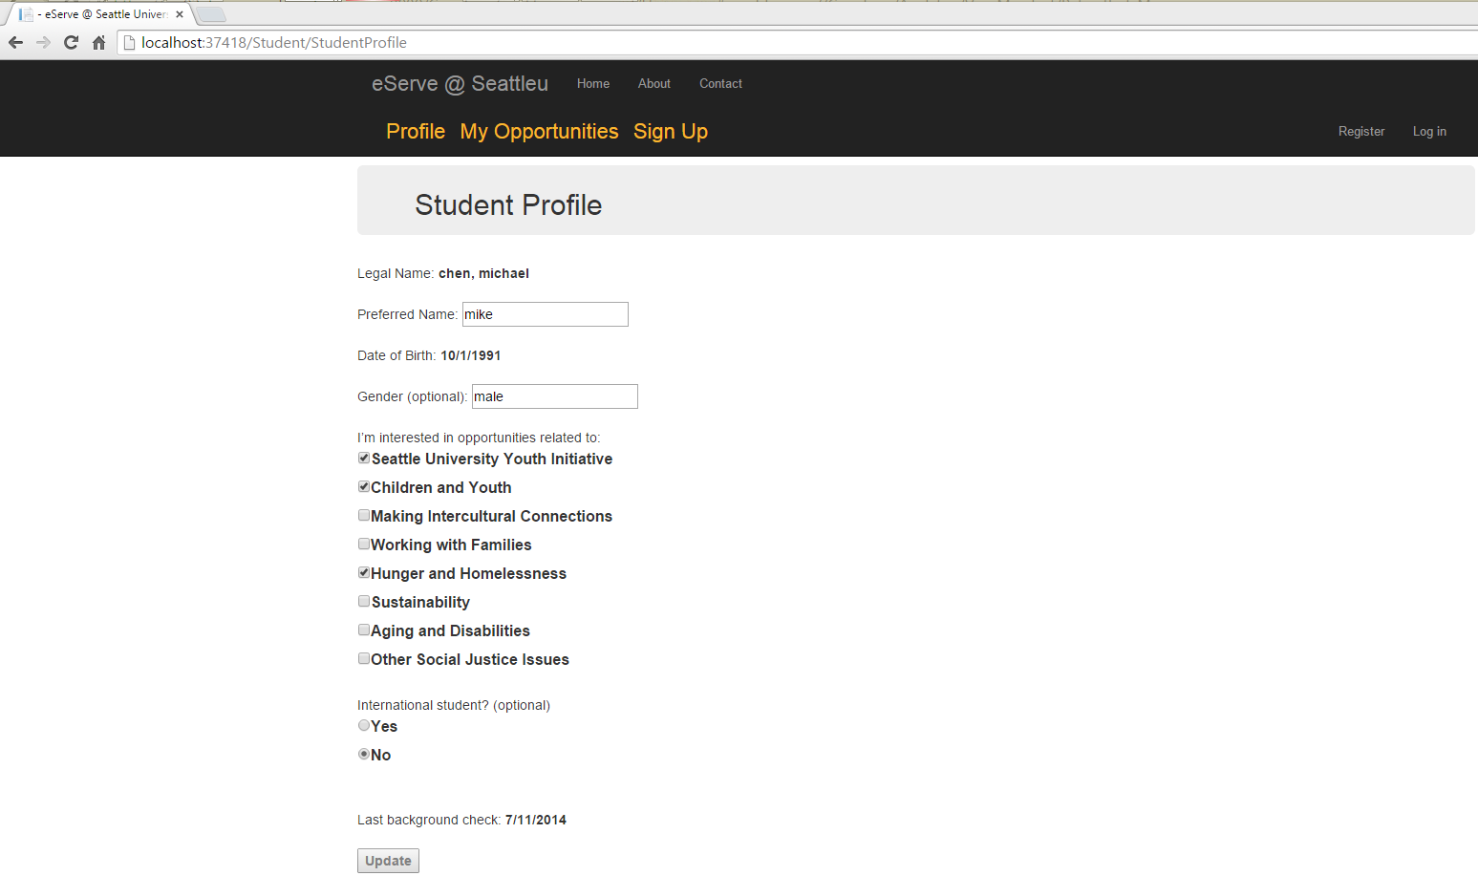

Slide 27
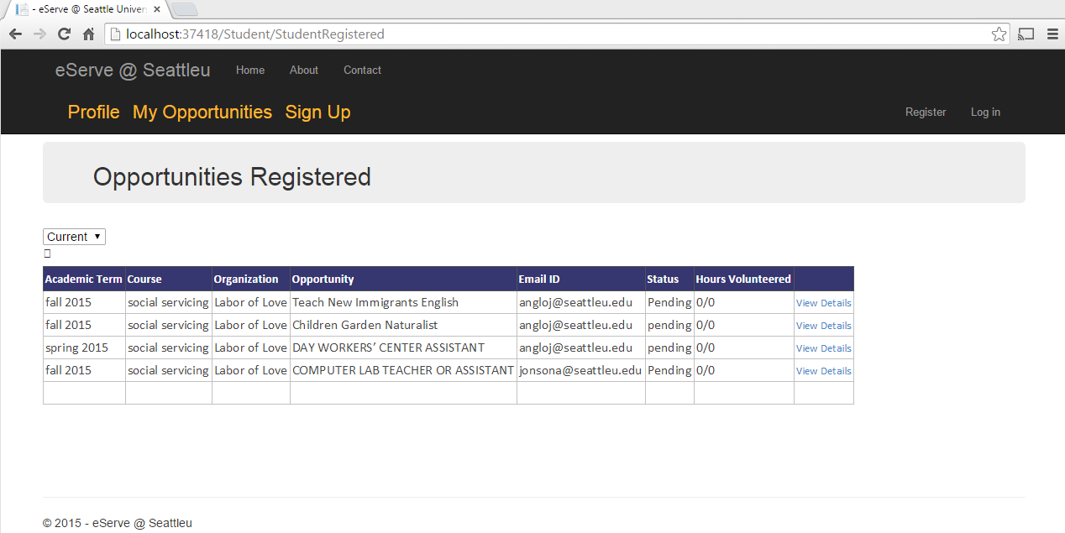

Slide 28
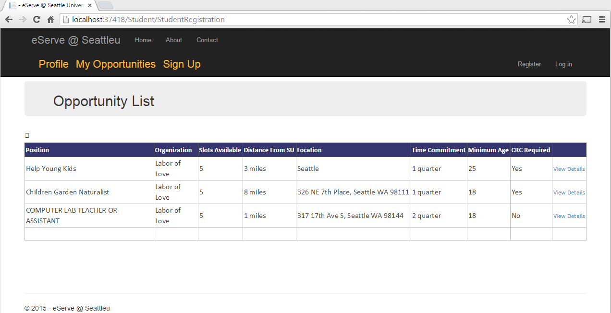

Slide 29
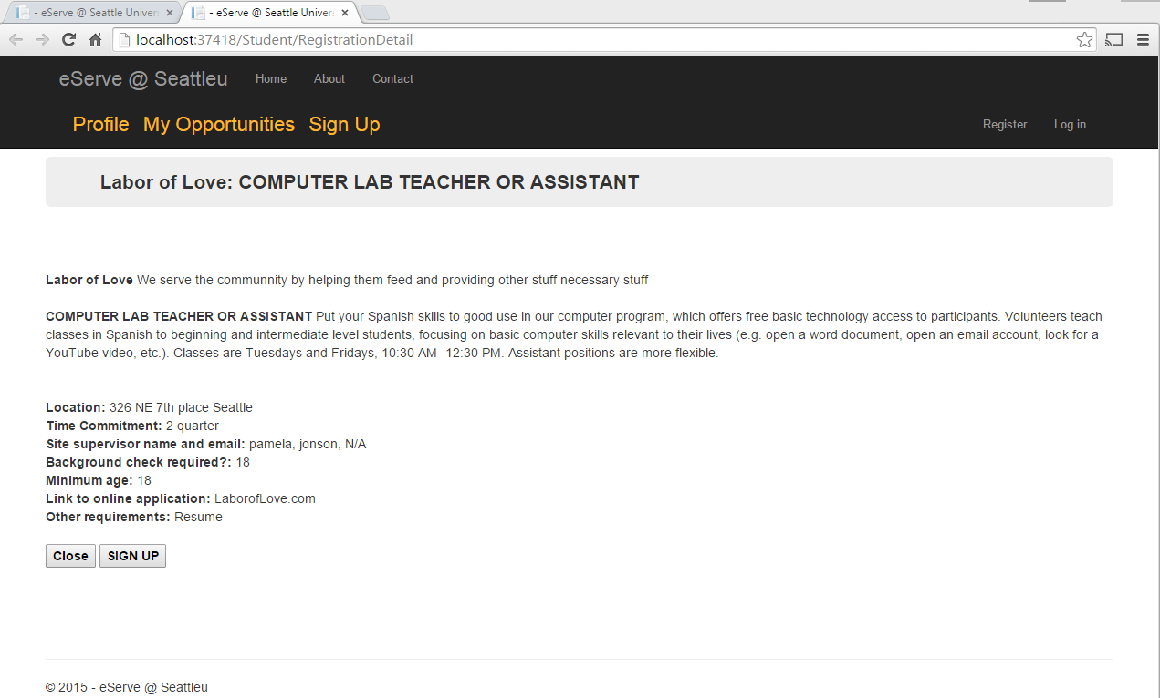

Slide 30
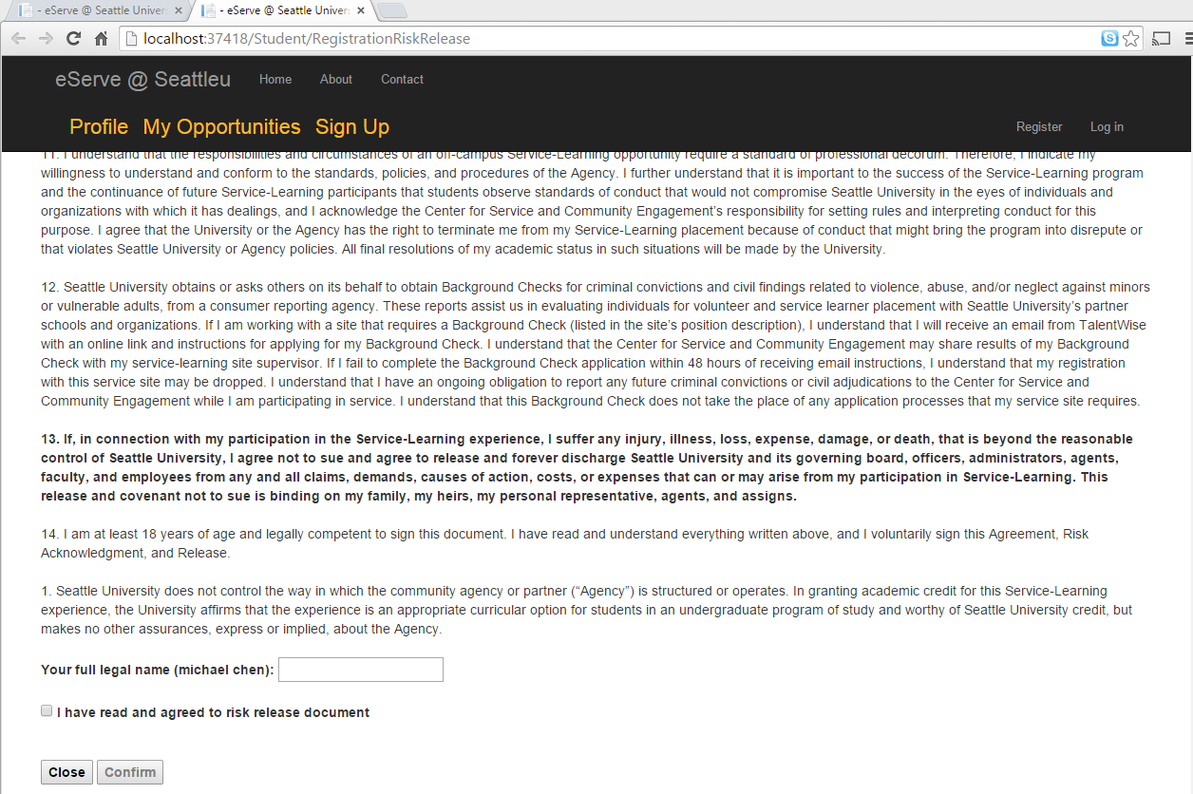

Slide 31
