Slide 1
ISTIO
Istio is an open source service mesh platform that provides a way to control how microservices share data with one another. It includes APIs that let Istio integrate into any logging platform, telemetry, or policy system. Istio is designed to run in a variety of environments: on-premise, cloud-hosted, in Kubernetes containers, in services running on virtual machines, and more.
Traffic management - Traffic routing and rules configuration in Isitio allow you to control the flow of traffic and API calls between services.
Security - Istio provides the underlying communication channel and manages authentication, authorization, and encryption of service communication at scale. With Istio, you can enforce policies consistently across multiple protocols and runtimes with minimal application changes. When using Istio with Kubernetes (or infrastructure) network policies, the benefits include the ability to secure pod-to-pod or service-to-service communication at the network and application layers.
Observability - Get insights into your service mesh deployment with Istio’s tracing, monitoring, and logging features. Monitoring lets you see how service activity impacts performance upstream and downstream. Custom dashboards provide visibility into the performance of all your services.

Slide 2
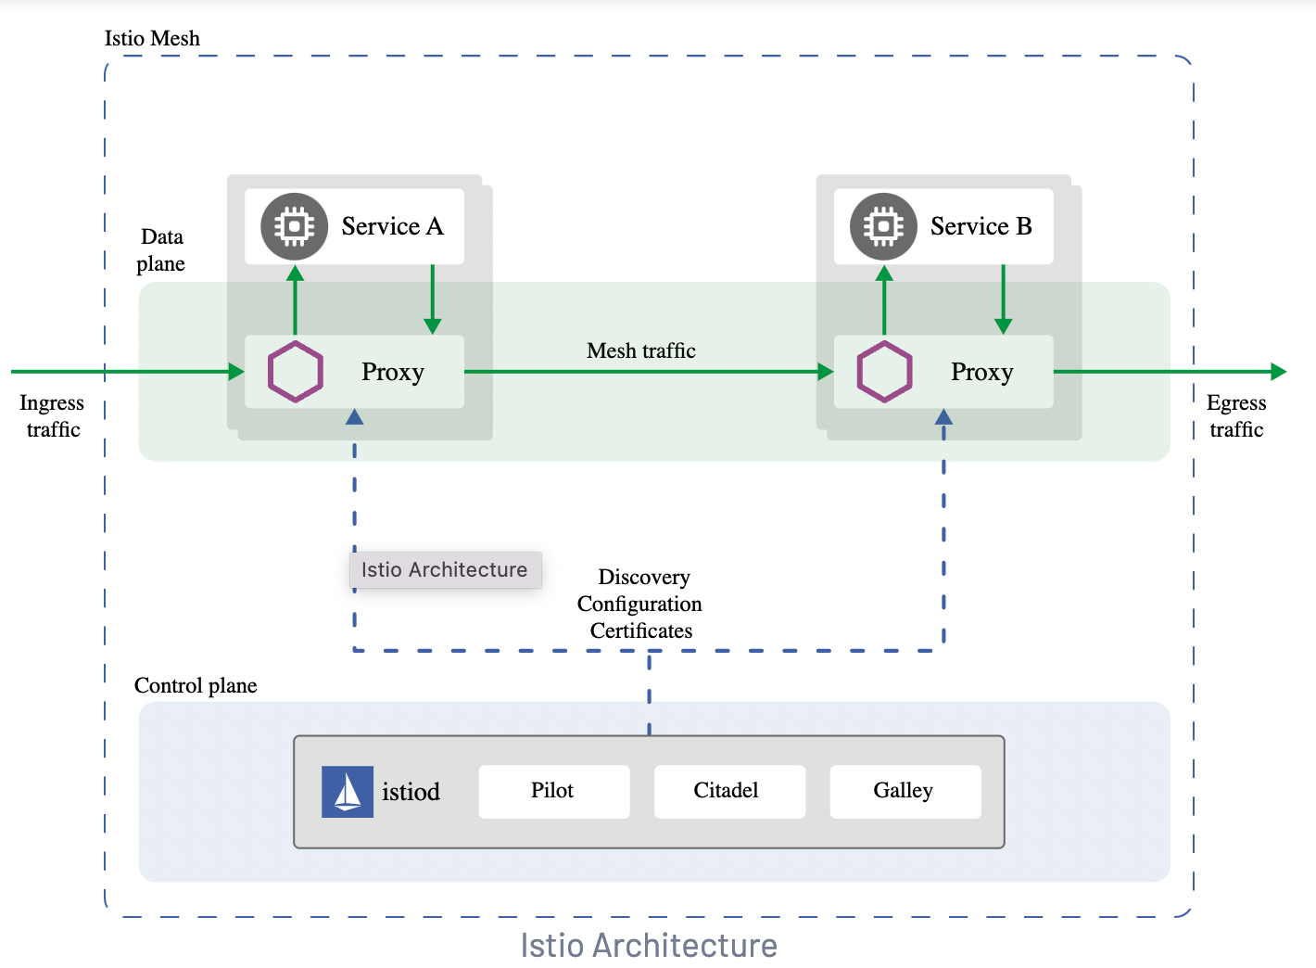
ISTIO Architecture
Istio service mesh provides a modular architecture similar to kubernetes logically splitted into a control plane and a data plane:
The control plane: is the brain of the main network who manage, control, and supervise the network of microservies.
The control plane manages and configures the proxies to route traffic. Additionally, the control plane configures Mixers to enforce policies and collect telemetry.
The data plane: The data plane is composed of a set of intelligent proxies (Envoy) deployed as sidecars.
These proxies mediate and control all network communication between microservices along with Mixer, a general-purpose policy and telemetry hub.
The sidecars deployed within the services and acting as proxy form the service mesh network.

Slide 3
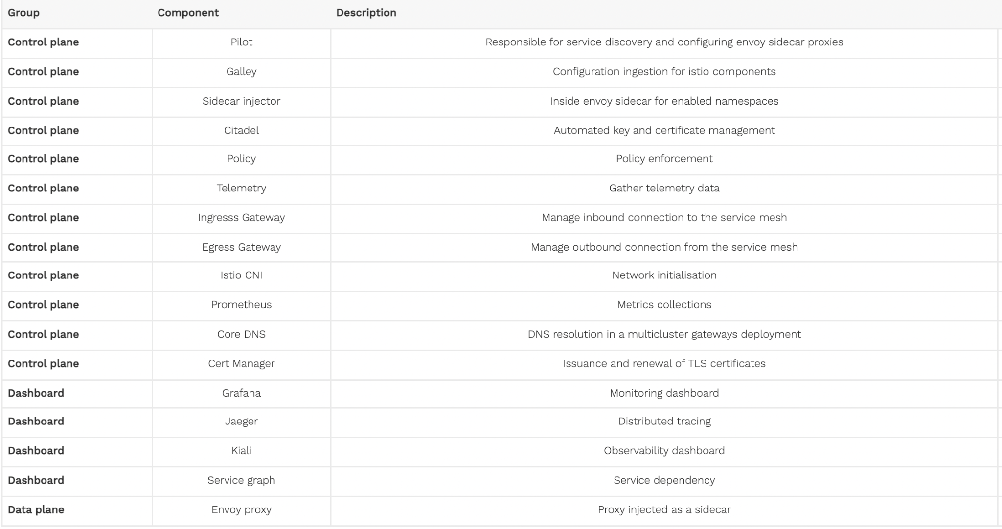
Components

Slide 4
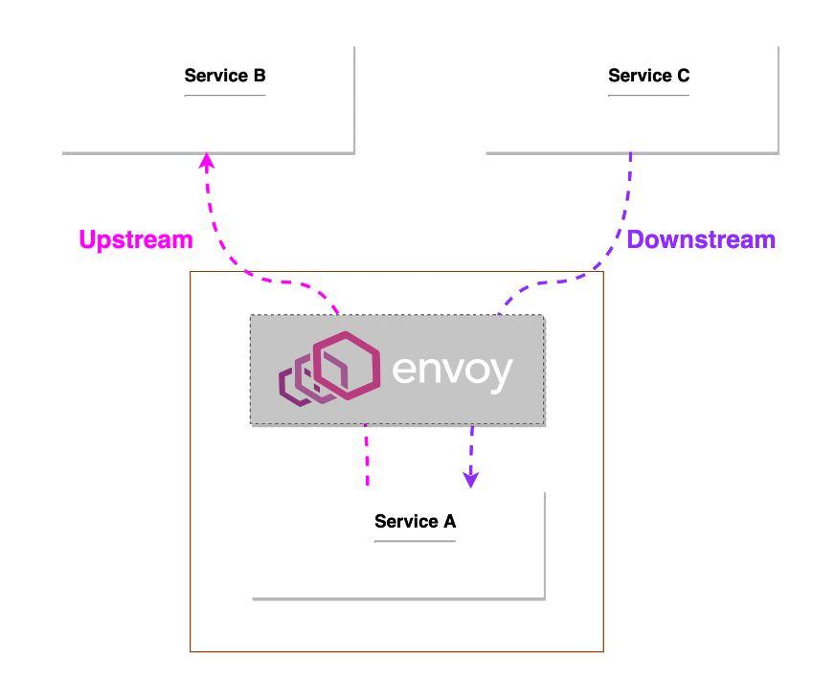
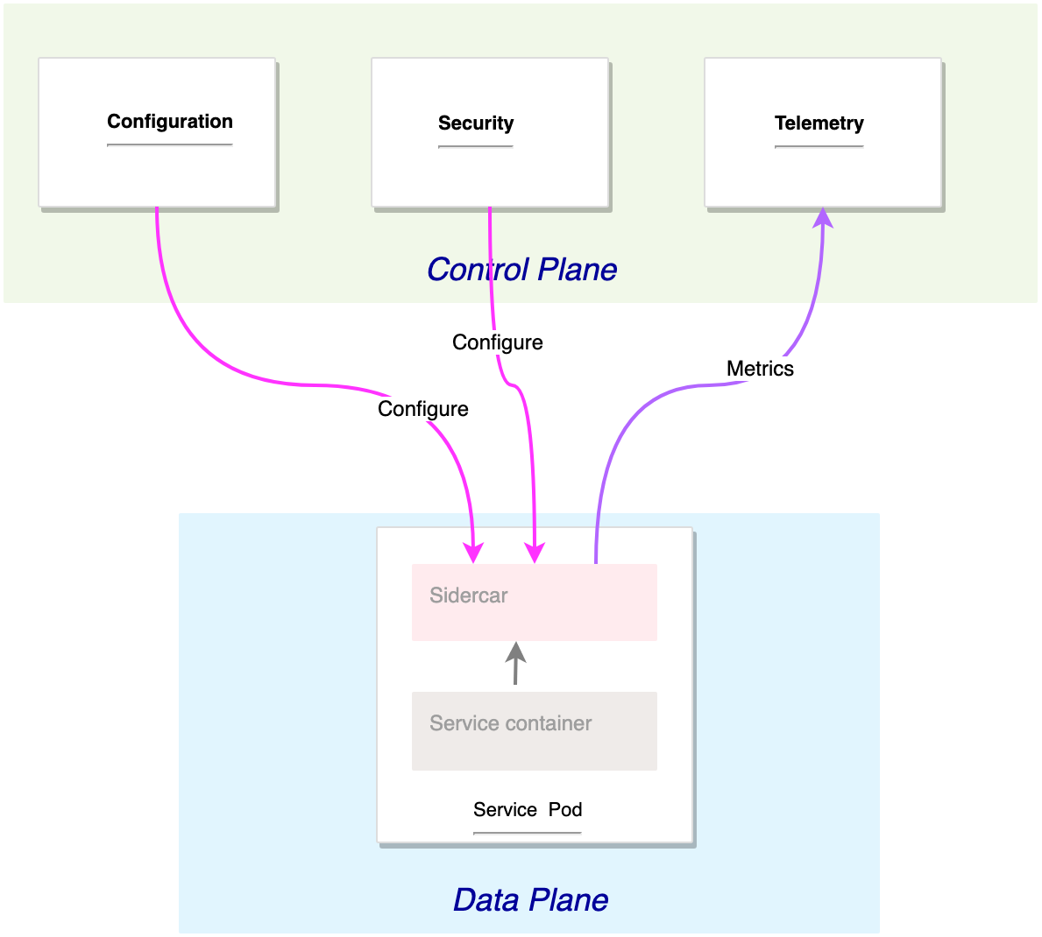
Routing in Small Picture

Slide 5
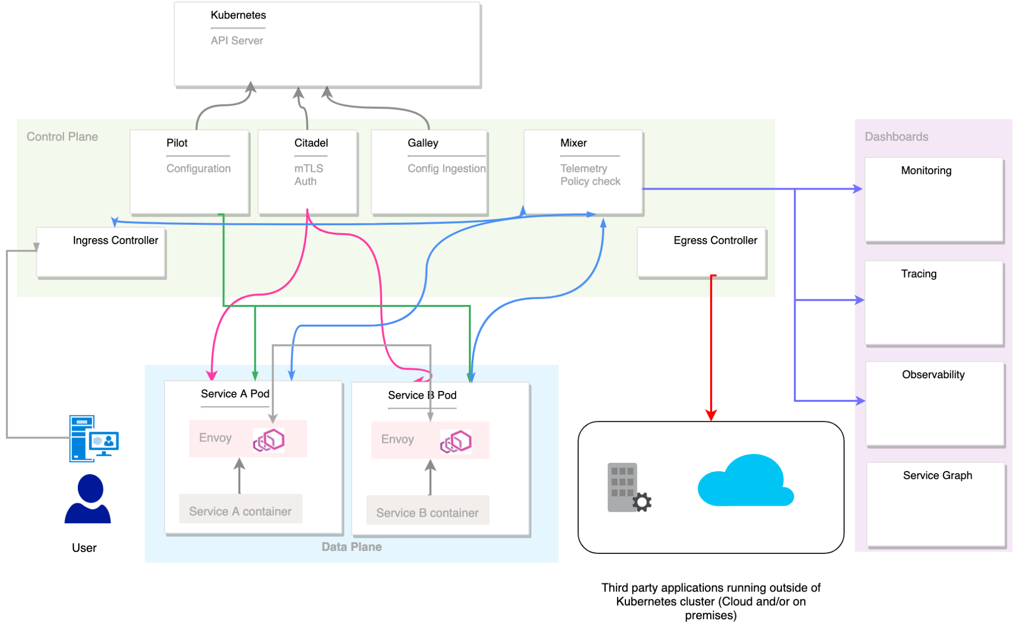
Routing in Big Picture

Slide 6
Final Overview
The ingress controller is responsible for allowing and redirecting the inbound traffic to the services running inside the service mesh.
The egress controller is responsible for allowing outbound traffic from the service mesh. If an application should connect, for example, to an external database or service, such configuration should be explicitly defined for the egress controller.
Pilot and Galley are responsible for the mesh configuration: they pull data from Kubernetes API Server and mix it with the local configuration defined within the mesh then push the configuration to different proxies forming the mesh.
Citadel push tls certificate to services enabling mutual TLS.
Mixer has two roles: gather metrics from the different components and enforce policy by double check each request. In a high level deployment scenario Telemetry and Policy check should be deployed separately.
Dashboards gather metrics from the telemetry service and display it in a user friendly format.
Ref - istioworkshop.io/03-servicemesh-overview/istio-architecture/

