Slide 1
云计算技术
陈果 副教授
湖南大学-信息科学与工程学院-计算机与科学系
邮箱：guochen@hnu.edu.cn
个人主页：1989chenguo.github.io

Slide 2
Host networking virtualization
Part I: Cloud networking
Most materials from UIUC MOOC
Ankit Singla
ETH Zürich
P. Brighten Godfrey
UIUC
Credits to

Slide 3
Host virtualization is the key part of Cloud
Sharing of physical infrastructure
Spin-up a virtual machine in seconds
Live VM migration
Notes:
Cloud computing depends heavily on server virtualization for several reasons:
Virtual machines allow multiplexing of hardware, with 10s to 100s of VMs on a physical server
Rapid deployment of new services: spinning up a VM takes seconds, while deploying an app on physical hardware may take much longer
If a workload requires migration, for example due to the physical server requiring maintenance, VMs can be migrated to other servers, often without interruption to service
Due to these advantages, today, more end-points or ports on the network are virtual than are physical (https://www.usenix.org/system/files/conference/nsdi15/nsdi15-paper-pfaff.pdf)

Slide 4
Some background: Virtual machine
Non-virtual machine
Virtual machine
From Silberschatz, Galvin and Gagne

Slide 5
Some background: Virtual machine
Types of virtual machine
Type 0 hypervisors - Hardware-based solutions that provide support for virtual machine creation and management via firmware
IBM LPARs and Oracle LDOMs
Type 1 hypervisors - Operating-system-like software built to provide virtualization
VMware ESX, Joyent SmartOS, and Citrix XenServer
Type 1 hypervisors – Also includes general-purpose operating systems that provide standard functions as well as VMM functions
Microsoft Windows Server with HyperV and RedHat Linux with KVM
Type 2 hypervisors - Applications that run on standard operating systems but provide VMM features to guest operating systems
VMware Workstation and Fusion, Parallels Desktop, and Oracle VirtualBox
From Silberschatz, Galvin and Gagne

Slide 6
Network virtualization
VM1
VM2
…
VMN
virtual
NIC
vNIC
vNIC
vNIC
Hypervisor
pNIC
Physical NIC
pSwitch
Physical switch
Notes:
Let’s look at how server virtualization works.
The physical hardware is managed by a hypervisor (XEN, KVM, VmWare’s ESXi, etc.)
On top of the hypervisor run several VMs in userspace
The hypervisor provides an emulated view of the hardware for the virtual machines.
Among other hardware resources, the network interface card, is also virtualized in this manner — with the hypervisor managing the physical NIC, while exposing virtual interfaces to the VMs.
The physical NIC connects this server to the rest of the network

Slide 7
Networking VMs
VM1
VM2
…
VMN
vNIC
vNIC
vNIC
virtual
switch
Hypervisor
vSw
pNIC
pSwitch
Notes:
How are these VMs networked?
The hypervisor runs a virtual switch
This can be a simple Layer 2 switch, operating in software, which is connected to all the virtual NICs and the physical NICs and moves packets between the VMs and the external network.

Slide 8
Sidenote: Docker
VM1
VM2
…
VMN
OS
Application
vNIC
vNIC
vNIC
Hypervisor
pNIC
pSwitch
Notes:
Before we examine the details of this, it’s worth noting that here are other ways of doing virtualization — one, using Docker, is becoming popular. In the model we just discussed, …
Each virtual machines run its own entire guest operating system
The application runs as a process inside this guest OS
- This means that running even a small application requires the overhead of running an entire OS.

Slide 9
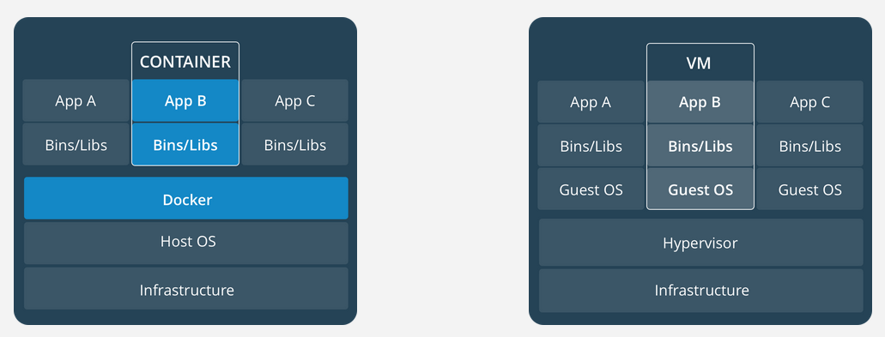
Sidenote: Docker
https://www.docker.com/what-container
Container
…
Docker
Application
Linux
pNIC
pSwitch
Notes:
An alternate approach is use Linux containers for virtualization, like Docker does.
In this setting, an application, together with its dependencies, is packaged into a linux container, which runs using the host machine’s linux kernel and any shared resources
Docker is simply a container manager
Applications are isolated from each other by the use of separate namespace — resources in one application cannot be addressed by other applications
This yields isolation similar to virtual machines
But with a reduced footprint — the container packages can be much smaller than the multiple Gigabytes needed for a guest OS
They also do not run any redundant guest OS processes
This enables much higher density, i.e., a larger number of applications can be supported on each server
Further containers can be brought up much faster than VMs (hundreds of milliseconds, as opposed to multiple seconds)
Recent work on comparing performance across these two approaches shows that container-based virtualization yields performance similar to or better than the virtual machine approach.

Slide 10
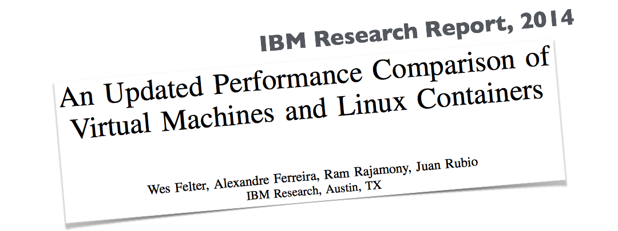
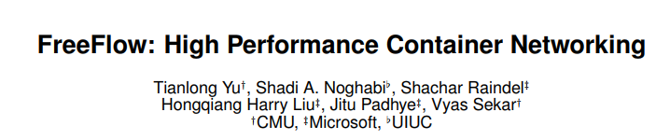
Sidenote: Docker
Container
…
Docker
Application
Linux
vSw
virtual
switch
pNIC
HotNets, 2016
pSwitch
Notes:
How does networking work for containers with Docker?
Each container is assigned a virtual interface
Docker creates a virtual Ethernet bridge connecting these interfaces and the physical NIC
Configuring docker and environment variables determines network connectivity
External network connectivity is supported through a NAT (i.e. network address translation)
However, multiple projects are working on extending network functionality in various way and ultimately, we can expect networking to look similar to that for virtual machines
In our discussion here, we’ve ignored here certain virtualization details (for instance, the distinction between Type-1 and Type-2 hypervisors), but the hypervisor-VM model as described will suffice for our discussion. So let’s look back at it …

Slide 11
Networking VMs
VM1
VM2
…
VMN
Notes:
Local-VM to local-VM within the hypervisor = tradeoff:
better performance, easier switch config (STP detail)
BUT no visibility / monitoring from the network

Slide 12
Networking VMs
VM1
VM2
…
VMN
Notes:
Local-VM to local-VM within the hypervisor is a tradeoff:
better performance for local VM-VM traffic
easier switch config (STP requires extension otherwise)
BUT no visibility / monitoring from the network
Also going to external physical switch means the vSwitch can be extremely simple
Public cloud setting => may not matter; configured to isolate VMs

Slide 13
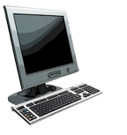

Addressing: routing to another LAN
walkthrough: send datagram from A to B via R
focus on addressing – at IP (datagram) and MAC layer (frame)
assume A knows B’s IP address
assume A knows IP address of first hop router, R (how?)
assume A knows R’s MAC address (how?)
A
B
R
111.111.111.111
222.222.222.222
74-29-9C-E8-FF-55
49-BD-D2-C7-56-2A
222.222.222.220
1A-23-F9-CD-06-9B
111.111.111.112
111.111.111.110
222.222.222.221
CC-49-DE-D0-AB-7D
E6-E9-00-17-BB-4B
88-B2-2F-54-1A-0F
From James F. Kurose and Keith W. Ross

Slide 14
Addressing: routing to another LAN
A creates IP datagram with IP source A, destination B
A creates link-layer frame with R's MAC address as dest, frame contains A-to-B IP datagram
MAC src: 74-29-9C-E8-FF-55
MAC dest: E6-E9-00-17-BB-4B
IP
Eth
Phy
IP src: 111.111.111.111
IP dest: 222.222.222.222
A
B
R
111.111.111.111
222.222.222.222
74-29-9C-E8-FF-55
49-BD-D2-C7-56-2A
222.222.222.220
1A-23-F9-CD-06-9B
111.111.111.112
111.111.111.110
222.222.222.221
CC-49-DE-D0-AB-7D
E6-E9-00-17-BB-4B
88-B2-2F-54-1A-0F
From James F. Kurose and Keith W. Ross

Slide 15
Addressing: routing to another LAN
frame sent from A to R
frame received at R, datagram removed, passed up to IP
MAC src: 74-29-9C-E8-FF-55
MAC dest: E6-E9-00-17-BB-4B
IP src: 111.111.111.111
IP dest: 222.222.222.222
IP
Eth
Phy
IP src: 111.111.111.111
IP dest: 222.222.222.222
IP
Eth
Phy
A
B
R
111.111.111.111
222.222.222.222
74-29-9C-E8-FF-55
49-BD-D2-C7-56-2A
222.222.222.220
1A-23-F9-CD-06-9B
111.111.111.112
111.111.111.110
222.222.222.221
CC-49-DE-D0-AB-7D
E6-E9-00-17-BB-4B
88-B2-2F-54-1A-0F
From James F. Kurose and Keith W. Ross

Slide 16
Addressing: routing to another LAN
R forwards datagram with IP source A, destination B
R creates link-layer frame with B's MAC address as dest, frame contains A-to-B IP datagram
MAC src: 1A-23-F9-CD-06-9B
MAC dest: 49-BD-D2-C7-56-2A
IP
Eth
Phy
IP
Eth
Phy
IP src: 111.111.111.111
IP dest: 222.222.222.222
A
B
R
111.111.111.111
222.222.222.222
74-29-9C-E8-FF-55
49-BD-D2-C7-56-2A
222.222.222.220
1A-23-F9-CD-06-9B
111.111.111.112
111.111.111.110
222.222.222.221
CC-49-DE-D0-AB-7D
E6-E9-00-17-BB-4B
88-B2-2F-54-1A-0F
From James F. Kurose and Keith W. Ross

Slide 17
Addressing: routing to another LAN
R forwards datagram with IP source A, destination B
R creates link-layer frame with B's MAC address as dest, frame contains A-to-B IP datagram
MAC src: 1A-23-F9-CD-06-9B
MAC dest: 49-BD-D2-C7-56-2A
IP
Eth
Phy
IP
Eth
Phy
IP src: 111.111.111.111
IP dest: 222.222.222.222
A
B
R
111.111.111.111
222.222.222.222
74-29-9C-E8-FF-55
49-BD-D2-C7-56-2A
222.222.222.220
1A-23-F9-CD-06-9B
111.111.111.112
111.111.111.110
222.222.222.221
CC-49-DE-D0-AB-7D
E6-E9-00-17-BB-4B
88-B2-2F-54-1A-0F
From James F. Kurose and Keith W. Ross

Slide 18
Addressing: routing to another LAN
R forwards datagram with IP source A, destination B
R creates link-layer frame with B's MAC address as dest, frame contains A-to-B IP datagram
MAC src: 1A-23-F9-CD-06-9B
MAC dest: 49-BD-D2-C7-56-2A
IP src: 111.111.111.111
IP dest: 222.222.222.222
IP
Eth
Phy
A
B
R
111.111.111.111
222.222.222.222
74-29-9C-E8-FF-55
49-BD-D2-C7-56-2A
222.222.222.220
1A-23-F9-CD-06-9B
111.111.111.112
111.111.111.110
222.222.222.221
CC-49-DE-D0-AB-7D
E6-E9-00-17-BB-4B
88-B2-2F-54-1A-0F
From James F. Kurose and Keith W. Ross

Slide 19
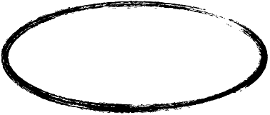
Improving networking performance
VM1
VM2
…
VMN
CPU does
the work!
vNIC
vNIC
vNIC
Hypervisor
vSw
pNIC
pSwitch
Notes:
As we saw earlier, the hypervisor runs a virtual switch to network the VMs.
But who’s doing the work for moving around packets?
The CPU

Slide 20
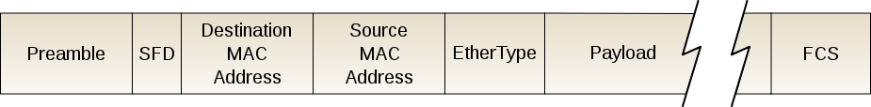
Packet processing on CPUs
Flexible
slow, CPU-expensive
10Gbps, 84 Byte packets ⇒ 67ns time budget
Context: CPU-memory takes tens of ns
Notes:
Packet forwarding on CPUs can be very flexible: one can use general packet forwarding logic, filter packets on arbitrary fields, run them through multiple filters if necessary, etc.
But, if done naively, it can also be CPU expensive, and slow
Let’s see why …
At 10Gbps, with the smallest size packets, which is 84 bytes, we’re left with a 67 nanosecond time window in which to make a packet forwarding decision before the next packet arrives. (Note that Ethernet frames are 64 bytes, but together with the preamble which tells the receiver a packet is coming, and the necessary gap between packets, the envelope comes to 84 bytes.)
For context, for a CPU to access memory takes tens of nanoseconds; so 67ns is quite small!
And we’re trying to accomplish a LOT in this time

Slide 21
Packet processing on CPUs
Flexible
slow, CPU-expensive
Packet I/O
Userspace overheads
Packet classification
Progress is being made!
Notes:
We need time for packet I/O: moving packets from the NIC buffers to the OS buffers, which requires CPU interrupts
Until recently, a single x86 CPU core couldn’t saturate a 10Gbps link (http://netoptimizer.blogspot.com/2014/10/unlocked-10gbps-tx-wirespeed-smallest.html) And this involves no switching — just a standard network stack moving packets between the OS and the NIC.
After significant engineering effort, packet I/O is now doable at these line rates
However, for a software switch, more effort is needed. If any of the switching logic is in userspace, one incurs the overhead for switching between userspace and kernel-userspace …
Further, for switching, we need to match rules for forwarding packets in a forwarding table
All this takes CPU time! Also, keep in mind that the CPU’s primary goal isn’t to forward packets — the primary goal is to run the applications.
Next, we’ll discuss two starkly different approaches to addressing the problem of networking virtual machines: one using specialized hardware, and the other, entirely in software.

Slide 22
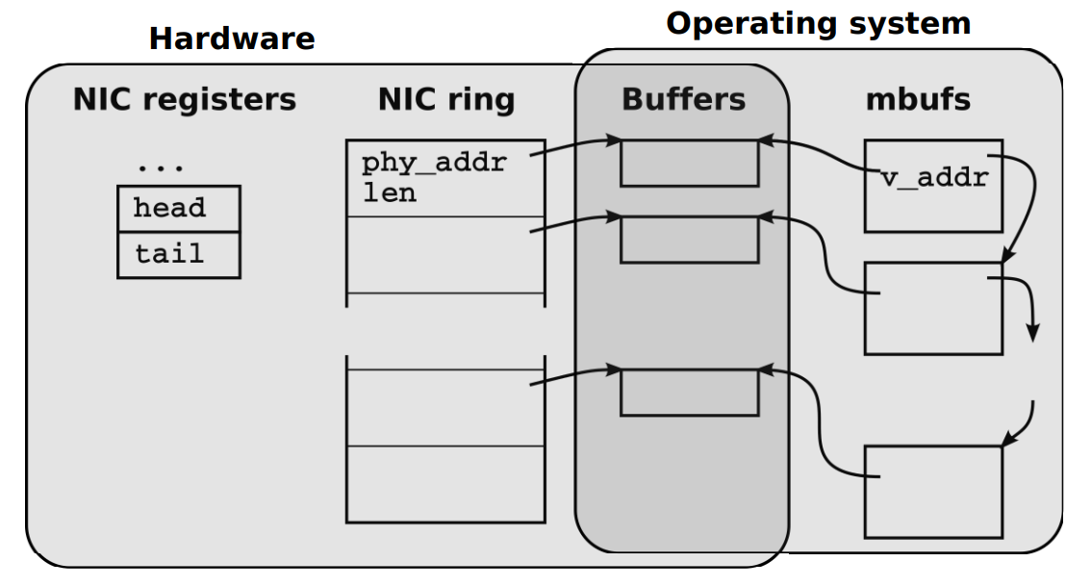
Packet processing on CPUs
Packet classification
User space
VM
Dispatcher
VM
VM
Packet I/O
Kernel-User space switch
Notes:
We need time for packet I/O: moving packets from the NIC buffers to the OS buffers, which requires CPU interrupts
Until recently, a single x86 CPU core couldn’t saturate a 10Gbps link (http://netoptimizer.blogspot.com/2014/10/unlocked-10gbps-tx-wirespeed-smallest.html) And this involves no switching — just a standard network stack moving packets between the OS and the NIC.
After significant engineering effort, packet I/O is now doable at these line rates
However, for a software switch, more effort is needed. If any of the switching logic is in userspace, one incurs the overhead for switching between userspace and kernel-userspace …
Further, for switching, we need to match rules for forwarding packets in a forwarding table
All this takes CPU time! Also, keep in mind that the CPU’s primary goal isn’t to forward packets — the primary goal is to run the applications.
Next, we’ll discuss two starkly different approaches to addressing the problem of networking virtual machines: one using specialized hardware, and the other, entirely in software.

Slide 23
How to solve this problem?
Two directions to improve the performance of host networking virtualization
Hardware-based solution
E.g., SR-IOV
Software-based solution
E.g., Open vSwitch

Slide 24
SR-IOV: Single-root I/O Virtualization
DMA to bypass
the hypervisor!
VM1
VM2
VMN
VM1
VM2
…
VMN
…
vNIC
vNIC
vNIC
vSw
…
pNIC
virtual
function
physical
function
L2 sorter
(switch)
Notes:
Main idea: CPUs are not designed for packet forwarding
The NIC is!!
Naive solution: give VMs direct access to physical NIC
Problem: sharing? access control? isolation?
SR-IOV provides a solution to this problem. SR-IOV = ? The SR part is not essential to this discussion and we’ll ignore it.
With SR-IOV, the physical NIC itself supports virtualization in hardware
Peek inside
The NIC provides a physical function which is just a standard ethernet port
In addition, it also provides several virtual functions (which are simple queues with transmit + receive ability)
Each VF is mapped to a VMs, so the VMs get access to NIC hardware resources
On the NIC also resides a simple L2 switch (which classifies traffic into queues for the virtual functions)
Further, packets are directly moved from the NIC VF to the corresponding VM memory using DMA, i.e. direct memory access (animate)
This allows us to bypass hypervisor!
Hypervisor is only involved in assignment and management of VFs and the PF
but not data path
Upshot: higher throughput, lower latency, lower CPU utilization. Close to native performance.
There are downsides to this approach though:
live VM migration is trickier because … the VM is tied to physical resources on the NIC
Also, forwarding isn’t flexible because we rely on the hardware L2 switch. In contrast, software defined networking allows very generic packet classification, on arbitrary combinations of fields, etc.
Next, we’ll look at a software switch approach which addresses these criticisms

Slide 25
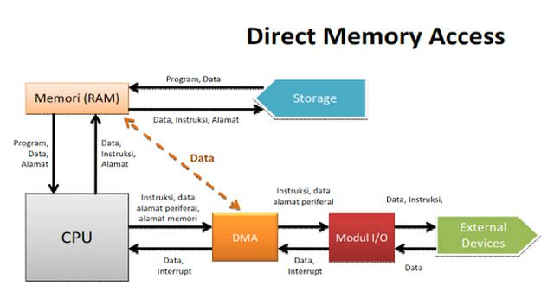
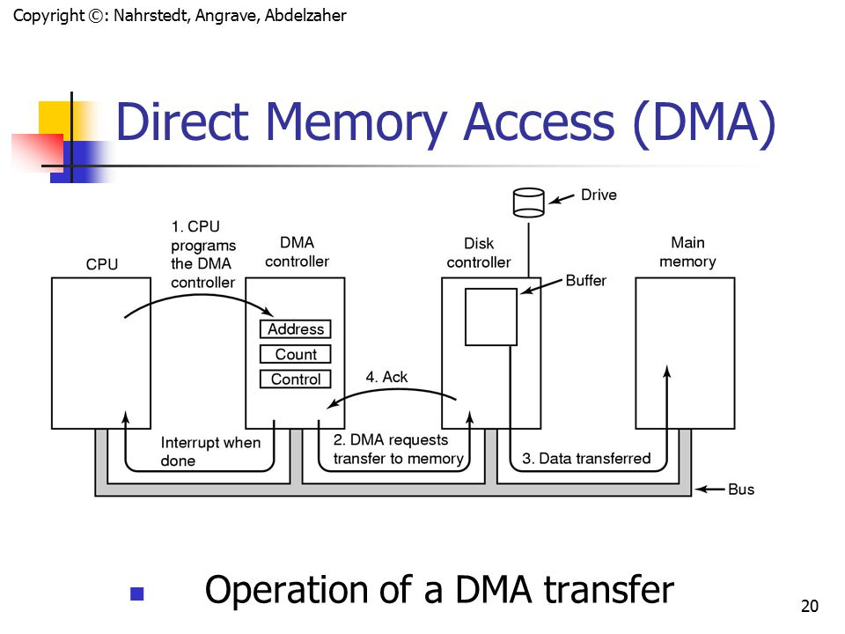
DMA background

Slide 26
SR-IOV: Single-root I/O Virtualization
DMA to bypass
the hypervisor!
VM1
VM2
VMN
VM1
VM2
…
VMN
…
vNIC
vNIC
vNIC
vSw
…
pNIC
virtual
function
physical
function
L2 sorter
(switch)
Notes:
Main idea: CPUs are not designed for packet forwarding
The NIC is!!
Naive solution: give VMs direct access to physical NIC
Problem: sharing? access control? isolation?
SR-IOV provides a solution to this problem. SR-IOV = ? The SR part is not essential to this discussion and we’ll ignore it.
With SR-IOV, the physical NIC itself supports virtualization in hardware
Peek inside
The NIC provides a physical function which is just a standard ethernet port
In addition, it also provides several virtual functions (which are simple queues with transmit + receive ability)
Each VF is mapped to a VMs, so the VMs get access to NIC hardware resources
On the NIC also resides a simple L2 switch (which classifies traffic into queues for the virtual functions)
Further, packets are directly moved from the NIC VF to the corresponding VM memory using DMA, i.e. direct memory access (animate)
This allows us to bypass hypervisor!
Hypervisor is only involved in assignment and management of VFs and the PF
but not data path
Upshot: higher throughput, lower latency, lower CPU utilization. Close to native performance.
There are downsides to this approach though:
live VM migration is trickier because … the VM is tied to physical resources on the NIC
Also, forwarding isn’t flexible because we rely on the hardware L2 switch. In contrast, software defined networking allows very generic packet classification, on arbitrary combinations of fields, etc.
Next, we’ll look at a software switch approach which addresses these criticisms

Slide 27
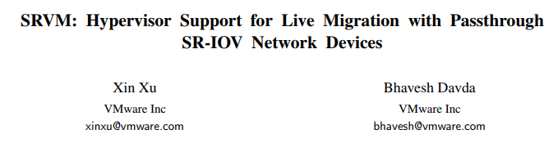

SR-IOV: Single-root I/O Virtualization
Problems：
Live migration is tricky (hardware states migration)
Can’t support flexible forwarding policies (L2 switch inside NIC)
DMA to bypass
the hypervisor!
VM1
VM2
VMN
VM1
VM2
…
VMN
…
vNIC
vNIC
ACM SIGPLAN/SIGOPS VEE, 2016
vNIC
vSw
…
pNIC
USENIX NSDI, 2017
virtual
function
physical
function
L2 sorter
(switch)
Notes:
Main idea: CPUs are not designed for packet forwarding
The NIC is!!
Naive solution: give VMs direct access to physical NIC
Problem: sharing? access control? isolation?
SR-IOV provides a solution to this problem. SR-IOV = ? The SR part is not essential to this discussion and we’ll ignore it.
With SR-IOV, the physical NIC itself supports virtualization in hardware
Peek inside
The NIC provides a physical function which is just a standard ethernet port
In addition, it also provides several virtual functions (which are simple queues with transmit + receive ability)
Each VF is mapped to a VMs, so the VMs get access to NIC hardware resources
On the NIC also resides a simple L2 switch (which classifies traffic into queues for the virtual functions)
Further, packets are directly moved from the NIC VF to the corresponding VM memory using DMA, i.e. direct memory access (animate)
This allows us to bypass hypervisor!
Hypervisor is only involved in assignment and management of VFs and the PF
but not data path
Upshot: higher throughput, lower latency, lower CPU utilization. Close to native performance.
There are downsides to this approach though:
live VM migration is trickier because … the VM is tied to physical resources on the NIC
Also, forwarding isn’t flexible because we rely on the hardware L2 switch. In contrast, software defined networking allows very generic packet classification, on arbitrary combinations of fields, etc.
Next, we’ll look at a software switch approach which addresses these criticisms

Slide 28
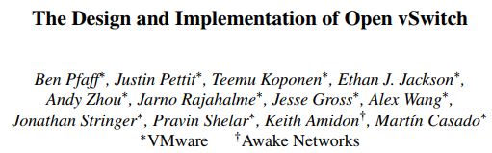
Open vSwitch
USENIX NSDI, 2015
Notes:
This discussion will be based on work by Pfaff et al. We’ll only see a very broad overview here, but I recommend that you check out the paper in its entirety — which will tell you not only about the final decision, but the process that led to it.

Slide 29
Open vSwitch
VM1
VM2
…
VMN
decision-making “smarts”
vNIC
vNIC
vNIC
user space
Hypervisor
vSw
kernel
simple, fast forwarding
pNIC
pSwitch
Notes:
Open vSwitch’s Design goals are
flexible, fast forwarding
This necessitates a division between userspace and kernelspace tasks
One cannot work entirely in kernel because of development difficulties — it’s hard to push changes to kernel-level code, and it’s desirable to keep logic that resides in the kernel as simple as possible
So, the “smarts” of this approach, i.e., switch routing decisions lie in user-space. This is where one decides what rules / filters apply to packets of a certain type
perhaps based on network-updates from other (virtual) switches in the network
This behavior can be programmed using OpenFlow (which we will cover in our SDN section)
So this part is optimized for processing network updates, and not necessarily for wirespeed packet forwarding
Packet forwarding is largely handed in the kernel
Broadly, open vswitch’s approach is to optimize the common case (as opposed to worst-case line-rate) and as we’ll see, caching is the answer to that need.

Slide 30
Inside Open vSwitch
srcMAC | dstMAC | action
dstIP | dstTCPPort | action
userspace
kernel
srcMAC | dstMAC | dstIP | dstTCPPort | action
Notes:
Let’s look at how packets flow through this architecture.
The first packet of a flow goes to userspace
Here, several different packet classifiers might be consulted, some actions may be based on MAC addresses, others may depend on TCPports etc.
The highest priority matching action will be used to forward the packet
Once a packet is forwarded, a collapsed rule used to forward that packet is installed in the kernel. This is a simple classifier, with no priorities. The following packets of this flow never enter userspace, seeing only the kernel classifier.

Slide 31
Inside Open vSwitch
srcMAC | dstMAC | action
dstIP | dstTCPPort | action
userspace
kernel
cache
hash-key | flow-table-entry
srcMAC | dstMAC | dstIP | dstTCPPort | action
hash-key = hash (srcMAC, dstMAC, dstIP, dstTCPPort)
Notes:
Problem: still running a packet classifier
Solution: create a simple hash table based cache into the classifier
No longer a packet classifier, just a simple O(1) hash table lookup
Works well for real workloads; the paper reports results in a large real deployment, showing high cache-hit rates (over 97%) and low CPU usage.

Slide 32
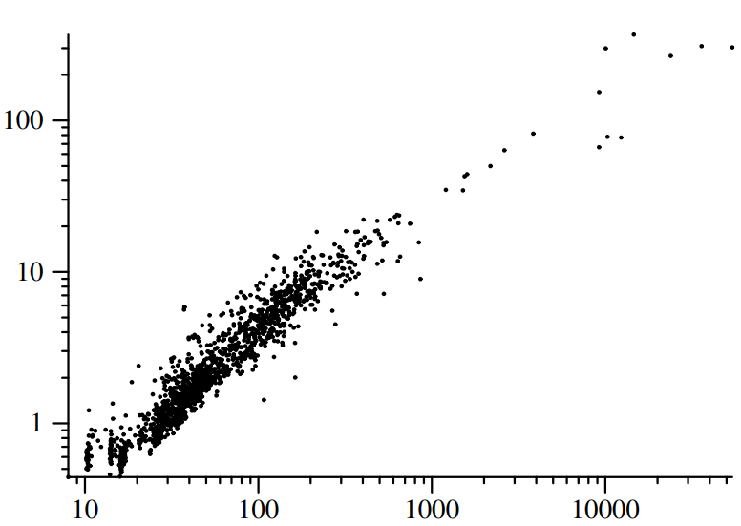
Inside Open vSwitch
CPU Load (%)
Kernel misses / second
[The Design and Implementation of Open vSwitch. Pfaff et. al, USENIX NSDI 2015]
Notes:
Let’s look at one of their results. This performance data was gathered from 24-hours of operations at a Rackspace data center with multiple tenants. Each point on this scatterplot represent one of more than 1000 hypervisors in this deployment. On the x-axis is number of kernel misses / second averaged over 24 hours. On the y-axis is average CPU load. As the number of switches to userspace increases, CPU load increases as well, but it’s almost always below 20%, and in the vast majority of cases, below 10%. This may not be clear from this scatterplot, but over 80% of the hypervisors averaged 5% or less CPU load. Minor note: The measured CPU load can sometimes exceed 100% due to multithreading. Interestingly, the authors found that all 6 instances of this happening (top-right corner) were due to previously unknown implementation bug.
Of course, performance can be expected to be drastically lower for things like port-scans, which cause caching to not be useful.
To summarize briefly: the hardware approach sacrifices flexibility in forwarding logic; while Open vSwitch’s software approach sacrifices worst-case performance in favor of flexibility.

Slide 33
Reading materials for group projects
“An Updated Performance Comparison of Virtual Machines and Linux Containers”, IBM Research Report 2014
“FreeFlow: High Performance Container Networking”, HotNets 2016
“SRVM: Hypervisor Support for Live Migration with Passthrough SR-IOV Network Devices”, VEE 2016 + “SR-IOV.PPTX”, http://www.cs.nthu.edu.tw/~ychung/slides/Virtualization/SR-IOV.pptx
“VFP: A Virtual Switch Platform for Host SDN in the Public Cloud”, NSDI 2017
“The Design and Implementation of Open vSwitch”, NSDI 2015
“NetVM: High Performance and Flexible Networking using Virtualization on Commodity Platforms”, NSDI 2014
“NetBricks: Taking the V out of NFV”, OSDI 2016
“High Performance Packet Processing with FlexNIC”, ASPLOS 2016

Slide 34
Thanks!
陈果 副教授
湖南大学-信息科学与工程学院-计算机与科学系
邮箱：guochen@hnu.edu.cn
个人主页：1989chenguo.github.io

