Slide 1
云计算技术
陈果 副教授
湖南大学-信息科学与工程学院-计算机与科学系
邮箱：guochen@hnu.edu.cn
个人主页：1989chenguo.github.io
https://1989chenguo.github.io/Courses/CloudComputing2018Spring.html

Slide 2
What we have learned
What is cloud computing
Cloud Networking
Cloud Distributed System
Introduction to Cloud Distributed System
MapReduce
Gossip
Membership
What it is for
Failure detector
SWIM

Slide 3
Peer to Peer (P2P) Systems
Part #2: Cloud Distributed System
Most materials from UIUC MOOC
Thanks Indranil Gupta

Slide 4


When I search peer-to-peer…

Slide 5
Outline
Introduction to P2P systems
Unstructured P2P systems
Napster, Gnutella, Fasttrack, BitTorrent
Structured P2P systems
Chord, Pastry, Kelips
Some of them have structured parts, but we defer the discussion of structured P2P to the latter section

Slide 6
Outline
Introduction to P2P systems
Unstructured P2P systems
Napster, Gnutella, FastTrack, BitTorrent
Structured P2P systems
Chord, Pastry, Kelips

Slide 7
Why Study Peer-to-Peer Systems?
First distributed systems that seriously focused on scalability with respect to number of nodes
P2P techniques abound in cloud computing systems
Key-value stores (e.g., Cassandra, Riak, Voldemort) use Chord p2p hashing

Slide 8


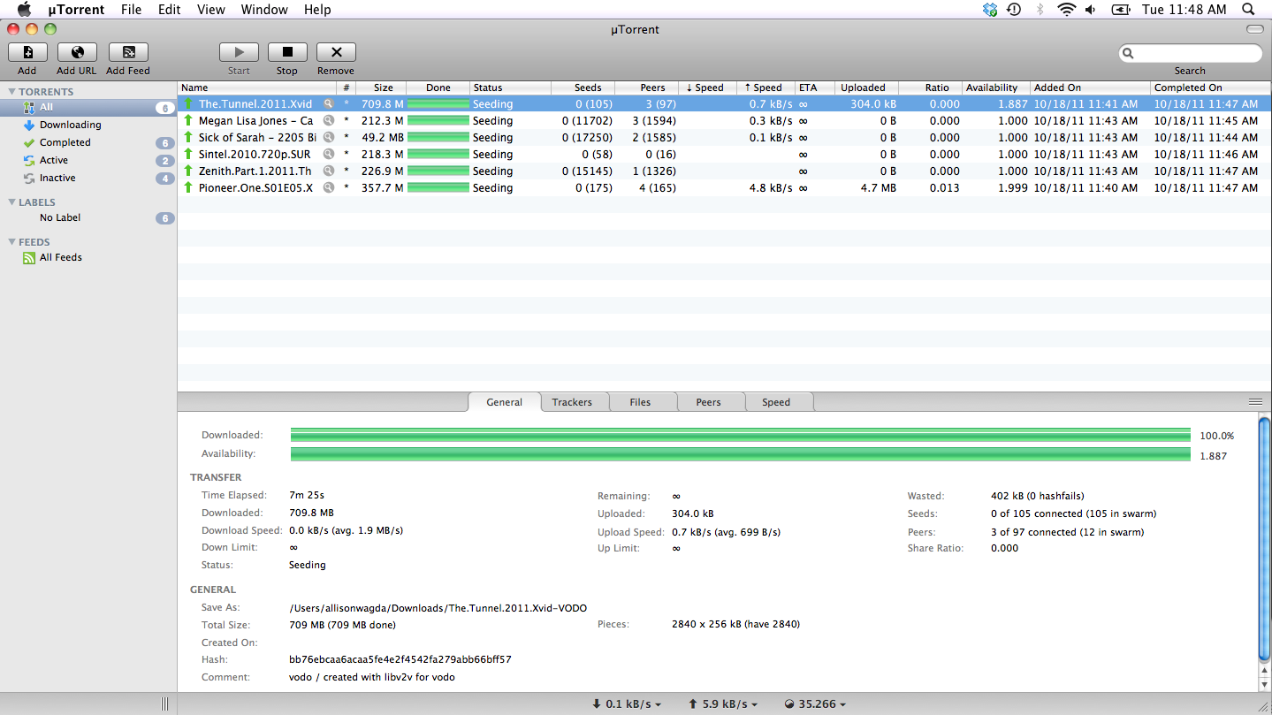
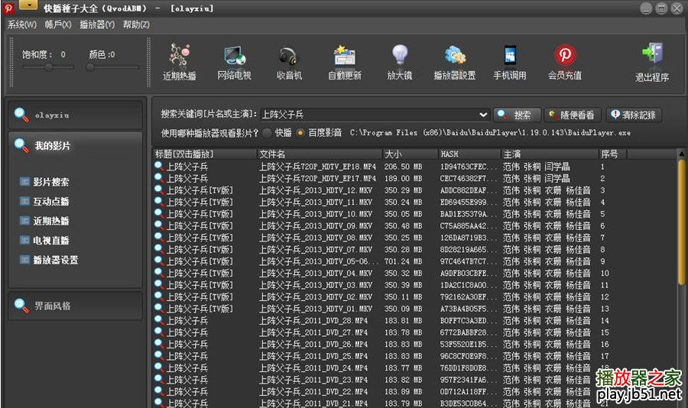

Why Study Peer-to-Peer Systems?
A snapshot of some P2P systems

Slide 9
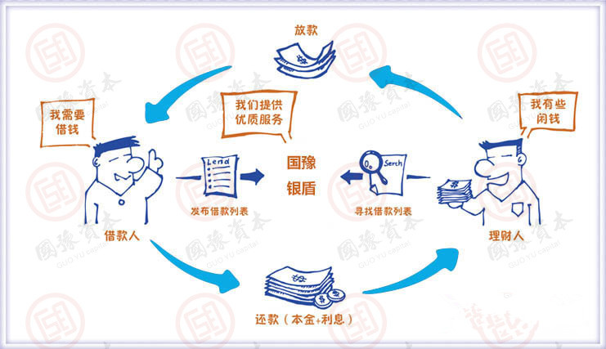
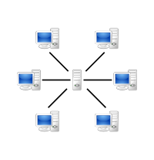
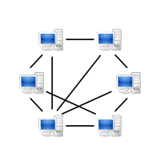
What is P2P system?
Peer-to-peer (P2P) computing or networking is a distributed application architecture that partitions tasks or workloads between peers. Peers are equally privileged, equipotent participants in the application.
https://en.wikipedia.org/wiki/Peer-to-peer#Routing_and_resource_discovery
Client-server system
P2P system

Slide 10

A Brief History
[6/99] Shawn Fanning (freshman Northeastern U.) releases Napster online music service
[12/99] RIAA sues Napster, asking $100K per download
[3/00] 25% UWisc traffic Napster, many universities ban it
[00] 60M users
[2/01] US Federal Appeals Court: users violating copyright laws, Napster is abetting this
[9/01] Napster decides to run paid service, pay % to songwriters and music companies
[Today] Napster protocol is open, people free to develop opennap clients and servers http://opennap.sourceforge.net
Gnutella: http://www.limewire.com (deprecated)
Peer to peer working groups: http://p2p.internet2.edu

Slide 11
Outline
Introduction to P2P systems
Unstructured P2P systems
Napster, Gnutella, Fasttrack, BitTorrent
Structured P2P systems
Chord, Pastry, Kelips

Slide 12
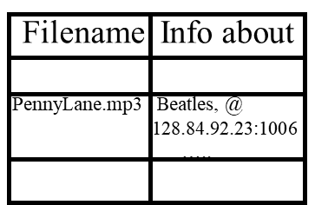
Napster Structure
Store a directory, i.e.,
filenames with peer pointers
napster.com Servers
S
S
S
P
P
Client machines
(“Peers”)
P
P
P
P
Store their own files

Slide 13
Napster Search
Store peer pointers for all files
2. All servers search their lists (ternary tree algorithm)
napster.com Servers
S
S
1. Query
S
P
3. Response
P
4. ping candidates
Client machines
(“Peers”)
P
P
P
P
Store their own files
5. download from best host

Slide 14
Napster Client Operations
Connect to a Napster server
Upload list of music files that you want to share
Server maintains list of <filename, ip_address, portnum> tuples. Server stores no files.
Search
Send server keywords to search with
(Server searches its list with the keywords)
Server returns a list of hosts - <ip_address, portnum> tuples - to client
Client pings each host in the list to find transfer rates
Client fetches file from best host
All communication uses TCP (Transmission Control Protocol)
Reliable and ordered networking protocol

Slide 15
Joining a P2P system
Can be used for any p2p system
Send an http request to well-known url for that P2P service - http://www.myp2pservice.com
Message routed (after lookup in DNS=Domain Name system) to introducer, a well known server that keeps track of some recently joined nodes in p2p system
Introducer initializes new peers’ neighbor table

Slide 16
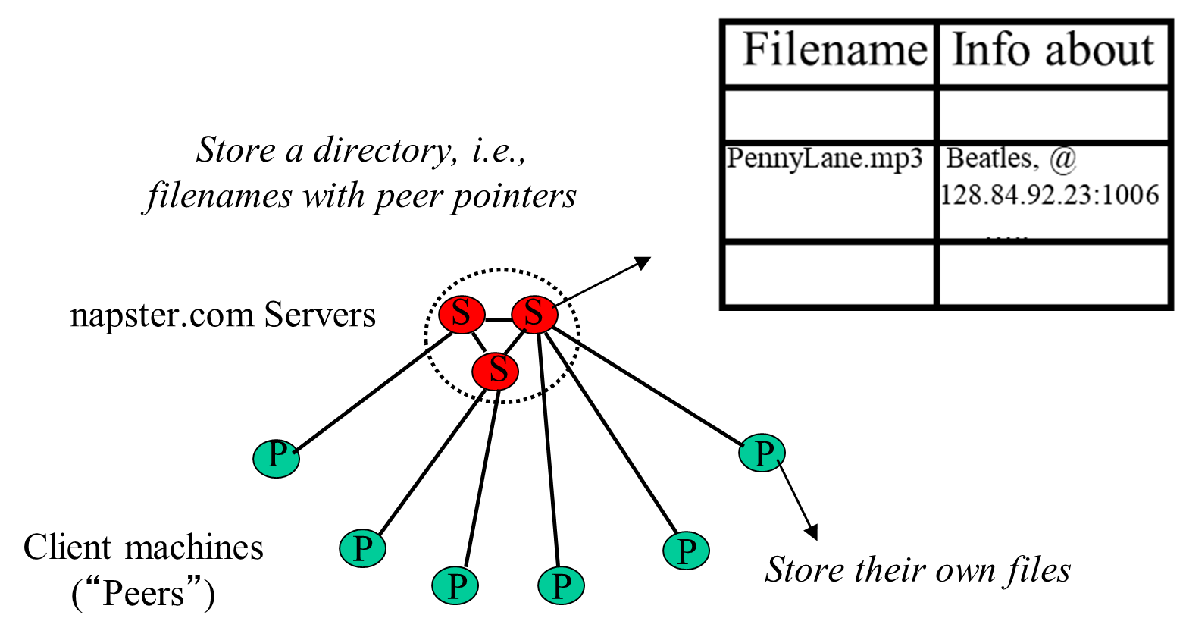
Napster Problems
Centralized server a source of congestion
Centralized server single point of failure
No security: plaintext messages and passwds
napster.com declared to be responsible for users’ copyright violation
“Indirect infringement”
Next system: Gnutella

Slide 17
Brief history of lawsuit to Napster
December 1999: RIAA filed a lawsuit against Napster
RIAA argued in District Court
Napster users directly infringe on plaintiff’s copyright
Napster is liable for contributory & vicarious copyright infringement
Internal Napster email from Sean Parker to Shawn Fanning stating that users know they are “exchanging pirated music.”
From Kaleb Fulgham

Slide 18
Brief history of lawsuit to Napster
Napster’s defense
Sony Corp. of America v. Universal City Studios, Inc.
Napster similar to Sony Betamax VHS recorder
Fair Use
Sampling
Space-shifting
Permissive distribution
Audio Home Recording Act
From Kaleb Fulgham

Slide 19
Brief history of lawsuit to Napster
United States District Court ruled in favor of the RIAA
United States Court of Appeals for the Ninth Circuit
Napster - Liable for contributory & vicarious infringement
Napster users infringe at least two of the copyright holders’ rights
the rights of reproduction, 106(1)
distribution, 106(3)
Ninth Circuit ruling March 5, 2001
Napster capable of commercially significant non-infringing uses
Could control the infringing behavior of users
Must prevent trading of copyright music
Napster paid roughly $36 million to copyright owners
From Kaleb Fulgham

Slide 20
Outline
Introduction to P2P systems
Unstructured P2P systems
Napster, Gnutella, FastTrack, BitTorrent
Structured P2P systems
Chord, Pastry, Kelips

Slide 21

Gnutella quick overview
Eliminate the servers
Client machines search and retrieve amongst themselves
Clients act as servers too, called servents
History
[3/00] release by AOL, immediately withdrawn, but 88K users by 3/03
Original design underwent several modifications

Slide 22
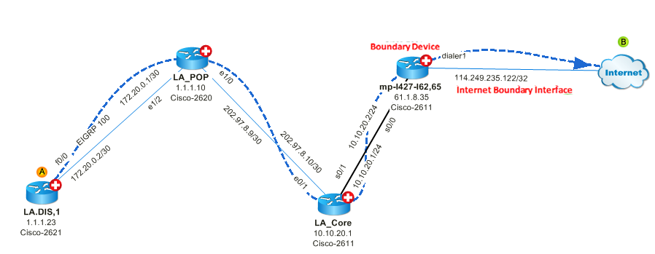
Gnutella quick overview
Store their own files
Servents (“Peers”)
P
P
P
Also store “peer pointers”
P
P
P
P
Each link is an implicit Internet path
Connected in an overlay graph

Slide 23
How do I search a file in Gnutella?
Gnutella routes different messages within the overlay graph
Gnutella protocol has 5 main message types
Query (search)
QueryHit (response to query)
Ping (to probe network for other peers)
Pong (reply to ping, contains address of another peer)
Push (used to initiate file transfer)

Slide 24
Gnutella Message Header Format
Descriptor Header
Payload
Descriptor ID Payload descriptor TTL Hops Payload length
Number of bytes of
message following
this header
Type of payload
0x00 Ping
0x01 Pong
0x40 Push
0x80 Query
0x81 Queryhit
ID of this
search
transaction
Decremented at each hop,
Message dropped when ttl=0
ttl_initial usually 7 to 10
Incremented at each hop

Slide 25
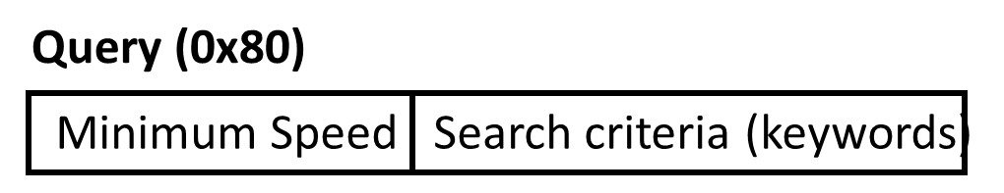


Gnutella Search #1: Query
Query’s flooded out, ttl-restricted, forwarded only once
(How?)
P
P
P
P
TTL=2
P
P
P
Who has PennyLane.mp3?

Slide 26
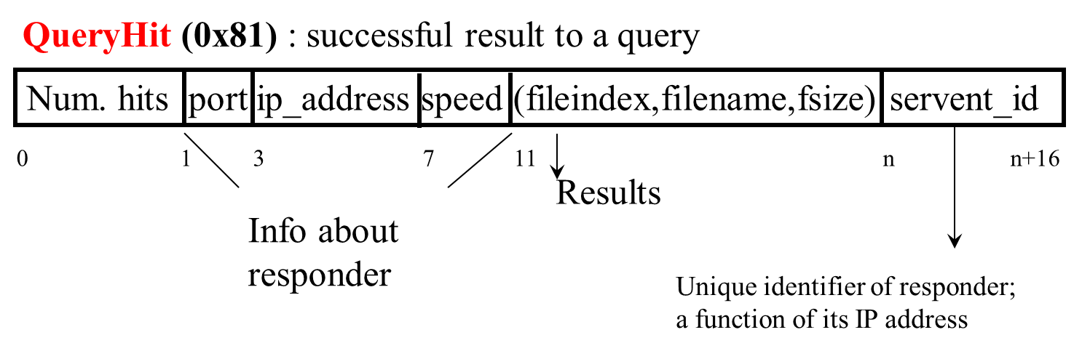
Gnutella Search #2: QueryHit

Slide 27
Gnutella Search #2: QueryHit
Successful results QueryHit’s routed on reverse path
(How?)
P
P
P
P
P
P
TTL=2
P
P
P
Who has PennyLane.mp3?

Slide 28
Avoiding excessive traffic
Query forwarded to all neighbors except peer from which received
To avoid duplicate transmissions, each peer maintains a list of recently received messages
Each Query (identified by DescriptorID) forwarded only once
Duplicates with same DescriptorID and Payload descriptor (msg type, e.g., Query) are dropped
QueryHit routed back only to peer from which Query received with same DescriptorID
QueryHit with DescriptorID for which Query not seen is dropped

Slide 29
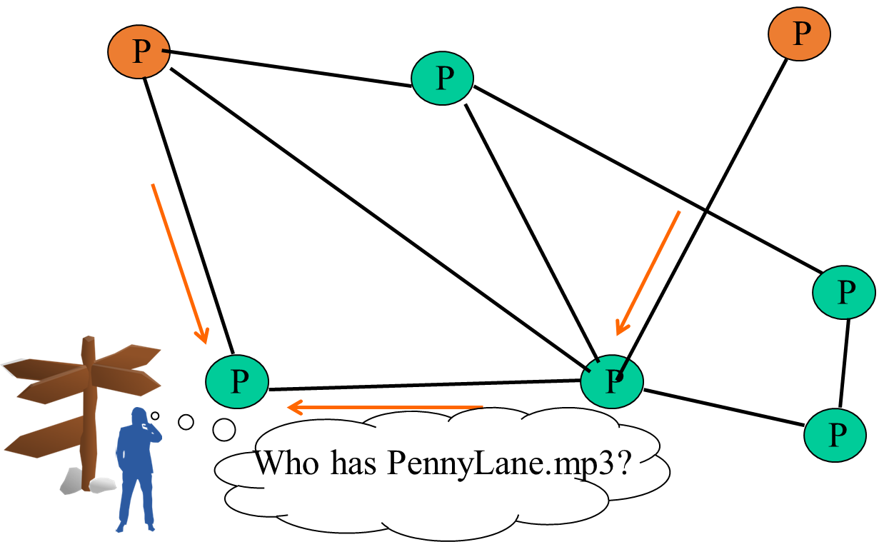
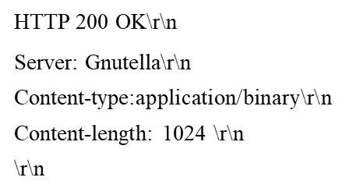
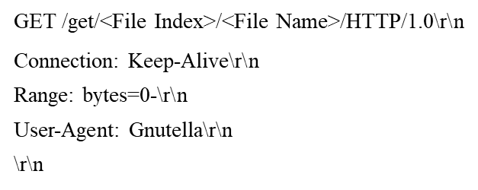
Gnutella Search #3: Transfer Files
Requestor chooses “best” QueryHit responder
Initiates HTTP request directly to responder’s ip+port
Responder then replies with file packets after this message
HTTP response
HTTP request

Slide 30

Gnutella Search #3: Transfer Files
What if responder is behind firewall that disallows incoming connections?
Requestor sends Push to responder asking for file transfer
HTTP request

Slide 31
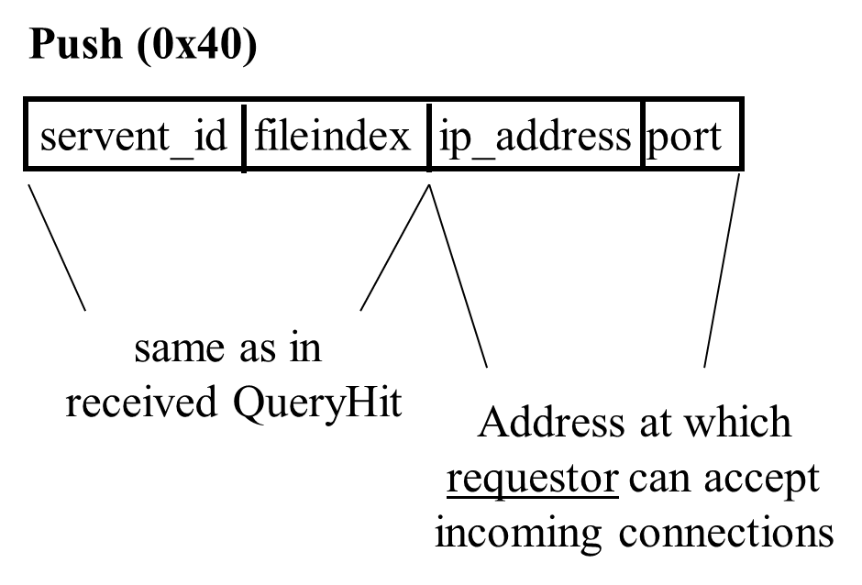
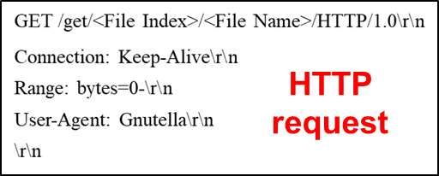
Gnutella Search #3: Transfer Files
What if responder is behind firewall that disallows incoming connections?
Requestor sends Push message to responder asking for file transfer
Responder establishes a TCP connection at ip_address, port specified
Requestor then sends GET to responder and file is transferred as before
Push

Slide 32
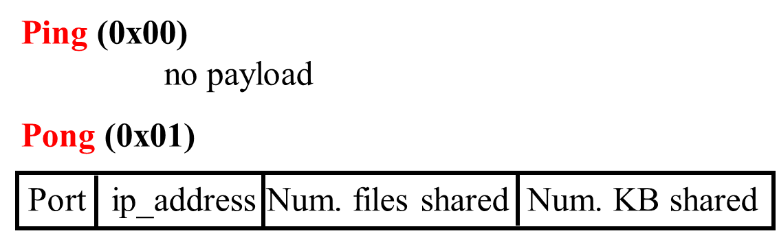
Gnutella Membership Maintaining
Peers initiate Ping’s periodically
Pings flooded out like Querys, Pongs routed along reverse path like QueryHits
Pong replies used to update set of neighboring peers
to keep neighbor lists fresh in spite of peers joining, leaving and failing

Slide 33
Gnutella Summary
No servers
Peers/servents maintain “neighbors”, this forms an overlay graph
Peers store their own files
Queries flooded out, ttl restricted
QueryHit (replies) reverse path routed
Supports file transfer through firewalls
Periodic Ping-pong to continuously refresh neighbor lists

Slide 34
Gnutella Problems
Large number of freeloaders
70% of users in 2000 were freeloaders
Only download files, never upload own files
Some hosts do not have enough bandwidth for passing Gnutella traffic
FastTrack System (soon)
Flooding causes excessive traffic. More intelligent routing?
Structured Peer-to-peer systems, e.g., Chord System (coming up next lecture)

Slide 35
Outline
Introduction to P2P systems
Unstructured P2P systems
Napster, Gnutella, FastTrack, BitTorrent
Structured P2P systems
Chord, Pastry, Kelips

Slide 36


FastTrack
Underlying technology in Kazaa, KazaaLite, Grokster
Hybrid between Gnutella and Napster
Takes advantage of “healthier” participants in the system
Proprietary protocol, but some details available
Like Gnutella, but with some peers designated as supernodes

Slide 37
FastTrack
A supernode stores a directory listing a subset of nearby (<filename,peer pointer>), similar to Napster servers
P
P
Peers
P
S
S
P
S
S
P
Supernodes

Slide 38
FastTrack
Supernode membership changes over time
Any peer can become (and stay) a supernode, provided it has earned enough reputation
Supernodes
P
S
P
P
Peers
S
Reputation:
Participation level
Economic factors
S
S
P
S
S
P
Supernodes

Slide 39
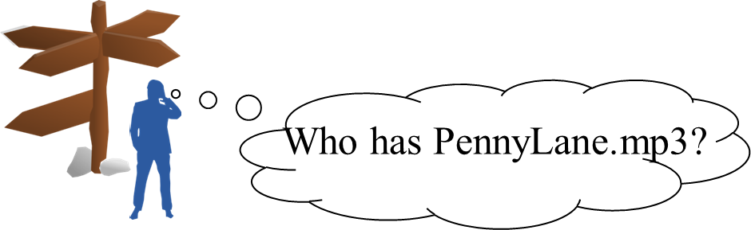
FastTrack
A peer searches by contacting a nearby supernode
P
P
Peers
P
S
S
1. Query
P
S
S
P
Supernodes

Slide 40
Next…
Large number of freeloaders
70% of users in 2000 were freeloaders
Only download files, never upload own files
BitTorrent
A smart way to incentivize users not to be freeloaders

Slide 41
Outline
Introduction to P2P systems
Unstructured P2P systems
Napster, Gnutella, FastTrack, BitTorrent
Structured P2P systems
Chord, Pastry, Kelips

Slide 42


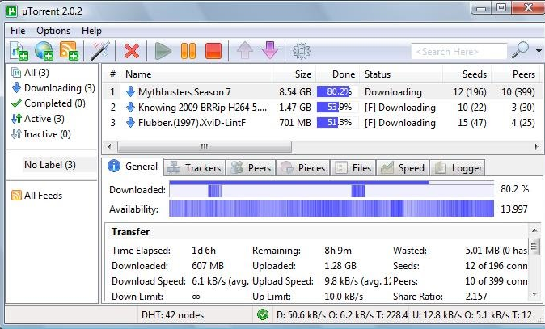
BitTorrent
Remember the membership protocol?
Website links to *.torrent
Tracker, per file
(keeps track of some peers;
receives heartbeats, joins
and leaves from peers)
1. Get *.torrent
2. Get peers
Peer
(seed,
has full file)
Peer
3. Get file blocks
(new, leecher)
Peer
Peer
(leecher,
has some blocks)
(seed)
Now I know the tracker

Slide 43
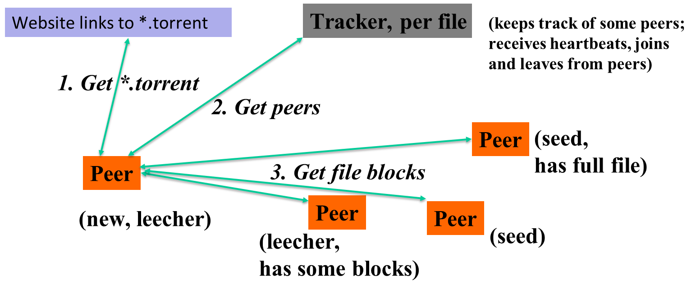
BitTorrent: More details
File split into blocks (32 KB – 256 KB)
Download Local Rarest First block policy: prefer early download of blocks that are least replicated among neighbors
Exception: New node allowed to pick one random neighbor: helps in bootstrapping
File block

Slide 44
BitTorrent: More details
Tit for tat bandwidth usage: Provide blocks to neighbors that provided it the best download rates
Incentive for nodes to provide good download rates
File block
Peer

Slide 45
BitTorrent: More details
Choking: Limit number of neighbors to which concurrent uploads <= a number (5), i.e., the “best” neighbors
Everyone else choked
Periodically re-evaluate this set (e.g., every 10 s), unchoke a random neighbor
Peer
Peer
File block
Peer
Peer
Peer

Slide 46
Next…
More intelligent routing?
Structured Peer-to-peer systems, e.g., Chord System

Slide 47
Outline
Introduction to P2P systems
Unstructured P2P systems
Napster, Gnutella, FastTrack, BitTorrent
Structured P2P systems
Chord, Pastry, Kelips

Slide 48
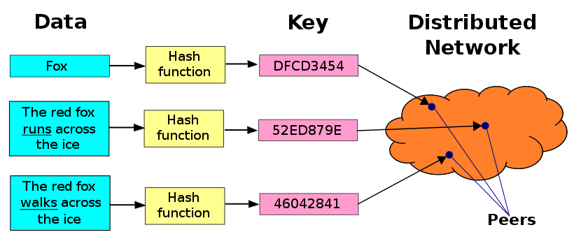
DHT (Distributed Hash Table)
A hash table allows you to insert, lookup and delete objects with keys
A distributed hash table allows you to do the same in a distributed setting (objects=files)
Performance Concerns:
Load balancing
Fault-tolerance
Efficiency of lookups and inserts
Locality
Napster, Gnutella, FastTrack are all DHTs (sort of)
So is Chord, a structured peer to peer system that we study next

Slide 49
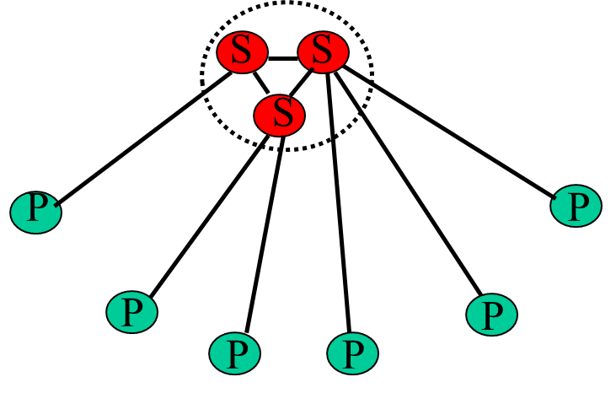
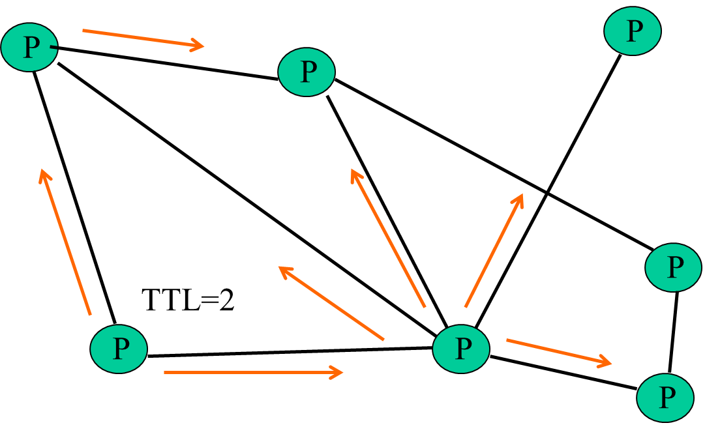
Comparative Performance
 | Memory | Lookup latency | #Messages per lookup
Napster | O(1) (O(N)@server) | O(1) | O(1)
Gnutella | O(N) | O(N) | O(N)
Chord | O(log(N)) | O(log(N)) | O(log(N))
Napster
Gnutella

Slide 50
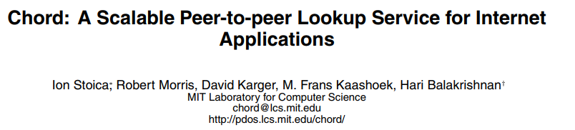





Chord
SIGCOMM 2001

Slide 51
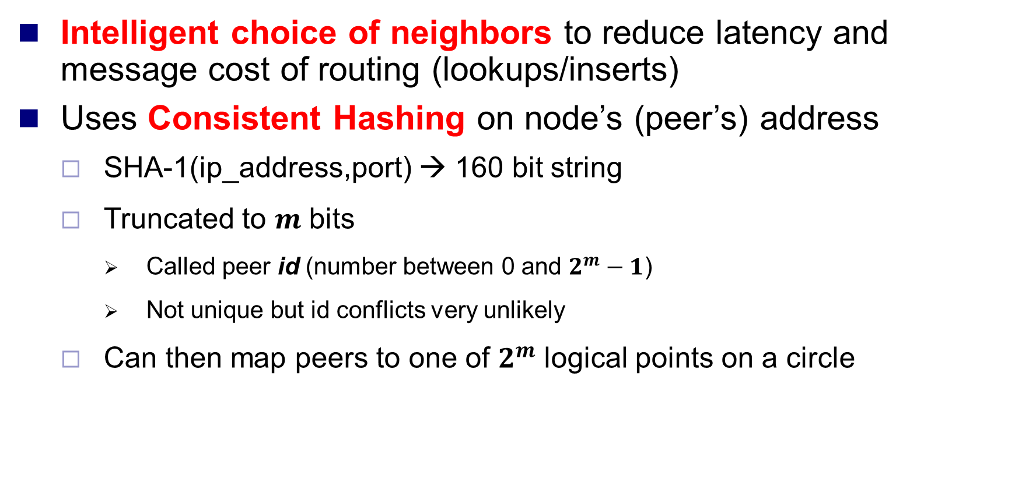
Chord Peer Neighboring Overview
Intelligent choice of neighbors to reduce latency and message cost of routing (lookups/inserts)
Uses Consistent Hashing on node’s (peer’s) address
SHA-1(ip_address,port) → 160 bit string
Truncated to $m$ bits
Called peer id (number between 0 and $2^{m}−1$)
Not unique but id conflicts very unlikely
Can then map peers to one of $2^{m}$ logical points on a circle

Slide 52
Ring of peers
SHA-1(ip_address,port) → 160 bit string. Then, truncate to 𝒎 bits
Called peer id (number between 0 and 𝟐^𝒎−𝟏)
Map peers to one of 𝟐^𝒎 logical points on a circle
Not unique but id conflicts very unlikely
127
0
N112
N16
Say m=7
6 nodes
N96
N32
N80
N45

Slide 53
Peer pointers
Which nodes are my peers?
What node information does each node maintains?
O(N)
N112
N16
?
Say m=7
6 nodes
N96
N32
N80
N45

Slide 54
Peer pointers (1): successors
Each node maintains its successor as its peer
The next node clockwise
N112
N16
Say m=7
6 nodes
N96
N32
N80
N45

Slide 55
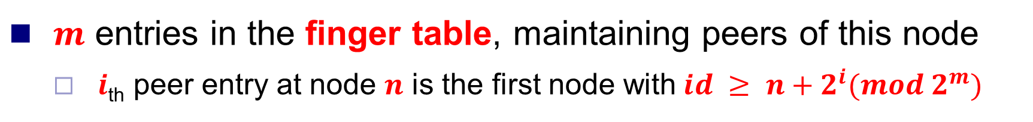
Peer pointers (2): finger tables
$m$ entries in the finger table, maintaining peers of this node
$i$_{th} peer entry at node $n$ is the first node with$id ≥ n+2^{i}(mod 2^{m})$
Finger table of N80
Say m=7
N112
N16
i | Peer node
80+2⁵
80+2⁶
0 | 96
1 | 96
N96
2 | 96
80+2⁴
N32
3 | 96
80+2³
4 | 96
80+2²
5 | 112
80+2¹
80+2⁰
6 | 16
N80
N45

Slide 56

What about the files?
Mapping Files
Filenames also mapped using same consistent hash function
SHA-1(filename) →160 bit string (key)
File is stored at first node with $id≥key mod {(2}^{m}−1)$
N112
N16
Say m=7
6 nodes
N96
File
cnn.com/index.html
N32
SHA-1
With K keys and N peers, each peer stores O(K/N) keys
Key = 42
N45
N80
N45
Stored at N45!

Slide 57
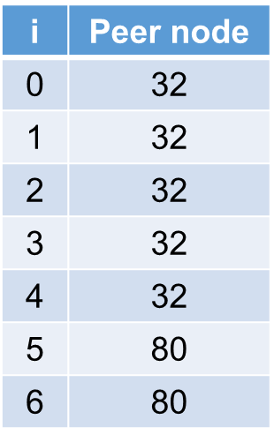
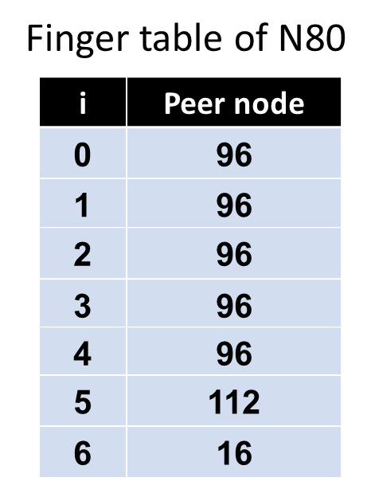


Search
At node n, send query for key k to largest successor/finger entry <= k
if none exist, send query to successor(n)
Say m=7
N112
N16
N96
N32
Who has cnn.com/index.html?
(hashes to K42)
N45
N80
N45
Stored at N45!

Slide 58
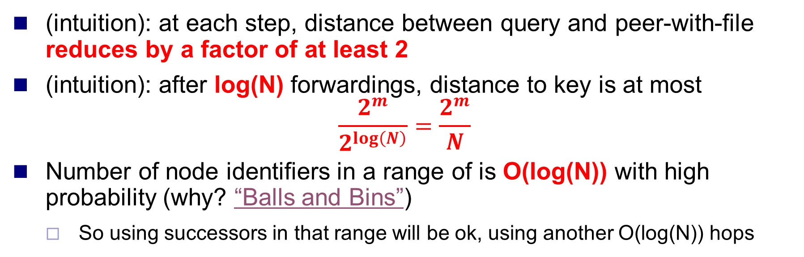
Analysis
Search takes O(log(N)) time
Here
Next hop
Key
(intuition): at each step, distance between query and peer-with-file reduces by a factor of at least 2
(intuition): after log(N) forwardings, distance to key is at most
$$\frac{2^{m}}{2^{\log\left(N\right)}}=\frac{2^{m}}{N}$$
Number of node identifiers in a range of is O(log(N)) with high probability (why? “Balls and Bins”)
So using successors in that range will be ok, using another O(log(N)) hops

Slide 59
Next…
O(log(N)) time true only if finger and successor entries correct
When might these entries be wrong?
When you have failures

Slide 60
Search under peer failures
Say m=7
N112
N16
N96
X
N32
Who has cnn.com/index.html?
(hashes to K42)
N45
N80
N45
Stored at N45!

Slide 61
Search under peer failures
One solution: maintain r multiple successor entries
In case of failure, use successor entries
Say m=7
N112
N16
N96
X
N32
Who has cnn.com/index.html?
(hashes to K42)
N45
N80
N45
Stored at N45!

Slide 62
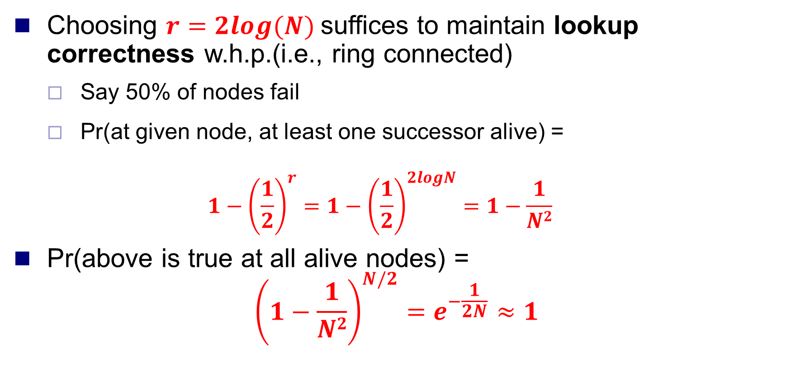
Analysis
Choosing $r=2log⁡(N)$suffices to maintain lookup correctness w.h.p.(i.e., ring connected)
Say 50% of nodes fail
Pr(at given node, at least one successor alive) =
$$1−{\left(\frac{1}{2}\right)}^{r}=1−{\left(\frac{1}{2}\right)}^{2logN}=1−\frac{1}{N2}$$
Pr(above is true at all alive nodes) =
$${\left(1−\frac{1}{N2}\right)}^{N/2}=e^{−\frac{1}{2N}}≈1$$

Slide 63
Search under peer failures (2)
One solution: replicate file/key at r successors and predecessors
Say m=7
N112
N16
N96
N32
N32
Who has cnn.com/index.html?
(hashes to K42)
X
N45
N80
N45
N80
Stored at N45!

Slide 64
Next…
Need to deal with dynamic changes
New peers join
Peers leave
P2P systems have a high rate of churn (node join, leave and failure)
25% per hour in Overnet (eDonkey)
100% per hour in Gnutella
Lower in managed clusters, but still common
So, all the time, need to:
Need to update successors and fingers, and copy keys

Slide 65
New peers joining
Introducer directs N40 to N45 (and N32)
N32 updates successor to N40
N40 initializes successor to N45, and inits fingers from it
N40 periodically talks to neighbors to update finger table
Stabilization Protocol
(followed by all nodes)
i | Peer node
N112
N16
0 | 45
Say m=7
1 | 45
2 | 45
N96
3 | 80
N32
4 | 80
5 | 80
N40
6 | 112
N80
N45

Slide 66
New peers joining (2)
N40 may need to copy some files/keys from N45
(files with file id between 32 and 40)
N112
N16
Say m=7
N96
Similar set of operations for dealing with peers leaving (For dealing with failures, also need failure detectors)
N32
N40
N80
N45
K34,K38

Slide 67
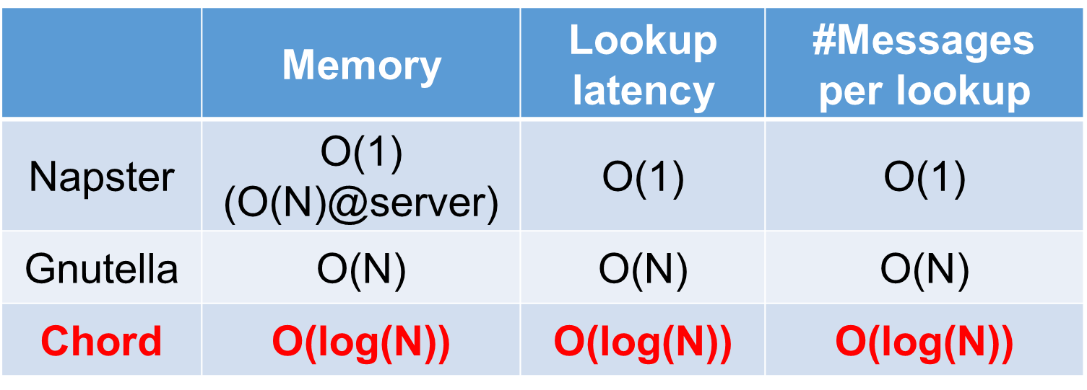
Chord Wrap-up Notes
Virtual Ring and Consistent Hashing used in Cassandra, Riak, Voldemort, DynamoDB, and other key-value stores
Current status of Chord project:
File systems (CFS,Ivy) built on top of Chord
DNS lookup service built on top of Chord
Internet Indirection Infrastructure (I3) project at UCB
Spawned research on many interesting issues about p2p systems
http://www.pdos.lcs.mit.edu/chord/

Slide 68
Chord Wrap-up Notes
Can we reduce the lookup latency to O(1)?
That’s Kelips!

Slide 69
Outline
Introduction to P2P systems
Unstructured P2P systems
Napster, Gnutella, FastTrack, BitTorrent
Structured P2P systems
Chord, Pastry, Kelips

Slide 70
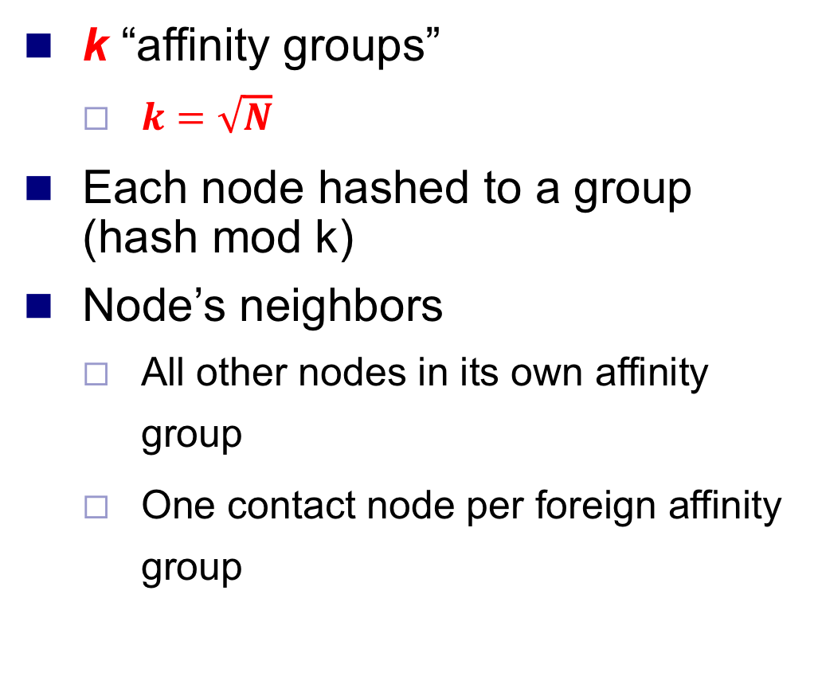
Kelips – A 1 hop Lookup DHT
k “affinity groups”
$k=\sqrt{N}$
Each node hashed to a group (hash mod k)
Node’s neighbors
All other nodes in its own affinity group
One contact node per foreign affinity group
15
76
18
160
129
167
30
…
# 1
Affinity
Group # 0
# k-1

Slide 71
Kelips Files and Metadata
PennyLane.mp3 hashes to k-1
Everyone in this group stores <PennyLane.mp3, who-has-file>
File can be stored at any node(s)
Decouple file replication/location from file querying
Each filename hashed to a group
All nodes in the group replicate pointer information, i.e., <filename, file location>
Spread using gossip
Affinity group does not store files
15
76
18
160
129
167
30
…
# 1
Affinity
Group # 0
# k-1

Slide 72
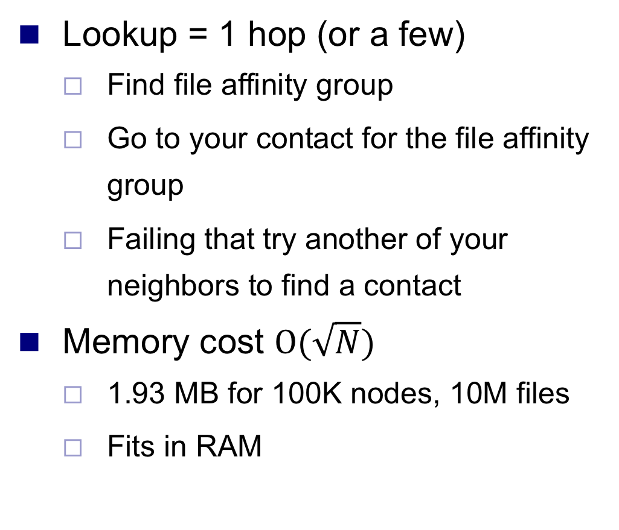
Kelips Lookup
Lookup = 1 hop (or a few)
Find file affinity group
Go to your contact for the file affinity group
Failing that try another of your neighbors to find a contact
Memory cost $O(\sqrt{N})$
1.93 MB for 100K nodes, 10M files
Fits in RAM
15
76
18
160
129
167
X
30
…
# 1
Affinity
Group # 0
# k-1

Slide 73
Kelips Soft State
Membership lists
Gossip-based membership
Within each affinity group
And also across affinity groups
O(log(N)) dissemination time
File metadata
Needs to be periodically refreshed from source node
Times out
15
76
18
160
129
167
30
…
# 1
Affinity
Group # 0
# k-1

Slide 74
What We Have Studied
Introduction to P2P systems
Unstructured P2P systems
Napster, Gnutella, FastTrack, BitTorrent
Structured P2P systems
Chord, Pastry, Kelips

Slide 75
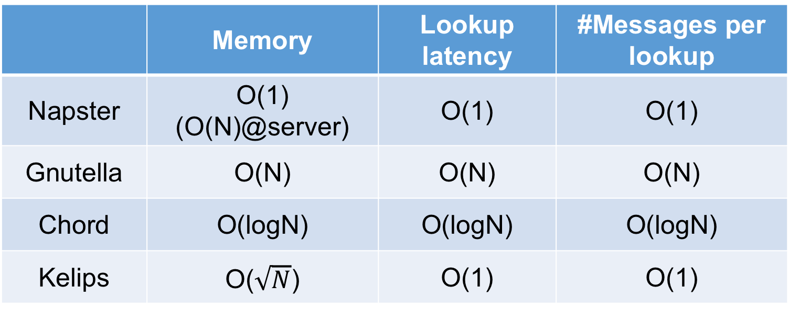
System design: All about tradeoff!
Range of tradeoffs available
Memory vs. lookup latency vs. lookup bandwidth
 | Memory | Lookup latency | #Messages per lookup
Napster | O(1) (O(N)@server) | O(1) | O(1)
Gnutella | O(N) | O(N) | O(N)
Chord | O(logN) | O(logN) | O(logN)
Kelips | O($\sqrt{N}$) | O(1) | O(1)

Slide 76
Thanks!
陈果 副教授
湖南大学-信息科学与工程学院-计算机与科学系
邮箱：guochen@hnu.edu.cn
个人主页：1989chenguo.github.io
https://1989chenguo.github.io/Courses/CloudComputing2018Spring.html

