Slide 1
云计算技术
陈果 副教授
湖南大学-信息科学与工程学院-计算机与科学系
邮箱：guochen@hnu.edu.cn
个人主页：1989chenguo.github.io
https://1989chenguo.github.io/Courses/CloudComputing2018Spring.html

Slide 2
What we have learned
What is cloud computing
Cloud Networking
Cloud Distributed System
Introduction to Cloud Distributed System
MapReduce
Gossip
Membership
P2P systems
Napster, Gnutella, FastTrack, BitTorrent
Chord, Kelips

Slide 3
Key-Value Store/NoSQL
Part #2: Cloud Distributed System
Most materials from UIUC MOOC
Thanks Indranil Gupta

Slide 4
Outline
Introduction to Key-Value Store/NoSQL
Cassandra
CAP theorem & Consistency spectrum
HBase

Slide 5
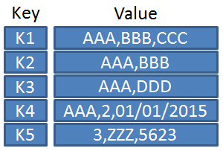
The Key-Value Abstraction
Key → Value
examples
(twitter.com) tweet id → information about tweet
(amazon.com) item number → information about it
(kayak.com) Flight number → information about flight, e.g., availability
(yourbank.com) Account number → information about it

Slide 6
The Key-Value Abstraction (2)
It’s a dictionary datastructure.
Insert, lookup, and delete by key
E.g., hash table, binary tree
But distributed.
Sound familiar? Remember Distributed Hash tables (DHT) in P2P systems?
It’s not surprising that key-value stores reuse many techniques from DHTs.

Slide 7
Isn’t that just a database?
Yes, sort of
Relational Database (RDB) has been around for ages
MySQL is the most popular among them
Data stored in tables
Schema-based, i.e., structured tables
Each row (data item) in a table has a primary key that is unique within that table
Queried using SQL (Structured Query Language)
Supports joins

Slide 8
Relational Database Example
Example SQL queries
SELECT zipcode
FROM users
WHERE name = “Bob”
2. SELECT url
FROM blog
WHERE id = 3
SELECT users.zipcode, blog.num_posts
FROM users JOIN blog
ON users.blog_url = blog.url
Primary keys
Foreign keys

Slide 9
Mismatch with today’s workloads
Data: Large and unstructured
Lots of random reads and writes
Sometimes write-heavy
Foreign keys rarely needed
Joins infrequent

Slide 10
Needs of Today’s Workloads
Speed
Avoid Single point of Failure (SPoF)
Low TCO (Total cost of operation)
Fewer system administrators
Incremental Scalability
Scale out, not up
What?

Slide 11
Scale out, not Scale up
Scale up = grow your cluster capacity by replacing with more powerful machines
Traditional approach
Not cost-effective, as you’re buying above the sweet spot on the price curve
And you need to replace machines often
Scale out = incrementally grow your cluster capacity by adding more COTS machines (Components Off the Shelf)
Cheaper
Over a long duration, phase in a few newer (faster) machines as you phase out a few older machines
Used by most companies who run datacenters and clouds today

Slide 12
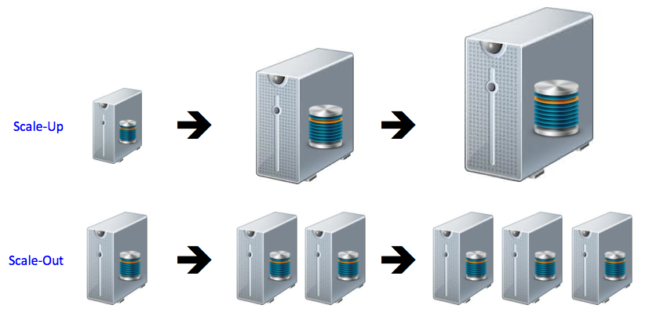
Scale out, not Scale up

Slide 13
Key-value/NoSQL Data Model
NoSQL = “Not Only SQL”
Necessary API operations: get(key) and put(key, value)
And some extended operations, e.g., “CQL” in Cassandra key-value store
Tables
“Column families” in Cassandra, “Table” in HBase, “Collection” in MongoDB
Like RDBMS tables, but …
May be unstructured: May not have schemas
Some columns may be missing from some rows
Don’t always support joins or have foreign keys
Can have index tables, just like RDBMSs

Slide 14
Key-value/NoSQL Data Model Example
Unstructured
Columns Missing from some Rows
No schema imposed
No foreign keys, joins may not be supported

Slide 15
Outline
Introduction to Key-Value Store/NoSQL
Cassandra
CAP theorem & Consistency spectrum
HBase

Slide 16

Cassandra
A distributed key-value store
Intended to run in a datacenter (and also across DCs)
Originally designed at Facebook
Open-sourced later, today an Apache project
Some of the companies that use Cassandra in their production clusters
IBM, Adobe, HP, eBay, Ericsson, Symantec
Twitter, Spotify
PBS Kids
Netflix: uses Cassandra to keep track of your current position in the video you’re watching

Slide 17
Inside Cassandra: Key → Server Mapping
How do you decide which server(s) a key-value resides on?
Cassandra uses a Ring-based DHT but without finger tables or routing
Key→server mapping is the “Partitioner”
One ring per DC
Say m=7
0
N112
N16
(Remember this?)
Primary replica for
key K13
N96
Read/write K13
N32
N80
N45
Client
Coordinator
Backup replicas for
key K13

Slide 18
Data Placement Strategies
Two Partitioner types
Random Partitioner: Chord-like hash partitioning

Slide 19
Data Placement Strategies
Two Partitioner types
Random Partitioner: Chord-like hash partitioning
Byte-Ordered Partitioner: Assigns ranges of keys to servers
Easier for range queries (e.g., Get me all twitter users starting with [a-b])
[u-z]
N112
N16
[a-d]
[q-t]
N96
[e-h]
N32
[m-p]
[i-l]
N80
N45

Slide 20
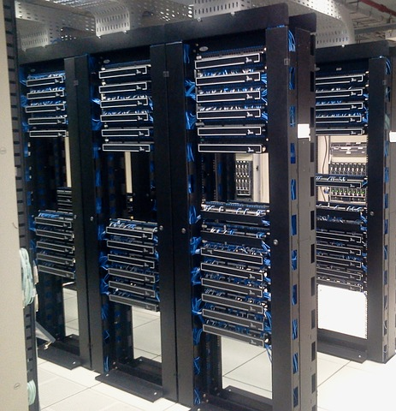
Data Placement Strategies
Two Partitioner types
Random Partitioner: Chord-like hash partitioning
Byte-Ordered Partitioner: Assigns ranges of keys to servers
Easier for range queries (e.g., Get me all twitter users starting with [a-b])
Replica strategy
Two/Three replicas per DC
Per DC
First replica placed according to Partitioner
Then go clockwise around ring until you hit a different rack

Slide 21
Writes Overview
Client sends write to one coordinator node
Coordinator may be per-key/per-client/per-query
Per-key Coordinator ensures writes for the key are serialized
Coordinator uses Partitioner to send query to all replica nodes
When X replicas respond, coordinator returns an acknowledgement to the client
X? We’ll see later.
0
N112
N16
N96
N32
write
N80
N45
Coordinator

Slide 22
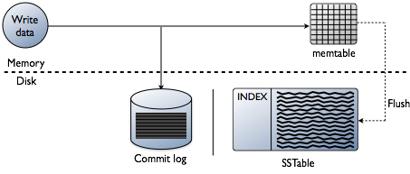
Writes at a replica node
On receiving a write
Log it in disk commit log
Make changes to appropriate memtables
When memtable is full or old, flush to disk
https://docs.datastax.com/en/cassandra/3.0/cassandra/dml/dmlHowDataWritten.html

Slide 23
Writes at a replica node: More details
For failure recovery

Slide 24
Writes at a replica node: More details
In-memory cache of multiple key-value pairs
Write-back cache

Slide 25
Writes at a replica node: More details
Data File: An SSTable (Sorted String Table) – list of key-value pairs, sorted by key
Index file: An SSTable of <key, position in data SSTable> pairs

Slide 26
Reads Overview
Coordinator contacts X replicas
Choose replicas that have responded quickest in past
Fetches the latest-timestamped value from among those X
Also fetches value from other replicas
Checks consistency in the background
Initiates a read repair if any two values are different
Eventually bring all replicas up to date
0
N112
N16
N96
N32
read
N80
N45
Coordinator

Slide 27

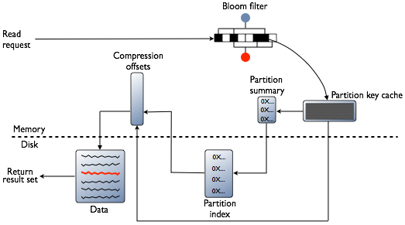
Reads at a replica node
Find in memtable
If not found, go to SSTable
Check bloom filter
Check key cache
Fetch from SSTable
https://docs.datastax.com/en/cassandra/3.0/cassandra/dml/dmlAboutReads.html

Slide 28
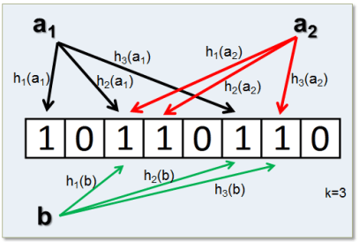
Reads at a replica node: Bloom filter
Compact way of representing a set of items
Checking for existence in set is cheap
A few false positives
Never false negatives
K has functions for one data
On insert, set all hashed bits
On check-if-present, return true if all hashed bits set
http://www.firatatagun.com/blog/2016/09/25/bloom-filters-explanation-use-cases-and-examples/

Slide 29
Data structure maintaining & updating
SSTables are immutable [For the speed!!!]
NEVER overwrite existing rows with inserts or updates
Insert or update data
Writes new timestamped versions of the inserted or updated data in new SSTables
Deletion
Doesn’t delete item right away. Adds a tombstone to the log
Compaction
Periodically merges SSTables and discards old data with tombstone

Slide 30
Cassandra Vs. RDBMS
MySQL is one of the most popular (and has been for a while)
On > 50 GB data
MySQL
Writes 300 ms avg
Reads 350 ms avg
Cassandra
Writes 0.12 ms avg
Reads 15 ms avg
Orders of magnitude faster!
What’s the catch? What did we lose?
http://cassandra.apache.org/download/

Slide 31
Outline
Introduction to Key-Value Store/NoSQL
Cassandra
CAP theorem & Consistency spectrum
HBase

Slide 32
CAP Theorem Background
Proposed by Eric Brewer (Berkeley)
Subsequently proved by Gilbert and Lynch (NUS and MIT)
Consistency: all nodes see same data at any time, or reads return latest written value by any client
Availability: the system allows operations all the time, and operations return quickly (no error or timeout)
Partition-tolerance: the system continues to work in spite of network partitions
The theorem about Consistency, Availability and Partition-tolerance

Slide 33
Why is Availability Important?
Availability = Reads/writes complete reliably and quickly.
Measurements have shown that a 500 ms increase in latency for operations at Amazon.com or at Google.com can cause a 20% drop in revenue.
At Amazon, each added millisecond of latency implies a $6M yearly loss.
SLAs (Service Level Agreements) is the key of the contract with users

Slide 34
Why is Consistency Important?
Consistency = all nodes see same data at any time, or reads return latest written value by any client.
When you access your bank or investment account via multiple clients (laptop, workstation, phone, tablet), you want the updates done from one client to be visible to other clients.
When thousands of customers are looking to book a flight, all updates from any client (e.g., book a flight) should be accessible by other clients.

Slide 35
Why is Partition-Tolerance Important?
Partition-tolerance = the system continues to work in spite of network partitions.
Partition is norm rather than exception in large distributed systems
Partitions across datacenters
Internet router outages
Under-sea cables cut
DNS not working
Partitions within a datacenter
Switch failure
Rack power outage

Slide 36
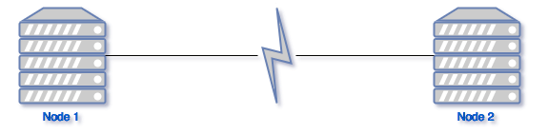
What’s CAP Theorem?
Only can choose one between consistency and availability when network partition or failure happens
Availability
V.S.
Consistency
Keeping partition-tolerance

Slide 37
How current systems choose?
Cassandra, Riak,
Dynamo, Voldemort
HBase, HyperTable,
BigTable, Spanner
Availability
V.S.
Consistency
AP
CP
Keeping partition-tolerance
Traditional RDBMSs
Strong consistency & availability under a partition

Slide 38
So, do AP systems totally give up Consistency?
No! Use some weaker consistency model
Cassandra chooses Eventual Consistency
If all writes stop (to a key), then all its values (replicas) will converge eventually.
If writes continue, then system always tries to keep converging.
Moving “wave” of updated values lagging behind the latest values sent by clients, but always trying to catch up.
May still return stale values to clients (e.g., if many back-to-back writes).
But works well when there a few periods of low writes – system converges quickly.

Slide 39
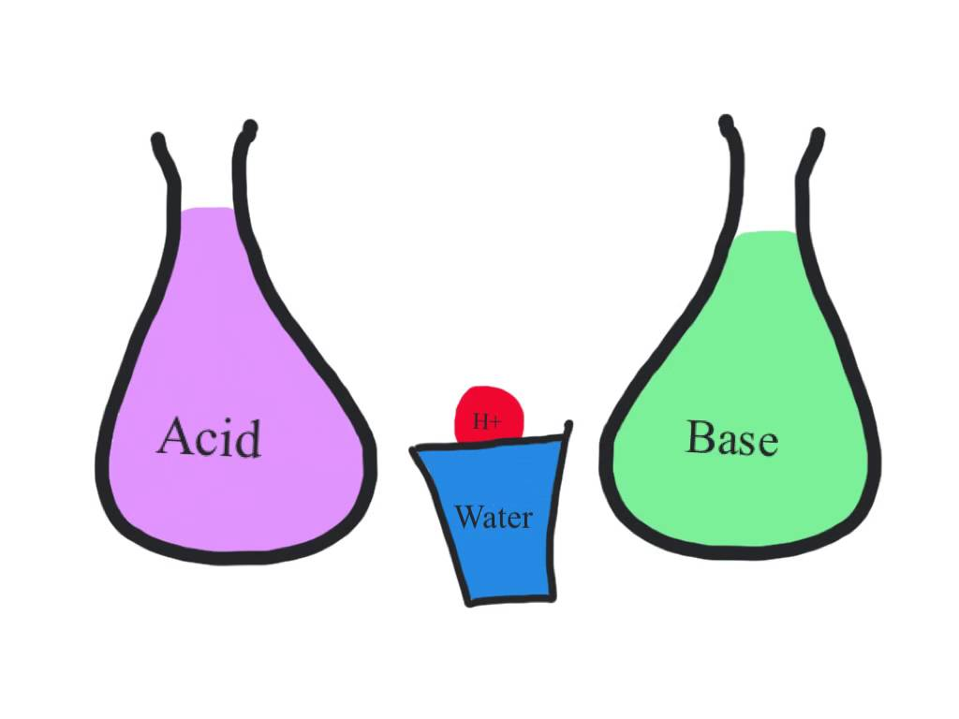
Consistency model: RDBMS vs. Key-value stores
RDBMS provide ACID
Atomicity
All operations in a transaction succeed or every operation is rolled back
Consistency
On the completion of a transaction, the database is structurally sound
Isolation
Transactions do not contend with one another
Durability
The results of applying a transaction are permanent, even in the presence of failures
Key-value stores provide BASE
Basically Available Soft-state Eventual Consistency
Basic Availability
Reads/writes complete reliably and quickly
Soft-state
Don’t have to be write-consistent, nor do different replicas have to be mutually consistent all the time.
Eventual consistency
Consistent at some later point

Slide 40
Back to Cassandra: Mystery of X
Write
When X replicas respond, coordinator returns an acknowledgement to the client
Read
Contacts X replicas
0
N112
N16
N96
N32
Write/Read
N80
N45
How to choose X to satisfy consistency and availability?
Coordinator

Slide 41
Consistency levels of Cassandra
Client is allowed to choose a consistency level for each operation (read/write)
ALL: all replicas
Ensures strong consistency, but slowest
ONE: at least one replica
Faster than ALL, but cannot tolerate a failure
QUORUM: quorum across all replicas in all datacenters (DCs)
What?

Slide 42
Quorums?
Quorum = majority
> 50%
Any two quorums intersect
Client 1 does a write in blue quorum
Then client 2 does read in red quorum
At least one server in blue quorum returns latest write
Quorums faster than ALL, but still ensure strong consistency
A second
quorum
A quorum
Server with latest value
Five replicas of a key-value pair
Several key-value/NoSQL stores (e.g., Riak and Cassandra) use quorums

Slide 43
Quorums in Detail
Reads
Client specifies value of R (≤ N = total number of replicas of that key).
R = read consistency level.
Coordinator waits for R replicas to respond before sending result to client.
In background, coordinator checks for consistency of remaining (N-R) replicas, and initiates read repair if needed.
Writes
Client specifies W (≤ N)
W = write consistency level.
Client writes new value to W replicas and returns. Two flavors:
Coordinator blocks until quorum is reached.
Asynchronous: Just write and return.

Slide 44
Quorums in Detail (Contd.)
R = read replica count, W = write replica count
Two necessary conditions:
W+R > N
W > N/2
Select values based on application
(W=N, R=1): good for read-heavy workloads
(W=N/2+1, R=N/2+1): good for write-read-equal workloads
Reads return the latest Write
Two conflict Writes, at least one server gets the latest Write

Slide 45
Types of Consistency
Cassandra offers Eventual Consistency
Are there other types of weak consistency models?

Slide 46

Consistency Spectrum
Faster reads and writes
More consistency
Strong
(e.g., Sequential)
Eventual
Strong consistency models
Strict consistency, sequential consistency
Weaker consistency models
Causal consistency, eventual consistency
Slide acks: Jinyang Li, Roxana Geambasu

Slide 47
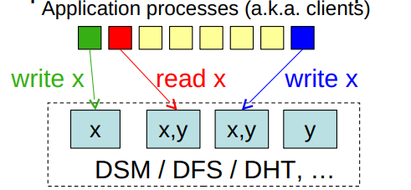
Consistency
What is consistency?
What processes can expect when RD/WR shared data concurrently
When do consistency concerns arise?
With replication and caching
Why are replication and caching needed?
For performance, scalability, fault tolerance, disconnection
Let’s focus on replication – here’s an example:
What are the results of those reads and writes?

Slide 48
Consistency Model
What is a consistency model?
Contract between a distributed data system (e.g., DFS, DSM) and processes constituting its applications
E.g.: “If a process reads a certain piece of data, I (the DFS/DSM) pledge to return the value of the last write”
What are some consistency models?
Strict consistency
Sequential consistency
Causal consistency
Eventual consistency
- Less intuitive, harder to program
- More feasible, scalable, efficient

Slide 49
Consistency challenges
No right or wrong consistency models
Tradeoff between ease of programmability and efficiency
E.g. what’s the consistency model for web pages?
Consistency is hard in (distributed) systems:
Data replication (caching)
Concurrency
Failures

Slide 50
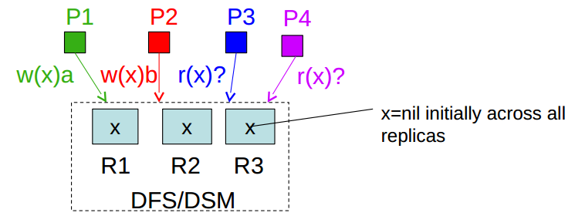
Example
Consistency model defines what values reads are admissible by the DFS/DSM
Wall-clock time
Time at which client process issues operation
P1:
w(x)a
P2:
w(x)b
P3:
r(x)?
r(x)?
May differ from the time at which the op request gets to relevant replica!
P4:
r(x)?
r(x)?

Slide 51
Strict Consistency
Any execution is the same as if all read/write ops were executed in order of wall-clock time at which they were issued
Therefore:
Reads are never stale
All replicas enforce wall-clock ordering for all writes
If strictly consistent, what can these reads return?
Wall-clock time
P1:
w(x)a
P2:
w(x)b
P3:
r(x)?
r(x)?
P4:
r(x)?
r(x)?

Slide 52

Strict Consistency
Any execution is the same as if all read/write ops were executed in order of wall-clock time at which they were issued
Therefore:
Reads are never stale
All replicas enforce wall-clock ordering for all writes
If strictly consistent, what can these reads return?
Wall-clock time
Wall-clock time
X
P1:
w(x)a
P1:
w(x)a
P2:
w(x)b
P2:
w(x)b
P3:
r(x)b
r(x)b
P3:
r(x)a
r(x)b
P4:
r(x)b
r(x)b
P4:
r(x)b
r(x)b

Slide 53
Strict Consistency
Strict consistency is not practical
No global wall-clock available
Sequential consistency
Slightly weaker to strict consistency
Easier to implement

Slide 54
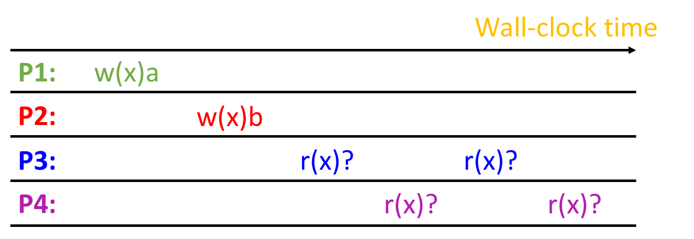
Sequential Consistency
Rules: There is a total order of operations s.t.
Each CPUs’ ops appear in order
All CPUs see results according to total order
If sequential consistent, what can these reads return?

Slide 55
Sequential Consistency
Rules: There is a total order of operations s.t.
Each CPUs’ ops appear in order
All CPUs see results according to total order
Wall-clock time
Wall-clock time
P1:
w(x)a
P1:
w(x)a
P2:
w(x)b
P2:
w(x)b
P3:
r(x)b
r(x)b
P3:
r(x)a
r(x)b
P4:
r(x)b
r(x)b
P4:
r(x)b
r(x)b
What’s a total order that can explain these results?
What’s a total order that can explain these results?
Wall-clock ordering
w(x)a, r(x)a, w(x)b, r(x)b, r(x)b, r(x)b
Also strictly consistent
Not strictly consistent, but sequential consistent

Slide 56
Sequential Consistency
Rules: There is a total order of operations s.t.
Each CPUs’ ops appear in order
All CPUs see results according to total order
Wall-clock time
Wall-clock time
X
X
P1:
w(x)a
P1:
w(x)a
w(x)c
P2:
w(x)b
P2:
w(x)b
P3:
r(x)b
r(x)a
P3:
r(x)c
r(x)a
P4:
r(x)a
r(x)b
P4:
r(x)a
r(x)b
No global ordering can explain these results…
No global ordering can explain these results…
X
X
X
w(x)a, r(x)a, w(x)b, r(x)b, r(x)b, r(x)a
w(x)c, r(x)c, w(x)a, r(x)a, …
X
w(x)b, r(x)b, w(x)a, r(x)a, r(x)a, r(x)b
Disobey P1’s ops order

Slide 57
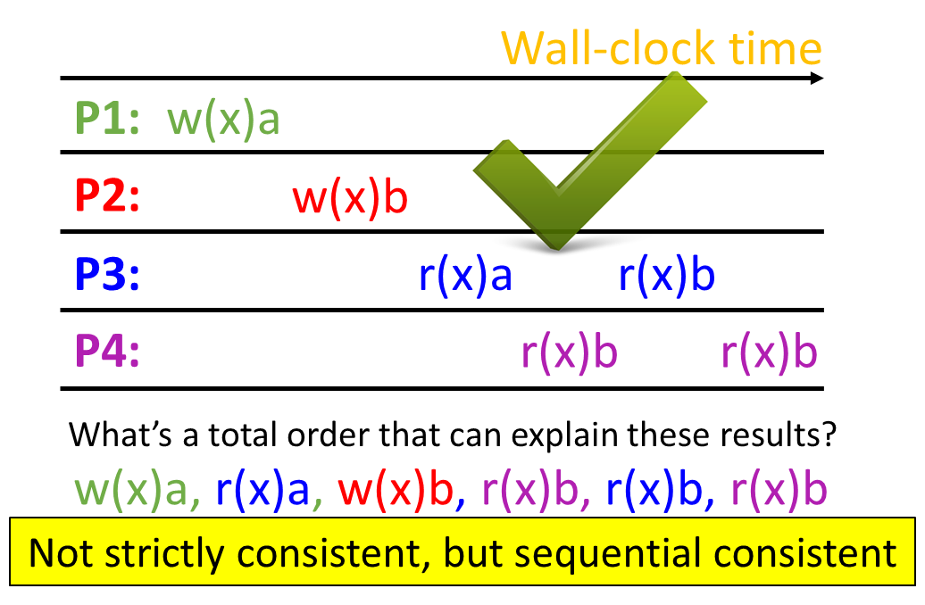
Sequential Consistency
Easier to implement
No global wall-clock time
Free to order concurrent events (not forced to order by op start time)
However, performance is still limited
Once a machine's write completes, other machines' reads must see new data
Thus communication cannot be omitted or much delayed
Thus either reads or writes (or both) will be expensive

Slide 58
Causal Consistency
Any execution is the same as if all causally-related read/write ops were executed in an order that reflects their causality
All causally-unrelated ops may be seen in different orders
In other words, all processes in the system agree on the order of the causally related operations
Therefore:
Reads are fresh only related to the writes that they are causally dependent on
Only causally-related writes are ordered by all replicas in the same way, but concurrent writes may be committed in different orders by different replicas, and hence read in different orders by different applications

Slide 59
Causal Consistency
Any execution is the same as if all causally-related read/write ops were executed in an order that reflects their causality
All causally-unrelated ops may be seen in different orders
Wall-clock time
Wall-clock time
X
P1:
w(x)a
P1:
w(x)a
w(x)c
P2:
w(x)b
P2:
w(x)b
P3:
r(x)b
r(x)a
P3:
r(x)c
r(x)a
P4:
r(x)a
r(x)b
P4:
r(x)a
r(x)b
Only per-process ordering (causality) restrictions:
Having read c (r(x)c), P3 must continue to read c or some newer value (perhaps b), but can’t go back to a, because w(x)c was conditional upon w(x)a having finished
Causality 1: w(x)b < r(x)b < r(x)a
Causality 2: w(x)a < r(x)a < r(x)b
w(x)b & w(x)a can be seen in different orders by different processes
Not sequentially consistent

Slide 60
Causal Consistency
Any execution is the same as if all causally-related read/write ops were executed in an order that reflects their causality
All causally-unrelated ops may be seen in different orders
Wall-clock time
Wall-clock time
X
P1:
w(x)a
P1:
w(x)a
P2:
w(x)b
P2:
r(x)a
w(x)b
P3:
r(x)b
r(x)a
P3:
r(x)b
r(x)a
P4:
r(x)a
r(x)b
P4:
r(x)a
r(x)b
Only per-process ordering (causality) restrictions:
w(x)b is causally-related on r(x)a, which is causally-related on w(x)a. Therefore, system must enforce w(x)a < w(x)b ordering. But P3 violates that ordering, because it reads a after reading b.
Causality 1: w(x)b < r(x)b < r(x)a
Causality 2: w(x)a < r(x)a < r(x)b
w(x)b & w(x)a can be seen in different orders by different processes
Not sequentially consistent

Slide 61
Why Causal Consistency?
Causal consistency is strictly weaker than sequential consistency and can give weird results, as you’ve seen
If system is sequentially consistent => it is also causally consistent
BUT: it also offers more possibilities for concurrency
Concurrent operations (which are not causally-dependent) can be executed in different orders by different people
In contrast, with sequential consistency, you need to enforce a global ordering of all operations
Hence, one can get better performance than sequential

Slide 62
Eventual Consistency
Allow stale reads, but ensure that reads will eventually reflect previously written values
Even after very long times
Doesn’t order concurrent writes as they are executed, which might create conflicts later: which write was first?
Used in Amazon’s Dynamo, Cassandra, and many key/value stores
Plus a lot of academic systems
Plus file synchronization

Slide 63
Why Eventual Consistency?
More concurrency opportunities than strict, sequential, or causal consistency
Sequential consistency requires highly available connections
Lots of chatter between clients/servers
Sequential consistency many be unsuitable for certain scenarios:
Disconnected clients (e.g. your laptop goes offline, but you still want to edit your shared document)
Network partitioning across datacenters
Apps might prefer potential inconsistency to loss of availability

Slide 64


Realizing Sequential Consistency
All reads/writes to address X must be ordered by one memory/storage module responsible for X
If you write data that others have, you must let them know
Thus, everyone must be online all the time
W(A)1
Invalidate, R(B)
W(B)3
Cache
or
replica
Cache
Or
replica
W(A)2

Slide 65
Why (Not) Eventual Consistency?
Support disconnected operations
Better to read a stale value than nothing
Better to save writes somewhere than nothing
Potentially anomalous application behavior
Stale reads and conflicting writes…

Slide 66
Sequential vs. Eventual Consistency
Sequential: pessimistic concurrency handling
Decide on update order as they are executed
Eventual: optimistic concurrency handling
Let updates happen, worry about deciding their order later
May raise conflicts
Think about when you code offline for a while – you may need to resolve conflicts with other team members when you commit
Resolving conflicts is not that difficult with code, but it’s really hard in general (e.g., think about resolving conflicts when you’ve updated an image)

Slide 67

Example Usage: File Synchronizer
One user, many devices, common files
Goal of file synchronization
All replica contents eventually become identical
No lost updates
Do not replace new version with old ones

Slide 68
Operating w/o total connectivity
Sync w/ server resolves
non-conflicting changes,
reports conflicting ones
to user
W(A)1
W(A)2
replica
replica
Client writes to its
local replica
No sync between clients

Slide 69
Pair-wise synchronization
Pair-wise sync resolves
non-conflicting changes,
reports conflicting ones
to users
W(B)3
replica
W(A)1
W(A)2
replica
replica

Slide 70
Prevent lost updates
Detect if updates were sequential
If so, replace old version with new one
If not, detect conflict

Slide 71
How to prevent lost updates?
W(f)a
W(f)b
H1
f
mtime: 15648
f
16679
W(f)c
f
12354
15648
23657
H2
Strawman: use mtime to decide which version should replace the other
Problem?
If clocks are unsynchronized: new data might have older timestamp than old data
Does not detect conflicts => may lose some contacts…

Slide 72
Strawman fix
W(f)a
W(f)b
H1
H1:15648
H1:15648
H1:16679
W(f)c
H2
H1:15648
H1:15648
H2:23657
Carry the entire modification history
If history X is a prefix of Y, Y is newer

Slide 73
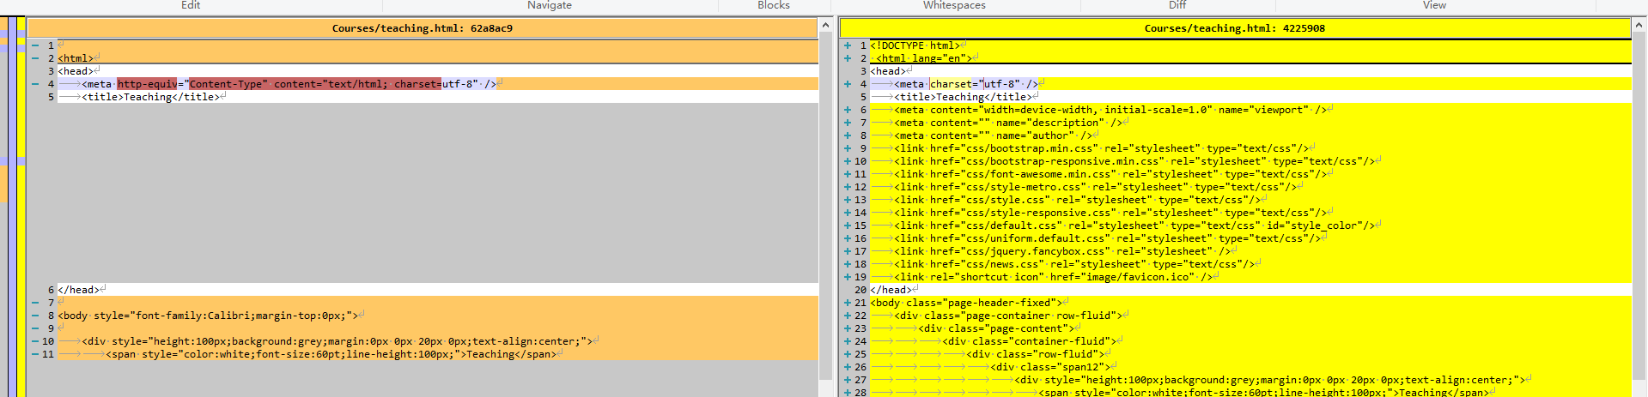
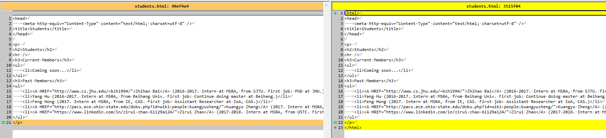
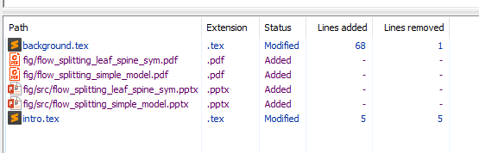
How to Deal w/ Conflicts?
X
W(f)a
W(f)b
H1
H1:15648
H1:15648
H1:16679
W(f)c
H2
H1:15648
H1:15648
H2:23657
Easy: mailboxes w/ two different set of messages
Medium: changes to different lines of a C source file
Hard: changes to same line of a C source file
After conflict resolution, add a new item to the history

Slide 74
So, What’s Used Where?
Strict consistency
Google’s just presented Spanner at OSDI ‘12 conference, which looks similar to strict consistency (they call it “external consistency”)
EXCITING: thus far thought of as impossible
Sequential consistency
A number of both academic and industrial systems provide (at least) sequential consistency (some a bit stronger – linearizability)
Examples: Yale’s IVY DSM, Microsoft’s Niobe DFS, Cornell’s chain replication, …
Causal consistency – not many
Eventual consistency
Very popular for a while both in industry and in academia
Examples: Cassandra, file synchronizers, Amazon’s Dynamo, Bayou

Slide 75
Outline
Introduction to Key-Value Store/NoSQL
Cassandra
CAP theorem & Consistency spectrum
HBase

Slide 76
HBase
History and current status
Google’s BigTable
Yahoo! Open-sourced it → HBase
Major Apache project today
Facebook uses HBase internally
API functions
Get/Put(row)
Scan(row range, filter) – range queries
MultiPut
Unlike Cassandra, HBase prefers consistency (over availability)

Slide 77
HBase Architecture
Hbase Table
Split it into multiple regions: replicated across servers
Small group of servers running
Zab, a consensus protocol (Paxos-like)
Client
HMaster
Zookeeper
HRegionServer
HRegionServer
HLog
Hregion
Store
Store
MemStore
MemStore
StoreFile
StoreFile
StoreFile
StoreFile
. . .
. . .
…
. . .
…
HFile
HFile
HFile
HFile
HDFS

Slide 78
HBase Architecture
Hbase Table
ColumnFamily
Split it into multiple regions: replicated across servers
subset of columns with similar query patterns
Client
HMaster
One Store per combination of ColumnFamily + region
Zookeeper
HRegionServer
HRegionServer
HLog
Memstore :in-memory updates to Store; flushed to disk when full
Hregion
Store
Store
MemStore
MemStore
StoreFile
StoreFile
StoreFile
StoreFile
. . .
. . .
…
. . .
…
HFile
HFile
HFile
HFile
HFile: where the data lives
HDFS

Slide 79
Strong Consistency: HBase Write-Ahead Log
Store
Client
HRegion
2. (k1)
MemStore
StoreFile
StoreFile
(k1, k2)
…
(k1, k2, k3, k4)
.
.
.
HFile
HFile
Log replay
After recovery from failure, or upon bootup
Replay any stale logs
Replay: add edits to the MemStore
(k3, k4)
.
.
.
HRegionServer
Log flush
HRegion
1. (k1)
Store
MemStore
StoreFile
StoreFile
…
HFile
HFile
HLog
Write to HLog before writing to MemStore
Helps recover from failure by replaying Hlog.

Slide 80
Outline
Introduction to Key-Value Store/NoSQL
Cassandra
CAP theorem & Consistency spectrum
HBase

Slide 81
Summary
Requirement of modern database
Traditional Databases (RDBMSs) work with strong consistency, and offer ACID
Modern workloads don’t need such strong guarantees, but do need fast response times (availability)
CAP theorem and consistency models
Key-value/NoSQL systems offer BASE
Tradeoff consistency for availability
We discussed design of
Cassandra
Hbase

Slide 82
Thanks!
陈果 副教授
湖南大学-信息科学与工程学院-计算机与科学系
邮箱：guochen@hnu.edu.cn
个人主页：1989chenguo.github.io
https://1989chenguo.github.io/Courses/CloudComputing2018Spring.html

