Slide 1
云计算技术
陈果 副教授
湖南大学-信息科学与工程学院-计算机与科学系
邮箱：guochen@hnu.edu.cn
个人主页：1989chenguo.github.io
https://1989chenguo.github.io/Courses/CloudComputing2018Spring.html

Slide 2
What we have learned
What is cloud computing
Cloud Networking
Cloud Distributed System
Introduction to Cloud Distributed System
MapReduce
Gossip
Membership
P2P systems
Key-value Stores
Basics
Cassandra
CAP theorem & Consistency models
HBase

Slide 3
Time and Ordering
Part #2: Cloud Distributed System
Most materials from UIUC MOOC
Thanks Indranil Gupta

Slide 4
Outline
Introduction and basics
Cristian’s algorithm
NTP
Lamport timestamp
Vector clocks

Slide 5

Why Synchronization?
You want to catch a bus at 6.05 pm, but your watch is off by 15 minutes
What if your watch is Late by 15 minutes?
You’ll miss the bus!
What if your watch is Fast by 15 minutes?
You’ll end up unfairly waiting for a longer time than you intended
Time synchronization is required for both
Correctness
Fairness

Slide 6

Synchronization In The Cloud
Distributed database for flight ticket reservation
Assuming only 1 ticket left
Server A receives a client request at local clock 9h:15m:32.45s
Server B receives a client request at local clock 9h:10m:10.11s
If clock not synchronized, then who should get the ticket?

Slide 7
Why is it Challenging?
End hosts in distributed systems
Each have their own clocks
Processes in distributed systems follow an asynchronous system model
No bounds on
Message delays
Processing delays
Unlike synchronous system model

Slide 8
Some Definitions
An Asynchronous Distributed System consists of a number of processes.
Each process has a state (values of variables).
Each process takes actions to change its state, which may be an instruction or a communication action (send, receive).
An event is the occurrence of an action.
Each process has a local clock – events within a process can be assigned timestamps, and thus ordered linearly.
But – in a distributed system, we also need to know the time order of events across different processes.

Slide 9
Clock Skew vs. Clock Drift
Each process (running at some end host) has its own clock.
When comparing two clocks at two processes:
Clock Skew = Relative Difference in clock values of two processes
Like distance between two vehicles on a road
Clock Drift = Relative Difference in clock frequencies (rates) of two processes
Like difference in speeds of two vehicles on the road
A non-zero clock skew implies clocks are not synchronized.
A non-zero clock drift causes skew to increase (eventually).
If faster vehicle is ahead, it will drift away
If faster vehicle is behind, it will catch up and then drift away

Slide 10
How often to Synchronize?
Maximum Drift Rate (MDR) of a clock
Absolute MDR is defined relative to Coordinated Universal Time (UTC). UTC is the “correct” time at any point of time.
MDR of a process depends on the environment.
Max drift rate between two clocks with similar MDR is 2 * MDR
Given a maximum acceptable skew M between any pair of clocks, need to synchronize
at least once every M / (2 * MDR) time units
Since time = distance/speed

Slide 11
External vs Internal Synchronization
Consider a group of processes
External Synchronization
Each process C(i)’s clock is within a bound D of a well-known clock S external to the group
|C(i) – S| < D at all times
External clock may be connected to UTC (Universal Coordinated Time) or an atomic clock
E.g., Cristian’s algorithm, NTP
Internal Synchronization
Every pair of processes in group have clocks within bound D
|C(i) – C(j)| < D at all times and for all processes i, j
E.g., Berkeley algorithm

Slide 12
External vs Internal Synchronization (2)
External Synchronization with D => Internal Synchronization with 2*D
Internal Synchronization does not imply External Synchronization
In fact, the entire system may drift away from the external clock S!

Slide 13
Next
Algorithms for Clock Synchronization

Slide 14
Outline
Introduction and basics
Cristian’s algorithm
NTP
Lamport timestamp
Vector clocks

Slide 15
Basics
External time synchronization
All processes P synchronize with a time server S
Set clock to t
Time
P
What’s the time?
Here’s the time t!
S
Check local clock to find time t

Slide 16
What’s Wrong
By the time response message is received at P, time has moved on
P’s time set to t is inaccurate!
Inaccuracy = a function of message latencies
Since latencies unbounded in an asynchronous system, the inaccuracy cannot be bounded
Set clock to t
Time
P
What’s the time?
Here’s the time t!
S
Check local clock to find time t

Slide 17
Cristian’s Algorithm
P measures the round-trip-time RTT of message exchange
Suppose we know the minimum P→S latency = min1
And the minimum S→P latency = min2
The actual time at P when it receives response is between
[t+min2, t+RTT-min1]
RTT
Set clock to t
Time
P
What’s the time?
Here’s the time t!
S
Check local clock to find time t

Slide 18
Cristian’s Algorithm Final
The actual time at P when it receives response is between [t+min2, t+RTT-min1]
P sets its time to halfway through this interval
To: t + (RTT+min2-min1)/2
Error is at most (RTT+min2-min1)/2
Bounded!
If error is too high, take multiple readings and average them
RTT
Set clock to t
Time
P
What’s the time?
Here’s the time t!
S
Check local clock to find time t

Slide 19
Outline
Introduction and basics
Cristian’s algorithm
NTP
Lamport timestamp
Vector clocks

Slide 20
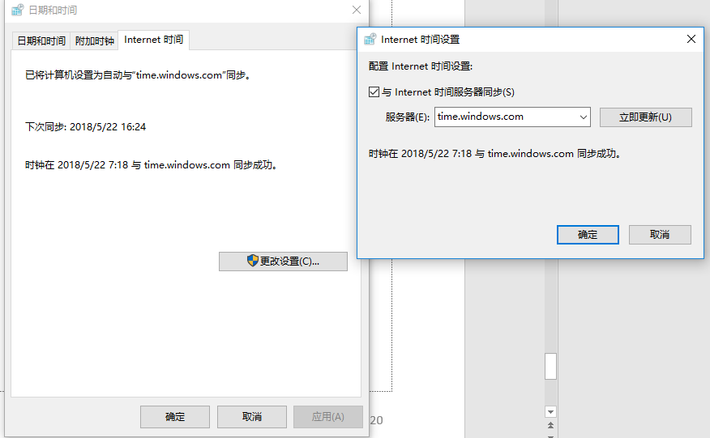
NTP
NTP = Network Time Protocol
Used everywhere

Slide 21
NTP Details
NTP Servers organized in a tree
Each Client = a leaf of tree
Each node synchronizes with its tree parent
Primary servers
Secondary servers
Tertiary servers
Client

Slide 22
NTP Protocol
Child calculates offset between its clock and parent’s clock
Offset is calculated as
o = (tr1 – tr2 + ts2 – ts1)/2
Message 1 recv time tr1
Message 2 send time ts2
Time
Child
Let’s start protocol
Message 2
ts1, tr2
Message 1
Parent
Message 2 recv time tr2
Message 1 send time ts1

Slide 23
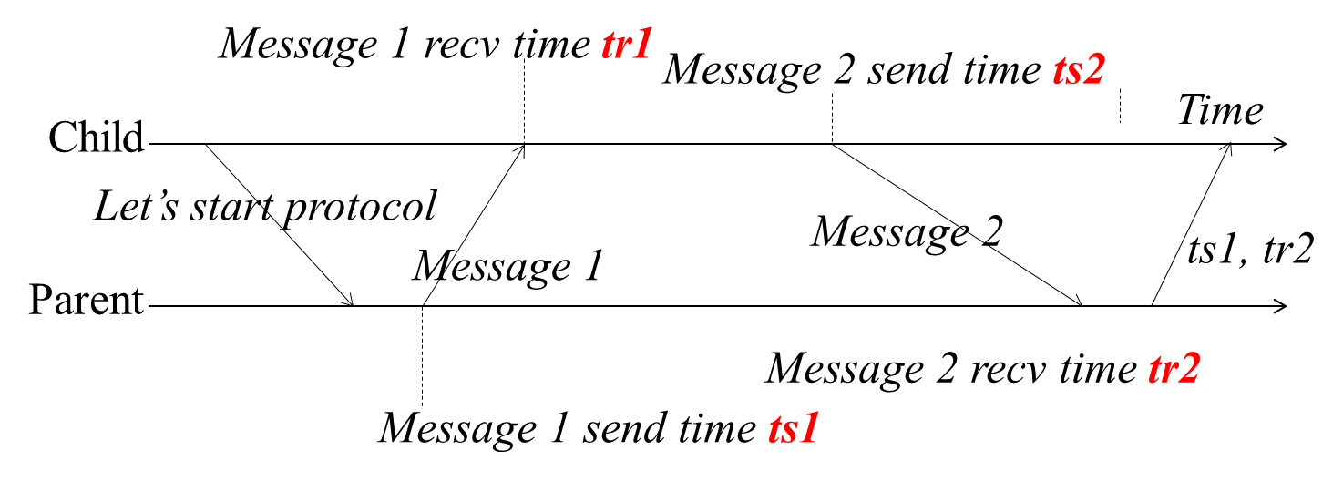
Why o = (tr1 - tr2 + ts2 - ts1)/2?
Suppose real offset is oreal
Child is ahead of parent by oreal
Parent is ahead of child by -oreal
Suppose one-way latency of Message 1 is L1 (L2 for Message 2)
tr1 = ts1 + L1 + oreal
tr2 = ts2 + L2 – oreal
Then
oreal = (tr1 – tr2 + ts2 – ts1)/2 + (L2 – L1)/2 = o + (L2 – L1)/2
=> |oreal – o| < |(L2 – L1)/2| < |(L2 + L1)/2| = |RTT/2|
Thus, the error is bounded by the round-trip-time

Slide 24
And yet…
We still have a non-zero error!
We just can’t seem to get rid of error
Can’t, as long as message latencies are non-zero
Can we avoid synchronizing clocks altogether, and still be able to order events?

Slide 25
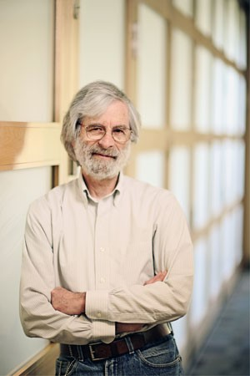
Outline
Introduction and basics
Cristian’s algorithm
NTP
Lamport timestamp
Vector clocks

Slide 26
Ordering Events in a Distributed System
To order events across processes, trying to sync clocks is one approach
What if we instead assigned timestamps to events that were not absolute time?
As long as these timestamps obey causality, that would work
If an event A causally happens before another event B, then timestamp(A) < timestamp(B)
Humans use causality all the time
E.g., I enter a house only after I unlock it
E.g., You receive a letter only after I send it

Slide 27
Logical (or Lamport) Ordering History
Proposed by Leslie Lamport in the 1970s
Used in almost all distributed systems since then
Almost all cloud computing systems use some form of logical ordering of events

Slide 28
Logical (or Lamport) Ordering
Define a logical relation Happens-Before among pairs of events
Happens-Before denoted as three rules
On the same process: if time(a) < time(b) (using the local clock), a → b
If p1 sends m to p2: send(m) → receive(m)
(Transitivity) If a → b and b → c, then a → c
Creates a partial order among events
Not all events related to each other via →

Slide 29
Example: Happens-Before
A B C D E
P1
Time
Instruction or step
F G H
Message
P2
I J K
P3
I → H
G → K
I → K
C → K
A → B
B → G
A → G

Slide 30
In practice: Lamport timestamps
Goal: Assign logical (Lamport) timestamp to each event
Timestamps obey causality
How to achieve that?
Each process uses a local counter (clock) which is an integer
initial value of counter is zero
A process increments its counter when a send or an instruction happens at it
The counter is assigned to the event as its timestamp.
A send (message) event carries its timestamp
For a receive (message) event the counter is updated by
max(local counter, message timestamp) + 1

Slide 31
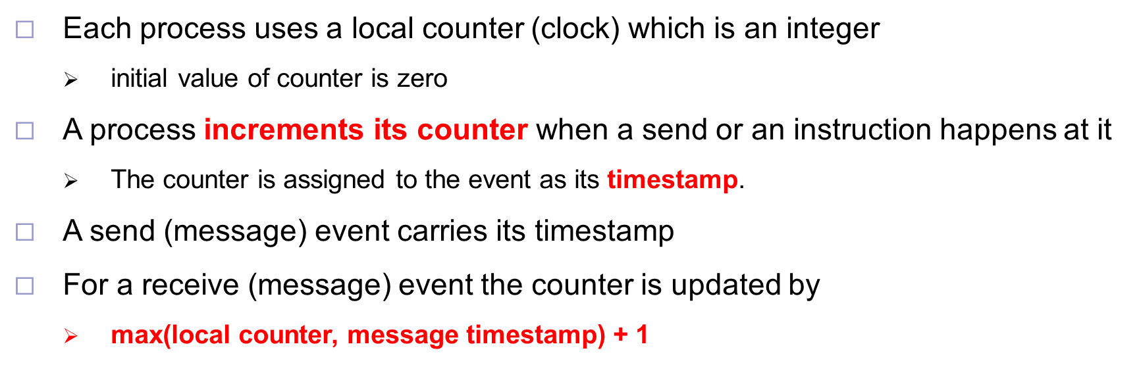
Example
0
0
0
A B C D E
P1
ts = 1
ts = max(local, msg) + 1
= max(0, 1)+1 = 2
Time
Instruction or step
F G H
Message
P2
Message carries
ts = 1
I J K
P3
ts = 1
Initial counters (timestamps)

Slide 32
Example
0
0
0
A B C D E
P1
1
2
Message carries
ts = 2
Time
Instruction or step
F G H
Message
P2
2
max(2, 2)+1=3
I J K
P3
1

Slide 33
Example
max(3, 4)+1=5
0
0
0
A B C D E
P1
1
2
3
Time
Instruction or step
F G H
Message
P2
4
2
3
I J K
P3
1

Slide 34
Example
0
0
0
A B C D E
P1
1
2
5
6
3
Time
Instruction or step
F G H
Message
P2
4
2
3
I J K
P3
1
7
Obeying Causality
But not always imply causality
I → H :: 1<4
G → K :: 3<7
I → K :: 1<7
C → K :: 3<7
A → B :: 1<2
B → G :: 2<3
A → G :: 1<3
? C → G ? :: 3=3
? I → C ? :: 1<3
(C,G) and (I,C) are pairs of concurrent events
E1 → E2 => timestamp(E1) < timestamp (E2), BUT timestamp(E1) < timestamp (E2) !=> E1 → E2

Slide 35
Lamport Timestamp Wrap-up
Order events without synchronizing times
Each process uses a local counter (clock) which is an integer
A process increments its counter when a send or an instruction happens at it
The counter is assigned to the event as its timestamp.
A send (message) event carries its timestamp
For a receive (message) event the counter is updated by
max(local counter, message timestamp) + 1
Timestamps obey causality
But does not imply causality, can be concurrent events

Slide 36
Next
Can we have causal or logical timestamps from which we can tell if two events are concurrent or causally related?

Slide 37
Outline
Introduction and basics
Cristian’s algorithm
NTP
Lamport timestamp
Vector clocks

Slide 38
Vector Timestamps
Used in key-value stores like Riak
Each process uses a vector of integer clocks
Suppose there are N processes in the group 1…N
Each vector has N elements
Process i maintains vector Vi[1…N]
jth element of vector clock at process i, Vi[j], is i’s knowledge of latest events at process j

Slide 39
Assigning Vector Timestamps
On an instruction or send event at process i, it increments only its ith element of its vector clock
Each message carries the send-event’s vector timestamp Vmessage[1…N]
On receiving a message at process i:
Vi[i] = Vi[i] + 1
Vi[j] = max(Vmessage[j], Vi[j]) for j ≠ i

Slide 40
Example
A B C D E
P1
Time
Instruction or step
F G H
Message
P2
I J K
P3
On an instruction or send event at process i, it increments only its ith element of its vector clock
Each message carries the send-event’s vector timestamp Vmessage[1…N]
On receiving a message at process i:
Vi[i] = Vi[i] + 1
Vi[j] = max(Vmessage[j], Vi[j]) for j ≠ i

Slide 41
Example
A B C D E
P1
(0,0,0)
(0,0,0)
(0,0,0)
Time
Instruction or step
F G H
Message
P2
I J K
P3
Initial counters (clocks)
On an instruction or send event at process i, it increments only its ith element of its vector clock
Each message carries the send-event’s vector timestamp Vmessage[1…N]
On receiving a message at process i:
Vi[i] = Vi[i] + 1
Vi[j] = max(Vmessage[j], Vi[j]) for j ≠ i

Slide 42
Example
A B C D E
P1
(0,0,0)
(0,0,0)
(0,0,0)
(1,0,0)
Time
Instruction or step
F G H
Message
P2
Message(0,0,1)
I J K
P3
(0,0,1)
On an instruction or send event at process i, it increments only its ith element of its vector clock
Each message carries the send-event’s vector timestamp Vmessage[1…N]
On receiving a message at process i:
Vi[i] = Vi[i] + 1
Vi[j] = max(Vmessage[j], Vi[j]) for j ≠ i

Slide 43
Example
A B C D E
P1
(0,0,0)
(0,0,0)
(0,0,0)
(1,0,0)
Time
Instruction or step
F G H
Message
P2
(0,1,1)
Message(0,0,1)
I J K
P3
(0,0,1)
On an instruction or send event at process i, it increments only its ith element of its vector clock
Each message carries the send-event’s vector timestamp Vmessage[1…N]
On receiving a message at process i:
Vi[i] = Vi[i] + 1
Vi[j] = max(Vmessage[j], Vi[j]) for j ≠ i

Slide 44
Example
A B C D E
P1
(0,0,0)
(0,0,0)
(0,0,0)
(1,0,0)
(2,0,0)
Message(2,0,0)
Time
Instruction or step
F G H
Message
P2
(0,1,1)
(2,2,1)
I J K
P3
(0,0,1)
On an instruction or send event at process i, it increments only its ith element of its vector clock
Each message carries the send-event’s vector timestamp Vmessage[1…N]
On receiving a message at process i:
Vi[i] = Vi[i] + 1
Vi[j] = max(Vmessage[j], Vi[j]) for j ≠ i

Slide 45
Example
A B C D E
P1
(0,0,0)
(0,0,0)
(0,0,0)
(1,0,0)
(2,0,0)
(3,0,0)
(4,3,1)
(5,3,1)
Time
Instruction or step
F G H
Message
P2
(0,1,1)
(2,2,1)
(2,3,1)
I J K
P3
(0,0,1)
(0,0,2)
(5,3,3)
On an instruction or send event at process i, it increments only its ith element of its vector clock
Each message carries the send-event’s vector timestamp Vmessage[1…N]
On receiving a message at process i:
Vi[i] = Vi[i] + 1
Vi[j] = max(Vmessage[j], Vi[j]) for j ≠ i

Slide 46
Causally-Related …
VT1 = VT2,
iff (if and only if), VT1[i] = VT2[i], for all i = 1, … , N
VT1 ≤ VT2,
iff VT1[i] ≤ VT2[i], for all i = 1, … , N
Two events are causally related iff
VT1 < VT2,
i.e., iff VT1 ≤ VT2 & there exists j such that 1 ≤ j ≤ N & VT1[j] < VT2 [j]

Slide 47
… or Not Causally-Related
Two events VT1 and VT2 are concurrent
Iff NOT (VT1 ≤ VT2) AND NOT (VT2 ≤ VT1)
We’ll denote this as VT2 ||| VT1

Slide 48
Obeying Causality
A B C D E
P1
(0,0,0)
(0,0,0)
(0,0,0)
(1,0,0)
(2,0,0)
(3,0,0)
(4,3,1)
(5,3,1)
Time
Instruction or step
F G H
Message
P2
(0,1,1)
(2,2,1)
(2,3,1)
I J K
P3
(0,0,1)
(0,0,2)
(5,3,3)
I → H :: (0,0,1) < (2,3,1)
G → K :: (2,2,1) < (5,3,3)
I → K :: (0,0,1) < (5,3,3)
C → K :: (3,0,0) < (5,3,3)
A → B :: (1,0,0)<(2,0,0)
B → G :: (2,0,0) < (2,2,1)
A → G :: (1,0,0) < (2,2,1)

Slide 49
Identifying Concurrent Events
A B C D E
P1
(0,0,0)
(0,0,0)
(0,0,0)
(1,0,0)
(2,0,0)
(3,0,0)
(4,3,1)
(5,3,1)
Time
Instruction or step
F G H
Message
P2
(0,1,1)
(2,2,1)
(2,3,1)
I J K
P3
(0,0,1)
(0,0,2)
(5,3,3)
C & G :: (3,0,0) ||| (2,2,1)
I & C :: (0,0,1) ||| (3,0,0)
(C, G) and (I, C) are pairs of concurrent events

Slide 50
Outline
Introduction and basics
Cristian’s algorithm
NTP
Lamport timestamp
Vector clocks

Slide 51
Logical Timestamps: Summary
Lamport timestamps
Integer clocks assigned to events
Obeys causality
Cannot distinguish concurrent events
Vector timestamps
Obey causality
By using more space, can also identify concurrent events

Slide 52
Time and Ordering: Summary
Clocks are unsynchronized in an asynchronous distributed system
But need to order events, across processes!
Time synchronization
Cristian’s algorithm
NTP
But error a function of round-trip-time
Can avoid time sync altogether by instead assigning logical timestamps to events
Lamport timestamps
Vector timestamps

Slide 53
Thanks!
陈果 副教授
湖南大学-信息科学与工程学院-计算机与科学系
邮箱：guochen@hnu.edu.cn
个人主页：1989chenguo.github.io
https://1989chenguo.github.io/Courses/CloudComputing2018Spring.html

