Slide 1
云计算技术
陈果 副教授
湖南大学-信息科学与工程学院-计算机与科学系
邮箱：guochen@hnu.edu.cn
个人主页：1989chenguo.github.io
https://1989chenguo.github.io/Courses/CloudComputing2018Spring.html

Slide 2
What we have learned
What is cloud computing
Cloud Networking
Physical Structure
Applications and network traffic
Host networking virtualization
Addressing & Routing
Software-Defined Networking Architecture
Decouple data plane and control plane
Killer apps
Cloud virtualization

Slide 3
SDN Case Study: VL2
Part I: Cloud networking
Most materials from MIT Courses
Credits to
Mohammad Alizadeh
MIT

Slide 4
Goal
Agility – Any service, Any Server
Location independent addressing
Tenant’s IP addresses can be taken anywhere
Performance uniformity
VMs receive same throughput regardless of placement
Security
Micro-segmentation: isolation at tenant granularity
Network semantics
Layer 2 service discovery, multicast, broadcast, …

Slide 5
Conventional DC Network Problems

Slide 6
Conventional DC Network
Internet
— L2 pros, cons?
— L3 pros, cons?
CR
CR
DC-Layer 3
. . .
AR
AR
AR
AR
DC-Layer 2
S
S
Key
CR = Core Router (L3)
AR = Access Router (L3)
S = Ethernet Switch (L2)
A = Rack of app. servers
S
S
S
S
. . .
A
A
…
A
A
A
…
A
~ 1,000 servers/pod == IP subnet
Reference – “Data Center: Load balancing Data Center Services”, Cisco 2004
Notes:
Ethernet switching (layer 2)
Fixed IP addresses and auto-configuration (plug & play)
Seamless mobility, migration, and failover
Broadcast limits scale (ARP)
Spanning Tree Protocol
IP routing (layer 3)
Scalability through hierarchical addressing
Multipath routing through equal-cost multipath
Can’t migrate w/o changing IP address
Complex configuration

Slide 7
Conventional DC Network Problems
CR
CR
~ 200:1
AR
AR
AR
AR
S
S
S
S
~ 40:1
S
S
S
S
. . .
S
S
S
S
~ 5:1
A
A
…
A
A
A
…
A
A
A
…
A
A
A
…
A
Dependence on high-cost proprietary routers
Extremely limited server-to-server capacity

Slide 8
Conventional DC Network Problems
CR
CR
~ 200:1
AR
AR
AR
AR
S
S
S
S
S
S
S
S
S
S
S
S
A
…
A
A
…
A
A
A
…
A
A
A
…
A
A
A
A
IP subnet (VLAN) #1
IP subnet (VLAN) #2
Dependence on high-cost proprietary routers
Extremely limited server-to-server capacity
Resource fragmentation

Slide 9
And More Problems …
CR
CR
~ 200:1
AR
AR
AR
AR
Complicated manual L2/L3 re-configuration
S
S
S
S
S
S
S
S
S
S
S
S
A
…
A
A
…
A
A
A
…
A
A
A
…
A
A
A
A
IP subnet (VLAN) #1
IP subnet (VLAN) #2
Poor reliability
Lack of performance isolation

Slide 10
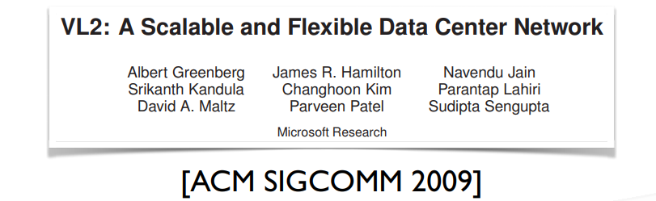
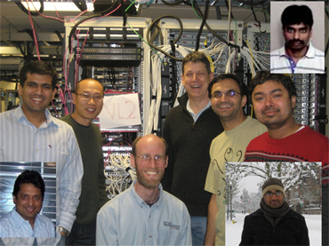
VL2 Paper
VL2 Design
Clos topology
Valiant LB
Name/location separation (precursor to network virtualization)
http://research.microsoft.com/en-US/news/features/datacenternetworking-081909.aspx

Slide 11
VL2 Goals
The Illusion of a Huge L2 Switch
1. L2 semantics
2. Uniform high capacity
3. Performance isolation
A
A
A
…
A
A
…
A
A
A
A
A
A
A
A
A
A
A
A
A
A
A
A
A
…
A
A
…
A
A
A
A
A
A
A
A
A
A
A
A
A

Slide 12
Clos Topology
Offer huge capacity via multiple paths (scale out, not up)
VL2
Int
. . .
Aggr
. . .
. . .
. . . . . .
TOR
. . .
. . . . . . . .
20 Servers

Slide 13
VL2 Design Principles
Randomizing to Cope with Volatility
Tremendous variability in traffic matrices
Separating Names from Locations
Any server, any service
Embracing End Systems
Leverage the programmability & resources of servers
Avoid changes to switches
Building on Proven Networking Technology
Build with parts shipping today
Leverage low cost, powerful merchant silicon ASICs

Slide 14
VL2 Goals and Solutions
Objective
Approach
Solution
1. Layer-2 semantics
Employ flat addressing
Name-location separation & resolution service
2. Uniform high capacity between servers
Guarantee bandwidth for hose-model traffic
Flow-based random traffic indirection (Valiant LB)
3. Performance Isolation
Enforce hose model using existing mechanisms only
TCP

Slide 15
Addressing and Routing: Name-Location Separation
VL2
Switches run link-state routing and maintain only switch-level topology
Directory Service
Allows to use low cost switches
Protects network from host-state churn
Obviates host and switch reconfiguration
…
x → ToR₂
y → ToR₃
z → ToR₄
…
…
x → ToR₂
y → ToR₃
z → ToR₃
…
ToR₁
. . .
ToR₂
. . .
ToR₃
. . .
ToR₄
ToR₃
y
payload
Lookup &
Response
y, z
ToR₄
x
y
z
ToR₃
z
z
payload
payload
Servers use flat names

Slide 16
VL2 Agent in Action
H(ft)
Int LA
src IP
dst IP
src IP
dst IP
H(ft)
dstToR LA
Int
(10.1.1.1)
src AA
dst AA
payload
(10.0.0.4)
ToR
(20.0.0.1)
(10.0.0.6)
ToR
(20.0.0.1)
VLB
ECMP
VL2 Agent
Why use hash for Src IP?
Why anycast & double encap?
Notes:
Why hash?
Why double encap?

Slide 17
Other details
How does L2 broadcast work?
How does Internet communication work?
Notes:
Broadcast?
-- no ARP (directory system handles it)
-- DHCP: intercepted at ToR using conventional DHCP relay agents and unicast forwarded to DHCP servers.
-- IP multicast per service, rate-limited
Internet?
-- L3 routing fabric for network, so external traffic does not need headers rewritten.
-- servers: have LA AND AA. LA is externally reachable and announced via BGP
-- Internet ←> Intermediate Switches <→ Server with LA

Slide 18
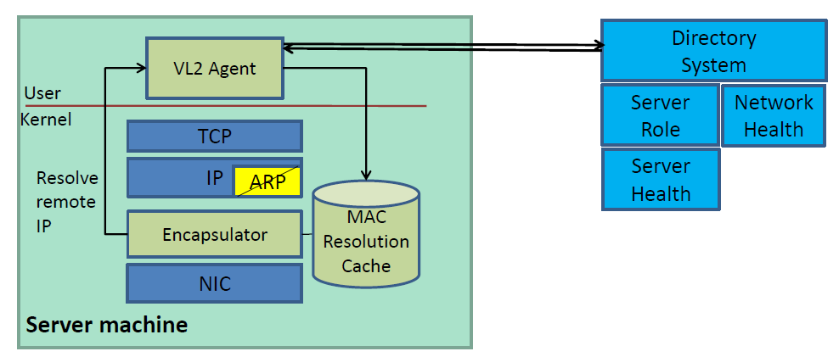
Embracing End Systems
Data center Oses already heavily modified for VMs, storage clouds, etc.
No change to apps or clients outside DC.

Slide 19
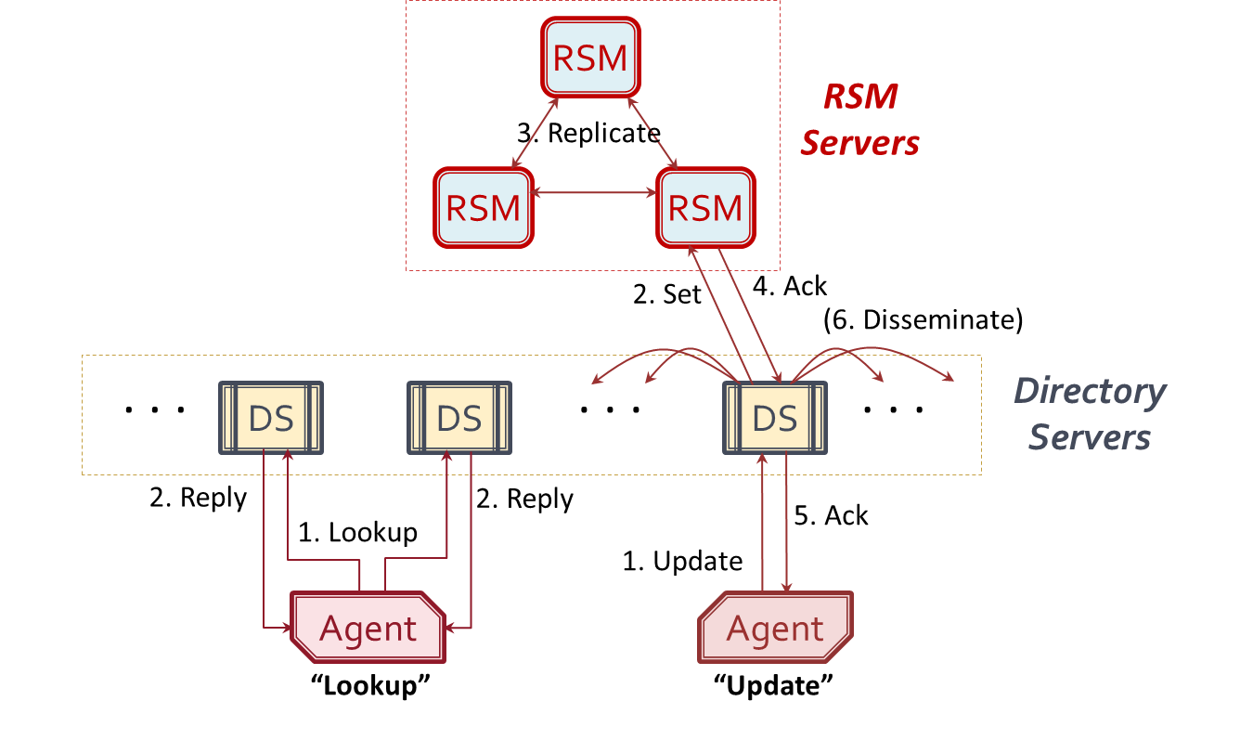
VL2 Directory System
Read-optimized Directory Servers for lookups
Write-optimized Replicated State Machines for updates
Stale mappings?
Notes:
Directory servers: low latency, high throughput, high availability for a high lookup rate
RSM: strongly consistent, reliable store of AA-to-LA mappings
Reactive cache updates: stale host mapping needs to be corrected only when that mapping is used to deliver traffic. Forward non-deliverable packets to a directory server, so directory server corrects stale mapping in source’s stale cache via unicast

Slide 20
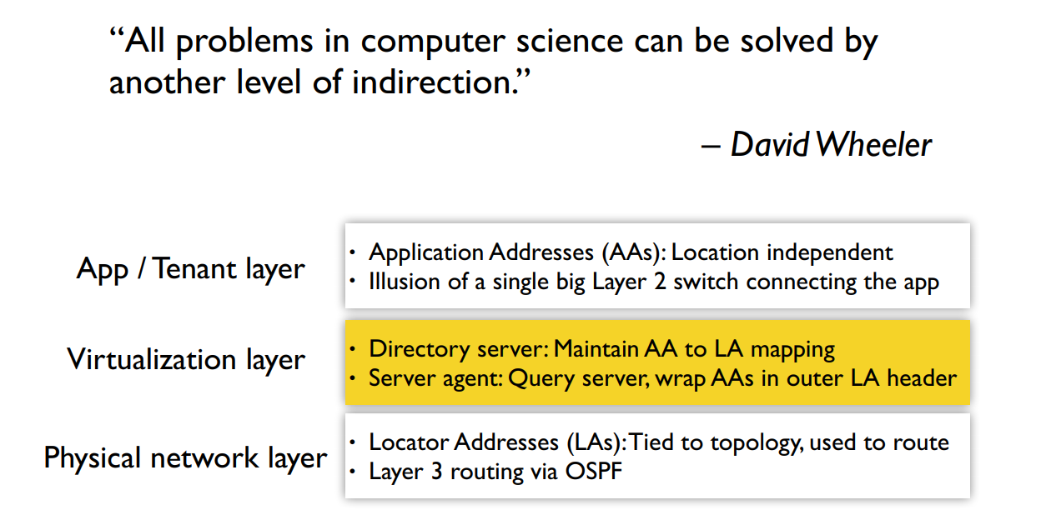
VL2 Virtualization Recap

Slide 21
Key Needs
Agility
Location independent addressing
Tenant’s IP addresses can be taken anywhere
Performance uniformity
VMs receive same throughput regardless of placement
Security
Micro-segmentation: isolation at tenant granularity
Network semantics
Layer 2 service discovery, multicast, broadcast, …

Slide 22
Did we achieve agility?
Location independent addressing
• AAs are location independent
L2 network semantics
• Agent intercepts and handles L2 broadcast, multicast
Performance uniformity • Clos network is nonblocking (non-oversubscribed) • Uniform capacity everywhere • ECMP provides good (though not perfect) load balancing
• But, performance isolation among tenants depends on TCP backing off to rate destination can receive • Leaves open the possibility of fast load balancing
Security • Directory system can allow/deny connections by choosing whether to resolve an AA to a LA
• But, segmentation not explicitly enforced at hosts

Slide 23
Where’s the SDN?
Directory servers: Logically centralized control • Orchestrate application locations • Control communication policy
Host agents: dynamic “programming” of data path

Slide 24
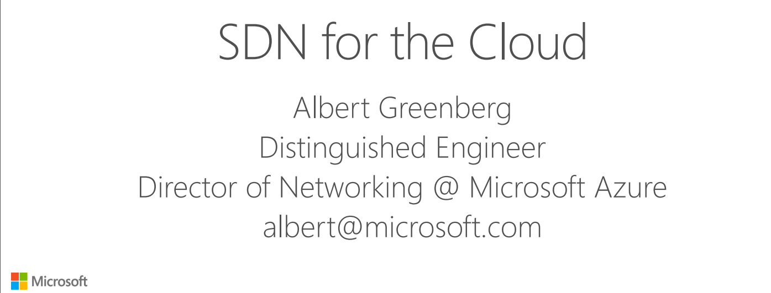
What’s more about SDN in the Cloud?
Keynote talk at SIGCOMM 2015
http://conferences.sigcomm.org/sigcomm/2015/pdf/papers/keynote.pdf

Slide 25
Thanks!
陈果 副教授
湖南大学-信息科学与工程学院-计算机与科学系
邮箱：guochen@hnu.edu.cn
个人主页：1989chenguo.github.io
https://1989chenguo.github.io/Courses/CloudComputing2018Spring.html

