Slide 1
云计算技术
陈果 副教授
湖南大学-信息科学与工程学院-计算机与科学系
邮箱：guochen@hnu.edu.cn
个人主页：1989chenguo.github.io
https://1989chenguo.github.io/Courses/CloudComputing2018Spring.html

Slide 2
What we have learned
What is cloud computing
Cloud Networking
Physical Structure
Applications and network traffic
Host networking virtualization
Addressing & Routing
Congestion control
Congestion control basics
DCTCP
Two latest multi-path transport works of mine
FUSO
MPRDMA

Slide 3
Software-Defined Networking Architecture
Part I: Cloud networking
Most materials from MIT Courses
Credits to
Mohammad Alizadeh
MIT

Slide 4
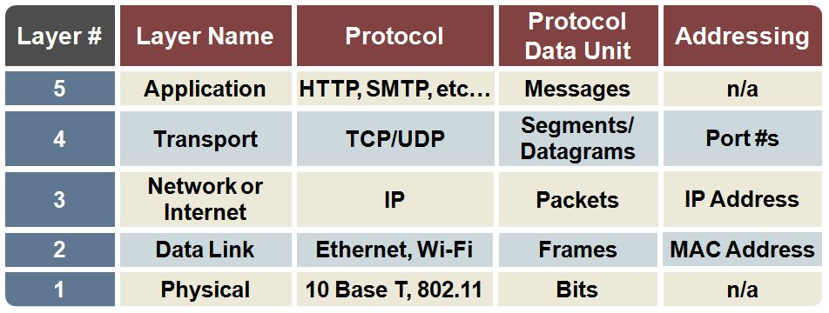
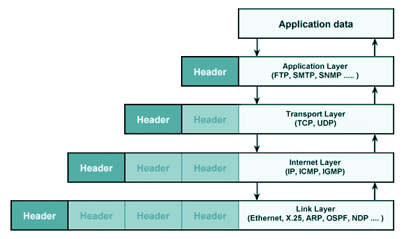
Network layer concepts

Slide 5
Software Defined Network
A network in which the control plane is physically separate from the data plane.
and
A single (logically centralized) control plane controls several forwarding devices.

Slide 6
Software Defined Network (SDN)
Control
Program
Control
Program
Control
Program
Global Network Map
Control Plane
Control
Packet
Forwarding
Control
Packet
Forwarding
Control
Control
Packet
Forwarding
Packet
Forwarding
Control
Packet
Forwarding
Notes:
Talk about forwarding & control planes

Slide 7
Outline
The networking “planes”
Traditional network challenges
How SDN changes the network?
Why is SDN happening now? (A brief history)

Slide 8
The Networking “Planes”
Data plane: processing and delivery of packets with local forwarding state
Forwarding state + packet header → forwarding decision
Filtering, buffering, scheduling
Control plane: computing the forwarding state in routers
Determines how and where packets are forwarded
Routing, traffic engineering, failure detection/recovery, …
Management plane: configuring and tuning the network
ACL config, device provisioning, …

Slide 9
Timescales
 | Data | Control | Management
Time-scale | Packet (nsec) | Event (10 msec to sec) | Human (min to hours)
Location | Linecard hardware | Router software | Humans or scripts

Slide 10
Data and Control Planes
Processor
control plane
data plane
Switching
Fabric
Line card
Line card
Line card
Line card
Line card
Line card

Slide 11
Data Plane
Streaming algorithms on packets
Matching on some header bits
Perform some actions
Example: IP Forwarding
1.2.3.4
1.2.3.7
1.2.3.156
5.6.7.8
5.6.7.9
host
host
...
host
host
host
...
host
LAN 1
LAN 2
router
router
router
WAN
WAN
1.2.3.0/24
5.6.7.0/24
forwarding table
Notes:
Firewall classifier

Slide 12
Example: Packet filtering
Stateless Firewall
1.2.3.4
1.2.3.7
1.2.3.156
5.6.7.8
5.6.7.9
host
host
...
host
host
host
...
host
LAN 1
LAN 2
router
router
router
WAN
WAN
1.2.3.4 -> * & dst_port=22 Allow
port = 80 Allow
* Deny
ACL table
Notes:
Firewall classifier

Slide 13
Example: Packet Scheduling
Link 1, ingress
Link 1, egress
Link 2, ingress
Link 2, egress
flow 1
Classifier
flow 2
Scheduler
Link 3, ingress
Link 3, egress
flow n
Notes:
Firewall classifier

Slide 14
Control Plane
Software
Software
Hardware
Software
Hardware
Software
Hardware
Hardware
Example: Link-state routing (OSPF, IS-IS)

Slide 15
Figure out which routers and links are present.
Run Dijkstra’s algorithm to find shortest paths.
B
“If a packet is going to B, then send it to output 3”
Software
Software
Hardware
Data
B
2
Software
1
Hardware
B
“If , send to 3”
Software
Hardware
B
3
Hardware

Slide 16
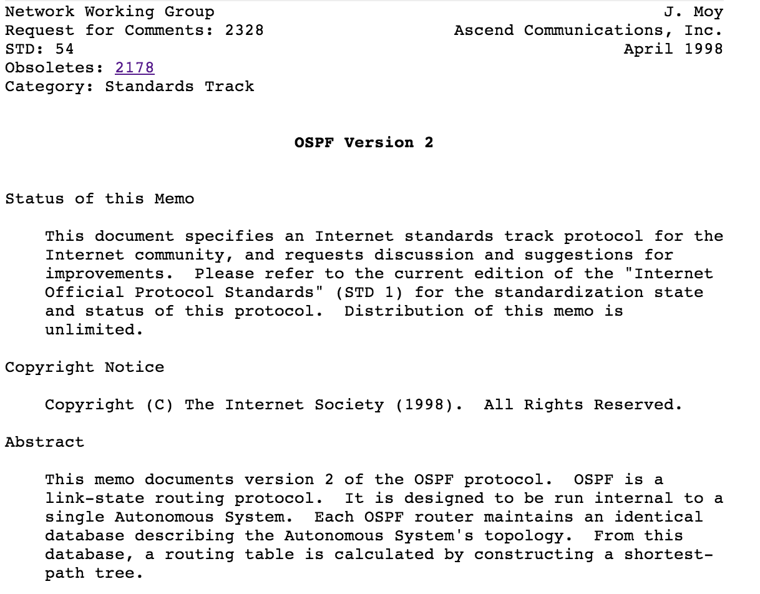
95%
Figure out which routers and links are present.
Run Dijkstra’s algorithm to find shortest paths.
5%
Software
Software
Hardware
Software
Hardware
Software
Hardware
B
Hardware

Slide 17
Example: Traffic Engineering
Which paths to use to deliver traffic?
How to control paths?
Set link weights used by routing protocol
2
3
1
1
3
2
3
1
5
4
3

Slide 18
Outline
The networking “planes”
Traditional network challenges
How SDN changes the network?
Why is SDN happening now? (A brief history)

Slide 19
Traditional Network Challenges
(Too) many task-specific control mechanisms
Routing, addressing, access control, QoS
No modularity, limited functionality
Indirect control
Must invert protocol behavior, “coax” it to do what you want
Ex. Changing weights instead of paths for TE
Uncoordinated control
Cannot control which router updates first
The network is
Hard to reason about
Hard to evolve
Expensive

Slide 20
Example 1: Inter-domain Routing
Today’s inter-domain routing protocol, BGP, artificially constrains routes
Routing only on destination IP address blocks
Can only influence immediate neighbors
Application-specific peering
Route video traffic one way, and non-video another
Blocking denial-of-service traffic
Dropping unwanted traffic further upstream
Inbound traffic engineering
Splitting incoming traffic over multiple peering links

Slide 21
Example 2: Access Control
R1
Chicago (chi)
R2
Data Center
New York (nyc)
Front Office
R5
R3
R4
Two locations, each with data center & front office
All routers exchange routes over all links

Slide 22
Example 2: Access Control
R1
Chicago (chi)
R2
Data Center
New York (nyc)
Front Office
R5
R3
chi-DC
R4
chi-FO
nyc-DC
nyc-FO
chi-DC
chi-FO
nyc-DC
nyc-FO

Slide 23
Example 2: Access Control
R1
Packet filter:
Drop nyc-FO -> *
Permit *
R2
chi
Data Center
Front Office
Packet filter:
Drop chi-FO -> *
Permit *
R5
nyc
R3
chi-DC
R4
chi-FO
nyc-DC
nyc-FO
chi-DC
chi-FO
nyc-DC
nyc-FO

Slide 24
Example 2: Access Control
R1
Packet filter:
Drop nyc-FO -> *
Permit *
R2
chi
Data Center
Front Office
Packet filter:
Drop chi-FO -> *
Permit *
R5
nyc
R3
R4
A new short-cut link added between data centers
Intended for backup traffic between centers

Slide 25
Example 2: Access Control
R1
Packet filter:
Drop nyc-FO -> *
Permit *
R2
chi
Data Center
Front Office
Packet filter:
Drop chi-FO -> *
Permit *
R5
nyc
R3
R4
Oops – new link lets packets violate access control policy!
Routing changed, but
Packet filters don’t update automatically

Slide 26
Outline
The networking “planes”
Traditional network challenges
How SDN changes the network?
Why is SDN happening now? (A brief history)

Slide 27
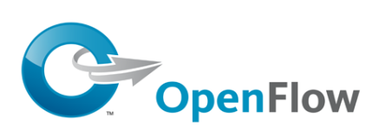
Software Defined Network (SDN)
Consistent, up-to-date global network view
Distributed system,
running on servers
[NOX, ONIX, Floodlight, ONOS, … + more]
Dijkstra
TE
ACL
Control Program 1
Control Program 2
Control Program 3
Network OS
Open interface to packet forwarding
Packet
Forwarding
Packet
Forwarding
Packet
Forwarding
Packet
Forwarding
Packet
Forwarding

Slide 28
OpenFlow
Control Program A
Control Program B
Network OS
“If header = p, send to port 4”
Packet
Forwarding
“If header = q, overwrite header with r, add header s, and send to ports 5,6”
“If header = ?, send to me”
Flow
Table(s)
Packet
Forwarding
Packet
Forwarding

Slide 29

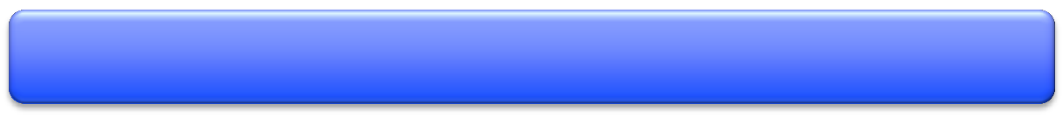







Network Hypervisor
Virtual Topology
Network Hypervisor
Control Program
Global Network View
Network OS

Slide 30





















Virtualization Simplifies Control Program
Abstract Network View
A
A→B drop
B
Hypervisor then inserts flow entries as needed
A
A→B drop
Global Network View
A→B drop
B

Slide 31
Does SDN Simplify the Network?
Abstraction doesn’t eliminate complexity
NOS, Hypervisor are still complicated pieces of code
SDN main achievements
Simplifies interface for control program (user-specific)
Pushes complexity into reusable code (SDN platform)
Just like OS & compilers….

Slide 32
Outline
The networking “planes”
Traditional network challenges
How SDN changes the network?
Why is SDN happening now? (A brief history)

Slide 33
The Road to SDN
Active Networking: 1990s
First attempt make networks programmable
Demultiplexing packets to software programs, network virtualization, …
Control/Dataplane Separation: 2003-2007
ForCes [IETF], RCP, 4D [Princeton, CMU], SANE/Ethane [Stanford/Berkeley]
Open interfaces between data and control plane, logically centralized control
OpenFlow API & Network Oses: 2008
OpenFlow switch interface [Stanford]
NOX Network OS [Nicira]
N. Feamster et al., “The Road to SDN: An Intellectual History of Programmable Networks”, ACM SIGCOMM CCR 2014.

Slide 34
SDN Drivers
Rise of merchant switching silicon
Democratized switching
Vendors eager to unseat incumbents
Cloud / Data centers
Operators face real network management problems
Extremely cost conscious; desire a lot of control
The right balance between vision & pragmatism
OpenFlow compatible with existing hardware
A “killer app”: Network virtualization

Slide 35
Virtualization is Killer App for SDN
Consider a multi-tenant datacenter
Want to allow each tenant to specify virtual topology
This defines their individual policies and requirements
Datacenter’s network hypervisor compiles these virtual topologies into set of switch configurations
Takes 1000s of individual tenant virtual topologies
Computes configurations to implement all simultaneously

Slide 36
Virtualization for Multi-Tenant Data Centers: Needs and Challenges
From Brighten Godfrey, UICU

Slide 37
Key Needs
Agility
Location independent addressing
Performance uniformity
Security
Network semantics

Slide 38
Agility
Agility: Use any server for any service at any time
Better economy of scale through increased utilization
Improved reliability
Service / tenant
Customer renting space in a public cloud
Application or service in a private cloud (internal customer)

Slide 39
Lack of Agility in Traditional DCs
Tenants in “silos”

Slide 40
Lack of Agility in Traditional DCs
Tenants in “silos”
Poor utilization

Slide 41
Lack of Agility in Traditional DCs
Tenants in “silos”
Poor utilization
Inability to expand

Slide 42
Lack of Agility in Traditional DCs
IP addresses locked to topological location!
10.0.4.0/24
10.0.6.0/24

Slide 43
Key Needs
Agility
Location independent addressing
Tenant’s IP addresses can be taken anywhere
Performance uniformity
Security
Network semantics

Slide 44
Lack of Agility in Traditional DCs
1:100 or worse
oversubscription
Nonuniform
performance
Full line rate

Slide 45
Key Needs
Agility
Location independent addressing
Tenant’s IP addresses can be taken anywhere
Performance uniformity
VMs receive same throughput regardless of placement
Security
Network semantics

Slide 46
Lack of Agility in Traditional DCs
Untrusted environment

Slide 47
Key Needs
Agility
Location independent addressing
Tenant’s IP addresses can be taken anywhere
Performance uniformity
VMs receive same throughput regardless of placement
Security
Micro-segmentation: isolation at tenant granularity
Network semantics

Slide 48
Lack of Agility in Traditional DCs
x 1000s of legacy apps in a large enterprise

Slide 49
Key Needs
Agility
Location independent addressing
Tenant’s IP addresses can be taken anywhere
Performance uniformity
VMs receive same throughput regardless of placement
Security
Micro-segmentation: isolation at tenant granularity
Network semantics
Layer 2 service discovery, multicast, broadcast, …

Slide 50
Thanks!
陈果 副教授
湖南大学-信息科学与工程学院-计算机与科学系
邮箱：guochen@hnu.edu.cn
个人主页：1989chenguo.github.io
https://1989chenguo.github.io/Courses/CloudComputing2018Spring.html

