Slide 1


Vroom: Accelerating the Mobile Web with Server-Aided Dependency Resolution
Vaspol Ruamviboonsuk¹, Ravi Netravali², Muhammed Uluyol¹, Harsha V. Madhyastha¹
¹University of Michigan, ²MIT
Notes:
Summary of the work - Rethinking page load on phones and tablets to improve page load performance.

Slide 2
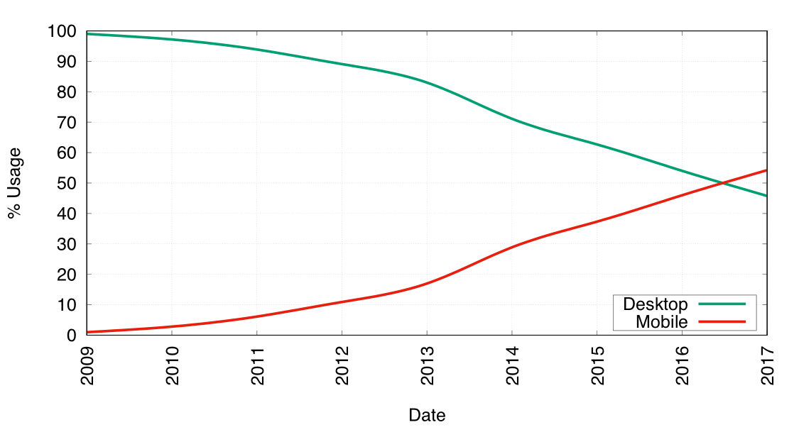
Mobile Web Dominant ...
but Slow...
“9.85s to load median mobile retail sites” - Keynote Systems
“Average load time 14s on 4G” - DoubleClick
Ref: http://gs.statcounter.com/press/mobile-and-tablet-internet-usage-exceeds-desktop-for-first-time-worldwide
Notes:
“Mobile network” → “Cellular network”
Make some connection to the graph + increase font size
Say that the web can be low from a various reasons such as flaky network but we did our measurement in the best case environment.
Add humor - stay away from using your mobile device in the next 20 mins :)
Instead of saying “mobile devices” → “Accessing from mobile devices such as smartphones and tables are increasing”
Say “Unfortunately, accessing websites on these devices when connected to cellular network is still slow”

Slide 3
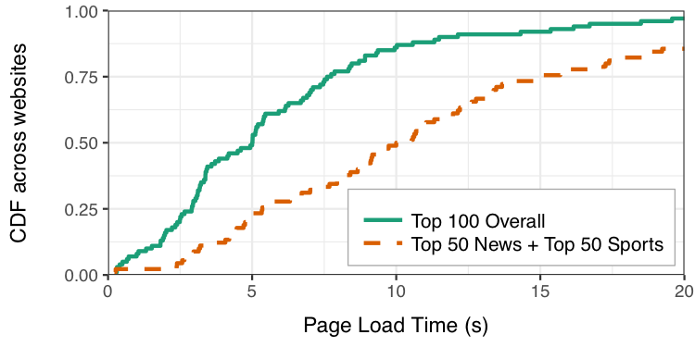
Problem: Slow web page loads
5s
10s
10s
Mobile Optimized Popular Pages,
State of the Art Phone, Good LTE network
Notes:
Point out the lines
Make sure the graph is at 5s and 10s.
Mobile “popular” pages
Let’s see how “process of loading a page” work

Slide 4
Simple Example Page
Dependency Graph
index.html
<html>
…
<script src=”script.js”></script>
…
</html>
a.com/index.html
script.js
var img = new Image();
img.src = “b.com/img.jpg”;
document.body.appendChild(img);
a.com/script.js
img.jpg
Notes:
Slow down a bit

Slide 5


Loading a Web Page
Dependency Graph
index.html
script.js
img.jpg
Onload
Parse HTML
Execute script.js
Client
GET script.js
GET a.com
HTML
script.js
GET img.jpg
a.com
img.jpg
b.com
Notes:
Slow down a bit

Slide 6
Waiting on CPU blocks network and vice versa
Onload
Parse HTML
Execute script.js
Client
Key to fast page loads:
Fully utilize CPU/network
Network
Utilization
CPU
Utilization
Notes:
These are the times -- not areas
Just say that
Be more direct -- describe what is going on.
Start with “The reason why the page load is inefficient is because …”
Pause a bit before explaining “Key to fast page load”
Try replacing a.com, b.com with CPU and network utilization

Slide 7
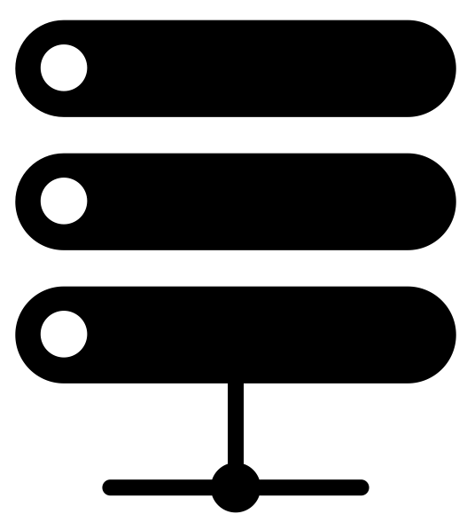
Proxy Based Solution
a.com
GET a.com/index.html
b.com
Web servers must aid client in discovering resources
Client
Stream downloaded resources
Proxy
c.com
Fetch resources
Shortcomings
Client must trust HTTPS content pushed by proxy
Proxy needs access to user’s cookies for all domains
Notes:
One way to achieve this decoupling is to use a proxy. And continue…
This would lead to infringement of users’ privacy.
Takeaway: the proxy breaks end-to-end nature of the web, so we want to use web servers to be more proactive.
Avoid extreme terms: “Proxy needs cookies for all domains, which would be infringing user’s privacy”
Say: “Instead of having proxies aiding dependency discovery, we want web servers to play a more proactive role and help clients in discovering resources.”
Make sure to have correct grammar tense
Show fetch resource before saying that proxy can fetch them faster because of more powerful
After presenting shortcomings, say that “we want to preserve end-to-end nature of the web by fetching from the web servers”

Slide 8
Challenges to approach
How can web servers discover dependencies?
How do web servers inform clients of discovered dependencies?
How should clients use input from servers?
Notes:
Third point, try to keep it short

Slide 9
Challenges to approach
How can web servers discover dependencies?
How do web servers inform clients of discovered dependencies?
How should clients use input from servers?
Notes:
Start with “Let me first start with describing the second challenge”
“Assuming that web servers somehow can discover dependencies, let’s see how web servers can inform clients of the discovered dependencies”

Slide 10
Inefficient Page Load
Dependency Graph
index.html
script.js
img.jpg
Onload
Parse HTML
Execute script.js
Client
GET script.js
GET a.com
HTML
script.js
GET img.jpg
a.com
img.jpg
b.com
Notes:
Run through the process quickly.

Slide 11
HTTP/2 Push
Dependency Graph
index.html
script.js
img.jpg
Onload
Parse HTML
Execute script.js
Client
GET script.js
GET a.com
HTML
script.js
script.js
GET img.jpg
a.com
img.jpg
b.com
Notes:
Transition: why does high number of resources lead to high load times. Look at simple example.
Expand: a.com → a.com/index.html and b.js → a.com/b.js
Too fast. Just go with the animation.

Slide 12
Push Only Load
Dependency Graph
index.html
script.js
img.jpg
Onload
Parse HTML
Execute script.js
Client
GET a.com
HTML
script.js
GET img.jpg
a.com
img.jpg
b.com
Notes:
Pushing script.js allows the client to achieve some improvement in page load time, but we are seeing only marginal improvements because of img.jpg. But, img.jpg is owned by b.com, so if a.com were to push the image, we will have the same security and privacy problems as the proxy based solution.
“This helps in page completing earlier, but we see marginal improvements because of img.jpg”
Say “if we allow pushing img.jpg from a.com, this lead to the same problems as proxy based solution”

Slide 13
Dependency Hints
Dependency Graph
index.html
script.js
img.jpg
Onload
Parse HTML
Execute script.js
Client
GET a.com
HTML &
b.com/img.jpg
GET img.jpg
a.com
GET img.jpg
img.jpg
img.jpg
b.com
Notes:
Since a.com cannot push the image, what can we do instead? We leaverage another technique called dependency hints which allows adding URL of a resource with a response… By combining HTTP/2 push and dependency hints we now see even more improvement in page load time.
Emphasize that we need dependency hints.
Say “when the image is being used” rather than discovered

Slide 14
Challenges to approach
How can web servers discover dependencies?
How do web servers inform clients of discovered dependencies?
HTTP/2 Push + Dependency Hints
How should clients use input from servers?
Notes:
Main challenge: server needs to identify precisely the URL of the dependencies. Stable dependency structure isn’t enough.

Slide 15
Strawman Dependency Resolution
GET https://foo.com
Response + Push and Hints
foo.com
a.com
b.com
c.com
Drawbacks
Back-to-back loads differ
Server cannot account for personalization
Notes:
When foo.com gets the request say: “Similar to a proxy, foo.com can go off and fetch dependencies. But, unlike a proxy, it can push everything that it hosts and provide hints for everything else”
Back-2-back load differs so dependencies determined by the server might be different from what the client needs to load the page. So because of this some of the hints from the server will cause the client to fetch unnecessary resources. So, rather than helping the hints can hurt performance.
Show more domains
Double sided arrows from foo.com and other domains.
Say back-to-back load “very often”
Have some structure: this leads to two problems: first, b-2-b and second personalization
Focus on the fact that web servers doesn’t have access to client cookies

Slide 16


Combined Offline-Online Discovery
GET https://foo.com
+
...
Parse
HTML Response
t₀
t₁
t₂
Response +
Push and Hints
foo.com
Stable dependencies: Intersection of offline loads
Dynamic Content: Online Parsing of HTML
Notes:
Offline too complex: “Server needs to perform loads in the background and if resources appear persistently that means that the resources are stable on the page”
“To account for that, we augment offline with parsing.”
Animate slide
Before request show offline loads with text “Offline loads to discover stable dependencies”
Show req from client
Show parse HTML response - “Discover dynamic content”
Show response back to client
To overcome the two drawbacks of the strawman solution, we have to use two techiques to discovery dependencies. First, we use offline dependency resolution to filter out all URL variance between loads. However, this only captures 70% of the dependencies on average. To increase the number of dependencies discovered, we augment the offline discovery with online parsing of HTML response. We found that by parsing the HTML response we are able to capture most of the dependencies.
Speak more precise and concise: 2 techniques. First, offline. Second, online parsing of HTML.

Slide 17
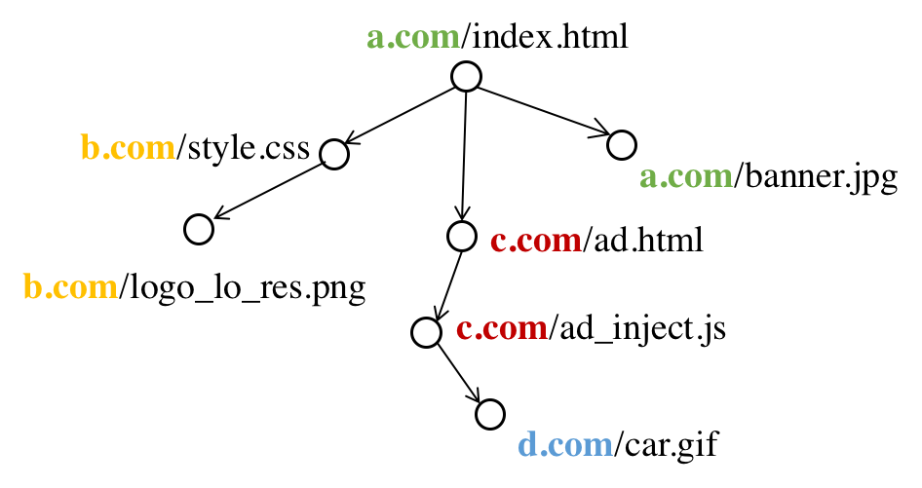
Personalized Dependencies from Third-party Domains
Start
Personalized Content?
Notes:
Use different colors for different domains.
Say that it is complex. Say that there are resources from various domains
Add envelop to all dependencies
Don’t use “iframes” → “third-party HTML”

Slide 18
Challenges to approach
How do web servers discover dependencies?
Combine offline and online + Defer to third parties
How do web servers inform clients of discovered dependencies?
HTTP/2 Push + Dependency Hints
How do clients use input from servers?

Slide 19
Need for Scheduling
No speedup with “Push All + Fetch ASAP”
Contention for access link bandwidth stalls processing
Prioritize pushes and fetches of HTML, CSS, and JS
Schedule in order of processing
Account for 20% of bytes on average
Notes:
Contention description: “If we take this approach, we can finished fetching all resources earlier, but this leads to bandwidth contention because of many concurrent fetches, so resource that require processing earlier in the page load end up getting delayed.”

Slide 20
Vroom scheduler in action
Fetch all HTML, JS, CSS
Fetch other dependencies
Parse HTML and CSS, Execute JS
T=0
Onload
Notes:
Say explicitly what the red line means
No need to say “dashed red”...
Say “largely decoupled” instead of “fully”
Drop “in the cache” description
Describe what are other dependencies : such as images
Say at the end that now CPU and network is fully decoupled.

Slide 21
Results overview
Accuracy of dependency discovery
Median: 0% false positives and < 5% false negatives
Improvements in client perceived performance
Speedup over status quo
Simple strawmans don't suffice
Speedup even with warm caches
Notes:
No need to describe all settings.

Slide 22
Results overview
Accuracy of dependency discovery
Median: 0% false positives and < 5% false negatives
Improvements in client perceived performance
Speedup over status quo
Simple strawmans don't suffice
Speedup even with warm caches

Slide 23
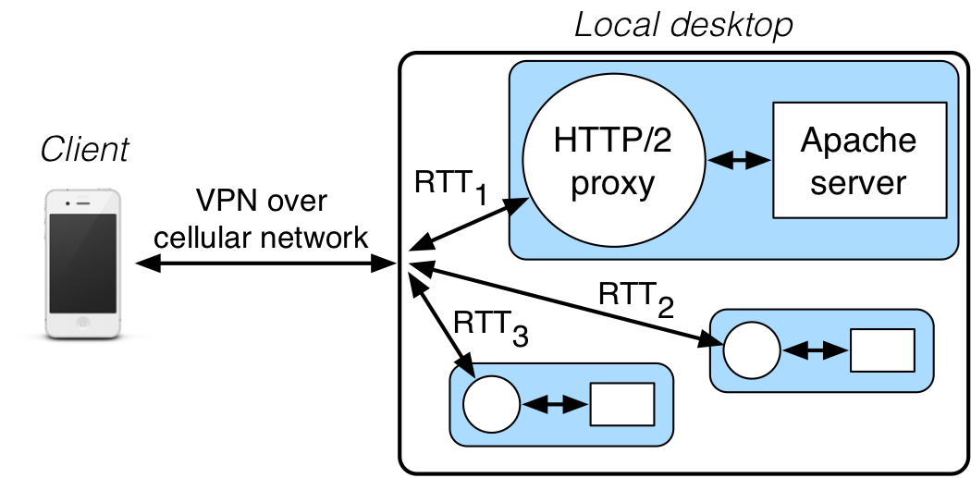
Evaluation Setup
Notes:
Describe Mahimahi
Don’t say them as an order say them quickly
Main challenge:
require server-side changes
replay based setup
Just say the changes no need to list them in an order

Slide 24
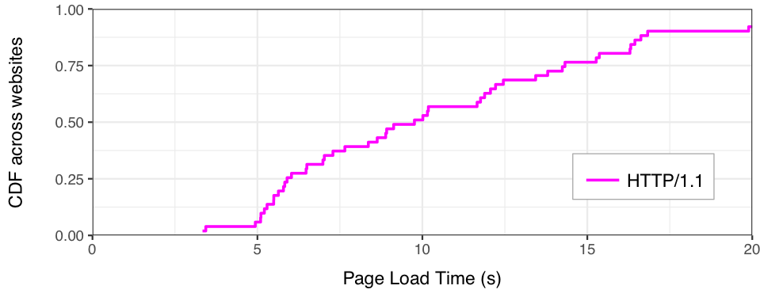
Vroom makes page loads much faster
10s
Alexa top 50 news and 50 sports sites
Notes:
Say “as I told you in the beginning of the talk”

Slide 25
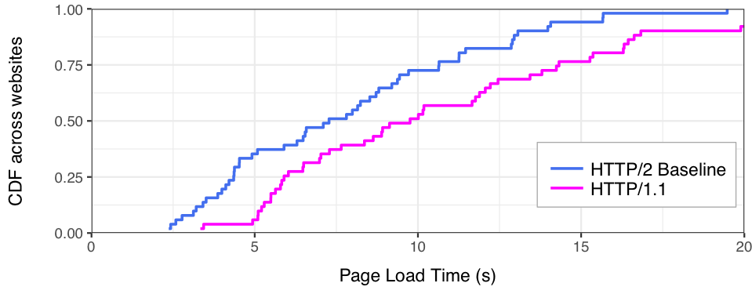
Vroom makes page loads much faster
7.5s
10s
Notes:
Now if all domains adopt HTTP/2 we get improvement with 2.5 at the median.

Slide 26
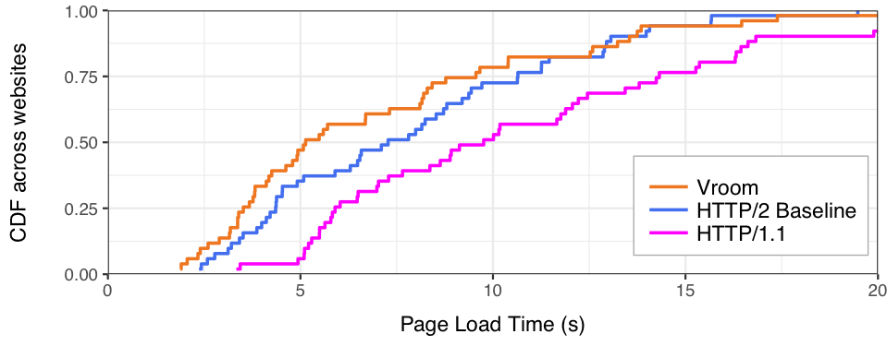
Vroom makes page loads much faster
7.5s
10s
5s
7.5s
10s
Notes:
But if we also enable Vroom we get even more significant speed up and median drops to 5s

Slide 27
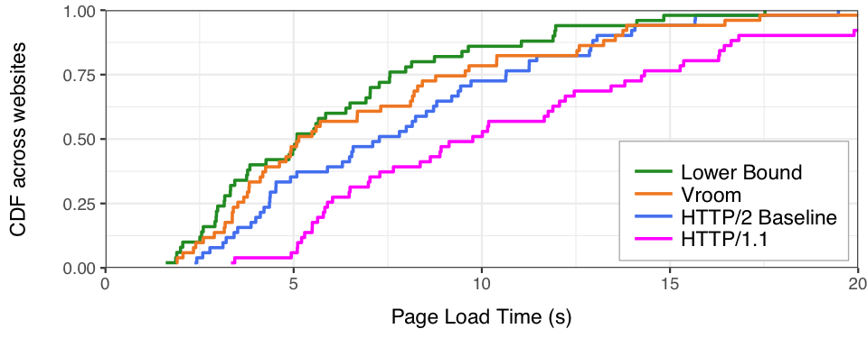
Vroom makes page loads much faster
5s
7.5s
10s
Notes:
Keep all the numbers. Tilt the arrows.
05/19
Remove 5.2s
In fact, this is the furthest it can go. Using the

Slide 28
Vroom makes page loads much faster
Visual Improvement
Vroom also significantly reduces above-the-fold time
Incremental Deployment
Most of Vroom’s benefits achievable with first-party adoption
5s
7.5s
10s
Notes:
I showed this benefits using the page load time metric, but this is also true with the above-the-fold time metric.
Furthermore, the nice thing about our design is that we are seeing benefits even only the first party adopts Vroom.

Slide 29
Conclusion
Vroom: End-to-end solution that fully utilizes CPU/Network
Decouples dependency discovery from parsing and execution
Decreases median page load time by 5s for popular sites
Notes:
Say 2 which leads to 1 which allows 3
Close to optimal.

