Slide 1
云计算技术
陈果 副教授
湖南大学-信息科学与工程学院-计算机与科学系
邮箱：guochen@hnu.edu.cn
个人主页：1989chenguo.github.io
https://1989chenguo.github.io/Courses/CloudComputing2018Spring.html

Slide 2
What we have learned
What is cloud computing
Cloud Networking
Physical Structure
Applications and network traffic
Host networking virtualization
Addressing & Routing
Software-Defined Networking Architecture
Inter-data-center networking
Content distribution networks
Client connectivity
Cope with network performance

Slide 3
Part #2: Cloud Distributed System

Slide 4
Introduction to Cloud Distributed System
Part #2: Cloud Distributed System
Most materials from UIUC MOOC
Thanks Indranil Gupta

Slide 5
So What IS a Distributed “System”?
Let’s try to define the term!

Slide 6
Wait, Wait…
Let’s first take a step back
And define the term “Operating System”
All machines (computers, devices, etc.) run an Operating System
Also called an “OS”
If you’ve used a computer, you’ve used an Operating System

Slide 7
Can you name some examples of Operating Systems?
For big devices:
Linux
Mac OS X (High Sierra, Yosemite, Mavericks, Mountain Lion…)
Windows (10, 8, 7, Vista, XP, …)
Unix
FreeBSD …
For small devices:
Android
iOS
TinyOS …

Slide 8
What is an Operating System?
User interface to hardware (device drivers)
Provides abstractions (processes, file system)
Resource manager (scheduler)
Means of communication (networking)
…

Slide 9
FOLDOC definition (Free Online Dictionary of Computing)
The low-level software which handles the interface to peripheral hardware, schedules tasks, allocates storage, and presents a default interface to the user when no application program is running.
The OS may be split into a kernel which is always present and various system programs which use facilities provided by the kernel to perform higher-level house-keeping tasks, often acting as servers in a client-server relationship.
Some would include a graphical user interface and window system as part of the OS, others would not. The operating system loader, BIOS, or other firmware required at boot time or when installing the operating system would generally not be considered part of the operating system, though this distinction is unclear in the case of a roamable operating system such as RISC OS.
The facilities an operating system provides and its general design philosophy exert an extremely strong influence on programming style and on the technical cultures that grow up around the machines on which it runs.
Let’s Repeat the Same Exercise for the term “Distributed System”

Slide 10
Can you name some examples of Distributed Systems?
Client communicating with a server
BitTorrent (peer to peer overlay)
The Internet
The Web (servers and clients)
Hadoop
Datacenters

Slide 11
NOT Distributed Systems
The following are NOT distributed systems
Humans Interacting with each other
A standalone machine not connected to the network, and with only one process running on it
Is there a Good Definition out there?

Slide 12
Definition from FOLDOC (Free Online Dictionary of Computing)
A collection of (probably heterogeneous) automata whose distribution is transparent to the user so that the system appears as one local machine.
This is in contrast to a network, where the user is aware that there are several machines, and their location, storage replication, load balancing and functionality is not transparent.
Distributed systems usually use some kind of client-server organization.
(Definition last updated in 1994)

Slide 13
The FOLDOC Definition for Distributed System is Incorrect
A collection of (probably heterogeneous) automata whose distribution is transparent to the user so that the system appears as one local machine.
This is in contrast to a network, where the user is aware that there are several machines, and their location, storage replication, load balancing and functionality is not transparent.
Distributed systems usually use some kind of client-server organization.
(Definition last updated in 1994)

Slide 14
The FOLDOC Definition for Distributed System is Incorrect
A collection of (probably heterogeneous) automata whose distribution is transparent to the user so that the system appears as one local machine.
This is in contrast to a network, where the user is aware that there are several machines, and their location, storage replication, load balancing and functionality is not transparent.
Distributed systems usually use some kind of client-server organization.
However, it’s never the case that all sites on the Web are all up or all down, e.g., site A may be up while B down; later B is up while A is down. Yet, the Web is a distributed system!
Peer to peer systems like BitTorrent rely largely on only clients, no servers.

Slide 15
Definitions from Textbooks
A distributed system is a collection of independent computers that appear to the users of the system as a single computer.
[Andrew Tanenbaum]
A distributed system is several computers doing something together. Thus, a distributed system has three primary characteristics: multiple computers, interconnections, and shared state.
[Michael Schroeder]

Slide 16
Definitions Look Unsatisfactory to Us
Why are these definitions short?
Why do these definitions look inadequate to us?
Because we are interested in the insides of a distributed system
algorithms
design and implementation
maintenance
study

Slide 17
Easy to Know when you See it
The following are NOT distributed systems
Humans Interacting with each other
A standalone machine not connected to the network, and with only one process running on it

Slide 18
Easy to Know when you See it
I shall not today attempt further to define the kinds of material I understand to be embraced within that shorthand description; and perhaps I could never succeed in intelligibly doing so. But I know it when I see it…
[Potter Stewart, Associate Justice, US Supreme Court (talking about his interpretation of a technical term laid down in the law, case Jacobellis versus Ohio 1964) ]

Slide 19
A Working Definition of “Distributed System”
A distributed system is a collection of entities, each of which is autonomous, programmable, asynchronous and failure-prone, and which communicate through an unreliable communication medium.
Our interest in distributed systems involves
algorithms, design and implementation, maintenance, study
Entity=a process on a device (PC, PDA, mote)
Communication Medium=Wired or wireless network

Slide 20
A Working Definition of “Distributed System”
A distributed system is a collection of entities, each of which is autonomous, programmable, asynchronous and failure-prone, and which communicate through an unreliable communication medium.
Eliminates “Humans Interacting with each other”
Distinguishes distributed systems from parallel systems (e.g., multiprocessor systems)

Slide 21
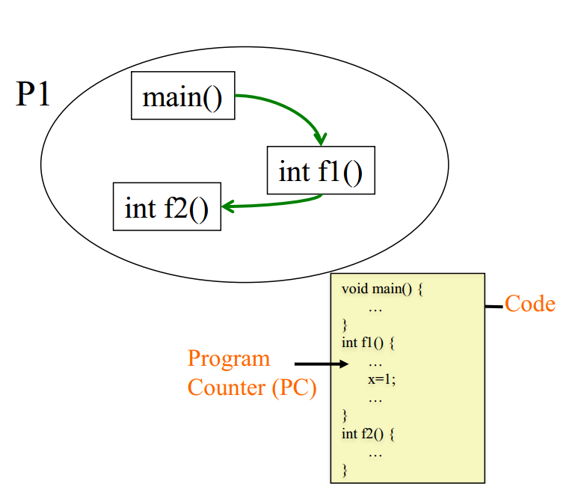
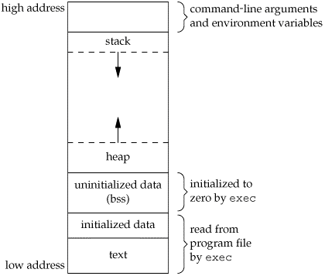
Remember a Process?

Slide 22
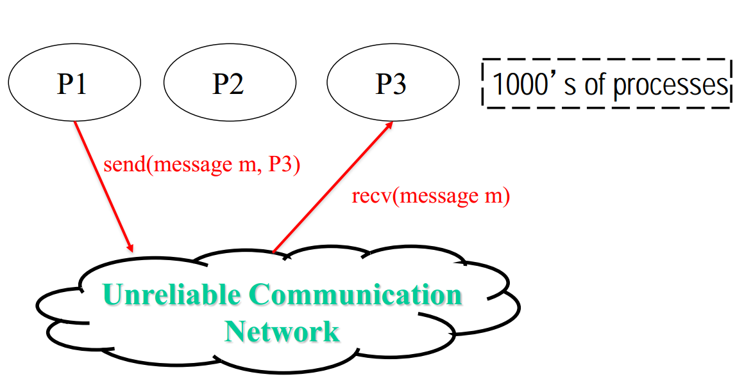
Distributed System = Many Processes (broad-sense) Sending and Receiving Messages

Slide 23
Not Meant to be a Perfect Definition
That’s only a working definition, good for this course
Feel free to come up with your own definition for distributed systems!
Try the exercise after you’ve seen the many different examples of distributed systems in this course!

Slide 24
A range of interesting problems for Distributed System designers
P2P systems [Gnutella, Kazaa, BitTorrent]
Cloud Infrastructures [AWS, Azure, Google Cloud]
Cloud Storage [Key-value stores, NoSQL, Cassandra]
Cloud Programming [MapReduce, Storm, Pregel]
Coordination [Paxos, Leader Election, Snapshots]
Managing Many Clients and Servers Concurrently [Concurrency Control, Replication Control]
(and many more that you’ll see in this course!)

Slide 25
In solving these problems, Many Challenges Abound…
Failures
no longer the exception, but rather a norm
Scalability
10K+ of machines
Perabytes of data
Asynchrony
clock skew and clock drift
Concurrency
10K+ of machines interacting with each other accessing the same data
…

Slide 26
Looking Forward
Over the next few weeks, we will see several core concepts of distributed systems
Gossip
Membership
Distributed Hash Tables (DHTs)
… and alternate this with their use in real systems
Peer-to-peer systems (which use DHTs)
Key-value/NoSQL stores (which use DHTs, gossip, membership)

Slide 27
Thanks!
陈果 副教授
湖南大学-信息科学与工程学院-计算机与科学系
邮箱：guochen@hnu.edu.cn
个人主页：1989chenguo.github.io
https://1989chenguo.github.io/Courses/CloudComputing2018Spring.html

