Slide 1
云计算技术
陈果 副教授
湖南大学-信息科学与工程学院-计算机与科学系
邮箱：guochen@hnu.edu.cn
个人主页：1989chenguo.github.io
https://1989chenguo.github.io/Courses/CloudComputing2018Spring.html

Slide 2
What we have learned
What is cloud computing
Cloud Networking
Cloud Distributed System
Introduction to Cloud Distributed System
What is cloud distributed system
What we’ll look at in this part

Slide 3
MapReduce
Part #2: Cloud Distributed System
Most materials from UIUC MOOC
Thanks Indranil Gupta

Slide 4
Outline
Paradigm
Examples
Scheduling
Fault-tolerance

Slide 5
Outline
Paradigm
Examples
Scheduling
Fault-tolerance

Slide 6
What is MapReduce?
“MapReduce is a programming model and an associated implementation for processing and generating big data sets with a parallel, distributed algorithm on a cluster.”
Terms are borrowed from functional language (e.g., Lisp)
Example: sum of squares
Map: square (1,2,3,4)
Output: (1²,2²,3²,4²) = (1,4,9,16)
Reduce: sum (1,4,9,16)
Output: (1+4+9+16) = 30
Let’s consider a sample application: WordCount
You’re given a huge dataset and asked to list the count for each of the words in all the documents
Processes each record independently
Processes (set of) all records in batches

Slide 7
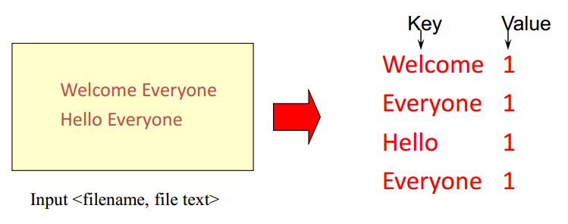
WordCount: Map
Process individual records to generate intermediate key/value pairs

Slide 8
WordCount: Map
Process individual records to generate intermediate key/value pairs in parallel
Map task 1
Map task 2

Slide 9
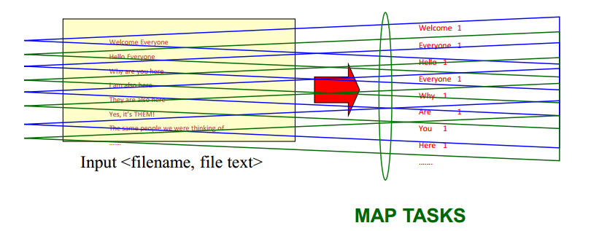
WordCount: Map
Process a large number of individual records to generate intermediate key/value pairs in parallel

Slide 10
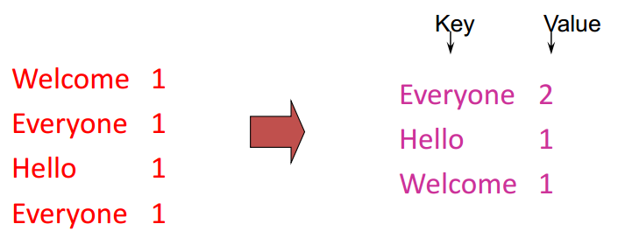
WordCount: Reduce
Processes and merges all intermediate values associated per key

Slide 11
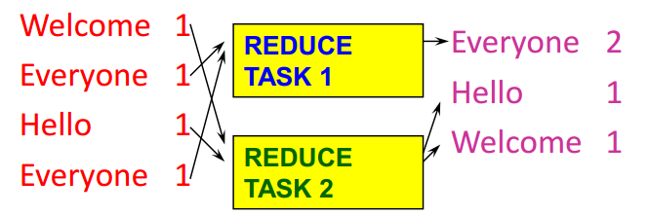
WordCount: Reduce
Each key assigned to one Reduce
Parallelly processes and merges all intermediate values by partitioning keys
Typically: hash partitioning, i.e., key is assigned to
reduce # = hash(key)%number_of_reduce_servers

Slide 12
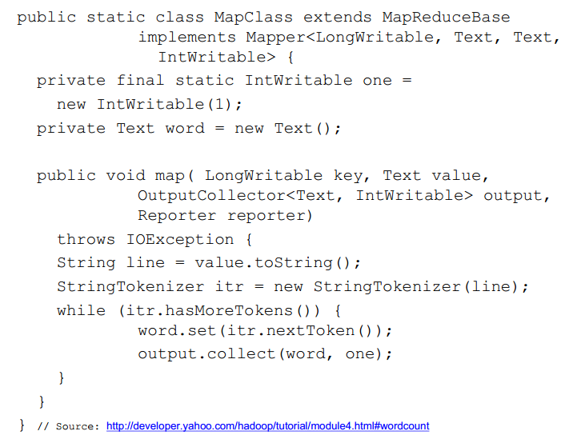
Hadoop code - Map

Slide 13
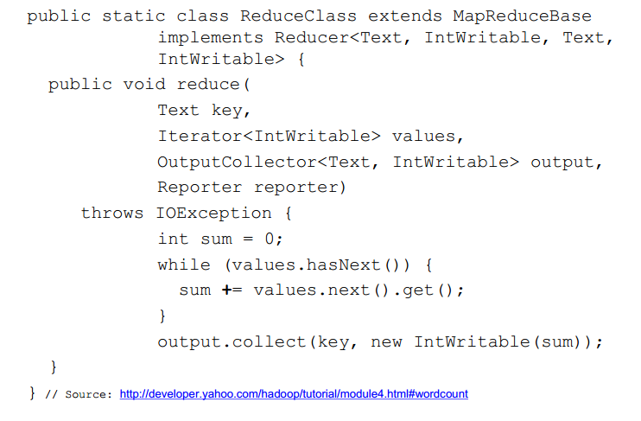
Hadoop code - Reduce

Slide 14
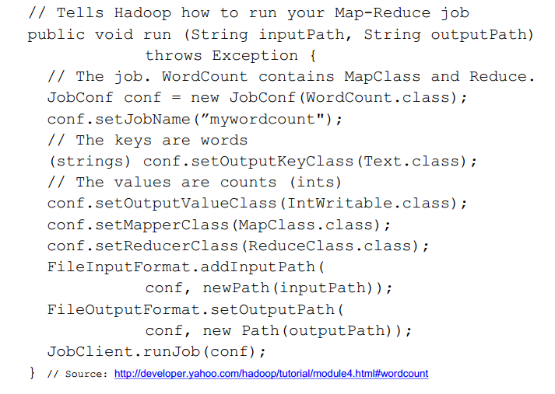
Hadoop code - Driver

Slide 15
Outline
Paradigm
Examples
Scheduling
Fault-tolerance

Slide 16
Some Applications of MapReduce #1
Distributed Grep
Input: large set of files
Output: lines that match pattern
Map
Emits a line if it matches the supplied pattern
Reduce
Copies the intermediate data to output

Slide 17
Some Applications of MapReduce #2
Reverse Web-Link Graph
Input:
Web graph: tuples (a, b) where (page a --> page b)
Output
For each page, list of pages that link to it
Map
For each input <source, target>, output <target, source>
Reduce
Emits <target, list(source)>

Slide 18
Some Applications of MapReduce #3
Count URL access frequence
Input:
Log of accessed URLs, e.g., from proxy server
Output
For each URL, % of total accesses for that URL
Map: Output <URL, 1>
Multiple reducers: Emits <URL, URL_count>
Chain another MapReduce jog after above one
Map: Process <URL, URL_count> and output <1, URL_count>
One reducer: Sum up <URL_count> to calculate overall _count
Now we got URL count, but still need %
Get % by URL_count/overall_count

Slide 19
Outline
Paradigm
Examples
Scheduling
Fault-tolerance

Slide 20
Programming MapReduce
Externally: For user
Write a Map program, write a Reduce program
Submit job; wait for result
Need to know nothing about parallel/distributed programming!
Internally: For the Paradigm and Scheduler
Parallelize Map
Transfer data from Map to Reduce
Parallelize Reduce
Implement storage for Map input/output, Reduce input/output

Slide 21
Inside MapReduce
Parallelize Map
Easy! Each Map task is independent
Transfer data from Map to Reduce
All Map output records with same key assigned to same Reduce
Partitioning function, e.g., hash(key)%number_of_reducers
Parallelize Reduce
Easy! Each Reduce task is independent
Implement storage for Map input/output, Reduce input/output
Map input: From distributed file system (GFS, HDFS, etc.)
Map output: To local file system
Reduce input: From remote file system
Reduce output: To distributed file system

Slide 22
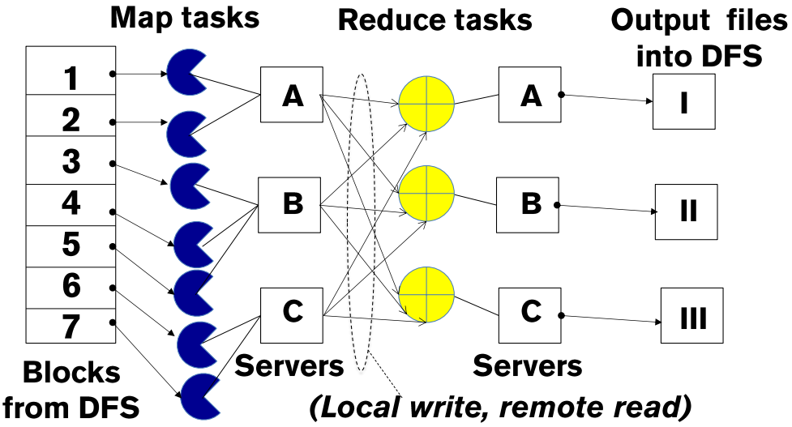
Inside MapReduce
Parallelize Map
Parallelize Reduce
Scheduling:
Assign Maps and Reduces to servers
Transfer data from Map to Reduce

Slide 23
The YARN Scheduler
Used in Hadoop 2.x +
YARN = Yet Another Resource Negotiator
Treats each server as a collection of containers
Container = some CPU + some memory
Has 3 main components
Global Resource Manager (RM)
Scheduling
Per-server Node Manager (NM)
Daemon and server-specific functions
Per-application (job) Application Master (AM)
Container negotiation with RM and NMs
Detecting task failures of that job
RM
Scheduler
1. Need container
2. Container completed
3. Container on Server B
What kind of algorithms used in scheduling?
Server A
Server B
NM
NM
4. Start task, please
AM 1
…
AM 2
Task (Container)

Slide 24
Why Scheduling?
Multiple “tasks” to schedule
The processes on a single-core OS
The tasks of a Hadoop job
The tasks of multiple Hadoop jobs
Limited resources that these tasks require
Processor(s)
Memory
(Less contentious) disk, network
Scheduling goals
Good throughput or response time for tasks (or jobs)
High utilization of resources

Slide 25
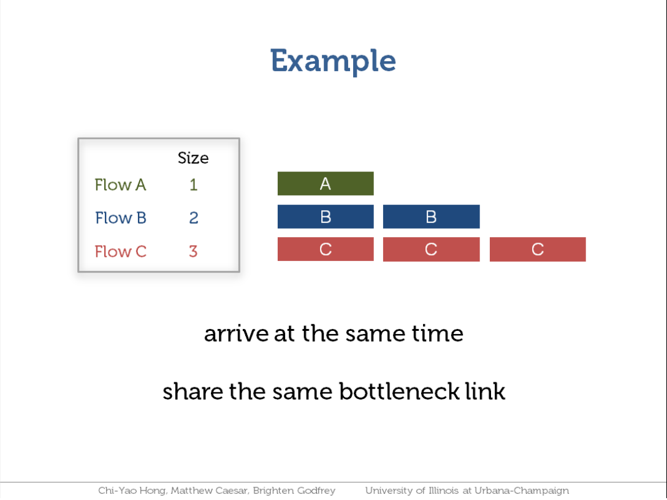

Slide 26
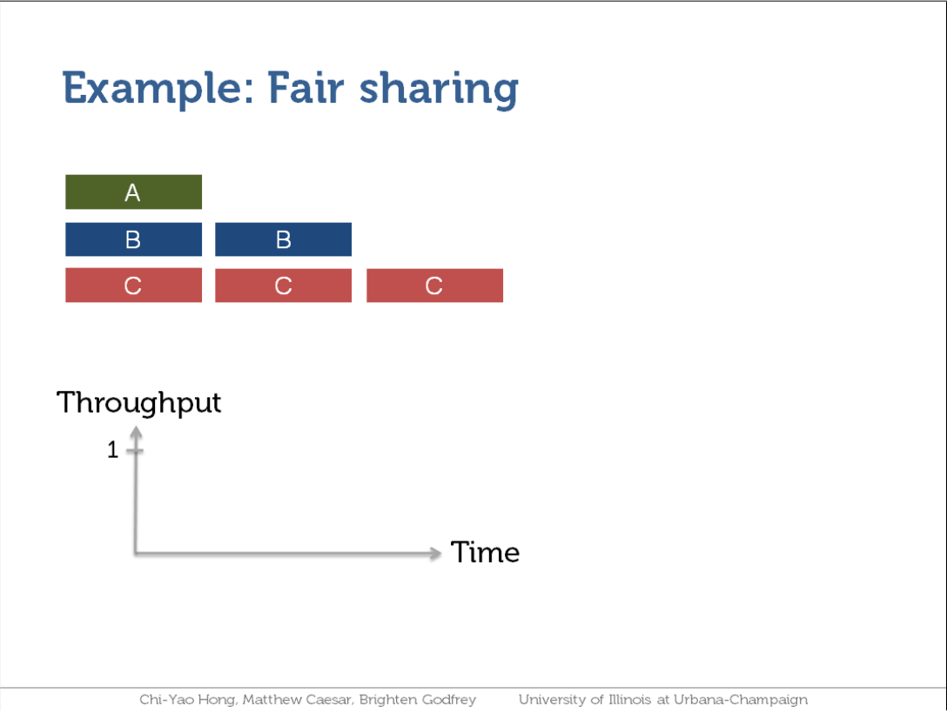

Slide 27
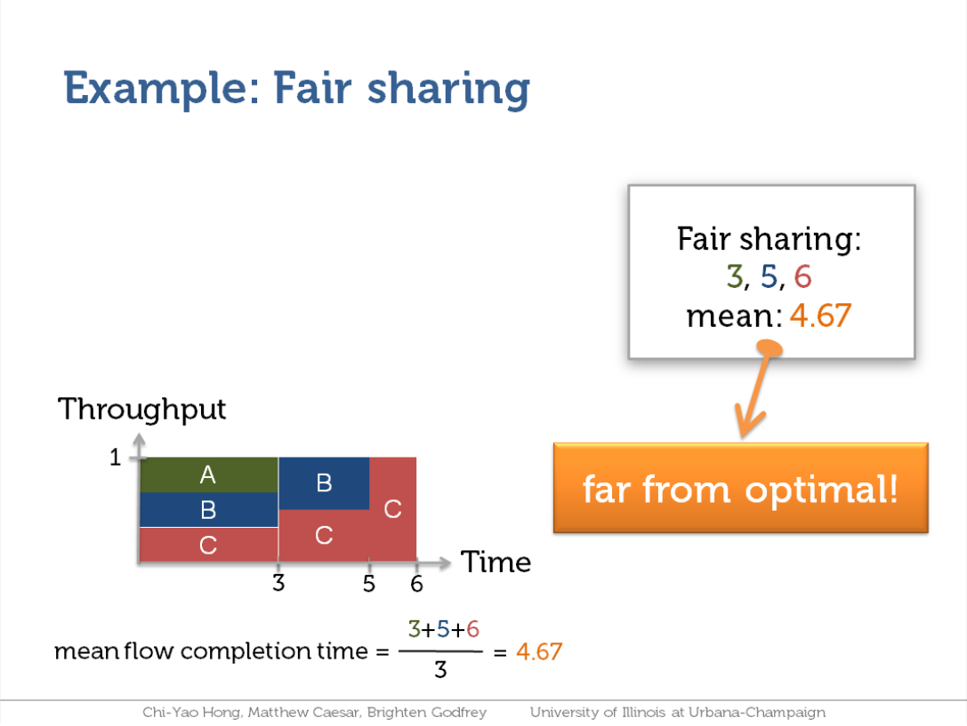

Slide 28
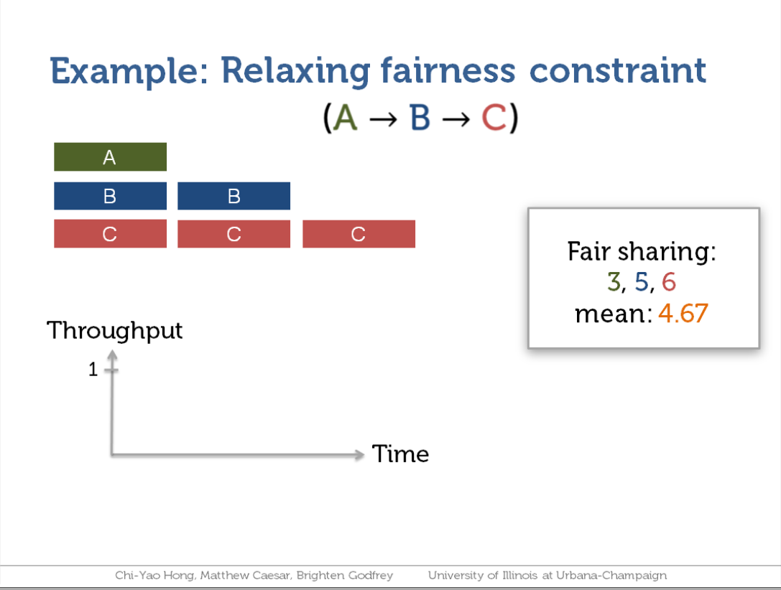

Slide 29
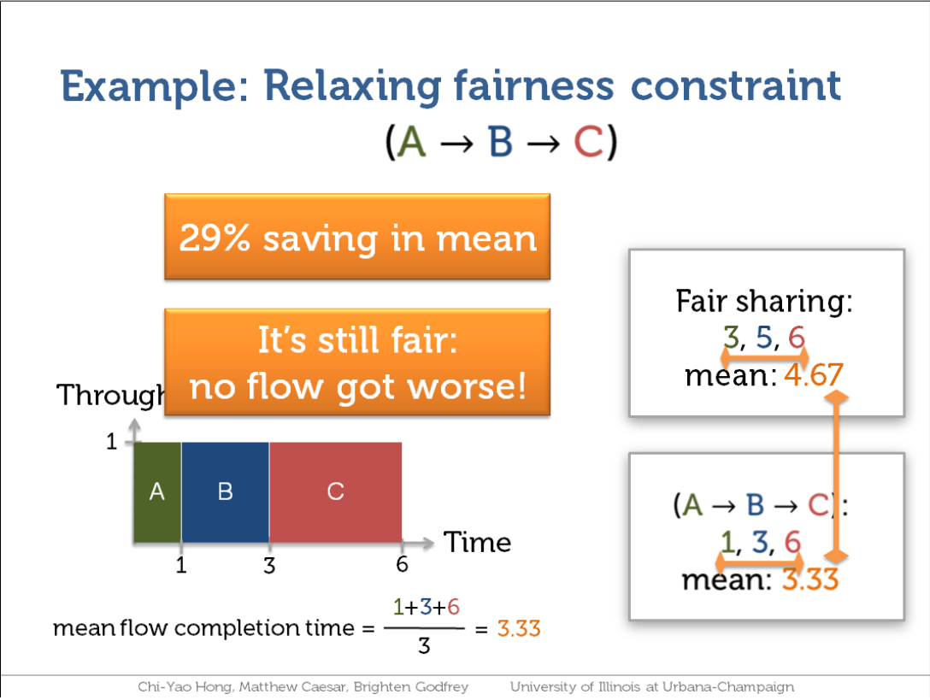

Slide 30
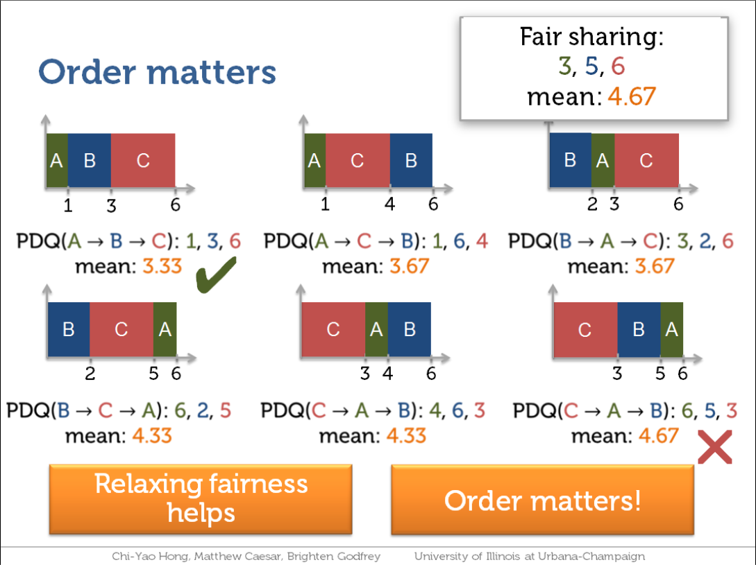
STF (Shortest Task First) is optimal!
A special case of priority scheduling

Slide 31
Outline
Paradigm
Examples
Scheduling
Fault-tolerance

Slide 32
Fault-tolerance
RM
Scheduler
Server failure
NM heartbeats to RM
If fails, RM notifies all affected AMs
NM monitors tasks running at its server
If fails, mark the task and restart it
AM heartbeats to RM
If fails, RM restarts AM, which then syncs up with its running tasks
RM failure
Use old checkpoints and bring up secondary RM
Heartbeats also used to piggyback container requests
Avoids extra messages
Server A
Server B
NM
NM
AM 1
…
AM 2
Task (Container)

Slide 33
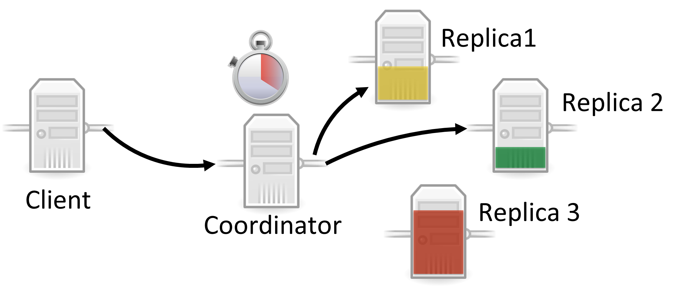
Slow Tasks (Stragglers)
The slowest machine slows the entire job down
Due to bad disk, network bandwidth, CPU, memory, etc.
Keep track of “progress” of each task
Perform backup (replicated) execution of straggler task

Slide 34
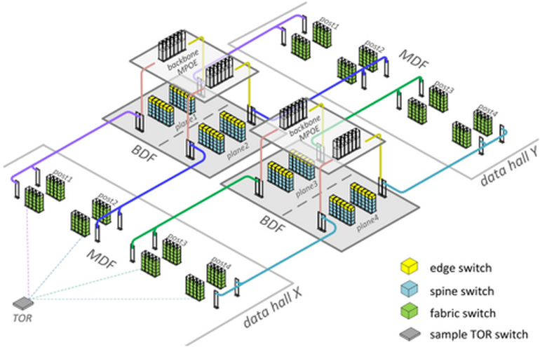
Locality
Cloud networking has hierarchical topology
Racks, pods, cluster, datacenter, …
GFS/HDFS stores 3 replicas for each chunk
Maybe on different racks
MapReduce tries to schedule a Map task using the following priority:
Same machine containing the input data, if fail
Same rack containing the input data, if fail
Anywhere

Slide 35
MapReduce Summary
Paradigm
Parallelization + Aggregation to deal with big data processing
Examples
Word count, Dsitributed Grep, URL count, …
Scheduling
For job: Maximize throughput, minimize latency
For cloud: Maximize utilization
Fault-tolerance
Need to be very careful about various failures

Slide 36
Thanks!
陈果 副教授
湖南大学-信息科学与工程学院-计算机与科学系
邮箱：guochen@hnu.edu.cn
个人主页：1989chenguo.github.io
https://1989chenguo.github.io/Courses/CloudComputing2018Spring.html

