Slide 1
云计算技术
陈果 副教授
湖南大学-信息科学与工程学院-计算机与科学系
邮箱：guochen@hnu.edu.cn
个人主页：1989chenguo.github.io
https://1989chenguo.github.io/Courses/CloudComputing2018Spring.html

Slide 2
What we have learned
What is cloud computing
Cloud Networking
Cloud Distributed System
Introduction to Cloud Distributed System
MapReduce
Paradigm
Examples
Scheduling
Fault-tolerance

Slide 3
Gossip
Part #2: Cloud Distributed System
Most materials from UIUC MOOC
Thanks Indranil Gupta

Slide 4



Slide 5
Outline
Introduction to multicast problem
Gossip protocol
Gossip analysis
Gossip implementation

Slide 6
Outline
Introduction to multicast problem
Gossip protocol
Gossip analysis
Gossip implementation

Slide 7
Multicast problem
Delivering the message to the targeting collection of nodes
Node with a piece of information to deliver to everyone
Distributed group of nodes

Slide 8
Requirement of multicast in cloud systems
Performance, fault-tolerance, scalability
Performance: Quickly deliver messages
Fault-tolerance: Nodes may crash; Packets may be dropped
Scalability: 10K+ of nodes

Slide 9
Simple solution #1: Centralized
Simplest implementation
Problem
Scalability, Fault-tolerance, Performance
Multicast sender
UDP/TCP packets

Slide 10
Simple solution #2: Tree-based
Build a spanning tree among the processes of the multicast group
Use spanning tree to disseminate multicasts
Use ACKs or negative ACK (NACKs) to repair multicasts not received
Multicast sender
UDP/TCP packets
ACK/NACK

Slide 11
Simple solution #2: Tree-based [Problem]
Scalability
ACK/NACK storm
Fault-tolerance
Single node crash affects a lot of downstream nodes
Multicast sender
ACK/NACK
ACK/NACK
ACK/NACK
UDP/TCP packets
ACK/NACK
ACK/NACK

Slide 12
Outline
Introduction to multicast problem
Gossip protocol
Gossip analysis
Gossip implementation

Slide 13
Gossip protocol
Periodically (e.g., every t minutes) transmit to b random targets
Multicast sender
b=2
Time = t
UDP gossip message

Slide 14
Gossip protocol
Other nodes do same after receiving multicast
Multicast sender
b=2
Time = t
UDP gossip message

Slide 15
Gossip protocol
Other nodes do same after receiving multicast
Multicast sender
b=2
Time = t
UDP gossip message

Slide 16
Gossip protocol
Other nodes do same after receiving multicast
Multicast sender
b=2
Time = 2t
UDP gossip message

Slide 17
Gossip protocol
Other nodes do same after receiving multicast
Multicast sender
b=2
Time = 2t
UDP gossip message

Slide 18
Gossip protocol
Other nodes do same after receiving multicast
Multicast sender
b=2
Time = 3t
UDP gossip message

Slide 19
Gossip protocol
Other nodes do same after receiving multicast
Multicast sender
b=2
Time = 3t
UDP gossip message

Slide 20
Gossip protocol
Periodically (e.g., every t minutes) transmit to b random targets
Asynchronized clock in each node
Other nodes do same after receiving multicast
Not rely on reliable transmission
Multicast sender
UDP gossip message

Slide 21
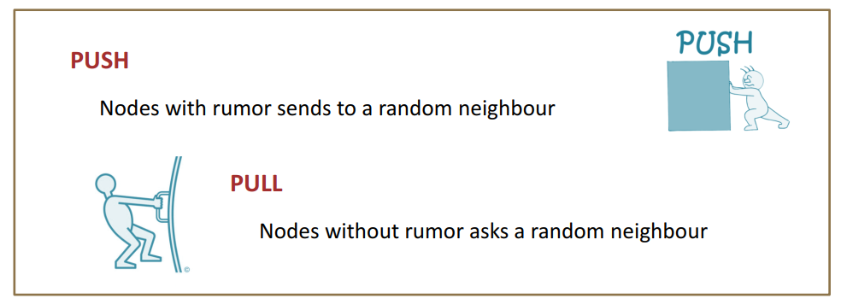
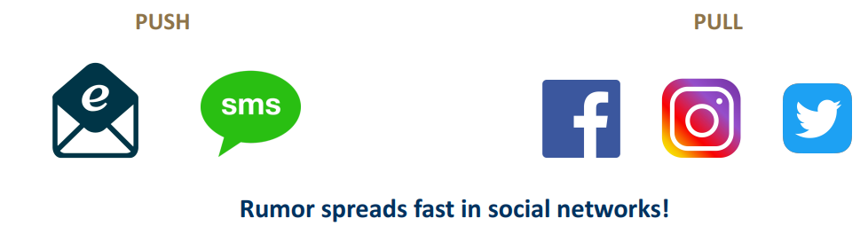
Gossip protocol
From He Sun, University of Edingburgh
From He Sun, University of Edingburgh
Two gossip versions: “Push” and “Pull”
Push: One with gossip periodically sends it to other random nodes
Pull: One without gossip periodically requests it from other random nodes

Slide 22
Outline
Introduction to multicast problem
Gossip protocol
Gossip analysis
Gossip implementation

Slide 23
Recall the requirement of multicast in cloud
Performance, fault-tolerance, scalability
Performance: Quickly deliver messages
Fault-tolerance: Nodes may crash; Packets may be dropped
Scalability: 10K+ of nodes
Now we analyze the gossip protocol, to see why it has:
High performance: Spreads multicast quickly
Good scalability: Lightweight in large groups
Good fault-tolerance: Robust to node and network failure

Slide 24
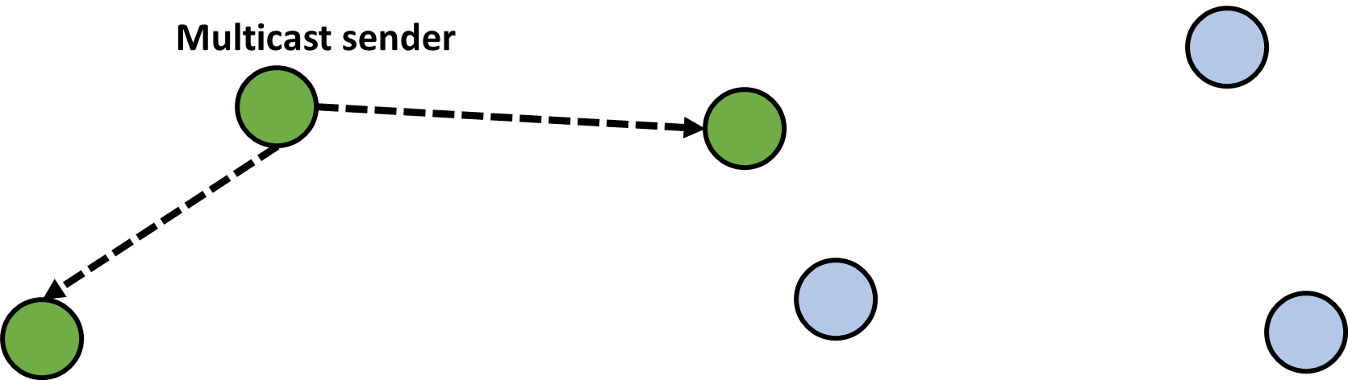

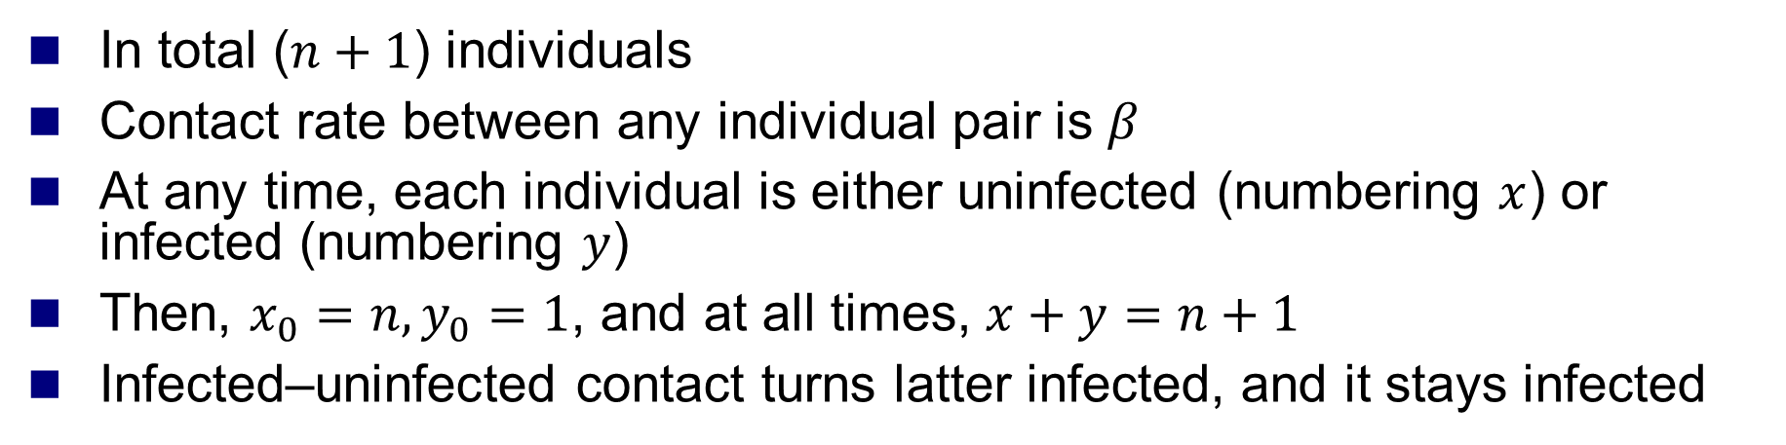
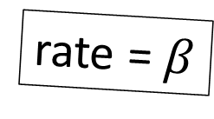
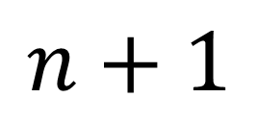

Some necessary definitions
From old mathematical branch of Epidemiology [Bailey 75]
In total ($n+1$) individuals
Contact rate between any individual pair is $β$
At any time, each individual is either uninfected (numbering $x$) or infected (numbering $y$)
Then, $x_{0}=n, y_{0}=1$, and at all times, $x+y=n+1$
Infected–uninfected contact turns latter infected, and it stays infected
rate = $β$
$$x$$
$$y$$
$$n+1$$

Slide 25
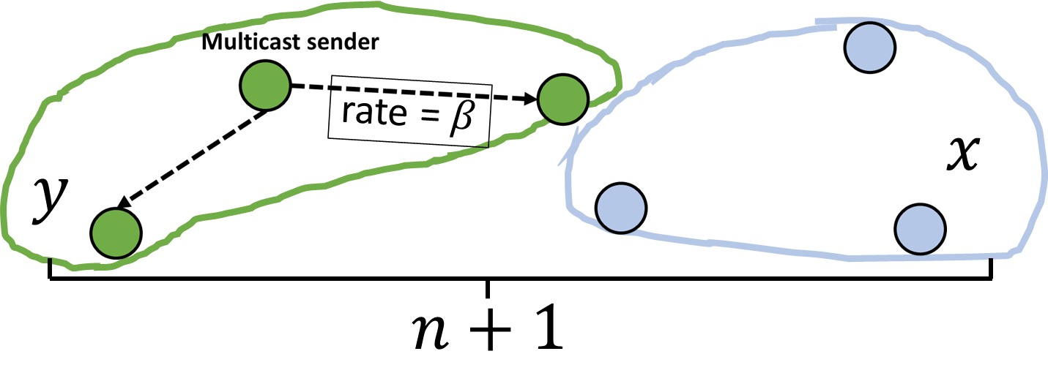

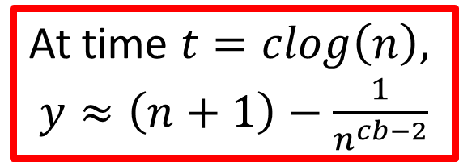
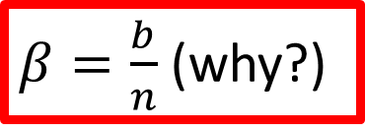
Analysis
Assuming to be a continuous time process
Then
$\frac{dx}{dt}=−βxy$ (why?)
With solution
$x=\frac{n(n+1)}{n+e^{β\left(n+1\right)t}}, y=\frac{n+1}{1+{ne}^{−β\left(n+1\right)t}}$
$β=\frac{b}{n}$ (why?)
At time $t=clog\left(n\right),$
$y≈\left(n+1\right)−\frac{1}{n^{cb−2}}$

Slide 26
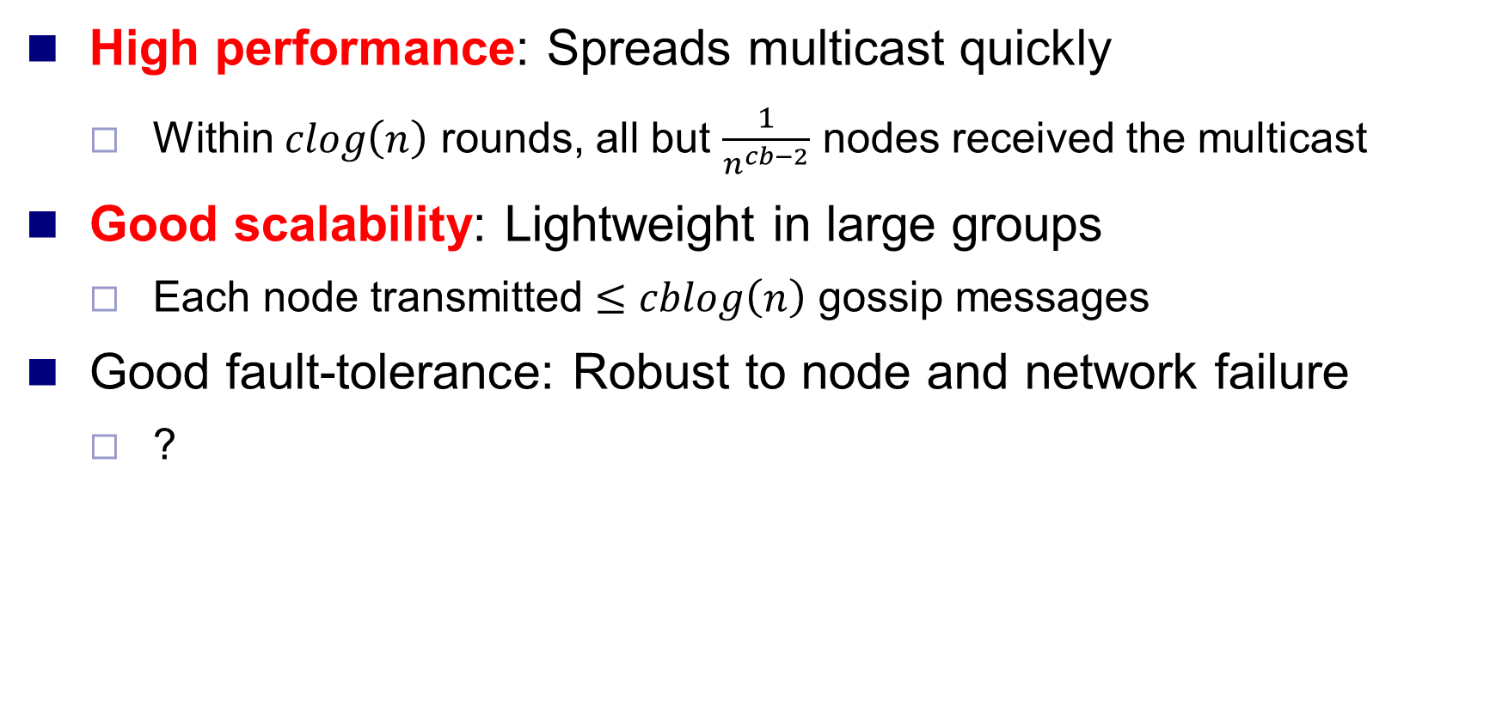
Analysis (contd.)
High performance: Spreads multicast quickly
Within $clog\left(n\right)$ rounds, all but $\frac{1}{n^{cb−2}}$ nodes received the multicast
Good scalability: Lightweight in large groups
Each node transmitted $≤cblog\left(n\right)$ gossip messages
Good fault-tolerance: Robust to node and network failure
?

Slide 27

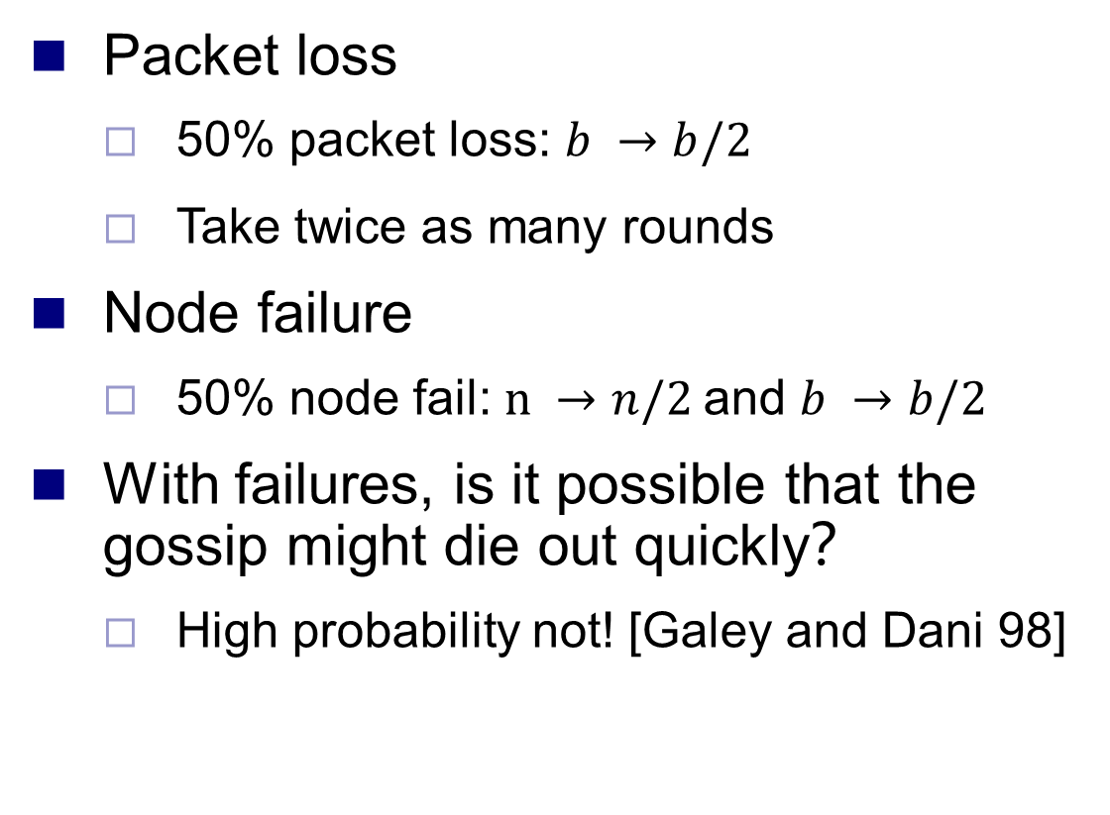
Analysis: Fault-tolerance
Packet loss
50% packet loss: $b →b/2$
Take twice as many rounds
Node failure
50% node fail: $n →n/2$and $b →b/2$
With failures, is it possible that the gossip might die out quickly？
High probability not! [Galey and Dani 98]
Think about infectious diseases

Slide 28
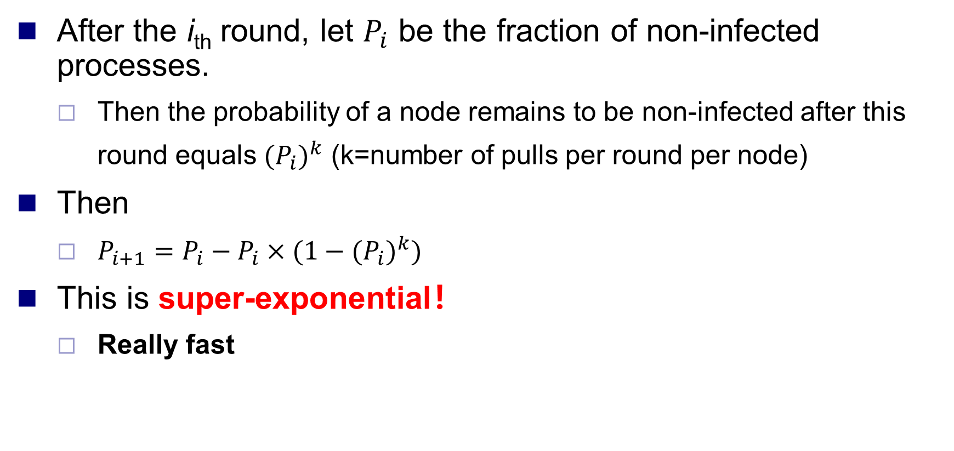
Analysis: Pull gossip
After the i_{th} round, let $P_{i}$ be the fraction of non-infected processes.
Then the probability of a node remains to be non-infected after this round equals ${{(P}_{i})}^{k}$ (k=number of pulls per round per node)
Then
$P_{i+1}=P_{i}−P_{i}×(1−{{(P}_{i})}^{k})$
This is super-exponential！
Really fast
Multicast sender
k=2

Slide 29
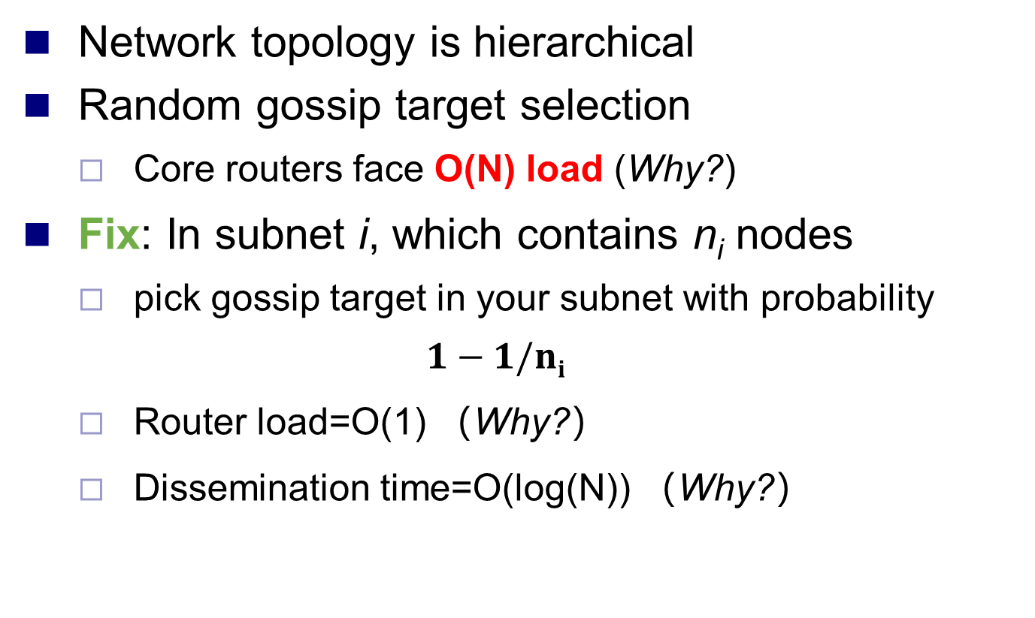
Analysis: Topology-aware Gossip
Network topology is hierarchical
Random gossip target selection
Core routers face O(N) load (Why?)
Fix: In subnet i, which contains n_{i} nodes
pick gossip target in your subnet with probability
$$1−1/ni$$
Router load=O(1) （Why?）
Dissemination time=O(log(N)) （Why?）
Spine
N/2 nodes
N/2 nodes

Slide 30
Outline
Introduction to multicast problem
Gossip protocol
Gossip analysis
Gossip implementation

Slide 31
So, …
Is this all theory and a bunch of equations?
Or are there implementations yet?

Slide 32
Some implementations
Clearinghouse and Bayou projects: email and database transactions [PODC’87]
refDBMS system [Usenix’94]
Bimodal Multicast [ACM TOCS’99]
Sensor networks [Li Li et al, Infocom’02, and PBBF, ICDCS’05]
AWS EC2 and S3 Cloud (rumored). [‘00s]
Cassandra key-value store (and others) use gossip for maintaining membership lists
Usenet NNTP (Network News Transport Protocol) [‘79]

Slide 33
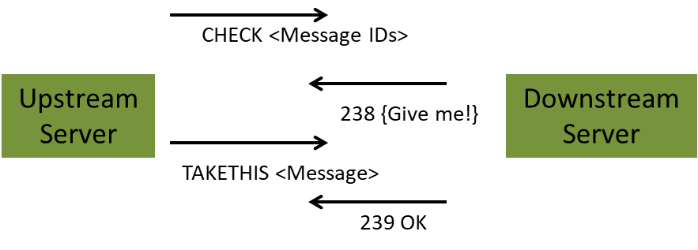
NNTP Inter-server Protocol
Each client uploads and downloads news posts from a news server
Server retains news posts for a while, transmits them lazily, deletes them after a while.

Slide 34
Summary
Multicast is an important problem
Tree-based multicast protocols not enough
When concerned about scale and fault-tolerance, gossip is an attractive solution
Also known as epidemics
Fast, reliable, fault-tolerant, scalable, topology-aware

Slide 35
Thanks!
陈果 副教授
湖南大学-信息科学与工程学院-计算机与科学系
邮箱：guochen@hnu.edu.cn
个人主页：1989chenguo.github.io
https://1989chenguo.github.io/Courses/CloudComputing2018Spring.html

