Slide 1
云计算技术
陈果 副教授
湖南大学-信息科学与工程学院-计算机与科学系
邮箱：guochen@hnu.edu.cn
个人主页：1989chenguo.github.io
https://1989chenguo.github.io/Courses/CloudComputing2018Spring.html

Slide 2
What we have learned
What is cloud computing
Cloud Networking
Cloud Distributed System
Introduction to Cloud Distributed System
MapReduce
Gossip
What’s for
Protocol
Analysis
Implementation

Slide 3
Membership
Part #2: Cloud Distributed System
Most materials from UIUC MOOC
Thanks Indranil Gupta

Slide 4
Outline
What is membership
Failure detectors
Gossip-style membership
Best failure detector
Another probabilistic failure detector
Dissemination and suspicion

Slide 5
Outline
What is membership
Failure detectors
Gossip-style membership
Best failure detector
Another probabilistic failure detector
Dissemination and suspicion

Slide 6


A challenge
You’ve been put in charge of a datacenter, and your manager has told you
“We don’t have any failures in our datacenter!”
Do you believe him/her?

Slide 7

Failures are the Norm
… not the exception, in datacenters.
Say, the rate of failure of one machine (OS/disk/motherboard/network, etc.) is once every 10 years (120 months) on average.
When you have 120 servers in the DC, the mean time to failure (MTTF) of the next machine is 1 month.
When you have 12,000 servers in the DC, the MTTF is about once every 7.2 hours!
Soft crashes and failures are even more frequent!
SIGCOMM’11 Understanding failures in DCN

Slide 8
Failure detector
You’ve been put in charge of a datacenter…
What would be your first responsibility facing these failures?
Build a failure detector

Slide 9
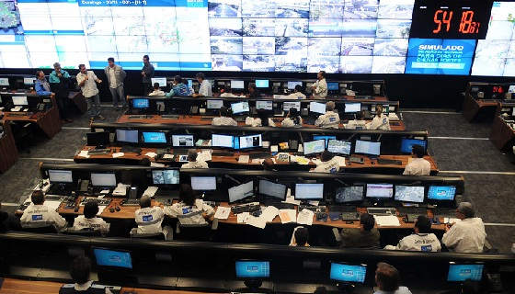
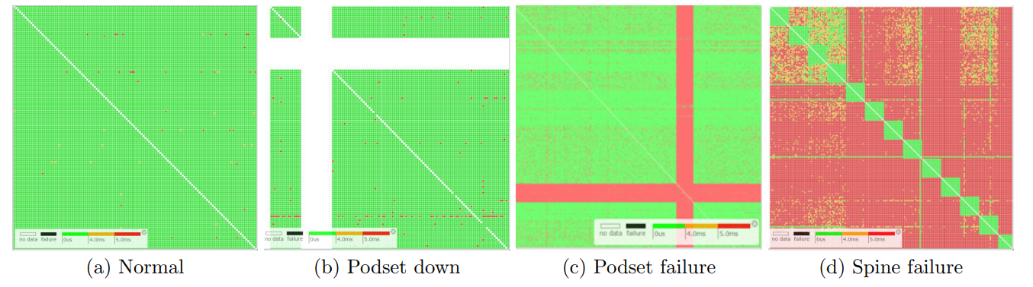
To build a failure detector
You have a few options
Hire 1000 people, each to monitor one machine in the datacenter and report to you when it fails.
Write a failure detector program (distributed) that automatically detects failures and reports to your workstation.
SIGCOMM’15 Pingmesh

Slide 10
To build a failure detector
You have a few options
Hire 1000 people, each to monitor one machine in the datacenter and report to you when it fails.
Write a failure detector program (distributed) that automatically detects failures and reports to your workstation.
SIGCOMM’15 Pingmesh

Slide 11
Target Settings
Process “group”-based systems
Clouds/Datacenters
Replicated servers
Distributed databases
Fail-stop (crash) process failures

Slide 12

Group Membership Service
Application Queries
e.g., gossip, overlays, DHT’s, etc.
Application Process pi
joins, leaves, failures
of members
Membership
Protocol
Membership List
Group
Membership List
Unreliable
Communication

Slide 13
Two sub-protocols
Application Process pi
Group Membership List
Complete list all the time (Strongly consistent)
Virtual synchrony
Almost-Complete list (Weakly consistent)
Gossip-style, SWIM, …
Or Partial-random list (other systems)
SCAMP, T-MAN, Cyclon,…
pj
Dissemination
Failure Detector
Unreliable Communication

Slide 14
Large Group: Scalability A Goal
this is us (pi)
Process Group “Members”
1000’s of processes
Unreliable Communication
Network

Slide 15
Group Membership Protocol
II
Failure Detector
I pj crashed
Some process finds out quickly
pi
pj
III
Dissemination
Unreliable Communication
Network
Fail-stop Failures only

Slide 16
Next
How do you design a group membership protocol?

Slide 17
Outline
What is membership
Failure detectors
Gossip-style membership
Best failure detector
Another probabilistic failure detector
Dissemination and suspicion

Slide 18
Node crashes
Nothing we can do about it!
A frequent occurrence
Common case rather than exception
Frequency goes up linearly with size of datacenter

Slide 19
Distributed Failure Detectors: Desirable Properties
Completeness = each failure is detected
Accuracy = there is no mistaken detection
Speed
Time to first detection of a failure
Scale
Equal Load on each member
Network Message Load

Slide 20
Distributed Failure Detectors: Desirable Properties
Completeness
Accuracy
Speed
Time to first detection of a failure
Scale
Equal Load on each member
Network Message Load
Impossible together in lossy networks [Chandra and Toueg]
If possible, then can solve consensus! (but consensus is known to be unsolvable in asynchronous systems)

Slide 21
What Real Failure Detectors Prefer
Guaranteed
Completeness
Accuracy
Speed
Time to first detection of a failure
Scale
Equal Load on each member
Network Message Load
Partial/Probabilistic Guaranteed

Slide 22
Failure Detector Properties
Guaranteed
Completeness
Accuracy
Speed
Time to first detection of a failure
Scale
Equal Load on each member
Network Message Load
Partial/Probabilistic Guaranteed
Time until SOME processes detects the failure
No bottlenecks/single
failure point

Slide 23
Failure Detector Properties
Completeness
Accuracy
Speed
Time to first detection of a failure
Scale
Equal Load on each member
Network Message Load
In spite of arbitrary simultaneous process failures

Slide 24
Centralized Heartbeating
pi
…
pi, Heartbeat Seq. l++
Single failure point
pj
Heartbeats sent periodically
If heartbeat not received from pi within timeout, mark pi as failed
Traffic hot spot

Slide 25
Ring Heartbeating
Unpredictable on
simultaneous multiple failures
High cost to build/rebuild ring
pi
pi, Heartbeat Seq. l++
pj
…
…

Slide 26
All-to-All Heartbeating
Equal load per member
Complete
High traffic load
Low acuracy
pi, Heartbeat Seq. l++
pi
…
pj

Slide 27
Next
How do we increase the robustness of all-to-all heartbeating?

Slide 28
Outline
What is membership
Failure detectors
Gossip-style membership
Best failure detector
Another probabilistic failure detector
Dissemination and suspicion

Slide 29
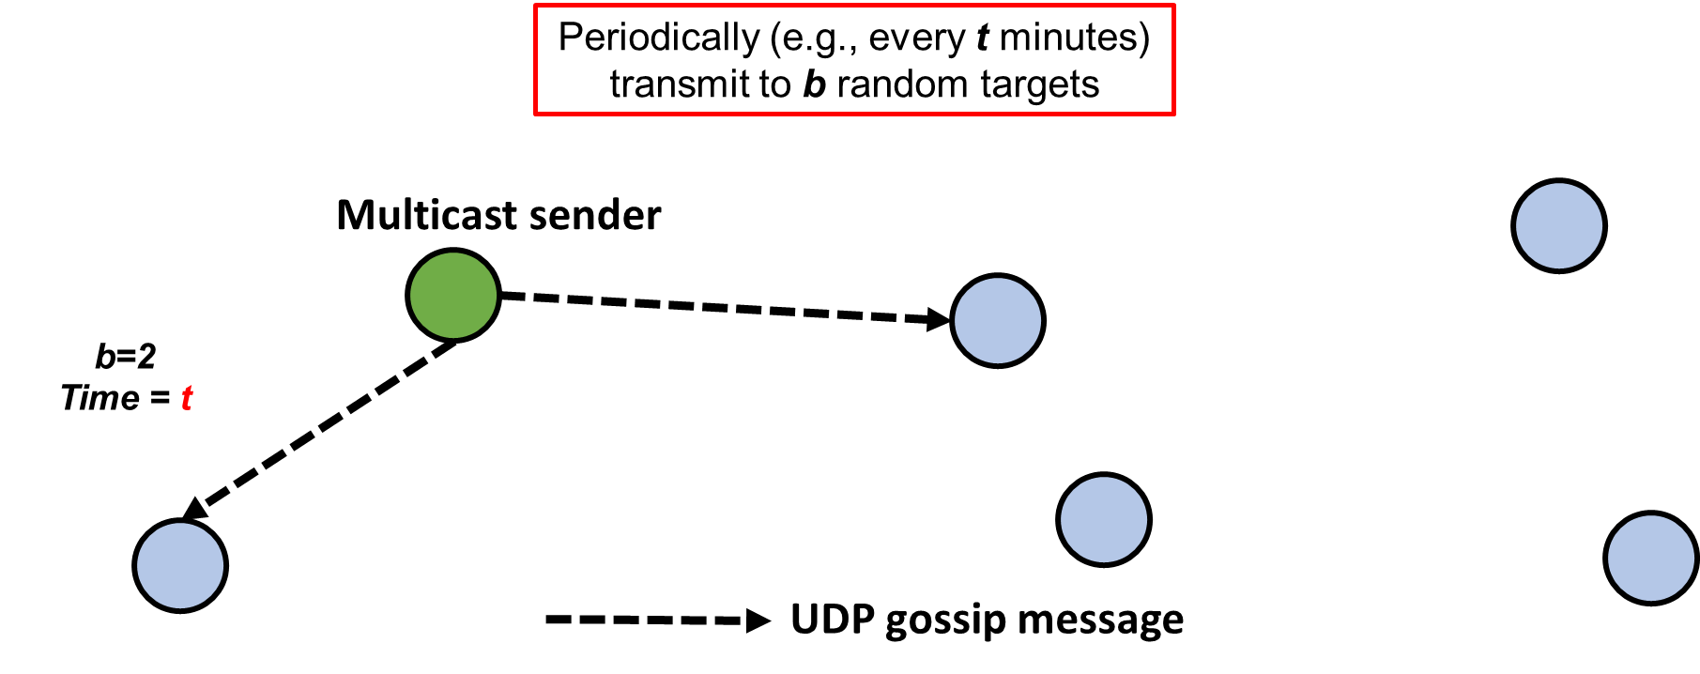
Gossip-style Heartbeating
☺ Good accuracy properties
Randomly choose a set of members to heartbeat
pi

Slide 30
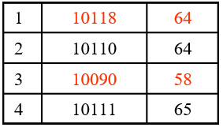
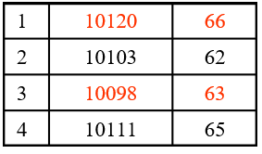
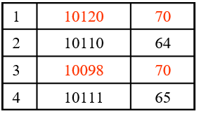
Gossip-Style Failure Detection
2
1
Address
Time (local)
Heartbeat Counter
4
3
Protocol:
Nodes periodically gossip their membership list: pick random nodes, send it list
On receipt, it is merged with local membership list
When an entry times out, member is marked as failed
Current time : 70 at node 2
(asynchronous clocks)

Slide 31
Gossip-Style Failure Detection
If the heartbeat has not increased for more than T_{fail} seconds, the member is considered failed
And after a further T_{cleanup} seconds, it will delete the member from the list
Why an additional timeout? Why not delete right away?

Slide 32
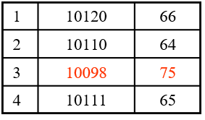
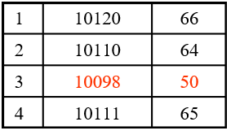
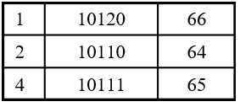
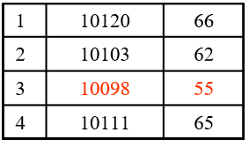
Gossip-Style Failure Detection
What if an entry pointing to a failed node is deleted right after T_{fail} (=24) seconds?
2
1
Current time : 75 at node 2
4
3
Fix: remember for another T_{cleanup}

Slide 33
Analysis/Discussion
Well-known result: a gossip takes O(log(N)) time to propagate.
So: Given sufficient bandwidth, a single heartbeat takes O(log(N)) time to propagate.
So: N heartbeats take:
O(log(N)) time to propagate, if bandwidth allowed per node is allowed to be O(N)
O(N.log(N)) time to propagate, if bandwidth allowed per node is only O(1)
What happens if gossip period T_{gossip} is decreased?
What happens to P_{mistake} (false positive rate) as T_{fail} ,T_{cleanup} is increased?
Tradeoff: False positive rate vs. detection time vs. bandwidth

Slide 34
Next
So, is this the best we can do? What is the best we can do?

Slide 35
Outline
What is membership
Failure detectors
Gossip-style membership
Best failure detector
Another probabilistic failure detector
Dissemination and suspicion

Slide 36

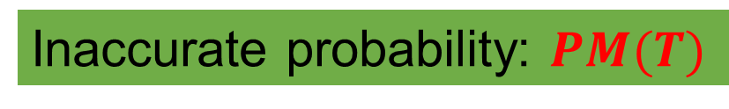
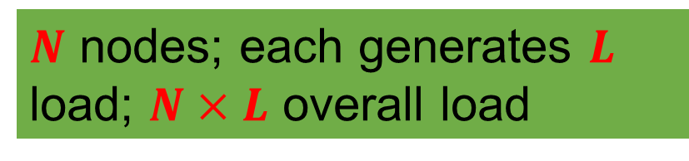
Which is the best failure detector?
Guaranteed
Completeness
Accuracy
Speed
Time to first detection of a failure
Scale
Equal Load on each member
Network Message Load
Inaccurate probability: $PM(T)$
$T$ time units
$N$ nodes; each generates $L$ load; $N×L$ overall load

Slide 37
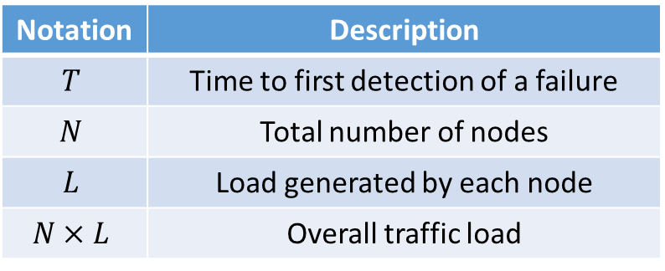
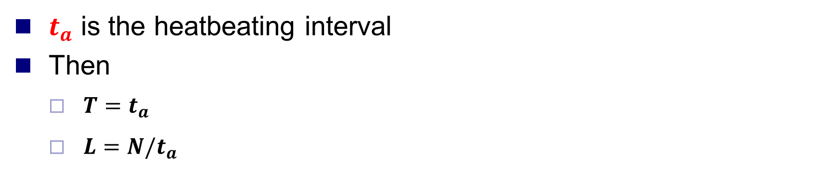
All-to-All Heartbeating
Notation | Description
$$T$$ | Time to first detection of a failure
$$N$$ | Total number of nodes
$$L$$ | Load generated by each node
$$N×L$$ | Overall traffic load
$t_{a}$ is the heatbeating interval
Then
$T=t_{a}$
$L=N/t_{a}$
pi, Heartbeat Seq. l++
pi
…
pj

Slide 38
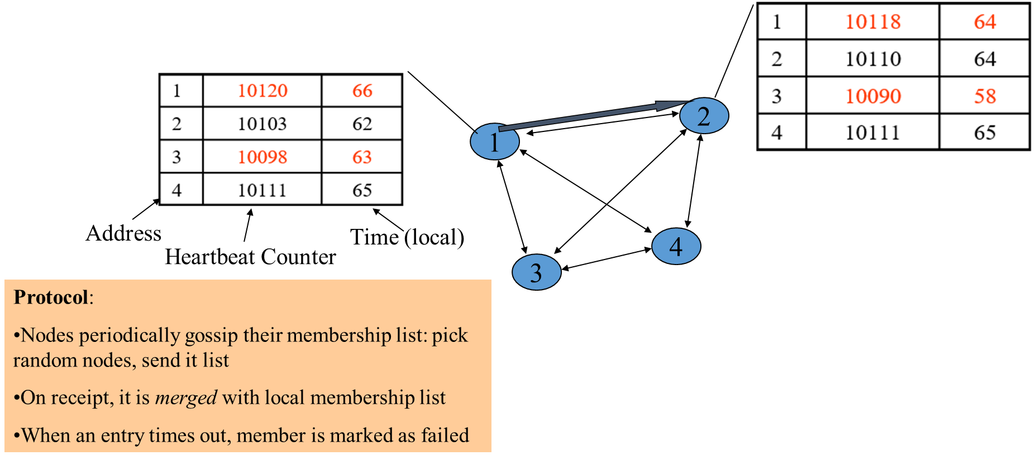
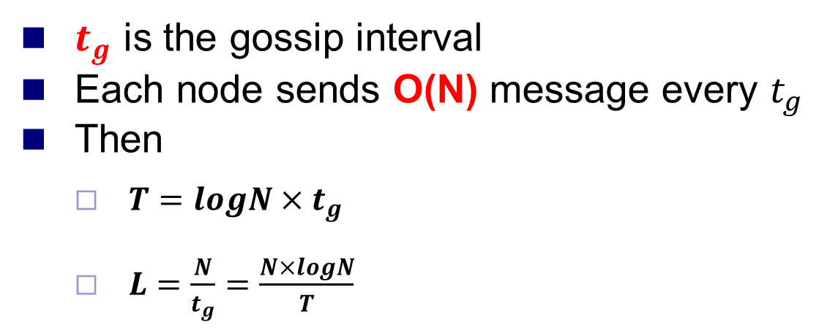
Gossip-style Heartbeating
Notation | Description
$$T$$ | Time to first detection of a failure
$$N$$ | Total number of nodes
$$L$$ | Load generated by each node
$$N×L$$ | Overall traffic load
$t_{g}$ is the gossip interval
Each node sends O(N) message every $t_{g}$
Then
$T=logN×t_{g}$
$L=\frac{N}{t_{g}}=\frac{N×logN}{T}$

Slide 39
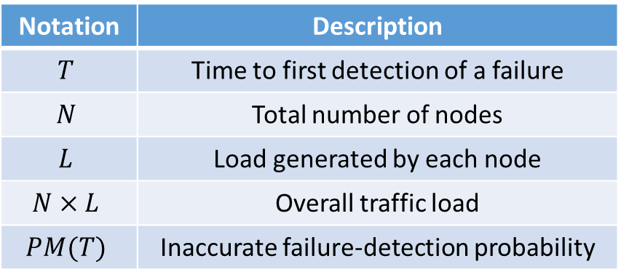

What’s the Best/Optimal we can do?
Worst case load $L^{∗}$ per member in the group (messages per second) as a function of $T, PM(T), N$
Independent Message Loss probability $P_{ml}$
Notation | Description
$$T$$ | Time to first detection of a failure
$$N$$ | Total number of nodes
$$L$$ | Load generated by each node
$$N×L$$ | Overall traffic load
$$PM(T)$$ | Inaccurate failure-detection probability

Slide 40
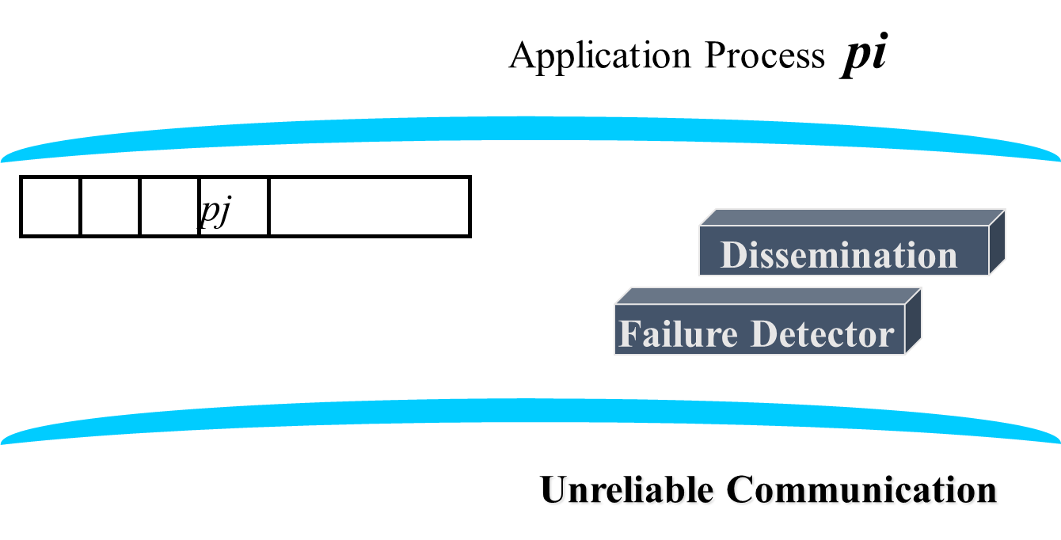
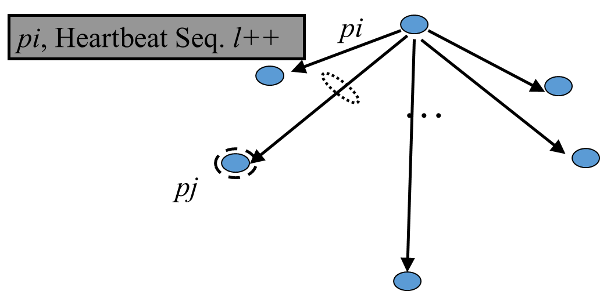
What’s the Best/Optimal we can do?
Optimal L is independent of N (!)
All-to-all and gossip-based: sub-optimal
L=O(N/T)
try to achieve simultaneous detection at all processes
fail to distinguish Failure Detection and Dissemination components

Slide 41
What’s the Best/Optimal we can do?
Optimal L is independent of N (!)
All-to-all and gossip-based: sub-optimal
L=O(N/T)
try to achieve simultaneous detection at all processes
fail to distinguish Failure Detection and Dissemination components
Can we reach this bound?
Key:
Separate the two components
Use a non heartbeat-based Failure Detection Component

Slide 42
Outline
What is membership
Failure detectors
Gossip-style membership
Best failure detector
Another probabilistic failure detector
Dissemination and suspicion

Slide 43
SWIM Failure Detector Protocol
pi
pj
random pj
ping
K random
processes
X
ack
random K
ping-req
X
If no ACK returns at the end of T’, pj is maked as failed
Protocol period
= T’ time units
ping
ack
ack
Second chance to pj
Tolerant the variance between pi and pi

Slide 44
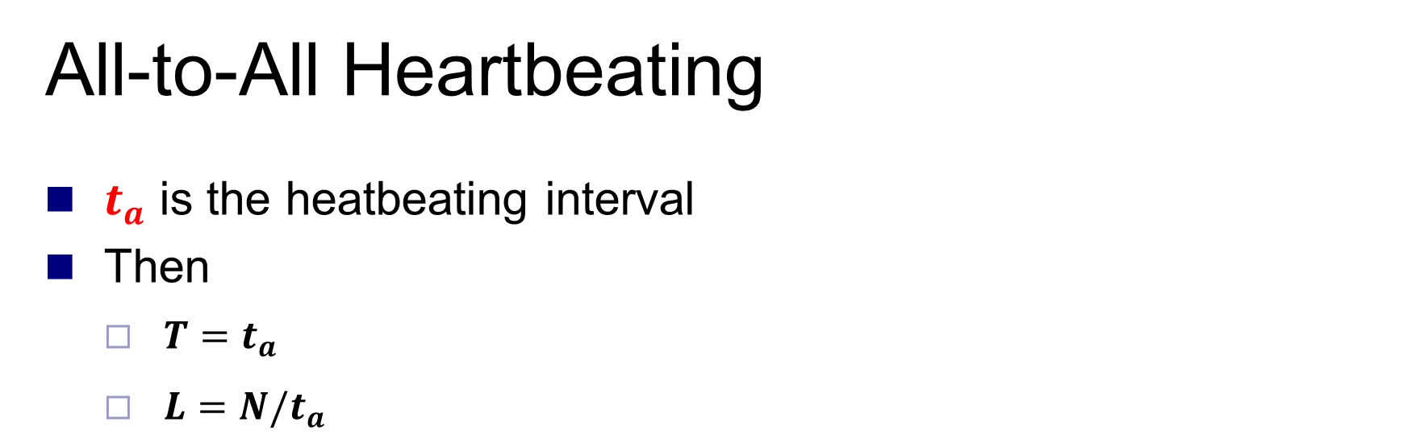
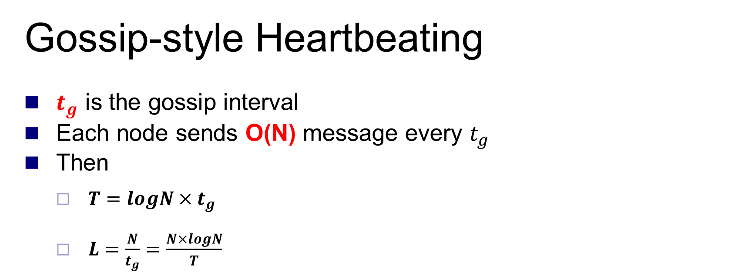
SWIM versus Heartbeating
Heartbeating
O(N)
First Detection
Time
SWIM
Heartbeating
Constant
Constant
Process Load
O(N)
For Fixed :
False Positive Rate
Message Loss Rate

Slide 45
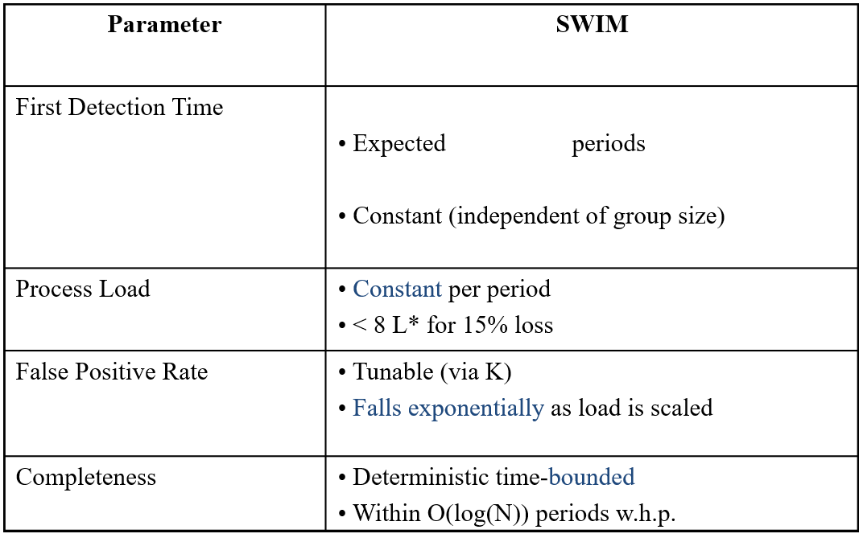
SWIM Analysis Results Overview

Slide 46

Accuracy, Load
Accuracy
$PM(T)$is exponential in $−K$. Also depends on $P_{ml}$ (and $P_{f}$ )
See paper for details
Load
Bounded to optimal for up to 15 % loss rates

Slide 47

Detection Time
Prob. of being pinged in $T’=1−{\left(1−\frac{1}{N}\right) }^{N−1}$
$\lim_{N→∞}{T′}=1−e^{−1}$
$E\left[T\right]=T^{′}×\frac{e}{e−1}$
Expected first detection time = $\frac{e−1}{e}$ time periods

Slide 48
Time-bounded Completeness
Completeness: Any alive member detects failure
Eventually
By using a trick: within worst case O(N) protocol periods
Key: select each membership element once as a ping target in a traversal
Round-robin pinging
Random permutation of list after each traversal
Each failure is detected in worst case 2N-1 time periods

Slide 49
Next
How do failure detectors fit into the big picture of a group membership protocol?
What are the missing blocks?

Slide 50
Outline
What is membership
Failure detectors
Gossip-style membership
Best failure detector
Another probabilistic failure detector
Dissemination and suspicion

Slide 51
Recall Group Membership Protocol
II
Failure Detector
I pj crashed
Some process finds out quickly
pi
pj
III
Dissemination
Unreliable Communication
Network
Fail-stop Failures only

Slide 52
Dissemination Options
Multicast (Hardware / IP)
unreliable
multiple simultaneous multicasts
Point-to-point (TCP / UDP)
expensive
Zero extra messages: Piggyback on Failure Detector messages
Gossip-style Dissemination

Slide 53
Gossip-style Dissemination
pi
pj
random pj
ping
K random
processes
X
ack
random K
ping-req
X
Protocol period
= T’ time units
ping
ack
ack
Group Membership List
pj
Piggybacked membership information

Slide 54
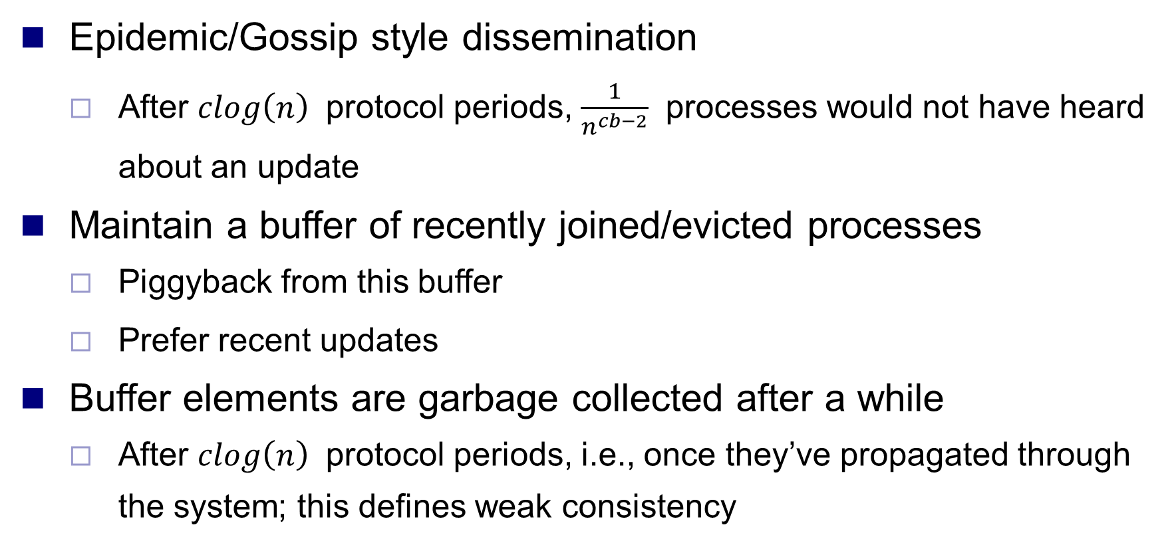
Gossip-style Dissemination
Epidemic/Gossip style dissemination
After $clog\left(n\right)$ protocol periods, $\frac{1}{n^{cb−2}}$ processes would not have heard about an update
Maintain a buffer of recently joined/evicted processes
Piggyback from this buffer
Prefer recent updates
Buffer elements are garbage collected after a while
After $clog\left(n\right)$ protocol periods, i.e., once they’ve propagated through the system; this defines weak consistency
Group Membership List
pj

Slide 55
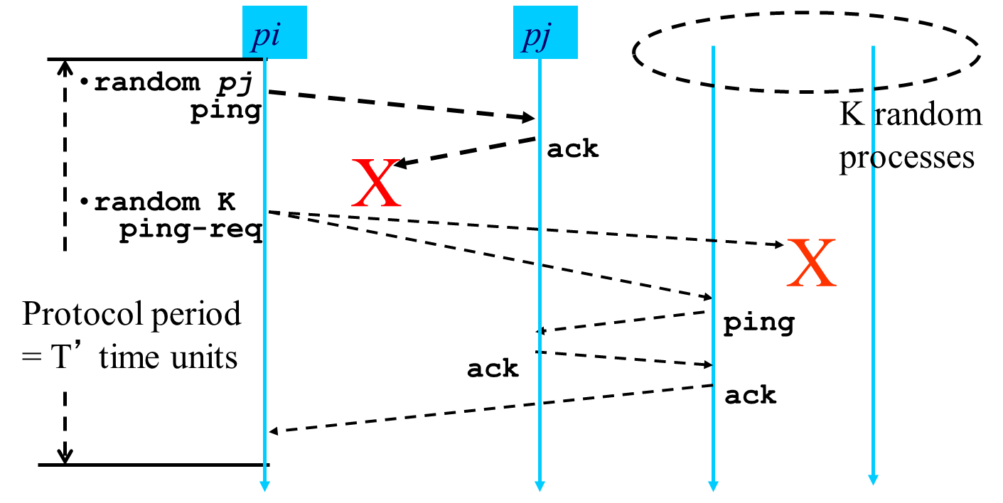
Suspicion Mechanism
False detections, due to
Perturbed processes
Packet losses, e.g., from congestion
Indirect pinging may not solve the problem
Key: suspect a process before declaring it as failed in the group

Slide 56
Suspicion Mechanism
pi :: state machine for pj view element
Dissmn (Suspect pj)
FD:: pi ping failed
Dissmn::(Suspect pj)
Suspected
Time out
FD::pi ping success
Dissmn::(Alive pj)
Alive
Failed
Dissmn (Alive pj)
Dissmn (Failed pj)

Slide 57
Membership wrap up
Failures the norm, not the exception in datacenters
Every distributed system uses a failure detector
Many distributed systems use a membership service
Ring failure detection underlies
IBM SP2 and many other similar clusters/machines
Gossip-style failure detection underlies
Amazon EC2/S3 (rumored!)
SWIM failure detection underlies
Uber, Oasis/CoralCDN

Slide 58
Thanks!
陈果 副教授
湖南大学-信息科学与工程学院-计算机与科学系
邮箱：guochen@hnu.edu.cn
个人主页：1989chenguo.github.io
https://1989chenguo.github.io/Courses/CloudComputing2018Spring.html

