Slide 1
云计算技术
陈果 副教授
湖南大学-信息科学与工程学院-计算机与科学系
邮箱：guochen@hnu.edu.cn
个人主页：1989chenguo.github.io

Slide 2
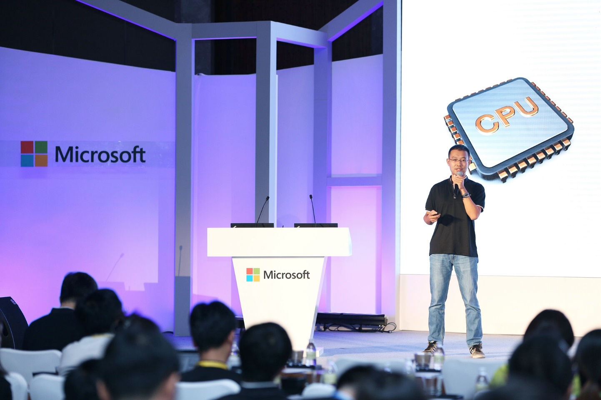
个人简介
简介
陈果，副教授
1989年生，湖南长沙人
工作经历
2018.01-
湖南大学-信科院-计算机系，副教授
2016.07-2018.01
微软亚洲研究院-网络组，高级副研究员
教育背景
2011.09-2016.06
清华大学计算机系，博士
2007.09-2011.06
武汉大学电信学院，本科
科研领域
网络系统：计算机网络，数据中心网络，异构高性能网络
邮箱：guochen@hnu.edu.cn
个人主页：https://1989chenguo.github.io/

Slide 3







What is cloud computing?
“Cloud computing is the delivery of computing services—servers, storage, databases, networking, software, analytics and more—over the Internet. ”

Slide 4

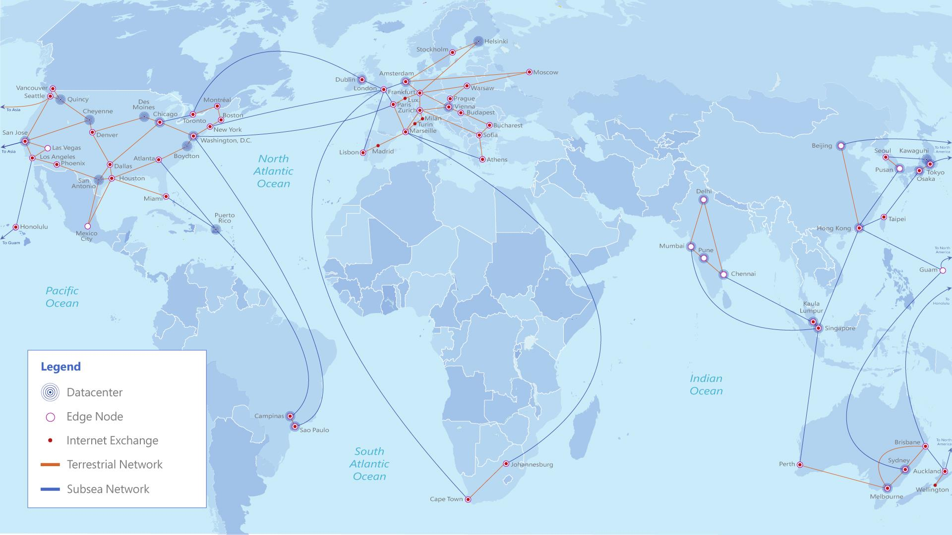
What is cloud computing?
Cloud = Lots of computation/memory resources somewhere else
Cloud computing = Deliver computing services based-on cloud

Slide 5
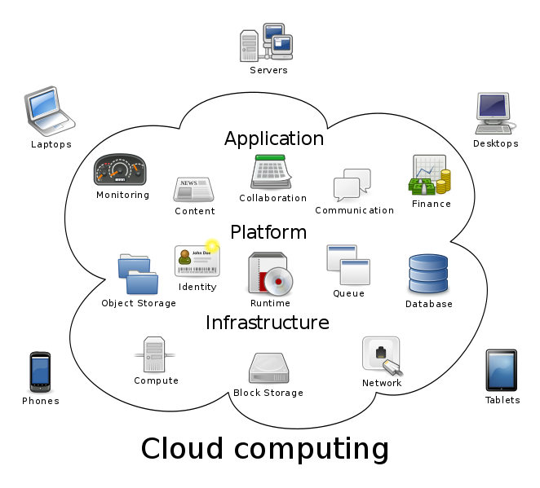
Cloud computing architecture
Service
Various cloud services
Distributed systems
Programming paradigm
Distributed algorithms
Resource pool
Virtualization
Scheduling
Mgmt.
Networking

Slide 6
Cloud computing architecture
What you’ll learn
in this class
Various cloud services
(I don’t care, haha)
Service
Various cloud services
Distributed systems
Programming paradigm
Distributed algorithms
Resource pool
Virtualization
Scheduling
Mgmt.
Networking

Slide 7
What you will learn in this class
Cloud networking
New application scenario
New challenges
Latest research
Distributed systems in cloud
Classic distributed algorithms
Latest systems

Slide 8
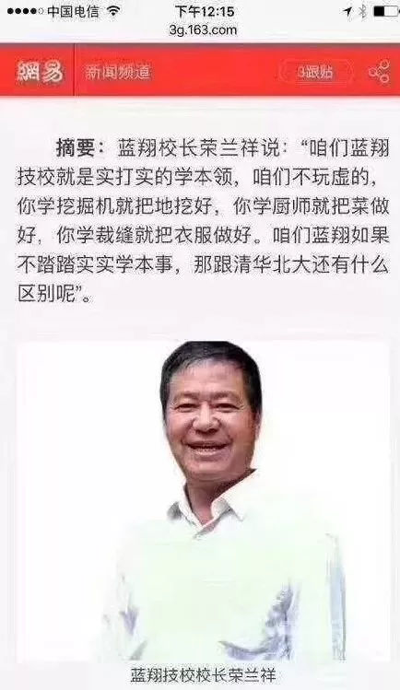
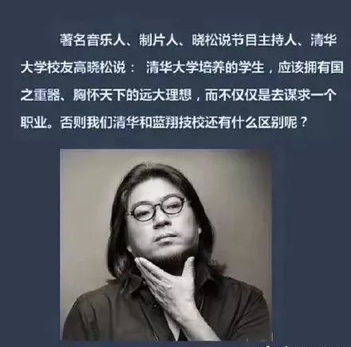
What you will learn in this class
别整这些虚的!
Know how underlying network and distributed system work + how they applied to nowadays hot cloud computing
Start to be an engineer
Catch up some latest research; Get the feeling of doing research and the taste of good research
Start to be a researcher

Slide 9
Course policies: Grading
Project report (70%)
Topic
New ideas/Reimplementation/Performance analysis/Survey/Understanding to the latest research in cloud networking
I will give a list; You are also welcome to find other good & new research
Group-based
5 students in a group; 1 leader, 4 members
Form
Tech. report (No length requirement; Just present your work clearly enough! )
Group presentation: < 5 minutes (Optional. +5 points for the group)
Final exam (30%)
Small quiz with no more than 10 questions
Open book exam

Slide 10
Thanks!

