Slide 1

Don’t Mind the Gap:
Bridging Network-wide Objectives
and Device-level Configurations
Ryan Beckett (Princeton, MSR)
Ratul Mahajan (MSR)
Todd Millstein (UCLA)
Jitu Padhye (MSR)
David Walker (Princeton)

Slide 2
Configuring Networks is Error-Prone
~60% of network downtime is caused by human error
-Yankee group 2002
50-80% of outages from configuration changes
-Juniper 2008
Notes:
number of studies that surveyed operators
… are responsible for …

Slide 3
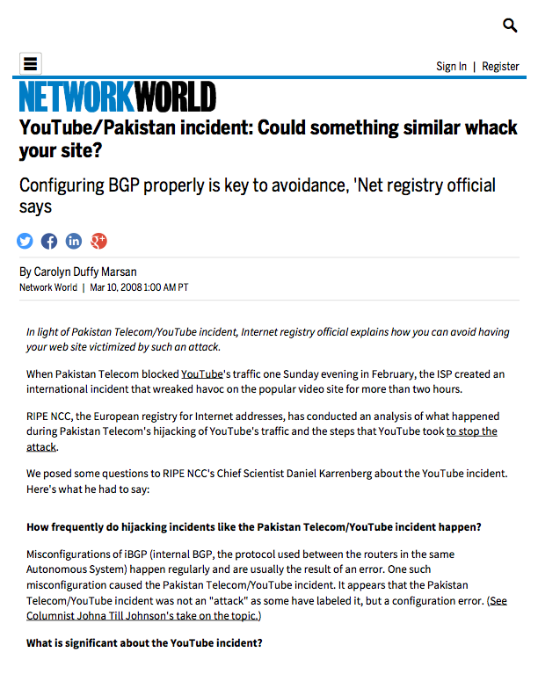
Configuring Networks is Error-Prone
Notes:
and the problem is that … can have very profound consequences

Slide 4
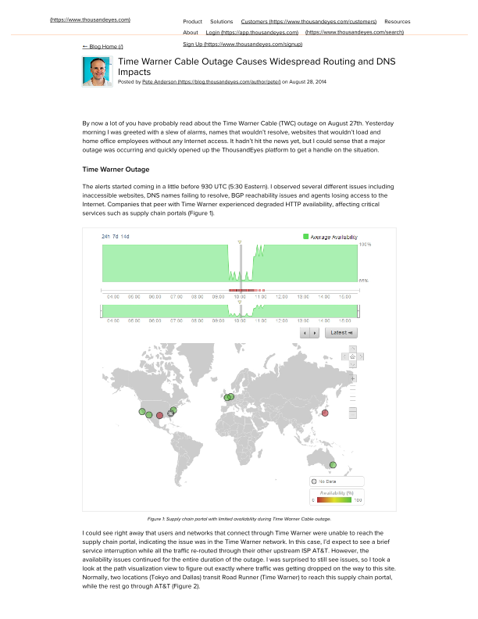
Configuring Networks is Error-Prone

Slide 5

Configuring Networks is Error-Prone

Slide 6

Configuring Networks is Error-Prone

Slide 7
Fundamental Tradeoff?
Configuration
Distributed
Centralized
Distributed
Control
Mechanism
Centralized
Notes:
One of the reasons why configuration is so difficult is because

Slide 8
Fundamental Tradeoff?
Configuration
Distributed
Centralized
OSPF
Scalability
Robustness
Complexity
Distributed
RIP
BGP
Control
Mechanism
Centralized
Notes:
for traditional networks — networks running protocols such as OSPF/BGP, the control plane mechanism is completely distributed

Slide 9
Fundamental Tradeoff?
Configuration
Distributed
Centralized
OSPF
Scalability
Robustness
Complexity
Distributed
RIP
BGP
Control
Mechanism
100,000s of
lines of config
Centralized
Notes:
Explain why BGP/OSPF fall into this category
Explain why SDN falls into this category (e.g., with concrete example: OpenDaylight)
Go through each property in detail for both cases

Slide 10
Fundamental Tradeoff?
Configuration
Distributed
Centralized
OSPF
Scalability
Robustness
Complexity
Distributed
RIP
BGP
Control
Mechanism
Scalability
Robustness
Complexity
Centralized
SDN

Slide 11
Fundamental Tradeoff?
Configuration
Distributed
Centralized
OSPF
Scalability
Robustness
Complexity
Distributed
RIP
Ideal
BGP
Control
Mechanism
Scalability
Robustness
Complexity
Centralized
SDN

Slide 12



Propane Overview
Topology
0,0
1,1
0,1
2,1
Propane
Compiler
BGP Configs

Slide 13
Propane System
I) Language for expressing network-wide objectives with:
Path constraints and preferences in case of failures
Uniform abstractions for intra- and inter-domain routing
AS 2
AS 1
AS 3
Notes:
New high-level language, similar in spirit to many SDN languages
A couple of key differences
The mechanisms for achieving inter domain routing and SDN are non-existent

Slide 14
Propane System
2) Compiler for a purely distributed implementation
Policy

Slide 15
Propane System
2) Compiler for a purely distributed implementation
Generate BGP configs for each router
Compiler guarantees policy-compliance for all failures
BGP
BGP
BGP
BGP
Notes:
Mention if it compiles!!!

Slide 16
Example: A DC network with traditional configs
Peer1
Peer2
Goals
Local prefixes reachable only internally
Global prefixes reachable externally
Aggregate global prefixes as GP
Prefer leaving through Peer1 over Peer2
Prevent transit traffic between peers
X
Y
Y
C
D
C
D
G
H
G
H
A
A
B
B
E
F
E
F
GP1
GP2
LP1
LP2
Global
Prefixes
Local
Prefixes
Notes:
Clarify that BGP is running on all routers

Slide 17

Example: A DC network with traditional configs
Peer1
Peer2
Goals
Local prefixes reachable only internally
Global prefixes reachable externally
Aggregate global prefixes as GP
Prefer leaving through Peer1 over Peer2
Prevent transit traffic between peers
GP
X
Y
Y
C
D
C
D
G
H
G
H
Configuration Attempt
Don’t export from G, H to external
Aggregate externally as GP
A
A
B
B
E
F
E
F
GP1
GP2
LP1
LP2
Global
Prefixes
Local
Prefixes
Notes:
Be clear about the direction of traffic vs. advertisement

Slide 18
Example: A DC network with traditional configs
Peer1
Peer2
Goals
Local prefixes reachable only internally
Global prefixes reachable externally
Aggregate global prefixes as GP
Prefer leaving through Peer1 over Peer2
Prevent transit traffic between peers
GP
X
Y
Y
C
D
C
D
G
H
G
H
Configuration Attempt
Don’t export from G, H to external
Aggregate externally as GP
A
A
B
B
E
F
E
F
GP1
GP2
LP1
LP2
Global
Prefixes
Local
Prefixes
Notes:
Be clear about the direction of traffic vs. advertisement

Slide 19
Example: A DC network with traditional configs
Peer1
Peer2
Goals
Local prefixes reachable only internally
Global prefixes reachable externally
Aggregate global prefixes as GP
Prefer leaving through Peer1 over Peer2
Prevent transit traffic between peers
X
Y
Y
C
D
C
D
G
H
G
H
Configuration Attempt
Don’t export from G, H to external
Aggregate externally as GP
X,Y block routes through each other
A
A
B
B
E
F
E
F
GP1
GP2
LP1
LP2
Global
Prefixes
Local
Prefixes

Slide 20
Example: A DC network with traditional configs
Peer1
Peer2
Goals
Local prefixes reachable only internally
Global prefixes reachable externally
Aggregate global prefixes as GP
Prefer leaving through Peer1 over Peer2
Prevent transit traffic between peers
GP
GP
X
Y
Y
C
D
C
D
G
H
G
H
Configuration Attempt
Don’t export from G, H to external
Aggregate externally as GP
X,Y block routes through each other
A
A
B
B
E
F
E
F
GP1
GP2
LP1
LP2
Global
Prefixes
Local
Prefixes

Slide 21
Example: A DC network with traditional configs
Peer1
Peer2
Goals
Local prefixes reachable only internally
Global prefixes reachable externally
Aggregate global prefixes as GP
Prefer leaving through Peer1 over Peer2
Prevent transit traffic between peers
GP1 traffic
dropped
GP
X
Y
Y
C
D
C
D
G
H
G
H
Configuration Attempt
Don’t export from G, H to external
Aggregate externally as GP
X,Y block routes through each other
A
A
B
B
E
F
E
F
GP1
GP2
LP1
LP2
Global
Prefixes
Local
Prefixes

Slide 22
Example: A DC network with traditional configs
Peer1
Peer2
Goals
Local prefixes reachable only internally
Global prefixes reachable externally
Aggregate global prefixes as GP
Prefer leaving through Peer1 over Peer2
Prevent transit traffic between peers
GP1 traffic
dropped
GP
X
Y
Y
C
D
C
D
G
H
G
H
Configuration Attempt
Don’t export from G, H to external
Aggregate externally as GP
X,Y block routes through each other
A
A
B
B
E
F
E
F
GP1
GP2
LP1
LP2
Global
Prefixes
Local
Prefixes
Aggregation-Induced Black Hole!

Slide 23
Example: A DC network with traditional configs
Peer1
Peer2
Goals
Local prefixes reachable only internally
Global prefixes reachable externally
Aggregate global prefixes as GP
Prefer leaving through Peer1 over Peer2
Prevent transit traffic between peers
X
Y
Y
C
D
C
D
G
H
G
H
A
A
B
B
E
F
E
F
GP1
GP2
LP1
LP2
Global
Prefixes
Local
Prefixes

Slide 24

Example: A DC network with Propane
define Destination =
{GP1 => end(A)
GP2 => end(B)
LP1 => end(E)
LP2 => end(F)
true => exit(Peer1 >> Peer2)}
Peer1
Peer2
X
Y
Y
C
D
C
D
G
H
G
H
A
A
B
B
E
F
E
F
GP1
GP2
LP1
LP2
Global
Prefixes
Local
Prefixes

Slide 25
Example: A DC network with Propane
define Destination =
{GP1 => end(A)
GP2 => end(B)
LP1 => end(E)
LP2 => end(F)
true => exit(Peer1 >> Peer2)}
define Locality =
{LP1 | LP2 => internal}
Peer1
Peer2
X
Y
Y
C
D
C
D
G
H
G
H
A
A
B
B
E
F
E
F
GP1
GP2
LP1
LP2
Global
Prefixes
Local
Prefixes

Slide 26
Example: A DC network with Propane
define Destination =
{GP1 => end(A)
GP2 => end(B)
LP1 => end(E)
LP2 => end(F)
true => exit(Peer1 >> Peer2)}
define Locality =
{LP1 | LP2 => internal}
define transit(X,Y) =
enter(X|Y) and exit(X|Y)
Peer1
Peer2
X
Y
Y
C
D
C
D
G
H
G
H
A
A
B
B
E
F
E
F
GP1
GP2
LP1
LP2
Global
Prefixes
Local
Prefixes

Slide 27
Example: A DC network with Propane
define Destination =
{GP1 => end(A)
GP2 => end(B)
LP1 => end(E)
LP2 => end(F)
true => exit(Peer1 >> Peer2)}
define Locality =
{LP1 | LP2 => internal}
define transit(X,Y) =
enter(X|Y) and exit(X|Y)
define NoTransit =
{true => !transit(Peer1,Peer2)}
Peer1
Peer2
X
Y
Y
C
D
C
D
G
H
G
H
A
A
B
B
E
F
E
F
GP1
GP2
LP1
LP2
Global
Prefixes
Local
Prefixes

Slide 28
Example: A DC network with Propane
define Destination =
{GP1 => end(A)
GP2 => end(B)
LP1 => end(E)
LP2 => end(F)
true => exit(Peer1 >> Peer2)}
define Locality =
{LP1 | LP2 => internal}
define transit(X,Y) =
enter(X|Y) and exit(X|Y)
define NoTransit =
{true => !transit(Peer1,Peer2)}
define Main =
Destination & Locality &
NoTransit & agg(GP, in -> out)
Peer1
Peer2
X
Y
Y
C
D
C
D
G
H
G
H
A
A
B
B
E
F
E
F
GP1
GP2
LP1
LP2
Global
Prefixes
Local
Prefixes
Notes:
Mention here the guarantees (policy-compliance modulo aggregation)

Slide 29

Compilation
Topology
Propane
Compiler
BGP Configs

Slide 30
Compilation
Constraints
on Policy
Topology
0
1
2
0
1
State Machines
Propane
Compiler
BGP Configs

Slide 31
Compilation
Jointly analyze
with topology
Topology
0,0
0
1
2
1,1
0,1
0
1
2,1
State Machines
Product Graph
Propane
Compiler
BGP Configs

Slide 32
Compilation: A simple Example
X
A
D
Y
C
B
E
end(Y) & (path(A,C,D) >> any)

Slide 33
Compilation: A simple Example
X
A
D
Y
C
B
E
end(Y) & (path(A,C,D) >> any)
Convert to Regex
XACDY >> (Σ*)Y

Slide 34
Reversed Automata from Policies
X
A
D
Y
C
B
E
Policy:
1. XACDY
2. (Σ*)Y
More preferred paths
Less preferred paths
Notes:
Be clear about the direction of traffic vs. advertisement

Slide 35
Reversed Automata from Policies
X
A
D
Y
C
B
E
Policy:
Y
D
C
A
X
0
1
2
3
4
5
1. XACDY
2. (Σ*)Y
Σ
Y
0
1

Slide 36
Reversed Automata from Policies
X
A
D
Y
C
B
E
Reversed automata
tracks BGP message flow
Policy:
Y
D
C
A
X
0
1
2
3
4
5
1. XACDY
2. (Σ*)Y
Σ
Y
0
1

Slide 37
Constructing the Product Graph (PG)
(-,0,0)
(Y,1,1)
X
A
D
Y
C
(E, -,1)
(D,2,1)
B
E
(C, -,1)
(D, -,1)
(C,3,1)
(A, -,1)
(B, -,1)
(A,4,1)
Y
D
C
A
X
0
1
2
3
4
5
(X, -, 1)
(X,5,1)
Σ
Y
{2}
{1,2}
0
1

Slide 38
Constructing the Product Graph (PG)
X
A
D
Y
Topology
Location
Automata
States
C
B
E
(X,5,1)
Y
D
C
A
X
0
1
2
3
4
5
Σ
Y
0
1

Slide 39
Constructing the Product Graph (PG)
X
A
D
Y
Topology
Location
Automata
States
C
B
E
(X,5,1)
{1,2}
Y
D
C
A
X
0
1
2
3
4
5
Σ
Y
Path preferences
0
1

Slide 40
Constructing the Product Graph (PG)
(-,0,0)
(Y,1,1)
X
A
D
Y
C
B
E
Y
D
C
A
X
0
1
2
3
4
5
Σ
Y
0
1

Slide 41
Constructing the Product Graph (PG)
(-,0,0)
(Y,1,1)
X
A
D
Y
C
(D,2,1)
B
E
Y
D
C
A
X
0
1
2
3
4
5
Σ
Y
0
1

Slide 42
Constructing the Product Graph (PG)
(-,0,0)
(Y,1,1)
X
A
D
Y
C
(E, -,1)
(D,2,1)
B
E
(C, -,1)
(D, -,1)
(C,3,1)
(A, -,1)
(B, -,1)
(A,4,1)
Graph capturing all possible policy-compliant paths through the topology
(X, -, 1)
(X,5,1)
{2}
{1,2}

Slide 43
Constructing the Product Graph (PG)
(-,0,0)
(Y,1,1)
X
A
D
Y
C
(E, -,1)
(D,2,1)
B
E
(C, -,1)
(D, -,1)
(C,3,1)
(A, -,1)
(B, -,1)
(A,4,1)
Y
D
C
A
X
0
1
2
3
4
5
(X, -, 1)
(X,5,1)
Σ
Y
{2}
{1,2}
0
1
Preferences

Slide 44
Constructing the Product Graph (PG)
(-,0,0)
(Y,1,1)
X
A
D
Y
C
(E, -,1)
(D,2,1)
B
E
(C, -,1)
(D, -,1)
(C,3,1)
(A, -,1)
(B, -,1)
(A,4,1)
Y
D
C
A
X
0
1
2
3
4
5
(X, -, 1)
(X,5,1)
Σ
Y
{2}
{1,2}
0
1
Preferences

Slide 45
Constructing the Product Graph (PG)
(-,0,0)
(Y,1,1)
X
A
D
Y
C
(E, -,1)
(D,2,1)
B
E
(C, -,1)
(D, -,1)
(C,3,1)
(A, -,1)
(B, -,1)
(A,4,1)
Y
D
C
A
X
0
1
2
3
4
5
(X, -, 1)
(X,5,1)
Σ
Y
{2}
{1,2}
0
1
Accept:
Y D C A X
Preferences

Slide 46
Constructing the Product Graph (PG)
start
(Y,1,1)
X
A
D
Y
C
(E, -,1)
(D,2,1)
B
E
(C, -,1)
(D, -,1)
(C,3,1)
(A, -,1)
(B, -,1)
(A,4,1)
Y
D
C
A
X
0
1
2
3
4
5
(X, -, 1)
(X,5,1)
Σ
Y
{2}
{1,2}
0
1
Accept:
Y E C A X
Preferences

Slide 47
Constructing the Product Graph (PG)
(-,0,0)
(Y,1,1)
X
A
D
Y
C
(E, -,1)
(D,2,1)
B
E
(C, -,1)
(D, -,1)
(C,3,1)
(A, -,1)
(B, -,1)
(A,4,1)
Y
D
C
A
X
0
1
2
3
4
5
(X, -, 1)
(X,5,1)
Σ
Y
{2}
{1,2}
0
1

Slide 48
Compilation to BGP:
(-,0,0)
(Y,1,1)
Idea 1: Restrict advertisements to edges
Encode state in a BGP community tag
Incoming edges — import filters
Outgoing edges — export filters
(E, -,1)
(D,2,1)
(C, -,1)
(D, -,1)
(C,3,1)
(A, -,1)
(B, -,1)
(A,4,1)
Let BGP find some allowed path dynamically
(X, -, 1)
(X,5,1)
{2}
{1,2}

Slide 49
Compilation to BGP:
(-,0,0)
X
A
D
Y
(Y,1,1)
C
B
E
(E, -,1)
(D,2,1)
D allows import matching regex(Y)
(C, -,1)
(D, -,1)
(C,3,1)
(A, -,1)
(B, -,1)
(A,4,1)
(X, -, 1)
(X,5,1)
{2}
{1,2}

Slide 50
Compilation to BGP:
(-,0,0)
X
A
D
Y
(Y,1,1)
C
B
E
(E, -,1)
(D,2,1)
(C, -,1)
(D, -,1)
(C,3,1)
D exports to C with tag (2,1)
(A, -,1)
(B, -,1)
(A,4,1)
(X, -, 1)
(X,5,1)
{2}
{1,2}

Slide 51
Compilation to BGP:
(-,0,0)
X
A
D
Y
(Y,1,1)
C
B
E
(E, -,1)
(D,2,1)
C allows import from D with tag (2,1)
(C, -,1)
(D, -,1)
(C,3,1)
(A, -,1)
(B, -,1)
(A,4,1)
(X, -, 1)
(X,5,1)
{2}
{1,2}

Slide 52
Compilation to BGP:
(-,0,0)
X
A
D
Y
(Y,1,1)
C
B
E
(E, -,1)
(D,2,1)
(C, -,1)
(D, -,1)
(C,3,1)
C exports to A,B,D,E with tag (3,1)
(A, -,1)
(B, -,1)
(A,4,1)
(X, -, 1)
(X,5,1)
{2}
{1,2}

Slide 53
Compilation to BGP:
start
(Y,1,1)
Idea 2: Find preferences
Direct BGP towards best path
Under all combinations of failures
(E, -,1)
(D,2,1)
(C, -,1)
(D, -,1)
(C,3,1)
Let BGP find the best path dynamically
(A, -,1)
(B, -,1)
(A,4,1)
(X, -, 1)
(X,5,1)
{2}
{1,2}

Slide 54
Compilation to BGP:
start
Router C
(Y,1,1)
match peer = D …
(E, -,1)
(D,2,1)
match peer = E …
(C, -,1)
(D, -,1)
(C,3,1)
(A, -,1)
(B, -,1)
(A,4,1)
(X, -, 1)
(X,5,1)
{2}
{1,2}

Slide 55
Compilation to BGP:
start
Router C
(Y,1,1)
match peer = D …
local-pref ← ???
(E, -,1)
(D,2,1)
match peer = E …
???
local-pref ← ???
???
(C, -,1)
(D, -,1)
(C,3,1)
(A, -,1)
(B, -,1)
(A,4,1)
(X, -, 1)
(X,5,1)
{2}
{1,2}

Slide 56
Compilation to BGP:
start
Router C
(Y,1,1)
match peer = D …
local-pref ← ???
(E, -,1)
(D,2,1)
match peer = E …
???
local-pref ← ???
???
(C, -,1)
(D, -,1)
(C,3,1)
(A, -,1)
(B, -,1)
(A,4,1)
Should we prefer messages
from E over D?
(X, -, 1)
(X,5,1)
{2}
{1,2}

Slide 57
Compilation to BGP:
start
X
A
D
Y
(Y,1,1)
C
B
E
(E, -,1)
(D,2,1)
(C, -,1)
(D, -,1)
(C,3,1)
(A, -,1)
(B, -,1)
(A,4,1)
Should we prefer messages
from E over D?
(X, -, 1)
(X,5,1)
{2}
{1,2}

Slide 58
Compilation to BGP:
start
X
A
D
Y
(Y,1,1)
C
B
E
(E, -,1)
(D,2,1)
(C, -,1)
(D, -,1)
(C,3,1)
(A, -,1)
(B, -,1)
(A,4,1)
Should we prefer messages
from E over D?
(X, -, 1)
(X,5,1)
Backup
{2}
{1,2}

Slide 59
Compilation to BGP:
start
X
A
D
Y
(Y,1,1)
C
B
E
(E, -,1)
(D,2,1)
(C, -,1)
(D, -,1)
(C,3,1)
(A, -,1)
(B, -,1)
(A,4,1)
Should we prefer messages
from E over D?
(X, -, 1)
(X,5,1)
Backup
Primary
{2}
{1,2}

Slide 60
Compilation to BGP:
start
X
A
D
Y
(Y,1,1)
C
B
E
(E, -,1)
(D,2,1)
(C, -,1)
(D, -,1)
(C,3,1)
(A, -,1)
(B, -,1)
(A,4,1)
A better path goes unused!
(X, -, 1)
(X,5,1)
{2}
{1,2}

Slide 61
Compilation to BGP:
start
X
A
D
Y
(Y,1,1)
C
B
E
???
(E, -,1)
(D,2,1)
???
(C, -,1)
(D, -,1)
(C,3,1)
What about preferring
messages from D over E?
(A, -,1)
(B, -,1)
(A,4,1)
(X, -, 1)
(X,5,1)
{2}
{1,2}

Slide 62
Compilation to BGP:
start
X
A
D
Y
(Y,1,1)
C
B
E
(E, -,1)
(D,2,1)
(C, -,1)
(D, -,1)
(C,3,1)
What about preferring
messages from D over E?
(A, -,1)
(B, -,1)
(A,4,1)
(X, -, 1)
(X,5,1)
Primary
{2}
{1,2}

Slide 63
Compilation to BGP:
start
X
A
D
Y
(Y,1,1)
C
B
E
(E, -,1)
(D,2,1)
(C, -,1)
(D, -,1)
(C,3,1)
(A, -,1)
(B, -,1)
(A,4,1)
No worse than preferring E
(X, -, 1)
(X,5,1)
Primary
{2}
{1,2}

Slide 64
Compilation to BGP:
Failure!
start
X
A
D
Y
(Y,1,1)
C
B
E
(E, -,1)
(D,2,1)
(C, -,1)
(D, -,1)
(C,3,1)
(A, -,1)
(B, -,1)
(A,4,1)
(X, -, 1)
(X,5,1)
Primary
{2}
{1,2}

Slide 65
Compilation to BGP:
start
X
A
D
Y
(Y,1,1)
C
B
E
(E, -,1)
(D,2,1)
(C, -,1)
(D, -,1)
(C,3,1)
(A, -,1)
(B, -,1)
(A,4,1)
No worse than preferring E
(X, -, 1)
(X,5,1)
Backup
{2}
{1,2}

Slide 66
Compilation to BGP:
Failure!
start
X
A
D
Y
(Y,1,1)
C
B
E
(E, -,1)
(D,2,1)
(C, -,1)
(D, -,1)
(C,3,1)
(A, -,1)
(B, -,1)
(A,4,1)
(X, -, 1)
(X,5,1)
{2}
{1,2}

Slide 67
Compilation to BGP:
start
X
A
D
Y
(Y,1,1)
C
B
E
(E, -,1)
(D,2,1)
(C, -,1)
(D, -,1)
(C,3,1)
(A, -,1)
(B, -,1)
(A,4,1)
Unreachable
(X, -, 1)
(X,5,1)
{2}
{1,2}

Slide 68
Compilation to BGP:
start
X
A
D
Y
(Y,1,1)
C
B
E
(E, -,1)
(D,2,1)
(C, -,1)
(D, -,1)
(C,3,1)
(A, -,1)
(B, -,1)
(A,4,1)
Unreachable
Unreachable
(X, -, 1)
(X,5,1)
{2}
{1,2}

Slide 69
Compilation to BGP:
start
X
A
D
Y
(Y,1,1)
C
B
E
(E, -,1)
(D,2,1)
(C, -,1)
(D, -,1)
(C,3,1)
(A, -,1)
(B, -,1)
(A,4,1)
No worse than preferring E
(X, -, 1)
(X,5,1)
{2}
{1,2}

Slide 70
Compilation to BGP:
start
Router C
(Y,1,1)
match peer = D …
local-pref ← ???
(E, -,1)
(D,2,1)
match peer = E …
local-pref ← ???
(C, -,1)
(D, -,1)
(C,3,1)
Efficient algorithm to assign preferences that forces BGP to find the best paths for all possible failures
(A, -,1)
(B, -,1)
(A,4,1)
(X, -, 1)
(X,5,1)
See the paper for details!
{2}
{1,2}

Slide 71
Compilation to BGP:
start
Less
preferred
import
(Y,1,1)
Implementation: Local preference
(E, -,1)
(D,2,1)
(C, -,1)
(D, -,1)
(C,3,1)
More
preferred
import
(A, -,1)
(B, -,1)
(A,4,1)
(X, -, 1)
(X,5,1)
{2}
{1,2}

Slide 72
Compilation to BGP:
start
(Y,1,1)
(E, -,1)
(D,2,1)
Implementation: MED/Prepending
(C, -,1)
(D, -,1)
(C,3,1)
(A, -,1)
(B, -,1)
(A,4,1)
More
preferred
import
Less
preferred
import
(X, -, 1)
(X,5,1)
{2}
{1,2}

Slide 73
Compilation: A simple Example
AS 100
filter(Y)
MED←80
X
A
lp←101
D
Y
C
B
lp←100
E
MED←81
filter(Y)
end(Y) & (path(A,C,D) >> any)
Notes:
Mention demo & poster here (unless it is before, which I think it might be)

Slide 74
Implementation
Written in 7000 lines of F#
Generates Quagga configurations
A number of other analyses & features
Notes:
We translated the documents into Propane
Mention that we verified our translations with operators.

Slide 75
Benchmarks
Configurations from a large cloud provider
Policy described in English documents
Datacenter and Backbone policies
Notes:
We translated the documents into Propane
Mention that we verified our translations with operators.

Slide 76
Policy Size
Without prefix/peer definitions
Datacenter policy: 31 lines of Propane
Backbone policy: 43 lines of Propane
Conventional BGP configurations are 1000s of lines
Notes:
Say something dramatic here (thousands of lines normally), orders of magnitude smaller
Biggest takeaway of the talk

Slide 77
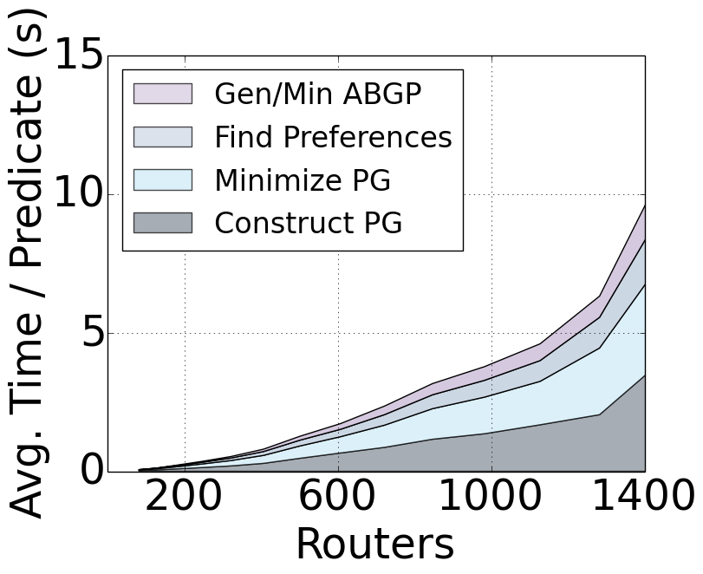
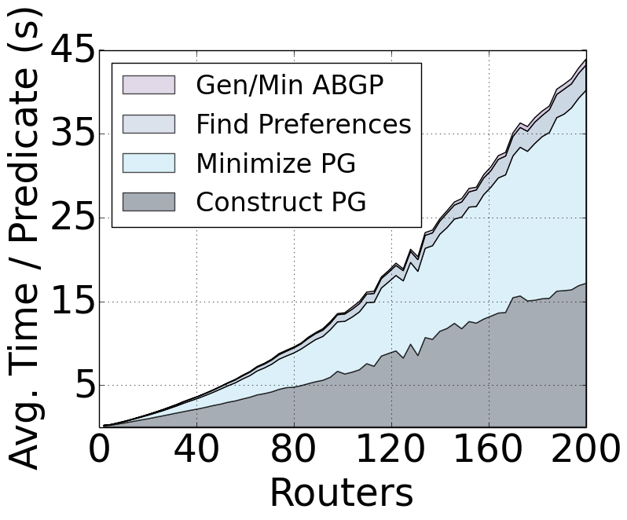
Compilation Time
Compile for each prefix equivalence class
Compile for each equivalence class in parallel
8 core, 3.6 GHz Intel Xeon processor
Data center (< 9 min)
Backbone (< 3 min)
Notes:
Mention prefix EC, way fewer than prefixes
Say what the axes are
Say what the colors are (can read more about it in the paper)

Slide 78
Configuration Size
Optimizations
Avoid using community tags when unambiguous
Reuse community values across peers
Merge import/export behaviors across peers
Results
Optimizations yield 50-100x decrease in config size
Configurations ~1000-10000 lines per router
Notes:
Mention bars in the graph

Slide 79
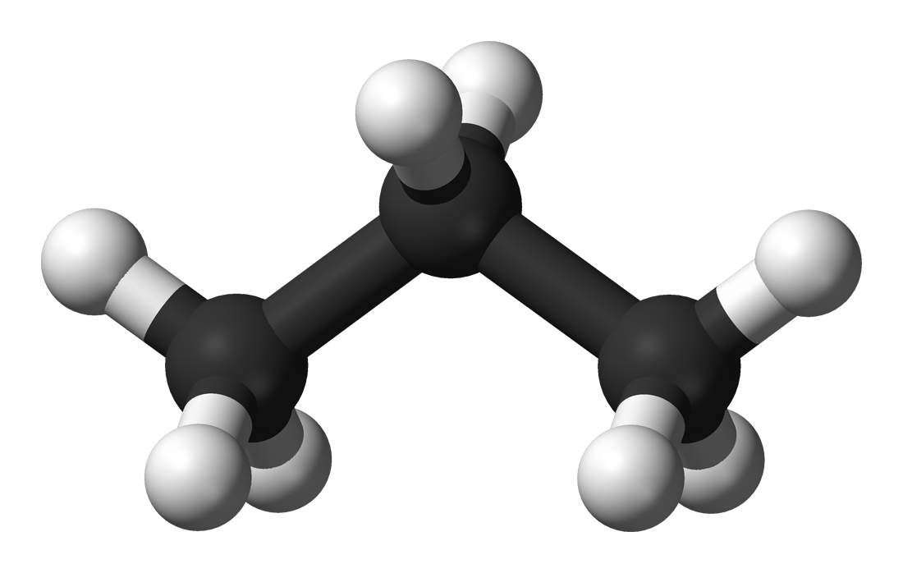
Propane: Summary
High-level language
Centralized network programmability
Constraints specify preferred paths and backups in case of failure
Uniform abstractions for Inter- and Intra-domain routing
Core policy in 30-50 lines of Propane vs. 1000s
Compiler
Distributed implementation via BGP
Static analysis guarantees policy compliance for all failures
Scales to reasonably sized network topologies

