Slide 1
Overview
Macro combinators (no new prefixes)
Dealing with partial information
Well-formedness checks
Controlling inbound traffic
MED
AS_PATH
Aggregation
No-export
Environment modeling

Slide 2
Policy Combinators
define peer = A or B or C
define transit = enterOut(peer) and exitOut(peer)
scope Routing {
10.10.1.0/24 => waypoint(M) >> waypoint(N) >> any
10.10.2.0/24 => any
true => none
}
scope Ownership {
10.10.1.0/24 => end(X)
10.10.2.0/24 => end(Y)
true => any
}
(Routing and Ownership) \ transit

Slide 3
Policy Combinators
define peer = A or B or C
define transit = enterOut(peer) and exitOut(peer)
10.10.1.0/24 =>
(waypoint(M) and end(X)) \ transit >>
(waypoint(N) and end(Y)) \ transit >>
(any and any) \ transit
10.10.2.0/24 =>
(any and end(Y)) \ transit
true =>
(none and any) \ transit

Slide 4
Overview
Macro combinators (no new prefixes)
Dealing with partial information
Well-formedness checks
Controlling inbound traffic
MED
AS_PATH
Aggregation
No-export
Environment modeling

Slide 5
Partial Information
Unknown
A
D
Y
X
C
B
Z

Slide 6
Partial Information
$$prefix⇒AS1⋅A⋅in^{∗}⋅Y⋅out^{∗}⋅China$$
???
Need to know the alphabet and topology ahead of time!
China
Unknown
A
D
Y
X
C
B
Z

Slide 7
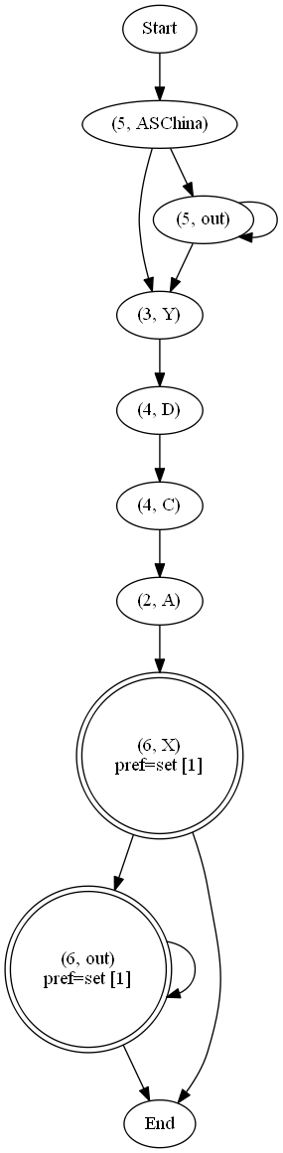
Partial Information
$$prefix⇒AS1⋅A⋅in^{∗}⋅Y⋅out^{∗}⋅China$$
Need to know the alphabet and topology ahead of time!
???
China
Unknown
A
D
Y
X
C
B
Z

Slide 8

Partial Information
$$Router D:$$
$$match (Y⋅ASChina+Y⋅out^{+}⋅ASChina)$$
$$prefix⇒AS1⋅A⋅in^{∗}⋅Y⋅out^{∗}⋅China$$
Need to know the alphabet and topology ahead of time!
???
China
Unknown
A
D
Y
X
C
B
Z

Slide 9


Partial Information
$$Router D:$$
$$match (Y⋅out^{∗}⋅ASChina)$$
$$prefix⇒AS1⋅A⋅in^{∗}⋅Y⋅out^{∗}⋅China$$
Need to know the alphabet and topology ahead of time!
???
China
Unknown
A
D
Y
X
C
B
Z

Slide 10
Overview
Macro combinators (no new prefixes)
Dealing with partial information
Well-formedness checks
Controlling inbound traffic
MED
AS_PATH
Aggregation
No-export
Environment modeling

Slide 11
Well-formedness
Topology is weakly connected
Paths match out*; in+; out*
Paths for final routers based on language emptiness

Slide 12
Overview
Macro combinators (no new prefixes)
Dealing with partial information
Well-formedness checks
Controlling inbound traffic
MED
AS_PATH
Aggregation
No-export
Environment modeling

Slide 13
Controlling Inbound Traffic
MED – Hints where a single neighbor should prefer to enter your network
MED=80
A
D
Y
X
C
B
Z
MED=81

Slide 14
Controlling Inbound Traffic
MED – Hints where a single neighbor should prefer to enter your network
AS_PATH – Hints where multiple neighbors should enter (affects an area)
Prepend 1
A
D
Y
X
C
Q
B
Z
Prepend 10

Slide 15
Controlling Inbound Traffic
MED – Hints where a single neighbor should prefer to enter your network
AS_PATH – Hints where multiple neighbors should enter (affects an area)
Aggregation – Ensures everyone in the internet will prefer the more specific prefix (modulo filters)
p1
A
D
Y
X
C
B
Z
p0

Slide 16
Controlling Inbound Traffic
MED – Hints where a single neighbor should prefer to enter your network
AS_PATH – Hints where multiple neighbors should enter (affects an area)
Aggregation – Ensures everyone in the internet will prefer the more specific prefix (modulo filters)
No-export – Orthogonal, controls shape of the paths
A
D
Y
X
C
B
Z

Slide 17
Controlling Inbound Traffic
New York
Europe
Seattle
AS

Slide 18
Controlling Inbound Traffic
SEA
NY
EUR
pref=1
X
pref=2
X
pref=3
Y
X
pref=3
out*
out*

Slide 19







Controlling Inbound Traffic
$$p_{1}$$
$$p_{1}$$
$$p_{1}$$
SEA
NY
EUR
$$p_{1}, p_{2}$$
$$p_{1}, p_{2}$$
$$p_{1}, p_{2}$$
$$p_{1}, p_{2}$$
pref=1
X
pref=2
X
pref=3
Y
X
pref=3
out*
out*

Slide 20
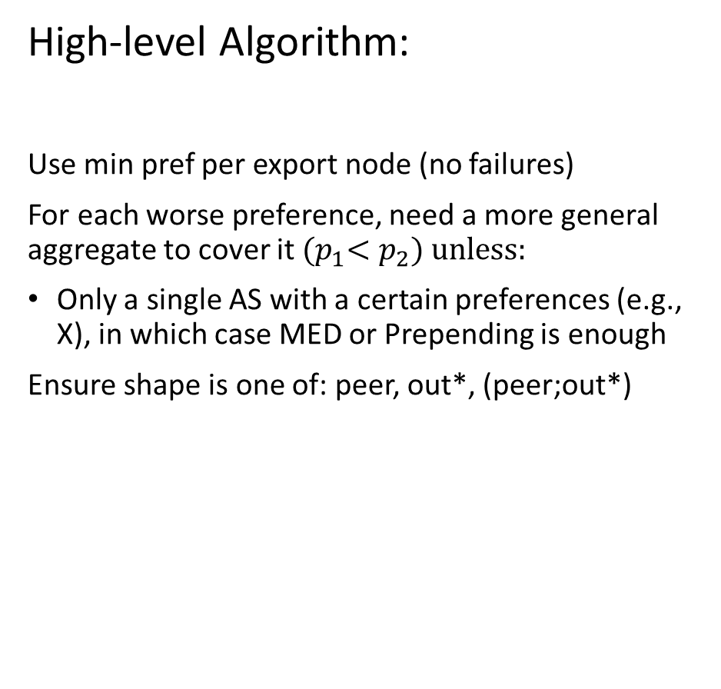
Controlling Inbound Traffic
High-level Algorithm:
Use min pref per export node (no failures)
For each worse preference, need a more general aggregate to cover it ${(p}_{1}<p_{2}) unless:$
Only a single AS with a certain preferences (e.g., X), in which case MED or Prepending is enough
Ensure shape is one of: peer, out*, (peer;out*)
$$p_{1}$$
$$p_{1}$$
$$p_{1}$$
SEA
NY
EUR
$$p_{1}, p_{2}$$
$$p_{1}, p_{2}$$
$$p_{1}, p_{2}$$
$$p_{1}, p_{2}$$
pref=1
X
pref=2
X
pref=3
Y
X
pref=3
out*
out*

Slide 21



Controlling Inbound Traffic
High-level Algorithm:
Use min pref per export node (no failures)
For each worse preference, need a more general aggregate to cover it ${(p}_{1}<p_{2}) unless:$
Only a single AS with a certain preferences (e.g., X), in which case MED or Prepending is enough
Ensure shape is one of: peer, out*, (peer;out*)
$$p_{1}$$
$$p_{1}$$
$$p_{1}$$
SEA
NY
EUR
$$p_{1}, p_{2}$$
$$p_{1}, p_{2}$$
$$p_{1}, p_{2}$$
$$p_{1}, p_{2}$$
pref=1
X
pref=2
X
pref=3
Y
X
pref=3
$$SEA→X: MED=80, Leak p_{1}$$
$$NY→X: MED=81, Leak p_{1}, noexport$$
out*
out*
$$EUR→X:$$
$$EUR→Y:$$

Slide 22



Controlling Inbound Traffic
$$p_{1}$$
$$p_{1}$$
$$p_{1}$$
SEA
NY
EUR
$$p_{1}$$
$$p_{2}$$
$$p_{3}$$
pref=1
Y
pref=2
X
pref=3
Y
Prepending is not enough
out*
out*

Slide 23
Controlling Inbound Traffic
Path length 9
Prepend 7
New York
Europe
Seattle
AS

Slide 24
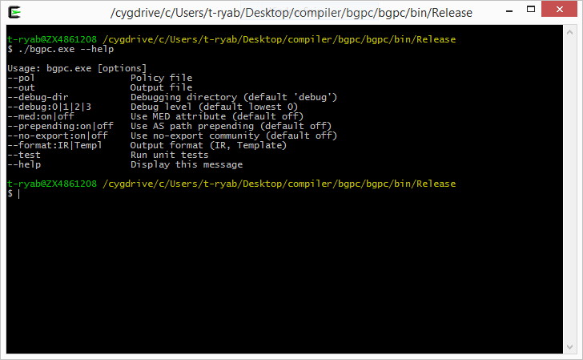
Current Snapshot

