Slide 1
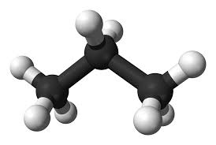
Propane
Programming
Distributed Control Planes
Ryan Beckett (Princeton & MSR)
Ratul Mahajan (MSR)
Todd Millstein (UCLA)
Jitu Padhye (MSR)
David Walker (Princeton)

Slide 2
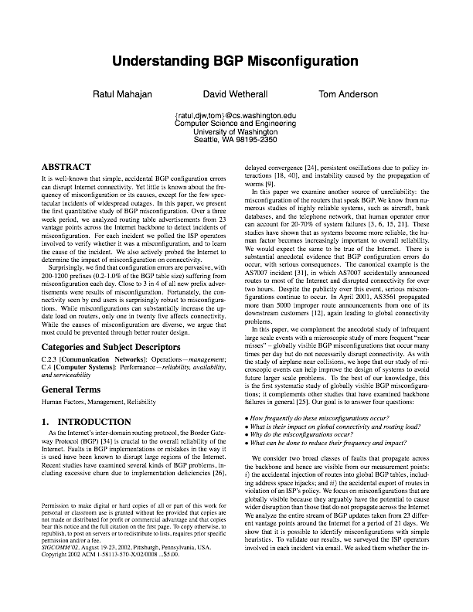
Configuring Networks is Error-Prone
“Close to 3 in 4 of all new prefix advertisements were results of misconfiguration”
Causes:
operator slips
low-level details: filters, communities
logical errors in plans
misunderstanding of configuration semantics
router bugs

Slide 3
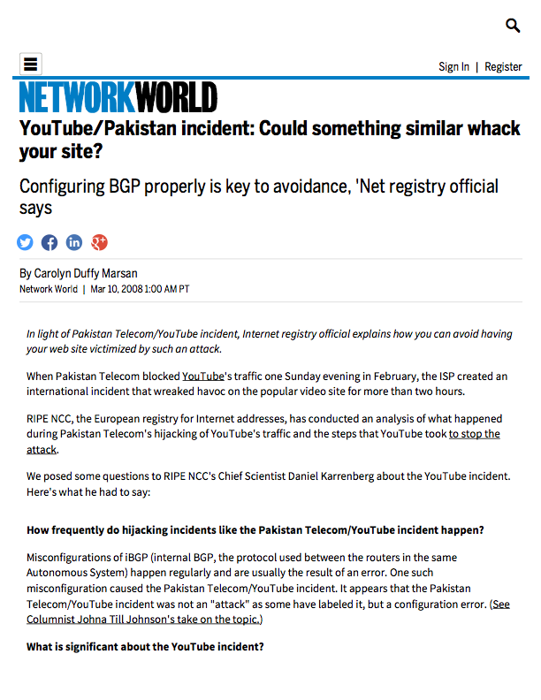


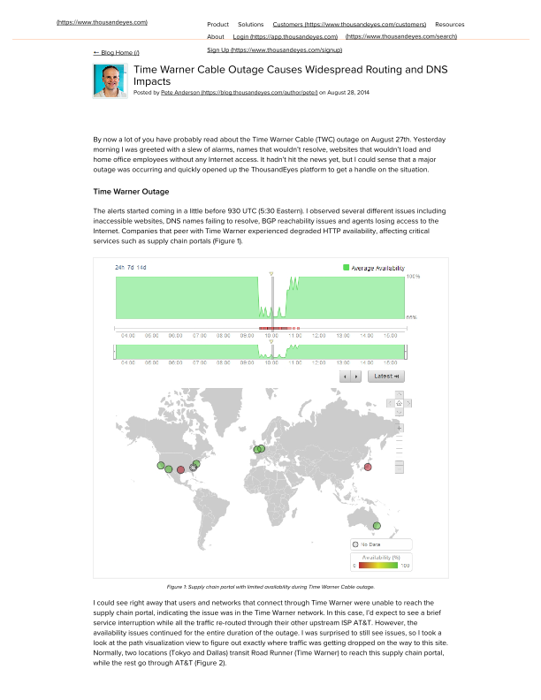
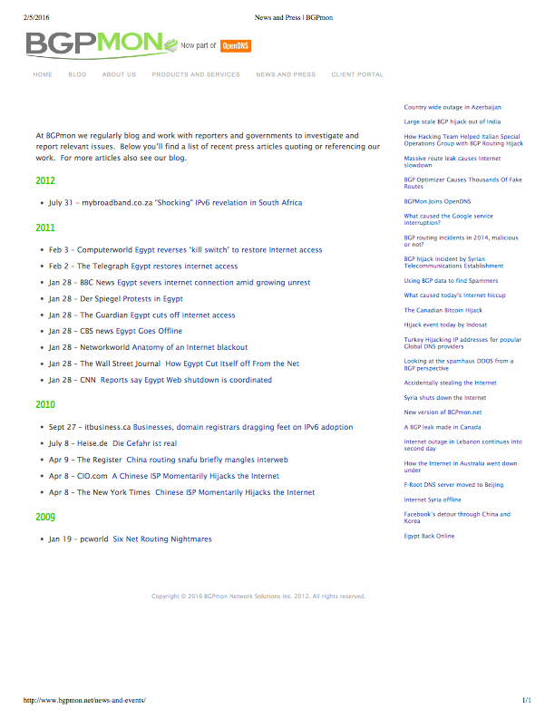
Configuring Networks is Error-Prone

Slide 4
Objectives Mechanisms
GAP
Objectives: Network-wide
Prefer traffic to go through AT&T over Verizon
Enforce isolation between two locations
Don’t use our network as transit between A and B
Traffic must stay within national boundaries
Don’t leak internal services to the outside world
Adhere to policies in the good times and the bad (failures)
Mechanisms: Device-by-Device
Local decisions made independently on each device
Several device-level actions together imply some higher-level behavior
Failures interact with local decision-making algorithms in complex ways

Slide 5
Recent Developments in Network Programming
A new suite of SDN programming languages provide:
Simpler, centralized programming models
Network-wide abstractions like paths
Compositional construction of complex policies from simpler parts
Examples include:
Frenetic [ICFP ’11], PANE [HotSDN ’12], Fat Tire [HotSDN ’13], Pyretic [NSDI ’13], Merlin [CoNext ’13], FlowLog [NSDI ’14], NetKAT [POPL ’14], …
But they aren’t a panacea:
They consider intra-domain routing but not inter-domain routing issues
Programs don’t express preferences ahead of time in case of failures
Their implementations don’t exploit existing network infrastructure
One must still build controller infrastructure that is fault tolerant and scalable — issues often left undiscussed in academic projects

Slide 6
Propane:
Programming a Distributed Control Plane
A language for expression of high-level operator objectives with:
regular paths and relative preferences with fall-backs in case of failures
uniform abstractions for intra- and inter-domain routing
network-wide constraints that make some low-level errors impossible to express
And a compiler that bridges the gap between high-level objectives and low-level distributed control plane mechanisms:
efficient algorithms to synthesize a set of policy-compliant BGP configs
reuse existing infrastructure
fault tolerant and scalable
failure analysis guarantees policy compliance under all failures

Slide 7
This Talk
Two Examples (simplified but emblematic of the issues)
Operator objectives and challenges
Propane solutions
The Propane Compiler
Intermediate representations
Compilation steps
Failure analyses
Wrap-up
Future work
Conclusions

Slide 8
BGP Protocol
Prefix = 1.2.3.4/32
BGP Nodes:
receive and filter announcements
modifying attributes
decide on the best route per prefix using announcement attributes:
local preference, AS path length, …
export and filter routes to neighbors
C
B
E
A
D
F

Slide 9



BGP Protocol
Prefix = 1.2.3.4/32
BGP Nodes:
receive and filter announcements
modifying attributes
decide on the best route per prefix using announcement attributes:
local preference, AS path length, …
export and filter routes to neighbors
C
B
E
A
D
F
{Path=C X, Comm={}, … }
{Path=B Y X, Comm={6054:10}, … }
{Path=A X, Comm={6054:10}, … }

Slide 10
BGP Protocol
Prefix = 1.2.3.4/32
BGP Nodes:
receive and filter announcements
modifying attributes
decide on the best route per prefix using announcement attributes:
local preference, AS path length, …
export and filter routes to neighbors
C
B
E
A
D
F
{Path=C X, Comm={}, … }
{Path=B Y X, Comm={6054:10}, … }
{Path=A X, Comm={6054:10}, … }

Slide 11
BGP Protocol
Prefix = 1.2.3.4/32
BGP Nodes:
receive and filter announcements
modifying attributes
decide on the best route per prefix using announcement attributes:
local preference, AS path length, …
export and filter routes to neighbors
C
B
E
A
D
F
{Path=C X, Comm={}, … }
{Path=B Y X, Comm={6054:10}, … }
{Path=A X, Comm={6054:10}, … }

Slide 12
BGP Protocol
Prefix = 1.2.3.4/32
BGP Nodes:
receive and filter announcements
modifying attributes
decide on the best route per prefix using announcement attributes:
local preference, AS path length, …
export and filter routes to neighbors
C
B
E
A
D
F

Slide 13
Example I: A Backbone Network

Slide 14

A Backbone Network
Prov
Cust
Peer
R2
R4
R1
R5
BGP Nodes:
receive and filter announcements
modifying attributes
decide on the best route per prefix using announcement attributes:
local preference, AS path length, …
export and filter routes to neighbors
Notes:
BGP is an inter-domain routing protocol…

Slide 15
A Backbone Network
Prov
Cust
Peer
R2
R4
R1
R5
Goals:
P1: Prefer to exit thru Cust > Peer > Prov
P2: Disallow traffic between Prov and Peer
P3: For Cust, prefer exit thru R1 > R2
P4: Cust must be on path for its prefixes

Slide 16
A Backbone Network
Prov
Cust
Peer
R2
R4
R1
R5
Goals:
P1: Prefer to exit thru Cust > Peer > Prov
P2: Disallow traffic between Prov and Peer
P3: For Cust, prefer exit thru R1 > R2
P4: Cust must be on path for its prefixes
Implementation Techniques:
Compute and set local preferences consistently at all Peer-facing, Cust-facing, Prov-facing interfaces
For Cust, ensure R2 local pref is lower than R1

Slide 17
A Backbone Network
Prov
Cust
Peer
R2
R4
R1
R5
Goals:
P1: Prefer to exit thru Cust > Peer > Prov
P2: Disallow traffic between Prov and Peer
P3: For Cust, prefer exit thru R1 > R2
P4: Cust must be on path for its prefixes
Implementation Techniques:
Use communities to mark the location an announcement entered the network

Slide 18
A Backbone Network
Prov
Cust
Peer
R2
R4
R1
R5
Goals:
P1: Prefer to exit thru Cust > Peer > Prov
P2: Disallow traffic between Prov and Peer
P3: For Cust, prefer exit thru R1 > R2
P4: Cust must be on path for its prefixes
Implementation Techniques:
More filters to drop undesirable routes

Slide 19
A Backbone Network
Prov
Cust
Peer
R2
R4
R1
R5
Goals:
Network-wide
High-level
Implementation Techniques:
Local, device-by-device
Several devices configured to satisfy one goal, requires coordination & consistency
Varied
Filters, MEDs, Local Pref, …
GAP
Notes:
Consider the backbone network. It has three neighbors, a customer Cust, a peer Peer, and a provider Prov.

Slide 20
Propane
A Propane policy associates sets of ranked paths with prefixes:
Such paths define the desired flow of traffic
Paths stretch from other networks, through our network, back out to neighbors
Preferences between sets of paths express desired behavior when faults occur

Slide 21
Propane
Prov
Cust
Peer
P1: Prefer to exit thru Cust > Peer > Prov
P2: Disallow traffic between Prov and Peer
P3: For Cust, prefer exit thru R1 > R2
P4: Cust must be on path for its prefixes
R2
R4
R1
R5
define Routing = {
true => exit(R1 >> R2 >> Peer >> Prov)
}

Slide 22
Propane
Prov
Cust
Peer
P1: Prefer to exit thru Cust > Peer > Prov
P2: Disallow traffic between Prov and Peer
P3: For Cust, prefer exit thru R1 > R2
P4: Cust must be on path for its prefixes
R2
R4
R1
R5
define Routing = {
true => exit(R1 >> R2 >> Peer >> Prov)
}
define Ownership = {
PCust => later(Cust)
}

Slide 23
Propane
Prov
Cust
Peer
P1: Prefer to exit thru Cust > Peer > Prov
P2: Disallow traffic between Prov and Peer
P3: For Cust, prefer exit thru R1 > R2
P4: Cust must be on path for its prefixes
R2
R4
R1
R5
define transit(X) = enter(X) & exit(X)
define NoTransit = {
true => !transit(Peer|Prov)
}

Slide 24
Propane
Prov
Cust
Peer
P1: Prefer to exit thru Cust > Peer > Prov
P2: Disallow traffic between Prov and Peer
P3: For Cust, prefer exit thru R1 > R2
P4: Cust must be on path for its prefixes
R2
R4
R1
R5
define transit(X) = enter(X) & exit(X)
define NoTransit = {
true => !transit(Peer|Prov)
}
define Main = Routing & Ownership & NoTransit

Slide 25
Example II: A Data Center Network

Slide 26
A Data Center Network
Goals:
P1: Announce global services externally as the aggregate PG
P2: Do not announce local services externally
X
Y
C
D
G
H
Implementation Techniques for X, Y:
do export announce’s from C, D outside
do not export announce’s from G,H outside
appeal: X, Y do not need to know which prefixes are local vs global
aggregate to PG if announce is subset of PG
A
B
E
F
PG1
PG2
PL1
PL2
Global
Services
Local
Services

Slide 27
A Data Center Network
Goals:
P1: Announce global services externally as the aggregate PG
P2: Do not announce local services externally
X
Y
C
D
G
H
Implementation Techniques for X, Y:
do export announce’s from C, D outside
do not export announce’s from G,H outside
appeal: X, Y do not need to know which prefixes are local vs global
aggregate to PG if announce is subset of PG
A
B
E
F
PG1
PG2
PL1
PL2
Global
Services
Local
Services
Consider X-G, X-H Failure:
PL* announcements travel H-Y-D-X
PL* announcements are then leaked
Without failure, X selects direct H-X path, which is shorter

Slide 28
A Data Center Network
Goals:
P1: Announce global services externally as the aggregate PG
P2: Do not announce local services externally
X
Y
C
D
G
H
Implementation Techniques for X, Y:
do export announce’s from C, D outside
do not export announce’s from G,H outside
appeal: X, Y do not need to know which prefixes are local vs global
aggregate to PG if announce is subset of PG
A
B
E
F
PG1
PG2
PL1
PL2
Global
Services
Local
Services
Consider X-G, X-H Failure:
PL* announcements travel H-Y-D-X
PL* announcements are then leaked

Slide 29
A Data Center Network
Implementation Techniques for X, Y:
do export announce’s from C, D outside
do not export announce’s from G,H outside
appeal: X, Y do not need to know which prefixes are local vs global
aggregate to PG if announce is subset of PG
disallow “valley” paths
X
Y
C
D
G
H
A
B
E
F
PG1
PG2
PL1
PL2
Global
Services
Local
Services

Slide 30
A Data Center Network
Implementation Techniques for X, Y:
do export announce’s from C, D outside
do not export announce’s from G,H outside
appeal: X, Y do not need to know which prefixes are local vs global
aggregate to PG if announce is subset of PG
disallow “valley” paths
X
Y
C
D
G
H
A
B
E
F
PG1
PG2
PL1
PL2
Consider D-A, X-C Failure:
Global
Services
Local
Services

Slide 31
A Data Center Network
Implementation Techniques for X, Y:
do export announce’s from C, D outside
do not export announce’s from G,H outside
appeal: X, Y do not need to know which prefixes are local vs global
aggregate to PG if announce is subset of PG
disallow “valley” paths
X
Y
C
D
G
H
A
B
E
F
PG1
PG2
PL1
PL2
Consider D-A, X-C Failure:
X and Y will hear PG2
Global
Services
Local
Services

Slide 32
A Data Center Network
Implementation Techniques for X, Y:
do export announce’s from C, D outside
do not export announce’s from G,H outside
appeal: X, Y do not need to know which prefixes are local vs global
aggregate to PG if announce is subset of PG
disallow “valley” paths
PG
PG
X
Y
C
D
G
H
A
B
E
F
PG1
PG2
PL1
PL2
Consider D-A, X-C Failure:
X and Y will hear PG2
X and Y will announce aggregate PG
Global
Services
Local
Services

Slide 33
A Data Center Network
PG1 Traffic
Implementation Techniques for X, Y:
do export announce’s from C, D outside
do not export announce’s from G,H outside
appeal: X, Y do not need to know which prefixes are local vs global
aggregate to PG if announce is subset of PG
disallow “valley” paths
PG
PG
X
Y
C
D
G
H
A
B
E
F
PG1
PG2
PL1
PL2
Consider D-A, X-C Failure:
X and Y will hear PG2
X and Y will announce aggregate PG
But PG1 is inaccessible through X because there is no valley routing
An aggregation-induced black hole is created [See Le et al, CoNext ’11]
Global
Services
Local
Services

Slide 34
A Data Center Network
Implementation Techniques for X, Y:
do export announce’s from C, D outside
do not export announce’s from G,H outside
appeal: X, Y do not need to know which prefixes are local vs global
aggregate to PG if announce is subset of PG
disallow “valley” paths
X
Y
C
D
G
H
A
B
E
F
PG1
PG2
PL1
PL2
Moral:
Reasoning about the interactions between failures and the device-level configs is hard
Not a good idea for humans to be doing that
Global
Services
Local
Services

Slide 35
A Data Center Network
P1: Traffic for prefixes for each TOR router must reach the router
P2: Do not announce local services externally
P3: Aggregation must be performed on global prefixes to reduce churn
X
Y
C
D
G
H
A
B
E
F
PG1
PG2
PL1
PL2
Global
Services
Local
Services

Slide 36
A Data Center Network
P1: Traffic for prefixes for each TOR router must reach the router
P2: Do not announce local services externally
P3: Aggregation must be performed on global prefixes to reduce churn
define Ownership = {
PG1 => end(A)
PG2 => end(B)
PL1 => end(E)
PL2 => end(F)
}
X
Y
C
D
G
H
A
B
E
F
PG1
PG2
PL1
PL2
Global
Services
Local
Services

Slide 37
A Data Center Network
P1: Traffic for prefixes for each TOR router must reach the router
P2: Do not announce local services externally
P3: Aggregation must be performed on global prefixes to reduce churn
define Ownership = {
PG1 => end(A)
PG2 => end(B)
PL1 => end(E)
PL2 => end(F)
}
define Routing = {
PL1 | PL2 => always(in)
}
X
Y
C
D
G
H
A
B
E
F
PG1
PG2
PL1
PL2
Global
Services
Local
Services

Slide 38
A Data Center Network
P1: Traffic for prefixes for each TOR router must reach the router
P2: Do not announce local services externally
P3: Aggregation must be performed on global prefixes to reduce churn
define Ownership = {
PG1 => end(A)
PG2 => end(B)
PL1 => end(E)
PL2 => end(F)
}
define Routing = {
PL1 | PL2 => always(in)
}
define Main =
Ownership & Routing &
agg(PG, in -> out)
X
Y
C
D
G
H
compiler
discovers
lower bound
on # failures
required to
induce a
black hole
A
B
E
F
PG1
PG2
PL1
PL2
Global
Services
Local
Services

Slide 39
Propane Language Summary
Programmers express high-level objectives via:
Sets of inter- and intra-domain paths
… defined by high-level abstractions: enter, exit, always, end, …
… as well as preferences between those paths for failures
Programmers may also use:
a small number of control constraints (agg)
… while counting on the compiler for failure analysis
… and combine constraints together using natural logical combinators

Slide 40
Compiling Propane

Slide 41

Propane
Compiler
Propane
Front End Constraint Language
Regular
IR
Regular Expression-based IR
Topology
Product
Graph IR
Failure
Analyses
Abstract
BGP
Vendor-independent BGP
CISCO
Juniper
Vendor-specific configurations

Slide 42
Propane Regular IR
Propane
Expand constraints in to regular expressions. EG:
Regular
IR
any = out*.in+.out*
end(X) = any ∩ (Σ*.X)
(out*.in*.(X ∩ in).out+)∪
exit(X) =
(out*.in+.(X ∩ out).out*)
A few other simple transformations:
conjunction of constraints ==> intersection of regular expressions
conjunction of policies ==> prefix-by-prefix intersection
nested preferences lifted: (x >> y) . z ==> (x.z) >> (y.z)

Slide 43
Compilation: An Idealized Example
X
Y
W
A
D
B
C
E
Z
(W.A.C.D.out) >> (W.B.in+.out)

Slide 44
Reversed Automata from Policies
X
Y
W
A
D
B
C
E
Reversed automata
tracks BGP message flow
Z
Policies
out
D
C
A
W
0
1
2
3
4
5
1. (W.A.C.D.out)
2. (W.B.in+.out)
ACDE
B
out
in
B
W
0
1
2
3
4
ACDE

Slide 45
Constructing the Product Graph (PG)
General Idea:
PG represents locations
reachable in the topology
while following the policy
X
Y
W
A
D
B
C
E
Each PG node contains:
topology node (S)
state of automaton 1 (a)
state of automaton 2 (b)
set of preferences achieved
Z
(S,a,b)
{2}
out
D
C
A
W
0
1
2
3
4
5
B
Two PG nodes are connected
if topology nodes are connected
and the automata make the
specified transition
ACDE
out
in
B
W
0
1
2
3
4
ACDE

Slide 46
Constructing the Product Graph (PG)
start
X
Y
W
A
D
B
C
E
Z
out
D
C
A
W
0
1
2
3
4
5
ACDE
B
out
in
B
W
0
1
2
3
4
ACDE

Slide 47
Constructing the Product Graph (PG)
start
X
Y
W
(X,1,1)
A
D
B
C
E
Z
out
D
C
A
W
0
1
2
3
4
5
ACDE
B
out
in
B
W
0
1
2
3
4
ACDE

Slide 48
Constructing the Product Graph (PG)
start
X
Y
W
(X,1,1)
A
(D,2,2)
D
B
C
E
Z
out
D
C
A
W
0
1
2
3
4
5
ACDE
B
out
in
B
W
0
1
2
3
4
ACDE

Slide 49
Constructing the Product Graph (PG)
start
X
Y
W
(X,1,1)
A
(D,2,2)
D
B
C
E
(C,3,2)
Z
out
D
C
A
W
0
1
2
3
4
5
ACDE
B
out
in
B
W
0
1
2
3
4
ACDE

Slide 50
Constructing the Product Graph (PG)
start
X
Y
(W,1,1)
(Z,1,1)
(Y,1,1)
W
(X,1,1)
A
(A, -,2)
(B, -,2)
(E, -,2)
(D,2,2)
D
B
C
E
(C, -,2)
(D, -,2)
(C,3,2)
Z
(B, -,3)
(A,4,2)
out
D
C
A
W
0
1
2
3
4
5
(W, -, 4)
(W,5, -)
ACDE
B
{2}
{1}
out
in
B
W
end
0
1
2
3
4
ACDE

Slide 51
Constructing the Product Graph (PG)
start
X
Y
(W,1,1)
(Z,1,1)
(Y,1,1)
W
(X,1,1)
A
(A, -,2)
(B, -,2)
(E, -,2)
(D,2,2)
D
B
C
E
(C, -,2)
(D, -,2)
(C,3,2)
Z
(B, -,3)
(A,4,2)
out
D
C
A
W
0
1
2
3
4
5
(W, -, 4)
(W,5, -)
ACDE
B
{2}
{1}
out
in
B
W
end
0
1
2
3
4
ACDE
Notes:
One of the useful properties about the Product Graph…

Slide 52
Constructing the Product Graph (PG)
start
X
Y
(W,1,1)
(Z,1,1)
(Y,1,1)
W
(X,1,1)
A
(A, -,2)
(B, -,2)
(E, -,2)
(D,2,2)
D
B
C
E
(C, -,2)
(D, -,2)
(C,3,2)
Z
(B, -,3)
(A,4,2)
out
D
C
A
W
0
1
2
3
4
5
(W, -, 4)
(W,5, -)
ACDE
B
{2}
{1}
out
in
B
W
end
0
1
2
3
4
ACDE

Slide 53
Product Graph Mimization
start
start
(W,1,1)
(Z,1,1)
(Y,1,1)
(X,1,1)
(Z,1,1)
(Y,1,1)
(X,1,1)
(A, -,2)
(B, -,2)
(E, -,2)
(D,2,2)
(E, -,2)
(D,2,2)
(C, -,2)
(D, -,2)
(C,3,2)
(C, -,2)
(C,3,2)
(B, -,3)
(A,4,2)
(B, -,3)
(A,4,2)
(W, -, 4)
(W,5, -)
{2}
(W, -, 4)
(W,5, -)
{1}
{2}
end
{1}
end

Slide 54
Compilation to BGP:
start
Idea:
Filter import messages according to incoming PG edges.
For each internal location,
decide which announcements to prefer,
forward messages along PG edges
Use a community value to tag the state of the automata
For each external location,
do nothing
(Z,1,1)
(Y,1,1)
(X,1,1)
(E, -,2)
(D,2,2)
(C, -,2)
(C,3,2)
(B, -,3)
(A,4,2)
{2}
(W, -, 4)
(W,5, -)
{1}
end

Slide 55
Compilation to BGP:
start
Router A
match peer=C comm=(3,2)
export peer←W, comm←(4,2),
comm← noexport, MED←80
Router B
match peer=C
export peer←W, comm←(-,2),
comm←noexport, MED←81
Router C
match[lp=99] peer=E, comm=(-,2)
export peer←B, comm←(-,2)
match[lp=100] peer=D, comm=(2,2)
export peer←A,B, comm←(3,2)
Router D
match regex=(X + Y)
export peer←C, comm←(2,2)
…
(Z,1,1)
(Y,1,1)
(X,1,1)
(E, -,2)
(D,2,2)
(C, -,2)
(C,3,2)
(B, -,3)
(A,4,2)
{2}
(W, -, 4)
(W,5, -)
{1}
end

Slide 56
Compilation to BGP:
start
Router A
match peer=C comm=(3,2)
export peer←W, comm←(4,2),
comm← noexport, MED←80
Router B
match peer=C
export peer←W, comm←(-,3),
comm←noexport, MED←81
Router C
match[lp=99] peer=E, comm=(-,2)
export peer←B, comm←(-,2)
match[lp=100] peer=D, comm=(2,2)
export peer←A,B, comm←(3,2)
Router D
match regex=(X + Y)
export peer←C, comm←(2,2)
…
(Z,1,1)
(Y,1,1)
(X,1,1)
(E, -,2)
(D,2,2)
(C, -,2)
(C,3,2)
(B, -,3)
(A,4,2)
{2}
(W, -, 4)
(W,5, -)
{1}
end

Slide 57
Compilation to BGP:
start
Router A
match peer=C comm=(3,2)
export peer←W, comm←(4,2),
comm← noexport, MED←80
Router B
match peer=C
export peer←W, comm←(-,3),
comm←noexport, MED←81
Router C
match[lp=99] peer=E, comm=(-,2)
export peer←B, comm←(-,2)
match[lp=100] peer=D, comm=(2,2)
export peer←A,B, comm←(3,2)
Router D
match regex=(X + Y)
export peer←C, comm←(2,2)
…
(Z,1,1)
(Y,1,1)
(X,1,1)
(E, -,2)
(D,2,2)
(C, -,2)
(C,3,2)
(B, -,3)
(A,4,2)
{2}
(W, -, 4)
(W,5, -)
{1}
end

Slide 58
Compilation to BGP:
start
Router A
match peer=C comm=(3,2)
export peer←W, comm←(4,2),
comm← noexport, MED←80
Router B
match peer=C
export peer←W, comm←(-,3),
comm←noexport, MED←81
Router C
match[lp=99] peer=E, comm=(-,2)
export peer←B, comm←(-,2)
match[lp=100] peer=D, comm=(2,2)
export peer←A,B, comm←(3,2)
Router D
match regex=(X + Y)
export peer←C, comm←(2,2)
…
(Z,1,1)
(Y,1,1)
(X,1,1)
(E, -,2)
(D,2,2)
(C, -,2)
(C,3,2)
(B, -,3)
(A,4,2)
{2}
(W, -, 4)
(W,5, -)
{1}
end

Slide 59
Compilation to BGP:
start
Router A
match peer=C comm=(3,2)
export peer←W, comm←(4,2),
comm← noexport, MED←80
Router B
match peer=C
export peer←W, comm←(-,3),
comm←noexport, MED←81
Router C
match[lp=99] peer=E, comm=(-,2)
export peer←B, comm←(-,2)
match[lp=100] peer=D, comm=(2,2)
export peer←A,B, comm←(3,2)
Router D
match regex=(X + Y)
export peer←C, comm←(2,2)
…
(Z,1,1)
(Y,1,1)
(X,1,1)
(E, -,2)
(D,2,2)
choice
(C, -,2)
(C,3,2)
(B, -,3)
(A,4,2)
{2}
(W, -, 4)
(W,5, -)
{1}
end

Slide 60
Compilation to BGP:
start
Router A
match peer=C comm=(3,2)
export peer←W, comm←(4,2),
comm← noexport, MED←80
Router B
match peer=C
export peer←W, comm←(-,3),
comm←noexport, MED←81
Router C
match[lp=99] peer=E, comm=(-,2)
export peer←B, comm←(-,2)
match[lp=100] peer=D, comm=(2,2)
export peer←A,B, comm←(3,2)
Router D
match regex=(X + Y)
export peer←C, comm←(2,2)
…
(Z,1,1)
(Y,1,1)
(X,1,1)
(E, -,2)
(D,2,2)
choice
(C, -,2)
(C,3,2)
…
…
{2}
{1}

Slide 61
Compilation to BGP:
start
Router A
match peer=C comm=(3,2)
export peer←W, comm←(4,2),
comm← noexport, MED←80
Router B
match peer=C
export peer←W, comm←(-,3),
comm←noexport, MED←81
Router C
match[lp=99] peer=E, comm=(-,2)
export peer←B, comm←(-,2)
match[lp=100] peer=D, comm=(2,2)
export peer←A,B, comm←(3,2)
Router D
match regex=(X + Y)
export peer←C, comm←(2,2)
…
(Z,1,1)
(Y,1,1)
(X,1,1)
(E, -,2)
(D,2,2)
choice
(C, -,2)
(C,3,2)
…
…
{2}
{1}
Highest preference
obtainable here

Slide 62
Compilation to BGP:
start
Router A
match peer=C comm=(3,2)
export peer←W, comm←(4,2),
comm← noexport, MED←80
Router B
match peer=C
export peer←W, comm←(-,3),
comm←noexport, MED←81
Router C
match[lp=99] peer=E, comm=(-,2)
export peer←B, comm←(-,2)
match[lp=100] peer=D, comm=(2,2)
export peer←A,B, comm←(3,2)
Router D
match regex=(X + Y)
export peer←C, comm←(2,2)
…
(Z,1,1)
(Y,1,1)
(X,1,1)
(E, -,2)
(D,2,2)
choice
(C, -,2)
(C,3,2)
…
…
{2}
{1}
But there
could be a
failure!

Slide 63
Compilation to BGP:
start
Router A
match peer=C comm=(3,2)
export peer←W, comm←(4,2),
comm← noexport, MED←80
Router B
match peer=C
export peer←W, comm←(-,3),
comm←noexport, MED←81
Router C
match[lp=99] peer=E, comm=(-,2)
export peer←B, comm←(-,2)
match[lp=100] peer=D, comm=(2,2)
export peer←A,B, comm←(3,2)
Router D
match regex=(X + Y)
export peer←C, comm←(2,2)
…
(Z,1,1)
(Y,1,1)
(X,1,1)
(E, -,2)
(D,2,2)
choice
(C, -,2)
(C,3,2)
…
…
{2}
{1}
Sometimes there is
no best choice

Slide 64
Compilation to BGP:
start
Router A
match peer=C comm=(3,2)
export peer←W, comm←(4,2),
comm← noexport, MED←80
Router B
match peer=C
export peer←W, comm←(-,3),
comm←noexport, MED←81
Router C
match[lp=99] peer=E, comm=(-,2)
export peer←B, comm←(-,2)
match[lp=100] peer=D, comm=(2,2)
export peer←A,B, comm←(3,2)
Router D
match regex=(X + Y)
export peer←C, comm←(2,2)
…
(Z,1,1)
(Y,1,1)
(X,1,1)
(E, -,2)
(D,2,2)
(C, -,2)
(C,3,2)
(B, -,3)
(A,4,2)
{2}
(W, -, 4)
(W,5, -)
{1}
end

Slide 65
Compilation to BGP:
start
Router A
match peer=C comm=(3,2)
export peer←W, comm←(4,2),
comm← noexport, MED←80
Router B
match peer=C
export peer←W, comm←(-,3),
comm←noexport, MED←81
Router C
match[lp=99] peer=E, comm=(-,2)
export peer←B, comm←(-,2)
match[lp=100] peer=D, comm=(2,2)
export peer←A,B, comm←(3,2)
Router D
match regex=(X + Y)
export peer←C, comm←(2,2)
…
(Z,1,1)
(Y,1,1)
(X,1,1)
(E, -,2)
(D,2,2)
(C, -,2)
(C,3,2)
Prefer D’s
announce
(B, -,3)
(A,4,2)
{2}
(W, -, 4)
(W,5, -)
{1}
end

Slide 66
Compilation to BGP:
start
(Z,1,1)
(Y,1,1)
(X,1,1)
(E, -,2)
(D,2,2)
If we remove this edge,
the policy becomes unimplementable.
If we choose D’s announcement and
forward to A, the A-W link may fail
If we choose E’s announcement and
forward to B, the B-W link may fail
(or the A-W link may not fail and
we will have a sub-optimal route)
(C, -,2)
(C,3,2)
(B, -,3)
(A,4,2)
{2}
(W, -, 4)
(W,5, -)
{1}
end

Slide 67
Implementation (5,500 lines of F#)
Propane
Benchmarks:
data center policies (~1600 routers) and backbone policies (~200 routers, many peers/router) from a large cloud provider
policy from English docs
Ignoring prefix, customer group and ownership definitions:
31 lines for data center
43 lines for backbone
Scaling (8 core Windows machine):
10s/pfx (mean) for largest data center
45s/pfx (mean) for largest backbone
3 minutes total for the backbone
9 minutes total for the data center
Regular
IR
Topology
Product
Graph IR
Abstract
BGP
CISCO
Juniper

Slide 68
Wrap-Up

Slide 69
Ongoing & Future Work
Infrastructure
building a simulator
more analyses, modeling communities, benchmarks
Transition technology
synthesizing high-level policies from low-level configurations
Looking for other gaps
high-level property low-level distributed mechanism
for example: load and congestion
other protocols (OSPF, OpenFlow), route redistribution
Dynamics
combining local and global control to react to new events

Slide 70
Summary
Propane
Propane users express high-level objectives.
Objectives involve both intra- and inter-domain constraints.
Failure analysis guarantees strong safety properties.
Compiler bridges the gap between objectives and device-by-device control plane configurations.
Regular
IR
Topology
Product
Graph IR
Abstract
BGP
CISCO
Juniper

Slide 71





Propane Team
Ryan
Beckett
CEO
Networking
Programming Languages
Ratul
Mahajan
Jitu
Padhye
Todd
Millstein
David
Walker

Slide 73
Failure Analysis

Slide 74
Compilation: The Issue
A
D
Policy:
(X.A.C.D.Y) >>
(X.B.C.E.Y)
Y
C
X
E
B
Attempt 1:
C - Prefer D over E
X - Prefer A over B

Slide 75
Compilation: The Issue
A
D
Policy:
(X.A.C.D.Y) >>
(X.B.C.E.Y)
Y
C
X
E
B
Attempt 1:
C - Prefer D over E
X - Prefer A over B
Issue:
Violation of soundness — take a path not specified by the policy

Slide 76
Compilation: The Issue
A
D
Policy:
(X.A.C.D.Y) >>
(X.B.C.E.Y)
Y
C
X
E
B
Attempt 1:
C - Prefer D over E
X - Prefer A over B
Issue:
Violation of soundness — take a path not specified by the policy
Soundness is easy to handle by filtering bad paths (filter at B)

Slide 77
Compilation: The Issue
A
D
Policy:
(X.A.C.D.Y) >>
(X.B.C.E.Y)
Y
C
X
E
B
Attempt 1:
C - Prefer D over E
X - Prefer A over B
B - Filter routes through D
Issue:
Violation of completeness — path with preference 2 exists, yet none is taken

Slide 78
Compilation: The Issue
A
D
Policy:
(X.A.C.D.Y) >>
(X.B.C.E.Y)
Y
C
X
E
B
Issue:
Violation of completeness — path with preference 2 exists, yet none is taken
Completeness is hard: C must make decision NOW but failures can happen upstream
Challenge:
C - Prefer D over E?

Slide 79
Product Graph IR
start
X
Y
(W,1,1)
(Z,1,1)
(Y,1,1)
W
(X,1,1)
A
(A, -,2)
(B, -,2)
(E, -,2)
(D,2,2)
D
B
C
E
(C, -,2)
(D, -,2)
(C,3,2)
Z
(B, -,3)
(A,4,2)
out
D
C
A
W
0
1
2
3
4
5
(W, -, 4)
(W,5, -)
ACDE
B
out
in
B
W
end
0
1
2
3
4
ACDE

Slide 80
Product Graph IR
start
X
Y
(W,1,1)
(Z,1,1)
(Y,1,1)
W
(X,1,1)
A
(A, -,2)
(B, -,2)
(E, -,2)
(D,2,2)
D
B
C
E
(C, -,2)
(D, -,2)
(C,3,2)
Z
(B, -,3)
(A,4,2)
out
D
C
A
W
0
1
2
3
4
5
(W, -, 4)
(W,5, -)
ACDE
B
out
in
B
W
end
0
1
2
3
4
ACDE

Slide 81
Product Graph Minimization
start
Goal: Improve failure safety analysis precision by removing nodes/edges not on any simple path
(W,1,1)
(Z,1,1)
(Y,1,1)
(X,1,1)
(A, -,2)
(B, -,2)
(E, -,2)
(D,2,2)
Graph dominators as a cheap approximation
(D,2,2) dominates (A,4,2)
(C, -,2)
(D, -,2)
(C,3,2)
(B, -,3)
(A,4,2)
Repeatedly remove:
Any nodes start can’t reach
Any nodes that can’t reach end
Any node X where some X′ postdominates X
Any edge from X to Y where some X′ postdominates Y
(W, -, 4)
(W,5, -)
end

Slide 82
Product Graph Minimization
start
Goal: Improve failure safety analysis precision by removing nodes/edges not on any simple path
(W,1,1)
(Z,1,1)
(Y,1,1)
(X,1,1)
(A, -,2)
(B, -,2)
(E, -,2)
(D,2,2)
Graph dominators as a cheap approximation
(D,2,2) dominates (A,4,2)
(C, -,2)
(D, -,2)
(C,3,2)
(B, -,3)
(A,4,2)
Repeatedly remove:
Any nodes start can’t reach
Any nodes that can’t reach end
Any node X where some X′ postdominates X
Any edge from X to Y where some X′ postdominates Y
(W, -, 4)
(W,5, -)
end

Slide 83
Product Graph Minimization
start
Goal: Improve failure safety analysis precision by removing nodes/edges not on any simple path
(W,1,1)
(Z,1,1)
(Y,1,1)
(X,1,1)
(A, -,2)
(B, -,2)
(E, -,2)
(D,2,2)
Graph dominators as a cheap approximation
(D,2,2) dominates (A,4,2)
(C, -,2)
(D, -,2)
(C,3,2)
(B, -,3)
(A,4,2)
Repeatedly remove:
Any nodes start can’t reach
Any nodes that can’t reach end
Any node X where some X′ postdominates X
Any edge from X to Y where some X′ postdominates Y
(W, -, 4)
(W,5, -)
end

Slide 84
Product Graph Minimization
start
Goal: Improve failure safety analysis precision by removing nodes/edges not on any simple path
(Z,1,1)
(Y,1,1)
(X,1,1)
(A, -,2)
(B, -,2)
(E, -,2)
(D,2,2)
Graph dominators as a cheap approximation
(D,2,2) dominates (A,4,2)
(C, -,2)
(D, -,2)
(C,3,2)
(B, -,3)
(A,4,2)
Repeatedly remove:
Any nodes start can’t reach
Any nodes that can’t reach end
Any node X where some X′ postdominates X
Any edge from X to Y where some X′ postdominates Y
(W, -, 4)
(W,5, -)
end

Slide 85
Product Graph Minimization
start
Goal: Improve failure safety analysis precision by removing nodes/edges not on any simple path
(Z,1,1)
(Y,1,1)
(X,1,1)
(E, -,2)
(D,2,2)
Graph dominators as a cheap approximation
(D,2,2) dominates (A,4,2)
(C, -,2)
(C,3,2)
(B, -,3)
(A,4,2)
Repeatedly remove:
Any nodes start can’t reach
Any nodes that can’t reach end
Any node X where some X′ postdominates X
Any edge from X to Y where some X′ postdominates Y
(W, -, 4)
(W,5, -)
end

Slide 86
Failure Safety
X
Y
W
1
start
2
A
D
B
C
E
(Z,1,1)
(Y,1,1)
(X,1,1)
Z
(E, -,2)
(D,2,2)
(C, -,2)
(C,3,2)
Case I:
Decision point (C, -, 2) and (C,3,2)
Only prefer one state if we are always better off
Can each step from (C,-,2) be simulated by a step from (C,3,2)?
(B, -,3)
(A,4,2)
{2}
(W, -, 4)
(W,5, -)
{1}
end

Slide 87
Failure Safety
start
(Z,1,1)
(Y,1,1)
(X,1,1)
Case 1I:
Unique topology node (D,2,2)
Same paths and preferences node (D,2,2) regardless of failures
Can prefer X and Y equally and let the shortest path decide
(E, -,2)
(D,2,2)
(C, -,2)
(C,3,2)
(B, -,3)
(A,4,2)
{2}
(W, -, 4)
(W,5, -)
{1}
end

Slide 88
Configuration Minimization
start
Router A
match peer=C comm=(3,2)
export comm←(4,2), comm← noexport
MED←80, peer←W
Router B
match peer=C
export comm←(-,2), comm←noexport
MED←81, peer←W
Router C
match[lp=99] peer=E, comm=(-,2)
export comm←(-,2), peer←B
match peer=D, comm=(2,2)
export comm←(3,2), peer←A,B
Router D
match regex=(X + Y)
export comm←(2,2), peer←C
…
(Z,1,1)
(Y,1,1)
(X,1,1)
(E, -,2)
(D,2,2)
(C, -,2)
(C,3,2)
(B, -,3)
(A,4,2)
{2}
(W, -, 4)
(W,5, -)
{1}
end

Slide 89
Failure Safety
start
(Z,1,1)
(Y,1,1)
(X,1,1)
Definition:
Restricted graph Gi — the product graph restricted to nodes that can reach an accepting state of i or better
(E, -,2)
(D,2,2)
(C, -,2)
(C,3,2)
(B, -,3)
(A,4,2)
{2}
(W, -, 4)
(W,5, -)
{1}
end

Slide 90
Failure Safety
start
(Z,1,1)
(Y,1,1)
(X,1,1)
High-level Idea:
Can prefer C1 to C2 when:
∀i, ∃j, j≤i ∧ protect(Gj, C1, Gi, C2)
(E, -,2)
(D,2,2)
(C, -,2)
(C,3,2)
(B, -,3)
(A,4,2)
Simulation Relation:
For each step C2 can take, C1 can take an equivalent next step
If no equivalent next step, see if an equivalent dominator exists
{2}
(W, -, 4)
(W,5, -)
{1}
end

Slide 91
Failure Safety: Example
C1
C2
F
A
G
A
H
B
C
B
C
D
D
D
E
F
E
G

Slide 92
Failure Safety: Example
C1
C2
F
A
G
A
H
B
C
B
C
D
D
D
E
F
E
G

Slide 93
Failure Safety: Example
C1
C2
F
A
G
A
H
B
C
B
C
D
D
D
E
F
E
G

Slide 94
Failure Safety: Example
C1
C2
F
A
G
A
H
B
C
B
C
D
D
D
E
F
E
G

Slide 95
Failure Safety: Example
C1
C2
F
A
G
A
H
B
C
B
C
D
D
D
E
F
E
G

Slide 96
Aggregation Safety
PG
PG
PG
X
Y
X
Y
C
D
G
H
C
D
G
H
A
B
E
F
A
B
E
F
PG1
PG2
PL1
PL2
PG1
Global
Services
Local
Services
start
end

