Slide 1
Network Device Manager
Design Principles:
Separate data (topology, devices) from configuration files
Reusable configuration templates for similar devices/roles
Promotes DRY (avoid some copy-paste, out-of-sync errors)

Slide 2




NDM Overview
Configs (Cisco/Juniper)
NDM
Network Graph
Config Templates

Slide 3
Network Graph
Data
ACLS
route-map
prefix-list
access-list
PNG
physical hardware
interconnections
DPG
ip interface map
Interface ACLs
CPG
address/router
start/end peers
keep alive, …
route-map for peers

Slide 4

Network Graph
DMIB

Slide 5
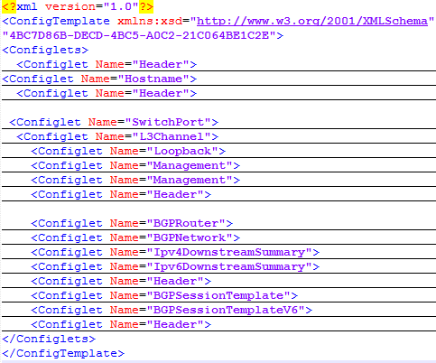
Configuration Templates
XML file over Cisco/Juniper configuration language
Organized into “configlets” for different functionality
Configlets used for organization + incremental deployment

Slide 6
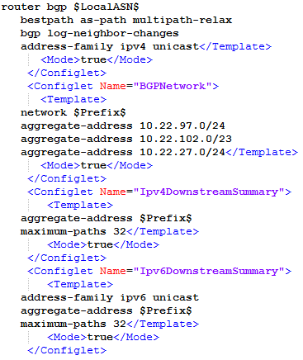
Configuration Templates
Variables of the form $var$ are populated by information from the network graph
Include in final configuration: <Mode>true</Mode>

Slide 7
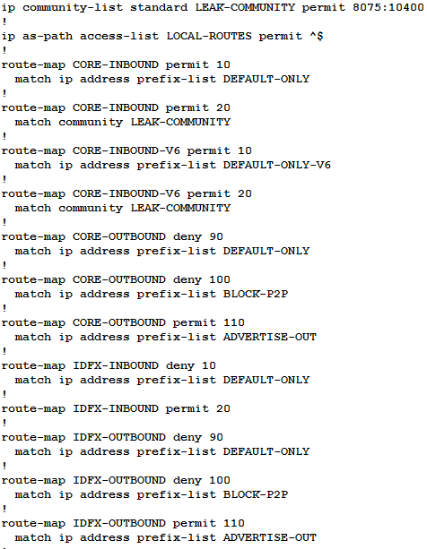
Limitations
No reuse between templates (e.g., lots of similar boiler plate between Cisco routers in different roles
ACLs split between template and ACL database
Most of the complexity is in the local inbound/outbound policies

Slide 8
Recap from last time
Language Limitations:
No way to talk about prefixes (or communities) explicitly
Regular expressions and logic constraints can be unified in terms of set operations
Multipath BGP vs Single path BGP
How to deal with Route aggregation

Slide 9
Route Aggregation (Example):
Aggregate route
10.1.0.0/20
Y
10.1.0.0/24
10.1.1.0/24
10.1.15.0/24
…
X1
X2
X15

Slide 10
Route Aggregation (Example):
Aggregate route
10.1.0.0/20
Y
10.1.0.0/24
10.1.1.0/24
10.1.15.0/24
…
X1
X2
X15

Slide 11
Route Aggregation (Idea #1)
Add operator to abstract paths/nodes
E.g., abstract the 50 states as USA
Failure in abstracted path is hidden since underlying representation is hidden
Is control-protocol independent (aggregation for BGP)

Slide 12

Example Language
$pol ∷=s_{1}, …, s_{n}$
$s ∷= p⇒\left[choose_{n} from\right] c [\min_{attr}]$
$p ∷= true \left| a=v \right| p_{1}∨p_{2} \left| p_{1}∧p_{2} \right| ¬p$
$c ∷= out \left| in \right| l$
$| c_{1}≫c_{2}$
$| c_{1}∪c_{2}$
$| c_{1}∩c_{2}$
$| c_{1} \backslash c_{2}$
$| c_{1}⋅c_{2}$
$| c^{∗}$
$| abstract(c)$
Policy
Statement
Predicate
Constraint

Slide 13
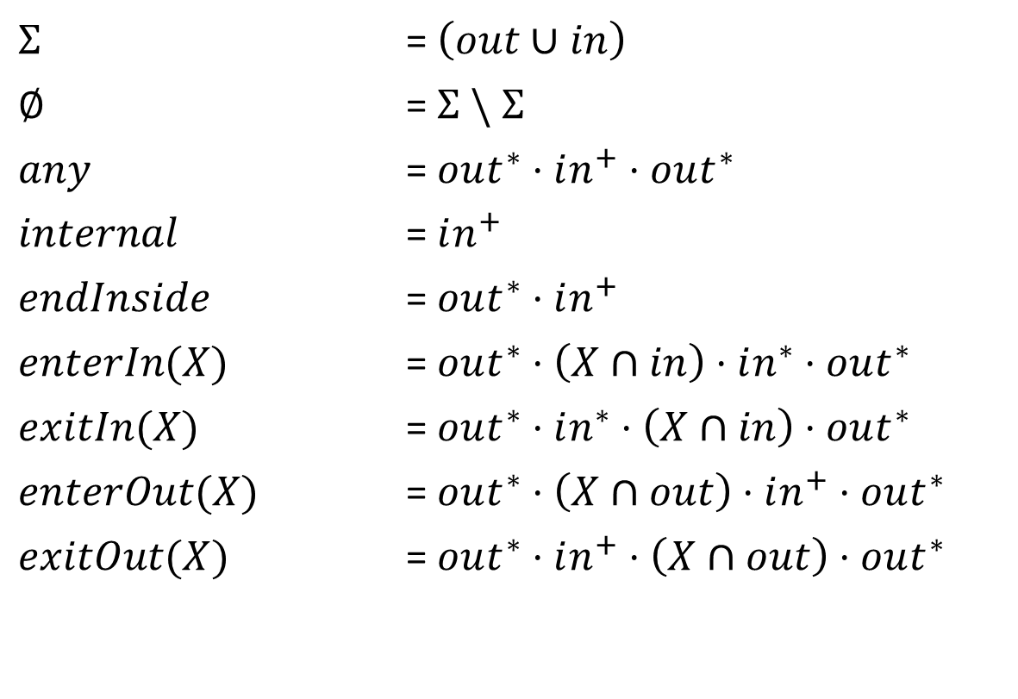
Definitions
$Σ$ = $\left(out∪in\right)$
$∅$ = $Σ \backslash Σ$
$any$ = $out^{∗}⋅in^{+}⋅out^{∗}$
$internal$ = $in^{+}$
$endInside$ = $out^{∗}⋅in^{+}$
$enterIn(X)$ = $out^{∗}⋅\left(X∩in\right)⋅in^{∗}⋅out^{∗}$
$exitIn(X)$ = $out^{∗}⋅in^{∗}⋅\left(X∩in\right)⋅out^{∗}$
$enterOut(X)$ = $out^{∗}⋅\left(X∩out\right)⋅in^{+}⋅out^{∗}$
$exitOut(X)$ = $out^{∗}⋅in^{+}⋅\left(X∩out\right)⋅out^{∗}$

Slide 14



Prefix predicates
Disallow all paths for bogon prefixes
$$bogon$$
$$bogon=p_{1}∨p_{2}∨ …$$
$bogon⇒$ $∅$

Slide 15


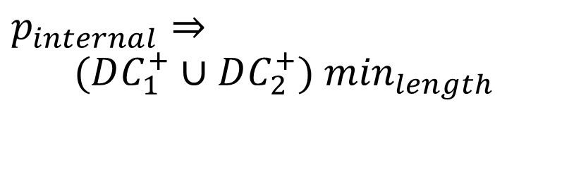
Examples
Reusable address space inferred from disjoint paths.
$p_{internal}⇒$
$$(DC_{1}^{+}∪DC_{2}^{+}) \min_{length}$$
DC1
DC2
$$p_{internal}$$
$$p_{internal}$$

Slide 16

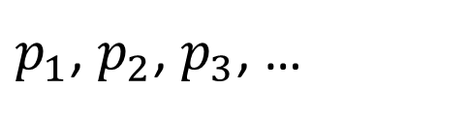
Example
$$p_{agg}$$
DC
$p_{1}$, $p_{2}$, $p_{3}$, …

Slide 17
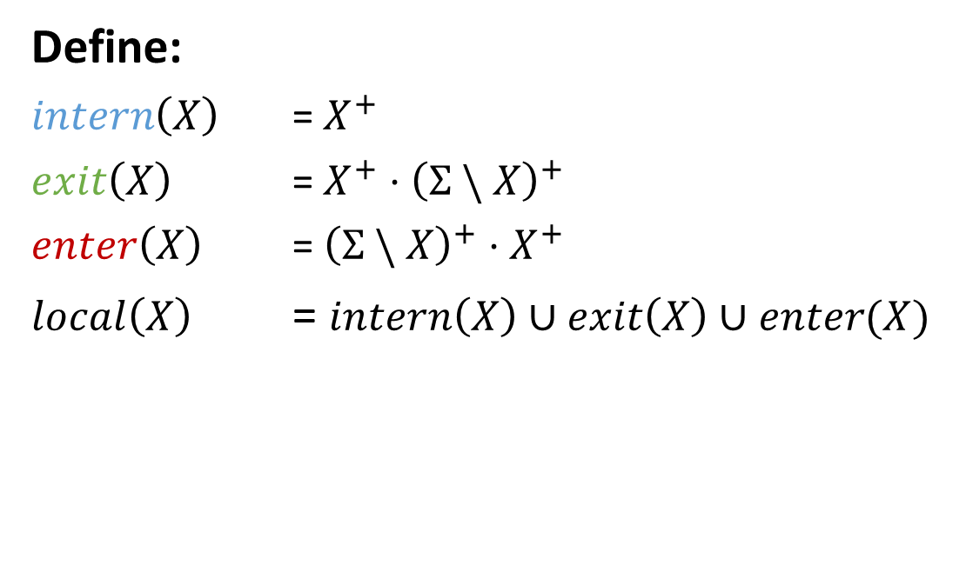
Example
Define:
$intern\left(X\right)$ = $X^{+}$
$exit\left(X\right)$ = $X^{+}⋅{\left(Σ \backslash X\right)}^{+}$
$enter\left(X\right)$ = ${\left(Σ \backslash X\right)}^{+}⋅X^{+}$
$local\left(X\right)$ = $intern\left(X\right)∪exit\left(X\right)∪enter(X)$
DC
$$p_{1}∨p_{2}∨ p_{3}⇒local\left(DC\right) \min_{length}$$
$p_{1}$, $p_{2}$, $p_{3}$, …

Slide 18
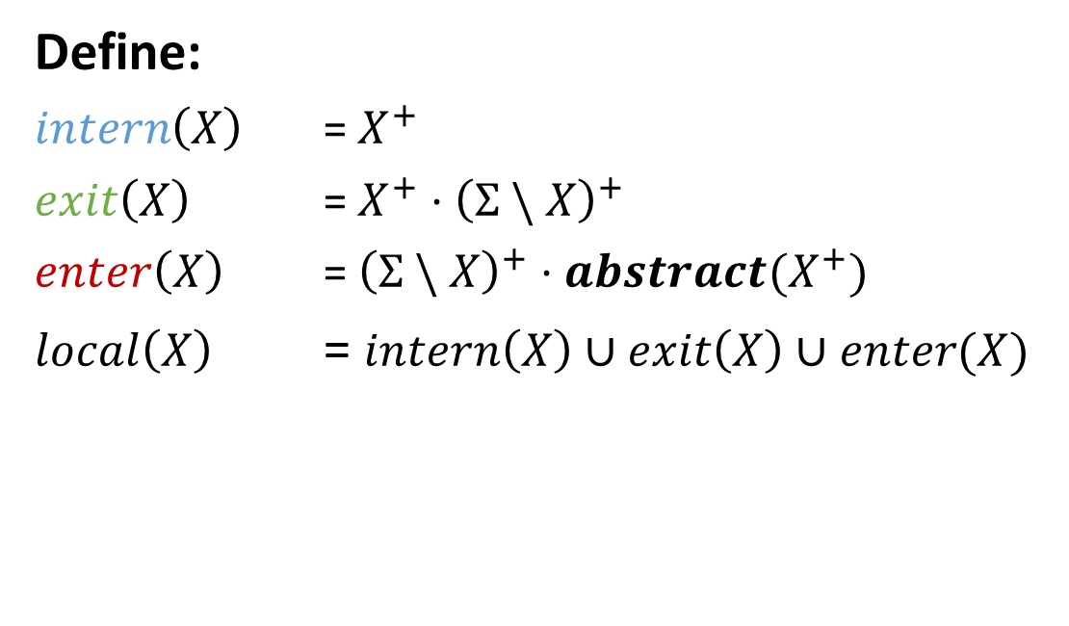
Example
Define:
$intern\left(X\right)$ = $X^{+}$
$exit\left(X\right)$ = $X^{+}⋅{\left(Σ \backslash X\right)}^{+}$
$enter\left(X\right)$ = ${\left(Σ \backslash X\right)}^{+}⋅{abstract(X}^{+})$
$local\left(X\right)$ = $intern\left(X\right)∪exit\left(X\right)∪enter(X)$
DC
$$p_{1}∨p_{2}∨ p_{3}⇒local\left(DC\right) \min_{length}$$
$p_{1}$, $p_{2}$, $p_{3}$, …

Slide 19





Example (AS w/mutihomed customers)
Aggregate
$$p_{1}$$
$$p_{0}$$
Requirements:
Filter bogons
Disallow prefixes more specific than /24
Never accept your own prefix from others
Aggregate your own prefix block
Also advertise multihomed customer prefix
Only allow traffic for allocated prefixes to self or customers
Otherwise prefer peers to providers
No transit between peers/providers
$$p_{1}$$
AS
$$p_{1}$$
$$p_{1}$$
Customer

Slide 20


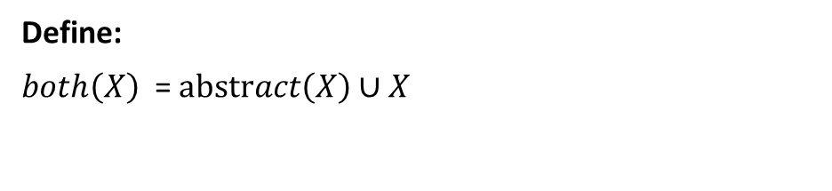

Example (AS w/mutihomed customers)
Aggregate
$$p_{1}$$
$$p_{0}$$
$$p_{1}$$
Define:
$both\left(X\right)$ = $abstract\left(X\right)∪X$
AS
$$bogon∨gt24⇒∅$$
$$p_{1}⇒out^{∗}⋅both\left(in^{+}\right)⋅customer$$
$$p_{0}⇒out^{∗}⋅abstract(in^{+})$$
$$p_{1}$$
$$p_{1}$$
$$true⇒\left(exitOut\left(peer\right)≫exitOut\left(paid\right)\right) \backslash transit$$
Customer

Slide 21




Example (Location-preference)
Aggregate
Aggregate
$$p_{1}$$
$$p_{0}$$
$$p_{2}$$
$$p_{0}$$
Seattle
New York
AS

Slide 22



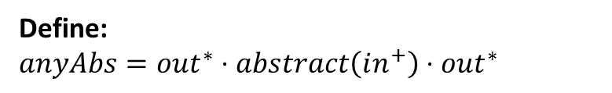
Example (Location-preference)
Define:
$$anyAbs=out^{∗}⋅abstract\left(in^{+}\right)⋅out^{∗}$$
$$p_{1}⇒enterIn\left(SEA\right)≫anyAbs$$
$$p_{2}⇒enterIn\left(NY\right)≫anyAbs$$
$$p_{0}⇒anyAbs$$
Aggregate
Aggregate
$$p_{1}$$
$$p_{0}$$
$$p_{2}$$
$$p_{0}$$
Seattle
New York
AS

Slide 23
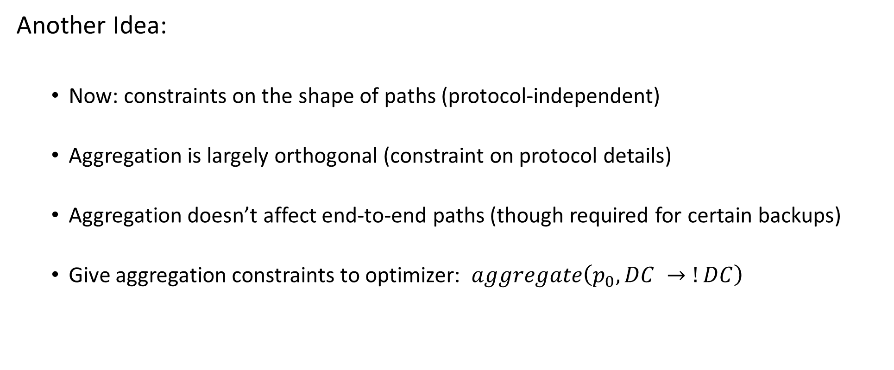
Route Aggregation (Idea #2)
Another Idea:
Now: constraints on the shape of paths (protocol-independent)
Aggregation is largely orthogonal (constraint on protocol details)
Aggregation doesn’t affect end-to-end paths (though required for certain backups)
Give aggregation constraints to optimizer: $aggregate\left(p_{0}, DC →!DC\right)$

Slide 24





Example
$$true⇒(in^{+} \backslash dcTransit)$$
CORE
$$aggregate(p_{0}, DC_{1}→CORE)$$
$$p_{0}$$
Aggregate
DC1
$$p_{1}, p_{2}, p_{3}, …$$
DC2
$$p_{1}, p_{2}, p_{3}, …$$

Slide 25



Example
$$p_{1}⇒enterIn\left(SEA\right)≫any$$
$$p_{2}⇒enterIn\left(NY\right)≫any$$
$$p_{0}⇒any$$
Aggregate
Aggregate
$$p_{1}$$
$$p_{0}$$
$$p_{2}$$
$$p_{0}$$
Seattle
New York
AS

Slide 26
Example
$$p_{1}⇒enterIn\left(SEA\right)≫any$$
$$p_{2}⇒enterIn\left(NY\right)≫any$$
$$p_{0}⇒any$$
ERROR: need aggregation
Aggregate
Aggregate
$$p_{1}$$
$$p_{0}$$
$$p_{2}$$
$$p_{0}$$
Seattle
New York
AS

Slide 27

Example
$$p_{1}⇒enterIn\left(SEA\right)≫any$$
$$p_{2}⇒enterIn\left(NY\right)≫any$$
$$p_{0}⇒any$$
$$aggregate(p_{0}, in→out)$$
Aggregate
Aggregate
$$p_{1}$$
$$p_{0}$$
$$p_{2}$$
$$p_{0}$$
Seattle
New York
AS

Slide 28

Example
Aggregate
$$p_{1}$$
$$p_{0}$$
$$p_{1}$$
$$policy…$$
AS
$$aggregate(p_{0}∧¬p_{1},in→out)$$
$$p_{1}$$
$$p_{1}$$
Customer

Slide 29
Example
Aggregate
$$p_{1}$$
$$p_{0}$$
$$p_{1}$$
$$policy…$$
AS
$$aggregate(p_{0},in→out)$$
$$leak(p_{1},in→out)$$
$$p_{1}$$
$$p_{1}$$
Customer

Slide 30

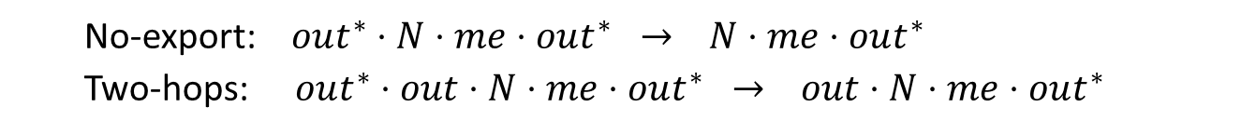
Environment Assumptions:
Path Rewriting:
Subset of original paths
Communities (N):
No-export: $out^{∗}⋅N⋅me⋅out^{∗} → N⋅me⋅out^{∗}$
Two-hops: $out^{∗}⋅out⋅N⋅me⋅out^{∗} → out⋅N⋅me⋅out^{∗}$
Filtering (X):
$$out^{∗}⋅me⋅X⋅out^{∗} → ∅$$
M
N
me
X

Slide 31
Semantics
Path constraints mapped to sets of paths
Default is to send traffic along all valid paths
Pick at most n using the choose operator
Abstraction by tracking:
Static topology – original topology with no failures
Dynamic topology – current topology, includes failures
Abstraction hides details (failures) by using static topology to present paths, even if they do not exist currently

Slide 32
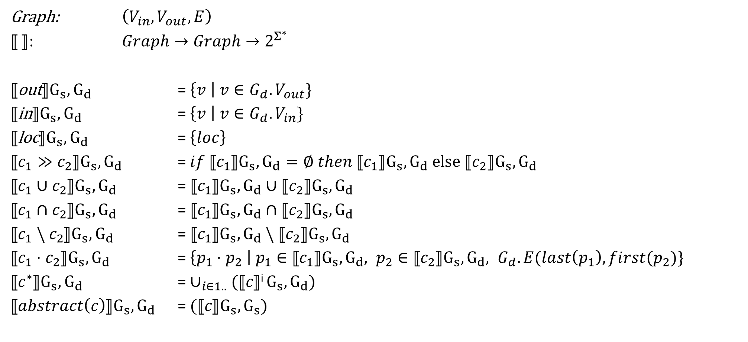
Semantics
Graph: $\left(V_{in}, V_{out}, E\right)$
⟦ ⟧: $Graph→Graph→2^{Σ^{∗}}$
⟦out⟧$G_{s}, G_{d}$ = $\left\{v \right| v∈G_{d}.V_{out}\}$
⟦in⟧$G_{s}, G_{d}$ = $\left\{v \right| v∈G_{d}.V_{in}\}$
⟦loc⟧$G_{s}, G_{d}$ = $\left\{loc\right\}$
⟦$c_{1}≫c_{2}$⟧$G_{s}, G_{d}$ = $if$⟦$c_{1}$⟧$G_{s}, G_{d}=∅ then \text{⟦}c_{1}\text{⟧}G_{s}, G_{d} else \text{⟦}c_{2}\text{⟧}G_{s}, G_{d}$
⟦$c_{1}∪c_{2}$⟧$G_{s}, G_{d}$ = ⟦$c_{1}$⟧$G_{s}, G_{d}∪\text{⟦}c_{2}\text{⟧}G_{s}, G_{d}$
⟦$c_{1}∩c_{2}$⟧$G_{s}, G_{d}$ = ⟦$c_{1}$⟧$G_{s}, G_{d}∩\text{⟦}c_{2}\text{⟧}G_{s}, G_{d}$
⟦$c_{1} \backslash c_{2}$⟧$G_{s}, G_{d}$ = ⟦$c_{1}$⟧$G_{s}, G_{d} \backslash \text{⟦}c_{2}\text{⟧}G_{s}, G_{d}$
⟦$c_{1}⋅c_{2}$⟧$G_{s}, G_{d}$ = $\left\{p_{1}⋅p_{2} \right| p_{1}∈\text{⟦}c_{1}\text{⟧}G_{s}, G_{d}, p_{2}∈\text{⟦}c_{2}\text{⟧}G_{s}, G_{d}, G_{d}.E(last\left(p_{1}\right), first(p_{2})\}$
⟦$c^{∗}$⟧$G_{s}, G_{d}$ = $∪_{i∈1..}$ $(\text{⟦}c\text{⟧}\text{i} G_{s}, G_{d})$
⟦$abstract\left(c\right)$⟧$G_{s}, G_{d}$ = $\text{(}\text{⟦}c\text{⟧}G_{s}, G_{s})$

