Slide 1
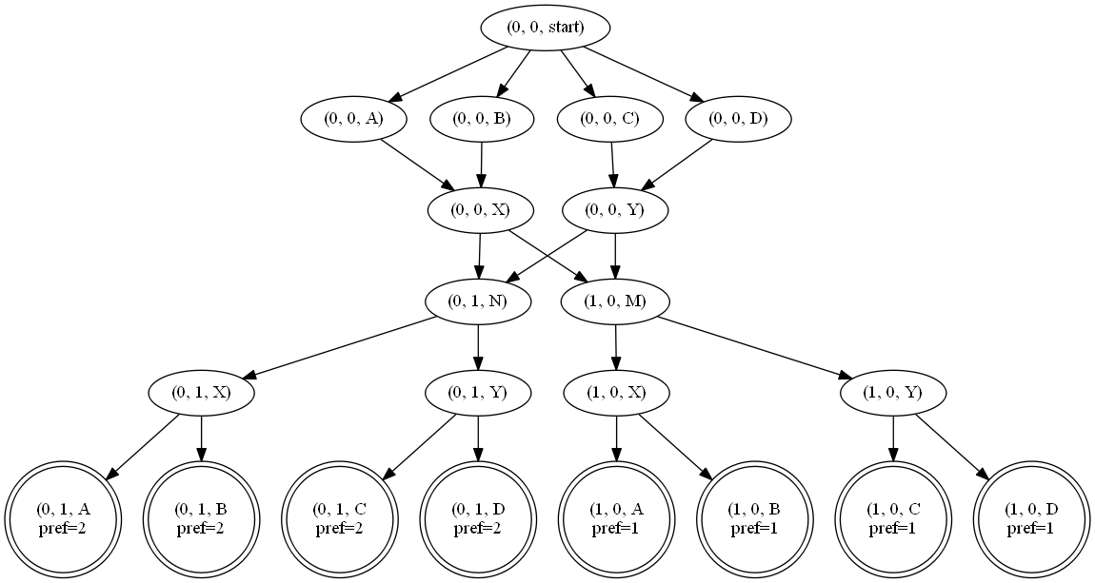
Consistency
M
N
X
Y
A
B
C
D
{1,2}
Most preferred
{1}
Least Preferred
{2}

Slide 2



Topology Consistency
$$G_{1}, X_{1}≥{G_{2}, X}_{2}$$
When
$X_{2} in G_{2} simulates X_{1} in G_{1}$
$$G,\left(0,1,X\right)≥G,(0,0,X)$$
{1,2}
{2}
{1}

Slide 3


Topology Consistency
$$(G|i)$$
Product graph restricted to
nodes that can reach accepting
state with preference i
{1,2}
$$(G|1)$$
{2}
{1}

Slide 4



Topology Consistency
Define “can prefer” relation
$$can prefer X_{1} to X_{2}$$
when
$$∀j∈X_{2}.accept, ∃i∈X_{1}.accept$$
{1,2}
$$i≤j∧\left(G | i\right){,X}_{1}≥\left(G | j\right),X_{2}$$
{2}
{1}

Slide 5




Topology Consistency
$$can prefer \left(1,0,X\right) to (0,0,X)$$
$$can prefer \left(1,0,X\right) to (0,1,X)$$
$$can prefer \left(0,0,X\right) to (1,0,X)$$
$$can prefer \left(0,0,X\right) to (0,1,X)$$
{1,2}
“can prefer” is reflexive and transitive
forms a preorder
{2}
{1}

Slide 6
Topology Consistency
$$can prefer \left(1,0,X\right) to (0,0,X)$$
$$can prefer \left(1,0,X\right) to (0,1,X)$$
$$can prefer \left(0,0,X\right) to (1,0,X)$$
(0,0,X)
$$can prefer \left(0,0,X\right) to (0,1,X)$$
(0,1,X)
“can prefer” is reflexive and transitive
forms a preorder
(1,0,X)

Slide 7
Topology Consistency
If any two nodes are incomparable, then
this is a counter example
(0,0,X)
(0,1,X)
(1,0,X)

Slide 8
Topology Consistency
Whenever we can prefer either node,
these edges can be dropped to indicate
that there is no constraint between them
(0,0,X)
(0,1,X)
(1,0,X)

Slide 9


Topology Consistency
Topological sort produces a valid
preference-based ordering
(0,0,X)
(0,1,X)
$$prefer \left(1,0,X\right) to \left(0,0,X\right) to (0,1,X)$$
$$prefer M to (A,B) to N$$
(1,0,X)

Slide 10
Consistency
START
$$\left(A⋅in⋅D\right)+\left(B⋅A⋅(Y∪Z)⋅D\right)+\left(C⋅B⋅A⋅Z⋅D\right)≫$$
$$\left(A⋅(Y∪Z)⋅D\right)+\left(B⋅A⋅(Y∪Z)⋅D\right)+\left(C⋅B⋅A⋅Z⋅D\right)≫$$
D
$$\left(A⋅Z⋅D\right)+\left(B⋅A⋅Z⋅D\right)+\left(C⋅B⋅A⋅Z⋅D\right)$$
X
Y
Z
X
{1}
A
{1,2}
A
A
{1,2,3}
C
B
A
Y
D
{1,2}
B
B
{1,2,3}
Z
C
{1,2,3}

