Slide 1
Example
S1
S2
A1
A2
A3
A4
A5
A6
A7
A8
T1
T2
T3
T4
T5
T6
T7
T8
P1
P2
P3
P4
P5
P6
P7
P8
Pod 1
Pod 2
Pod 3
Pod 4
Global services
Local services

Slide 2
S1
S2
S3
S4
A1
A2
A3
A4
A5
A6
A7
A8
T1
T2
T3
T4
T5
T6
T7
T8
P1
P2
P3
P4
P5
P6
P7
P8
Pod 1
Pod 2
Pod 3
Pod 4
Global services
Local services

Slide 3


N1
N2
S1
S2
A1
A2
A3
A4
A5
A6
A7
A8
T1
T2
T3
T4
T5
T6
T7
T8
P1
P2
P3
P4
P5
P6
P7
P8
Pod 1
Pod 2
Pod 3
Pod 4
Global services
Local services

Slide 4
N1
N2
S1
S2
S3
S4
A1
A2
A3
A4
A5
A6
A7
A8
T1
T2
T3
T4
T5
T6
T7
T8
P1
P2
P3
P4
P5
P6
P7
P8
Pod 1
Pod 2
Pod 3
Pod 4
Global services
Local services

Slide 5
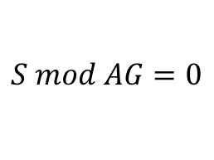


























N1
N2
$$mincut(1)$$
$$mincut(1)$$
$$S$$
$$e4$$
$$e8$$
$$e3$$
$$e7$$
$$e3≥2$$
Q
$$e1=AG$$
P
$$AG$$
$$AL$$
$$e2=TG$$
$$e4≥1$$
$$e2$$
$$e6$$
$$e5=AL$$
$$e7≥2$$
$$e1$$
$$e5$$
$$e6=TL$$
$$S mod AG=0$$
$$TG$$
$$TL$$
$$AG=AL$$
$$S mod AL=0$$
GP
LP
$$AG≤S$$
$$2≤S≤4$$
Global services
Local services

Slide 7
N1
N2
N1
N2
S1
S2
S
A1
A2
A3
A4
AG
AL
T1
T2
T3
T4
TG
TL

Slide 8
Start
(out,0,0)
(N1,0,0)
(N2,0,0)
(S1,1,0)
(S2,1,0)
(S1,0,1)
(S2,0,1)
(A1,1,0)
(A2,1,0)
(A3,1,0)
(A4,1,0)
(A1,0,1)
(A2,0,1)
(A3,0,1)
(A4,0,1)
(T1,1,0)
(T2,1,0)
(T3,1,0)
(T4,1,0)
(T1,0,1)
(T2,0,1)
(T3,0,1)
(T4,0,1)

Slide 9
Start
(out,0,0)
(N1,0,0)
(N2,0,0)
(S,1,0)
(S,0,1)
(AG,1,0)
(AG,1,0)
(AL,0,1)
(AL,0,1)
(TG,1,0)
(TG,1,0)
(TL,0,1)
(TL,0,1)

Slide 10
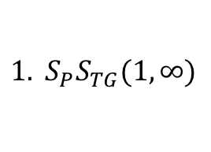
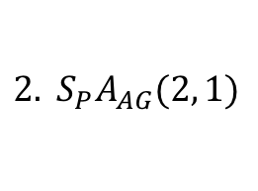
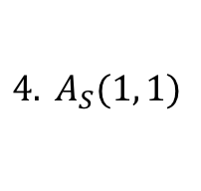
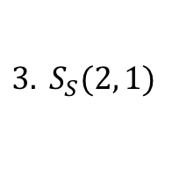
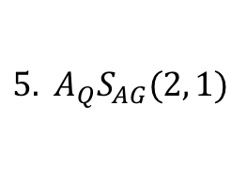
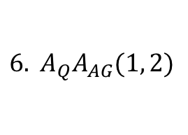
Start
$${1. S}_{P}S_{TG}(1,∞)$$
(TG,0)
...
(TL,0)
$${6. A}_{Q}A_{AG}(1, 2)$$
...
1, I-local, I-mesh1
5, I-local, I-mesh2
$${2. S}_{P}A_{AG}(2, 1)$$
(AG,0)
...
(AL,0)
$${5. A}_{Q}S_{AG}(2, 1)$$
2, I-global, I-striping
2, I-striping
2, I-out2
$$3. S_{S}(2, 1)$$
$$4. A_{S}(1, 1)$$
(S,0)
(N1,0)
(N2,0)

Slide 11
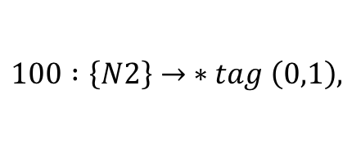


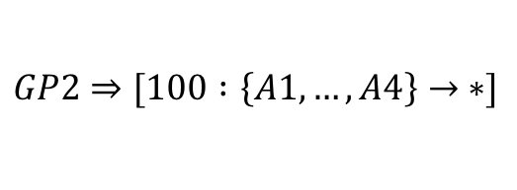
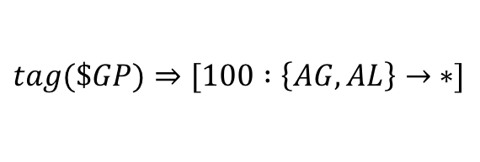
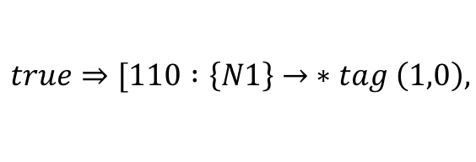
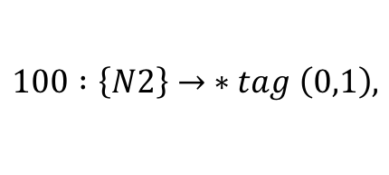

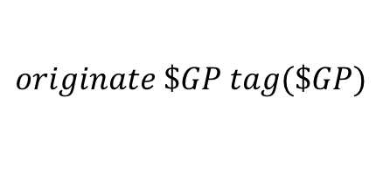
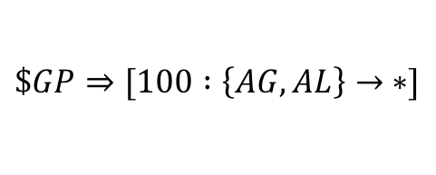
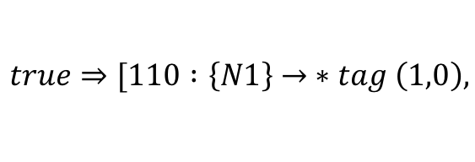
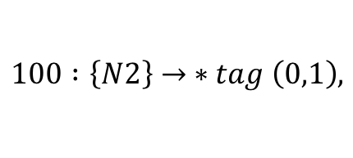


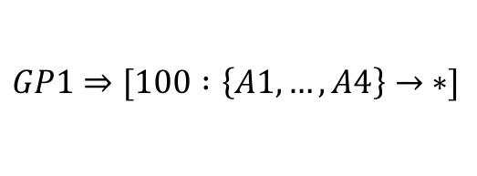
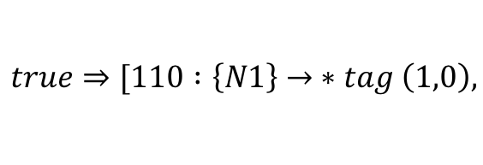
Template S
Incremental Template S
$$\$GP⇒[100 :\left\{AG,AL\right\}→ ∗]$$
$$tag(\$GP)⇒[100 :\left\{AG,AL\right\}→ ∗]$$
$$\$LP⇒[100 :\left\{AG,AL\right\}→\{AG,AL\}]$$
$$tag(\$LP)⇒[100 :\left\{AG,AL\right\}→\{AG,AL\}]$$
$$true⇒[110 :\left\{N1\right\}→ ∗tag \left(1,0\right),$$
$$true⇒[110 :\left\{N1\right\}→ ∗tag \left(1,0\right),$$
$$100 :\left\{N2\right\}→ ∗tag \left(0,1\right),$$
$$100 :\left\{N2\right\}→ ∗tag \left(0,1\right),$$
$$…$$
$$…$$
Configuration S1, S2
Incremental Template TG
$$GP1⇒[100 :\left\{A1,…, A4\right\}→ ∗]$$
$$originate \$GP tag(\$GP)$$
$$GP2⇒[100 :\left\{A1,…, A4\right\}→ ∗]$$
$$…$$
$$…$$
$$LP1⇒[100 :\left\{A1,…, A4\right\}→\{A1,…, A4\}]$$
$$LP2⇒[100 :\left\{A1,…, A4\right\}→\{A1,…, A4\}]$$
$$…$$
$$true⇒[110 :\left\{N1\right\}→ ∗tag \left(1,0\right),$$
$$100 :\left\{N2\right\}→ ∗tag \left(0,1\right),$$
$$…$$

Slide 12
%{for $n in neighbors do}%
interface $n.interface
ip address $n.interfaceIP
!
%{end for}%
router bgp %{$bgpASN}%
no synchronization
no auto-summary
bgp router-id %{$routerID}%
bgp bestpath compare-routerid
%{for $n in neighbors do}%
neighbor $n.IP remote-as $n. ASN
neighbor $n.IP send-community both
neighbor $n.IP route-map peer-in in
%{if $n.isLocalPeer then}%
neighbor $n.IP route-map local out
%{else}%
neighbor $n.IP route-map global out
%{end if}%
%{end for}%
%{for $p in localPrefixes do}%
ip prefix-list localPL permit $p
%{end for}%
!
ip prefix-list other permit 0.0.0.0/0 le 32
!
route-map local permit 10
match ip address prefix-list localPL
!
route-map local deny 20
match ip address prefix-list other
!
route-map peer-in permit 10
match as-path list WAN1
set community additive 64512:3200
!
route-map peer-in permit 20
match as-path list WAN2
set local-preference 90
set community additive 64512:3201
!

Slide 13
Concrete
Topology
Abstract
Topology
Well
Formed
Joint
Analysis
Abstract
Product Graph
Routing &
Fault-tolerance
Policy
Global to
Local policy
Device
Templates
Concretize
Device
Configurations

Slide 14











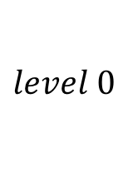
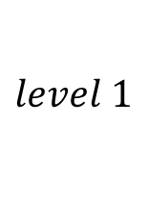












$$L=2$$
$$S_{1}=3$$
$$S_{2}=3$$
P
$$e2$$
$$e1$$
$$e1=X$$
$$e2=X$$
$$X$$
$$e1=1$$
$$e2=1$$
$$X≥1$$
…
$$level 1$$
$$K_{1}$$
$$e4$$
P
$$e1=K_{0}$$
$$level 0$$
$$K_{0}$$
$$e2=S$$
$$e2$$
$$e3=1$$
…
$$e1$$
$$e3$$
$$e4=1$$
$$S$$
$$K_{1}≥4$$
$$K_{0}≥1$$

Slide 15












BCube
$$k=1$$
$$K_{1}$$
$$e4$$
$$e1=K_{0}$$
P
$$e2=S$$
$$k=0$$
$$K_{0}$$
$$e3=1$$
$$e2$$
$$e4=1$$
$$e1$$
$$e3$$
$$K_{1}≥4$$
$$S$$
$$K_{0}≥1$$

