Slide 1
X
Y
D
A
W
C
E
B
Z

Slide 2
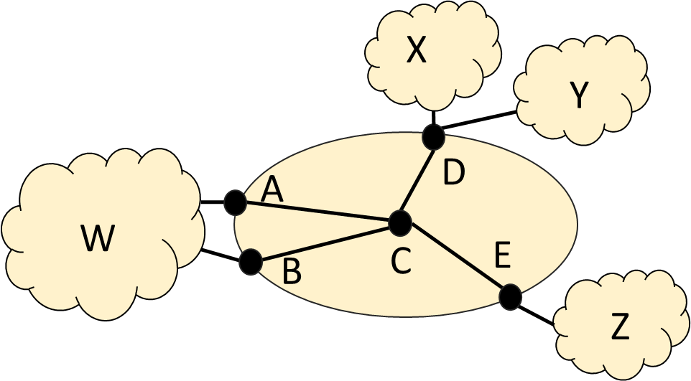

Slide 3
Start
(W,1,1)
(Z,1,1)
(Y,1,1)
(X,1,1)
(A,–,2)
(B,–,2)
(E,–,2)
(D,2,2)
(C,–,2)
(D,–,2)
(C,3,2)
(B,–,3)
(A,4,2)
(W,–,4)
(W,5,–)
Prefs: {2}
Prefs: {1}
end

Slide 4
Start
(W,1,1)
(Z,1,1)
(Y,1,1)
(X,1,1)
(A,–,2)
(B,–,2)
(E,–,2)
(D,2,2)
(C,–,2)
(D,–,2)
(C,3,2)
(B,–,3)
(A,4,2)
(W,–,4)
(W,5,–)
Prefs: {2}
Prefs: {1}
end

Slide 5
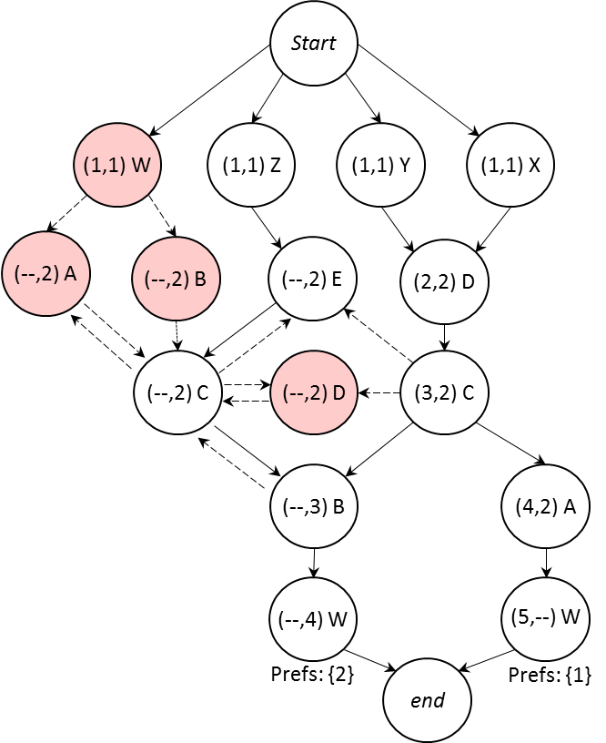

Slide 6













$$Router A:$$
$$match peer=C, Comm=\left(3,2\right):$$
$$export Comm←\left(4,2\right), MED←80, peer←W$$
$$Router B:$$
$$match peer=C, Comm=\left(−, 2\right):$$
$$export Comm←\left(−,3\right), MED←81, peer←W$$
$$match peer=C, Comm=\left(3, 2\right):$$
$$export Comm←\left(−,3\right), MED←81, peer←W$$
$$Router C:$$
$$match peer=E, Comm=\left(−, 2\right): LP=99$$
$$export Comm←\left(−,2\right), peer←B$$
$$match peer=D, Comm=\left(2, 2\right):$$
$$export Comm←\left(3,2\right), peer←A,B$$
$$Router D:$$
$$match regex(X+Y):$$
$$export Comm←\left(2,2\right), peer←C$$
$$Router E:$$
$$match regex(Z):$$
$$export Comm←\left(−,2\right), peer←C$$

Slide 7
