Slide 1
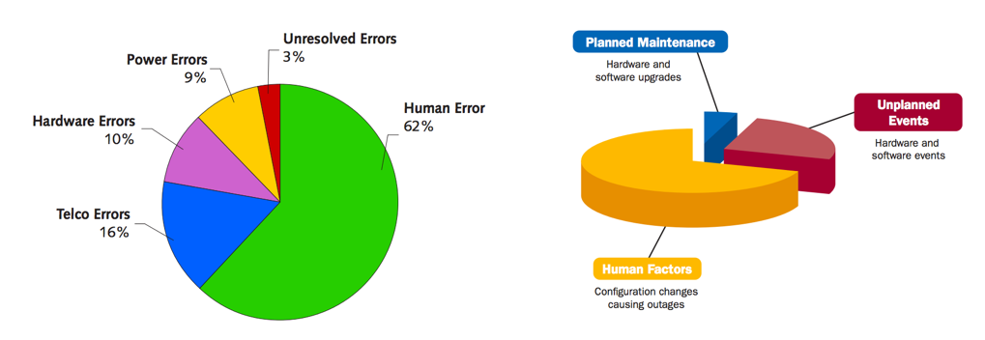
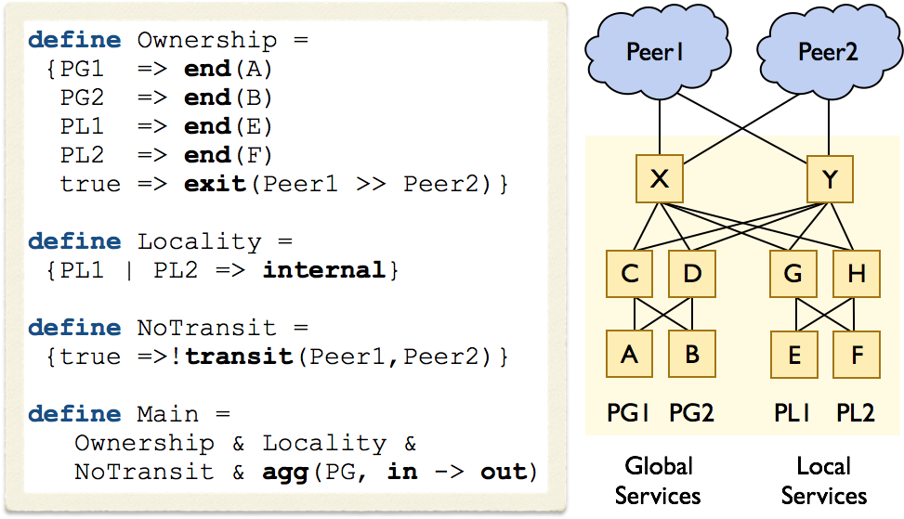
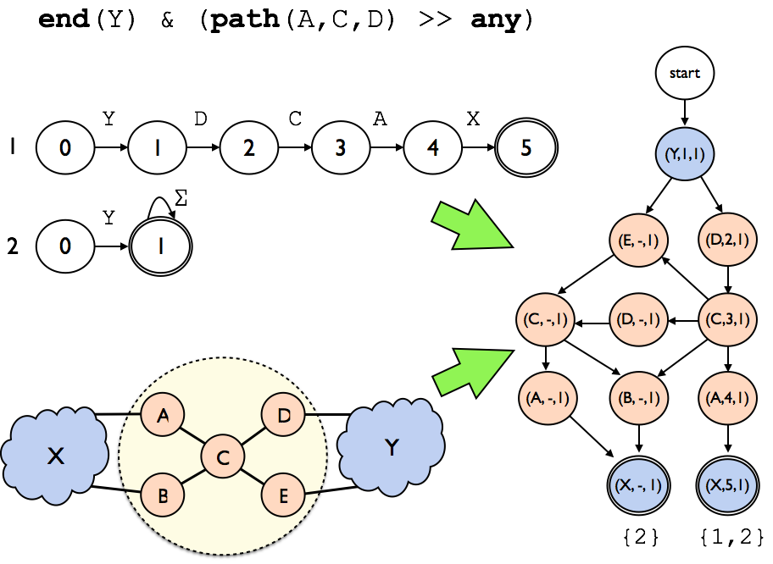
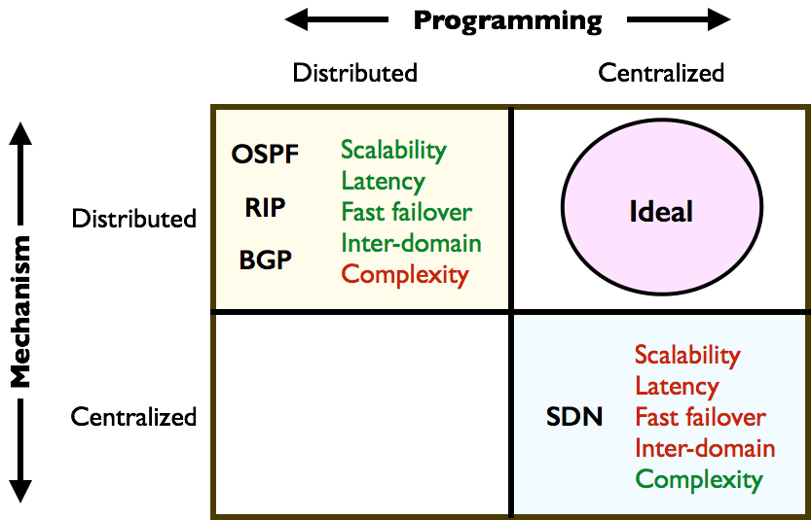
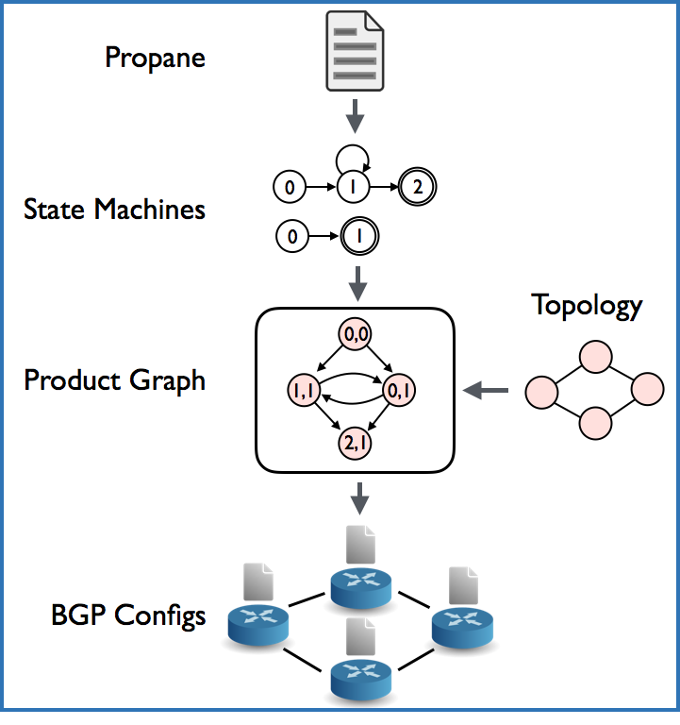
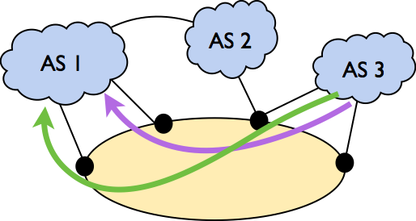
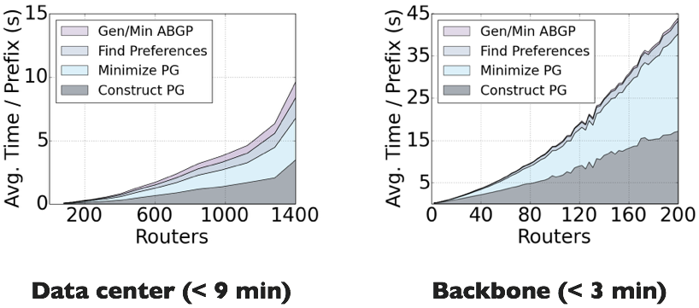
Don’t Mind the Gap: Bridging Network-wide Objectives and Device-level Configurations
Ryan Beckett¹, Todd Millstein², Jitendra Padhye³, Ratul Mahajan³, David Walker¹
¹Princeton University, ²University of California Los Angeles, ³Microsoft Research
Motivation
Example: Configuring a datacenter with BGP
BGP running on every router
Keep local services internal to the datacenter
Aggregate global prefixes externally
Prefer leaving through Peer1 over Peer2
Don’t let the datacenter become a transit point
Example: Creating a product graph
Add an edge in the Product Graph if
The edge exists in the topology
The state machines transition on the edge target
Translation to BGP:
Tag Product Graph state with BGP communities
Incoming edges → import filters
Outgoing edges → export filters
BGP local preferences inferred from analysis
Ensures that BGP will always dynamically find some best path to each destination.
It is well known that traditional network configuration is highly error-prone [1,2,3].
Surveys of network operators often point to human error as a leading cause of misconfigurations [4,5].
High-level Idea: Traditional networks rely on distributed mechanisms to compute forwarding paths. This means they have many nice properties (e.g., scalability, latency), but configuration is hard because it involves distributed programming (a configuration for each device). SDN simplifies configuration but this comes at the cost of many such properties [6,7].
Distributed programming: a config for each device
Centralized programming: a config for the network
Distributed mechanism: devices talk to each other
Centralized mechanism: a controller decides
Figure 1. Operator survey on network misconfiguration causes [4,5]
Figure 3. Configuring a datacenter with Propane
Figure 5. Product Graph construction
Compilation
Compilation Stages:
Compile Propane to per-destination state machines that associate paths with ranks. A lower rank means the path is preferred.
Combine this with the topology to get a graph representing all policy-compliant paths
After checking the graph for failure safety, we generate per-device BGP configs from this graph.
Product Graph:
Intermediate representation for policies
Combines topology and policy
Graph that captures all policy-compliant paths
Associates ranks with paths to a destination
Used for safety analysis / failure analysis of
Implementation
Compiler:
Compiler is 6700 lines of F# code
Flags to configure using: no-export, MEDS, Prepending, anycast, etc.
Compilation parallelized across prefixes
Benchmarks:
Policy translated to Propane for datacenter and transit networks for a large cloud provider
Topology scaled to determine the effect of topology size on compilation time
Policy Size:
Lines of Propane: 31 for the datacenter, 43 for the transit network – orders of magnitude reduction.
Compilation Time:
Figure 2. Tradeoffs between tradition networks and SDN
Propane Language
Programming Model:
A fully centralized view of the network
Including other autonomous system
High-level constraints and preferences on paths
Can describe both intra- and inter-domain routes
Guarantees:
Complies to pure distributed BGP configurations
Policy-compliant under all possible failures
That is, preserves the centralized abstraction
Figure 4. Compilation pipeline for the Propane language
Figure 6. Compilation time for data center and backbone networks
Contact
References
Ryan Beckett
Princeton University
rbeckett@princeton.edu
(303) 956-6712
M. Al-Fares, A. Loukissas, and A. Vahdat. A scalable commodity data center network architecture. In SIGCOMM, 2008.
N. Feamster and H. Balakrishnan. Detecting BGP configuration faults with static analysis. In NSDI, 2005
R. Mahajan, D. Wetherall, and T. Anderson. Understanding BGP misconfiguration. In SIGCOMM, 2002.
Juniper. What’s behind network downtime? https://www-935.ibm.com/services/au/gts/pdf/200249.pdf.
Yankee Group. As the value of enterprise networks excalates, so does the need for configuration management. https://www.cs.princeton.edu/courses/archive/fall10/cos561/papers/Yankee04.pdf.
J. McCauley, A.Panda, M. Casado, T. Koponen, and S. Shenker. Extending SDN to large-scale networks. In Open Networking Summit, 2013.
P. Berde, M. Gerola, J. Hart, Y. Higuchi, M. Kobayashi, T. Koide, B. Lantz, B. O’Connor, P. Radoslavov, W. Snow, and G. Parulkar. ONOS: towards an open, distributed SDN OS. In HotSDN, 2014.

