Slide 1
Internal Routes
(0,0,A)
(0,0,B)
Policy: $\left(in^{∗}⋅M⋅in^{∗}\right)≫(in^{∗}⋅N⋅in^{∗})$
(0,0,X)
M
N
X
Y
(0,0,M)
(0,0,N)
A
B
C
D
(1,0,X)
(1,0,Y)
(0,1,X)
(0,1,Y)
in
in
M
0
1
1
in
in
1
1
1
1
2
2
2
2
N
0
1
1
(1,0,A)
(1,0,B)
(1,0,C)
(1,0,D)
(0,1,A)
(0,1,B)
(0,1,C)
(0,1,D)

Slide 2
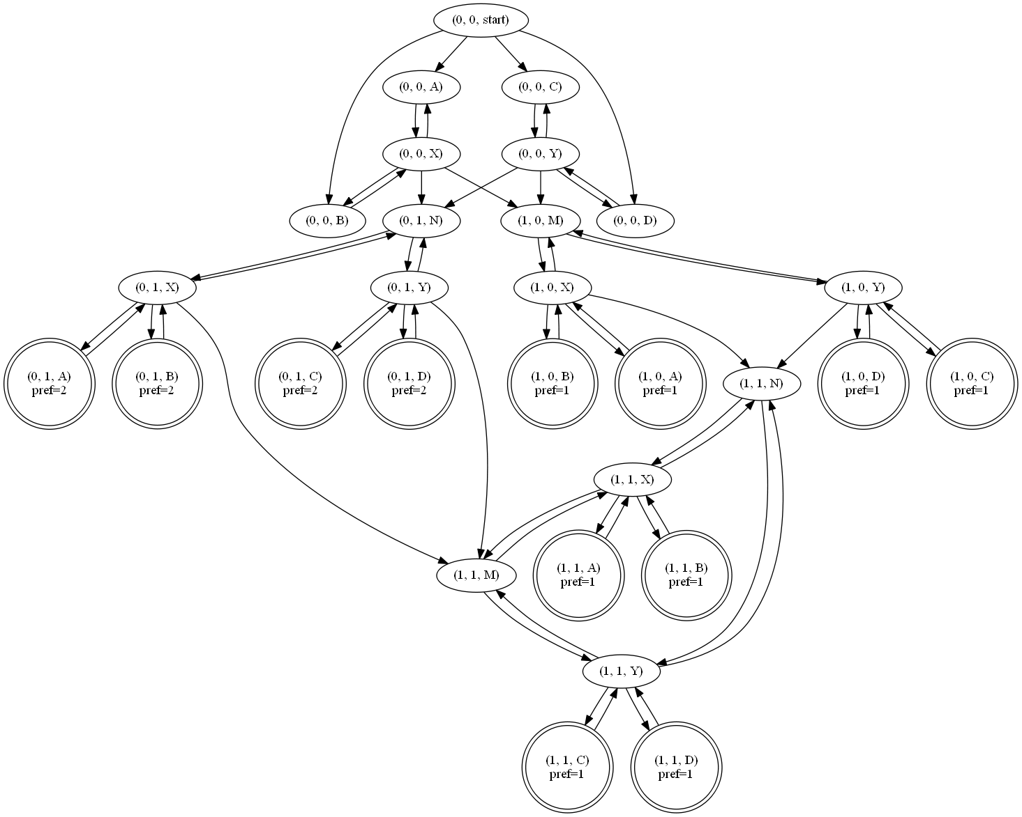

Slide 4
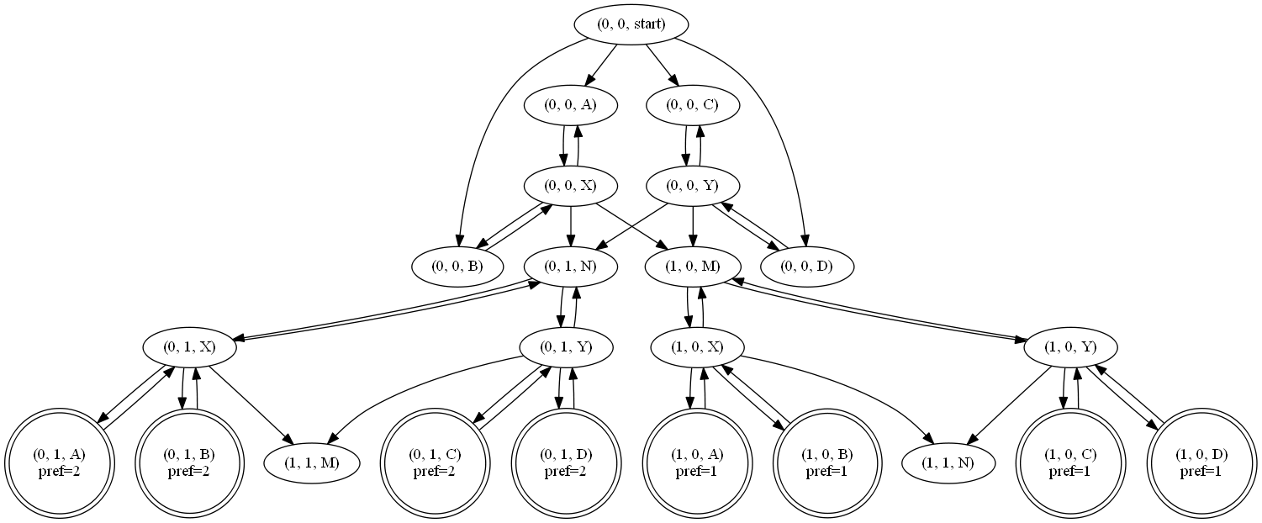

Slide 6
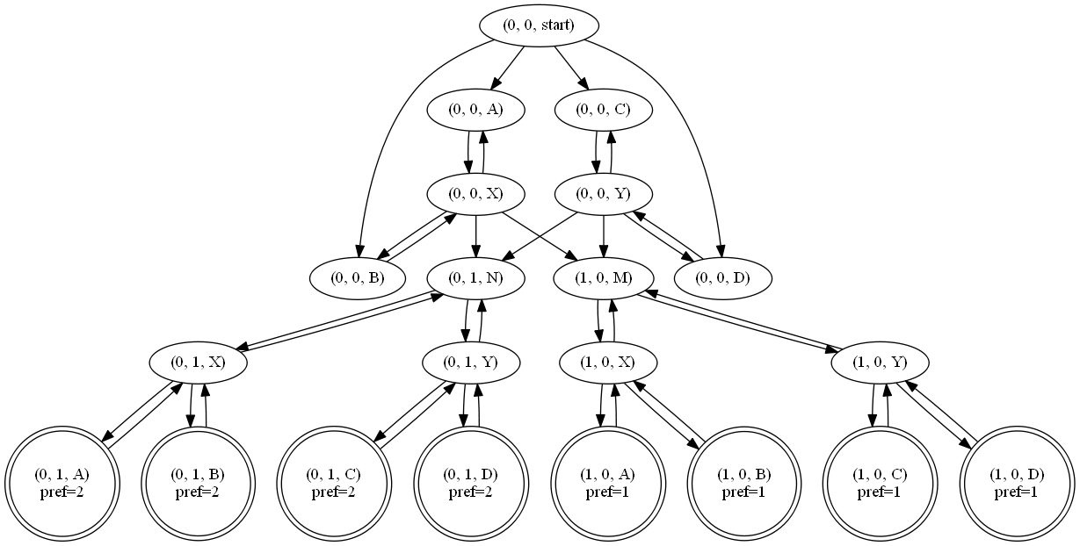

Slide 8
