Slide 1
Network Device Manager
Design Principles:
Separate data (topology, devices) from configuration files
Reusable configuration templates for similar devices/roles
Promotes DRY (avoid some copy-paste, out-of-sync errors)

Slide 2



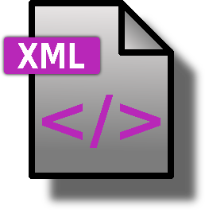
NDM Overview
Configs (Cisco/Juniper)
NDM
Network Graph
Config Templates

Slide 3
Network Graph
Data
ACLS
route-map
prefix-list
access-list
PNG
physical hardware
interconnections
DPG
ip interface map
Interface ACLs
BGP
address/router
start/end peers
keep alive, …
route-map for peers

Slide 4
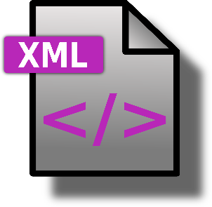
Network Graph
DMIB

Slide 5
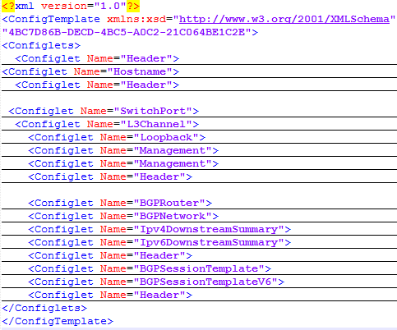
Configuration Templates
XML file over Cisco/Juniper configuration language
Organized into “configlets” for different functionality
Configlets used for organization + incremental deployment

Slide 6
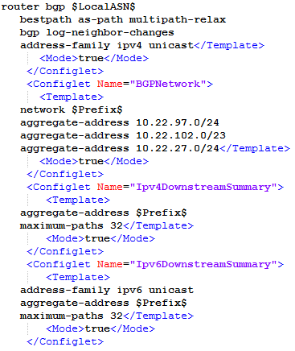
Configuration Templates
Variables of the form $var$ are populated by information from the network graph
Include in final configuration: <Mode>true</Mode>

Slide 7
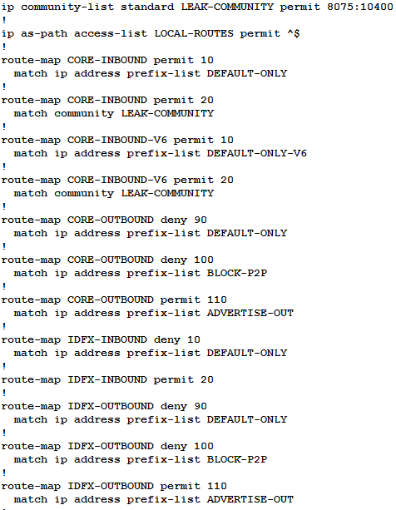
Limitations
No reuse between templates (e.g., lots of similar boiler plate between Cisco routers in different roles
ACLs split between template and ACL database
Most of the complexity is in the local inbound/outbound policies

