Slide 1
Last Time:
Two kinds of abstraction
Destination – summarize a larger prefix group
Topology – abstract the 50 states as USA
Both kinds of abstraction required for specification

Slide 2


Example: (Location Preference)
$$p_{1}⇒out^{∗}⋅SEA⋅in^{∗} ≫out^{∗}⋅in^{+}$$
$$…$$
Aggregate
$$p_{1}$$
$$p_{0}$$
Seattle
New York
AS

Slide 3
Example: (Location Preference)
Must hide
$$p_{1}⇒out^{∗}⋅SEA⋅in^{∗} ≫out^{∗}⋅in^{+}$$
$$…$$
Not Implementable
Aggregate
$$p_{1}$$
$$p_{0}$$
Seattle
New York
AS

Slide 4
Example: (Location Preference)
$$p_{1}⇒out^{∗}⋅SEA⋅in^{∗} ≫out^{∗}⋅hide\left(p_{0}\right)⋅in^{+}$$
$$p_{0}∧¬p_{1}⇒out^{∗}⋅hide\left(p_{0}\right)⋅NY⋅in^{∗}$$
Aggregate
$$p_{1}$$
$$p_{0}$$
Seattle
New York
AS

Slide 5
Example: (Location Preference)
$$p_{1}⇒out^{∗}⋅SEA⋅in^{∗} ≫out^{∗}⋅hide\left(p_{0}\right)⋅in^{+}$$
$$p_{0}∧¬p_{1}⇒out^{∗}⋅hide\left(p_{0}\right)⋅NY⋅in^{∗}$$
Aggregate
Aggregate
$$p_{1}$$
$$p_{0}$$
$$p_{0}$$
Seattle
New York
AS

Slide 6

Example: (Location Preference)
Must hide
$$p_{1}⇒out^{∗}⋅SEA⋅in^{∗} ≫out^{∗}⋅hide\left(p_{0}\right)⋅in^{+}$$
$$p_{0}∧¬p_{1}⇒out^{∗}⋅hide\left(p_{0}\right)⋅in^{+}$$
Not Implementable
Aggregate
Aggregate
$$p_{1}$$
$$p_{0}$$
$$p_{0}$$
Seattle
New York
AS

Slide 7



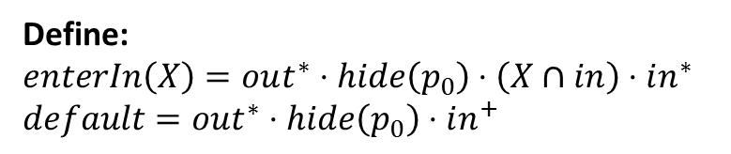
Example: (Location Preference)
Define:
$$enterIn\left(X\right)=out^{∗}⋅hide\left(p_{0}\right)⋅\left(X∩in\right)⋅in^{∗}$$
$$default=out^{∗}⋅hide\left(p_{0}\right)⋅in^{+}$$
$$p_{1} ⇒enterIn\left(SEA\right)≫default$$
$p_{2} ⇒enterIn\left(NY\right)≫default$
$$p_{0}∧¬p_{1}∧¬p_{2}⇒default$$
Aggregate
Aggregate
$$p_{1}$$
$$p_{0}$$
$$p_{2}$$
$$p_{0}$$
Seattle
New York
AS

Slide 8
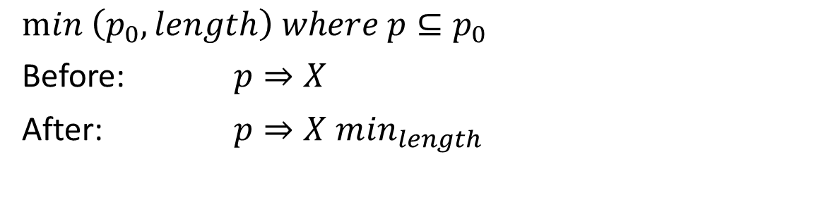
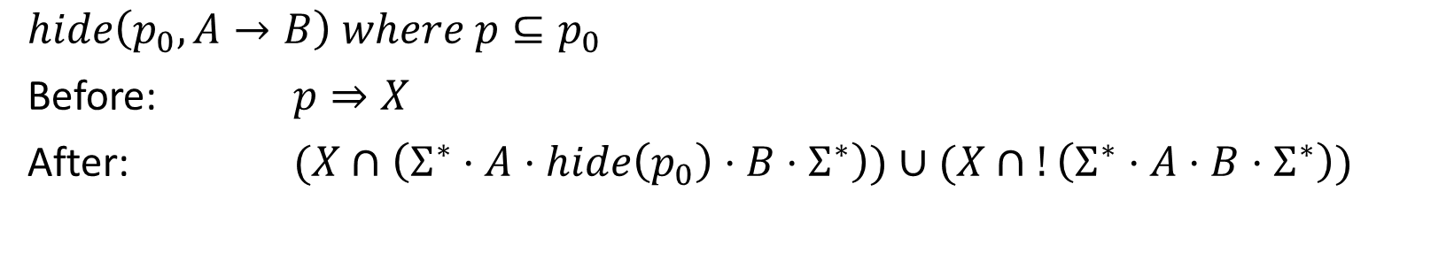
Modular Specification:
Summarization:
$$hide\left(p_{0}, A→B\right) where p⊆p_{0}$$
Before: $p⇒X$
After: $(X∩\left(Σ^{∗}⋅A⋅hide\left(p_{0}\right)⋅B⋅Σ^{∗}\right))∪(X∩!\left(Σ^{∗}⋅A⋅B⋅Σ^{∗}\right))$
Minimization:
$min \left(p_{0}, length\right) where p⊆p_{0}$
Before: $p⇒X$
After: $p⇒X m{in}_{length}$

Slide 9


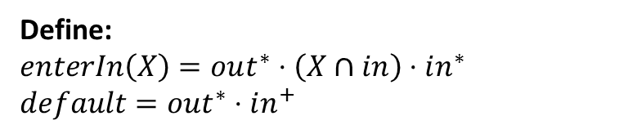
Example: (Location Preference)
Define:
$$enterIn\left(X\right)=out^{∗}⋅\left(X∩in\right)⋅in^{∗}$$
$$default=out^{∗}⋅in^{+}$$
$$p_{1} ⇒enterIn\left(SEA\right)≫default$$
$p_{2} ⇒enterIn\left(NY\right)≫default$
$$p_{0}∧¬p_{1}∧¬p_{2}⇒default$$
Aggregate
$$hide(p_{0},out→in)$$
Aggregate
$$p_{1}$$
$$p_{0}$$
$$p_{2}$$
$$p_{0}$$
Seattle
New York
AS

Slide 10





Example: (Multihoming Customer)
Aggregate
$$p_{1}$$
$$p_{0}$$
$$p_{1}$$
$$p_{1}⇒out^{∗}⋅in^{+}⋅customer$$
AS
$${p_{0}∧¬p}_{1}⇒out^{∗}⋅in^{+}$$
$$hide(p_{0},out→in)$$
$$p_{1}$$
$$p_{1}$$
Customer

Slide 11
Example: (Multihoming Customer)
Aggregate
$$p_{1}$$
$$p_{0}$$
Preferred to external routes
$$p_{1}$$
$$p_{1}⇒out^{∗}⋅in^{+}⋅customer≫out^{+}$$
AS
$${p_{0}∧¬p}_{1}⇒out^{∗}⋅in^{+}$$
$$hide(p_{0},out→in)$$
$$p_{1}$$
$$p_{1}$$
Customer

Slide 12


Example: (Multihoming Customer)
Aggregate
$$p_{1}$$
$$p_{0}$$
$$p_{1}$$
AS
$$bogon∨gt24⇒∅$$
$$p_{1}⇒throughMe⋅customer≫external$$
$$p_{0}⇒throughMe$$
$$true⇒\left(exitOut\left(peer\right)≫exitOut\left(paid\right)\right) \backslash transit$$
$$p_{1}$$
$$p_{1}$$
$$hide(p_{0},in→peer∪paid)$$
Customer

Slide 13
OSPF Areas
Improves scalability (smaller topology), less CPU intensive
Area border routers (ARBs) for inter-area connectivity
Single backbone area connected to all other areas
Inter-area aggregation is common

Slide 14
OSPF Areas
Takeaways:
Should not affect on routing
Programmer may want to specify areas explicitly

Slide 15

OSPF Areas
Backbone Area
ABR
Area 1
Area 2
Area 0

Slide 16
Ownership
Common invariant: Prefix p is known to be associated with certain location(s)
AS knows which prefixes go to which customers (filter other routes)
AS knows which prefixes it owns (filter external routes)
Internal routing (OSPF areas) aggregate prefix by location
$$own\left(X,p\right)=p⇒{\left(!X\right)}^{∗}⋅hide(p)⋅{abstract(X}^{+})$$
$$own(AREA_{1}, 1.1.1.0/24)$$
$$own(AREA_{2}, 2.2.2.0/24)$$

Slide 17

Example Language
$pol ∷=s_{1}, …, s_{n}$
$$c ∷= \left[choose_{n}\right] r_{1}≫…≫r_{m} [m{in}_{attr}]$$
$p ∷= true \left| x.x.x.x/m \right| p_{1}∨p_{2} \left| p_{1}∧p_{2} \right| ¬p$
r$∷= out$
$| in$
$| l$
$| r_{1}∪r_{2}$
$| r_{1}∩r_{2}$
$| r_{1} \backslash r_{2}$
$| r_{1}⋅r_{2}$
$| r^{∗}$
$| hide(p)$
$| abstract(r)$
Policy
Constraint
Predicate
Regular Path

Slide 18


Environment Assumptions:
Path Rewriting:
Subset of original paths
Communities (N):
No-export: $out^{∗}⋅N⋅me⋅out^{∗} → N⋅me⋅out^{∗}$
Two-hops: $out^{∗}⋅out⋅N⋅me⋅out^{∗} → out⋅N⋅me⋅out^{∗}$
Filtering (X):
$$out^{∗}⋅me⋅X⋅out^{∗} → ∅$$
M
N
me
X

Slide 19



Questions:
1. Should topology abstraction be based on paths or nodes?
$$abstract R_{1},R_{2},R_{3} as X in …$$
$$abstract( {\left(R_{1}∪R_{2}∪R_{3}\right)}^{+} )$$
2. What do set intersection and set difference mean with hide(p) and abstract(x)

Slide 20
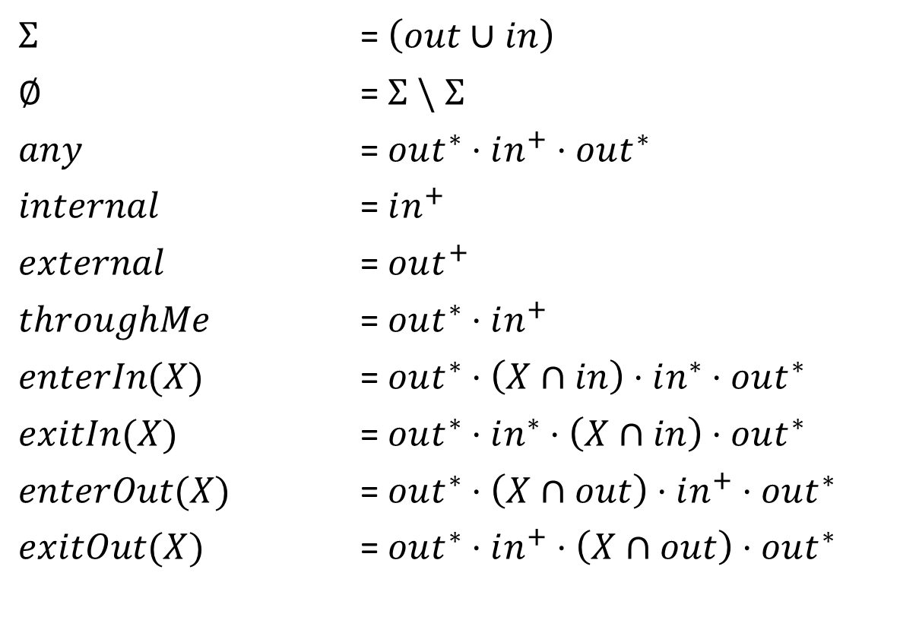
Definitions
$Σ$ = $\left(out∪in\right)$
$∅$ = $Σ \backslash Σ$
$any$ = $out^{∗}⋅in^{+}⋅out^{∗}$
$internal$ = $in^{+}$
$external$ = $out^{+}$
$throughMe$ = $out^{∗}⋅in^{+}$
$enterIn(X)$ = $out^{∗}⋅\left(X∩in\right)⋅in^{∗}⋅out^{∗}$
$exitIn(X)$ = $out^{∗}⋅in^{∗}⋅\left(X∩in\right)⋅out^{∗}$
$enterOut(X)$ = $out^{∗}⋅\left(X∩out\right)⋅in^{+}⋅out^{∗}$
$exitOut(X)$ = $out^{∗}⋅in^{+}⋅\left(X∩out\right)⋅out^{∗}$

