Slide 1
Complexity (Graph algorithms)
Database literature:
Regular path queries (RPQ)
Directed graph
Edge labelled graph
a
b, c
e
c
d
a, b

Slide 2
Complexity (Graph algorithms)
Database literature:
Regular path queries (RPQ)
Directed graph
Edge labelled graph
Shortest path: P
Simple path: NP
a
b, c
e
c
d
a, b

Slide 3
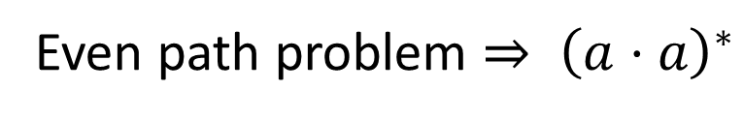
Complexity (Graph algorithms)
Database literature:
Regular path queries (RPQ)
Directed graph
Edge labelled graph
Shortest path: P
Simple path: NP
a
b, c
e
c
d
a, b
Even path problem ${⇒ \left(a⋅a\right)}^{∗}$

Slide 4
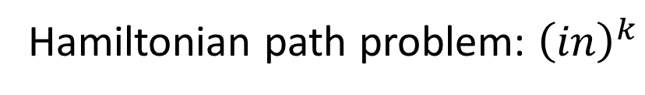
Complexity (Graph algorithms)
Networks:
Undirected graph
Vertex labelled graph
Shortest path: P
Simple path: NP
M
N
X
Y
A
B
C
D
Hamiltonian path problem: ${\left(in\right)}^{k}$

Slide 5
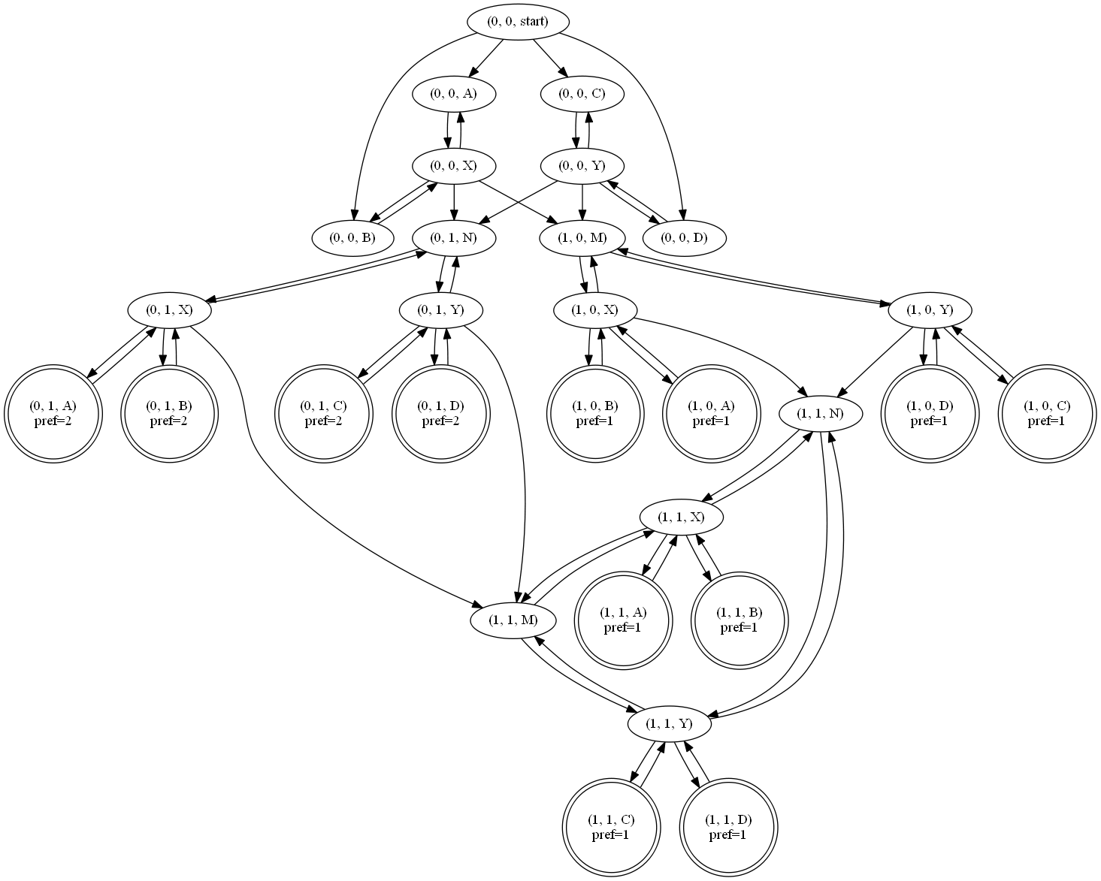

Slide 6
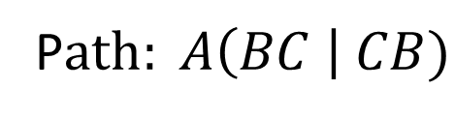
Acyclic Topology?
Multiple acyclic orientations
P$ath: A\left(BC \right| CB)$
A
A
A
B
C
B
C
B
C

Slide 7
Product Graph Minimization:
Exact minimization: Find all nodes/edges on some simple path
Heuristic minimization: Remove edges and nodes separately

Slide 8
Product Graph Minimization (Exact):

Slide 9
Product Graph Minimization (Exact):

Slide 10
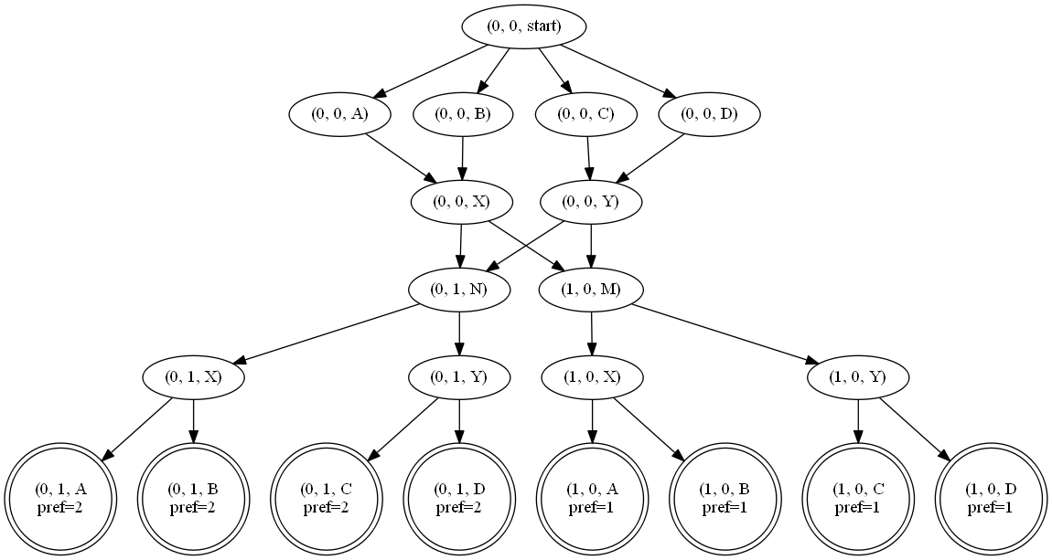
Product Graph Minimization (Exact):

Slide 11
Product Graph Minimization (Heuristic):
Remove any edge where:
Y cannot reach an accepting state without X
Start cannot reach X without going through Y
X
Y

Slide 12
Product Graph Minimization (Heuristic):

Slide 13
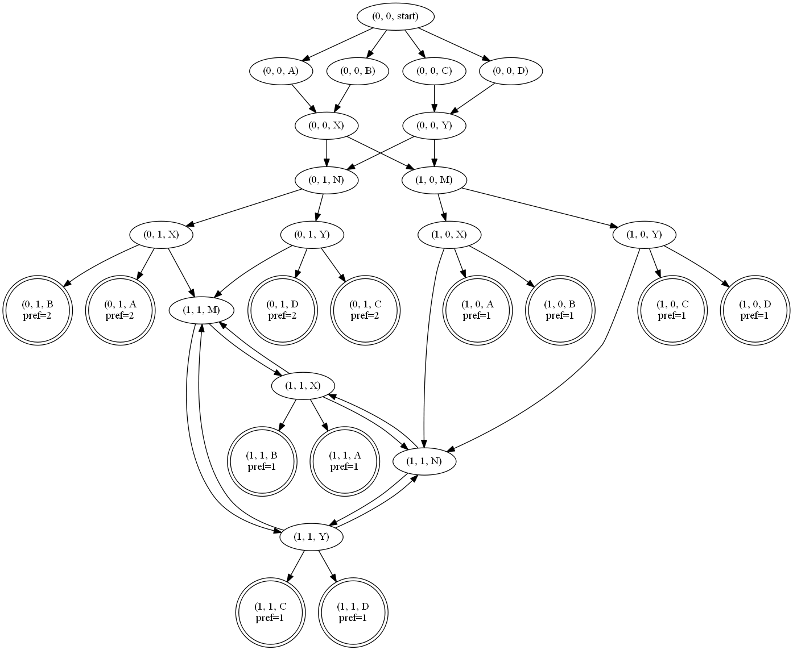
Product Graph Minimization (Heuristic):

Slide 14
Product Graph Minimization (Heuristic):

Slide 15
Product Graph Minimization (Heuristic):

Slide 16
Product Graph Minimization (Heuristic):

Slide 17
Product Graph Minimization (Heuristic):

Slide 18

Product Graph Minimization (Heuristic):

Slide 19
Product Graph Minimization (Heuristic):

Slide 20
Product Graph Minimization (Heuristic):
Can’t reach an accepting state without
going through one of: {start, A, X, M, Y}

Slide 21
Product Graph Minimization (Heuristic):

Slide 22
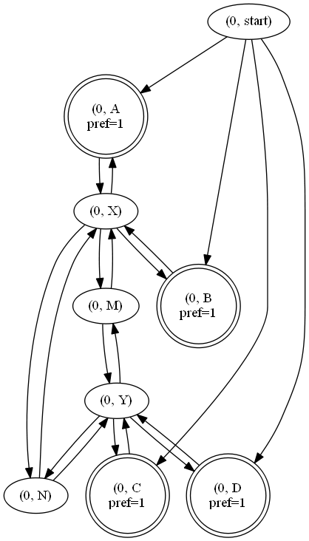

Product Graph Minimization (Heuristic):
Policy: $in^{∗}$
Single pass over each vertex and edge

Slide 23
Compilation:
Policy: $\left(in^{∗}⋅M⋅in^{∗}\right)≫(in^{∗}⋅N⋅in^{∗})$
M
N
Router M, N:
local-pref(X) = 100
local-pref(Y) = 100
Router X:
local-pref(M) = 100
local-pref(A) = 101
local-pref(B) = 101
local-pref(N) = 102
…
X
Y
A
B
C
D
in
in
M
0
1
1
in
in
N
0
1
1

Slide 24
Topology Consistency
Sufficient Condition:
More preferred nodes have a superset of the paths of less preferred nodes

Slide 25
Topology Consistency
Necessary and sufficient condition:
Whenever:
There is a simple path to node N
There is no simple path through N to an accepting state
There is no simple path through a less preferred node to an accepting state.

Slide 26
Topology Consistency
M
N
X
Y
A
B
C
D
{1,2}
Most preferred
{1}
Least Preferred
{2}

Slide 27
Topology Consistency
M
N
X
Y
A
B
C
D

