Slide 1

Valley-Free routing
Policy:
$$p⇒waypoint\left(X\right)∩ endAt(F)$$
X
Y
C
D
G
H
A
B
E
F

Slide 2
Valley-Free routing
Policy:
$$p⇒waypoint\left(X\right)∩ endAt(F)$$
X
Y
Not possible!
BGP Instability can arise
C
D
G
H
A
B
E
F

Slide 3






Valley-Free routing
Policy:
$$p⇒$$
$$waypoint\left(X\right)∩$$
$$endAt\left(F\right)∩$$
X
Y
$$valleyFree(\left(A+B+E+F\right),$$
$$\left(C+D+G+H\right),$$
$$\left(X+Y\right))$$
C
D
G
H
A
B
E
F

Slide 4
Valley-Free routing
Policy:
$$p⇒$$
$$waypoint\left(X\right)∩endAt\left(F\right)∩valleyFree\left(…\right)≫$$
X
Y
Not possible!
Should G prefer X or F?
C
D
G
H
Should H prefer X or F?
A
B
E
F

Slide 5

Valley-Free routing
Policy:
$$p⇒$$
$$waypoint\left(X\right)∩endAt\left(F\right)∩valleyFree\left(…\right)≫$$
X
Y
$$endAt\left(F\right)$$
C
D
G
H
A
B
E
F

Slide 6

Configuration Minimization
Policy:
$$p⇒waypoint\left(M\right)∩ endAt\left(A\right)$$
M
N
X
Y
A
B
C
D

Slide 7
Configuration Minimization
Policy:
$$p⇒waypoint\left(M\right)∩ endAt\left(A\right)≫endAt(A)$$
M
N
X
Y
A
B
C
D

Slide 8
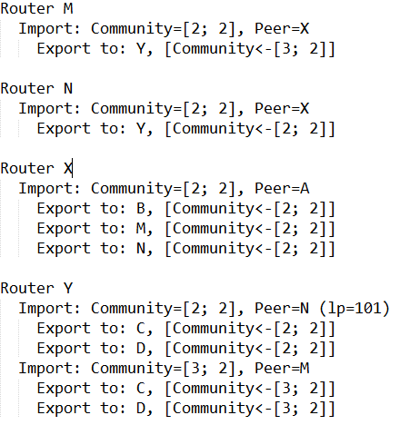
Configuration Minimization
Policy:
$$p⇒waypoint\left(M\right)∩ endAt\left(A\right)≫endAt(A)$$
M
N
X
Y
A
B
C
D

Slide 9
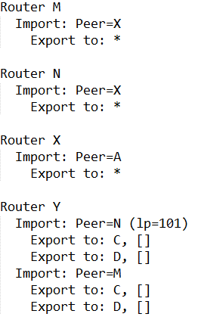
Configuration Minimization
Remove community matching/tagging for unique edges in the product graph (e.g., (A, X)
Never tag with a community if the peer doesn’t match it
Remove back-to back preferences for the same neighbor
Remove community matching/tagging for nodes with equivalent subgraphs in the product graph
If you export to all neighbors except who you imported a route from, then don’t selectively filter exports
M
N
X
Y
A
B
C
D

Slide 10
Partial Information
AS3
Start
AS3
unknown
Router A

Slide 11

Partial Information
AS3
Start
AS3
unknown
$$filter: regex( _∗AS3)$$
Router A

Slide 12


Environment Assumptions
$$no_export$$
AS1

Slide 13
Environment Assumptions
Can’t Control
Start

