Slide 1
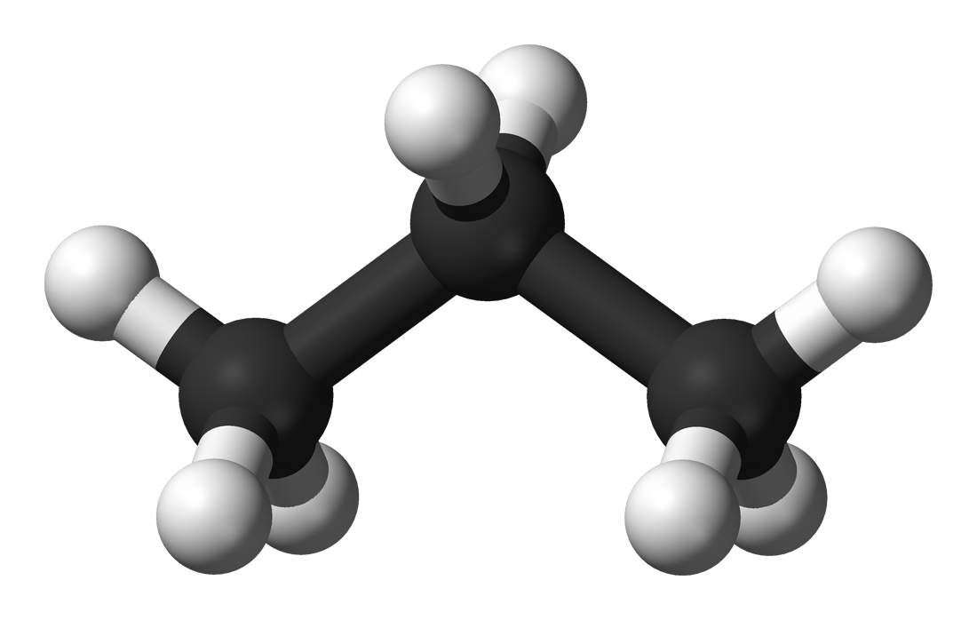


Propane: Programming
Distributed Control Planes
Ryan Beckett (Princeton, MSR)
Ratul Mahajan (MSR)
Todd Millstein (UCLA)
Jitu Padhye (MSR)
David Walker (Princeton)

Slide 2
Configuring Networks is Error-Prone
~60% of network downtime is caused by human error
-Yankee group 2002
50-80% of outages are the result of human error
-Juniper 2008

Slide 3
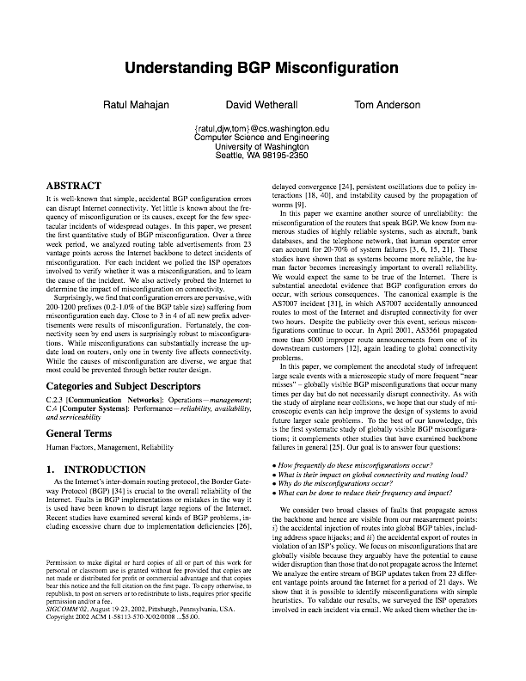
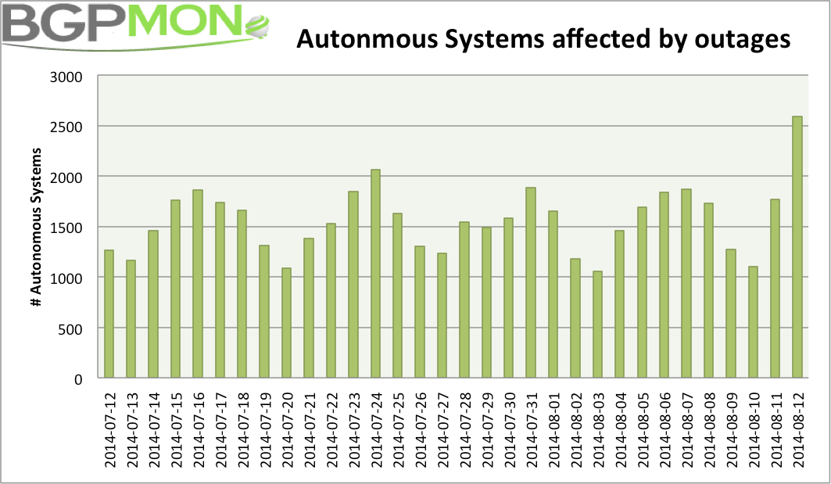
Configuring Networks is Error-Prone
“Close to 3 in 4 of all new prefix advertisements were results of misconfiguration”
~1500 ASes affected by outages every day

Slide 4

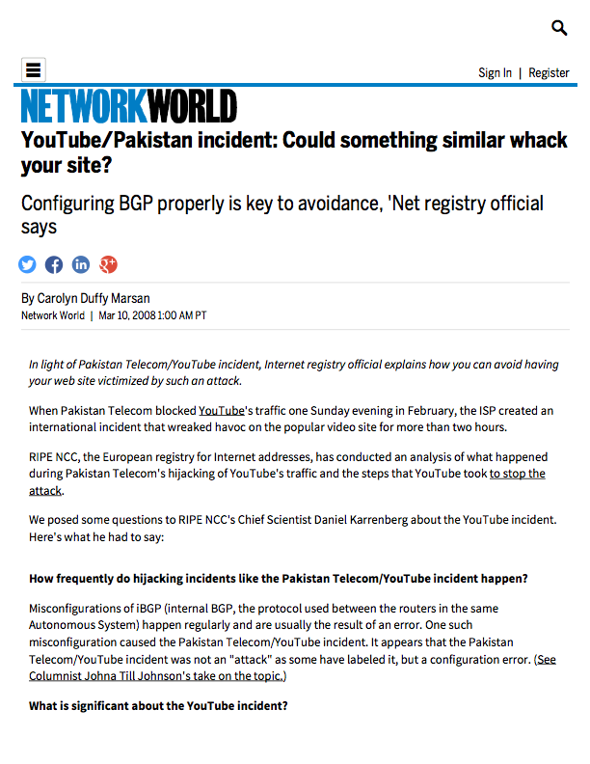
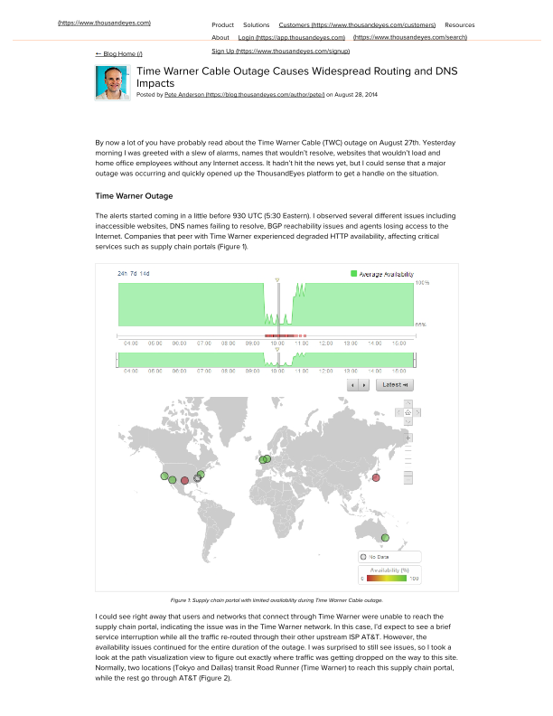

Configuring Networks is Error-Prone

Slide 5
Objectives Mechanisms
GAP
Objectives: Network-wide
Prefer traffic go through AT&T over Sprint
Don’t use our network as transit between A and B
Traffic must stay within national boundaries
Ensure traffic goes through X
Adhere to policies even when failures occur

Slide 6
Objectives Mechanisms
GAP
Objectives: Network-wide
Prefer traffic go through AT&T over Sprint
Don’t use our network as transit between A and B
Traffic must stay within national boundaries
Ensure traffic goes through X
Adhere to policies even when failures occur

Slide 7
Objectives Mechanisms
GAP
Objectives: Network-wide
Prefer traffic go through AT&T over Sprint
Don’t use our network as transit between A and B
Traffic must stay within national boundaries
Ensure traffic goes through X
Adhere to policies even when failures occur
Mechanisms: Device-by-Device
Local decisions made independently on each device
Several device-level actions together imply some higher-level behavior
Failures interact with local decision-making algorithms in complex ways

Slide 8
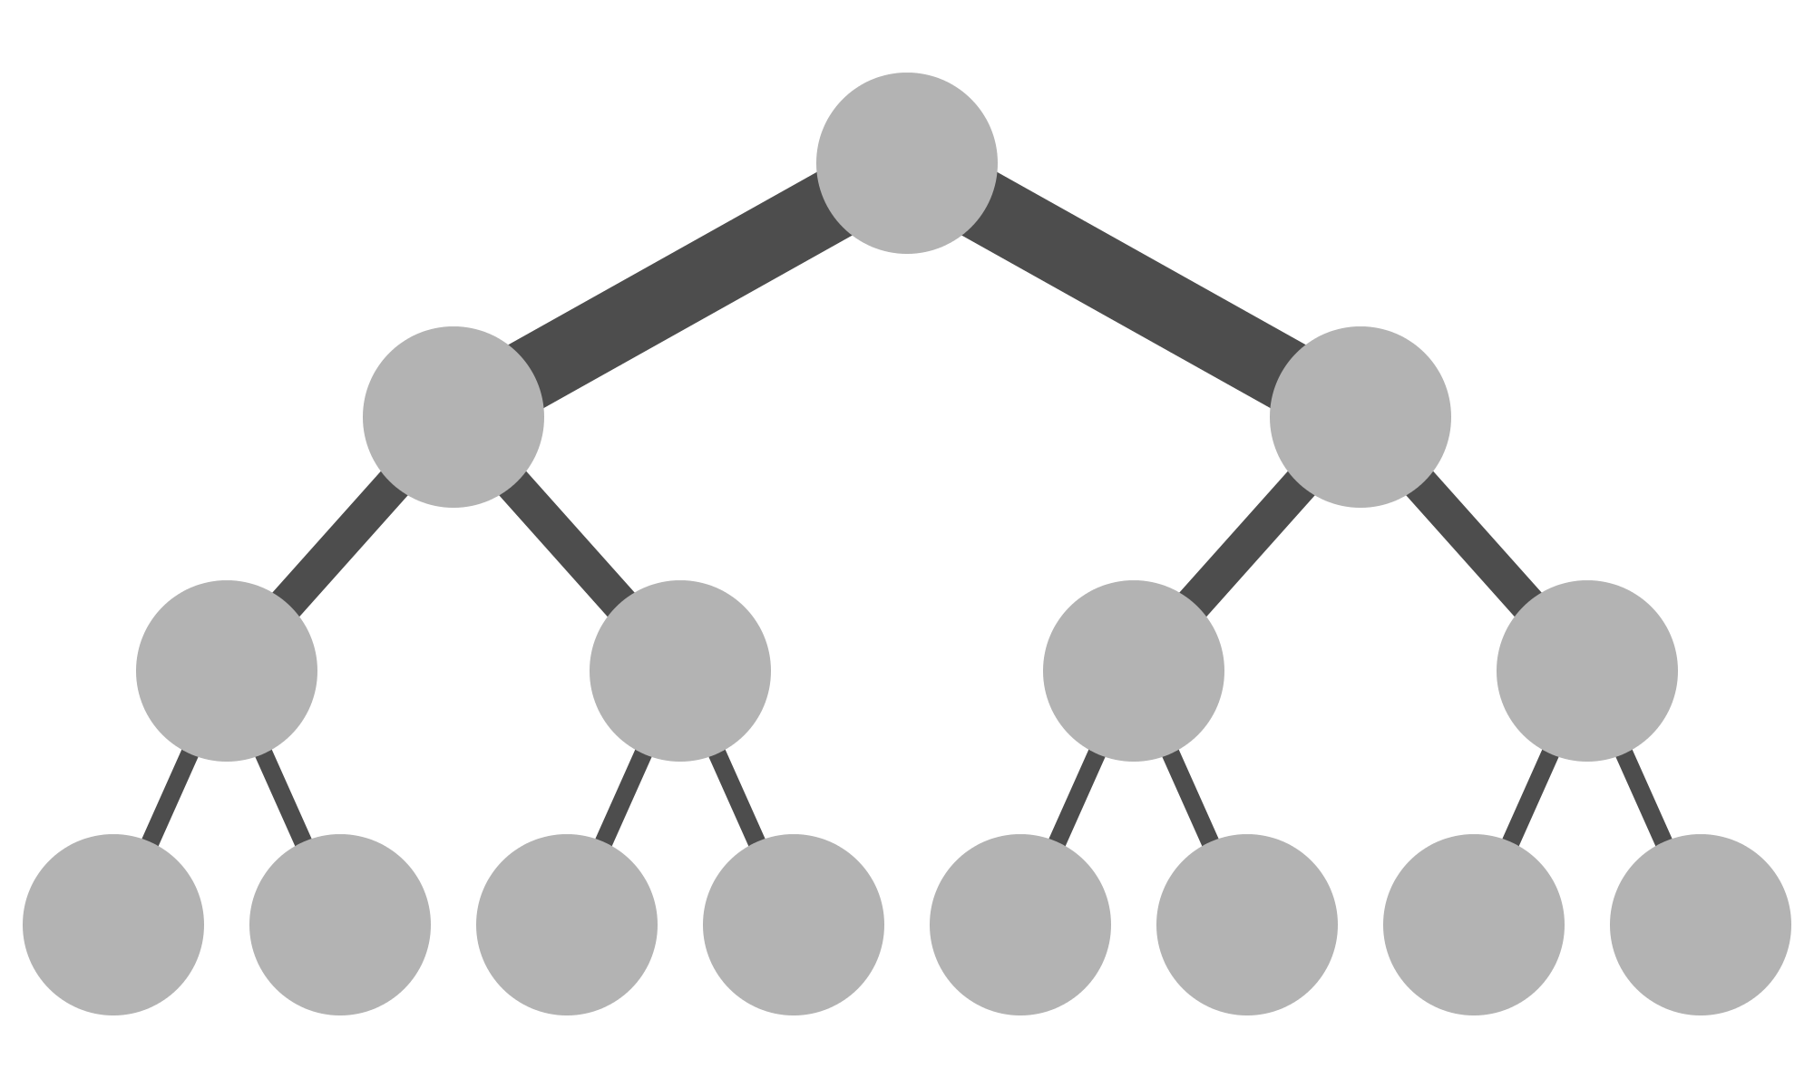

Why use BGP?
Advantages
Allows for local policy among nodes
Massively scalable — hundreds of thousands of IP prefixes
Fully distributed — does not require global knowledge of network state
BGP in the Wild
Inter-domain routing between Autonomous Systems (AT&T, Sprint)
Intra-domain routing in data centers
Sprint
AT&T
Notes:
If so hard to configure, why is BGP used, and how is it used?

Slide 9
What about SDN?
Software Defined Networks
Simpler, centralized programming models
Network-wide abstractions like paths
Centralized controller programs the network
But they are not a panacea:
Do not usually help with inter-domain routing
Latency, and scalability can be problematic for large networks
Require careful design and engineering to be robust to failures
Their implementations don’t exploit existing network infrastructure

Slide 10
Propane: Programming a
Distributed Control Plane
I) Language for expressing high-level operator objectives with:
Network-wide programming abstraction
Uniform abstractions for intra- and inter-domain routing
Paths constraints and relative preferences with fall-backs in case of failures
AS 2
AS 1
AS 3

Slide 11

Propane: Programming a
Distributed Control Plane
2) Compiler to generate a low-level distributed implementation:
Efficient algorithms to synthesize a set of policy-compliant BGP configs
Static analysis guarantees policy compliance under all failures
Backup
Network partition — drop
11￼

Slide 12
Border Gateway Protocol (BGP)
Routers send advertisements for a destination (e.g., 16.4.0.0/16)
Advertisements contain the AS path traffic would take
Each router applies local policy to choose best route
Import filters drop advertisements or modify attributes
Highest preference is chosen. Path length as a tie breaker
Export filters drop advertisements or modify attributes
local-pref←100
drop
X
tag←“foo”
local-pref←99

Slide 13
Border Gateway Protocol (BGP)
1. Prefer C over A
1. Block “red” routes
B
D
A
16.4.0.0/16
C
E
1. Prefer B over A
2. Tag routes “red”
3. Don’t export to E

Slide 14
Border Gateway Protocol (BGP)
1. Prefer C over A
1. Block “red” routes
B
D
path = A
A
16.4.0.0/16
C
E
path = A
1. Prefer B over A
2. Tag routes “red”
3. Don’t export to E
advertisement
pkt forwarding

Slide 15
Border Gateway Protocol (BGP)
1. Prefer C over A
1. Block “red” routes
B
D
A
16.4.0.0/16
C
E
1. Prefer B over A
2. Tag routes “red”
3. Don’t export to E
advertisement
pkt forwarding

Slide 16
Border Gateway Protocol (BGP)
1. Prefer C over A
1. Block “red” routes
B
D
X
A
16.4.0.0/16
path = CA
C
E
X
1. Prefer B over A
2. Tag routes “red”
3. Don’t export to E
advertisement
pkt forwarding

Slide 17
Border Gateway Protocol (BGP)
1. Prefer C over A
1. Block “red” routes
B
D
A
16.4.0.0/16
C
E
1. Prefer B over A
2. Tag routes “red”
3. Don’t export to E
advertisement
pkt forwarding

Slide 18
Border Gateway Protocol (BGP)
1. Prefer C over A
1. Block “red” routes
B
D
X
A
16.4.0.0/16
path = BCA
C
E
1. Prefer B over A
2. Tag routes “red”
3. Don’t export to E
advertisement
pkt forwarding

Slide 19
Border Gateway Protocol (BGP)
1. Prefer C over A
1. Block “red” routes
B
D
A
16.4.0.0/16
C
E
1. Prefer B over A
2. Tag routes “red”
3. Don’t export to E
advertisement
pkt forwarding

Slide 20
Border Gateway Protocol (BGP)
Aggregation (Route summarization)
Advertise a more general subnetwork
Information hiding for routers
Reduces router table size and improves stability
C
16.4.2.0/24
B
D
16.4.0.0/16
E
16.4.1.0/24
A
16.4.0.0/24

Slide 21
Example 1: A Data Center Network
Peer1
Peer2
Goals
Local prefixes reachable only internally
Global prefixes reachable externally
Aggregate global prefixes as PG
Prefer leaving through Peer1 over Peer2
Prevent transit traffic between peers
X
Y
Y
C
D
C
D
G
H
G
H
A
A
B
B
E
F
E
F
PG1
PG2
PL1
PL2
Global
Services
Local
Services

Slide 22
Example 1: A Data Center Network
Peer1
Peer2
Goals
Local prefixes reachable only internally
Global prefixes reachable externally
Aggregate global prefixes as PG
Prefer leaving through Peer1 over Peer2
Prevent transit traffic between peers
PG
X
Y
Y
C
D
C
D
G
H
G
H
Attempt (1)
Don’t export from G, H to external
Aggregate externally as PG
A
A
B
B
E
F
E
F
PG1
PG2
PL1
PL2
Global
Services
Local
Services

Slide 23
Example 1: A Data Center Network
Peer1
Peer2
Goals
Local prefixes reachable only internally
Global prefixes reachable externally
Aggregate global prefixes as PG
Prefer leaving through Peer1 over Peer2
Prevent transit traffic between peers
PG
X
Y
Y
C
D
C
D
G
H
G
H
Attempt (1)
Don’t export from G, H to external
Aggregate externally as PG
A
A
B
B
E
F
E
F
PG1
PG2
PL1
PL2
Global
Services
Local
Services

Slide 24
Example 1: A Data Center Network
Peer1
Peer2
Goals
Local prefixes reachable only internally
Global prefixes reachable externally
Aggregate global prefixes as PG
Prefer leaving through Peer1 over Peer2
Prevent transit traffic between peers
X
Y
Y
C
D
C
D
G
H
G
H
Attempt (1)
Don’t export from G, H to external
Aggregate externally as PG
X,Y block routes through each other
A
A
B
B
E
F
E
F
PG1
PG2
PL1
PL2
Global
Services
Local
Services

Slide 25
Example 1: A Data Center Network
Peer1
Peer2
Goals
Local prefixes reachable only internally
Global prefixes reachable externally
Aggregate global prefixes as PG
Prefer leaving through Peer1 over Peer2
Prevent transit traffic between peers
PG
PG
X
Y
Y
C
D
C
D
G
H
G
H
Attempt (1)
Don’t export from G, H to external
Aggregate externally as PG
X,Y block routes through each other
A
A
B
B
E
F
E
F
PG1
PG2
PL1
PL2
Global
Services
Local
Services

Slide 26
Example 1: A Data Center Network
Peer1
Peer2
Goals
Local prefixes reachable only internally
Global prefixes reachable externally
Aggregate global prefixes as PG
Prefer leaving through Peer1 over Peer2
Prevent transit traffic between peers
Traffic
for PG1
dropped
X
Y
Y
C
D
C
D
G
H
G
H
Attempt (1)
Don’t export from G, H to external
Aggregate externally as PG
X,Y block routes through each other
A
A
B
B
E
F
E
F
PG1
PG2
PL1
PL2
Global
Services
Local
Services

Slide 27
Example 1: A Data Center Network
Peer1
Peer2
Goals
Local prefixes reachable only internally
Global prefixes reachable externally
Aggregate global prefixes as PG
Prefer leaving through Peer1 over Peer2
Prevent transit traffic between peers
Traffic
for PG1
dropped
X
Y
Y
C
D
C
D
G
H
G
H
Attempt (1)
Don’t export from G, H to external
Aggregate externally as PG
X,Y block routes through each other
A
A
B
B
E
F
E
F
PG1
PG2
PL1
PL2
Global
Services
Local
Services
Aggregation-Induced Black Hole!

Slide 28
Example 1: A Data Center Network
Peer1
Peer2
Goals
Local prefixes reachable only internally
Global prefixes reachable externally
Aggregate global prefixes as PG
Prefer leaving through Peer1 over Peer2
Prevent transit traffic between peers
X
Y
Y
C
D
C
D
G
H
G
H
A
A
B
B
E
F
E
F
PG1
PG2
PL1
PL2
Global
Services
Local
Services

Slide 29
Example 2: Backbone Network
Sprint
Level3
R1
R2
Cust
Princeton
16.4.0.0/16

Slide 30
Example 2: Backbone Network
block(“Peer”)
block(“Peer”)
tag(“Peer”)
tag(“Peer”)
Sprint
Level3
R1
R2
Cust
Princeton
16.4.0.0/16
Goals
Prevent transit between peers ($$$)
16.4.0.0/16

Slide 31
Example 2: Backbone Network
block(“Peer”)
block(“Peer”)
tag(“Peer”)
tag(“Peer”)
Sprint
Level3
R1
R2
lp←99
lp←100
lp←101
Cust
Princeton
16.4.0.0/16
Goals
Prevent transit between peers ($$$)
Prefer R2 > R1 > Peer ($$$)
16.4.0.0/16

Slide 32
Example 2: Backbone Network
filter(16.4.0.0/16, _Princeton)
block(“Peer”)
block(“Peer”)
tag(“Peer”)
tag(“Peer”)
Sprint
Level3
R1
R2
lp←99
lp←100
lp←101
filter(16.4.0.0/16, _Princeton)
Cust
Princeton
16.4.0.0/16
Goals
Prevent transit between peers ($$$)
Prefer R2 > R1 > Peer ($$$)
Filter customer by prefix (security)
16.4.0.0/16

Slide 33
Example 2: Backbone Network
Sprint
Level3
R1
R2
Cust
Prevent transit between peers
Princeton
16.4.0.0/16
define Peer = {Sprint, Level3}
define NoTransit = {
true => !transit(Peer,Peer)
}

Slide 34
Example 2: Backbone Network
Sprint
Level3
R1
R2
Cust
Prefer R2 > R1 > Peer
Princeton
16.4.0.0/16
…
define Preferences = {
true => exit(R2 >> R1 >> Peer)
}

Slide 35
Example 2: Backbone Network
Sprint
Level3
R1
R2
Cust
Filter customer by prefix
Princeton
16.4.0.0/16
…
define Ownership = {
16.4.0.0/16 => end(Princeton),
}
define Main =
Preferences & Ownership & NoTransit

Slide 36
Propane: Summary
High-level language
Single, network-wide policy
Program using constraints and preferences
Create new, reusable abstractions (e.g., transit traffic)
Configure the network modularly
Compiler
Automatically generates filters, preferences, community values, etc
Static analysis guarantees policy compliance under all failures
Lower bound on failures for aggregation-induced black holes

Slide 37


Compilation
Propane
Front End Constraint Language
Regular
IR
Regular Expression-based IR
Topology
Product
Graph IR
Failure
Analyses
Abstract
BGP
Vendor-independent BGP
…
Quagga
Vendor-specific configurations

Slide 38

Propane Regular IR
Propane
Step 1: Combine modular constraints
Regular
IR
define Ownership =
{PG1 => end(A)
PG2 => end(B)
PL1 => end(E)
PL2 => end(F)
true => exit(Peer1 >> Peer2)}
define NoTransit =
{true => !transit(Peer,Peer)}
define Locality =
{PL1 | PL2 => always(in)}
define Main =
Ownership & Locality & NoTransit
& agg(PG, in -> out)

Slide 39

Propane Regular IR
Propane
Regular
IR
Prefix-by-prefix intersection of constraints
PG1 => !transit(Peer,Peer) & end(A)
PG2 => !transit(Peer,Peer) & end(B)
PL1 => !transit(Peer,Peer) & always(in) & end(E)
PL2 => !transit(Peer,Peer) & always(in) & end(F)
true => !transit(Peer,Peer) & exit(Peer1 >> Peer2)

Slide 40
Propane Regular IR
Propane
Step 2: Expand constraints in to regular expressions
Regular
IR
any = out*.in+.out*
end(X) = (Σ*.X)
always(X) =
(X)*
exit(X) =
(out*.in*.(X ∩ in).out+)|
(out*.in+.(X ∩ out).out*)
(X.Σ*)
start(X) =
avoid(X) =
(!X)*
(Σ*.X.Σ*)
waypoint(X) =
Step 3: Reduced syntax
true => A.(X >> Y).out*
true => (A.X.out*) >> (A.Y.out*)

Slide 41
Compilation: An Idealized Example
X
Y
W
A
D
B
C
E
Z
Policy:
enter(A) & exit(D) >> enter(B) & exit(out)
Policy:
(W.A.C.D.out) >> (W.B.in+.out)

Slide 42
Compilation: An Idealized Example
X
Y
W
A
D
B
C
E
Z
Policy:
enter(A) & exit(D) >> enter(B) & exit(out)
Policy:
(W.A.C.D.out) >> (W.B.in+.out)

Slide 43
Compilation: An Idealized Example
X
Y
W
A
D
B
C
E
Z
Policy:
enter(A) & exit(D) >> enter(B) & exit(out)
Policy:
(W.A.C.D.out) >> (W.B.in+.out)

Slide 44
Reversed Automata from Policies
X
Y
W
A
D
B
C
E
Z
Reversed automata
tracks BGP message flow
Policy:
out
D
C
A
W
0
1
2
3
4
5
1. (W.A.C.D.out)
2. (W.B.in+.out)
ACDE
B
out
in
B
W
0
1
2
3
4
ACDE

Slide 45
Constructing the Product Graph (PG)
start
(W.A.C.D.out) >> (W.B.in+.out)
X
Y
W
A
D
B
C
E
Z
out
D
C
A
W
0
1
2
3
4
5
ACDE
B
out
in
B
W
0
1
2
3
4
ACDE

Slide 46
Constructing the Product Graph (PG)
start
(W.A.C.D.out) >> (W.B.in+.out)
(X,1,1)
X
Y
W
A
D
B
C
E
Z
out
D
C
A
W
0
1
2
3
4
5
ACDE
B
out
in
B
W
0
1
2
3
4
ACDE

Slide 47
Constructing the Product Graph (PG)
start
(W.A.C.D.out) >> (W.B.in+.out)
(X,1,1)
X
Y
W
A
(D,2,2)
D
B
C
E
Z
out
D
C
A
W
0
1
2
3
4
5
ACDE
B
out
in
B
W
0
1
2
3
4
ACDE

Slide 48
Constructing the Product Graph (PG)
start
(W.A.C.D.out) >> (W.B.in+.out)
(X,1,1)
X
Y
W
A
(D,2,2)
D
B
C
E
(C,3,2)
Z
out
D
C
A
W
0
1
2
3
4
5
ACDE
B
out
in
B
W
0
1
2
3
4
ACDE

Slide 49
Constructing the Product Graph (PG)
start
(W.A.C.D.out) >> (W.B.in+.out)
(X,1,1)
X
Y
W
A
(D,2,2)
D
B
C
E
(C,3,2)
Z
(A,4,2)
out
D
C
A
W
0
1
2
3
4
5
ACDE
B
out
in
B
W
0
1
2
3
4
ACDE

Slide 50
Constructing the Product Graph (PG)
start
(W.A.C.D.out) >> (W.B.in+.out)
(X,1,1)
X
Y
W
A
(D,2,2)
D
B
C
E
(C,3,2)
Z
(A,4,2)
out
D
C
A
W
0
1
2
3
4
5
(W,5, -)
ACDE
B
{1}
out
in
B
W
0
1
2
3
4
ACDE

Slide 51
Constructing the Product Graph (PG)
start
(W.A.C.D.out) >> (W.B.in+.out)
(Y,1,1)
(X,1,1)
X
Y
W
A
(D,2,2)
D
B
C
E
(C,3,2)
Z
(A,4,2)
out
D
C
A
W
0
1
2
3
4
5
(W,5, -)
ACDE
B
{1}
out
in
B
W
0
1
2
3
4
ACDE

Slide 52
Constructing the Product Graph (PG)
start
(W.A.C.D.out) >> (W.B.in+.out)
(W,1,1)
(Z,1,1)
(Y,1,1)
(X,1,1)
X
Y
W
A
(A, -,2)
(B, -,2)
(E, -,2)
(D,2,2)
D
B
C
E
(C, -,2)
(D, -,2)
(C,3,2)
Z
(B, -,3)
(A,4,2)
out
D
C
A
W
0
1
2
3
4
5
(W, -, 4)
(W,5, -)
ACDE
B
{2}
{1}
out
in
B
W
end
0
1
2
3
4
ACDE

Slide 53
Constructing the Product Graph (PG)
start
(W.A.C.D.out) >> (W.B.in+.out)
(W,1,1)
(Z,1,1)
(Y,1,1)
(X,1,1)
X
Y
W
A
(A, -,2)
(B, -,2)
(E, -,2)
(D,2,2)
D
B
C
E
(C, -,2)
(D, -,2)
(C,3,2)
Z
(B, -,3)
(A,4,2)
out
D
C
A
W
0
1
2
3
4
5
(W, -, 4)
(W,5, -)
ACDE
B
{2}
{1}
out
in
B
W
end
0
1
2
3
4
ACDE
Notes:
One of the useful properties about the Product Graph…

Slide 54
Constructing the Product Graph (PG)
start
(W.A.C.D.out) >> (W.B.in+.out)
(W,1,1)
(Z,1,1)
(Y,1,1)
(X,1,1)
X
Y
W
A
(A, -,2)
(B, -,2)
(E, -,2)
(D,2,2)
D
B
C
E
(C, -,2)
(D, -,2)
(C,3,2)
Z
(B, -,3)
(A,4,2)
out
D
C
A
W
0
1
2
3
4
5
(W, -, 4)
(W,5, -)
ACDE
B
{2}
{1}
out
in
B
W
end
0
1
2
3
4
ACDE

Slide 55
Constructing the Product Graph (PG)
start
(W,1,1)
(Z,1,1)
(Y,1,1)
(X,1,1)
X
Y
W
A
(A, -,2)
(B, -,2)
(E, -,2)
(D,2,2)
D
B
C
E
(C, -,2)
(D, -,2)
(C,3,2)
Z
(B, -,3)
(A,4,2)
(W, -, 4)
(W,5, -)
Compact representation of all paths through
the topology subject to policy constraints
{2}
{1}
end

Slide 56
Constructing the Product Graph (PG)
start
(W,1,1)
(Z,1,1)
(Y,1,1)
(X,1,1)
X
Y
W
A
(A, -,2)
(B, -,2)
(E, -,2)
(D,2,2)
D
B
C
E
(C, -,2)
(D, -,2)
(C,3,2)
Z
(B, -,3)
(A,4,2)
out
D
C
A
W
0
1
2
3
4
5
(W, -, 4)
(W,5, -)
ACDE
B
{2}
{1}
out
in
B
W
end
0
1
2
3
4

Slide 57
PG Minimization (Loop analysis)
start
start
(W,1,1)
(Z,1,1)
(Y,1,1)
(X,1,1)
(Z,1,1)
(Y,1,1)
(X,1,1)
(A, -,2)
(B, -,2)
(E, -,2)
(D,2,2)
(E, -,2)
(D,2,2)
(C, -,2)
(D, -,2)
(C,3,2)
(C, -,2)
(C,3,2)
(B, -,3)
(A,4,2)
(B, -,3)
(A,4,2)
Must end at W
(W, -, 4)
(W,5, -)
{2}
(W, -, 4)
(W,5, -)
{1}
{2}
end
{1}
end

Slide 58
Compilation to BGP:
start
(Z,1,1)
(Y,1,1)
(X,1,1)
Idea 1: Restrict advertisements to PG edges
Encode PG state in community tag
Incoming edges — import filters
Outgoing edges — export filters
(E, -,2)
(D,2,2)
(C, -,2)
(C,3,2)
(B, -,3)
(A,4,2)
Let BGP find some allowed path dynamically
{2}
(W, -, 4)
(W,5, -)
{1}
end

Slide 59
Compilation to BGP:
start
(Z,1,1)
(Y,1,1)
(X,1,1)
(E, -,2)
(D,2,2)
C allows import from D with tag (2,2)
(C, -,2)
(C,3,2)
(B, -,3)
(A,4,2)
{2}
(W, -, 4)
(W,5, -)
{1}
end

Slide 60
Compilation to BGP:
start
(Z,1,1)
(Y,1,1)
(X,1,1)
(E, -,2)
(D,2,2)
(C, -,2)
(C,3,2)
C exports to A,B with tag (3,2)
(B, -,3)
(A,4,2)
{2}
(W, -, 4)
(W,5, -)
{1}
end

Slide 61
Compilation to BGP:
start
(Z,1,1)
(Y,1,1)
(X,1,1)
X
Y
W
(E, -,2)
(D,2,2)
(2,2)
A
(C, -,2)
(C,3,2)
D
B
C
E
(B, -,3)
(A,4,2)
(-,2)
Z
{2}
(W, -, 4)
(W,5, -)
{1}
end
Policy:
(W.A.C.D.out) >> (W.B.in+.out)

Slide 62
Compilation to BGP:
start
(Z,1,1)
(Y,1,1)
(X,1,1)
X
Y
W
(E, -,2)
(D,2,2)
A
(C, -,2)
(C,3,2)
(3,2)
D
B
C
E
(-,2)
(B, -,3)
(A,4,2)
Z
{2}
(W, -, 4)
(W,5, -)
{1}
end
Policy:
(W.A.C.D.out) >> (W.B.in+.out)

Slide 63
Compilation to BGP:
start
(Z,1,1)
(Y,1,1)
(X,1,1)
X
Y
W
(E, -,2)
(D,2,2)
A
(C, -,2)
(C,3,2)
D
B
C
E
(-,3)
(B, -,3)
(A,4,2)
Z
{2}
(W, -, 4)
(W,5, -)
{1}
end
Policy:
(W.A.C.D.out) >> (W.B.in+.out)

Slide 64
Compilation to BGP:
start
(Z,1,1)
(Y,1,1)
(X,1,1)
X
Y
W
(E, -,2)
(D,2,2)
A
(-,4)
(C, -,2)
(C,3,2)
D
B
C
E
(B, -,3)
(A,4,2)
Z
{2}
(W, -, 4)
(W,5, -)
{1}
end
Policy:
(W.A.C.D.out) >> (W.B.in+.out)

Slide 65
Compilation to BGP:
start
(Z,1,1)
(Y,1,1)
(X,1,1)
X
Y
W
(E, -,2)
(D,2,2)
A
Not ideal!
(C, -,2)
(C,3,2)
D
B
C
E
(B, -,3)
(A,4,2)
Z
{2}
(W, -, 4)
(W,5, -)
{1}
A better path exists in the
network, but is not used!
end

Slide 66
Compilation to BGP:
start
(Z,1,1)
(Y,1,1)
(X,1,1)
Idea 2: Find local preferences
Direct BGP towards best path
Under all combinations of failures
Frame in terms of graph algorithms
(E, -,2)
(D,2,2)
(C, -,2)
(C,3,2)
(B, -,3)
(A,4,2)
Let BGP find the best allowed path dynamically
{2}
(W, -, 4)
(W,5, -)
{1}
end

Slide 67
Compilation to BGP:
start
Router A
match peer=C comm=(3,2)
export peer←W, comm←(4,2),
comm← noexport, MED←80
Router B
match peer=C
export peer←W, comm←(-,3),
comm←noexport, MED←81
Router C
match[lp=99] peer=E, comm=(-,2)
export peer←B, comm←(-,2)
match[lp=100] peer=D, comm=(2,2)
export peer←A,B, comm←(3,2)
Router D
match regex=(X + Y)
export peer←C, comm←(2,2)
…
(Z,1,1)
(Y,1,1)
(X,1,1)
(E, -,2)
(D,2,2)
(C, -,2)
(C,3,2)
(B, -,3)
(A,4,2)
{2}
(W, -, 4)
(W,5, -)
{1}
end

Slide 68
Compilation to BGP:
start
Router A
match peer=C comm=(3,2)
export peer←W, comm←(4,2),
comm← noexport, MED←80
Router B
match peer=C
export peer←W, comm←(-,3),
comm←noexport, MED←81
Router C
match[lp=99] peer=E, comm=(-,2)
export peer←B, comm←(-,2)
match[lp=100] peer=D, comm=(2,2)
export peer←A,B, comm←(3,2)
Router D
match regex=(X + Y)
export peer←C, comm←(2,2)
…
(Z,1,1)
(Y,1,1)
(X,1,1)
(E, -,2)
(D,2,2)
(C, -,2)
(C,3,2)
(B, -,3)
(A,4,2)
{2}
(W, -, 4)
(W,5, -)
{1}
end

Slide 69
Compilation to BGP:
start
Router A
match peer=C comm=(3,2)
export peer←W, comm←(4,2),
comm← noexport, MED←80
Router B
match peer=C
export peer←W, comm←(-,3),
comm←noexport, MED←81
Router C
match[lp=99] peer=E, comm=(-,2)
export peer←B, comm←(-,2)
match[lp=100] peer=D, comm=(2,2)
export peer←A,B, comm←(3,2)
Router D
match regex=(X + Y)
export peer←C, comm←(2,2)
…
(Z,1,1)
(Y,1,1)
(X,1,1)
(E, -,2)
(D,2,2)
(C, -,2)
(C,3,2)
(B, -,3)
(A,4,2)
{2}
(W, -, 4)
(W,5, -)
{1}
end

Slide 70
Compilation to BGP:
start
Router A
match peer=C comm=(3,2)
export peer←W, comm←(4,2),
comm← noexport, MED←80
Router B
match peer=C
export peer←W, comm←(-,3),
comm←noexport, MED←81
Router C
match[lp=99] peer=E, comm=(-,2)
export peer←B, comm←(-,2)
match[lp=100] peer=D, comm=(2,2)
export peer←A,B, comm←(3,2)
Router D
match regex=(X + Y)
export peer←C, comm←(2,2)
…
(Z,1,1)
(Y,1,1)
(X,1,1)
(E, -,2)
(D,2,2)
(C, -,2)
(C,3,2)
(B, -,3)
(A,4,2)
{2}
(W, -, 4)
(W,5, -)
{1}
end

Slide 71
Compilation to BGP:
start
Router A
match peer=C comm=(3,2)
export peer←W, comm←(4,2),
comm← noexport, MED←80
Router B
match peer=C
export peer←W, comm←(-,3),
comm←noexport, MED←81
Router C
match[lp=99] peer=E, comm=(-,2)
export peer←B, comm←(-,2)
match[lp=100] peer=D, comm=(2,2)
export peer←A,B, comm←(3,2)
Router D
match regex=(X + Y)
export peer←C, comm←(2,2)
…
(Z,1,1)
(Y,1,1)
(X,1,1)
(E, -,2)
(D,2,2)
choice
(C, -,2)
(C,3,2)
(B, -,3)
(A,4,2)
{2}
(W, -, 4)
(W,5, -)
{1}
end

Slide 72
Compilation to BGP:
start
Router A
match peer=C comm=(3,2)
export peer←W, comm←(4,2),
comm← noexport, MED←80
Router B
match peer=C
export peer←W, comm←(-,3),
comm←noexport, MED←81
Router C
match[lp=99] peer=E, comm=(-,2)
export peer←B, comm←(-,2)
match[lp=100] peer=D, comm=(2,2)
export peer←A,B, comm←(3,2)
Router D
match regex=(X + Y)
export peer←C, comm←(2,2)
…
(Z,1,1)
(Y,1,1)
(X,1,1)
(E, -,2)
(D,2,2)
choice
(C, -,2)
(C,3,2)
…
…
2
1

Slide 73
Compilation to BGP:
start
Router A
match peer=C comm=(3,2)
export peer←W, comm←(4,2),
comm← noexport, MED←80
Router B
match peer=C
export peer←W, comm←(-,3),
comm←noexport, MED←81
Router C
match[lp=99] peer=E, comm=(-,2)
export peer←B, comm←(-,2)
match[lp=100] peer=D, comm=(2,2)
export peer←A,B, comm←(3,2)
Router D
match regex=(X + Y)
export peer←C, comm←(2,2)
…
(Z,1,1)
(Y,1,1)
(X,1,1)
(E, -,2)
(D,2,2)
choice
(C, -,2)
(C,3,2)
…
…
2
1
Highest preference
obtainable here

Slide 74
Compilation to BGP:
start
Router A
match peer=C comm=(3,2)
export peer←W, comm←(4,2),
comm← noexport, MED←80
Router B
match peer=C
export peer←W, comm←(-,3),
comm←noexport, MED←81
Router C
match[lp=99] peer=E, comm=(-,2)
export peer←B, comm←(-,2)
match[lp=100] peer=D, comm=(2,2)
export peer←A,B, comm←(3,2)
Router D
match regex=(X + Y)
export peer←C, comm←(2,2)
…
(Z,1,1)
(Y,1,1)
(X,1,1)
(E, -,2)
(D,2,2)
choice
(C, -,2)
(C,3,2)
…
…
2
1
But there
could be a
failure!

Slide 75
Compilation to BGP:
start
Router A
match peer=C comm=(3,2)
export peer←W, comm←(4,2),
comm← noexport, MED←80
Router B
match peer=C
export peer←W, comm←(-,3),
comm←noexport, MED←81
Router C
match[lp=99] peer=E, comm=(-,2)
export peer←B, comm←(-,2)
match[lp=100] peer=D, comm=(2,2)
export peer←A,B, comm←(3,2)
Router D
match regex=(X + Y)
export peer←C, comm←(2,2)
…
(Z,1,1)
(Y,1,1)
(X,1,1)
(E, -,2)
(D,2,2)
choice
(C, -,2)
(C,3,2)
…
…
2
1
Sometimes there is
no best choice

Slide 76
Compilation to BGP:
start
Router A
match peer=C comm=(3,2)
export peer←W, comm←(4,2),
comm← noexport, MED←80
Router B
match peer=C
export peer←W, comm←(-,3),
comm←noexport, MED←81
Router C
match[lp=99] peer=E, comm=(-,2)
export peer←B, comm←(-,2)
match[lp=100] peer=D, comm=(2,2)
export peer←A,B, comm←(3,2)
Router D
match regex=(X + Y)
export peer←C, comm←(2,2)
…
(Z,1,1)
(Y,1,1)
(X,1,1)
(E, -,2)
(D,2,2)
(C, -,2)
(C,3,2)
(B, -,3)
(A,4,2)
{2}
(W, -, 4)
(W,5, -)
{1}
end

Slide 77
Compilation to BGP:
start
Router A
match peer=C comm=(3,2)
export peer←W, comm←(4,2),
comm← noexport, MED←80
Router B
match peer=C
export peer←W, comm←(-,3),
comm←noexport, MED←81
Router C
match[lp=99] peer=E, comm=(-,2)
export peer←B, comm←(-,2)
match[lp=100] peer=D, comm=(2,2)
export peer←A,B, comm←(3,2)
Router D
match regex=(X + Y)
export peer←C, comm←(2,2)
…
(Z,1,1)
(Y,1,1)
(X,1,1)
(E, -,2)
(D,2,2)
(C, -,2)
(C,3,2)
Prefer D’s
announce
(B, -,3)
(A,4,2)
{2}
(W, -, 4)
(W,5, -)
{1}
end

Slide 78
Compilation to BGP:
Policy:
enter(A) & exit(D) >> enter(B) & exit(out)
drop from C
X
Y
X
Y
W
W
A
A
D
D
B
C
E
B
C
E
Backup path
Z
Backup path
Z
Implementation: C prefers D to E and tags accordingly
The implementation always uses the best available path

Slide 79
Implementation
Propane
Benchmarks:
Network configurations from Microsoft’s networks (Policy from English docs)
Data center policies (~1400 routers)
Backbone policies (~200 routers, many peers/router)
Ignoring prefix, customer group and ownership definitions:
31 lines for data center
43 lines for backbone
Regular
IR
Topology
Product
Graph IR
Abstract
BGP
…
Quagga

Slide 80
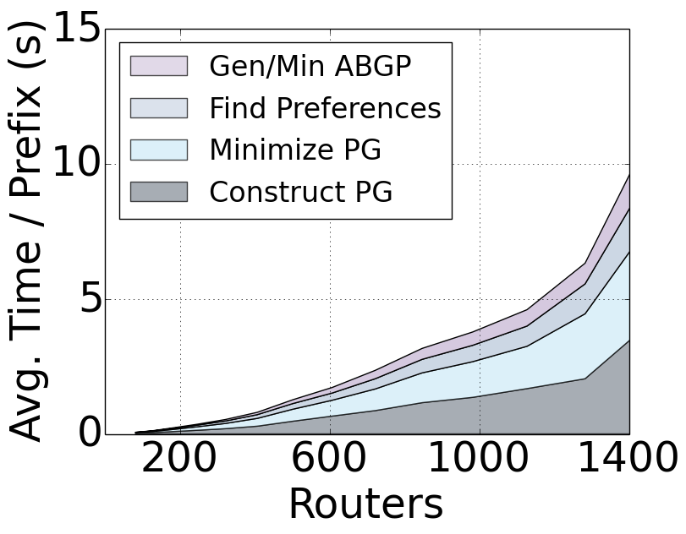
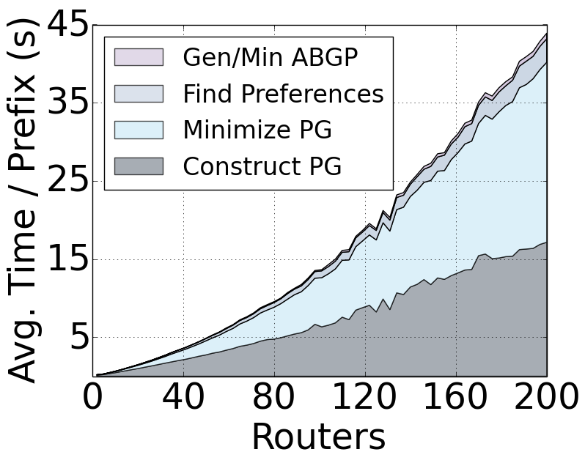
Compilation Time
Parallelize compilation by prefix
Use artificial topology to explore scalability
Data center (< 9 min)
Backbone (< 3 min)

Slide 81
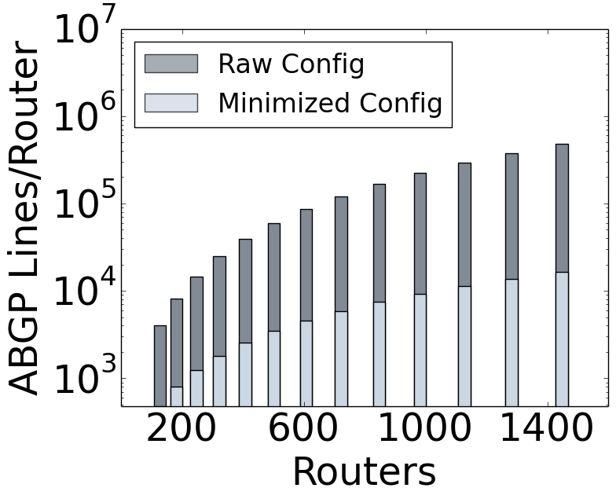
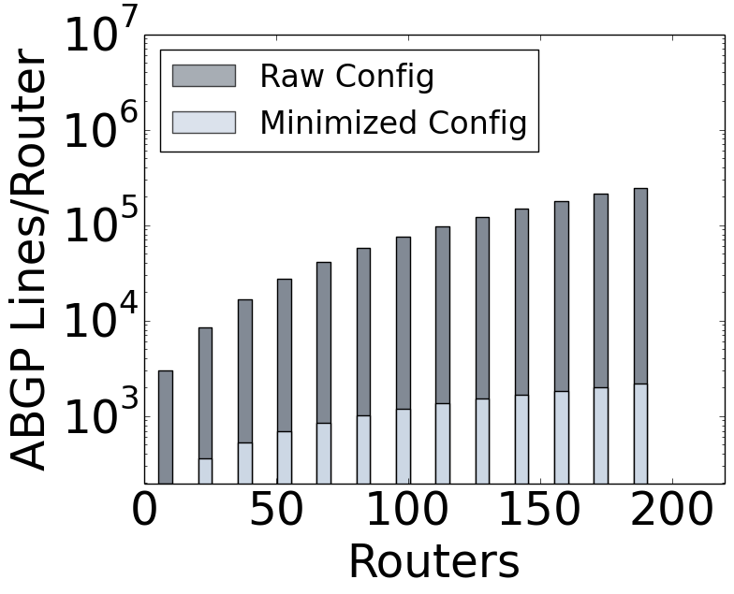
Configuration Size
Perform configuration minimization during generation
Avoid using community tags when choices are unambiguous
Fall-through elimination of route maps
Data center
Backbone

