Slide 1
Compilation Overview
Preprocess prefixes so they are disjoint
For each prefix in parallel
Build graph tracking topology, query matching state, and preference
Check additional conditions due to limitations in path-vector protocol
Two different ways to construct the graph
Source-based (follows flow of traffic)
Destination-based (follows flow of advertisements)

Slide 2

Language Syntax
$pol ∷=s_{1}, …, s_{n}$
$$c ∷= \left[choose_{n}\right] r_{1}≫…≫r_{m} [m{in}_{attr}]$$
$p ∷= true \left| x.x.x.x/m \right| p_{1}∨p_{2} \left| p_{1}∧p_{2} \right| ¬p$
r$∷= out$
$| in$
$| l$
$| r_{1}∪r_{2}$
$| r_{1}∩r_{2}$
$| r_{1} \backslash r_{2}$
$| r_{1}⋅r_{2}$
$| r^{∗}$
$| hide(p)$
$| abstract(r)$
Policy
Constraint
Predicate
Regular Path
Preferences only at outermost level

Slide 3
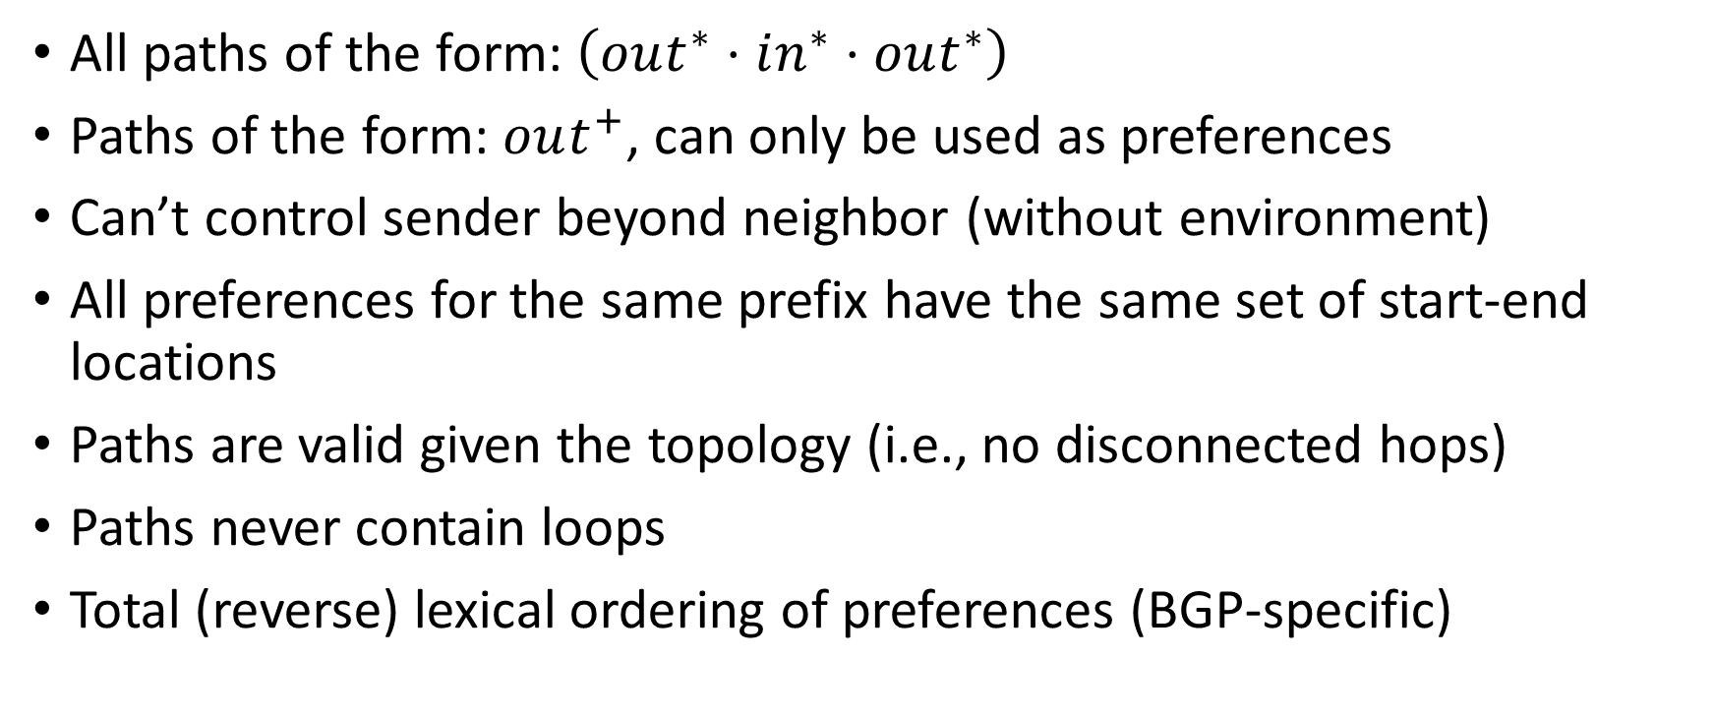
Well-formedness Conditions
All paths of the form: $\left(out^{∗}⋅in^{∗}⋅out^{∗}\right)$
Paths of the form: $out^{+}$, can only be used as preferences
Can’t control sender beyond neighbor (without environment)
All preferences for the same prefix have the same set of start-end locations
Paths are valid given the topology (i.e., no disconnected hops)
Paths never contain loops
Total (reverse) lexical ordering of preferences (BGP-specific)

Slide 4
Source-based Automata

Slide 5
Internal Routes
Policy: $\left(A⋅X⋅Y⋅B\right)≫(A⋅in^{∗}⋅Z⋅B)$
Y
LP=100
A
X
B
LP=99
Z

Slide 6
Internal Routes
Policy: $\left(A⋅X⋅N⋅Y⋅B\right)≫(A⋅in^{∗}⋅Z⋅B)$
X
LP=100
Y
A
N
B
M
LP=99
Z

Slide 7
Internal Routes
Policy: $\left(A⋅X⋅N⋅Y⋅B\right)≫(A⋅in^{∗}⋅Z⋅B)$
X
X
LP=100
Y
A
N
B
M
LP=99
Z

Slide 8
Internal Routes
(0,0,A)
Policy: $\left(A⋅X⋅N⋅Y⋅B\right)≫(A⋅in^{∗}⋅Z⋅B)$
X
Y
(1,1,M)
(1,1,X)
A
N
B
M
Z
(drop,1,N)
(2,1,N)
A
X
N
Y
B
(drop,1,Z)
(3,1,Z)
0
1
2
(3,1,Y)
3
4
5
in
A
Z
B
(drop,2,B)
2
(drop,3,B)
2
(4,1,B)
1
0
1
2
3

Slide 9

Preferences:
Relative preferences (N):
M
X
Best | Worst
A
B
N
N
A
1
B
2

Slide 10

Preferences:
Relative preferences (N):
M
X
Best | Worst
A
A | B
N
N
A
1
A
3
B
4

Slide 11
Preferences:
Relative preferences (N):
M
X
Best | Worst
A
(A or B) | (A or B)
N
N
A
1
A
2
B
2

Slide 12
Preferences:
Relative preferences (N):
M
X
Best |  |  | Worst
(A or AD) | (A or AD) | B | AC
(A or B) | (A or B)
N
N
A
1
B
2
A
2
B
2
C
4
D
1

Slide 13
Preferences:
Relative preferences (N):
M
X
Best |  |  | Worst
A | B | (AC or AD) | (AC or AD)
(A or B) | (A or B)
N
N
A
1
B
2
A
2
B
2
Satisfiable
C
4
D
4
changed

Slide 14
Internal Routes
(0,0,A)
Policy: $\left(A⋅X⋅N⋅Y⋅B\right)≫(A⋅in^{∗}⋅Z⋅B)$
X
Y
(1,1,M)
(1,1,X)
A
N
B
M
Z
(drop,1,N)
(2,1,N)
A
X
N
Y
B
(drop,1,Z)
(3,1,Z)
0
1
2
(3,1,Y)
3
4
5
in
A
Z
B
(drop,2,B)
2
(drop,3,B)
2
(4,1,B)
1
0
1
2
3

Slide 15
Internal Routes
(0,0,A)
Policy: $\left(A⋅X⋅N⋅Y⋅B\right)≫(A⋅in^{∗}⋅Z⋅B)$
Relative preferences (N):
(1,1,M)
(1,1,X)
Best | Worst
ZB
YB | ZB
(drop,1,N)
(2,1,N)
(drop,1,Z)
(3,1,Z)
(3,1,Y)
(drop,2,B)
2
(drop,3,B)
2
(4,1,B)
1

Slide 16
Lemma: Path Prefixes
(0,0,A)
1
Two different nodes with the same topology location must each have some unique path prefix from start node.
Example: (AMN, AXN)
Proof Outline:
If they had the same prefixes, then they would be the same node. Inductive argument on the number of hops from the starting node. At each hop, only one choice for each next topology location.
(1,1,M)
(1,1,X)
Problem
(drop,1,N)
(2,1,N)
(drop,1,Z)
(3,1,Z)
(3,1,Y)
(drop,2,B)
2
(drop,3,B)
2
(4,1,B)
1

Slide 17
Lemma: Necessity
(0,0,A)
1
Consistent preferences is necessary for BGP
Proof Outline:
Contradiction – assume inconsistent preferences. Since they are different nodes, they each have a different path prefix. We can fail everything except each unique path prefix to exploit the inconsistency.
(1,1,M)
(1,1,X)
Problem
(drop,1,N)
(2,1,N)
(drop,1,Z)
(3,1,Z)
(3,1,Y)
(drop,2,B)
2
(drop,3,B)
2
(4,1,B)
1

Slide 18
External Routes
out
out
in
in
AS1
Start
AS4
in
out
AS2
AS3
out
C
A
out

Slide 19
External Routes
out
out
in
in
AS1
Start
AS4
in
out
AS2
AS3
out
C
A
out

Slide 20
External Routes:
(0,0,AS1)
Policy: $\left(out⋅A⋅in^{∗}⋅X\right)≫(out⋅B⋅in^{∗}⋅Y)$
Outside
1
A
D
X
(1,1,A)
(1,1,B)
AS1
C
B
Y
Inside
(2,_,C)
(_,2,C)
in
out
A
X
(2,_,D)
(_,2,D)
0
1
2
3
in
Outside
out
B
Y
(2,_,X)
1
(_,2,Y)
2
0
1
2
3

Slide 21
External Routes:
(0,0,AS1)
Policy: $\left(out⋅A⋅in^{∗}⋅X\right)≫(out⋅B⋅in^{∗}⋅Y)$
1
A
D
X
(1,1,A)
(1,1,B)
AS1
C
B
Y
(2,_,C)
(_,2,C)
Problem
in
out
A
X
(2,_,D)
(_,2,D)
0
1
2
3
in
out
B
Y
(2,_,X)
1
(_,2,Y)
2
0
1
2
3

Slide 22
External Routes:
(0,0,AS1)
Policy: $\left(out⋅A⋅in^{∗}⋅X\right)≫(out⋅B⋅in^{∗}⋅out)$
A
D
X
(1,1,A)
(1,1,B)
AS1
C
Fixed
B
Y
(2,_,C)
(_,2,C)
in
out
A
X
(2,_,D)
(_,2,D)
0
1
2
3
in
(_,2,X)
(_,2,Y)
out
B
(2,_,X)
1
2
2
out
0
1
2
3

Slide 23
External Routes:
Entering decision point:
Use MED
(0,0,AS1)
Policy: $\left(out⋅A⋅in^{∗}⋅X\right)≫(out⋅B⋅in^{∗}⋅out)$
Match path CDX
Implementation:
At each node, match only its valid paths
Set local-pref at decision points
Set MED at entering decision points
Optimizations:
Use communities to avoid always matching
(1,1,A)
(1,1,B)
(2,_,C)
(_,2,C)
Internal decision point:
Use local-pref
(2,_,D)
(_,2,D)
Match path X
(_,2,X)
(_,2,Y)
(2,_,X)
1
2
2

Slide 24
















External Routes:
(0,0,AS1)
Policy: $\left(out⋅A⋅in^{∗}⋅X\right)≫(out⋅B⋅in^{∗}⋅out)$
Router D:
Router A:
$$match path=X$$
$$match path=C⋅D⋅X$$
(1,1,A)
(1,1,B)
$$LP←100$$
$$MED←80$$
$$D→C$$
$$A→AS1$$
$$match path=Y$$
Router B:
$$LP←99$$
$$match path=C ⋅D⋅(X∪Y)$$
(2,_,C)
(_,2,C)
$$D→C$$
$$MED←81$$
Router C:
$$B→AS1$$
$$match path=D⋅X$$
(2,_,D)
(_,2,D)
$$C→A,B$$
$$match path=D⋅Y$$
$$C→B$$
(_,2,X)
(_,2,Y)
(2,_,X)
1
2
2

Slide 25
















External Routes:
Policy: $\left(out⋅A⋅in^{∗}⋅X\right)≫(out⋅B⋅in^{∗}⋅out)$
Router D:
Router A:
A
D
X
$$match path=X$$
$$match path=C⋅D⋅X$$
AS1
C
$$LP←100$$
$$MED←80$$
$$D→C$$
$$A→AS1$$
$$match path=Y$$
Router B:
B
Y
$$LP←99$$
$$match path=C ⋅D⋅(X∪Y)$$
$$D→C$$
$$MED←81$$
Router C:
$$B→AS1$$
in
$$match path=D⋅X$$
out
A
X
$$C→A,B$$
0
1
2
3
$$match path=D⋅Y$$
$$C→B$$
in
out
B
Y
0
1
2
3

Slide 26
Problems:
Checking preference consistency is non-trivial (enumerate all paths)
Generating regular expression matches is slow and computationally expensive (look at all paths to accepting states)
No great way to deal with different starting locations
Leads to many non-DAG structures
Compounds difficulties finding all paths in (2)
Solution:
Build automata for advertisement flow (traffic end point)
Simplifies compilation
Multiple starting locations fine – compressed into single graph
Checking preference consistency is much more efficient.

Slide 27
Destination-based Automata

Slide 28
Internal Routes
(0,0,A)
Policy: $\left(A⋅X⋅N⋅Y⋅B\right)≫(A⋅in^{∗}⋅Z⋅B)$
X
Y
(1,1,M)
(1,1,X)
A
N
B
M
Z
(drop,1,N)
(2,1,N)
A
X
N
Y
B
(drop,1,Z)
(3,1,Z)
0
1
2
(3,1,Y)
3
4
5
in
A
Z
B
(drop,2,B)
2
(drop,3,B)
2
(4,1,B)
1
0
1
2
3

Slide 29
Internal Routes
(0,0,B)
Policy: $\left(A⋅X⋅N⋅Y⋅B\right)≫(A⋅in^{∗}⋅Z⋅B)$
X
Y
(1,1,Y)
(1,1,Z)
A
N
B
M
Z
(2,_,N)
(_,2,N)
(3,_,X)
(_,2,X)
(_,2,M)
B
Y
N
X
A
0
1
2
3
4
5
in
(4,_,A)
1
(_,2,A)
2
B
Z
A
Reversed
0
1
2
3

Slide 30
Internal Routes
(0,0,B)
Policy: $\left(A⋅X⋅N⋅Y⋅B\right)≫(A⋅in^{∗}⋅Z⋅B)$
(1,1,Y)
(1,1,Z)
Implementable with BGP
Remove nodes that always create loopy paths
Ordered set of preferences reachable from each node
More preferred node must contain a superset of the loop-free paths to an accepting state for less preferred node
(2,_,N)
(_,2,N)
(3,_,X)
(_,2,X)
(_,2,M)
(4,_,A)
1
(_,2,A)
2

Slide 31
Internal Routes
(0,0,A)
(0,0,B)
Policy: $\left(in^{∗}⋅M⋅in^{∗}\right)≫(in^{∗}⋅N⋅in^{∗})$
(0,0,X)
M
N
X
Y
(0,0,M)
(0,0,N)
A
B
C
D
(1,0,X)
(1,0,Y)
(0,1,X)
(0,1,Y)
in
in
M
0
1
1
in
in
1
1
1
1
2
2
2
2
N
0
1
1
(1,0,A)
(1,0,B)
(1,0,C)
(1,0,D)
(0,1,A)
(0,1,B)
(0,1,C)
(0,1,D)

Slide 32
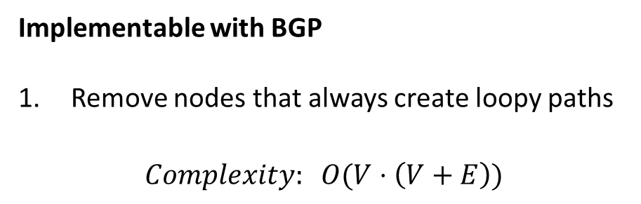
Internal Routes
(0,0,A)
(0,0,B)
Policy: $\left(in^{∗}⋅M⋅in^{∗}\right)≫(in^{∗}⋅N⋅in^{∗})$
(0,0,X)
Implementable with BGP
Remove nodes that always create loopy paths
$$Complexity: O(V⋅\left(V+E\right))$$
(0,0,M)
(0,0,N)
(1,0,Y)
(0,1,Y)
1
1
2
2
(1,0,C)
(1,0,D)
(0,1,C)
(0,1,D)

Slide 33
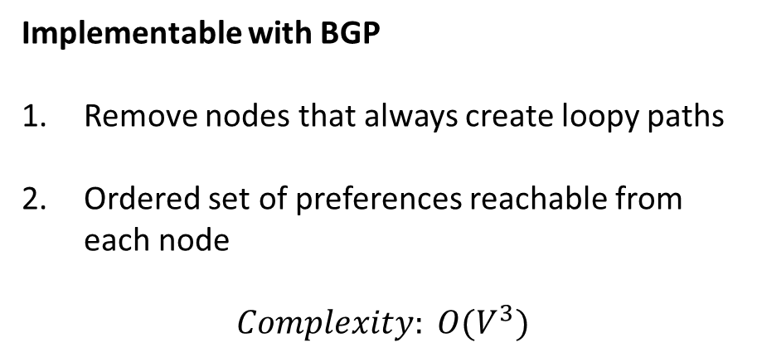
Internal Routes
(0,0,A)
(0,0,B)
Policy: $\left(in^{∗}⋅M⋅in^{∗}\right)≫(in^{∗}⋅N⋅in^{∗})$
(0,0,X)
Implementable with BGP
Remove nodes that always create loopy paths
Ordered set of preferences reachable from each node
$$Complexity: O(V^{3})$$
(0,0,M)
(0,0,N)
{1}
(1,0,Y)
(0,1,Y)
{2}
1
1
2
2
(1,0,C)
(1,0,D)
(0,1,C)
(0,1,D)

Slide 34
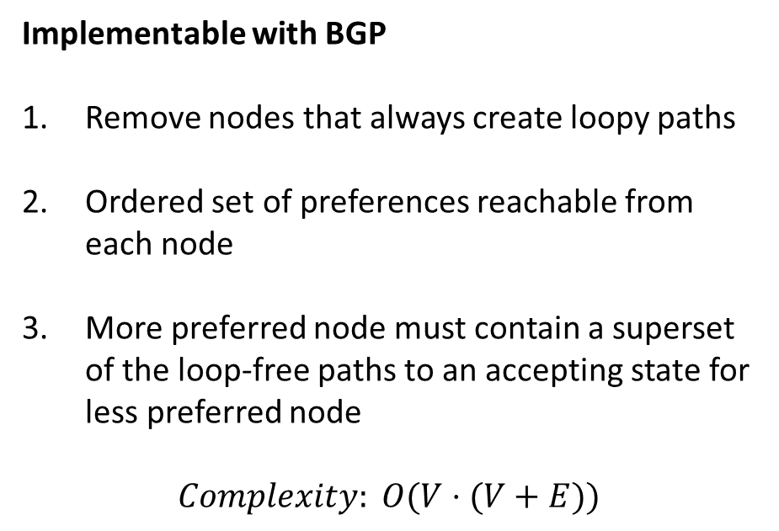
Internal Routes
(0,0,A)
(0,0,B)
Policy: $\left(in^{∗}⋅M⋅in^{∗}\right)≫(in^{∗}⋅N⋅in^{∗})$
(0,0,X)
Implementable with BGP
Remove nodes that always create loopy paths
Ordered set of preferences reachable from each node
More preferred node must contain a superset of the loop-free paths to an accepting state for less preferred node
$$Complexity: O(V⋅(V+E))$$
(0,0,M)
(0,0,N)
(1,0,Y)
(0,1,Y)
1
1
2
2
(1,0,C)
(1,0,D)
(0,1,C)
(0,1,D)

Slide 35

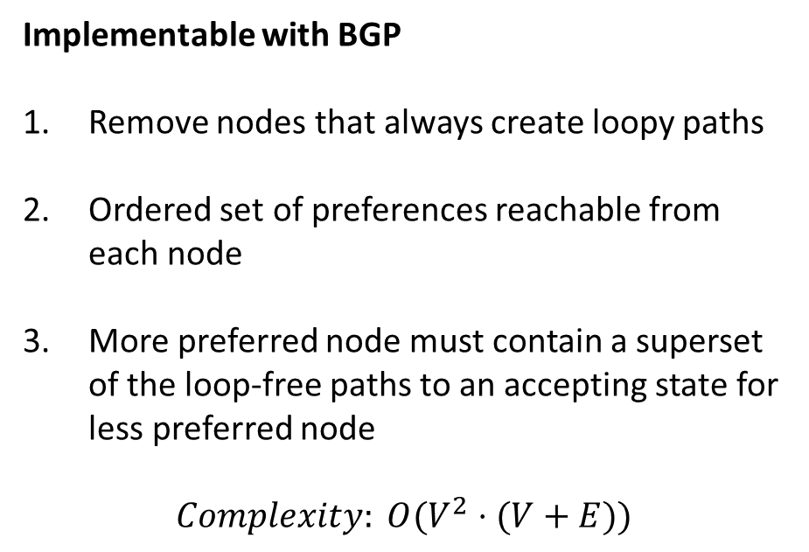


Internal Routes
Policy: $\left(in^{∗}⋅M⋅in^{∗}\right)≫(in^{∗}⋅N⋅in^{∗})$
Find all nodes reachable from N1 and N2
For each reachable node, check if it can reach an accepting state without N1 (respectively N2) with BFS. Remove if not.
Check equivalent paths by doing BFS from both nodes and checking next-hop neighbors in both frontiers at each step
Implementable with BGP
Remove nodes that always create loopy paths
Ordered set of preferences reachable from each node
More preferred node must contain a superset of the loop-free paths to an accepting state for less preferred node
$$Complexity: O(V^{2}⋅(V+E))$$
$$O(V+E)$$
$$O(V⋅(V+E))$$
$$O(V⋅(V+E))$$
Do this V times

Slide 36





















Internal Routes
(0,0,A)
(0,0,B)
Policy: $\left(in^{∗}⋅M⋅in^{∗}\right)≫(in^{∗}⋅N⋅in^{∗})$
(0,0,X)
Router X:
Router Y:
$$match comm=(0,0,A)$$
$$match comm=(0,0,M)$$
$$comm←(0,0,X)$$
$$LP←100$$
$$X→M,N,B$$
$$comm←(1,0,Y)$$
(0,0,M)
(0,0,N)
$$match comm=(0,0,B)$$
$$Y→C,D$$
$$comm←(0,0,B)$$
$$match comm=(0,0,N)$$
$$X→M,N,A$$
$$LP←99$$
Router M:
$$comm←(0,1,Y)$$
(1,0,Y)
(0,1,Y)
$$match comm=(0,0,X)$$
$$Y→C,D$$
$$comm←(0,0,M)$$
$$…$$
$$M→Y$$
Router N:
$$match comm=(0,0,X)$$
$$comm←(0,0,N)$$
1
1
2
2
$$N→Y$$
(1,0,C)
(1,0,D)
(0,1,C)
(0,1,D)

Slide 37

















Internal Routes
(0,0,A)
(0,0,B)
Policy: $\left(in^{∗}⋅M⋅in^{∗}\right)≫(in^{∗}⋅N⋅in^{∗})$
(0,0,X)
Router X:
Router Y:
$$match peer=A$$
$$match peer=M$$
$$X→M,N,B$$
$$LP←100$$
(0,0,M)
(0,0,N)
$$match peer=B$$
$$comm←(1,0,Y)$$
$$X→M,N,A$$
$$Y→C,D$$
$$match peer=N$$
Router M:
$$LP←99$$
(1,0,Y)
(0,1,Y)
$$match peer=X$$
$$comm←(0,1,Y)$$
$$M→Y$$
$$Y→C,D$$
Router N:
$$…$$
$$match peer=X$$
$$N→Y$$
1
1
2
2
(1,0,C)
(1,0,D)
(0,1,C)
(0,1,D)

Slide 38
External Routes:
(0,0,X)
(0,0,Y)
Policy: $\left(out⋅A⋅in^{∗}⋅X\right)≫(out⋅B⋅in^{∗}⋅Y)$
A
D
X
(1,1,D)
(_,1,D)
AS1
C
B
Y
(1,1,C)
(_,1,C)
in
out
A
X
(1,_,A)
(1,1,B)
(_,1,B)
0
1
2
3
in
out
B
Y
(2,_,AS1)
1
2
(1,2,AS1)
2
(_,2,AS1)
0
1
2
3

Slide 39
External Routes:
(0,0,X)
(0,0,Y)
Policy: $\left(out⋅A⋅in^{∗}⋅X\right)≫(out⋅B⋅in^{∗}⋅Y)$
A
D
X
(1,1,D)
(_,1,D)
AS1
C
More preferred
Less preferred
B
Y
(1,1,C)
(_,1,C)
in
out
A
X
(1,_,A)
(1,1,B)
(_,1,B)
0
1
2
3
in
out
B
Y
(2,_,AS1)
1
2
(1,2,AS1)
2
(_,2,AS1)
0
1
2
3

Slide 40
Other concerns:

Slide 41
iBGP
Policy: $\left(out^{+}⋅R_{2}⋅R_{3}⋅out^{+}\right)≫(out^{+}⋅R_{4}⋅R_{1}⋅out^{+})$
R1
Differences with iBGP:
Virtual links expanded into concrete path
When not otherwise constrained, shortest IGP cost path is chosen.
5
R2
R3
7
R4
Virtual link

Slide 42

Aggregation:
(0,0,X)
(0,0,Y)
Policy: $\left(out⋅A⋅in^{∗}⋅X\right)≫(out⋅B⋅in^{∗}⋅Y)$
A
D
X
(1,1,D)
(_,1,D)
AS1
C
B
Y
(1,1,C)
(_,1,C)
in
out
A
X
(1,_,A)
(1,1,B)
(_,1,B)
0
1
2
3
$$summary(p_{0})$$
in
out
B
Y
(2,_,AS1)
1
2
(1,2,AS1)
2
(_,2,AS1)
0
1
2
3

