Slide 1
Example
S1
S2
A1
A2
A3
A4
A5
A6
A7
A8
T1
T2
T3
T4
T5
T6
T7
T8
P1
P2
P3
P4
P5
P6
P7
P8
Pod 1
Pod 2
Pod 3
Pod 4
Global services
Local services

Slide 2
S1
S2
S3
S4
A1
A2
A3
A4
A5
A6
A7
A8
T1
T2
T3
T4
T5
T6
T7
T8
P1
P2
P3
P4
P5
P6
P7
P8
Pod 1
Pod 2
Pod 3
Pod 4
Global services
Local services

Slide 3


Example
Peer1
Peer2
S1
S2
A1
A2
A3
A4
A5
A6
A7
A8
T1
T2
T3
T4
T5
T6
T7
T8
P1
P2
P3
P4
P5
P6
P7
P8
Pod 1
Pod 2
Pod 3
Pod 4
Global services
Local services

Slide 4
Peer1
Peer2
S1
S2
S3
S4
A1
A2
A3
A4
A5
A6
A7
A8
T1
T2
T3
T4
T5
T6
T7
T8
P1
P2
P3
P4
P5
P6
P7
P8
Pod 1
Pod 2
Pod 3
Pod 4
Global services
Local services

Slide 5
















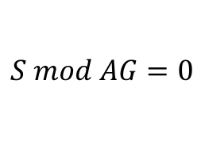











$$S$$
$$e4$$
$$e8$$
$$e1=AG$$
$$e3≥2$$
$$e3$$
$$e7$$
$$e2=TG$$
$$e4≥1$$
P
Q
$$AG$$
$$AL$$
$$e5=AL$$
$$e7≥2$$
$$e2$$
$$e6$$
$$e6=TL$$
$$e8≥1$$
$$e1$$
$$e5$$
$$TG=AG$$
$$S≥2$$
$$TG$$
$$TL$$
$$TL=AL$$
$$S mod AG=0$$
GP
LP
$$AG≥2$$
$$S mod AL=0$$
Global services
Local services
$$AL≥2$$

Slide 7
P1
P2
P1
P2
S1
S2
S
A1
A2
A3
A4
AG
AL
T1
T2
T3
T4
TG
TL

Slide 8
Start
(out,0,0)
(P1,0,0)
(P2,0,0)
(S1,1,0)
(S2,1,0)
(S1,0,1)
(S2,0,1)
(A1,1,0)
(A2,1,0)
(A3,1,0)
(A4,1,0)
(A1,0,1)
(A2,0,1)
(A3,0,1)
(A4,0,1)
(T1,1,0)
(T2,1,0)
(T3,1,0)
(T4,1,0)
(T1,0,1)
(T2,0,1)
(T3,0,1)
(T4,0,1)

Slide 9
Start
(out,0,0)
(P1,0,0)
(P2,0,0)
(S,1,0)
(S,0,1)
(AG,1,0)
(AG,1,0)
(AL,0,1)
(AL,0,1)
(TG,1,0)
(TG,1,0)
(TL,0,1)
(TL,0,1)

Slide 10
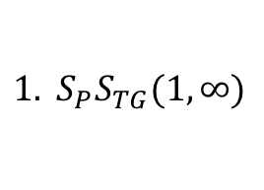
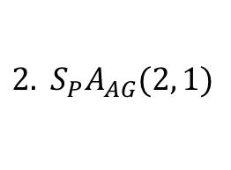
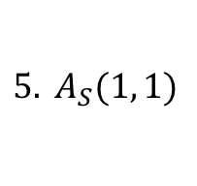
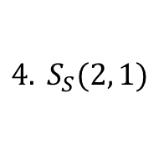
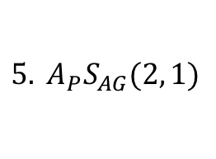
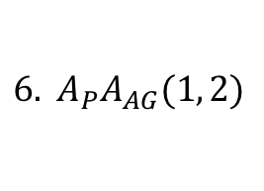
Start
$${1. S}_{P}S_{TG}(1,∞)$$
(TG,0)
...
(TL,0)
$${6. A}_{P}A_{AG}(1, 2)$$
...
1, I-local, I-mesh1
5, I-local, I-mesh2
$${2. S}_{P}A_{AG}(2, 1)$$
(AG,0)
...
(AL,0)
$${5. A}_{P}S_{AG}(2, 1)$$
2, I-global, I-striping
2, I-striping
2, I-out2
$$4. S_{S}(2, 1)$$
$$5. A_{S}(1, 1)$$
(S,0)
(P1,0)
(P2,0)

