Slide 1
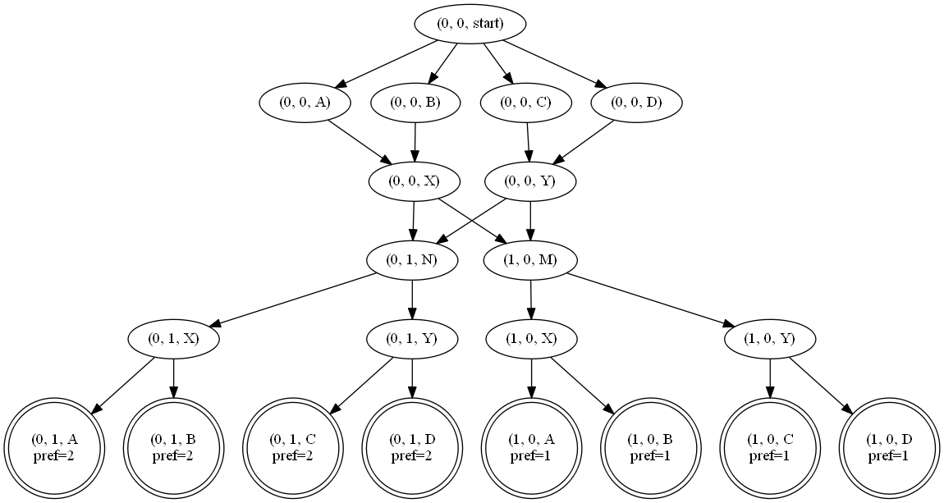
Topology Consistency
Necessary and sufficient condition:
Whenever:
There is a simple path to node N
There is no simple path through N to an accepting state
There is no simple path through a less preferred node to an accepting state.

Slide 2
Topology Consistency
M
N
X
Y
A
B
C
D
{1,2}
Most preferred
{1}
Least Preferred
{2}

Slide 3

Topology Consistency
M
N
X
Y
A
B
C
D
{1,2}
{2}
{1}

Slide 4
Topology Consistency
M
N
X
Y
A
B
C
D
{1,2}
{2}
{1}

Slide 5
Topology Consistency
Sufficient Condition:
More preferred nodes have a superset of the paths of less preferred nodes

Slide 6
Topology Consistency
Sufficient Condition:
More preferred nodes have a superset of the paths of less preferred nodes
4 Cases:
If X1 can’t reach an accepting state, then X2 can’t reach an accepting state
If X1 can’t reach an accepting state, then X2 can reach Start in reverse
Symmetric to case 1
Symmetric to case 2

Slide 7
Topology Consistency
Bisimulation?
Repeat (#nodes) times
Follow transitions from both states
Ensure superset of next hop locations
Relate next hop states
Check that no more preferred states relate the same less preferred state
Key Invariant:
At most a single unique next topology location.
More Preferred
Less Preferred
X
X
N
M
C
N
M
Y
D
Y
Y
A
B
C
A
B
C
Q
Q

Slide 8

Topology Consistency
More Preferred
Less Preferred
Bisimulation?
Repeat (#nodes) times
Follow transitions from both states
Ensure superset of next hop locations
Relate next hop states
Check that no more preferred states relate the same less preferred state
Key Invariant:
At most a single unique next topology location.
X
X
N
M
C
N
M
Y
D
Y
Y
A
B
C
A
B
C
Q
Q
$$[X↦\{X\}]$$

Slide 9

Topology Consistency
More Preferred
Less Preferred
Bisimulation?
Repeat (#nodes) times
Follow transitions from both states
Ensure superset of next hop locations
Relate next hop states
Check that no more preferred states relate the same less preferred state
Key Invariant:
At most a single unique next topology location.
X
X
N
M
C
N
M
Y
D
Y
Y
A
B
C
A
B
C
Q
Q
$$[N↦\{N\}, M↦\{M\}]$$

Slide 10

Topology Consistency
More Preferred
Less Preferred
Bisimulation?
Repeat (#nodes) times
Follow transitions from both states
Ensure superset of next hop locations
Relate next hop states
Check that no more preferred states relate the same less preferred state
Key Invariant:
At most a single unique next topology location.
X
X
N
M
C
N
M
Y
D
Y
Y
A
B
C
A
B
C
Q
Q
$$[Y↦\{Y_{1},Y_{2}\}]$$

Slide 11
Topology Consistency
More Preferred
Less Preferred
Bisimulation?
Repeat (#nodes) times
Follow transitions from both states
Ensure superset of next hop locations
Relate next hop states
Check that no more preferred states relate the same less preferred state
Key Invariant:
At most a single unique next topology location.
X
X
N
M
C
N
M
Y
D
Y
Y
A
B
C
A
B
C
Q
Q
$$[A↦\left\{A\right\}, B↦\left\{B\right\}, C↦\{C\}]$$

Slide 12

Topology Consistency
More Preferred
Less Preferred
Bisimulation?
Repeat (#nodes) times
Follow transitions from both states
Ensure superset of next hop locations
Relate next hop states
Check that no more preferred states relate the same less preferred state
Key Invariant:
At most a single unique next topology location.
X
X
N
M
C
N
M
Y
D
Y
Y
A
B
C
A
B
C
Q
Q
$$[Q↦\left\{Q\right\}]$$

Slide 13

Topology Consistency
More Preferred
Less Preferred
Bisimulation?
Repeat (#nodes) times
Follow transitions from both states
Ensure superset of next hop locations
Relate next hop states
Check that no more preferred states relate the same less preferred state
Key Invariant:
At most a single unique next topology location.
X
X
N
M
C
N
M
Y
D
Y
Y
A
B
C
A
B
C
Q
Q
$$[ ]$$

Slide 14
Topology Consistency
More Preferred
Less Preferred
Bisimulation?
Repeat (#nodes) times
Follow transitions from both states
Ensure superset of next hop locations
Relate next hop states
Check that no more preferred states relate the same less preferred state
Key Invariant:
At most a single unique next topology location.
X
X
N
M
C
N
M
Y
D
Y
Y
A
B
C
A
B
C
Q
Q

Slide 15

Topology Consistency
$$[(1,0,X)↦\left\{(0,0,X)\right\}]$$
{1,2}
{2}
{1}

Slide 16
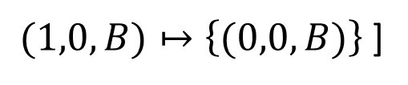

Topology Consistency
$$[ (1,0,A)↦\left\{(0,0,A)\right\}$$
$(1,0,B)↦\left\{(0,0,B)\right\}$ ]
{1,2}
{2}
{1}

Slide 17
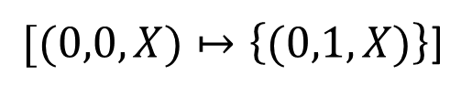
Topology Consistency
$[(0,0,X)↦\left\{(0,1,X)\right\}$]
{1,2}
{2}
{1}

Slide 18
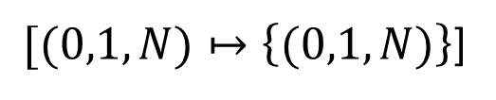
Topology Consistency
$[(0,1,N)↦\left\{(0,1,N)\right\}$]
{1,2}
{2}
{1}

Slide 19
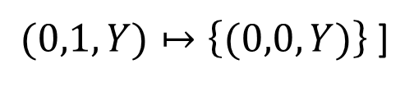

Topology Consistency
$$[ (0,1,X)↦\left\{(0,0,X)\right\}$$
$(0,1,Y)↦\left\{(0,0,Y)\right\}$ ]
{1,2}
{2}
{1}

Slide 20

Semantics
$$(in⋅M⋅C)≫(in⋅N⋅C)$$
C
Ranked paths:
M
N
$$\{\left(AMC, 1\right), \left(ANC, 2\right), \left(BMC,1\right), \left(BNC, 2\right)\}$$
A
B
Choose 1 path per start/end locations

Slide 21
Semantics
$$(in⋅M⋅C)≫(in⋅N⋅C)$$
C
Ranked paths:
M
N
$$\{\left(AMC, 1\right), \left(ANC, 2\right), \left(BMC,1\right), \left(BNC, 2\right)\}$$
A
B
Choose 1 path per start/end locations

Slide 22




Expressiveness
BAD
BAED
Enumerate
Total ordering of routes per device
B
$$\left(CD+BAD+AED+ED\right)≫$$
AED
AD
AB
CD
CBAD
$$\left(CBAD+BAED+AD\right)≫$$
C
A
$$\left(AB\right)≫$$
$$∅$$
E
ED
D

Slide 23



Expressiveness
BA
B
BGP divergence
B
$$\left(CB+BA+AC\right)≫$$
$$\left(C+B+A\right)≫$$
CB
C
AC
A
$$∅$$
C
A

Slide 24
Expressiveness:
Divergence
Problem somewhat mitigated by only talking about end-to-end paths
M
N
X
Y
A
B
C
D

Slide 25






Practical Concerns:
Description | Example | Safe/Unsafe
Route aggregation |  | Safe
Community tagging |  | Safe
Limit max routes |  | Safe*
Filter by max path length |  | Safe*
Multipath routing |  | Safe
Allow private AS numbers to be repeated |  | Unsafe*
Remove private AS numbers |  | Unsafe*
$$summary(, in→out)$$
$$community(p_{0}, in→out, REGIONAL_LEAK)$$
$$max_routes(12000, in→out)$$
$$max_aspath_len(80, in→out)$$
$$multipath$$
$$allow_as_in(T_{0})$$
$$del_private(T_{0})$$

Slide 26
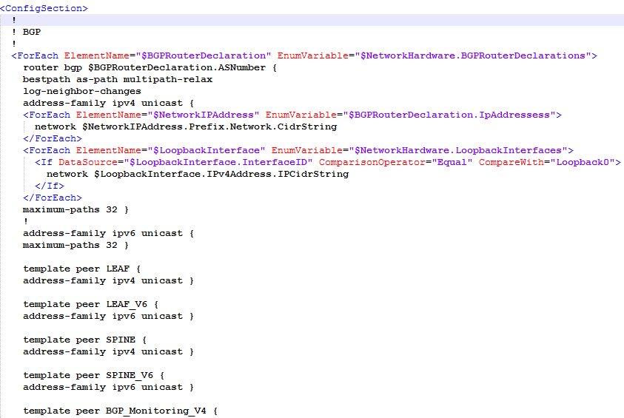
Practical Concerns:

Slide 27
