Slide 1
Compilation Recap
Properties:
Soundness – any path we take must match a regex
Completeness – if a path exists that matches a regex, then we must take it
Fault Tolerance – soundness and completeness under all failure scenarios
Stability – Resulting BGP configurations always converge
BGP Limitations:
Single best route
No knowledge of failures
Only simple paths
Language Constraints:
One path per starting location
Only simple paths

Slide 2
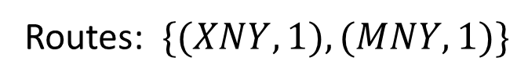
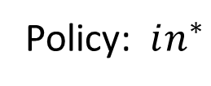
Policy Semantics
Policy: $in^{∗}$
Routes: $\{(XNY, 1), (MNY, 1)\}$
X
Y
N
Route advertised
M
Z
We want different paths depending on where the advertisement originates from.

Slide 3
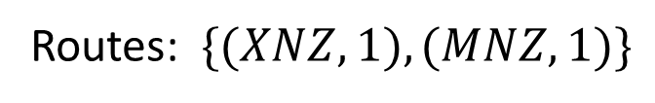
Policy Semantics
Policy: $in^{∗}$
Routes: $\{(XNZ, 1), (MNZ, 1)\}$
X
Y
N
Route advertised
M
Z
We want different paths depending on where the advertisement originates from.

Slide 4
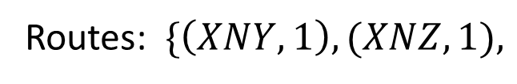

Policy Semantics
Policy: $in^{∗}$
Routes: $\{\left(XNY, 1\right), (XNZ,1),$
$$\left(MNY, 1\right), (MNZ, 1)\}$$
X
Y
N
Route advertised
M
Z
We want different paths depending on where the advertisement originates from.

Slide 5
Policy Semantics
Policy: $in^{∗}$
Routes: $\{\left(XNY, 1\right), (XNZ,1),$
$$\left(MNY, 1\right), (MNZ, 1)\}$$
X
Y
N
Select one per (start location, preference level)
M
Z

Slide 6
Compilation Recap
Properties:
Soundness – any path we take must match a regex
Completeness – if a path exists that matches a regex, then we must take it
Fault Tolerance – soundness and completeness under all failure scenarios
Stability – Resulting BGP configurations always converge
BGP Limitations:
Single best route
No knowledge of failures
Only simple paths
Language Constraints:
One path per starting location
Only simple paths

Slide 7
Examples:
Policy: $\left(A⋅X⋅Y⋅B\right)≫(A⋅in^{∗}⋅Z⋅B)$
B
Y
Z
X
Y
A
N
B
N
N
M
Z
X
X
M
A
A
1
2

Slide 8
Examples:
Policy: $\left(A⋅X⋅Y⋅B\right)≫(A⋅in^{∗}⋅Z⋅B)$
B
Y
Z
X
Y
A
N
B
N
N
M
Z
X
X
M
Sound but not complete!
A
A
1
2

Slide 9

Examples:
Policy: $\left(A⋅X⋅Y⋅B\right)≫(A⋅in^{∗}⋅Z⋅B)$
B
Y
Z
X
Y
A
N
B
N
N
M
Z
X
X
M
Sound but not complete!
A
A
1
2

Slide 10
Examples:
Policy: $\left(A⋅X⋅Y⋅B\right)≫(A⋅in^{∗}⋅Z⋅B)$
B
Y
Z
X
LP=100
Y
A
N
B
N
N
M
LP=99
Z
X
X
M
A
A
1
2

Slide 11
Examples:
Policy: $\left(A⋅X⋅Y⋅B\right)≫(A⋅in^{∗}⋅Z⋅B)$
B
Y
Z
X
Y
A
N
B
N
N
M
Z
X
X
M
Neither sound nor complete!
A
A
1
2

Slide 12
Compilation Recap
Properties:
Soundness – any path we take must match a regex
Completeness – if a path exists that matches a regex, then we must take it
Fault Tolerance – soundness and completeness under all failure scenarios
Stability – Resulting BGP configurations always converge
BGP Limitations:
Single best route
No knowledge of failures
Only simple paths
Language Constraints:
One path per starting location
Only simple paths

Slide 13
Example 1

Slide 14
Examples:
START
Policy: $\left(A⋅X⋅Y⋅B\right)≫(A⋅in^{∗}⋅Z⋅B)$
B
X
Y
Y
Z
A
N
B
M
Z
N
N
X
X
M
Soundness:
Given for free by the product graph
A
A
{1}
{2}

Slide 15
Examples:
START
Policy: $\left(A⋅X⋅Y⋅B\right)≫(A⋅in^{∗}⋅Z⋅B)$
B
X
Y
Y
A
N
B
M
Z
N
X
Completeness:
Remove dark nodes that aren’t accepting
(violates the path suffix condition)
A
{1}

Slide 16
Examples:
START
Policy: $\left(A⋅X⋅Y⋅B\right)≫(A⋅in^{∗}⋅Z⋅B)$
B
X
Y
Y
A
N
B
M
Z
N
X
Completeness:
Remove nodes not on simple path
A
{1}

Slide 17

Examples:
START
Policy: $\left(A⋅X⋅Y⋅B\right)≫(A⋅in^{∗}⋅Z⋅B)$
B
X
Y
Y
A
N
B
M
Z
N
X
Completeness:
Check if there is a path for each starting location
A
{1}

Slide 18
Examples:
START
Policy: $\left(A⋅X⋅Y⋅B\right)≫(A⋅in^{∗}⋅Z⋅B)$
B
X
Y
Y
A
N
B
M
Z
N
X
Completeness:
Resolve ambiguity (done)
A
{1}

Slide 19
Examples:
START
Policy: $\left(A⋅X⋅Y⋅B\right)≫(A⋅in^{∗}⋅Z⋅B)$
B
X
Y
Z
A
N
B
M
Z
N
X
M
Completeness:
Check if there is a path for each starting location
A
{2}

Slide 20
Examples:
START
Policy: $\left(A⋅X⋅Y⋅B\right)≫(A⋅in^{∗}⋅Z⋅B)$
B
X
Y
Z
A
N
B
M
Z
N
X
M
Completeness:
Resolve ambiguity (done)
A
{2}

Slide 21

Examples:
START
Policy: $\left(A⋅X⋅Y⋅B\right)≫(A⋅in^{∗}⋅Z⋅B)$
B
X
Y
Y
Z
A
N
B
M
Z
N
N
X
X
M
Fault Tolerant:
Policy holds under failures
A
A
{1}
{2}

Slide 22
Example 2

Slide 23
Examples:
START
Policy:$CAED+ABD$
D
A
E
B
E
A
A
C
D
B
{1}
C
Soundness:
Given for free by the product graph
{1}

Slide 24
Examples:
START
Policy:$CAED+ABD$
D
A
E
B
E
A
A
C
D
B
{1}
C
Completeness:
Remove dark nodes that aren’t accepting
(violates the path suffix condition)
{1}

Slide 25
Examples:
START
Policy:$CAED+ABD$
D
A
E
B
E
A
C
D
B
{1}
C
Completeness:
Remove nodes not on simple path
{1}

Slide 26
Examples:
START
Policy:$CAED+ABD$
D
A
B
E
A
C
D
B
{1}
Completeness:
Check if there is a path for each starting location

Slide 27
Example 3

Slide 28
Examples:
START
Policy: $\left(ACD+BAD+CBD\right)≫(AD+BD+CD)$
D
A
{2}
A
{2}
B
{2}
C
D
{1}
B
{1}
C
{1}
A
C
B
Soundness:
Given for free by the product graph

Slide 29
Examples:
START
Policy: $\left(ACD+BAD+CBD\right)≫(AD+BD+CD)$
D
A
D
{1}
B
{1}
C
{1}
A
C
B
Completeness:
Remove dark nodes that aren’t accepting
(violates the path suffix condition)

Slide 30
Examples:
START
Policy: $\left(ACD+BAD+CBD\right)≫(AD+BD+CD)$
D
A
D
{1}
B
{1}
C
{1}
A
C
B
Completeness:
Check if there is a path for each starting location

Slide 31
Example 4

Slide 32
Examples:
START
Policy: $\left(ACD+BAD+CBD+AD+BD+CD\right)$
D
A
{1}
A
{1}
B
{1}
C
D
{1}
B
{1}
C
{1}
A
C
B
Soundness:
Given for free by the product graph

Slide 33
Examples:
START
Policy: $\left(ACD+BAD+CBD+AD+BD+CD\right)$
D
A
{1}
A
{1}
B
{1}
C
D
{1}
B
{1}
C
{1}
A
C
B
Completeness:
Remove dark nodes that aren’t accepting
(violates the path suffix condition)

Slide 34
Examples:
START
Policy: $\left(ACD+BAD+CBD+AD+BD+CD\right)$
D
A
{1}
A
{1}
B
{1}
C
D
{1}
B
{1}
C
{1}
A
C
B
Completeness:
Remove nodes not on simple path

Slide 35
Examples:
START
Policy: $\left(ACD+BAD+CBD+AD+BD+CD\right)$
D
A
{1}
A
{1}
B
{1}
C
D
{1}
B
{1}
C
{1}
A
C
B
Completeness:
Check if there is a path for each starting location

Slide 36
Examples:
START
Policy: $\left(ACD+BAD+CBD+AD+BD+CD\right)$
D
A
{1}
A
{1}
B
{1}
C
D
{1}
B
{1}
C
{1}
A
C
B
Completeness:
Resolve ambiguity (should A prefer D or C?)
Recall, A1 > A2 if A2 simulates A1

Slide 37
Examples:
START
Policy: $\left(ACD+BAD+CBD+AD+BD+CD\right)$
D
A
{1}
A
{1}
B
{1}
C
D
{1}
B
{1}
C
{1}
A
C
B
Completeness:
Resolve ambiguity (should A prefer D or C?)
A prefers D over C
B prefers D over A
C prefers D over B

Slide 38
Examples:
START
Policy: $\left(ACD+BAD+CBD+AD+BD+CD\right)$
D
A
{1}
A
{1}
B
{1}
C
D
{1}
B
{1}
C
{1}
A
C
B
Completeness:
Resolve ambiguity (should A prefer D or C?)
A prefers D over C
B prefers D over A
C prefers D over B

Slide 39
Examples:
START
Policy: $\left(ACD+BAD+CBD+AD+BD+CD\right)$
D
A
{1}
A
{1}
B
{1}
C
D
{1}
B
{1}
C
{1}
A
C
B
Completeness:
Resolve ambiguity (should A prefer D or C?)
A prefers D over C
B prefers D over A
C prefers D over B

Slide 40
Example 5

Slide 41
Examples:
START
Policy: $(CAED+AED+AD)$
D
A
E
A
{1}
C
D
E
A
{1}
C
{1}
Soundness:
Given for free by the product graph

Slide 42
Examples:
START
Policy: $(CAED+AED+AD)$
D
A
E
A
{1}
C
D
E
A
{1}
C
{1}
Completeness:
Remove dark nodes that aren’t accepting
(violates the path suffix condition)

Slide 43
Examples:
START
Policy: $(CAED+AED+AD)$
D
A
E
A
{1}
C
D
E
A
{1}
C
{1}
Completeness:
Remove nodes not on simple path

Slide 44
Examples:
START
Policy: $(CAED+AED+AD)$
D
A
E
A
{1}
C
D
E
A
{1}
C
{1}
Completeness:
Resolve ambiguity
A prefers E over D

Slide 45
Properties
Soundness:
Any path will follow a path through the product graph, and will match the regular expression.
Completeness:
The preference level always being higher than the backup path
The simulation check (per preference level) ensures we get all paths when possible
Check to make sure all starting locations are reachable
Fault Tolerance:
Total ordering of all nodes (combined check)
Stability:
Iterated Dominance Proof? (Related to path suffix property)

Slide 46

Language Syntax
$pol ∷=s_{1}, …, s_{n}$
$$c ∷= {p⇒re}_{1}≫…≫{re}_{m}$$
$p ∷= true \left| x.x.x.x/m \right| p_{1}∨p_{2} \left| p_{1}∧p_{2} \right| ¬p$
r$e ∷= out$
$| in$
$| l$
$| {re}_{1}∪{re}_{2}$
$| {re}_{1}∩{re}_{2}$
$| {re}_{1} \backslash {re}_{2}$
$| {re}_{1}⋅{re}_{2}$
$| {re}^{∗}$
Policy
Constraint
Predicate
Regular Path

Slide 47

Semantics (definitions)
Graph: $\left(V_{in}, V_{out}, E\right)$
Path: $v_{1}…v_{n}$
⟦ ⟧: $re→Graph→2^{Path}$
⟦ ⟧: $c→Graph→{2^{IP} x 2}^{Path x N x N}$
first($v_{1}…v_{n}$) = $v_{1}$
last($v_{1}…v_{n}$) = $v_{n}$
|$v_{1}…v_{n}$| = n

Slide 48
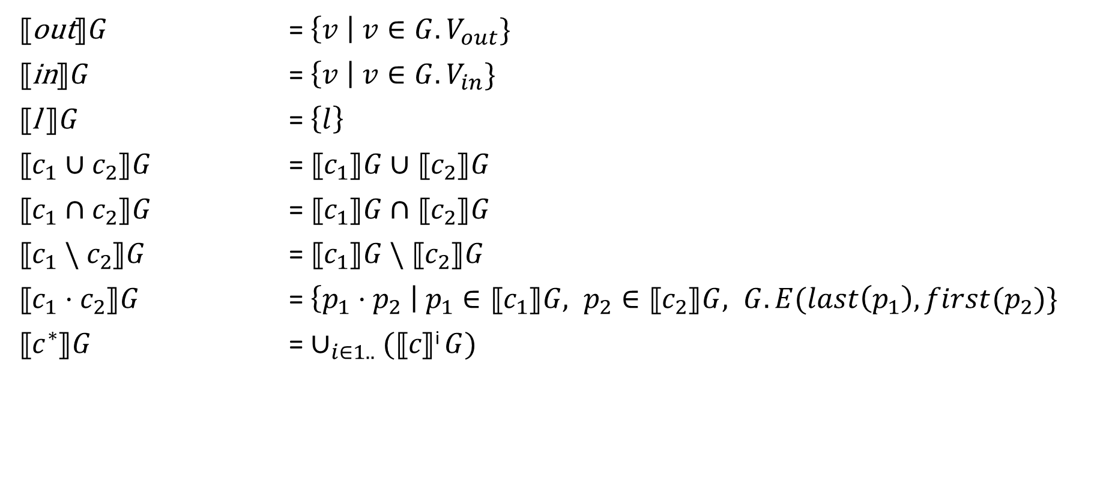
Semantics
⟦out⟧$G$ = $\left\{v \right| v∈G.V_{out}\}$
⟦in⟧$G$ = $\left\{v \right| v∈G.V_{in}\}$
⟦l ⟧$G$ = $\left\{l\right\}$
⟦$c_{1}∪c_{2}$⟧$G$ = ⟦$c_{1}$⟧$G∪\text{⟦}c_{2}\text{⟧}G$
⟦$c_{1}∩c_{2}$⟧$G$ = ⟦$c_{1}$⟧$G∩\text{⟦}c_{2}\text{⟧}G$
⟦$c_{1} \backslash c_{2}$⟧$G$ = ⟦$c_{1}$⟧$G \backslash \text{⟦}c_{2}\text{⟧}G$
⟦$c_{1}⋅c_{2}$⟧$G$ = $\left\{p_{1}⋅p_{2} \right| p_{1}∈\text{⟦}c_{1}\text{⟧}G, p_{2}∈\text{⟦}c_{2}\text{⟧}G, G.E(last\left(p_{1}\right), first(p_{2})\}$
⟦$c^{∗}$⟧$G$ = $∪_{i∈1..}$ $(\text{⟦}c\text{⟧}\text{i} G)$

Slide 49
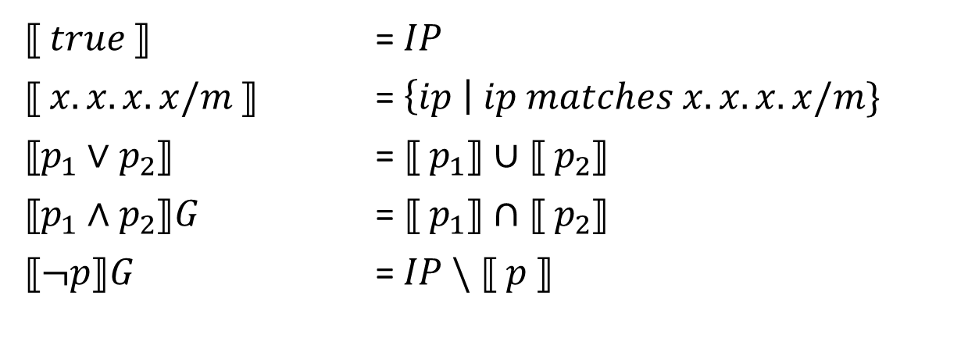
Semantics
⟦ $true$⟧ = $IP$
⟦ $x.x.x.x/m$⟧ = $\left\{ip \right| ip matches x.x.x.x/m\}$
⟦$p_{1}∨p_{2}$⟧ = ⟦ $p_{1}\text{⟧}∪\text{⟦} p_{2}$⟧
⟦$p_{1}∧p_{2}$⟧$G$ = ⟦ $p_{1}\text{⟧}∩\text{⟦} p_{2}$⟧
⟦$¬p$⟧$G$ = $IP \backslash$ ⟦ $p \text{⟧}$

Slide 50

Semantics
$$simple\left(X\right)=\{x | x∈X, x=v_{1}…v_{n}, ∀i j, i≠j⇒v_{i}≠v_{j}\}$$
rank$\left(X,i\right)=\left\{\left(p,i,\left|p\right|\right) \right| p∈X, simple(p)\}$
⟦${p⇒re}_{1}≫…≫{re}_{m}$⟧$G=$
(⟦ $p$⟧$, \text{rank}\text{(}$⟦${re}_{1}\text{⟧}G\text{,} 1)∪ …∪\text{rank}\text{(}\text{⟦}{re}_{n}\text{⟧}G\text{,} n\text{) )}$

