Slide 1
Internet Banking Solutions
Teenovators
►►►
The Great Mind Challenge’ 08

Slide 2

Teenovators
►►►
Project Scenario
An online comprehensive solution to manage Internet banking.
Functional Requirements
Proper Login Functionality
Block on >3 Invalid Attempts
View Accounts’ Info & Statement
Fund Transfer Enabled
Request for Cheque Book
Non-Functional Requirements
SSL Implementation
24x7 availability
Better Service Architecture
Better Component Design
User Interface Priorities
Professional Look & Feel
Use of AJAX
Reports in PDF,XLS,etc format
Users of the System
Customer
Entrepreneur, Industrialist, etc
Administrator

Slide 3
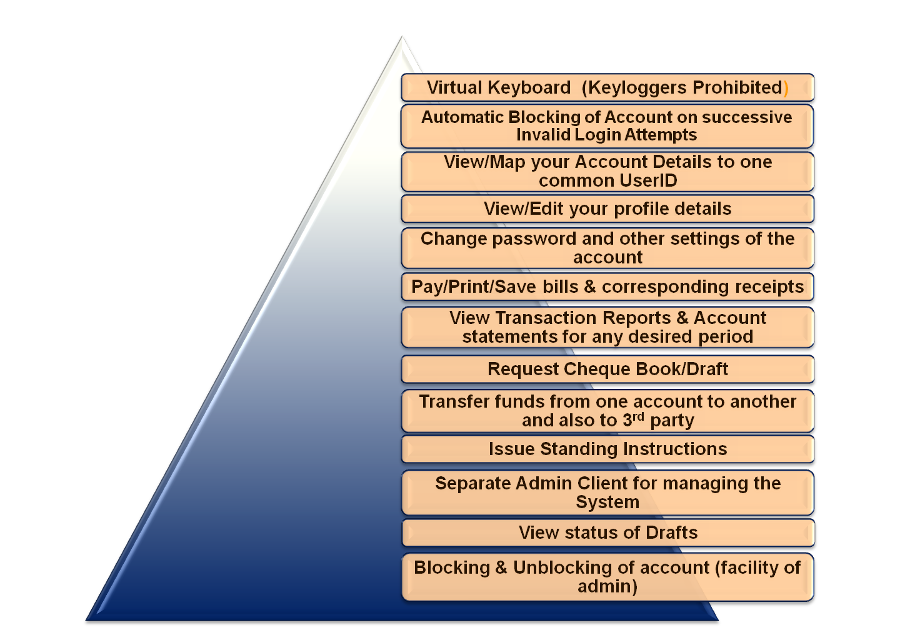
Teenovators
►►►
Scope
SCOPE →

Slide 4
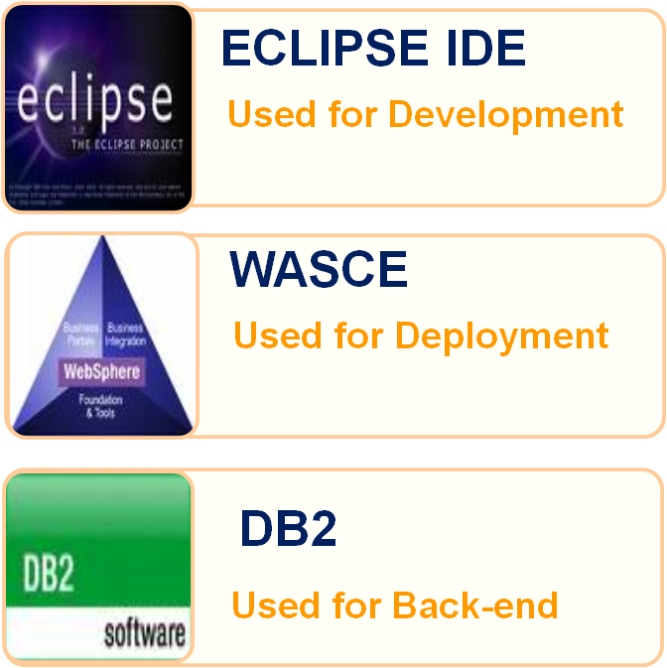
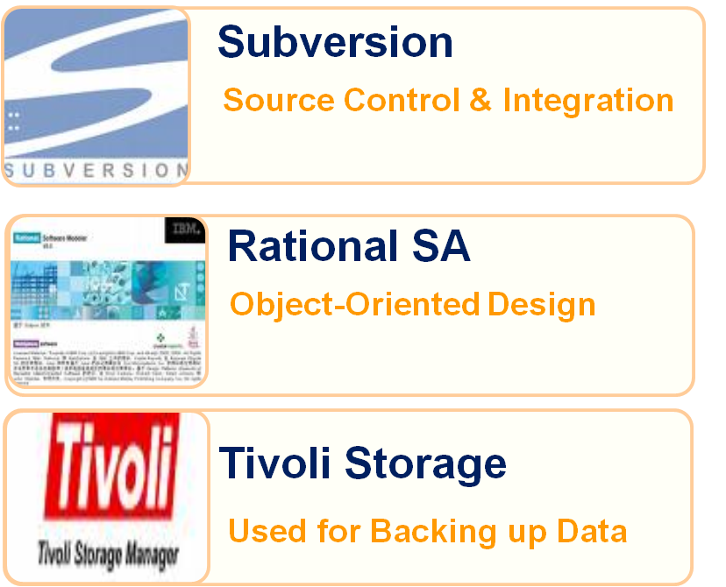
Tools
Teenovators
►►►

Slide 5


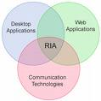

Technologies Used
Teenovators
►►►

Slide 6
Specials
Teenovators
►►►
XML
  For loading Dynamic Data such as:
    Service Provider Names
    Branch Names, etc.
  Used in Jump Box Module where a list of predefined commands is listed which serve as Shortcuts in the module.
Tivoli Storage Manager
  Integration with DB2 to act as a Backup Store where Database Backup is created periodically.
  Integrated with WAS to allow proper User Authentication & avoidance of inter-module interference.

Slide 7




Team
Teenovators
►►►
Ajay Kr. Gautam
Dept. of Computer Science & Engg.
IDD – Part IV
IT-BHU, Varanasi
Karan Jain
Dept. of Computer Science & Engg.
IDD – Part IV
IT-BHU, Varanasi
Gaurav Gupta
Dept. of Computer Science & Engg.
B.Tech Part III
IT-BHU, Varanasi
Rohit Jaiswal
Dept. of Computer Science & Engg.
B.Tech Part III
IT-BHU, Varanasi
Copyright © 2008 Teenovators. All rights reserved.

