Slide 1
Analyzing and PREDICTING HOUSE PRICES
Yuan Hui
Yao Ji

Slide 2

Introduction
Problems:
Which house features are important to its price?
With certain budget, which kind of house can you afford?
Objective:
Predict the sales price of each house in Ames, Iowa
Kaggle challenge: https://www.kaggle.com/c/house-prices-advanced-regression-techniques/data
Notes:
Nearshore water quality has wide influence
Water surface area: 19,000 km²;drainage basin area: 64,000 km²;
Watershed demographics: about 5.6 million (U.S. side)
at nuisance levels from the mid-1990’s.
Shoreline fouling, beach closures and intake clogging at St. Catharines, Oakville, Ajax, Newcastle, Presqu’ile and Kingston (Ontario); Rochester, Kendall and Hamlin (New York).

Slide 3
Data Description
Training data:
1460 observations with 78 house features (37 numeric and 41 categorical variables) and Sale Price as response variables.
Testing data:
1459 observations with 78 house features (37 numeric and 41 categorical variables)

Slide 4
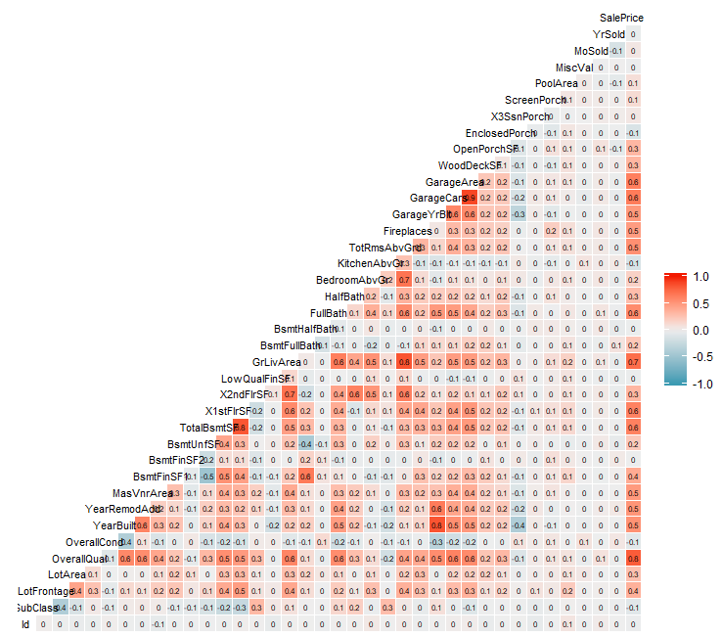
Exploratory Data Analysis
Correlation Matrix
The correlation matrix shows the relationship between any two of numerical variables in training data.
GarageYrBlt: Year garage was built
Fireplaces: Number of fireplaces
TotRmsAbvGrd: Total rooms above ground (does not include bathrooms)
YearBuilt: Original construction date
YearRemodAdd: Remodel date (same as construction date if no remodeling or additions)
GarageArea: Size of garage in square feet
GarageCars: Size of garage in car capacity
FullBath: Full bathrooms above grade
1stFlrSF: First Floor square feet
TotalBsmtSF: Total square feet of basement area
GrLivArea: Above grade (ground) living area square feet
OverallQual: Rates the overall material and finish of the house
High correlated variables: coefficient ≥ 0.5

Slide 5
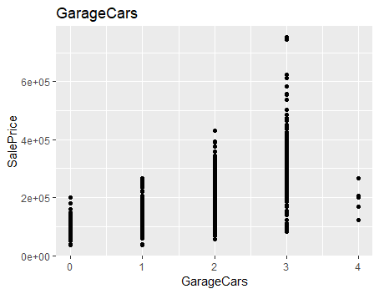
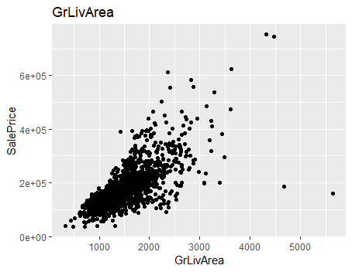
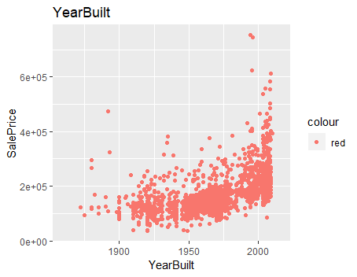
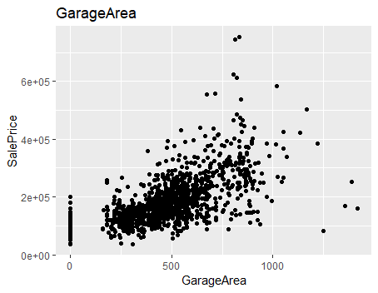
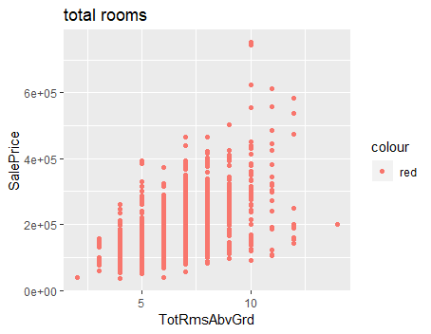
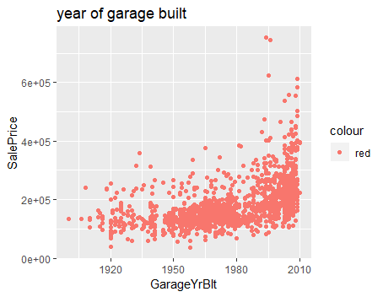
Exploratory Data Analysis
High Correlated Numerical Variables V.S. Sale Price

Slide 6
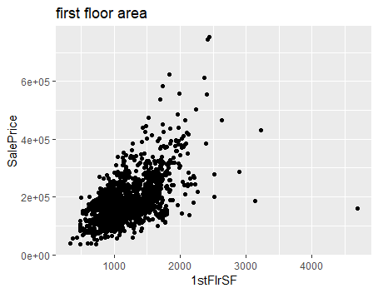
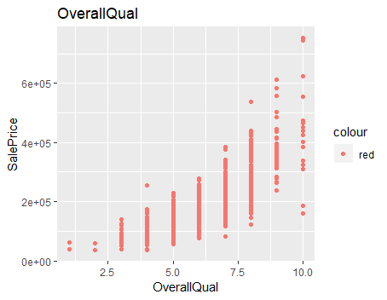
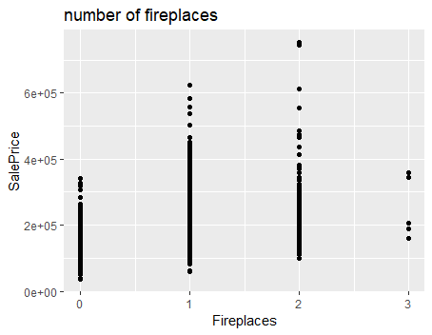
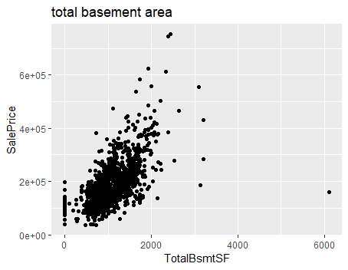
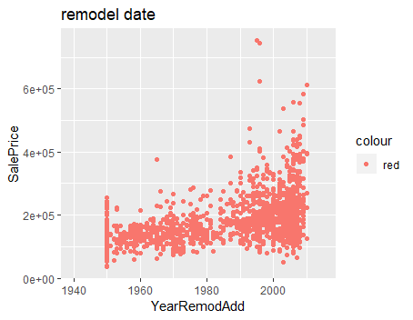
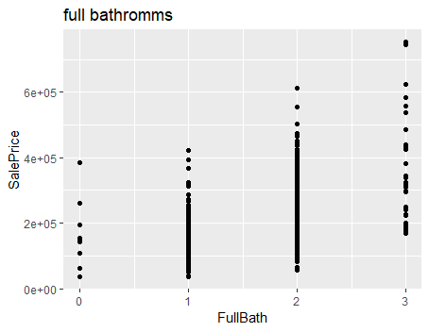
Exploratory Data Analysis
High Correlated Numerical Variables V.S. Sale Price

Slide 7
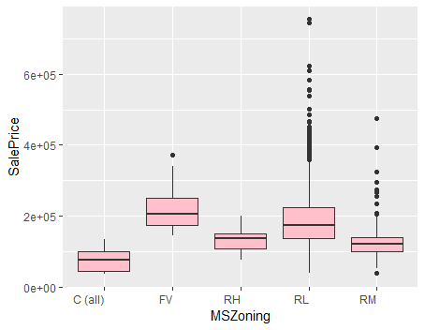
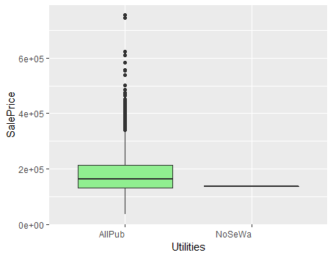
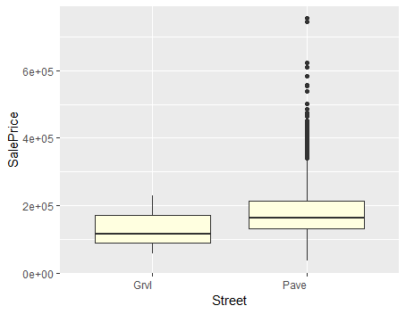
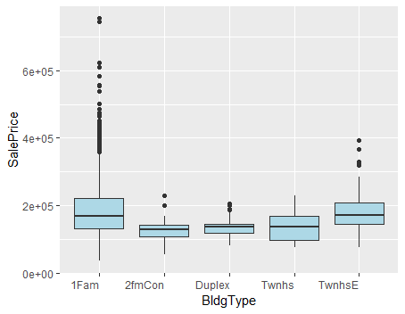
Exploratory Data Analysis
Selected Categorical Variables V.S. Sale Price

Slide 8
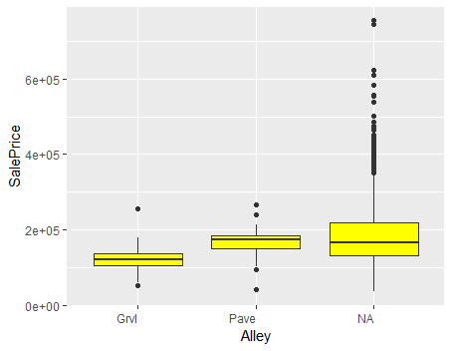
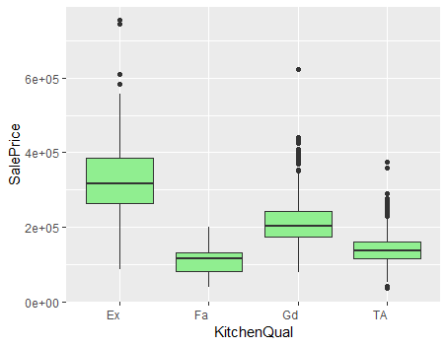
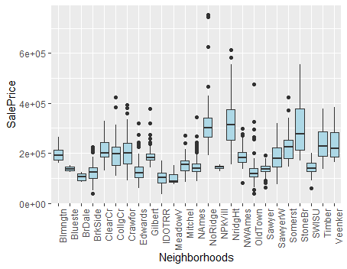
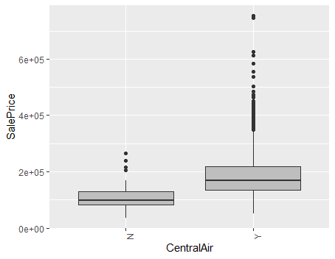
Exploratory Data Analysis
Selected Categorical Variables V.S. Sale Price

Slide 9
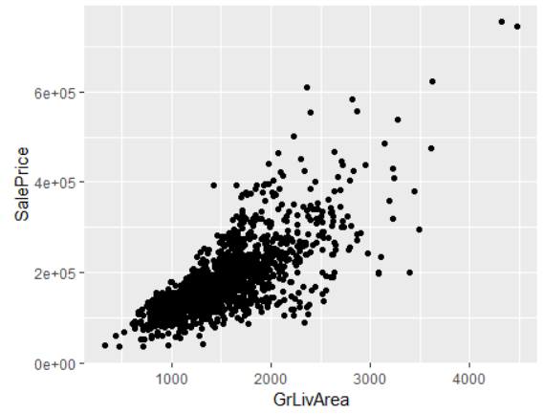
Exploratory Data Analysis
Outlier Analysis
With outliers
Without outliers

Slide 10
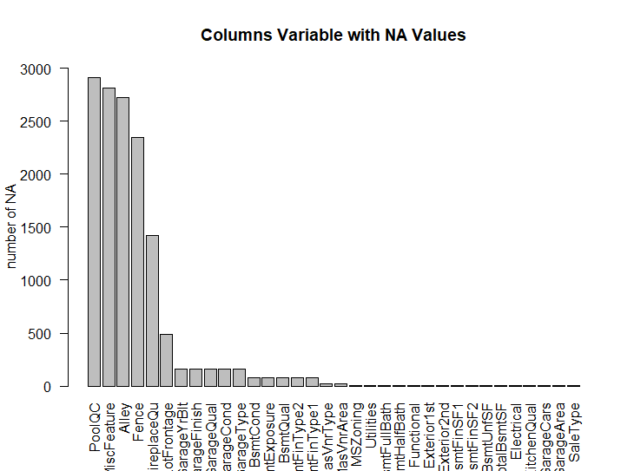
Exploratory Data Analysis
Missing Values
34 column variables have NA values. Especially, PoolQC, MiscFeature, Alley, Fence, FirePlaceQu that have more than 50% data missing
Total data size: 230601; missing data size: 13965; (about 6% of total data is missing).
Notes:
and the integrated processes that cause the nearshore algae issue is significant to explain the causes of this water quality issue, and to predict the summer algae concentration in spring. So that the effective controlling methods could be proposed.

Slide 11
Exploratory Data Analysis
Missing Values
Missing values ‘NA’ is filled up based on different situations:
Impute selected categorical variables NAs by None since NA does not actually mean missing but means no.
e.g. PoolQC(pool quality) has 2909 NAs which means 2909 houses probably do not have pools.
Impute selected numerical variables NA by 0 by related variables.
Replace the NAs of selected categorical variables who have less missing values by the category which appeared most frequently in this variable.
Special case: replacing the NAs of “LotFrontage” by grouping “Neigborhood” and fill the NAs by the median of each LotFrontage.

Slide 12
Exploratory Data Analysis
Numerate categorical variables
Table: Examples of numerate variables
Variable: ‘ExterQual’
None | Po | Fa | TA | Gd | EX
0 | 1 | 2 | 3 | 4 | 5
Variable: ‘Strret’
Grvl | Pave
0 | 1
Split the combined data into new training and testing data set

Slide 13
Model Fitting-Regression
This is a regression problem, with 78 predictors
Not all predictors are significant
Regression shrinkage and dimension reduction methods are applied
Ridge
Lasso
XGBoost
Notes:
Nearshore water quality has wide influence
Water surface area: 19,000 km²;drainage basin area: 64,000 km²;
Watershed demographics: about 5.6 million (U.S. side)
at nuisance levels from the mid-1990’s.
Shoreline fouling, beach closures and intake clogging at St. Catharines, Oakville, Ajax, Newcastle, Presqu’ile and Kingston (Ontario); Rochester, Kendall and Hamlin (New York).

Slide 14
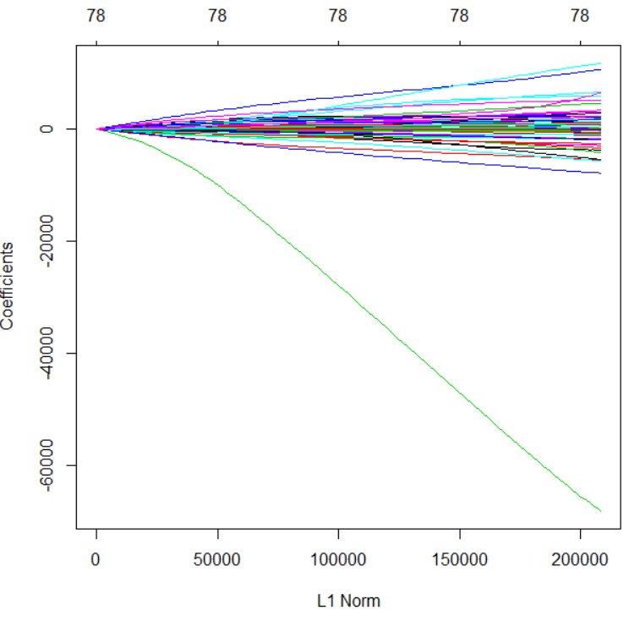
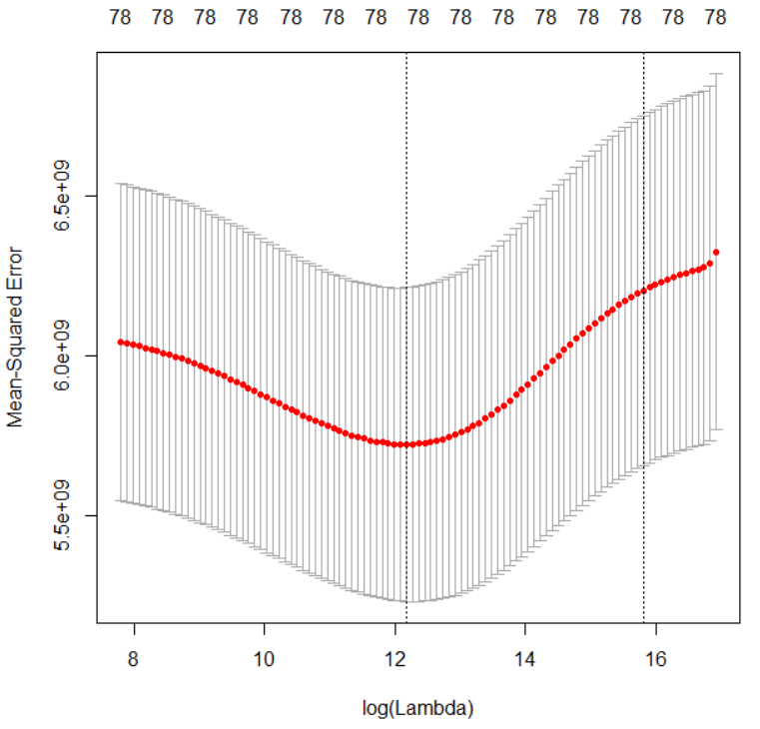
Model Fitting-Regression
Ridge Regression
Test error (mean absolute percentage error, MAPE): 11%
Notes:
Nearshore water quality has wide influence
Water surface area: 19,000 km²;drainage basin area: 64,000 km²;
Watershed demographics: about 5.6 million (U.S. side)
at nuisance levels from the mid-1990’s.
Shoreline fouling, beach closures and intake clogging at St. Catharines, Oakville, Ajax, Newcastle, Presqu’ile and Kingston (Ontario); Rochester, Kendall and Hamlin (New York).

Slide 15
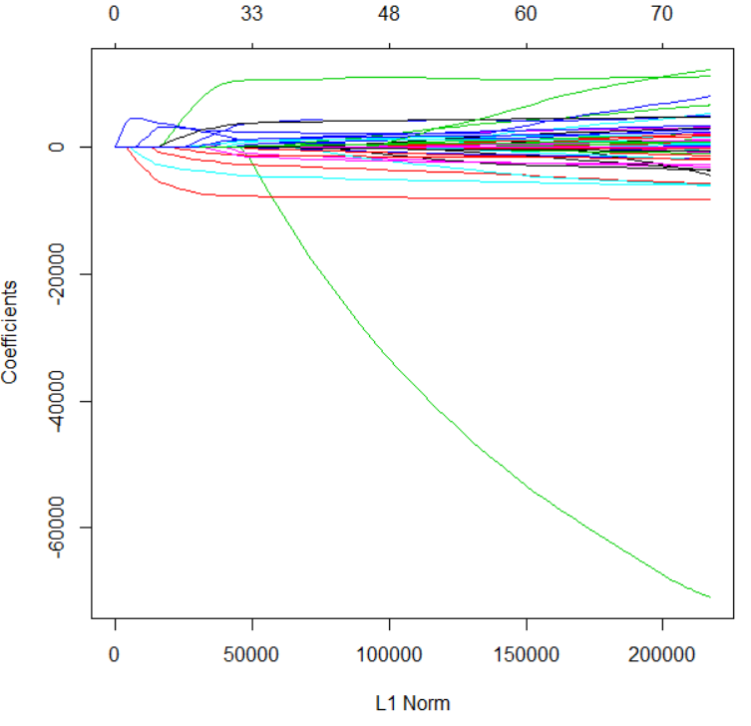
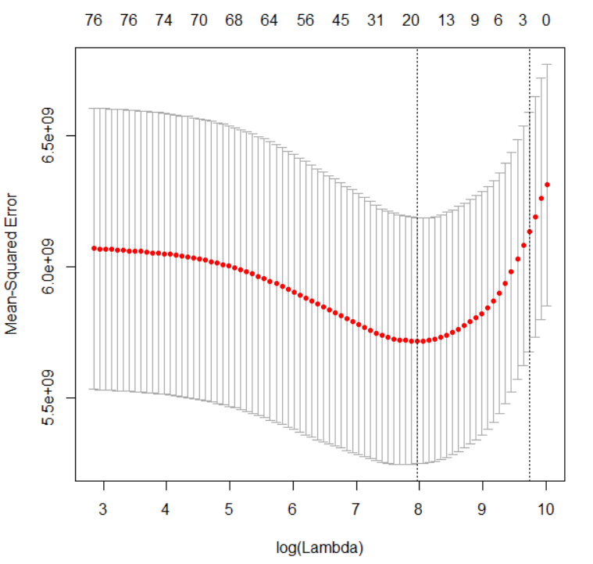
Model Fitting-Regression
Lasso Regression
Test MAPE: 12%
Notes:
Nearshore water quality has wide influence
Water surface area: 19,000 km²;drainage basin area: 64,000 km²;
Watershed demographics: about 5.6 million (U.S. side)
at nuisance levels from the mid-1990’s.
Shoreline fouling, beach closures and intake clogging at St. Catharines, Oakville, Ajax, Newcastle, Presqu’ile and Kingston (Ontario); Rochester, Kendall and Hamlin (New York).

Slide 16
Model Fitting-Regression
Lasso Regression
17 significant predictors
LotFrontage | LotArea | OverallQual | ExterQual | BsmtQual | BsmtFinSF1 | TotalBsmSF
HeatingQC | CentralAir | GrLivArea | FullBath | KitchenQual | Fireplaces | GarageCars
GarageCond | ScreenPorch | SaleCondition
Area Related
Quality Related
Facility Related
Notes:
and the integrated processes that cause the nearshore algae issue is significant to explain the causes of this water quality issue, and to predict the summer algae concentration in spring. So that the effective controlling methods could be proposed.

Slide 17
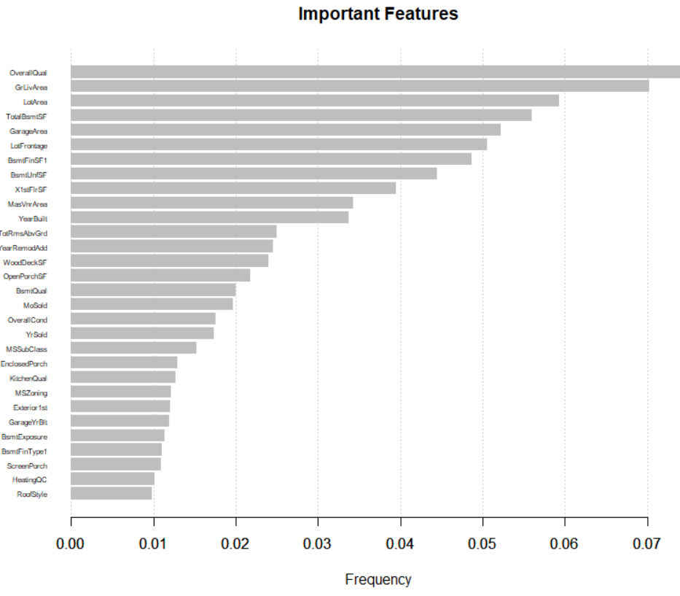
Model Fitting-Regression
XGBoost
Use Cross Validation to decide the best number of round: 450
Top 5 predictors:
OverallQual
GrLiveArea
LotArea
TotalBsmtSF
GarageArea
Test MAPE: 10%

Slide 18
Model Fitting-Classification
Hypothesis:
IF: house price > medium price
High price house. YES
ELSE:
Low price house. NO
This is a binary classification problem
Random Forest
Support Vector Classifier

Slide 19
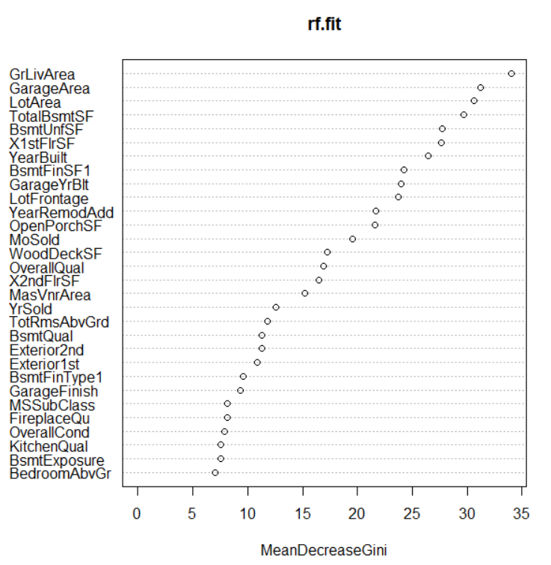
Model Fitting-Classification
Random Forest
Misclassification error: 0.4
Table: Confusion matrix of test data
 | TRUTH.NO | TRUTH.YES
PREDICT.NO | 727 | 172 (Type II)
PREDICT.YES | 339 (Type I) | 220

Slide 20
Model Fitting-Classification
Support Vector Classifier
Misclassification error 0.43
The optimized cost value 1
Table: Confusion matrix of test data
 | TRUTH.NO | TRUTH.YES
PREDICT.NO | 639 | 467 (Type II)
PREDICT.YES | 173 (Type I) | 180

Slide 21
Conclusion
Fill up missing data for high dimensional dataset is tricky and more efforts on data pre-processing is necessary
For this dataset, XGBoost performs better than other regression models
For the users benefit, Lasso is preferred
House properties related to area and quality are most significant to house prices.

Slide 22
THANK YOU FOR YOUR ATTENTION!
Q & A!

