Slide 1
JPA

Slide 2
Agenda:
ORM Components
Jpa Class level Architecture
Jpa Components description
Jpa Components relation
Entity lifecycle & Entitymanager Interface
Getting started with JPA
Using @Transactional with JpaSpringModule
Examples, Best practises
Caching
Locking
Transactions

Slide 3
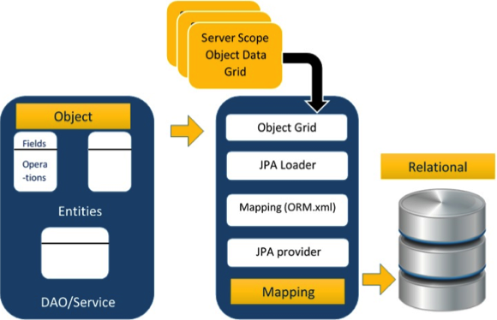
ORM components

Slide 4
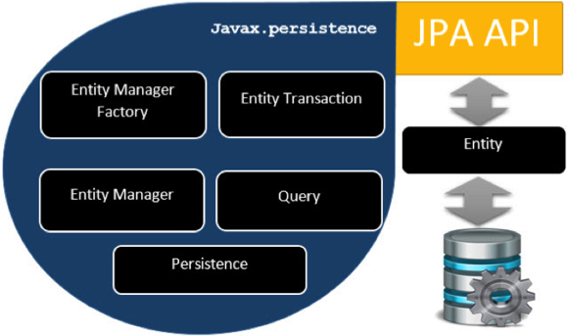
JPA Class Level Architecture

Slide 5
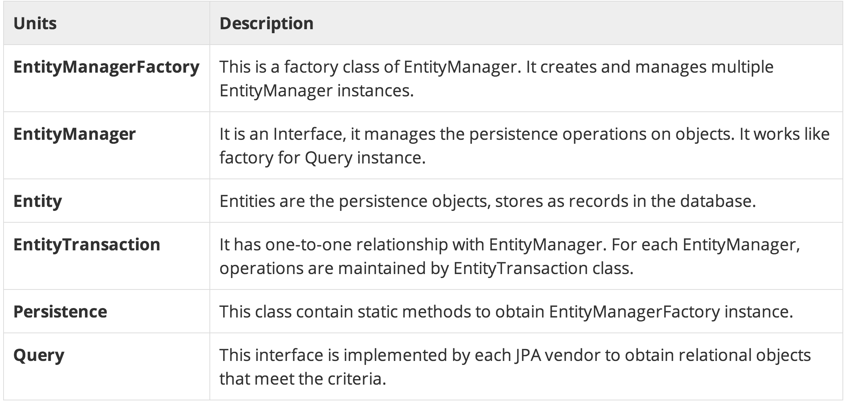

Slide 6
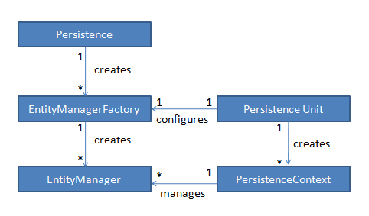
Components of JPA

Slide 7
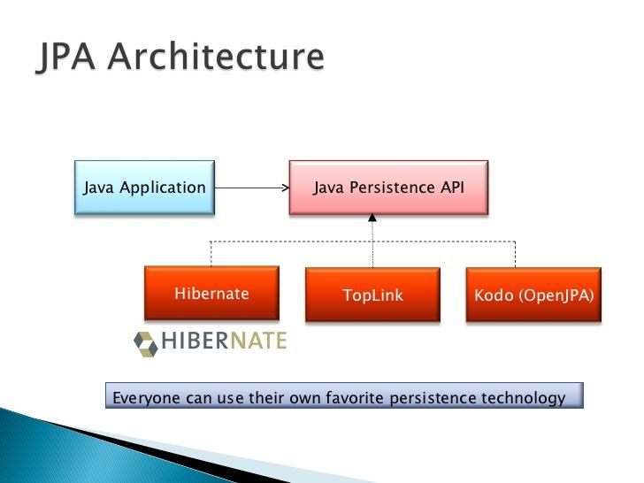

Slide 8
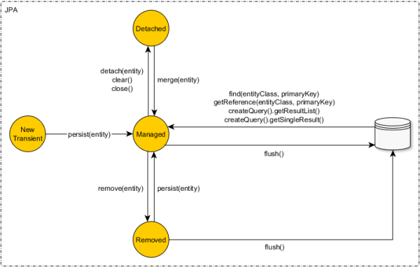
Entity Manager

Slide 9
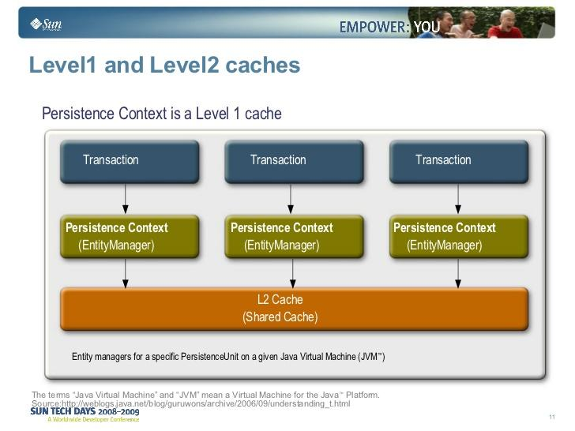

Slide 10
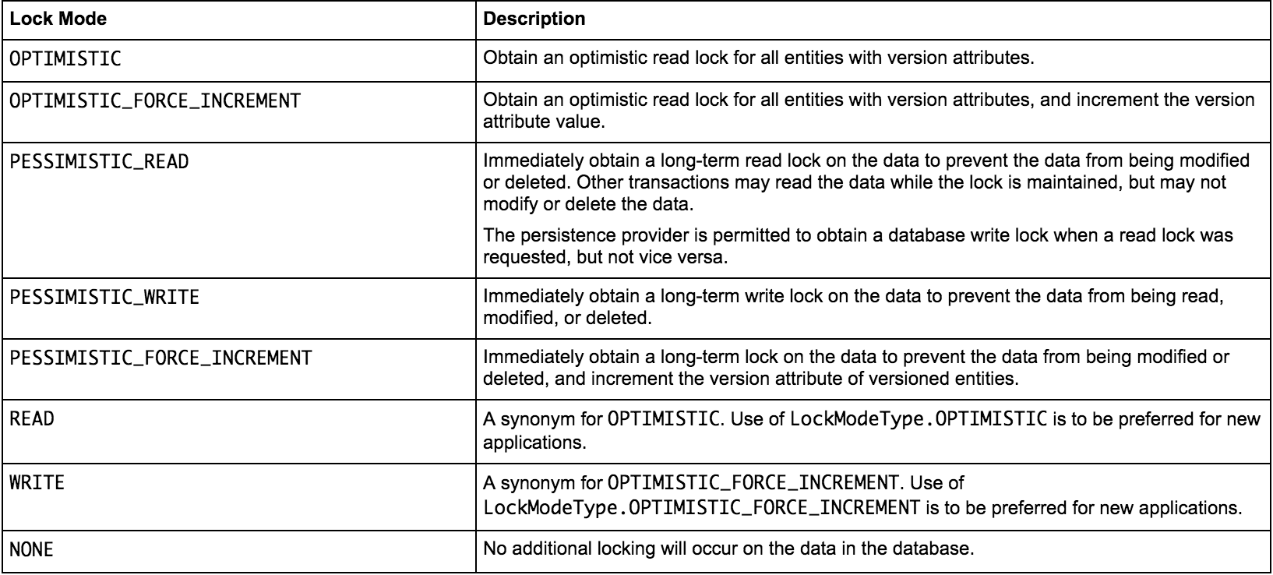
Lock Modes for Concurrent Entity Access

