Slide 1
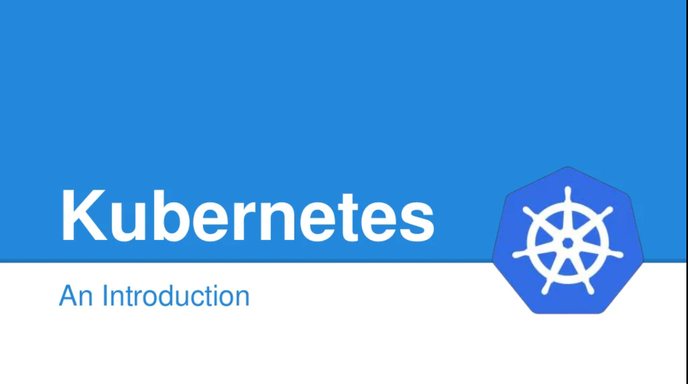
Kubernetes

Slide 2
Agenda
Kubernetes Overview
Kubernetes Architecture
Kubernetes Installation and Dashboard Setup
Kubernetes Pod
Kubernetes Node
Kubernetes Service
Kubernetes Deployment
Kubernetes Namespace
Kubernetes Volume
Kubernetes Secrets
Deploy a NodeJS application in Kubernetes Cluster

Slide 3
Overview
Q. What is Kubernetes and Its benefits ?
Container management (orchestration) tool
Used to manage Docker containers as default implementation
Redundancy and availability of containers
Scalability or high performance
Self-Healing Capabilities
Service discovery and load balancing

Slide 4
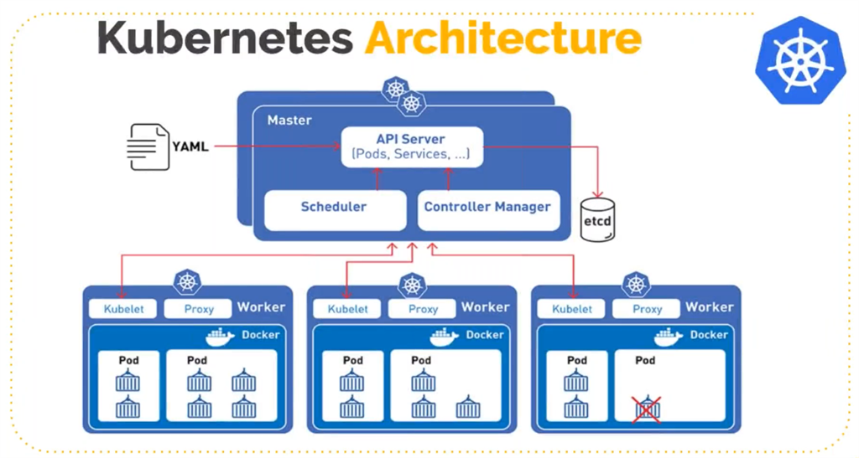
Architecture

Slide 5
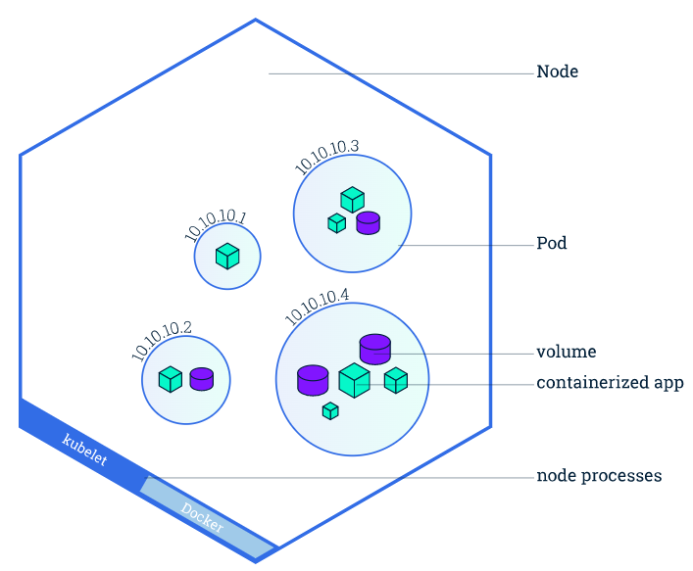
POD

Slide 6
POD
A Pod contains one or multiple application containers
Storage resources
Each Pod gets its own IP address
New IP address on re-creation
apiVersion: v1
kind: Pod
metadata:
name: nodejs-pod
labels:
name: nodejs
spec:
containers:
- name: nodejs
image: nodejs:14.16.0
resources:
limits:
memory: "128Mi"
cpu: "500m"
ports:
- containerPort: 80

Slide 7
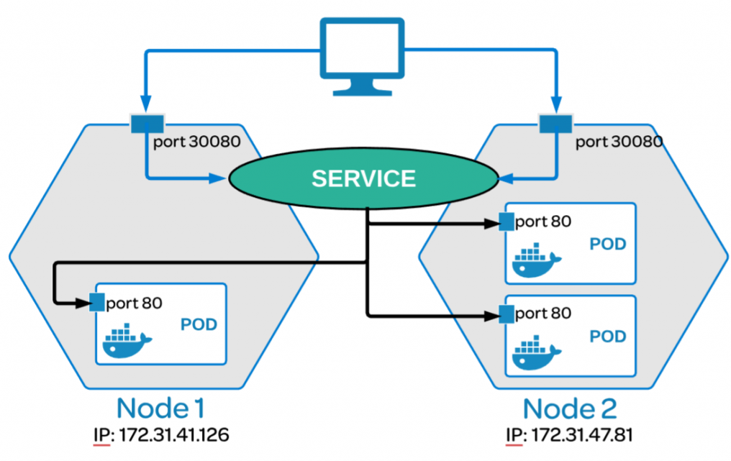
Service

Slide 8
Service
Pods can be configured to talk to the Service
Services provide discovery and routing between pods
Permanent IP address
Service do the load-balancing on available pod
It use labels and selectors to match pods with other applications.
Types: ClusterIP, NodePort, LoadBalancer, ExternalName
apiVersion: v1
kind: Service
metadata:
name: nodejs-service
spec:
selector:
app: nodejs
ports:
- port: 80
targetPort: 3000

Slide 9
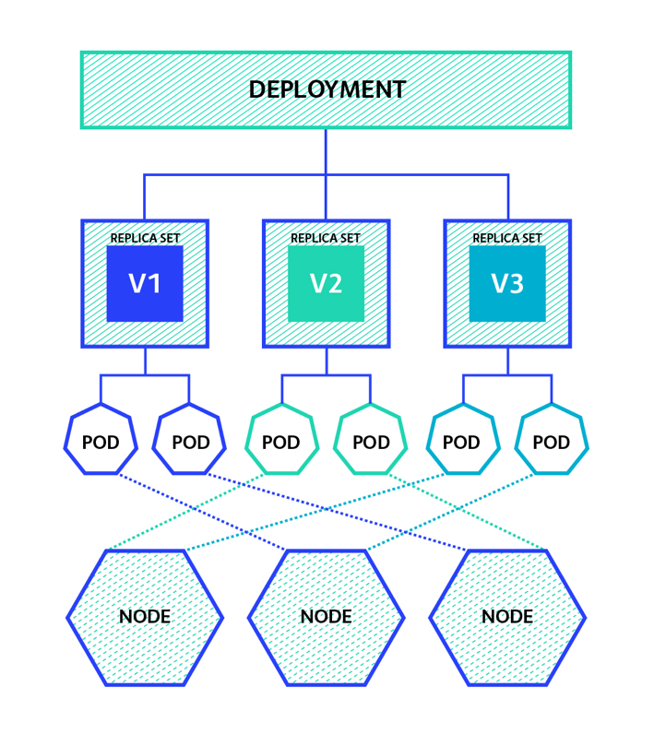
Deployment

Slide 10
Deployment
Create a Deployment to rollout a ReplicaSet.
Declare the new state of the Pods
Rollback to an earlier Deployment revision
Scale up the Deployment to facilitate more load.
Clean up older ReplicaSets

Slide 11
Deployment
apiVersion: apps/v1
kind: Deployment
metadata:
name: nodejs-deployment
spec:
replicas: 2
selector:
matchLabels:
app: nodejs
template:
metadata:
labels:
app: nodejs
spec:
containers:
- name: nodejsapp
image: sofyspace/nodejs-starter:1.0
resources:
limits:
memory: "128Mi"
cpu: "500m"
ports:
- containerPort: 3000

Slide 12
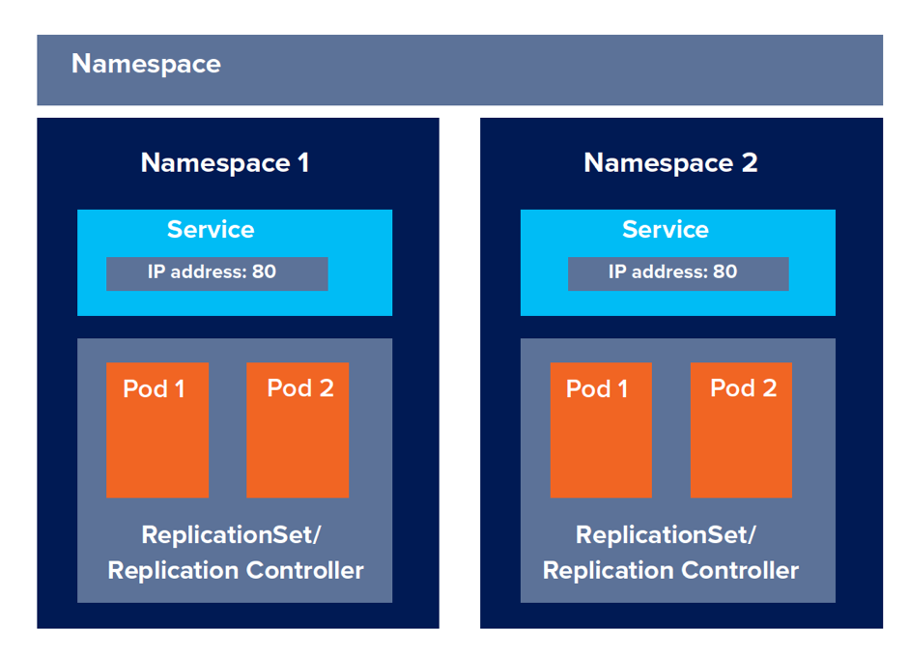
Namespace

Slide 13
Namespace
It is a logical cluster or environment.
It is a widely used method which is used for scoping access or dividing a cluster.
Partitioning landscapes: dev vs. test vs. prod
It divide cluster resources between multiple users
apiVersion: v1
kind: Namespace
metadata:
name: scm-dev-namespace
$ kubectl get namespaces
$ kubectl apply -f scm-dev-namespace.yaml
$ kubectl get namespace
$ kubectl describe namespace scm-dev-namespace

Slide 14
Volume

