Slide 1
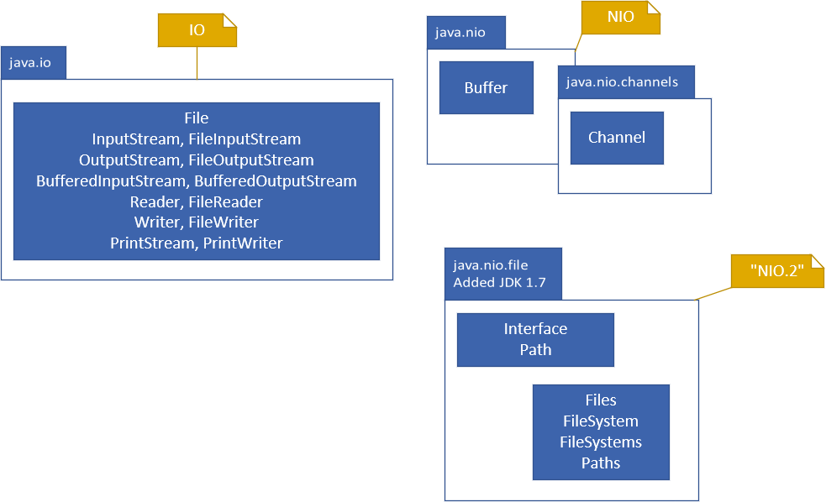

IO, NIO, NIO.2
Java has what seems like a very confusing and large series of classes, in many packages, to support input/output.
I'll be covering the most commonly used types but first let's talk about Java's somewhat confusing terminology which includes IO, NIO and NIO.2.
First, IO is a term for input/output, and java.io is a package that contains the original set of types that support reading and writing data from external resources.
COMPLETE JAVA MASTERCLASS
Introduction

Slide 2
IO, NIO, NIO.2
NIO was introduced as Non-blocking IO, with the java.nio package in Java 1.4, as well as a few other related packages. The communication with resources is facilitated through specific types of Channels, and the data stored in containers called Buffers, when exchanged.
NIO.2 stands for New IO, and is a term that came into being with Java 1.7, emphasizing significant improvements to the java.nio package, most importantly the java.nio.file package and its types.
COMPLETE JAVA MASTERCLASS
Introduction

