Slide 1

A Review of IO, the old school way
In a previous video, I showed you a very simple way to read lines from a file, with Files.readAllLines.
I would certainly suggest taking that route for the majority of your file reading requirements.
However, to understand how that magical little method works, I want to roll back the clock, to a time in Java development when we only had methods offered in Java 1.0.
These methods somewhat reflect the actual process of reading data from a file, as opposed to a black box method like readAllLines.
COMPLETE JAVA MASTERCLASS
Reading text from a file using java.io (the old way)

Slide 2
Disk Read
A disk read means, something is physically, or mechanically, occurring on your hard disk to read that character from the file.
This is expensive, in terms of time and resource usage. Fortunately, Java provides ways to reduce the number of disk reads being done.
COMPLETE JAVA MASTERCLASS
Reading text from a file using java.io (the old way)

Slide 3
What's a file buffer?
A file buffer is just computer memory temporarily used to hold data, while it's being read from a file.
Its primary purpose is to improve the efficiency of data transfer and processing.
It reduces the number of direct interactions, or disk reads, against the actual storage device.
COMPLETE JAVA MASTERCLASS
Reading text from a file using java.io (the old way)

Slide 4
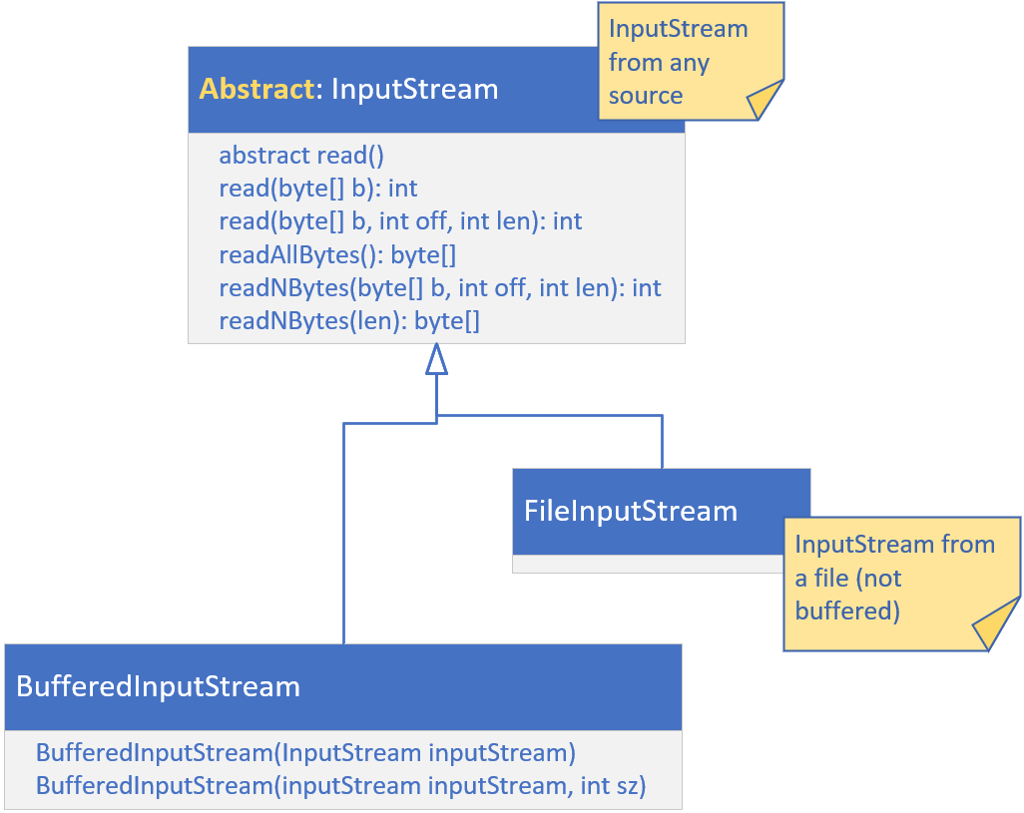
Input Streams
An InputStream is an abstract class, representing an input stream of bytes.
It represents a source of data, and a common interface for reading that data.
Input Streams can return a byte stream or a character stream.
COMPLETE JAVA MASTERCLASS
Reading text from a file using java.io (the old way)

Slide 5
Input Streams
For files, the implementation is the FileInputStream.
This class is used for files containing binary data, so we'll be getting back to it later.
Using the read method on a FileInputStream is very inefficient, so if you're going to use a FileInputStream, you'll want to wrap it in a BufferedInputStream.
COMPLETE JAVA MASTERCLASS
Reading text from a file using java.io (the old way)

Slide 6
An InputStream is not a source for a Stream pipeline
We've talked a lot about streams before this, but an input stream is not that kind of stream.
It's a similar concept, in that we get a stream of data, in some kind of sequential way.
However, an InputStream can't be used in a Stream pipeline, without first transforming it.
COMPLETE JAVA MASTERCLASS
Reading text from a file using java.io (the old way)

Slide 7
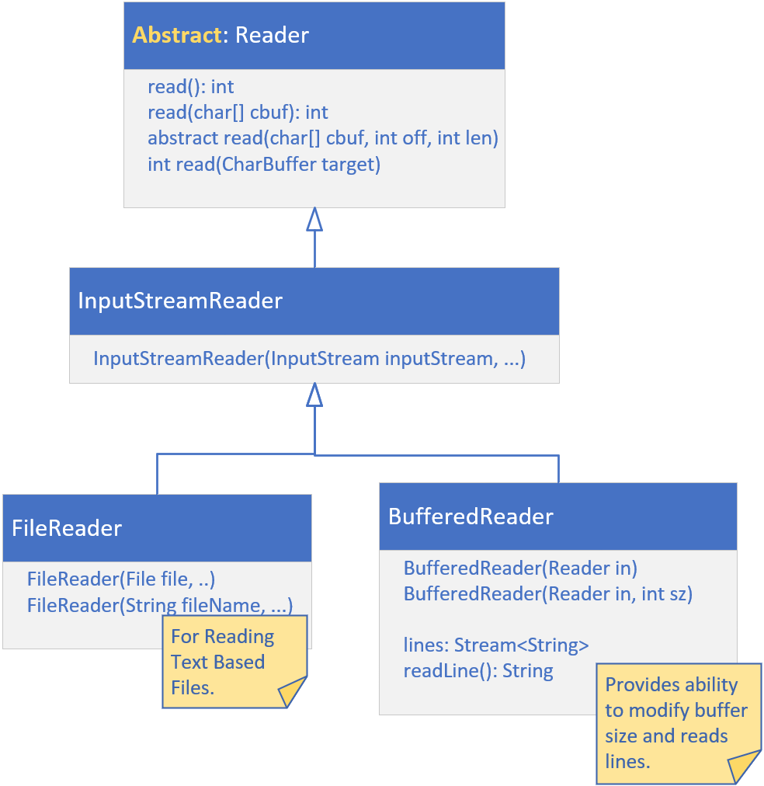
Readers
Readers read characters, as you can see from the methods on the abstract parent shown on this slide.
An InputStreamReader is a bridge, from byte streams to character streams.
If you want to read a character stream, it's recommended you use a FileReader.
FileReader is doing buffered reading.
COMPLETE JAVA MASTERCLASS
Reading text from a file using java.io (the old way)

Slide 8
Readers
A BufferedReader will also do buffered reading, using a much larger buffer size than the FileReader.
You can modify the size of the buffer on BufferedReader.
The default buffer size is large enough for most purposes.
The BufferedReader also provides convenience methods for reading lines of text.
COMPLETE JAVA MASTERCLASS
Reading text from a file using java.io (the old way)

