Slide 1
Digitization of Aircraft Engine Logbook using Large Language Model
BITS-WILP DISSERTATION
Anubhav Kumar Saurav
BITS ID: 2023MT12232

Slide 2
Problem Statement
The lifecycle of aircraft engines is approx. 20-30 years depending on the engine types such as turboprop, turbojet, turboshaft, turboprop etc.
Maintenance crews have relied on paper logbooks to record maintenance activities and compliance checks when an engine undergoes maintenance, repair or overhaul activities.
Paper-based maintenance record keeping still dominates the aviation industry.
While traditional method is effective, this method has limitations including the risk of damage or loss, difficulty in data retrieval, data preservation for decades and the potential for human error.

Slide 3
Objective
Digitizing the aircraft engine maintenance logbook records, using the application of large language model that leverages computer vision, natural language processing and machine learning techniques.
To automate data extraction, document classification and visual document interpretation of engine service logbook records, that will convert unstructured data into a desired structured output directly from an input document image
Digitizing service log records of aircraft engines reduces administrative workload, data preservation in digital form, enable real-time access to digital logs from multiple locations and better collaboration and communication among stakeholders.

Slide 4
Scope of the Project Work
Study of different state-of-the art large language models, their underlying architecture and capabilities in solving specific use cases pertaining to industry needs are surveyed.
Selecting a LLM model specific to our use case
Dataset preparation for engine logbooks
Data pre-processing tasks (Tokenization, image formatting, image to tensor etc)
Training and fine-tuning the LLM model
Model Evaluation and Comparison with other benchmark models
Challenges and Future work

Slide 5
Current Method Adopted
OCR-free multimodal transformer-based Document Understanding Transformer (DONUT) model framework for visual document understanding (VDU) tasks.
VDU aims at understanding digital documents either born as PDF’s or as images.
VDU interpret both textual content and spatial features of the document image using computer vision (CV), perform information extraction, contextual understanding and key-value pair mapping using natural language processing (NLP) methods.
Transformer based architecture and machine learning methods also features textual prompt and visual question answering (VQA) capability on the extracted information.
Traditional Method Limitations
Traditional approach to VDU was based on Optical Character Recognition based processing.
It has two step process: (a)Text extraction with off the shelf OCR engines (b) Downstream processing of information
This traditional OCR based method comes with several limitations like high computational cost, limited flexibility of OCR with different types of fonts, languages and document layout.
Error propagation in one step affects all subsequent processing steps.
Machine learning methods are not applied.

Slide 6
DONUT Model for Visual Document Understanding
For the implementation of training methods and fine tuning the model for visual document understanding, the donut model is chosen, which is an OCR free transformer-based architecture model.
Transformer Architecture :Donut model has simple transformer based encoder-decoder architecture which has the advantage of efficient memory utilization and time cost.
OCR free operation: Donut bypasses the need for Optical Character Recognition (OCR) engines which are often prone to errors and require additional processing steps.
Scalable: Donut's transformer-based architecture allows for efficient scaling to handle large volumes of documents, and its OCR-free nature reduces operational costs
Memory Efficiency: Donut is designed to be memory efficient, making it suitable for deployment on devices with limited resources

Slide 7
Practical Implementation
Technical Considerations:
Software Requirements | Programming Languages | Python (version 3.8 or higher)
 | Software Libraries | PyTorch (version ≥ 1.12): A deep learning framework for building and training models. Hugging Face Transformers (version ≥ 4.45): A library that provides pre-trained models and tools for various NLP tasks, including Donut. Hugging Face Repository: To save the trained models and processed dataset on cloud repo so that it can be accessed from any location.
Hardware Requirements | GPU | NVIDIA L4, T4 or A100 GPU with at least 16-32 GB of memory for efficient training of the model
 | Cloud Platforms | Google Colab Pro for scalable and powerful training environment
 | RAM, Hard Disk | 16-32 GB System RAM and at least 256 GB hard disk.

Slide 8
Task Accomplished
Dataset Preparation:
Created a dataset of engine service logbooks comprising of different templates, layouts and data in-order to train the transformer-based donut model on the custom dataset.
The dataset comprises of 150 annotated data images categorized into three classes– EMR, RTS & ECS.

Slide 9
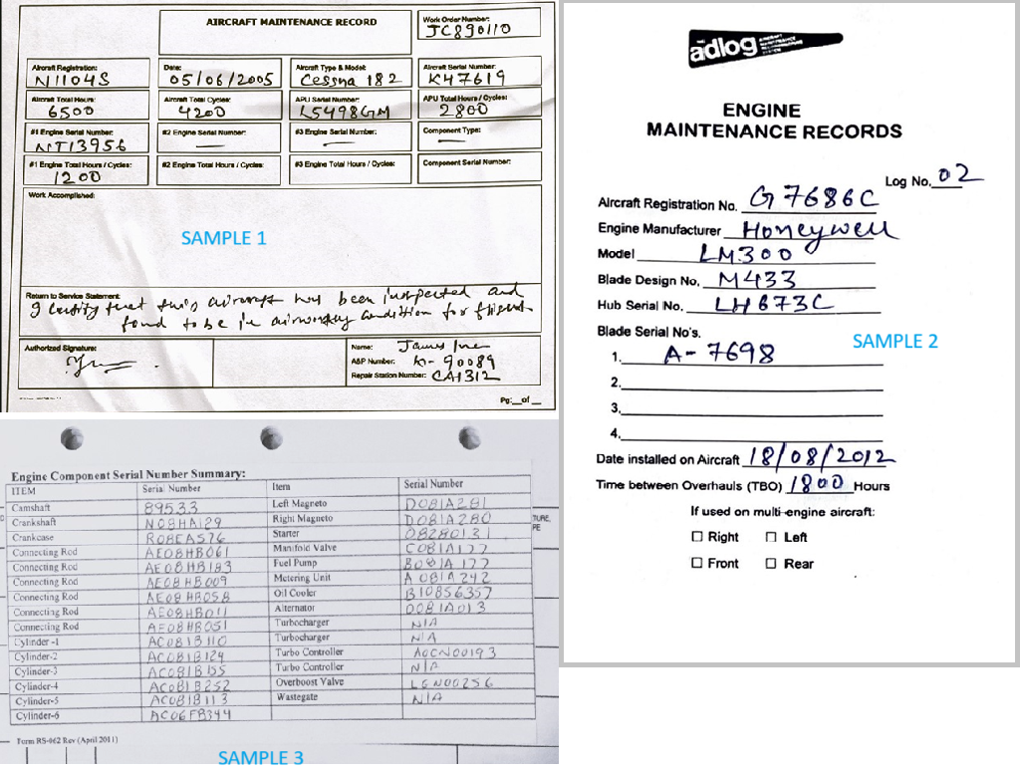
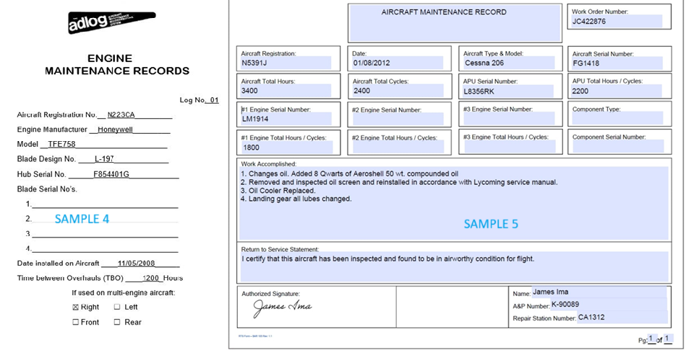
Dataset Sample

