Slide 1
Digitization of Aircraft Engine Logbook using Large Language Model
BITS-WILP DISSERTATION
Anubhav Kumar Saurav
BITS ID: 2023MT12232

Slide 2
Problem Statement
The lifecycle of aircraft engines is approx. 20-30 years depending on the engine types such as turboprop, turbojet, turboshaft, turboprop etc.
Maintenance crews have relied on paper logbooks to record maintenance activities and compliance checks when an engine undergoes maintenance, repair or overhaul activities.
Paper-based maintenance record keeping still dominates the aviation industry.
While traditional method is effective, this method has limitations including the risk of damage or loss, difficulty in data retrieval, data preservation for decades and the potential for human error.

Slide 3
Objective
Digitizing the aircraft engine maintenance logbook records, using the application of large language model that leverages computer vision, natural language processing and machine learning techniques.
To automate data extraction, document classification and visual document interpretation of engine service logbook records, that will convert unstructured data into a desired structured output directly from an input document image
Digitizing service log records of aircraft engines reduces administrative workload, data preservation in digital form, enable real-time access to digital logs from multiple locations and better collaboration and communication among stakeholders.

Slide 4
Scope of the Project Work
Study of different state-of-the art large language models, their underlying architecture and capabilities in solving specific use cases pertaining to industry needs are surveyed.
Selecting a LLM model specific to our use case
Dataset preparation for engine logbooks
Data pre-processing tasks (Tokenization, image formatting, image to tensor etc)
Training and fine-tuning the LLM model
Model Evaluation and Comparison with other benchmark models
Challenges and Future work

Slide 5
Current Method Adopted
OCR-free multimodal transformer-based Document Understanding Transformer (DONUT) model framework for visual document understanding (VDU) tasks.
VDU aims at understanding digital documents either born as PDF’s or as images.
VDU interpret both textual content and spatial features of the document image using computer vision (CV), perform information extraction, contextual understanding and key-value pair mapping using natural language processing (NLP) methods.
Transformer based architecture and machine learning methods also features textual prompt and visual question answering (VQA) capability on the extracted information.
Traditional Method Limitations
Traditional approach to VDU was based on Optical Character Recognition based processing.
It has two step process: (a)Text extraction with off the shelf OCR engines (b) Downstream processing of information
This traditional OCR based method comes with several limitations like high computational cost, limited flexibility of OCR with different types of fonts, languages and document layout.
Error propagation in one step affects all subsequent processing steps.
Machine learning methods are not applied.

Slide 6
DONUT Model for Visual Document Understanding
For the implementation of training methods and fine tuning the model for visual document understanding, the donut model is chosen, which is an OCR free transformer-based architecture model.
Transformer Architecture :Donut model has simple transformer based encoder-decoder architecture which has the advantage of efficient memory utilization and time cost.
OCR free operation: Donut bypasses the need for Optical Character Recognition (OCR) engines which are often prone to errors and require additional processing steps.
Scalable: Donut's transformer-based architecture allows for efficient scaling to handle large volumes of documents, and its OCR-free nature reduces operational costs
Memory Efficiency: Donut is designed to be memory efficient, making it suitable for deployment on devices with limited resources

Slide 7
Practical Implementation
Technical Considerations:
Software Requirements | Programming Languages | Python (version 3.8 or higher)
 | Software Libraries | PyTorch (version ≥ 1.12): A deep learning framework for building and training models. Hugging Face Transformers (version ≥ 4.45): A library that provides pre-trained models and tools for various NLP tasks, including Donut. Hugging Face Repository: To save the trained models and processed dataset on cloud repo so that it can be accessed from any location.
Hardware Requirements | GPU | NVIDIA L4, T4 or A100 GPU with at least 16-32 GB of memory for efficient training of the model
 | Cloud Platforms | Google Colab Pro for scalable and powerful training environment
 | RAM, Hard Disk | 16-32 GB System RAM and at least 256 GB hard disk.

Slide 8
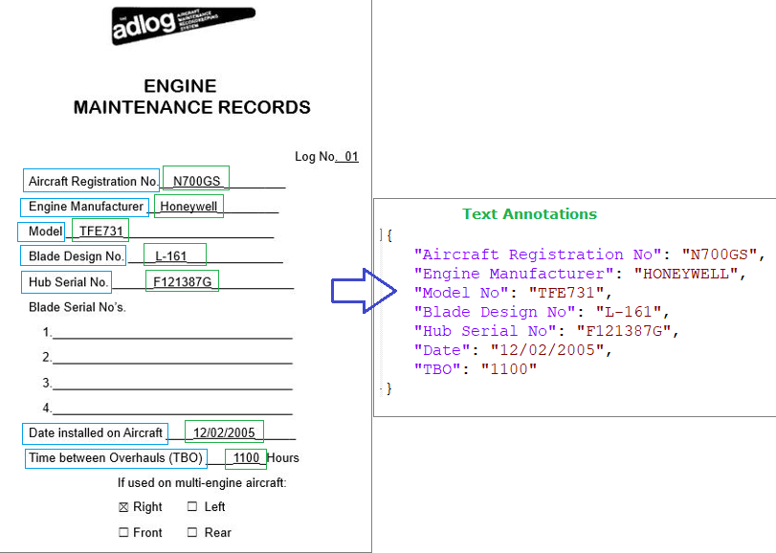
Task Performed
Dataset Preparation:
Created a dataset of engine service logbooks comprising of different templates, layouts and data in-order to train the transformer-based donut model on the custom dataset.
The dataset comprises of 150 annotated data images of service logbook records categorized into three classes– EMR, RTS & ECS.
Donut model doesn’t accept just image as input. It needs text annotations along with the input image.
For 150 data images, 150 text annotation files in JSON format are created which guide the model what data to exactly look for and extract the meaningful key-value pair.
A metadata file for each class of the dataset is created that contains two columns :text and filename. Donut requires paired image-text data

Slide 9
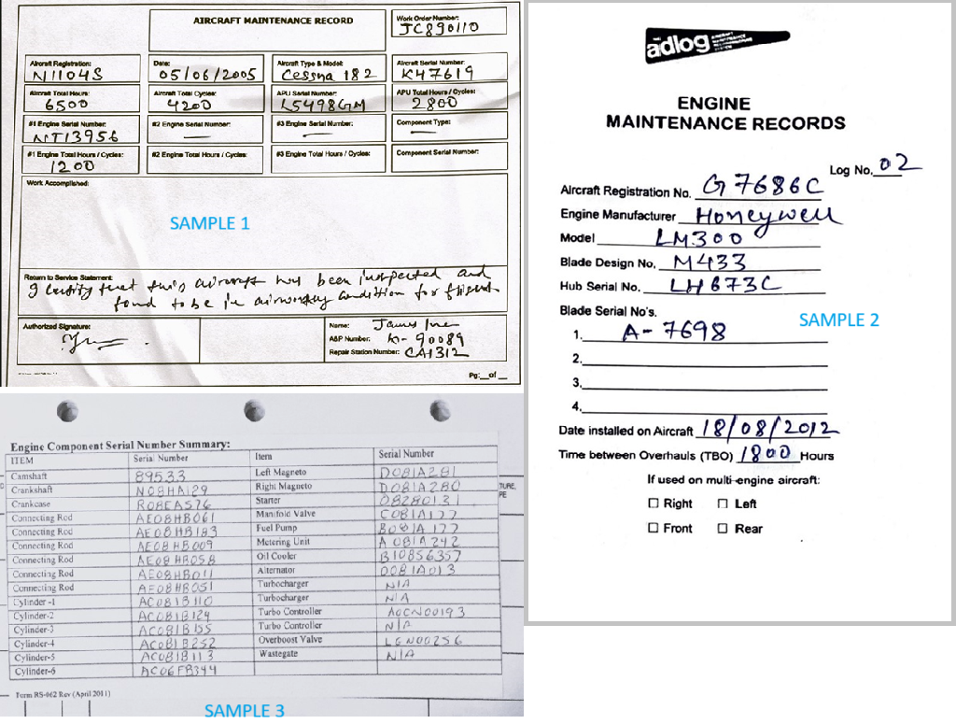
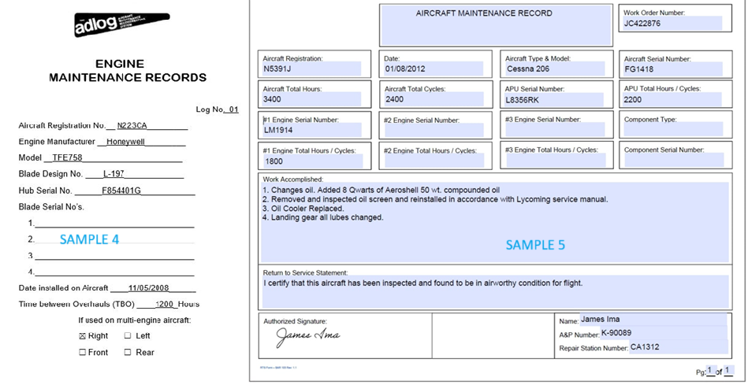
Dataset Samples:

Slide 10
Data Pre-processing
Following pre-processing tasks are performed on the created dataset before it is used for training.
Tokenization: The text annotations are converted into tokens here. we have used special tokens like <s> (start), </s> (end), and <sep> (separator) to format the JSON output properly.
Ex: (start) <s>'<s_Work Order No>'JC543876 '</s_Work Order No>', '<s_Engine Serial No>' TFE731'</s_Engine Serial No>’,
'<s_Aircraft Type>' Cessna 182 '</s_Aircraft Type>’,</s>
Resize and Normalize: We have resized the images to a consistent resolution of 720 * 960 (width x height) to ensure uniformity before being processed by the model.
Image conversion to Tensors: Tensors are multidimensional arrays that are used to represent data. The images are converted to pytorch tensors for GPU processing.

Slide 11
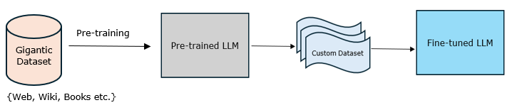
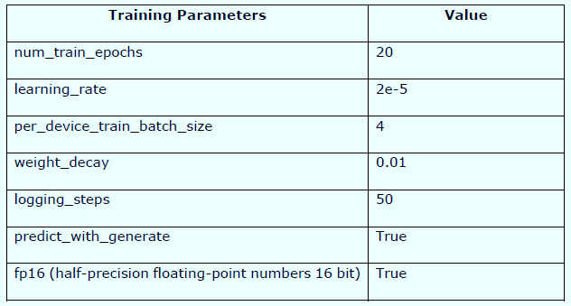
Training & Fine Tuning
Pre-trained Donut base model is selected for the purpose of fine tuning the model on top of our custom dataset.
Engine Logbook dataset is split into training (85%) and test data (15%)
Adjusted training hyperparameters in multiple iterations to get best accuracy, minimal loss and better convergence of learning curve.

Slide 12
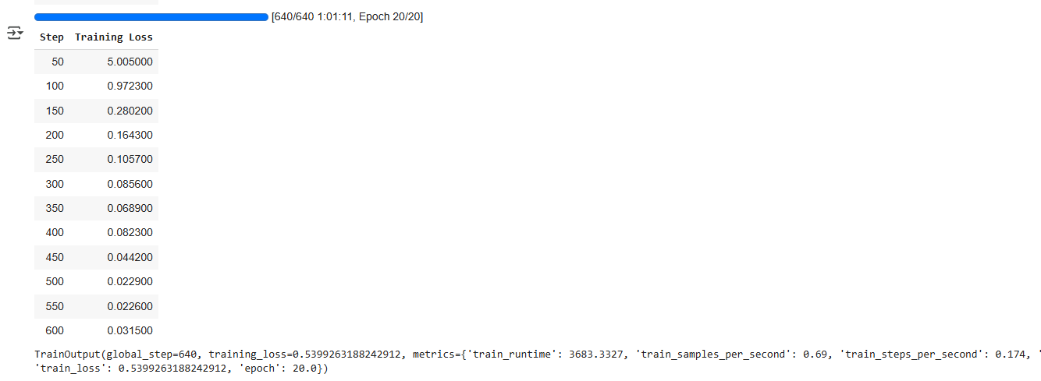
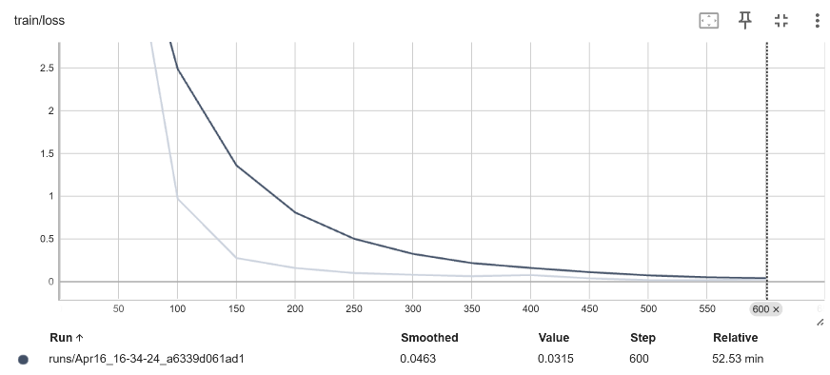
Training Metrics
Training took approx. 66 minutes on NVIDIA L4 GPU with 32 GB RAM and 256 GB Hard disk.
Training was run for 20 epochs and 640 steps. Average training loss of 0.539 is achieved.

Slide 13
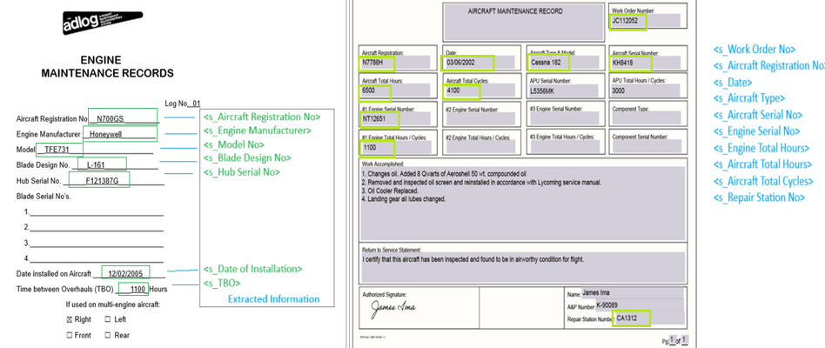
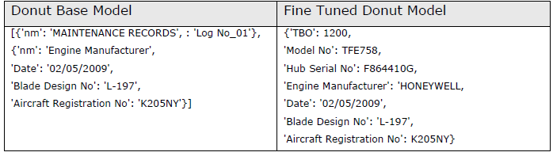
Performance Evaluation
Evaluation Method 1: Compared the output of raw base donut model (without fine tuning) with the output generated by the fine-tuned donut model on our custom dataset
The Donut base model has predicted few key-value pairs correctly but missed others while the fine-tuned donut model is able to extract the required meaningful information from the input image with more than 90 % accuracy

Slide 14
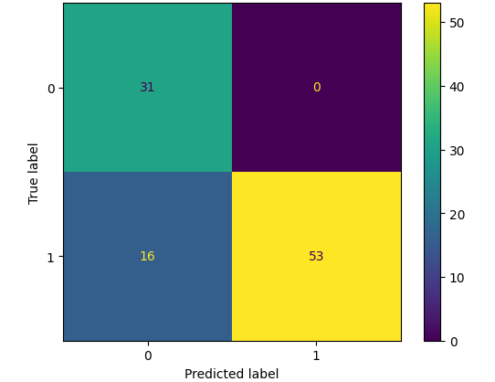
Performance Evaluation
Evaluation Method 2: Tested fine-tuned model on unseen data of 10 different images.
The fine-tuned model was able to extract the information from the test images correctly with some loss.
Here are the metrics:
Total parameters Extracted: 69
Correctly Predicted: 53
Accuracy: 76.811594 %
Confusion Matrix: [[31 0]
[16 53]]

Slide 15
Performance Evaluation
Evaluation Method 3: Tested fine-tuned model with other benchmark models – SmolDocling (from IBM) and Qwen2.5-VL (from Alibaba cloud) which are good in visual understanding tasks.
The output of SmolDocling model was not consistent and predicted key-value pairs from the input image in a random manner which was not much relevant. This implies that SmolDocling requires fine tuning on custom dataset and then its performance could be improved.
The output of Qwen-2.5VL model was consistent and precise. It has predicted the key-value pairs from the input image accurately with minimum loss.
Qwen-2.5VL is a massive model and comes with 7 Billion, 32 Billion and 72 Billion model variants which implies that it needs more high-end GPU’s computational power and time as compared to Donut model which is a compact model particularly for document understanding tasks.

Slide 16
Key Points on Performance Evaluation
Information Extraction: The fine-tuned model is able to extract data from the scanned input images of engine logbooks which also includes manually written texts by the maintenance personnel. The model has shown satisfactory performance on the information extraction task on the input document images
Document Classification: Given an input document image, the fine-tuned model is able to identify the type of document or template it belongs and it extracts the right key-value pairs from the input image on which it was trained.
Visual Question Answering: We have evaluated the performance of the donut model for document visual question answering where the model needs to answer questions asked on document image content. The donut model shows good performance on visual question answering tasks also.

Slide 17
Conclusion
Large Language Models offers immense potential of transforming the landscape of aviation industry, offering groundbreaking capabilities and use cases that can ultimately redefine the functioning of industries bringing more efficiency and better collaboration among the stakeholders.
Adequate training of large language models requires massive amounts of high-quality training data with extensive pre-processing tasks
This project work helped in understanding –
the application of LLM in automating the task of business operations,
effectiveness of industry specific custom dataset,
data pre-processing tasks which are crucial for the training and fine-tuning activities
significance of pre-trained base model and fine-tuned model,
how fine-tuning helps to predict the output with higher accuracy and minimal loss

Slide 18
THANK YOU

