Slide 1
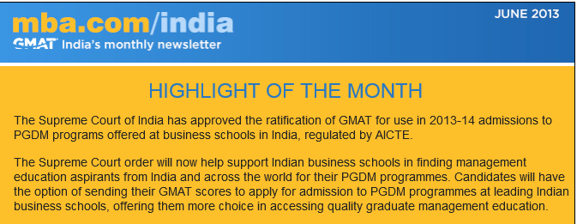
Free Question
Dummy Question
Registered on mba.com? Login in to get 4 more questions
Not registered on mba.com? Register now to get free GMAT questions

Slide 2
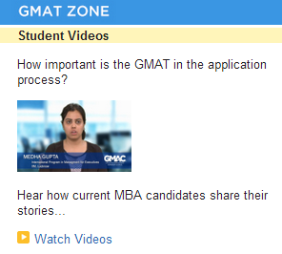

What prompted you to pursue an MBA abroad?
A graduate management education at an international institution offers Indian students an enormous opportunity for professional growth.

Slide 3
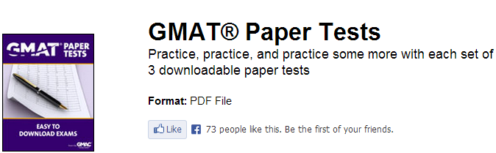
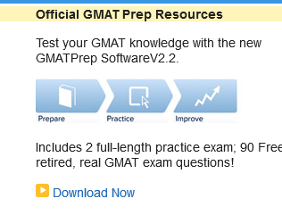

Slide 4
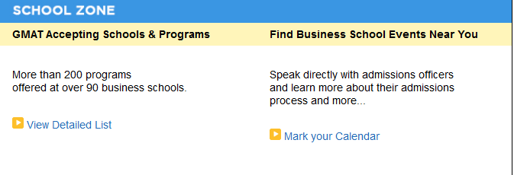
Connect with Schools
Schools that are looking for you
Questions on B Schools? Admissions? Classrooms? Programs?
Get them answered by experts. Featured School of the month
IIM Bangalore
Whether you have taken the GMAT exam or not, make your profile visible to more than 400 global programs through Graduate Management Admission Search Service (GMASS) and know where you fit.
Sign up for free
http://www.mba.com/schools-and-programs/how-schools-find-you.aspx

Slide 5
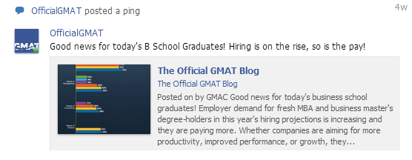
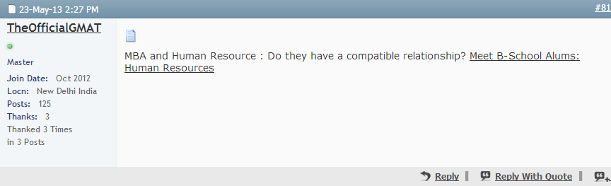
Social media

Slide 6

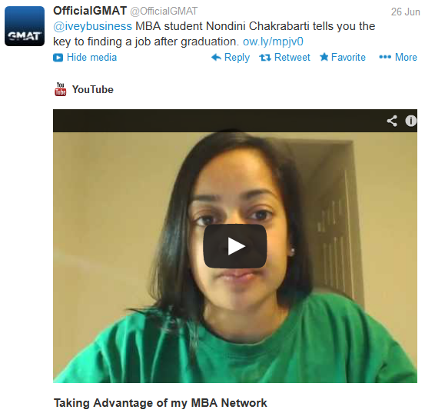
Social media

